Slide 1
Saying who receives the action: ‘lo’ and ‘la’ in object-first sentences PART 1: OVS (Object-Verb-Subject) order with an overt subject and object (e.g. al hombre lo llama la mujer)
Nick Avery and Emma Marsden

Slide 2
Saying who receives the action: ‘lo’ and ‘la’ in object-first sentences
In English, the person (or thing) that ‘receives’ the action (the object) goes after the verb.
In the example, ‘the man calls the woman’, the object ‘woman’ comes after the verb.
In Spanish, there are two ways to say this:
(1) El hombre llama a la mujer.
(2) A la mujer la llama el hombre.
So, in sentences like (2) which start with the object:
‘lo’ or ‘la’ (object pronouns) are used between the object and verb.
‘lo’ is for a masculine object; ‘la’ is for a feminine object.
¡Ojo! The words ‘el’ and ‘la’ (‘the’) are different to these.
Note: when the object is a person (or pet) ‘a’ is usually used before the object, too.
Nick Avery / Emma Marsden
Notes:
This sequence is divided into four parts. Variations in pronoun use are gradually phased in.
Part 1 (slides 2–15): OVS order with an overt subject and object (e.g. al hombre lo llama la mujer)
Part 2 (slides 16–43): OVS order with an overt subject but object pronoun only (e.g. lo llama la mujer)
*Includes special narration activity for speaking/listening practice*
Part 3 (slides 45–87): The absence of subject pronouns in SVO order (e.g. llama al hombre)
Part 4 (slides 88–103): The presence of subject pronouns in SVO order (e.g. ella llama al hombre)

Slide 3
Your Spanish agent has just spotted a criminal!
She is following him and reporting back to you in HQ.
Read her messages and decide if the statements are true or false.
 | Messages
1 | El hombre mira a la mujer.
2 | Al hombre lo lleva la mujer en su coche.
3 | El hombre ve la cámara de seguridad.
4 | La policía sigue al hombre.
5 | El coche lo para el tráfico.
6 | Al hombre lo besa la mujer.
7 | El hombre llama a alguien.
8 | La mujer ve a la policía.
9 | Al hombre lo deja salir la mujer.
10 | ¡El coche lo destruye la policia!
 | True | False
The man looks at the woman.
The man takes the woman in his car.
The man sees the security camera.
The police follow the man.
The car stops the traffic.
The woman kisses the man.
Someone calls the man.
The woman sees the police.
The man lets the woman leave.
The police destroy the car!
leer
Nick Avery / Emma Marsden
Notes:
Note: Animations are set up so that the teacher offers whole class feedback after each answer. (Teachers just need to re-order the animations by clicking on ‘Animation Pane’ and moving all the ‘pictures’ to the end so that the English sentences appear first, students complete all of the task, and then the teacher corrects all answers with the class).
Word frequency rankings (1 is the most common word in Spanish):
Verbs: mirar [125]; llevar [101]; ver [38]; seguir [99]; parar [706]; besar [1591]; llamar [122]; dejar [86]; salir [114]; destruir [1283].
Nouns: hombre [97]; coche [1190]; cámara [903]; seguridad [538]; policía [629]; tráfico [2226].
Source: Davies, M. & Davies, K. (2018). A frequency dictionary of Spanish: Core vocabulary for learners (2nd ed.). London: Routledge.

Slide 4
The criminal’s accomplice escaped. Spanish police are now spying on her.
She has just been spotted with a different person.
What do they say about their actions?
 | The woman does it | The man does it
call the other person
see the other person
follow the other person
take the other person in their car
observe the other person
greet the other person
hide the other person
contact the other person
help the other person
look for the other person
1
2
3
4
5
6
7
8
9
10
escuchar
Nick Avery / Emma Marsden
Notes:
Note: Here the audio is activated for each sentence by clicking on the number. The audio is heard twice, but can be clicked again to repeat. Answers appear on each click. The task sentences are not animated. Teachers can choose whether to listen and correct each one or complete the whole task, and then correct (without making any changes to the slide animations)
Transcript: 1. La mujer llama al hombre. / 2. A la mujer la ve el hombre. / 3. La mujer sigue al hombre. / 4. A la mujer la lleva el hombre en su coche. / 5. La mujer observa al hombre. / 6. La mujer saluda al hombre. / 7. la mujer esconde al hombre. / 8. A la mujer la contacta el hombre. / 9. La mujer ayuda al hombre. / 10. A la mujer la busca el hombre.
Verb frequency: llamar [122]; ver [38]; seguir [99]; llevar [101]; mirar [125]; saludar [1575]; esconder [1130]; contactar [3866]; ayudar [328]; buscar [179].
Noun frequency: coche [1190]; hombre [97]; mujer [120]

Slide 5
Listen again and decide if the statements are true or false.
 | True | False
1
The man calls the woman.
2
The man sees the woman.
3
The man follows the woman.
4
The man takes the woman in his car.
5
The woman watches the man.
6
The man greets the woman.
7
The woman hides the man.
8
The man contacts the woman.
9
The woman helps the man to hide.
10
The man looks for the woman.
escuchar
Nick Avery / Emma Marsden
Notes:
This second part of the activity is optional. The true-false decision adds a challenge for more able students.
Transcript: 1. La mujer llama al hombre. / 2. A la mujer la ve el hombre. / 3. La mujer sigue al hombre. / 4. A la mujer la lleva el hombre en su coche. / 5. La mujer observa al hombre. / 6. La mujer saluda al hombre. / 7. A la mujer la esconde el hombre. / 8. A la mujer la contacta el hombre. / 9. La mujer ayuda al hombre. / 10. A la mujer la busca el hombre.
Verb frequency: llamar [122]; ver [38]; seguir [99]; llevar [101]; mirar [125]; saludar [1575]; esconder [1130]; contactar [3866]; ayudar [328]; buscar [179].
Noun frequency: coche [1190]; hombre [97]; mujer [120]

Slide 6
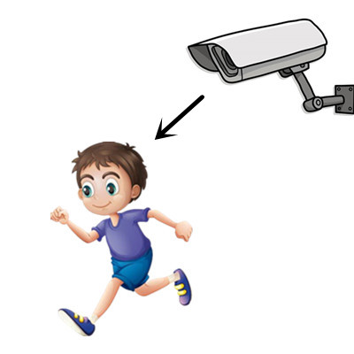
Al criminal lo ve
1) _____________________ la cámara de seguridad.
escribir
Nick Avery / Emma Marsden
Notes:
In this activity, there are 5 pairs of pictures which have been intentionally juxtaposed. This is slightly less challenging than using a different lexical item for each sentence.
NB: NCELP will soon be creating a full set of pictures to suit the police/criminal context.

Slide 7
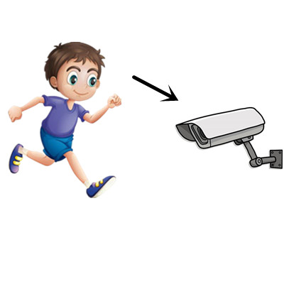
El criminal ve
2) ___________________ la cámara de seguridad.
escribir
Nick Avery / Emma Marsden

Slide 8
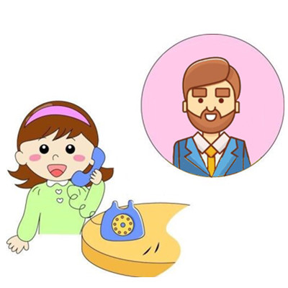
Al hombre lo llama
3) ______________________ la chica.
escribir
Nick Avery / Emma Marsden

Slide 9
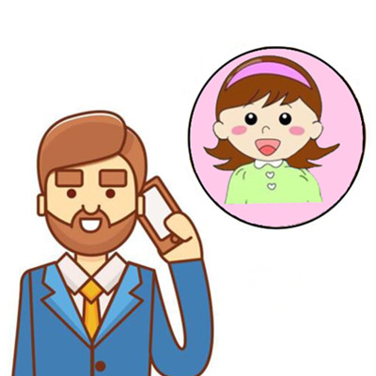
El hombre llama
4) ___________________ a la chica.
escribir
Nick Avery / Emma Marsden

Slide 10
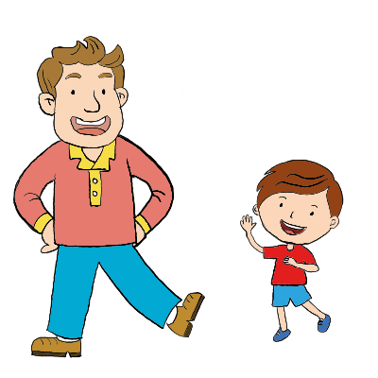
El chico saluda
5) ___________________ al hombre.
escribir
Nick Avery / Emma Marsden

Slide 11
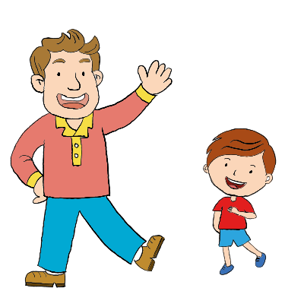
Al chico lo saluda
6) ___________________ el hombre.
escribir
Nick Avery / Emma Marsden

Slide 12
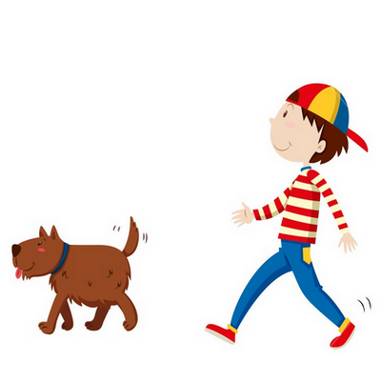
El chico sigue
7) ___________________ al perro.
escribir
Nick Avery / Emma Marsden

Slide 13
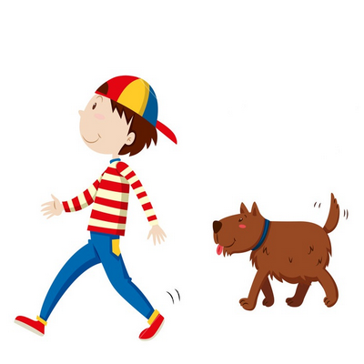
Al chico lo sigue
8) ___________________ el perro.
escribir
Nick Avery / Emma Marsden

Slide 14
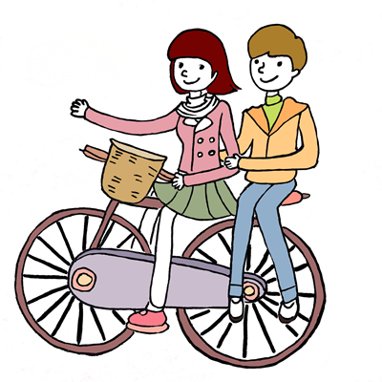
Al chico lo lleva
9) ___________________ la chica.
escribir
Nick Avery / Emma Marsden

Slide 15
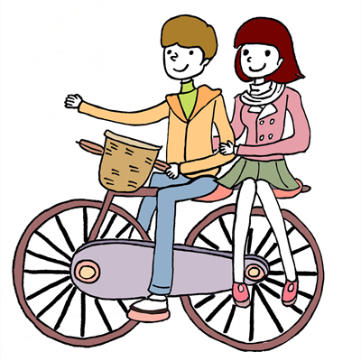
El chico lleva
10) ___________________ a la chica.
escribir
Nick Avery / Emma Marsden

