Slide 1
Describing your family members and those of others
Spelling changes for –ar verbs in the preterite
Possessive adjective ‘mi/s’ [revisited] and ‘su/s’
Y8 Spanish
Term 3.1 – Week 2 – Lesson 51
Pete Watson / Nick Avery / Rachel Hawkes Artwork: Mark Davies
Date updated: 30/06/21
Notes:
Artwork by Mark Davies. All additional pictures selected are available under a Creative Commons license, no attribution required, and are taken from clipart-library.com
Native-speaker teacher feedback provided by Blanca Román.
Learning outcomes (lesson 1):
Sounds and spelling: introduce (-qué) ending for –ar verbs ending in –car in 1st person singular preterite
Grammar: consolidate ‘mi/s’ and introduce possessive adjectives ‘su/s’
Grammar: consolidate ‘es’ and ‘son’ and adjective agreement for number and gender
Vocabulary: introduce new vocabulary and consolidate vocabulary from the sets below
Word frequency (1 is the most frequent word in Spanish):
New vocabulary (introduce in lesson 1): tío [988]; tía [1205]; hijo [140]; hija [769]; conocido [159]; débil [1946]
New vocabulary (introduce in lesson 2): nuestro [77]; científico [1067]; médico [1443]; músico [2060]; abogado [1211]; tan [104]; numbers 21-30
Vocabulary to revisit:
8.2.2.2 me [22]; te [48]; le [25]; regalar [1420]; tirar [685]; quitar [668]; reloj [1683]; caja [1074]; lleno/a [684], vacío/a [1585]
8.2.1.5 cuidar [751]; olvidar [415]; traer [341]; salud [613]; novio [1322]; novia [1996]; cumpleaños [3372]
The frequency rankings for words that occur in this PowerPoint which have been previously introduced in NCELP resources are given in the NCELP SOW and in the resources that first introduced and formally re-visited those words.
For any other words that occur incidentally in this PowerPoint, frequency rankings will be provided in the notes field wherever possible.

Slide 2
Vocabulario
hablar
to take away / remove
he/she/it (object)
myself, me (object)
yourself / you (object)
box
full (m)
to give
to throw
full (f)
watch
empty (f)
empty (m)
quitar
le
quitar
le
el reloj
el reloj
la caja
lleno
la caja
lleno
vacío
vacío
llena
me
llena
me
regalar
regalar
tirar
vacía
te
vacía
tirar
te
Notes:
Timing: 3 minutes
Aim: to revise items of vocabulary from one of this week’s revisited vocabulary sets (8.2.2.2) in receptive mode.
Procedure:
1. The teacher clicks for the English prompt to appear.
2. Students say the word in Spanish in choral response to match the English.
Note: the activity on slide 8 revisits the same set of words, but in the productive mode. This slide is therefore seen as a reminder activity before that exercise.
Some higher-achieving groups may be able to dothe activity on slide 8 without also doing this activity.

Slide 3
Spelling changes for –ar verbs in the preterite: using the verb ending ‘-qué’
gramática / fonética
As you know, some verbs in Spanish end in –ar.
To talk about ‘I’ for completed events in the past with -ar verbs, remove ‘-ar’ and add ____ .
é
Remember that when the stress is on the last syllable and the word ends with a vowel, an accent is needed.
Ejemplos:
tirar
tiré
regalar
regalé
(to throw)
(I threw)
(to give)
(I gave)
However, for –ar verbs ending in ‘-car’, remove –car and add –qué.
Ejemplos:
sacar
saqué
buscar
busqué
(to take out)
(I took out)
(to look for)
(I looked for)
As the infinitive has a hard ‘c’, it needs to keep the same sound in the past tense. If the ‘c’ didn’t change to ‘qu’, the verb ending would be a soft [ce] sound.
Notes:
Spelling changes for verbs ending in ‘-car’ in the preterite
Timing: 2 minutes
Aim: to explain the formation of the 1st person singular ending for verbs ending in ‘-car’, based on the need for the verbs to maintain the correct pronunciation
Procedure:
1. Remind students of the rule for forming the 1st person singular preterite form of regular ‘-ar’ verbs. Ask students what the verb ending is, which will be revealed with a click.
2. Click to show examples of regular ‘-ar’ verbs using two verbs from this week’s revisited vocabulary sets. You can check the meaning of these verbs at this time.
3. Click to show the rule for ‘-car’ verbs
4. Click again to show examples of the rule. These verbs are both known vocabulary items.
5. Click to show the explanation for this spelling change. This is an opportunity to revisit the ‘soft’ [ce] SSC and juxtapose it with the [qué] SSC.
6. Click to remind students why an accent is needed on the last letter

Slide 4
Daniel describe unas cosas del pasado. Escucha y completa la frase con el verbo correcto. ¿El verbo termina en ‘é’ o ‘qué’?
escuchar / escribir
[1/2]
Quité
______ la caja de fotos de la mesa.
1
I removed the box of photos from the table.
publiqué
La semana pasada __________ un artículo en el periódico local.
2
Last week I published an article in the local newspaper.
busqué
Ayer _________ mi reloj en el parque.
3
Yesterday I looked for my watch in the park.
regalé
El año pasado le _________ un vestido.
4
Last year I gave him/her/it a dress.
Notes:
There are two versions of this activity that can be used, depending on the ability of the class: slides 4-5 (single word transcription) or slides 6-7 (whole sentence transcription).
Timing: 4 minutes
Aim: aural recognition of the ‘-qué’ ending used for –car verbs in 1st person singular preterite; to also revise vocabulary from this week’s revisited sets
Procedure:
1. Explain to the students that they need to fill the gap in the sentence with a verb in the ‘I’ form of the preterite tense. Some will be need the usual ‘é’ endings, others will need ‘qué’ endings. Students only need to write the missing word.
2. Click the button to hear the recording
3. Click to reveal each answer. Ask the students to translate the now completed sentence into English. This can be done orally, once the Spanish is displayed on the board. Then click to reveal the translation.
Transcript:
Quité la caja de fotos de la mesa.
La semana pasada publiqué un artículo en el periódico local.
Ayer busqué mi reloj en el parque.
El año pasado le regalé un vestido.

Slide 5
escuchar / escribir
[2/2]
__________ a mi primo porque olvidó mi cumpleaños.
5
Critiqué
I criticised my cousin (m) because he forgot my birthday.
criticar = to criticise
En el viaje a Valencia, ________ muchas fotos de los monumentos.
6
saqué
On the trip to Valencia I took lots of photos of the monuments.
Cuidé
7
_______ a mi novio ayer por la tarde.
I looked after my boyfriend yesterday afternoon.
acompañé
8
Ayer por la noche ____________ a mi novia al cine.
Yesterday in the evening I went with my girlfriend to the cinema.
Notes:
Listening activity (2/2)
Activity continues from the previous slide, same procedure. The verb ‘criticar’ and its meaning will be shown with an extra click after the answer is shown for item 5.
Transcript
5. Critiqué a mi primo porque olvidó mi cumpleaños.
6. En el viaje a Valencia, saqué muchas fotos de los monumentos.
7. Cuidé a mi novio ayer por la tarde.
8. Ayer por la noche acompañé a mi novia al cine
There are some unknown words in this article that are near cognates. These are below.
Frequency of unknown words (1 is the most common word in Spanish)
criticar [1849]; monumento [3149]

Slide 6
Daniel describe unas cosas del pasado. Escucha y escribe la frase. ¿El verbo termina en ‘é’ o ‘qué’?
escuchar / escribir
[1/2]
Quité la caja de fotos de la mesa.
1
I removed the box of photos from the table.
La semana pasada publiqué un artículo en el periódico local.
2
Last week I published an article in the local newspaper.
3
Ayer busqué mi reloj en el parque.
Yesterday I looked for my watch in the park.
4
El año pasado le regalé un vestido.
Last year I gave him/her/it a dress.
Notes:
VARIATION
Listening activity (1/2)
Timing: 6 minutes (lesson timings allow for this to be done within the 50 minutes)
Aim: aural recognition of the ‘-qué’ ending used for –car verbs in 1st person singular preterite; to also revise vocabulary from this week’s revisited sets
Procedure:
1. Explain to the students that they need to listen to the whole sentence and write it all out. There will be either a verb with ‘-é’ or ‘-qué’ in each sentence, so they should listen carefully to each verb ending and decide on the correct spelling.
2. Click the button to hear the recording.
3. Click to reveal each answer. Then click to reveal the translation of the phrase. This can be done orally, once the Spanish is displayed on the board.
Transcript:
Quité la caja de fotos de la mesa.
La semana pasada publiqué un artículo en el periódico local.
Ayer busqué mi reloj en el parque.
El año pasado le regalé un vestido.

Slide 7
escuchar / escribir
[2/2]
5
Critiqué a mi primo porque olvidó mi cumpleaños.
I criticised my cousin (m) because he forgot my birthday.
criticar = to criticise
6
En el viaje a Valencia, saqué muchas fotos de los monumentos.
On the trip to Valencia I took lots of photos of the monuments.
7
Cuidé a mi novio ayer por la tarde.
I looked after my boyfriend yesterday afternoon.
8
Ayer por la noche acompañé a mi novia al cine.
Yesterday in the evening I went with my girlfriend to the cinema.
Notes:
VARIATION
Listening activity (2/2)
This slide continues the previous activity with the same procedure. The verb ‘criticar’ and its meaning will be shown with an extra click after the answer is shown for item 5.
Transcript:
5. Critiqué a mi tío porque olvidó mi cumpleaños.
6. En el viaje a Valencia, saqué muchas fotos de los monumentos históricos.
7. Cuidé mi novio ayer por la tarde.
8. Ayer por la noche acompañé a mi novia al cine
There are some unknown words in this article that are near cognates. These are below.
Frequency of unknown words (1 is the most common word in Spanish)
criticar [1849]; monumento [3149]

Slide 8
Vocabulario
escribir
Completa las frases con las palabras que no están.
caja
¡Mi ________ de regalos está ________!
1
vacía
My box of gifts is empty!
me
regala
reloj
cumpleaños
Mi ________ ____ ___________ un ________ el día de mi ______________.
2
novia
My girlfriend gives / is giving me a watch on my birthday.
novio
quitar
El _______ de Juana siempre _________ __________ sus libros de la mesa.
3
olvida
Juana’s boyfriend always forgets to remove his books from the table.
llena
tirar
4
Mi habitación está ______. Necesito ______ unas cosas en la basura.
My bedroom is full. I need to throw some things into the rubbish / rubbish bin.
cuida
te
*la habitación - bedroom
Mi madre ___ ________ y ___ ______ la medicina.
5
te
trae
My mother looks after / is looking after you and she brings / is bringing you the medicine
Notes:
Timing: 7 mins
Aim: to accurately produce revisited vocabulary items in writing
Procedure:
1. Students complete the Spanish translations of the English sentences, filling in the missing words from the revisited vocabulary sets. They can simply write the answers in note form, e.g. (1. caja, vacía)
2. Reveal answers at the end of the exercise with each click.
3. Audio is provided for further reinforcement, if desired. Click again to reveal each button to then click for the recording.
Notes: the vocabulary activity on this slide revisits the same set of words as slide 3 (vocabulary from 8 2.2.2) but also adds vocabulary from this week’s other revisited vocabulary (8 2.1.5). The words not included from these sets in this exercise are ‘le’, ‘lleno’, ‘vacío’ and ‘salud’. The feminine forms of ‘lleno’ and ‘vacío’ are used, however.
It could be highlighted that ‘basura’ can mean ‘rubbish bin’. In earlier resources, ‘basura’ has been used in a general sense to refer to ‘rubbish’.
Use of ‘de’ for possession (see item 3) is included here incidentally and doesn’t need to be processed to complete the task. This feature will be taught explicitly in the next week of the scheme of work.
Transcript:
¡Mi caja de regalos está vacía!
Mi novia me regala un reloj en mi cumpleaños.
El novio de Juana siempre olvida quitar sus libros de la mesa.
Mi habitación está llena. Necesito tirar unas cosas en la basura.
Mi madre te cuida y te trae la medicina.
Frequency rankings of unknown words
habitación [1069] (to be introduced in 8.3.1.5); medicina [1474]

Slide 9
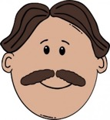
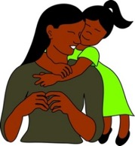
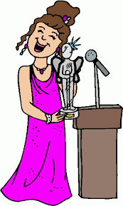
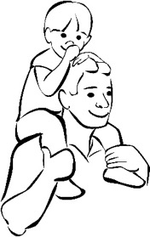
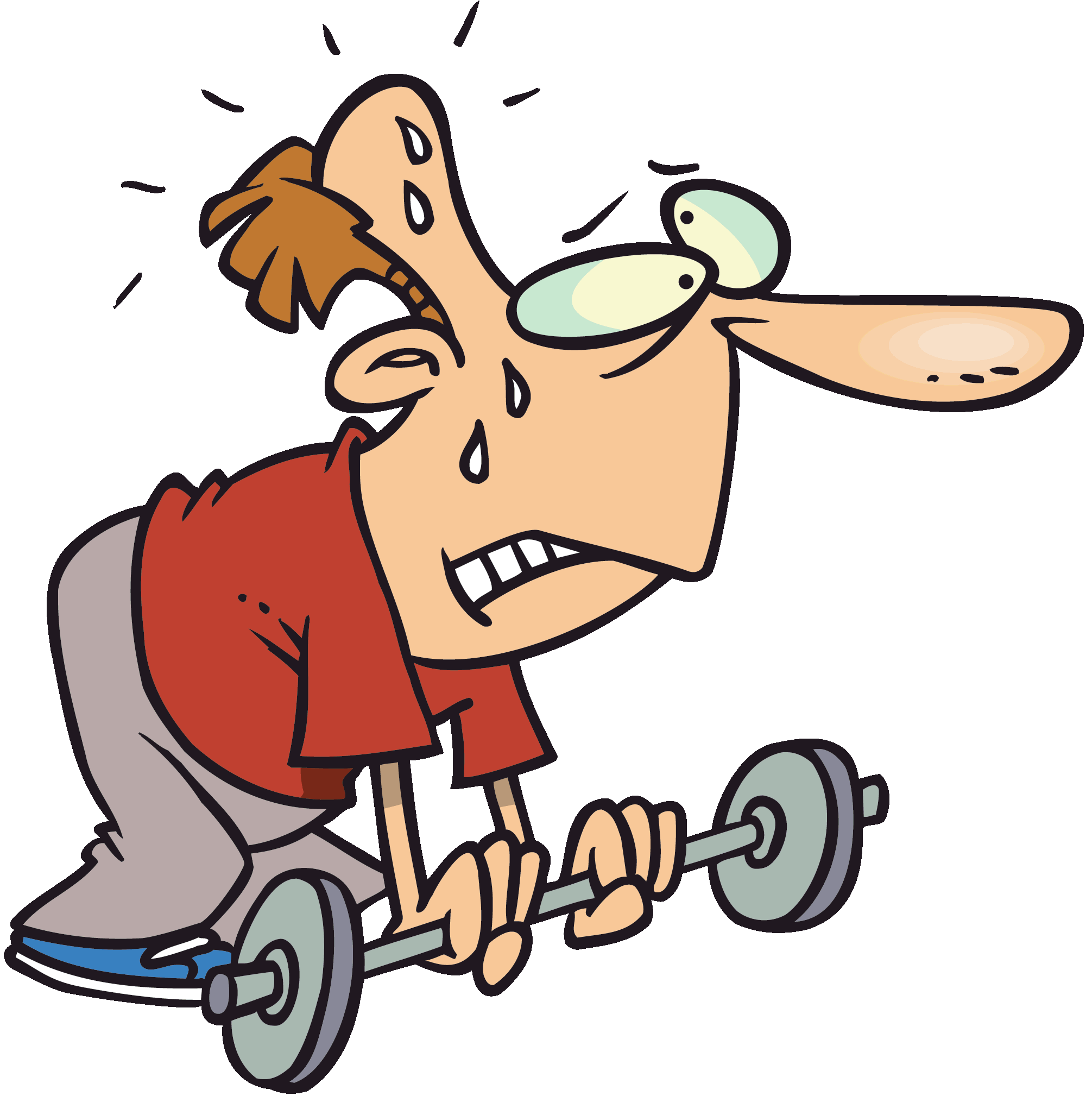
Vocabulario
uncle
el tío
daughter, child (f)
la hija
conocido, conocida
aunt
la tía
well-known, famous
‘Ser débil’ can also mean mentally weak (e.g. not standing up for values).
son, child (m)
el hijo
weak
débil
Notes:
Vocabulary presentation slide
Timing: 2 mins
Aim: to introduce some of this week’s new vocabulary
Procedure:
Click to bring up the English word and picture, then the Spanish
Draw students’ attention to the fact that English has different words for two of the nouns, whereas Spanish uses the same word with a different ending (-o, -a). Ask students if they can think of any other words like this (hermano, hermana).
Notes:
1. 'Es débil' could refer to a person with a tendency to not respect values or morals, as in the saying 'la carne es débil' (a phrase for those prone to 'sinning'). But it could also be used to refer to somebody with little physical strength: 'María no va a ganar la competición porque es más débil que Lucía'. 'Está débil' is a reference to a physical state, but as a result of something, generally an illness.
2. The animation here is simply intended for vocabulary presentation. Words don’t disappear and reappear to promote recall. This would be too easy given that most of these words are inflected forms of another word that is already given on the slide.

Slide 10
Talking about mixed gender groups Plural masculine nouns [revisited]
gramática
Remember that to talk about a mixed gender group of people (male and female), you use the masculine form of the noun.
Ejemplo:
‘Mis hermanos’ can mean either ‘my brothers’ or ‘my brothers and sisters’.
‘Mis hijos’ can mean either ‘my sons’ or ‘my sons and daughters / my children’.
What could the following phrases mean?
Mis abuelos = _________________ or __________________
Mis tíos = _______________ or ____________________
Mis primos = ____________________ or _______________________
my grandfathers
my grandparents
my uncles
my uncles and aunts
my cousins (m)
my cousins (m and f)
Notes:
Timing: 2 minutes
Aim: To remind students that the masculine form of a plural noun can have two meanings
Procedure
Click to remind students of the rule that when there are mixed groups of men and women, the male form is used. Therefore, two meanings are possible.
Click to show examples with family members.
Click to show some short questions to elicit what the two possible meanings are. Click to reveal each answer.

Slide 11
Talking about possessions Possessive adjectives ‘su’ and ‘sus’
gramática
To say ‘his’, ‘her’ or ‘its’ before a singular or uncountable noun use ‘su’.
It does not matter whether the noun is masculine or feminine.
Ejemplos:
¡Ojo! As su(s) has different meanings, you may need context to know if it is she, he or it.
Su hijo es alto.
His / her son is tall.
Su hija es baja.
His / her daughter is short.
To say ‘his’, ‘her’ or ‘its’ before a plural noun use ‘sus’.
Sus tíos son raros.
His / her uncles OR aunts and uncles are strange.
Sus tías son serias.
His / her aunts are serious.
Remember to use ‘es’ for a singular noun and ‘son’ for a plural noun.
Notes:
Timing: 2 minutes
Aim: to introduce ‘su’ and ‘sus’
Procedure:
1. Click to reveal each new part of explanation of ‘su’ and ‘sus’ and then the examples. Each example and answer is revealed by a click, so teachers can ask students for the answers.
You could choose to revisit previously learned vocabulary (for example from the homework sheet completed before this class) by asking students how they would say ‘his uncle’, ‘her aunt’, ‘his cousin (f)’ etc. The teacher could alternatively say phrases like ‘su abuelo’, ‘sus hermanas’ etc to elicit English translations.
2. Click to show explanation of ‘su’ or ‘sus’ and how this will inform the verb choice between ‘es’ or ‘son’.

Slide 12
Hugo y su familia
leer
Daniel habla con Lucía. Describe a la familia de Hugo. Completa las frases.
¿Debes usar ‘su’ o ‘sus’? ¿‘Es’ o ‘son’?
 | ¿’Su’ o ‘sus’? |  | ¿Es o son?
1. | Su / Sus | novia | es / son | graciosa.
2. | Su / Sus | hermanos | es / son | altos.
3. | Su / Sus | tías | es / son | serias.
4. | Su / Sus | primo | es / son | fuerte.
5. | Su / Sus | abuelos no | es / son | débiles.
6. | Su / Sus | tío no | es / son | divertido.
7. | Su / Sus | hermana | es / son | loca.
8. | Su / Sus | padres | es / son | geniales.
Who is/are strong?
Who is/are great?
Who is/are serious?
Who is/are funny?
Who is/are crazy?
Who is/are tall?
His cousin
His parents
His aunts
His girlfriend
His sister
His brothers OR brothers and sisters
Notes:
Timing: 6 minutes
Aim: This reading activity focuses on two features:
Possessive adjectives ‘su’ vs ‘sus’ [new]
SER in singular persons: ‘es’ vs ‘son’ [revisited]
Attention to the noun in the second column is needed to determine whether to use ‘su’ or ‘sus’.
Attention to the noun in the second column OR the adjective ending in fourth column is needed to decide whether to use ‘es’ or son’.
Procedure:
Tell students to write 1-8 in their books, and then either write the correct words (e.g. 1: su, es).
Students then write a-f in their books and answer the comprehension questions (Who is/are…) to check understanding of the family members and adjectives in English.
Answers will be revealed on each click of the mouse. One click is needed for ‘su’ or ‘sus’ and another for ‘es’ or ‘son’ to allow teachers to ask different students for answers.
Note: Vocabulary covers family members, some from this week’s vocabulary list (tío, tías) as well as others that have been previously learned including from Yr 8 2.1.5 (novia). Adjectives from various weeks are also revisited, including 5 adjectives from Year 7

Slide 13
Describing family members Possessive adjective ‘mi’ [revisited]
gramática
Remember, to say ‘my’ before a singular or uncountable noun use ______.
It does not matter whether the noun is masculine or feminine.
mi
Ejemplos:
Mi novio es aburrido.
My boyfriend is boring.
Remember, adjectives agree with the gender and number of the noun.
-o, -os for masculine nouns
-a, -as for feminine nouns
Mi tía es activa.
My aunt is active.
mis
To say ‘my’ before a plural noun use _____.
Mis abuelos son graciosos.
My grandfathers OR grandparents are funny.
Mis primas son guapas.
My cousins (f) are good looking.
Notes:
Timing: 2 minutes
Aim: revisit ‘mi’ and ‘mis’
Procedure:
Click to revisit use of ‘my’. Ask students to remember how to say ‘my’ for singular and then plural nouns. Click to reveal answers. You could choose to revisit previously learned vocabulary (for example from the homework sheet this week) by asking students how they would say ‘my uncle’, ‘her aunt’, ‘his cousin’ etc, or eliciting translations of phrases like ‘mi primo’, ‘mis amigas’ etc.
2. Click to show reminder of the need for adjective agreement when describing a person (or people). This will feature in the next activity.

Slide 14
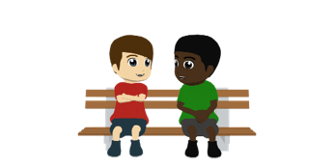
Daniel describe a su familia y a la familia de Hugo.
escuchar
Escucha la frase y completa la tabla. Es ¿‘mi/s’ o ‘su/s’?
La frase, ¿cómo continúa? Elige ‘es’ o ‘son’ y el adjetivo correcto (A o B).
 | My | His | ¿’Es’ o ‘son’? | A | B
 |  |  |  | hermoso | hermosa
 |  |  |  | divertidos | divertidas
 |  |  |  | locos | locas
 |  |  |  | alto | alta
 |  |  |  | gracioso | graciosa
 |  |  |  | serios | serias
 |  |  |  | aburridos | aburridas
 |  |  |  | activo | activa
1
es
1
2
son
2
3
son
3
4
es
4
5
es
5
6
son
6
7
son
7
8
es
8
Notes:
Timing: 7 minutes
Aim: This listening exercise focuses on three pairs of features:
mi(s) and su(s)
es and son [revisited]
adjective-noun gender agreement for masculine vs feminine nouns [revisited]
Procedure:
1. Students copy out the grid and headers in their book (they need not write the adjectives in both forms).
2. Click on the number on the left-hand side to listen to the recording. Students listen to the cue and tick either the ‘my’ or ‘his/her’ box for each question, then write either ‘es’ or son’, depending on whether the cue is singular or plural.
3. Students listen again and write the correct adjective (or A or B), by focusing on the gender of the noun in the cue.
4. Answers will be revealed on a click for each question. The first click will show a tick in either ‘my’ or ‘his/her’ box, next click shows either ‘es’ or son’, and then the next click will circle the correct adjective. This allows teachers to ask for separate answers from different students.
5. Sentences could be translated after revealing the correct answers and listening to the recording of the full sentence by clicking on the number on the right-hand side. These will appear after the final answer with a click.
Note: Numbers 5 and 8 will produce unlikely answers, ‘my son is’ and ‘his daughter is’ (given the age of the characters!). After going through the answers and translating the sentences teachers could ask students which answers are unlikely.
Transcript:
Su tío…
Mis tías …
Sus primos …
Su novia …
Mi hijo …
Mis abuelos …
Sus tíos…
Su hija…
Answers transcript:
Su tío es hermoso.
Mis tías son divertidas.
Sus primos son locos.
Su novia es alta.
Mi hijo es gracioso.
Mis abuelos son serios.
Sus tíos son aburridos.
Su hija es activa.

Slide 15
Una videollamada con tu amigo de intercambio
hablar / escuchar
You and your exchange partner are getting to know each other online.
You are describing your family members and those of your best friends.
Person A: describe the family member using the information on the cards.
Use ‘mi(s)’ (my) OR ‘su(s)’ (his/her), as well as either ‘es’ or ‘son’ and an adjective.
1
His grandparents
“Sus abuelos son nerviosos.”
[are nervous]
Person B: listen and complete the grid in English.
 | My partner says ‘my’ | My partner says ‘his / her’ | ¿Quién es / quiénes son? Escribe en inglés | ¿Cómo es / cómo son? Escribe en inglés
1.
grandparents
nervous
Notes:
Timing: 11 minutes
Aim: This paired speaking/listening activity brings together productive practice of ‘mi’, ‘mis’, ‘su’ and ‘sus’. It is also a chance to reinforce accurate production of ‘es’ or ‘son’, as well as adjective-noun gender and number agreement.
Procedure
Click to show each line of the instructions to students. After the Person A instructions, the next click will show an example sentence. Clicking again will show what Person B needs to do, and then the next click will show an answer grid with the answers filled in for the example sentence.
Confirm that the answer in the ‘quién es / quiénes son’ column should be in English, and the answers in the ‘Cómo es / cómo son’ column should be in English

Slide 16
Hablar/escuchar
1
2
3
My aunt
My uncles
His/her girlfriend
[is weak]
[are tall]
[is serious]
4
5
6
His/her friends (m)
My parents
His/her cousins (f)
[are not active]
[are not crazy / insane]
[are funny]
Notes:
DO NOT DISPLAY
Person A speaking cards
Available to print in separate Word doc.

Slide 17
Hablar/escuchar
1
2
3
Her/his friends (f)
My boyfriend
My grandparents
[are not bad]
[is strong]
[are not boring]
4
5
6
His/her mother
His/her uncles
My grandmother
[is well-known]
[are fun]
[is great]
Notes:
DO NOT DISPLAY
Person B speaking cards
Available to print in separate Word doc.

Slide 18
Respuestas: Persona A
escuchar
 | My partner says ‘my’ | My partner says ‘his/her’ | ¿Quién es / quiénes son? Escribe en inglés. | ¿Cómo es / cómo son? Escribe en inglés.
1.
2.
3.
4.
5.
6.
friends (f)
not bad
boyfriend
strong
grandparents
not boring
mother
well-known
uncles
fun
grandmother
great
Notes:
Person A answer grid

Slide 19
Respuestas: Persona B
escuchar
 | My partner says ‘my’ | My partner says ‘his / her’ | ¿Quién es / quiénes son? Escribe en inglés | ¿Cómo es / cómo son? Escribe en inglés
1.
2.
3.
4.
5.
6.
aunt
weak
uncles
tall
girlfriend
serious
friends
not active
parents
not crazy / insane
cousins (f)
funny
Notes:
Person B answer grid

Slide 20
Ahora escribe seis frases en español.
escribir
A | My | His /her | ¿Quién es / quiénes son? | ¿Cómo es /como son?
1 |  |  | friends (f) | not bad
2 |  |  | boyfriend | strong
3 |  |  | grandpar-ents | not boring
4 |  |  | mother | well-known
5 |  |  | uncles | fun
6 |  |  | grand-mother | great
B | My | His /her | ¿Quién es / quiénes son? | ¿Cómo es /como son?
1 |  |  | aunt | weak
2 |  |  | uncles | tall
3 |  |  | girlfriend | serious
4 |  |  | friends | not active
5 |  |  | parents | not crazy / insane
6 |  |  | cousins (f) | funny
Notes:
OPTIONAL
Aim: To be able to write a correct sentence using the correct possessive adjective, ‘es’ or ‘son’ and adjective agreement, based on information in the last activity. This is in some ways a translation exercise, where students are applying both grammar and vocabulary.
Procedure:
The slide displays the completed correct grids that students should have finished with at the end of the last speaking activity.
Students A and B should write out their grid in sentence form in Spanish, paying attention to ‘mi’ / ‘mis’ / ‘su’ / ‘sus’, translating the family member, using ‘es’ or ‘son’, and then translating the adjective and making it agree with the noun.
The answers are provided on the next slide

Slide 21
Respuestas correctas
escribir
Persona A Persona B
1.
2.
3.
4.
5.
6.
1.
2.
3.
4.
5.
6.
Sus amigas no son malas.
Mi tía es débil.
Mi novio es fuerte.
Mis tíos son altos.
Mis abuelos no son aburridos.
Su novia es seria.
Su madre es conocida.
Sus amigos no son activos.
Sus tíos son divertidos.
Mis padres no son locos.
Mi abuela es genial.
Sus primas son graciosas.
Notes:
OPTIONAL
Procedure:
1. Answers are revealed to each question on each click, starting with person A, and then moving on to person B

Slide 22
Describing family members and their jobs
Spelling changes for –ar verbs in the preterite
Possessive adjective ‘nuestro’
Y8 Spanish
Term 3.1 – Week 2 – Lesson 52
Pete Watson / Nick Avery / Rachel Hawkes Artwork: Mark Davies
Date updated: 09/09/22
Notes:
Learning outcomes (lesson 2):
Sounds and spelling: consolidate (-qué) ending for –ar verbs in 1st person singular preterite and introduce (-gué) ending
Vocabulary: learn and practise numbers 21-30; learn jobs in masculine and feminine forms (o-a and r-ra)
Grammar: consolidate possessive adjectives tu/tus and su/sus
Grammar: learn ‘nuestro’ and its agreement in gender with singular nouns (nuestro/nuestra)
Word frequency (1 is the most frequent word in Spanish):
New vocabulary (introduce in lesson 2): nuestro [77]; científico [1067]; médico [1443]; músico [2060]; abogado [1211]; tan [104], in addition to words introduced in lesson 1: tío [988]; tía [1205]; hijo/a [140]; conocido [159]; débil [1946]
Vocabulary to revisit:
8.2.2.2 me [22]; te [48]; le [25]; regalar [1420]; tirar [685]; quitar [668]; reloj [1683]; caja [1074]; lleno/a [684)], vacío/a [1585]
8.2.1.5 cuidar [751]; olvidar [415]; traer [341]; salud [613]; novio [1322]; novia [1996]; cumpleaños [3372]
Source: Davies, M. & Davies, K. (2018). A frequency dictionary of Spanish: Core vocabulary for learners (2nd ed.). Routledge: London

Slide 23
Spelling changes for –ar verbs in the preterite: using the verb ending ‘-gué’
gramática
As you know, some verbs in Spanish end in –ar.
To talk about ‘I’ for completed events in the past with –ar verbs ending in -car, remove ‘-ar’ and add _____ .
qué
practicar
practiqué
atacar
ataqué
Ejemplos:
(to practise)
(I practised)
(to attack)
(I attacked)
However, for –ar verbs ending in ‘-gar’, remove –gar and add –gué.
Ejemplos:
jugar
jugué
llegar
llegué
(to play)
(I played)
(to arrive)
(I arrived)
As the infinitive has a hard ‘g’, it needs to keep the same sound in the past tense. If the ‘g’ didn’t change to ‘gu’, the verb ending would be a soft [ge] sound.
Notes:
Timing: 2 minutes
Aim: recap the 1st person singular ending –qué and introduce the new verb ending –gué. These endings are based on the need for the verbs to maintain the correct pronunciation.
Procedure:
1. Remind students of the rule for forming the 1st person singular preterite form of –ar verbs ending in –car. Ask students what the verb ending is, which will be revealed with a click.
2. Click to show examples of regular ‘car’ verbs using new ‘car’ verbs from the top 2000 most frequent words. Click again to show the conjugated verb and again to show the translation. This allows teachers to ask students for the correct form of the verb and its meaning. These are both cognates, and their meanings are given.
3. Click to show the rule for ‘gar’ verbs.
4. Click again to show examples of the rule. ‘Jugar’ and ‘llegar’ verbs are both known vocabulary items.
5. Click to show the explanation for this spelling change. This is an opportunity to revisit the ‘soft’ [ge] SSC and juxtapose it with [gué].
Frequency of unknown words (1 is the most common word in Spanish)
practicar [1495]; atacar [1504]

Slide 24
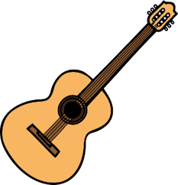
Lucía describe el fin de semana pasado. Escucha. ¿Cuántas veces escuchas verbos en –é, –qué o –gué? Escribe las palabras.
escuchar / escribir
é
qué
gué
¿Qué palabras escuchas?
é
qué
gué
desayuné
quité
gané
saqué
practiqué
busqué
identifiqué
jugué
pagué
llegué
*quitar la mesa – to clear the table
*pagar – to pay
Notes:
Slide 1/2
Timing: 8 minutes (slides 24-5)
Aim: to identify how frequently the three SSCs occur in the text.
Procedure:
Students copy the tally grids into their books for this. Click on the ‘play’ button (top right) of the audio player to begin.
The first (and second) time they listen, they just tally how many times they hear the three SSCs.
Students listen again. They write the words that they hear with these SSCs. It may be necessary to replay the audio multiple times to give students the chance to complete all three boxes. There isn’t a problem with this – it is more likely to support errorless learning (see NCELP phonics rationale document (https://resources.ncelp.org/concern/parent/kd17cs85f/file_sets/sn009x76k).
Notes:
This fully readable text (i.e., a text that includes 100% or near to 100% previously taught language) could also be used for a dictation.
Transcript:
Text (77 words): Un día muy lleno
El sábado pasado, desayuné temprano y quité la mesa después. Me gusta la música, entonces saqué mi guitarra y practiqué casi toda la mañana. Después, busqué mi balón de fútbol y jugué en el parque con Hugo. ¡Yo gané cinco a cuatro! Por la tarde pagué unos billetes de autobús para un viaje a Sevilla, luego identifiqué unos lugares para visitar. Llegué a casa con sueño después de un día muy lleno.
Word frequency of unknown words/cognates (1 is the most frequent word in Spanish): identificar [1080]; pagar [377]

Slide 25
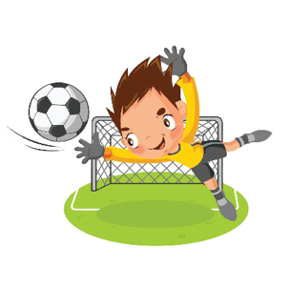
Lee el párrafo a tu compañero. Cambia el infinitivo del verbo a la forma correcta del ‘yo’ en el pasado.
hablar
El sábado pasado, [desayunar] temprano y [quitar] la mesa después. Me gusta la música, entonces [sacar] mi guitarra y [practicar] casi toda la mañana. Después, [buscar] mi balón de fútbol y [jugar] en el parque con Hugo. ¡Yo [ganar] cinco a cuatro! Por la tarde [pagar] unos billetes de autobús para un viaje a Sevilla, luego [identificar] unos lugares para visitar. [Llegar] a casa con sueño después de un día muy lleno.
desayuné
quité
saqué
practiqué
busqué
jugué
billetes
gané
pagué
identifiqué
Llegué
Notes:
Slide 2/2
Aim: pronunciation and fluency practice, with a specific focus on recognising verbs that require –qué and –gué in the preterite, and pronouncing these correctly.
Procedure:
1. Students work in pairs and take it in turns to read out the passage to their partner. They need to convert the verbs in bold in the infinitive into the ‘I’ form of the preterite. This is the same passage as the previous exercise. It could be worth doing the first verb (desayuné) in class, or asking which verbs are going to need the [qué] or [gué] endings before starting the activity.
2. The other student should then read the passage out.
3. The teacher can then go through the entire text with students, reading out individual sentences. Clicking will reveal the conjugated verb.
Notes: a native speaker from mainland Spain commented that she personally would use ‘ocupado’ (un día muy ocupado), but was aware that in other parts of Spain and in Latin American countries, ‘lleno’ is used.
If desired, the text could also also be translated as an extension activity.
Word frequency of unknown words/cognates (1 is the most frequent word in Spanish): identificar [1080]; pagar [377]

Slide 26
Vocabulario
escuchar
21
22
23
24
25
26
27
28
29
30
Notes:
Timing: 2 minutes
Aim: to introduce and practise the new vocabulary items (numbers 21-30) in the oral modality. Their pronunciation is modelled by a native speaker.
Procedure:
1. Click the blue trigger to play the audio for each word.
2. The teacher could also ask students to repeat the number out loud, after hearing it, and could focus students on where the stress falls within each word.
3. For further practice, students could turn away from the board, (or the teacher can blank the board), and so not see which audio button the teacher clicks. They would listen and write down the number they hear in numerical form or in English.

Slide 27
Vocabulario
hablar
veintiuno
veintidós
veintitrés
veinticuatro
veinticinco
veintiséis
veintisiete
veintiocho
veintinueve
treinta
Notes:
Timing: 4 minutes
Aim: to introduce and practise the new vocabulary items (numbers 13-20) in the written modality
Procedure:
The teacher chooses a number, writing it down on a mini-whiteboard or piece of paper.
The students have to guess the number the teacher has chosen.
The teacher tallies a point for every incorrect guess. This will show students how the game will work when they play it in pairs (see next steps).
Students play the game in pairs, taking it in turns to be the person guessing. Note: Teachers may want to suggest that students write down their chosen number (in case of disputes!). After each round students can show each other proof of the number they chose.
Students keep a tally for every incorrect guess. The person with the lowest score wins (i.e. the person who has made the fewest incorrect guesses during the whole game).
Notes
It might be worth drawing attention to the idea that the numbers between 21-29 are effectively pronounced like twenty and one, twenty and two, in Spanish , veinte y uno, veinte y dos, but pushed together into one word, so that the e-y becomes one sound and letter, ‘i’.

Slide 28
Recap: stress and spelling rules
Remember: for words with final-syllable stress, there is an accent on the final vowel if the word ends with the consonants ___or ___ .
This rule applies to several numbers between 13 and 30.
n
s
dieciséis
veintiún
veintidós
16
21
22
Veintiuno changes before a noun.
veintitrés
Hay veintiún chicos (m).
There are 21 boys.
23
26
veintiséis
Hay veintiuna chicas (f).
There are 21 girls.
Notes:
Timing: 2 minutes
Aim: recap accent rules on final syllables to explain number spellings
Procedure:
1. Teachers click to go through the slide. Gaps are left for teachers to elicit answers from students.
2. When the numbers appear, teachers can ask the students to say the number and say where the accent would go. They can also play a recording of the number by clicking on the number buttons for students to hear the stress on the last syllable.
3. The spelling of the numbers will appear on the next clicks.
Source: https://www.rae.es/espanol-al-dia/veintiuna-personas-veintiuno-por-ciento
Transcript:
Dieciséis
Veintiún
Veintidós
Ventitrés
Veinticinco

Slide 29
Escucha y escribe los números en español. ¿Cuáles llevan acento?
escuchar
 | Número | Número en español |  | Número | Número en español
1
18
dieciocho
6
16
dieciséis
2
25
veinticinco
7
23
veintitrés
3
22
veintidós
8
14
catorce
4
17
diecisiete
9
26
veintiséis
5
29
veintinueve
10
21
veintiún
Notes:
OPTIONAL
Aim: practise recognising and spelling the numbers 13-30, with a focus on those with accents
Procedure:
1. Students should write 1-10 in their exercise books.
2. Teachers play the recording. Students need to write both the number they hear in figures and then in Spanish.
3. Answers are shown in order by clicking.
Transcript:
dieciocho
veinticinco
veintidós
diecisiete
veintinueve
dieciseís
veintitrés
catorce
veintiséis
veintiún

Slide 30
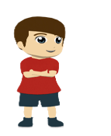
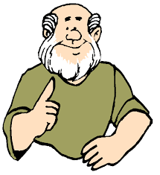
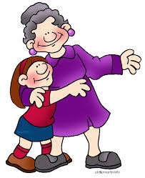
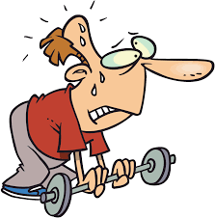
Vocabulario
hablar
[1/2]
conocido
conocida
c_ _ _ _ _ _ _
c_ _ _ _ _ _ _
el hijo
[son]
el h_ _ _
[well-known, famous]
la hija
[daughter]
la h_ _ _
el tío
el t_ _
[uncle]
[weak]
d_ _ _ _
débil
la t_ _
la tía
[aunt]
Notes:
Vocabulary practice slide [1/2]
Timing: 2 minutes
Note: the words tío, tía, hijo, hija, débil, conocido (this slide) were taught in lesson 1. The first letter is given so that students have to recall the words.
The words nuestro, científico, médico, músico, abogado, tan (next slide) are introduced for the first time.
Procedure 1. The teacher elicits the Spanish words by pointing the English word and picture. Each click reveals a word.
Pictures by Mark Davies and free from clipart-library.com

Slide 31
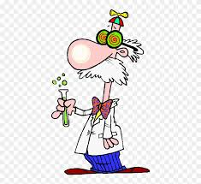
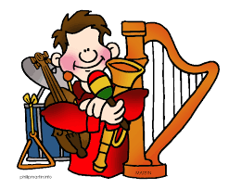
Vocabulario
hablar
[2/2]
Many jobs end in an ‘-o’ when they refer to a man and in an ‘-a’ when they refer to a woman.
el científico, la científica
el abogado, la abogada
[scientist]
[lawyer]
‘Tan’ is used to give emphasis to an adjective.
Ejemplo:
tan grande = so big
el médico, la médica
nuestro, nuestra
[doctor]
[our]
el músico, la música
[so]
tan
[musician]
Notes:
Vocabulary practice slide [2/2]
Timing: 3 minutes
Procedure 1. Click to reveal each new word. Two short callouts will appear with the new vocabulary to explain:
a) how ‘tan’ is used, in contrast to ‘así que’ and ‘entonces’ which have also been previously taught as ‘so’. Explain that ‘tan’ is used to emphasise an adjective quality.
b) how gender marking is used for job titles. If the person is a man or a woman, then certain jobs will change their ending as happens with adjectives. Students could be asked here if they can remember any examples of jobs that don’t end in –o or –a (anticipate ‘profesor’, ‘director’ and ‘autor’ – as jobs may also end in ‘r’ when referring to a man).
2. Pupils either work by themselves or in pairs, reading out the words and recapping their English meaning (1 minute). 3. Then the teacher removes the English words or pictures (one by one) and they try to recall the English orally (chorally), looking at the Spanish (1 minute). 4. Then the Spanish meanings are removed (one by one) and they to recall them orally (again, chorally), looking at the English (1 minute) 5. Further rounds of learning can be facilitated by one pupil turning away from the board, and his/her partner asking him/her the meanings (‘Cómo se dice X en español?’). This activity can work from L2 → L1 or L1 → L2.

Slide 32
Saying what jobs people do Use of the indefinite article
gramática
In English, we use the indefinite article (a, an) to say what job someone does
(e.g. He is a teacher). In Spanish, no indefinite article (un/una) is used.
Ejemplos:
Mi padre es médico.
My father is a doctor.
Mi tía es abogada.
My aunt is a lawyer.
However, if you use an adjective to describe the job, the indefinite article is used:
Mi madre es una directora seria.
My mother is a serious headteacher.
Mi primo es un músico genial.
My cousin is a great musician.
Notes:
Timing: 2 minutes
Aim: Teaching how do say what jobs people do (highlighting the absence of the indefinite article in Spanish)
Procedure:
Click to show the rule about not using indefinite article with jobs in Spanish. It could be worth saying that in Spanish, you are effectively saying ‘My uncle is scientist.’
Click to show the examples.
Explain that when qualifying the job, i.e making it more specific, or using an adjective, then the indefinite article is used.
Click to show two examples with adjectives.

Slide 33
Talking about possession Possessives ‘tu’ and ‘su’ [revisited]
gramática
tu
Remember that to say ‘your’ before a singular or uncountable noun, use ____.
To say ‘your’ before a plural noun, use _____.
Ejemplos:
To say ‘his’, ‘her’ or ‘its’ before a singular or uncountable noun, use _____.
To say ‘his’, ‘her’ or ‘its’ before a plural noun, use _____.
Ejemplos:
tus
your cousin (f)
tu prima
your cousins (m or m/f)
tus primos
Remember: when talking about a mixed group (boys and girls), use the masculine plural form.
su
sus
his / her son
su hijo
his / her daughters
sus hijas
Notes:
Timing: 2 minutes
Aim: Review use of ‘tu’/’tus’ and ‘su’/’sus’
Procedure:
Click to show the rule for saying ‘your’ in the singular form, ask students what the missing word is, click to reveal.
Same process for saying your in the plural form.
Click to show examples
Click to show a reminder that the masculine plural form can have two possible meanings, either just male family members, or male and female family members. This was mentioned on a slide in the previous lesson.
Click to show rule for saying his/her before a singular noun, ask students what the missing word is, click to reveal.
Same process for his/her in the plural form.
Click to show examples.
Notes
You could add to this and review family vocabulary by asking the class to say ‘your son’, ‘your daughters’, ‘your aunt’, ‘his grandmother’, ‘her grandparents’ etc, if more practice is needed.

Slide 34
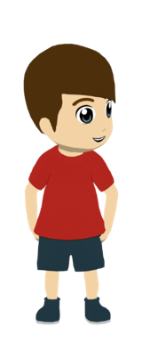
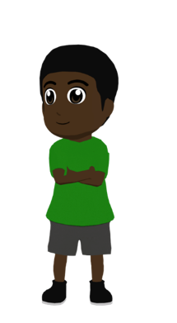
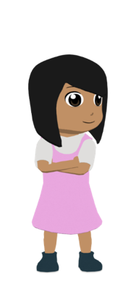
Escucha. Daniel habla de la familia de Hugo (‘your…’) o de la familia de Nadia (‘her…’)? Completa la tabla en inglés.
escuchar
 | Hugo (‘your’) | Nadia (‘her’) | ¿Quién es / quiénes son? Escribe en inglés | ¿Qué trabajo? Escribe en inglés | Número de la casa. Escribe el número
1
uncle
lawyer
27
2
cousins
doctors
24
3
aunts
musicians
29
4
grandmother
author
23
5
father
scientist
21
6
grandfather
headmaster
30
Notes:
Teachers can choose to do either this listening activity OR the reading activity on the next slide, which uses the same question content.
Timing: 8 minutes
Aim: Distinguish in listening between your and his/her, translate information about family, job and numbers
Procedure:
1. Explain that in this exercise they will hear recordings saying what jobs family members do and where they live. Ask students to copy down the grid in their books
2. Students should tick either the ‘your’ box or the ‘his/her’ box for each question, and write the answers in English for the columns about the family member and the job. The number of the house in the final column can be written in number form.
3. Click the button for each question to play the recording. It could be played two or three times.
4. Answers will be revealed with a click for each column for each question in order to allow students to give answers for each box.
Transcript:
Su tío es abogado. Vive en la casa número veintisiete.
Tus primos son médicos. Viven en la casa número veinticuatro
Sus tías son músicas. Viven en la casa número veintinueve.
Su abuela es autora. Vive en la casa número veintitrés
Tu padre es científico. Vive en la casa número veintiuno.
Su abuelo es director. Vive en la casa número treinta.

Slide 35
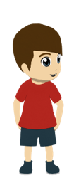
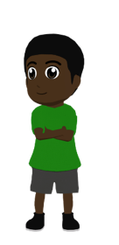
Lee las frases. Daniel le escribe mensajes a Hugo. Habla de la familia de Hugo (‘your…’) o la familia de Nadia (‘her…’)? Completa la tabla en inglés.
leer
 | Hugo ‘Your’ | Nadia ‘Her’ | Family member? | Job? | House?
1. Su tío es abogado. Vive en la casa veintisiete.
2. Tus primos son médicos. Viven en la casa veinticuatro.
3. Sus tías son músicas. Viven en la casa veintinueve.
4. Su abuela es autora. Vive en la casa veintitrés.
5. Tu padre es científico. Vive en la casa veintiuno.
6. Su abuelo es director. Vive en la casa treinta.
uncle
lawyer
27
cousins
doctors
24
aunts
musicians
29
grandmother
author
23
father
scientist
21
grandfather
headteacher
30
Notes:
Teachers can choose to do either this reading activity OR the listening activity on the previous slide, which uses the same question content.
Timing: 8 minutes
Aim: to recognise ‘your’ or ‘his/her’ and translate information on family members, jobs and numbers.
Procedure:
1. Tell students to copy down a grid, ignoring the first column (the Spanish sentences) 2. Students should tick either the ‘your’ or ‘his/her’ column. They should write out the family member in English and the job in English, and the house number in digits.
3. Answers will be revealed by clicking for each column for each question to allow teachers to elicit individual answers from students.
Note: teachers could draw students’ attention to the fact that ‘veintiuno’ is used in item 5 (rather than ‘veintiún’ or ‘veintiuna’) because it does not appear before the noun.

Slide 36
Talking about possessions Possessive adjective ‘nuestro’
gramática
To say ‘our’, use ‘nuestro’. ‘Nuestro’ needs to agree in gender with the noun.
For singular masculine nouns use ‘nuestro’.
nuestro hijo
our son
For singular feminine nouns use ‘nuestra’.
nuestra hija
our daughter
Notes:
Timing: 3 minutes
Aim: Teach how to use the possessive adjective ‘nuestro’ and ‘nuestra’
Procedure:
Click to show the explanation of nuestro use in the singular. Show how nuestro will agree with the gender of the noun that it is describing.
Click to show examples. Click to show the Spanish, then you can ask what the phrase means, before clicking to reveal. There are two examples. It could be worth some quick practice here with other family members, e.g., ‘¿Cómo se dice ‘our father’, ‘our mother’, ‘our grandmother’, ‘our grandfather’? etc.

Slide 37
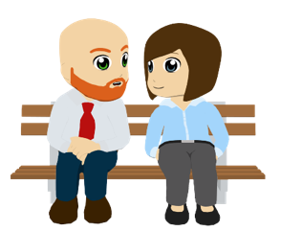
Ana y Diego describen a la familia. Escucha y completa la tabla.
escuchar
 | ¿Nuestro o nuestra? | ¿Quién es? | ¿Cuántos años tiene? | ¿Qué trabajo tiene?
 |  | hijo / hija |  | médico / médica
 |  | abuelo /abuela |  | científico / científica
 |  | primo / prima |  | autor / autora
 |  | tío / tía |  | director / directora
 |  | hijo / hija |  | músico / música
 |  | amigo / amiga |  | abogado / abogada
1
1
Nuestra
26
2
2
Nuestra
22
3
3
Nuestro
25
4
4
Nuestra
28
5
5
Nuestro
20
6
6
Nuestro
27
Notes:
Timing: 7 minutes
Aim: To apply gender agreement rules to ‘nuestro’ to decide which noun is correct. To also use the gender marking to decide which job is correct and to consolidate understanding of vocabulary (numbers and family members).
Procedure:
1. Students should copy the grid into their books. For the ¿Quién es? and ¿Qué trabajo tiene? Students could just leave blank and just write the correct answer.
2. Students will hear the sentence with the family member bleeped out. They will need to pay attention to the possessive adjective (nuestro or nuestra) to establish who the correct family member is. Students should also write either ‘nuestro’ or ‘nuestra’ in the first column and then the correct family member in the second.
3. Students listen again. This time they decide how old the person is and what their job must be (based on the gender of the possessive adjective), as the sentence ending is incomplete. They add this information to the third and fourth columns.
4. Each answer will be revealed for each question by clicking so that teachers can elicit individual answers from students. The beige action buttons can be clicked to play the full sentence.
5. It might be worth asking which question gives an unlikely age answer (number 2, not many 22 year old grandmothers!)
6. Sentences can be translated after the correct answers have been revealed.
Transcript:
Words in brackets are bleeped out.
Nuestra [hija] tiene veintiséis años. Es...
Nuestra [abuela] tiene veintidós años. Es…
Nuestro [primo] tiene veinticinco años. Es…
Nuestra [tía] tiene veintiocho años. Es…
Nuestro [hijo] tiene veinte años. Es…
Nuestro [amigo] tiene veintisiete años. Es…
Answers
Nuestra hija tiene veintiséis años. Es médica.
Nuestra abuela tiene veintidós años. Es científica.
Nuestro primo tiene veinticinco años. Es autor.
Nuestra tía tiene veintiocho años. Es directora.
Nuestro hijo tiene veinte años. Es músico.
Nuestro amigo tiene veintisiete años. Es abogado.

Slide 38
¿Quién es?
hablar / escuchar
Persona A: lee las dos frases en español. Lee las frases en orden (1, 2, 3 etc.)
Persona B: escucha. ¿Quién es la persona? Usa ‘su’ o ‘nuestro/a’ + nombre.
¡Atención! En ocasiones la misma persona está en dos tarjetas (e.g. our sister y her sister)
Es médica. Vive en la casa 23.
Persona B
Persona A
1
f
Our sister
Say in Spanish:
Job: Doctor
She’s a doctor (f).
She lives in house number
23.
Es nuestra hermana.
Who is it? Write in English.
23
Our sister
_______________
Notes:
Timing: 12 minutes
Aim: Speaking and listening practice of jobs, numbers, possessive pronouns ‘su’ and ‘nuestro’ and family members
Procedure:
1. Students work in pairs. Give out a Person A and person B sheet to the pairs. On one side students should have 6 prompts, and on the other they should have 8 answer cards.
2. Person A reads out their prompt. Person B looks at their answer cards and translates the person they link it is, deciding whether to use ‘su’ or ‘nuestro’. Person A writes down what they hear in Spanish under the ‘who is it’ heading on the card.
3. Each person speaking will only have to use one form of ‘nuestro’ across the 6 sentences. This retains the focus on a single pair of features (‘su’ or ‘nuestro’), thus making the task more achievable than (su vs nuestro vs nuestra).
4. After Person A has received 4 answers, Person B will take their turn to give the prompts
Note: There are pairs of potential answers (e.g. her father and our father), with either the jobs or the house numbers being the distractor information. By designing activity in this way, the aim is to make the vocabulary an essential part of the task.

Slide 39
1
2
3
Say in Spanish:
Say in Spanish:
Say in Spanish:
She’s a doctor (f).
She lives in house number 23.
Who is it? Write in English.
________________________
She’s a musician (f).
She lives in house number 30.
Who is it? Write in English.
________________________
She’s a scientist (f).
She lives in house number 27.
Who is it? Write in English.
________________________
4
5
6
Say in Spanish:
Say in Spanish:
Say in Spanish:
She’s a lawyer (f).
She lives in house number 24.
Who is it? Write in English.
________________________
She’s an author (f).
She lives in house number 27.
Who is it? Write in English.
________________________
She’s a lawyer (f).
She lives in house number 28.
Who is it? Write in English.
________________________
Notes:
Student A ¿Quién es? Prompt cards, with space to write answer

Slide 40
1
2
3
Say in Spanish:
Say in Spanish:
Say in Spanish:
He’s a scientist (m).
He lives in house number 22.
Who is it? Write in English.
________________________
He’s an author (m).
He lives in house number 26.
Who is it? Write in English.
________________________
He’s a musician (m).
He lives in house number 25.
Who is it? Write in English.
________________________
4
5
6
Say in Spanish:
Say in Spanish:
Say in Spanish:
He’s a headteacher (m).
He lives in house number 20.
Who is it? Write in English.
________________________
He’s a lawyer (m).
He lives in house number 25.
Who is it? Write in English.
________________________
He’s a scientist (m).
He lives in house number 21.
Who is it? Write in English.
________________________
Notes:
Student B ¿Quién es? Speaking activity prompt sheet

Slide 41
a
Her son
b
Her uncle
c
Our father
d
Our son
Job: Lawyer
Job: Scientist
Job: Headteacher
Job: Musician
25
22
20
25
e
Her cousin (m)
f
Our uncle
g
Our cousin (m)
h
Her father
Job: Author
Job: Scientist
Job: Author
Job: Doctor
26
21
27
20
Notes:
Student A ¿Quién es? speaking activity answer cards

Slide 42
a
His aunt
b
His grandma
c
Our friend (f)
d
Our grandma
Job: Lawyer
Job: Headteacher
Job: Scientist
Job: Doctor
24
23
27
23
e
His friend (f)
f
Our mother
g
Our aunt
h
His mother
Job: Author
Job: Musician
Job: Lawyer
Job: Musician
27
20
28
30
Notes:
Student B ¿Quién es? speaking activity answer cards

Slide 43
Respuestas
hablar
Persona A :
Nuestra abuela
Su madre
Nuestra amiga
Su tía
Su amiga
Nuestra tía
Persona B :
Su tío
Su primo
Nuestro hijo
Nuestro padre
Su hijo
Nuestro tío
Notes:
Timing: 2 minutes
Procedure:
Click to reveal the answers
Correct card combinations
Person A
Prompt 1 = card d of Person B
Prompt 2 = card h of Person B
Prompt 3 = card c of Person B
Prompt 4 = card a of Person B
Prompt 5 = card e of Person B
Prompt 6 = card g of Person B
Person B
Prompt 1= card b of Person A
Prompt 2 = card e of Person A
Prompt 3 = card d of Person A
Prompt 4 = card c of Person A
Prompt 5 = card a f Person A
Prompt 6 = card f of Person A

Slide 44
Gaming Grammar
Gaming Grammar
Gaming Grammar mini-game Possessive adjectives: number in the ‘Possessive adjective agreement’ menu practices aspects of this week’s lessons.
Notes:
This slide links to Gaming Grammar login screen. The appropriate mission can then be selected from the menu page.
Students will progress through the game at their own rate; teachers should use the teacher interface to check progress. This will help to inform future lesson planning.

Slide 45
Deberes
Vocabulary Learning Homework (Y8, Term 3.1, Week 3)
Audio file
Audio file QR code:
Student worksheet
Quizlet link
In addition, revisit: Term 2.2 Week 3
Term 2.1 Week 6
Notes:
Links to homework sheet to be updated.

