Slide 1
Vocabulary
Y7 German
Term 1.1 - Week 2
Author name(s): Inge Alferink / Rachel Hawkes
Date updated: 13/12/19

Slide 2
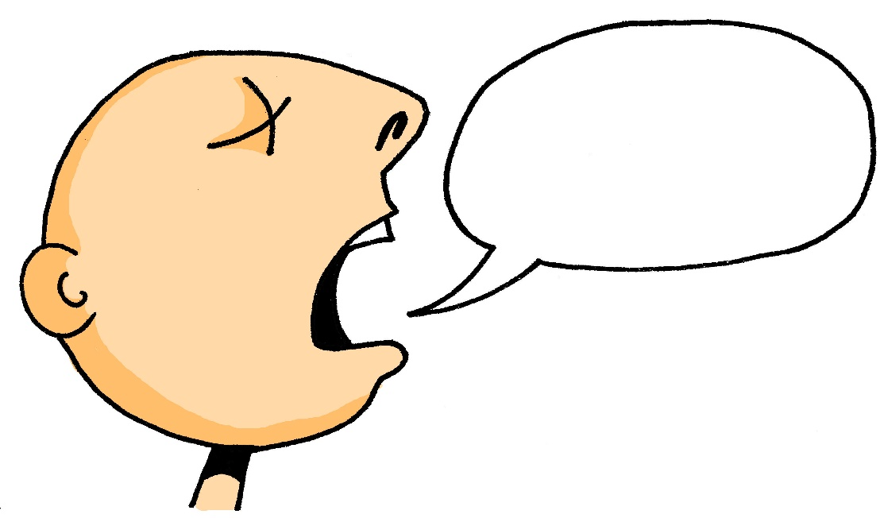
sagen
[to say / tell | saying / telling]
sagt
[says / tells]
Notes:
Introducing the verb sagen more explicitly. Sagen is one of the 25 most frequently used words in German. All 25 most frequent verbs will be introduced early on using the same format. Both long form (infinitive) and short form (3rd person singular) are introduced in order to familiarise students with the various forms of the same verb.
1. Bring up the word sagen on its own, say it, students repeat it, and remind them of the phonics.
2. Try to elicit the meaning from the students. They have already seen the verb as a phonics source word.
3. Bring up the picture, and if using gestures, a possible gesture for this would be to mime speech coming out of your mouth, opening your mouth and drawing your hand away quickly away from you. Establish the meaning of the word in English, clearly, i.e., ‘to say, tell’. 4. Bring up the short form sagt, say it, students repeat it. Try to elicit the meaning from the students. They have already heard the short version in the previous exercise, but have not seen it written down.

Slide 3
sagen
[to say /tell | saying / telling]
sagt
[tells /says]
Notes:
Cycle through the long and short form again.

Slide 4
sagt
[says / tells]
Der Mann sagt nichts.
[The man says nothing.]
Notes:
Introduce the short form in a sentence. Der Mann is a noun from Week 1 vocabulary and should at this point be familiar. Nichts (frequency ranking 111) is not on the vocabulary list for this week, but is a highly frequent word.

Slide 5
sagen
[to tell / say | telling / saying]
Der Mann kann nichts sagen.
[The man cannot say anything.]
Notes:
Introduce the long form in a sentence. Der Mann is a noun from Week 1 vocabulary and should at this point be familiar. Nichts (frequency ranking 111) and kann (23) are not on the vocabulary list for this week, but are a highly frequent words. Out loud kann sounds similar to English can which students might be able to use to infer the meaning.

Slide 6
sagt
[tells / says]
Der Mann _____ nichts.
sagt
[The man says nothing.]
Notes:
Cycle through the short form in context again.

Slide 7
sagen
[to tell / say | telling / saying]
Der Mann kann nichts ______.
sagen
[The man cannot say anything.]
Notes:
Cycle through the long form in context again.

Slide 8
was?
what?
Notes:
Introducing question word ‘Was?’ [frequency ranking: 39]

Slide 9
was?
what?

Slide 10
was?
what?
Was denkst du?
[What do you think?]
Notes:
The verb denken will come back in the phonics section in lessons 1 & 2 this week.

Slide 11
was?
what?
____ denkst du?
Was
[What do you think?]

Slide 12
Was ist nicht mehr da?
1
die Flasche
das Fenster
der Tisch
die Tafel
das Heft
der Tag
Notes:
Kim's game activity - Was ist nicht mehr da? (What is no longer there?)
Teacher shows words on the slide, then slide goes blank, when it returns, one of the words is missing.
Students supply the missing word.
The task requires 'the' in the answer. E.g. der Mann.
Antwort: der Tisch

Slide 13
Was ist nicht mehr da?
2
die Flasche
das Fenster
der Tisch
die Tafel
das Heft
der Tag
Notes:
Kim's game activity - Was ist nicht mehr da? (What is no longer there?)
Teacher shows words on the slide, then slide goes blank, when it returns, one of the words is missing.
Students supply the missing word.
The task requires 'the' in the answer. E.g. der Mann.
Antwort: das Heft

Slide 14
Was ist nicht mehr da?
3
die Flasche
das Fenster
der Tisch
die Tafel
das Heft
der Tag
Notes:
Kim's game activity - Was ist nicht mehr da? (What is no longer there?)
Teacher shows words on the slide, then slide goes blank, when it returns, one of the words is missing.
Students supply the missing word.
The task requires 'the' in the answer. E.g. der Mann.
Antwort: das Fenster

Slide 15
Was ist nicht mehr da?
4
die Flasche
das Fenster
der Tisch
die Tafel
das Heft
der Tag
Notes:
Kim's game activity - Was ist nicht mehr da? (What is no longer there?)
Teacher shows words on the slide, then slide goes blank, when it returns, one of the words is missing.
Students supply the missing word.
The task requires 'the' in the answer. E.g. der Mann.
Antwort: die Tafel

Slide 16
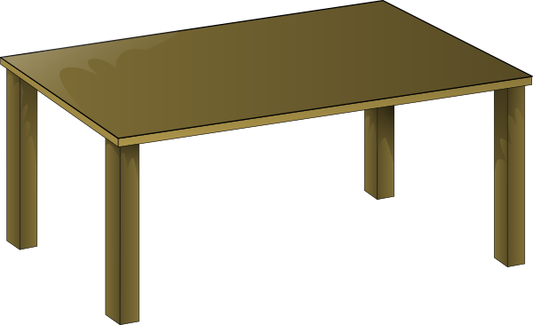
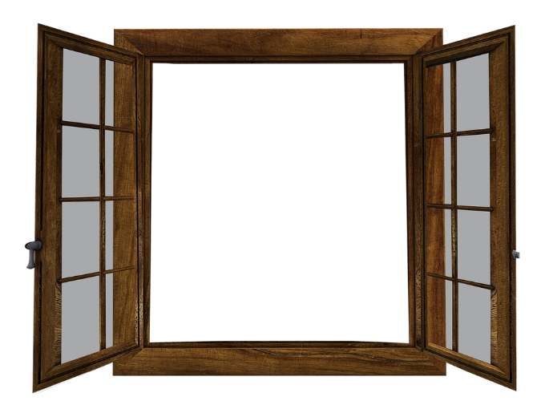
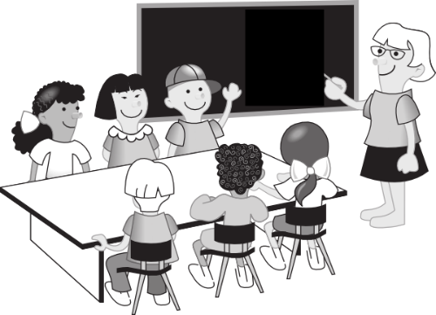
Was ist nicht mehr da?
1
Notes:
A second round variation on the game (with all 9 nouns instead of 6), and where the words are replaced by pictures.
Students respond with nouns and definite articles. Note: It is worth eliciting all of the nouns quickly once first, to ensure secure recall of all 9 nouns, before starting.
Antwort: das Paar

Slide 17
Was ist nicht mehr da?
2
Notes:
Antwort: die Tafel

Slide 18
Was ist nicht mehr da?
3
Notes:
Antwort: die Klasse

Slide 19
Was ist nicht mehr da?
4
Notes:
Antwort: der Tag

Slide 20
sein
[to be | being]
ist
[is]
Notes:
Note: The SEIN slides have audio embedded (Turn the volume down and use your own voice, if preferred). Introducing the verb SEIN more explicitly. SEIN is the third most frequently used word in German. All 25 most frequent verbs will be introduced early on using the same format. Both long form (infinitive) and short form (3rd person singular) are introduced in order to familiarise students with the various forms of the same verb.
1. Bring up the word SEIN on its own, say it, students repeat it. They are going to learn the all important SSC ‘EI’ next week more formally.
2. Tell them the meaning.
4. Bring up the short form ist, say it, students repeat it. They know ‘ist’ already, but it’s important that they connect ‘is’ and ‘be’, ‘ist’ and ‘sein’. These verbs are so irregular in English and German that many students will not know that ‘is’ and ‘be’ are connected. It’s important to establish and reinforce this, often.
Continue with the rest of the SEIN sequence.

Slide 21
sein
[to be | being]
ist
[is]

Slide 22
ist
[is]
Hanna ist intelligent.
[Hanna is intelligent.]

Slide 23
sein
[to be | being]
Hanna kann intelligent sein.
[Hanna can be intelligent.]

Slide 24
ist
[is]
Hanna ___ intelligent.
ist
[Hanna is intelligent.]

Slide 25
sein
[to be | being]
sein
Hanna kann intelligent ____.
[Hanna can be intelligent.]

Slide 26
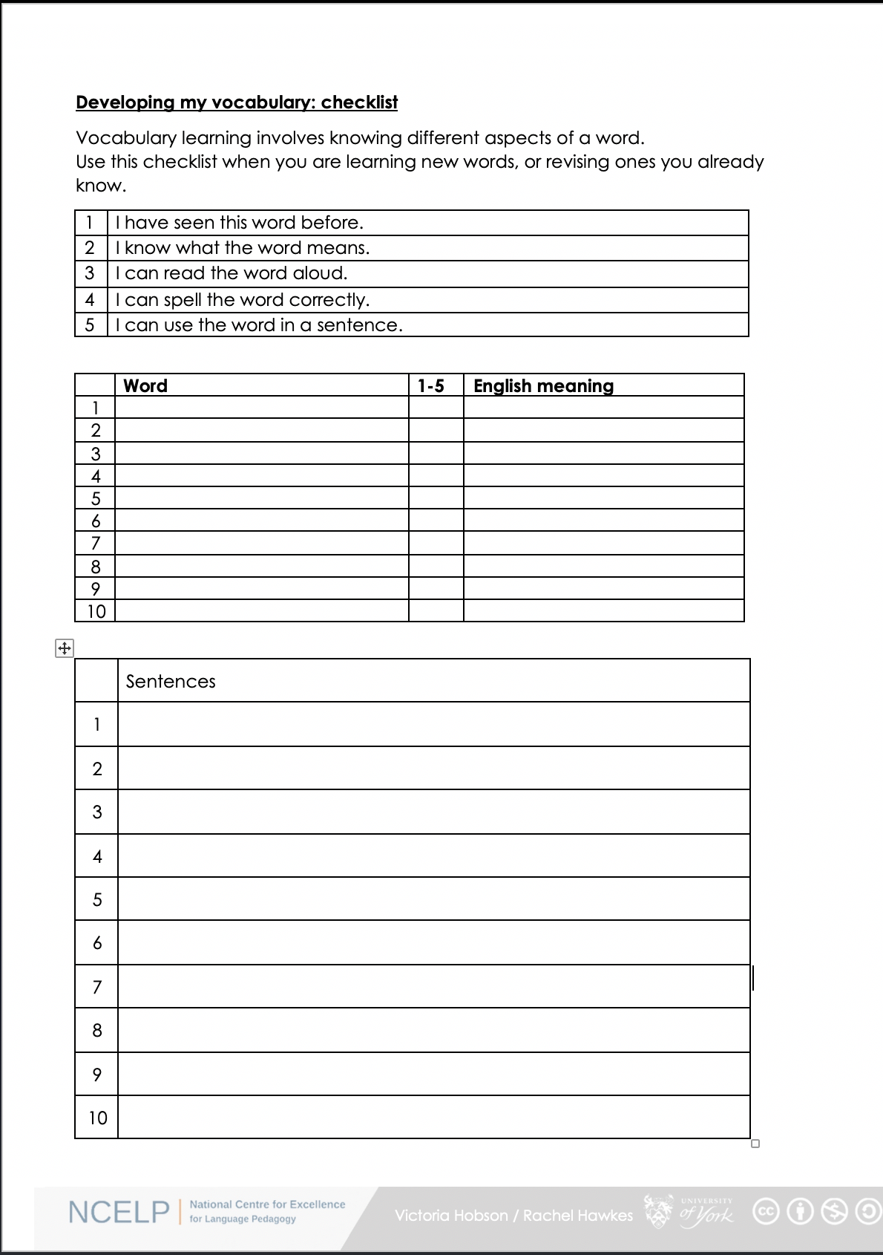
Was denkst du?
1. I have seen this word before.
2. I know what the word means.
3. I can read the word aloud.
4. I can spell the word correctly.
5. I can use the word in a sentence.
6. For nouns, I know the gender and the correct word for ‘the’
Notes:
Was denkst du? What do you think? (Elicit the meaning of this from students).
Teacher talks students through the checklist. The next slide presents all the vocabulary for week 1 and 2.
Vocabulary learning involves knowing different aspects of a word. Students can use this checklist when to check what they know when they are learning new words, or revising ones they already know.
For each word the checklist asks students to asses whether the following statement apply:
1. I have seen this word before.
2. I know what the word means.
3. I can read the word aloud.
4. I can spell the word correctly.
5. I can use the word in a sentence.
Students then translate the word and try to use it in a sentence.
We suggest giving students a print out of the template they can refer to throughout the year.
A word template is available on the NCELP resource portal.
https://resources.ncelp.org/concern/resources/gf06g264k?locale=en

Slide 27
Vokabeln
sein | die Flasche | sagen | das Paar | nicht
das Fenster | wo? | was? | die Klasse | oder
das Heft | hier | sagt | richtig | ja
der Tisch | da | der Tag | falsch | nein
dier Tafel | der, die, das | der Mann | ist
Notes:
Vocabulary for Week 1
sein [3] ist [3] das Heft [3594] das Fenster [634] der Tisch [492] die Tafel [3656] die Flasche [1758] wo? [94] hier [71] da [35] der, die, das [1]
Vocabulary for Week 2
sagen [46] sagt [46] was?[39] der Tag [108] der Mann [131] das Paar [284] die Klasse [619] richtig [211] falsch [638] nicht [12] oder [30] ja [27] nein [120]

