Slide 1
Asking and answering questions about activities at home
Present tense weak verbs: 1st person vs 2nd person singular; VSO questions plus question words
wo, was, wer, wie
SSC [ch]
Y7 German
Term 1.2 - Week 3 - Lesson 19
Natalie Finlayson / Rachel Hawkes
Artwork: Steve Clarke
Date updated: 15/12/21
Notes:
Artwork by Steve Clarke. All additional pictures selected are available under a Creative Common license; no attribution required.
Learning outcomes (lesson 1):
Introduction of SSC – long and short [ch]
Introduction of present tense weak verbs: 1st person singular (juxtaposed with 2nd person singular)
Word frequency (1 is the most frequent word in German):
7.1.2.3 (introduce) gehen [66] hören [146] tanzen [1497] kaum [272] manchmal [382] nie [186] oft [223] sehr [81] einmal die Woche [n/a] jeden Tag [n/a]
7.1.1.7 (revisit) Band [<5009] Buch [300] Film [505] Lehrerin [695] Lied [1733] Sänger [3029] Sängerin [3916] leider [643] Lieblings- [n/a]
7.1.1.1 (revisit) sein¹, ist [4] Fenster [674] Flasche [1602] Heft [3862] Tafel [3855] Tisch [529] da [48] hier [68] wo? [108] der, die, das [1] Hallo! [1077] Tschüs! [3766]
Source: Jones, R.L. & Tschirner, E. (2019). A frequency dictionary of German: core vocabulary for learners. Routledge

Slide 2
Phonetik
lesen / sprechen
Wie sagt man das?
 | long o | short o |  | long i | short i
Moritz |  |  | Mia
Leonie |  |  | Felix
Jonas |  |  | Emil
Leon |  |  | Finn
Oskar |  |  | Luisa
Sofia |  |  | Elias
Anton |  |  | Lina
Notes:
Timing: 5 minutes Aim: To recap long and short /o/ and /i/.
Note: These German names consist of these sounds together with previously studied SSCs and transferable consonants, with the exception of /j/ in Jonas and /s/ in Sofia.
Students may be interested to know that these are taken from the list of most popular German baby names 2016: https://www.expatica.com/de/living/family/german-baby-names-popular-german-boys-and-girls-names-1067023
Procedure: 1. Teacher reads the names and students identify if they are long or short vowels.
2. If the class have German names, they should at this point identify any long or short vowels they contain.

Slide 3
ch
ich
Notes:
Timing: 1 minute
Aim: To introduce/consolidate SSC [ch]
Procedure: 1. Present the letter(s) and say the [ch] sound first, on its own. Students repeat it with you. 2. Bring up the word ”ich” on its own, say it, students repeat it, so that they have the opportunity to focus all of their attention on the connection between the written word and its sound.
3. A possible gesture for this would be to do an exaggerated gesture of pointing to yourself.
4. Roll back the animations and work through 1-3 again, but this time, dropping your voice completely to listen carefully to the students saying the [ch] sound, pronouncing ”ich” and, if using, doing the gesture. Word frequency (1 is the most frequent word in German): ich [8]
Source: Jones, R.L. & Tschirner, E. (2006). A frequency dictionary of German: core vocabulary for learners. Routledge

Slide 4
ch
ich
Notes:
With sound and no pictures to focus all attention on the sound-symbol correspondence.

Slide 5
ch
ich
Notes:
Without sound to elicit pronunciation (without first hearing the teacher).
Teacher to elicit pronunciation by asking “Wie sagt man…”

Slide 6
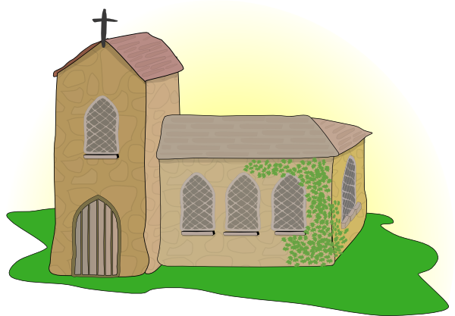
ch
Licht
Kirche
ich
nicht
endlich
[finally]
manchmal
[sometimes]
Notes:
Timing: 2 minutes
Aim: To introduce/consolidate SSC [ch]
Procedure:
Introduce and elicit the pronunciation of the individual SSC [ch] and then the source word again ‘ich’ (with gesture, if using).
Then present and elicit the pronunciation of the five cluster words.
The cluster words have been chosen for their high-frequency, from a range of word classes, with the SSC (where possible) positioned within a variety of syllables within the words (e.g. initial, 2nd, final etc.). Additionally, we have tried to use words that build cumulatively on previously taught SSCs (see the Phonics Teaching Sequence document) and do not include new SSCs. Where new SSCs are used, they are often consonants which have a similar symbol-sound correspondence in English.
Word frequency (1 is the most frequent word in German): ich [8]; Licht [503] Kirche [519]; endlich [496]; manchmal [394]; nicht [12]
Source: Jones, R.L. & Tschirner, E. (2006). A frequency dictionary of German: core vocabulary for learners. Routledge

Slide 7
ch
Licht
Kirche
ich
nicht
endlich
manchmal
Notes:
With sound and no pictures to focus all attention on the sound-symbol correspondence.

Slide 8
ch
Licht
Kirche
ich
nicht
endlich
manchmal
Notes:
Without sound to elicit pronunciation (without first hearing the teacher).
Teacher to elicit pronunciation by asking “Wie sagt man…”

Slide 9
ch
Buch
Notes:
Timing: 1 minute
Aim: To introduce/consolidate SSC [ch]
Procedure: 1. Present the letter(s) and say the [ch] sound first, on its own. Students repeat it with you. 2. Bring up the word ”Buch” on its own, say it, students repeat it, so that they have the opportunity to focus all of their attention on the connection between the written word and its sound.
3. A possible gesture for this would be to mime opening the pages of a book with both hands.
4. Roll back the animations and work through 1-3 again, but this time, dropping your voice completely to listen carefully to the students saying the [ch] sound, pronouncing ”Buch” and, if using, doing the gesture. Word frequency (1 is the most frequent word in German): Buch [195]
Source: Jones, R.L. & Tschirner, E. (2006). A frequency dictionary of German: core vocabulary for learners. Routledge

Slide 10
ch
Buch
Notes:
With sound and no pictures to focus all attention on the sound-symbol correspondence.

Slide 11
ch
Buch
Notes:
Without sound to elicit pronunciation (without first hearing the teacher).
Teacher to elicit pronunciation by asking “Wie sagt man…”

Slide 12
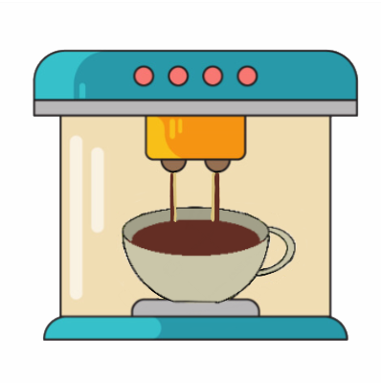
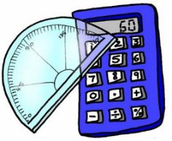
ch
machen
nochmal
Buch
acht
Nacht
Fach
Notes:
Timing: 2 minutes
Aim: To introduce/consolidate SSC [ch]
Procedure:
Introduce and elicit the pronunciation of the individual SSC [ch] and then the source word again ‘Buch’ (with gesture, if using).
Then present and elicit the pronunciation of the five cluster words.
The cluster words have been chosen for their high-frequency, from a range of word classes, with the SSC (where possible) positioned within a variety of syllables within the words (e.g. initial, 2nd, final etc.). Additionally, we have tried to use words that build cumulatively on previously taught SSCs (see the Phonics Teaching Sequence document) and do not include new SSCs. Where new SSCs are used, they are often consonants which have a similar symbol-sound correspondence in English.
Word frequency (1 is the most frequent word in German): Buch [195]; machen [49] nochmal [773]; acht [458]; Fach [698]; Nacht [335]. Source: Jones, R.L. & Tschirner, E. (2006). A frequency dictionary of German: core vocabulary for learners. Routledge

Slide 13
ch
machen
nochmal
Buch
acht
Nacht
Fach
Notes:
With sound and no pictures to focus all attention on the sound-symbol correspondence.

Slide 14
ch
machen
nochmal
Buch
acht
Nacht
Fach
Notes:
Without sound to elicit pronunciation (without first hearing the teacher).
Teacher to elicit pronunciation by asking “Wie sagt man…”

Slide 15
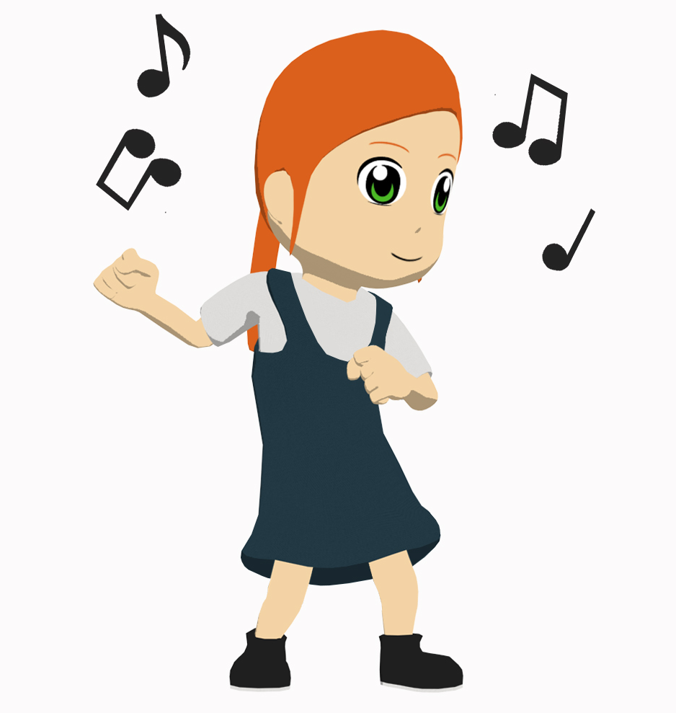
tanzen
[to dance | dancing]
tanzt
[dances | is dancing]
Notes:
Timing: 3 minutes for sequence of six slides
Aim: To introduce the verb tanzen more explicitly.
Note: Tanzen is one of the NCELP 15 prototypical verbs in German. Prototypical verbs are common verbs that illustrate the typical characteristics of a class of verb – the German prototypical verbs contain examples of regular/weak verbs, but also common examples of changes to the stem. All 15 prototypical verbs will be introduced early on using the same format. Both long form (infinitive) and short form (3rd person singular) are introduced in order to familiarise students with various forms of the same verb.
Procedure:
Bring up the word tanzen on its own, say it, students repeat it, and remind them of the phonics. Draw attention to the SSC [z].
Try to elicit the meaning from the students. Students have had explicit teaching that the present tense in German communicates two different present tense meanings in English. This reinforces that learning. Emphasise the two meanings for the short form, reminding students that German only has one form and does not have a direct equivalent of the grammar for ‘is + ing’, the continuous form (as covered in previous weeks).
Bring up the picture, and, if using gestures, a possible gesture would be to mime dancing.
Then bring up the English translations. Emphasise the two meanings for the infinitive.
Bring up the short form tanzt, say it, students repeat it. Draw attention to the SSC [z].
Try to elicit the meaning from the students. Emphasise the two meanings for the short form.

Slide 16
tanzen
[to dance | dancing]
tanzt
[dances | is dancing]
Notes:
Cycle through the long and short form again.

Slide 17
tanzt
[dances | is dancing]
Laura tanzt oft.
[Laura often dances.]
Notes:
Introduce the short form in a sentence.

Slide 18
tanzen
[to dance| dancing]
Laura lernt tanzen.
[Laura learns | is learning to dance.]
Notes:
Introduce the long form in a sentence.

Slide 19
tanzt
[dances | is dancing]
Laura _____ oft.
tanzt
[Laura often dances.]
Notes:
Cycle through the short form in context again.

Slide 20
tanzen
[to dance | dancing]
tanzen
Laura lernt _______.
[Laura learns | is learning to dance.]
Notes:
Cycle through the long form in context again.

Slide 21
hören
[to listen to, hear | listening to, hearing]
hört
[listens to, hears | is listening to, hearing]
Notes:
Timing: 3 minutes for sequence of six slides
Aim: To introduce the verb hören more explicitly.
Note: Hören is one of the NCELP 15 prototypical verbs in German. Prototypical verbs are common verbs that illustrate the typical characteristics of a class of verb – the German prototypical verbs contain examples of regular/weak verbs, but also common examples of changes to the stem. All 15 prototypical verbs will be introduced early on using the same format. Both long form (infinitive) and short form (3rd person singular) are introduced in order to familiarise students with various forms of the same verb.
Procedure:
Bring up the word hören on its own, say it, students repeat it, and remind them of the phonics. Draw attention to [ö]
Try to elicit the meaning from the students. Students have had explicit teaching that the present tense in German communicates two different present tense meanings in English. This reinforces that learning. Emphasise the two meanings for the short form, reminding students that German only has one form and does not have a direct equivalent of the grammar for ‘is + ing’, the continuous form (as covered in previous weeks).
Bring up the picture, and, if using gestures, a possible gesture would be to cup a hand to one ear, as if listening to something.
Then bring up the English translations. Emphasise the two meanings for the infinitive.
Bring up the short form hört, say it, students repeat it. Draw attention to [ö].
Try to elicit the meaning from the students. Emphasise the two meanings for the short form.

Slide 22
hören
[to listen to, hear | listening to, hearing]
hört
[listens to, hears | is listening to, hearing]
Notes:
Cycle through the long and short form again.

Slide 23
hört
[listens to, hears | is listening to, hearing]
Laura hört Musik.
[Laura listens | is listening to music.]
Notes:
Introduce the short form in a sentence.

Slide 24
hören
[to listen to, hear | listening to, hearing]
Laura kann Musik hören.
[Laura can listen to music.]
Notes:
Introduce the long form in a sentence.

Slide 25
hört
[listens to, hears | is listening to, hearing]
hört
Laura ____ Musik.
[Laura listens | is listening to music.]
Notes:
Cycle through the short form in context again.

Slide 26
hören
[to listen to, hear | listening to, hearing]
hören
Laura kann Musik ______.
[Laura can listen to music.]
Notes:
Cycle through the long form in context again.

Slide 27
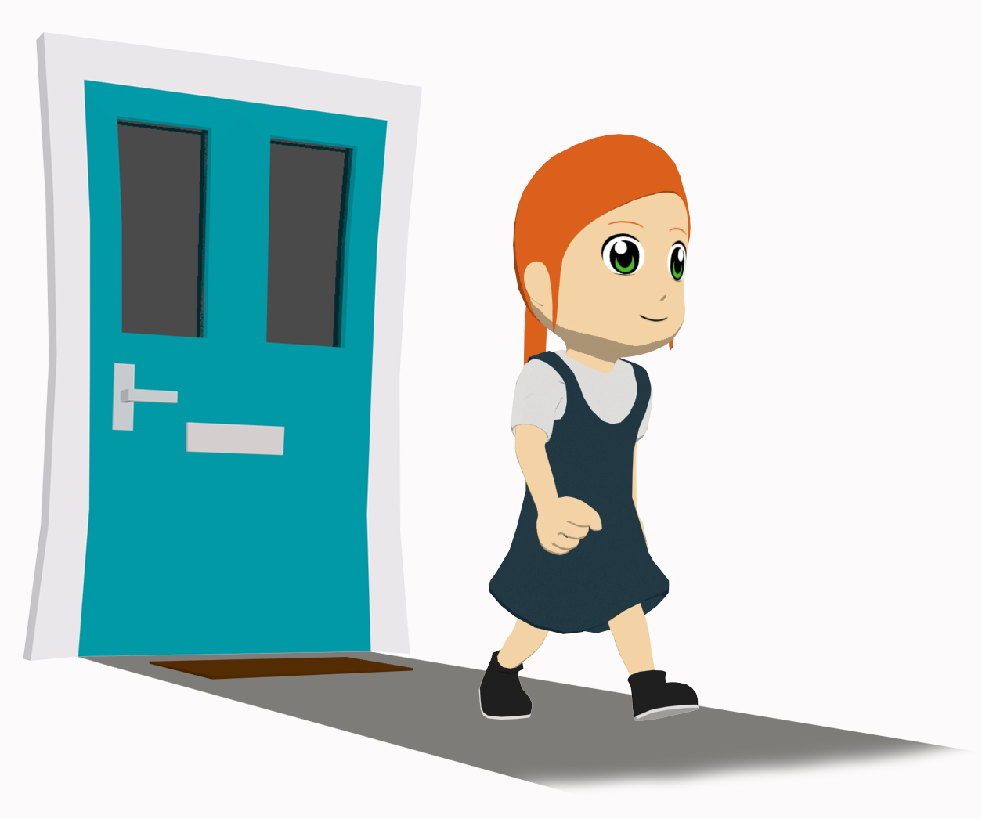
gehen
[to go|going]
geht
[goes | is going]
Notes:
Timing: 3 minutes for sequence of six slides
Aim: To introduce the verb gehen more explicitly.
Note: Gehen is one of the 25 most frequently used verbs in German. All 25 most frequent verbs will be introduced early on using the same format. Both long form (infinitive) and short form (3rd person singular) are introduced in order to familiarise students with various forms of the same verb.
Procedure
Bring up the word gehen on its own, say it, students repeat it, and remind them of the phonics. Draw attention to long [e].
Try to elicit the meaning from the students. Students have had explicit teaching that the present tense in German communicates two different present tense meanings in English. This reinforces that learning. Emphasise the two meanings for the short form, reminding students that German only has one form and does not have a direct equivalent of the grammar for ‘is + ing’, the continuous form (as covered in previous weeks).
Bring up the picture, and, if using gestures, a possible gesture would be [to put your hands together, palms facing up, and open and close like a book].
Then bring up the English translations. Emphasise the two meanings for the infinitive.
Bring up the short form geht, say it, students repeat it. Draw attention to long [e].
Try to elicit the meaning from the students. Emphasise the two meanings for the short form.

Slide 28
gehen
[to go| going]
geht
[goes | is going]
Notes:
Cycle through the long and short form again.

Slide 29
geht
[goes | is going]
Laura geht in die Schule.
[Laura goes | is going to school.]
Notes:
Introduce the short form in a sentence.

Slide 30
gehen
[to go | going]
Laura kann in die Schule gehen.
[Laura can go to school.]
Notes:
Introduce the long form in a sentence.

Slide 31
geht
[goes | is going]
geht
Laura ______ in die Schule.
[Laura goes | is going to school.]
Notes:
Cycle through the short form in context again.

Slide 32
gehen
[to go | going]
gehen
Laura kann in die Schule ______.
[Laura can go to school]
Notes:
Cycle through the long form in context again.

Slide 33
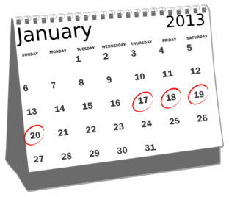
Wie oft?
lesen
Put these adverbs of frequency in order, from most to least frequent.
manchmal
einmal die Woche
nie
jeden Tag
oft
sehr oft
kaum
Notes:
Timing: 2 minutes Aim: To consolidate knowledge of the adverbs in this week’s vocabulary set.
Procedure: 1. Explain that adverbs are words that give more information about verbs – here, how often the verb happens.
2. Students put the terms in order.
3. Check meanings are known, and check pronunciation before the main task begins.

Slide 34
Wie oft?
Vokabeln
Put the adverbs of frequency in order, from most to least frequent.
very often
sehr oft
jeden Tag
every day
often
einmal die Woche
oft
once a week
sometimes
manchmal
kaum
hardly
never
nie
Notes:
Timing: 1 minute Aim: To present the answers to the activity on the previous slide.
Procedure: 1. The correct order appears with the slide.
2. Click to display the English translations of the terms.
3. With the English meanings displayed, try to elicit the German from students, to deepen their knowledge of this week’s vocabulary. This constant repetition of retrieval strengthens the memory of the words, whilst also giving the teacher valuable information as to how well the students know them. i.e. it is a form of ongoing assessment.

Slide 35
Ich oder du?
Grammatik
As we know, the German verb ending tells us who a statement is about:
Ich singe das Lied. Der Sänger singt das Lied.
To talk to or about another person in the du form:
The stem of a verb is what remains when the –en ending is removed from the infinitive, e.g. schreib-, hab-, koch-.
Infinitive
singen
= to sing, singing
I
ich singe
= I sing / am singing
you
du singst
= you sing / are singing
Remove –en and add –st.
lernen →
lern- →
du lernst →
you learn / are learning
tanzen →
tanz- →
du tanzt →
you dance / are learning
If the stem ends in –z add only –t.
Notes:
Timing: 2 minutes Aim: To introduce the second person singular form of the verb.
Procedure: 1. Click to animate the explanation.
2. Ensure students’ understanding at each stage.

Slide 36
Ich oder du?
lesen
Wolfgang and Mia want to help more often, but they can’t agree!
Wer macht was? Schreib ich (I) oder du (you).
Ich
Du
a) @mia2008: ___ koche einmal die Woche und ___ arbeitest im Garten.
b) @der_wolf: Nein! ___ putzt jeden Tag den Boden und ___ koche manchmal.
c) @mia2008: Was?! ___ putze manchmal den Boden und ___ machst das Bett.
d) @der_wolf: Das ist unfair! ___ machst das Bett und ___ putze das Fenster.
e) @mia2008: Okay. ___ schreibe eine Liste.
f) @der_wolf: Nein! ___ schreibe die Liste und ___ machst die Arbeit. @mia2008: …
du
ich
Du
Ich
ich
Ich
Ich
du
du
Notes:
Timing: 5 minutes Aim: To practise distiguishing between the first and second person singular forms of the verb (reading).
Procedure: 1. Go through question 1 as a whole-class example before giving students time to complete the rest of the activity.
2. Students can complete the activity by writing e.g. a) ich, du in their exercise books.
3. Click to reveal the answers one by one.
4. Remind students of the 3rd person singular form learnt previously by asking ‘Wer kocht? Ich oder du?’ to elicit the response ‘’Ich koche…’ etc.

Slide 37
Ich oder du?
hören
Mia is reading out a list of what she and Wolfgang do each week. Wer macht was? Schreib ich (I) oder du (you).
 | einmal die Woche tanzen gehen |  |  |  | manchmal Suppe kochen
 | kaum Hausaufgaben machen |  |  |  | jeden Tag eine Liste schreiben
 | sehr oft Computer spielen |  |  |  | sehr oft mit Freunden reden
 | jeden Tag in den Garten gehen |  |  |  | nie tanzen
ich
du
ich
du
A
E
B
F
C
G
D
H
Notes:
Timing: 5 minutes Aim: To practise distiguishing between the first and second person singular forms of the verb (listening).
Procedure: 1. Click on the audio buttons to play each recording. Pronouns are obscured by noises.
2. Students can complete the activity by writing e.g. A) ich, du in their exercise books.
3. Click to advance to the next slide to reveal the answers one by one.
Note: All words in this exercise have been encountered previously, with the exception of Suppe which can be inferred from the English soup.
Transcript:
a. _______ gehst einmal die Woche tanzen.
b. _______ machst kaum Hausaufgaben.
c. _______ spielst sehr oft Computer.
d. _______ gehe jeden Tag in den Garten.
e. _______ kochst manchmal Suppe.
f. _______ schreibe jeden Tag eine Liste.
g. _______ rede sehr oft mit Freunden.
h. _______ tanze nie.
Word frequency (1 is the most frequent word in German):
die Suppe [>4037]
Source: Jones, R.L. & Tschirner, E. (2011). A frequency dictionary of German: core vocabulary for learners. Routledge

Slide 38
Ich oder du?
hören
Mia is reading out a list of what she and Wolfgang do each week. Wer macht was? Schreib ich (I) oder du (you).
 | einmal die Woche tanzen gehen |  |  |  | manchmal Suppe kochen
 | kaum Hausaufgaben machen |  |  |  | jeden Tag eine Liste schreiben
 | sehr oft Computer spielen |  |  |  | sehr oft mit Freunden reden
 | jeden Tag in den Garten gehen |  |  |  | nie tanzen
ich
du
ich
du
A
E
B
F
C
G
D
H
Notes:
Timing: 2 minutes Aim: To present the answers to the activity on the previous slide.
Procedure: 1. Click on the audio buttons to play the full version of each recording (the pronouns were obscured by noises for the acitivity itself).
3. Click to reveal the answers one by one.
Note: All words in this exercise have been encountered previously, with the exception of Suppe which can be inferred from the English soup.
Transcript:
a. Du gehst einmal die Woche tanzen.
b. Du machst kaum Hausaufgaben.
c. Du spielst sehr oft Computer.
d. Ich gehe jeden Tag in den Garten.
e. Du kochst manchmal Suppe.
f. Ich schreibe jeden Tag eine Liste.
g. Ich rede sehr oft mit Freunden.
h. Ich tanze nie.
Word frequency (1 is the most frequent word in German):
die Suppe [>4037]
Source: Jones, R.L. & Tschirner, E. (2011). A frequency dictionary of German: core vocabulary for learners. Routledge

Slide 39
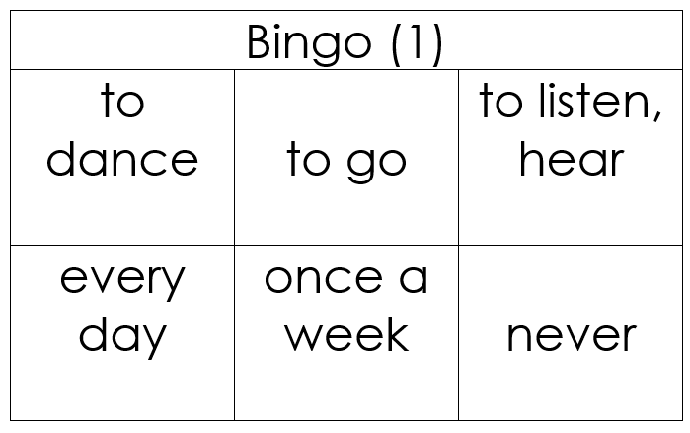
Vokabeln
hören / lesen
Ich gewinne!
Ich gewinne!
Notes:
Timing: 3 minutes Aim: To explain the rules of the Bingo game (English-German version, for additional vocabulary practice).
Procedure: 1. Teacher distributes the Bingo cards included as supplementary materials this week. (The cards are double-sided, and there are three cards per page, so each printed sheet must be folded as instructed and cut into three). If teachers prefer, they can give students scrap paper, they can draw three 3x2 tables (for 3 rounds of the game) and select their own words from the vocabulary set, writing the English on one side and replicate the 3 x 2 tables with German words on the reverse.
2. Depending on the class ability, teachers may choose to display or not to display the German words in the list. (The final slide in this lesson gives a list of the vocabulary from this week with the option to obscure the German words).
3. Tell students to begin with the English side up. The teacher reads German words at random from this week’s vocabulary list.
4. Students cross off the words they hear. When a student has crossed of all of his/her words, they use the German interjection ‘Ich gewinne!’ to indicate that they win. Gewinnen (infinitive) is a cluster word from 1.1.5, recycled here, in the first person singular. Ensure that students are clear about the meaning and that they can explain the verb ending change.
Note: As there are only 10 words on this week’s vocabulary list, the game will not last very long! It is highly like that one or more students will win after only 6 words have been called. For that reason, it is suggested that at least three rounds are played for additional practice.

Slide 40
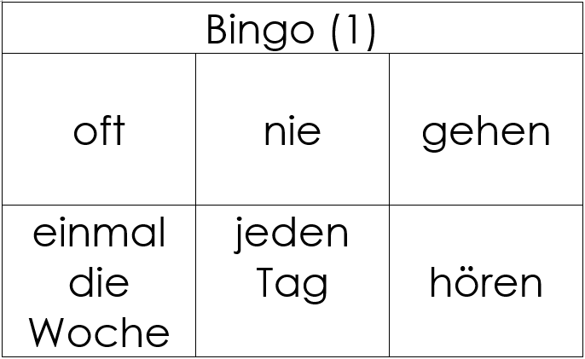
Vokabeln
hören / lesen
Ich gewinne!
Ich gewinne!
Notes:
Timing: 5 minutes Aim: To play the Bingo game German – English version (for additional vocabulary practice).
Procedure: 1. Tell students to turn their cards German side up. The teacher reads English words at random from this week’s vocabulary list. 2. Depending on the class ability, teachers may choose to display or not to display the German words in the list. (The final slide in this lesson gives a list of the vocabulary from this week with the option to obscure the German words).
2. Students cross off the words they hear. When a student has crossed of all of his/her words, they use the German interjection ‘Ich gewinne!’ to indicate that they win.

Slide 41
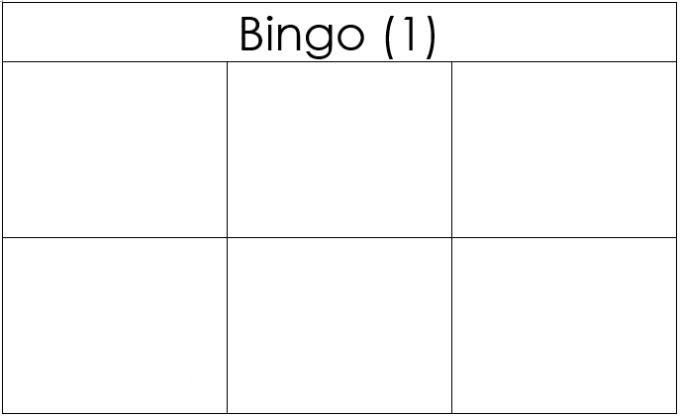
Du bist dran!
sprechen / schreiben
Schreib 6 Wörter auf Englisch.
Ich gewinne!
Ich gewinne!
Notes:
Timing: 5 minutes Aim: To provide an additional group version of Bingo (English-German).
Procedure: 1. Now, students play on their own in small groups (around 4 students).
2. Students write six English words from the list. They then take it in turns to act as ‘gamemaster,’ and read German words from the list at random until one of their classmates shouts ‘Ich gewinne’.
Note: Students have not yet met dran/daran [290]. It is used idiomatically here in the sense of ‘you’re up/it’s your turn/you’re it/you’re on’. It’s literal meaning is often given as ‘on it’ Explain the meaning of ‘dran’ to students. Teachers can then use this in their classroom language, and encourage students to do the same.

Slide 42
Du bist dran!
sprechen / schreiben
Schreib 6 Wörter auf Deutsch.
Ich gewinne!
Ich gewinne!
Notes:
OPTIONAL ADDITIONAL SLIDE
Timing: 5 minutes Aim: To provide an additional group version of Bingo (German-English), time permitting.
Procedure: 1. Again, students play on their own in small groups (around 4 students).
2. This time, students write six German words from this week’s vocabulary (without referring to their notes/vocabulary list, ideally). They then take it in turns to act as ‘gamemaster,’ and read English words from the list at random until one of their classmates shouts ‘Ich gewinne’.

Slide 43
Vokabeln
lesen / sprechen
 | Word | English meaning
1 | tanzen | to dance, dancing
2 | gehen | to go, going
3 | hören | to listen/hear
4 | jeden Tag | every day
5 | einmal die Woche | once a week
6 | nie | never
7 | kaum | seldom
8 | manchmal | sometimes
9 | sehr | very
10 | oft | often
Notes:
Timing: 1-4 minutes Aim: To reactivate and strengthen vocabulary knowledge.
Procedure: Round 1: Look at the German, recall the English meanings, saying them aloud. [1 minute] Round 2: Look at the English, recall the German meanings, saying them aloud. [1 minute] Repeat for two further minutes, to speed up recall.

Slide 44
Asking and answering questions about activities at home
Present tense weak verbs: 1st person vs 2nd person singular; VSO questions plus question words
wo, was, wer, wie
SSC [ch]
Y7 German
Term 1.2 - Week 3 - Lesson 20
Natalie Finlayson / Rachel Hawkes
Artwork: Steve Clarke
Date updated: 15/12/21
Notes:
Artwork by Steve Clarke. All additional pictures selected are available under a Creative Common license; no attribution required.
Learning outcomes (lesson 2):
Consolidation of SSC – long and short [ch]
Consolidation of present tense weak verbs: 1st person singular (juxtaposed with 2nd person singular)
Consolidation of VSO questions with question words wo, was, wer, wie
Word frequency (1 is the most frequent word in German):
7.1.2.3 (introduce) gehen [66] hören [146] tanzen [1497] kaum [272] manchmal [382] nie [186] oft [223] sehr [81] einmal die Woche [n/a] jeden Tag [n/a]
7.1.1.7 (revisit) Band [<5009] Buch [300] Film [505] Lehrerin [695] Lied [1733] Sänger [3029] Sängerin [3916] leider [643] Lieblings- [n/a]
7.1.1.1 (revisit) sein¹, ist [4] Fenster [674] Flasche [1602] Heft [3862] Tafel [3855] Tisch [529] da [48] hier [68] wo? [108] der, die, das [1] Hallo! [1077] Tschüs! [3766]
Source: Jones, R.L. & Tschirner, E. (2019). A frequency dictionary of German: core vocabulary for learners. Routledge

Slide 45
Vokabeln
F
o
s
die __ lasche
k__ chen
der Ti__ch
r
d
a
hie__
das Lieblingslie__
Mont__g
a
e
die T__fel
s__in
t
das Au__o
g
die Auf__abe
r
Z
leide__
das __immer
e
die L__hrerin
F
r
a
g
e
o
d
e
r
S
a
t
z
?
Notes:
Timing: 5 minutes Aim: To share the grammar learning objective for the lesson with students, whilst revising previously-learned vocabulary.
Procedure: 1. By working out which letters are missing and putting them in order into the spaces below, students create the question ‘Frage oder Satz?’, which is the grammatical focus for this lesson
2. Elicit the English translation of this question from students to ensure that they are all clear about its meaning. Note: ‘Frage’ is a word students learnt in 1.1.6 but ‘Satz’ is a new, but highly frequent word, which we want to use from now on in classroom language/task instructions. Ensure that the meaning of Satz is clear.
Frequency rankings (1 is the most common word in German):
der Satz [582]
Source: Jones, R.L. & Tschirner, E. (2011). A frequency dictionary of German: core vocabulary for learners. Routledge

Slide 46
Frage oder Satz?
Grammatik
Closed (yes/no) questions
As you know, closed questions are formed by swapping the verb and subject:
Note that when you hear questions, you get an extra clue from the intonation, and when you read, you see the question mark.
Statement
Du | spielst | oft Tennis.
You often play Tennis.
Question
Spielst | du | oft Tennis?
Do you often play Tennis?
Statement
Du | schreibst | ein Buch.
You are writing a book.
Question
Schreibst | du | ein Buch?
Are you writing a book?
This is how you ask ‘do’ or ‘are’ questions in German.
Notes:
Timing: 3 minutes Aim: To revisit knowledge that students were taught in 1.1.7 on the formation of closed questions.
Procedure: 1. Click to animate the explanation.
2. Highlight that German does not have a word for do/does, or the continuous equivalent are/is, and that inversion must be used to translate these.
3. Ensure students’ understanding at each stage.

Slide 47
Frage oder Satz?
hören
Zorg is making observations about Wolfgang. He can produce a lot of words, but lacks intonation (and manners!)
Is Zorg asking a question or making a statement? Write ? or .
?
.
C
A
B
D
E
F
G
H
I
Notes:
Timing: 3 minutes
Aim: To revisit the VSO syntax of questions vs SVO of statements.
Note: This slide is an example to do first with students and correct. It has audio inserted for A and B only (with the corresponding answers).
Procedure: 1. Click on the audio buttons to play each recording. The voice is robotic and has flat intonation, to remove this clue as to whether each sentence is a question or a statement.
2. Students can complete the activity by writing e.g. A) ?/ . in their exercise books.
3. If it seems strange to students that we have so many appearances from Zorg, the robot, explain that it is important that we remove the audible clues (i.e. raised intonation) that come with questions, so that they only focus on the syntax.
4. Click to advance to the next slide for students to do the full exercise.
Transcript:
a) Hörst du jeden Tag das Lied
b) Du arbeitest kaum im Garten

Slide 48
Frage oder Satz?
hören
Zorg is making observations about Wolfgang. He can produce a lot of words, but lacks intonation (and manners!)
Is Zorg asking a question or making a statement? Write ? or .
?
.
C
?
A
B
.
.
?
D
E
F
.
?
I
?
G
H
Notes:
Timing: 5 minutes
Aim: To revisit the VSO syntax of questions vs SVO of statements.
Note: This slide is the full task slide.
Procedure: 1. Click on the audio buttons to play each recording. The voice is robotic and has flat intonation, to remove this clue as to whether each sentence is a question or a statement.
2. Students can complete the activity by writing e.g. A) ?/ . in their exercise books.
3. Click to bring up the answers one by one. Teacher elicits responses by asking ‘Ist A eine Frage oder ein Satz?’ (‘A ist eine Frage … B ist ein Satz …’)
Transcript:
a) Hörst du jeden Tag das Lied
b) Du arbeitest kaum im Garten
c) Putzt du manchmal das Auto
d) Du tanzt nicht so gut
e) Du sitzt oft zu Hause am Computer
f) Gehst du nie in den Garten
g) Du redest sehr oft im Unterricht
h) Lernst du manchmal in der Schule
i) Spielst du nie mit Freunden Fußball

Slide 49
Open (wh-) questions
Grammatik
Open (wh-) questions
To ask an open question, place a question word directly in front of the verb:
Closed
Schreibst | du | ein Buch?
Are you writing a book?
Open
Wer
Who is writing a book?
Wo
schreibst | du | ein Buch?
Where are you writing a book?
schreibt |  | ein Buch?
Beispiel:
Was hast du am Montag?
What do you have on Monday?
Wo spielst du Tennis?
Where do you play tennis?
Wie oft putzt du dein Zimmer?
How often do you clean your room?
Wer ist dein Lieblingslehrer?
Who is your favourite (male) teacher?
Notes:
Timing: 3 minutes Aim: To revisit knowledge that students were taught in 1.1.7 on the formation of closed questions.
Procedure: 1. Click to animate the explanation.
2. Draw attention to word order: VSO for closed questions, Question word + VSO or VO for open questions.
3. Ensure students’ understanding at each stage.

Slide 50
Open (wh-) questions
lesen / sprechen
- Was ________ du? - Tennis.
- _________? - Im Sportunterricht.
- ______ oft? - ________ die Woche.
- Mit ___________? - Ja!
- _____ ist der Lehrer? - Herr Meier. Er ist super!
Open (wh-) questions
wer
spielst
wo
Wo
spielst
Wie
Einmal
wie
Freunden
einmal
Wer
Freunden
Notes:
Timing: 5 minutes Aim: To practise distiguishing between the first and second person singular forms of the verb (reading/speaking).
Procedure: 1. Students write the text, completing the gaps with one of the options. This will help them further practise the 1st & 2nd person singular form of verbs & question words.
2. Click to reveal the answers one by one.
3. Once complete, they can practise reading this conversation in pairs.
After initial practice reading their own (completed) texts, an extra challenge could be to ask them to practise with the incomplete text displayed on the board. This will prompt speeded recall of the words that are missing!

Slide 51
Wie oft machst du das?
Oft, kaum, nicht etc. are adverbs. They come directly after the verb.
sprechen
Frag einen Partner oder eine Partnerin!
Beispiel: “Wie oft spielst du am Computer?” “Ich spiele kaum am Computer.”
oft
manchmal
kaum
nie
einmal die Woche
jeden Tag
Notes:
Timing: 6 minutes Aim: To practise distiguishing between the first and second person singular forms of the verb (speaking).
Note: This version of the speaking task expects students to generate the correct question with no verbal support at all. There is an alternative version on the next slide, which gives the infinitive phrase. That version still requires students to use the correct verb form and question syntax.
Procedure: 1. This slide can be printed and given to pupils, or they can quickly sketch a table in their workbooks.
2. Students know the noun Frage (1.2.6), but have not encountered the verb form, fragen. Teacher to ask students what they think the instruction means and make the connection with Frage.
3. In this oral exercise, students ask a partner how often they do the pictured activities, and tick the appropriate box. 3. On completion, first, second and third person forms can be brought together through teacher elicitation of responses, e.g. ‘Wie oft spielt Mary Computer? Mary spielt kaum Computer’. ‘Wer kocht manchmal?’ ‘Sally kocht manchmal’ etc.

Slide 52
Wie oft machst du das?
Oft, kaum, nicht etc. are adverbs. They come directly after the verb.
sprechen
Frag einen Partner oder eine Partnerin!
Beispiel: “Wie oft spielst du Fußball?” “Ich spiele kaum Fußball.”
 | Fußball spielen | Musik hören | am Computer spielen | kochen | im Garten sitzen | singen | tanzen
oft
manchmal
kaum
nie
einmal die Woche
jeden Tag
Notes:
ALTERNATIVE FORMAT
Timing: 6 minutes Aim: To practise distiguishing between the first and second person singular forms of the verb (speaking).
Note: Alternative format for the speaking activity, giving more support. It is often beneficial to repeat speaking tasks. In this instance, students could first use this supported version of the task, and then repeat the task with a different partner, referring only to the picture table on the previous slide.
Procedure: 1. This slide can be printed and given to pupils, or they can quickly sketch a table in their workbooks.
2. Students know the noun Frage (1.2.6), but have not encountered the verb form, fragen. Teacher to ask students what they think the instruction means and make the connection with Frage.
3. In this oral exercise, students ask a partner how often they do the specified activities, and tick the appropriate box. 3. On completion, first, second and third person forms can be brought together through teacher elicitation of responses, e.g. ‘Wie oft spielt Mary Computer? Mary spielt kaum Computer’. ‘Wer kocht manchmal?’ ‘Sally kocht manchmal’ etc.

Slide 53
Fragen
schreiben
You now know a lot of verbs! Here they are on one slide.
What questions could you ask German students (about home or school) using these verbs? Schreib 5 Fragen.
schreiben
machen
singen
hören
haben
putzen
sein
spielen
gehen
kochen
reden
sitzen
wohnen
sagen
arbeiten
lernen
tanzen
Notes:
Timing: 20 minutes Aim: To revise the infinitive form of all verbs learned so far.
Procedure: 1. Click to bring up the verbs one by one, eliciting the English meaning of each from the students. The final click brings up the main task instruction.
2. Students prepare a survey with questions that they could send to a partner school (where there is a partner school, they should actually do this). First each student writes 5 questions individually.
3. Then they pair up and ensure that they have 10 different ones between them.
4. Then they join with another pair, and decide on the best 10 questions overall, eliminating those they think aren't as interesting.
5. On the slide that follows, the teacher gathers 20 different questions to put as survey to a German class (real or hypothetical).

Slide 54
Fragen
schreiben
Fragen:
Notes:
This is a blank slide for the teacher to use to gather 20 different questions to pose to a German class in a survey (see activity on previous slide).

Slide 55
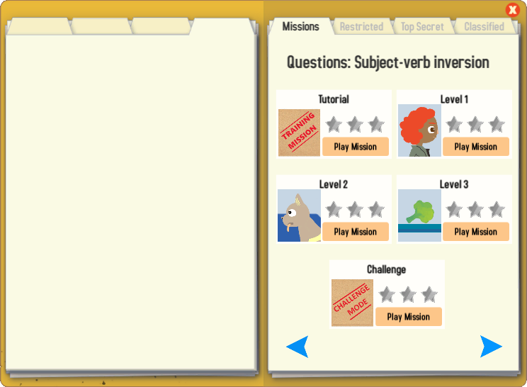
Gaming Grammar
Try the following Gaming Grammar missions to practise:

Slide 56
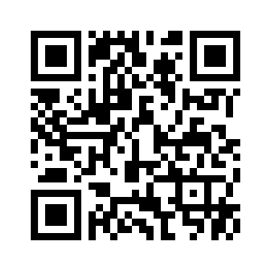
Hausaufgaben
Vocabulary Learning Homework (Term 1.2, Week 4)
Audio file
Audio file QR code:
Student worksheet
Quizlet
In addition, revisit: Term 1.2 Week 1
Term 1.1 Week 2
Notes:
Use this slide to set the homework.
Icon made by Darius from www.flaticon.com (freely usable image).

