Slide 1
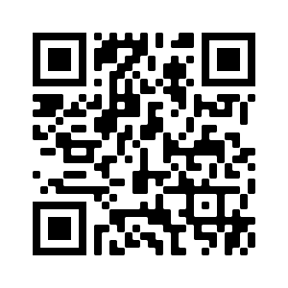
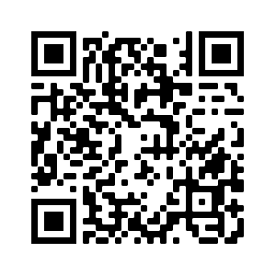
Hausaufgaben
Vocabulary Learning Homework (Term 3.2, Week 3)
Audio file: [http://www.ncelp.org/audio/GY7T3-2W3]
Audio file QR code:
Student worksheet
Quizlet link
In addition, revisit: Term 2.2 Week 1
Term 3.1 Week 3
Notes:
TO BE DONE → I don’t have the worksheet and the audio link.

