Slide 1
Phonics: [rr] and [r] SSCs
Y7 Spanish
Term 2.1 - Week 2 - Lesson 31/32
Victoria Hobson / Rachel Hawkes / Nick Avery
Date updated: 30/03/2019

Slide 2
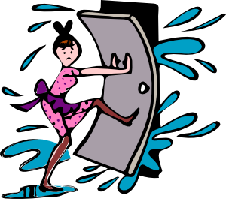
rr
correr
barrio
cerrar
perro
correcto
correo
@
Nick Avery
Notes:
Introduce and elicit the pronunciation of the individual SSC ‘rr’ and then the source word again (with gesture, if using). Then present and elicit the pronunciation of the five cluster words.
The cluster words have been chosen for their high-frequency, from a range of word classes, with the SSC (where possible) positioned within a variety of syllables within the words (e.g. initial, 2nd, final etc.). Additionally, we have tried to use words that build cumulatively on previously taught SSCs (see the Phonics Teaching Sequence document) and do not include new SSCs. Where new SSCs are used, they are often consonants which have a similar symbol-sound correspondence in English.

Slide 3
rr
correr
barrio
cerrar
perro
correcto
correo
Nick Avery
Notes:
Without the images, students focus this time again closely on the SSC and the cluster words.

Slide 4
rr
correr
barrio
cerrar
perro
correcto
correo
Nick Avery
Notes:
Without the images or sound, students have to pronounce the words themselves.

Slide 5
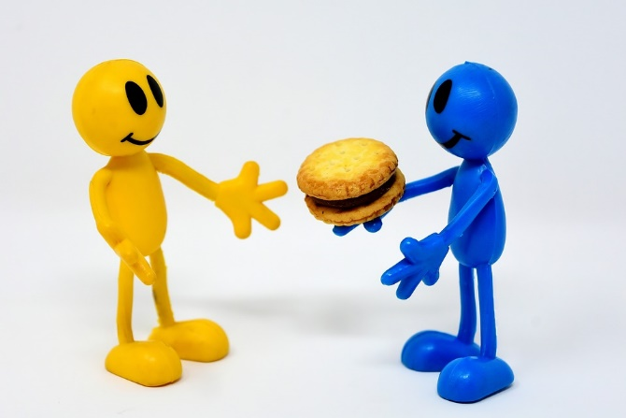
r
dar
abrir
seria
pero
rico
sobre
[about; on top of]
Nick Avery
Notes:
Introduce and elicit the pronunciation of the individual SSC ‘r’ and then the source word again (with gesture, if using). Then present and elicit the pronunciation of the five cluster words.
The cluster words have been chosen for their high-frequency, from a range of word classes, with the SSC (where possible) positioned within a variety of syllables within the words (e.g. initial, 2nd, final etc.). Additionally, we have tried to use words that build cumulatively on previously taught SSCs (see the Phonics Teaching Sequence document) and do not include new SSCs. Where new SSCs are used, they are often consonants which have a similar symbol-sound correspondence in English.

Slide 6
r
dar
abrir
seria
pero
rico
sobre
Nick Avery
Notes:
Without the images, students focus this time again closely on the SSC and the cluster words.

Slide 7
r
dar
abrir
seria
pero
rico
sobre
Nick Avery
Notes:
Without the images or sound, students have to pronounce the words themselves.

Slide 8
¿r o rr?
escuchar
Escucha y escribe la letra. ¿Es ‘r’ o ‘rr’?
Escucha otra vez. Escribe la palabra en español.
r
abrir
rr
correo
1
6
r
dar
r
seria
2
7
rr
correcto
rr
cerrar
3
8
rr
perro
rr
correr
4
9
r
pero
r
caro
5
10
Notes:
Play each sound twice. Those that quickly understand the SSC on the first hearing can then write the word.
TRANSCRIPT
abrir
dar
correcto
perro
pero
correo
seria
cerrar
correr
caro

Slide 9
escuchar
Escucha las frases. Marca cada vez que hay una ‘r’
y una ‘rr.’ Luego, escribe las palabras o la frase en español.
r | rr | Frase / Palabras
1
Estudiar arte es importante.
2
La señora es seria pero es interesante.
3
Tienes cuatro correctas.
El perro es grande y está en Inglaterra.
4
Notes:
TRANSCRIPT
Estudiar arte es importante.
La señora es seria, pero es interesante.
Tienes cuatro correctas.
El perro es grande y está en Inglaterra.
Students should tally every time they hear ‘r’ and ‘rr.’
There are then two levels of differentiation available.
Students write the words containing the target SSCs in Spanish.
Higher ability students may be able to transcribe the whole sentence.
The vocabulary used here is all known to students, taken from previously learnt vocab sets.

