Slide 1
Talking about more than one thing
Phonics
Y7 Spanish, Term 1.2, Week 2, Lesson 17
Nick Avery & Rachel Hawkes

Slide 2
que
parque
pequeño
porque
¿qué?
querer
[because]
[to want]
quedar
[to remain; stay; suit]
Notes:
Introduce and elicit the pronunciation of the individual SSC ‘que’ and then the source word again (with gesture, if using). Then present and elicit the pronunciation of the five cluster words.
The cluster words have been chosen for their high-frequency, from a range of word classes, with the SSC (where possible) positioned within a variety of syllables within the words(e.g. initial, 2nd, final etc..) and additionally, we have tried to use words that build cumulatively on previously taught SSCs (see the Phonics Teaching Sequence document) and do not include new SSCs. Where new SSCs are used, they are often consonants which have a similar symbol-sound correspondence in English.

Slide 3
que
parque
pequeño
porque
¿qué?
querer
quedar
Notes:
Without the images, students focus this time again closely on the SSC and the cluster words.

Slide 4
que
parque
pequeño
porque
¿qué?
querer
quedar
Notes:
Without the images or sound, students have to pronounce the words themselves.

Slide 5
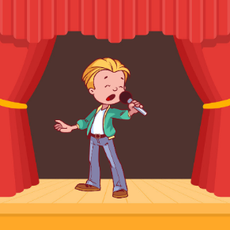
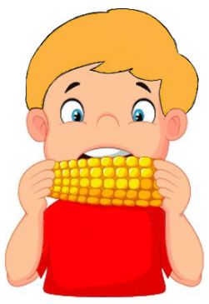
¿QUE, CA o CO?
escuchar / escribir
1
3
que
par____
__ntar
ca
5
que
pe____ño
2
4
[to want]
que
co
___rer
__mer
Notes:
‘QUE’ is practised with two previously learnt SSCs here: ‘CA’ and ‘CO’. All of these SSCs share the /k/ phoneme.
Click on the orange number next to each picture to hear the corresponding word.
Learners then write down the missing graphemes in the word
Items 1-5 on this slide. 6-10 on next slide.

Slide 6
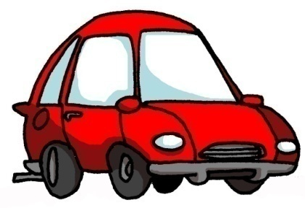
¿QUE, CA o CO?
escuchar / escribir
Con ketchup
6
8
¿qué?
co
__n
10
co
__che
7
[street]
9
[to remain; stay; suit]
ca
__lle
que
___dar

Slide 7
¿QUE, CA o CO?
escuchar / escribir
1
3
parque
cantar
5
pequeño
2
4
[to want]
comer
querer
Notes:
‘QUE’ is practised with two previously learnt SSCs here: ‘CA’ and ‘CO’. All of these SSCs share the /k/ phoneme.
Variation: students have to write the whole word
Click on the orange number next to each picture to hear the corresponding word.
Learners then write down the missing word.
Items 1-5 on this slide; 6-10 on next slide.

Slide 8
¿QUE, CA o CO?
escuchar / escribir
Con ketchup
6
8
¿qué?
con
10
coche
7
[street]
9
[to remain; stay; suit]
calle
quedar

Slide 9
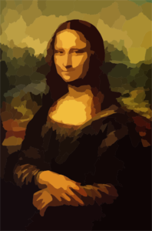
QUE
CO
CU
[to want]
A
B
C
D
escuchar
querer
comer
pequeño
E
F
G
H
[with]
coche
parque
documento
con
I
cultura
Notes:
Which pictures go together (based on the obscured SSC)? There are three groups of three: QUE (pequeño, querer, parque), CO (comer, coche, con), and CU (escuchar, documento, cultura).
Ask students to write down which ones they think go together.
Clicking on the pictures will play the word if the students need an extra prompt. Clicking on the paw prints will remove them.

