Slide 1
Talking about what you read
Subject pronouns il/elle meaning 'it' and ils/elles meaning 'they’
faire (all persons)
SFC and SFE
Y9 French
Term 3.1 - Week 1 - Lesson 47
Author name(s): Catherine Salkeld / Louise Bibbey
Artwork by: Chloé Motard
Date updated: 04/03/22
Notes:
Artwork by Chloé Motard. All additional pictures selected are available under a Creative Commons license, no attribution required.
Native teacher feedback provided by Sarah Brichory.
Learning outcomes (lesson 1):
Revision to subject pronoun il/elle meaning “it” and ils/elles meaning “they”
Revision of faire (present tense, all persons)
Word frequency (1 is the most frequent word in French):
coûter [984], je dis [37], tu dis [37], il dit [37], elle dit [37], vous dites [37], dit [37], je fais [25], tu fais [25], il fait [25], elle fait [25], nous faisons [25], vous faites [25], ils font [25], elles font [25], fait [25], fermer [757], interdire [533], prendre [43], je prends [43], tu prends [43], il prend [43], elle prend [43], pris [43], tuer [591], elle veut [57], allemand [844], anglais2 [784], anniversaire [2043], bibliothèque [2511], effort [388], fenêtre [1604], français2 [251], journal [520], lettre [480], marché [280], modèle [958], photo [1412], phrase [2074], roman [1262], texte [631], vérité [907], cher [803], intéressant [1244], drôle [2166], mauvais [274], moins [62], vrai [292], chez [206], dans [11], faire les magasins [25/3/1/1736], il fait beau [13/25/393], il fait mauvais [13/25/274], la [1], le [1], les [1], puisque [528], si1 [34]
Source: Lonsdale, D., & Le Bras, Y. (2009). A Frequency Dictionary of French: Core vocabulary for learners London: Routledge.
The frequency rankings for words that occur in this PowerPoint which have been previously introduced in NCELP resources are given in the NCELP SOW and in the resources that first introduced and formally re-visited those words.
For any other words that occur incidentally in this PowerPoint, frequency rankings will be provided in the notes field wherever possible.

Slide 2
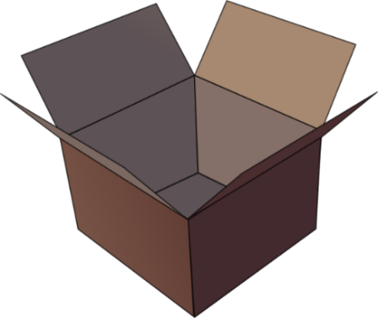
SFC
Silent final consonant
dans
X
Notes:
Timing: 1 minute
Aim: To consolidate SSC [SFC]
Explanation in English, if desired: Something that makes French sounds very different from English is that some consonants at the ends of words are silent. This means you don’t pronounce/sound them out at all. As in the word ‘dans’ in French.
Procedure: 1. Present the letter(s) and say the [SFC] sound first, on its own. Students repeat it with you. 2. Bring up the word ”dans” on its own, say it, students repeat it, so that they have the opportunity to focus all of their attention on the connection between the written word and its sound.
3. A possible gesture for this would be to hold ones finger to ones lips to indicate ‘Shhhh!’. 4. Roll back the animations and work through 1-3 again, but this time, dropping your voice completely to listen carefully to the students saying the [SFC] sound, pronouncing ”dans” and, if using, doing the gesture.
Word frequency (1 is the most frequent word in French):
dans [11] Source: Lonsdale, D., & Le Bras, Y. (2009). A Frequency Dictionary of French: Core vocabulary for learners London: Routledge.

Slide 3
SFC
petit
prix
€15.95
grand
mot
dans
X
mais
[but]
Notes:
Timing: 2 minutes
Aim: To consolidate SSC [SFC]
Procedure:
1. Introduce and elicit the pronunciation of the individual SSC [SFC] (in this case is SFC – silent final consonant so nothing to pronounce as an individual sound!) and then the source word again ‘dans’ (with gesture, if using). 2. Then present and elicit the pronunciation of the five cluster words.
The cluster words have been chosen for their high-frequency, from a range of word classes, with the SSC (where possible) positioned within a variety of syllables within the words (e.g. initial, 2nd, final etc.). Additionally, we have tried to use words that build cumulatively on previously taught SSCs (see the Phonics Teaching Sequence document) and do not include new SSCs. Where new SSCs are used, they are often consonants which have a similar symbol-sound correspondence in English.
Word frequency (1 is the most frequent word in French): dans [11]; petit [138] prix [310]; mot [220]; mais [30]; grand [59]. Source: Lonsdale, D., & Le Bras, Y. (2009). A Frequency Dictionary of French: Core vocabulary for learners London: Routledge.

Slide 4
SFE
Silent final -e
[shy]
timide
Notes:
Timing: 1 minute
Aim: To consolidate SSC [SFE]
Procedure: 1. Present the letter(s) and say the [SFE] sound first, on its own. Students repeat it with you. 2. Bring up the word ”timide” on its own, say it, students repeat it, so that they have the opportunity to focus all of their attention on the connection between the written word and its sound.
3. A possible gesture for this would be to cower and cover one’s face slightly, simulating shyness. 4. Roll back the animations and work through 1-3 again, but this time, dropping your voice completely to listen carefully to the students saying the [SFE] sound, pronouncing ”timide” and, if using, doing the gesture.
Word frequency (1 is the most frequent word in French):
timide [3835]
Source: Lonsdale, D., & Le Bras, Y. (2009). A Frequency Dictionary of French: Core vocabulary for learners London: Routledge.

Slide 5
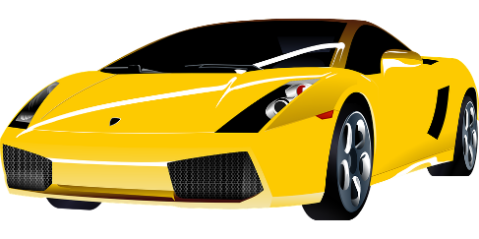
SFE
monde
moderne
[silent final –e]
[shy]
centre
timide
douze
vie
[life]
Notes:
Timing: 2 minutes
Aim: To consolidate SSC [SFE]
Procedure:
1. Introduce and elicit the pronunciation of the individual SSC [SFE] and then the source word again ‘timide’ (with gesture, if using). 2. Then present and elicit the pronunciation of the five cluster words.
The cluster words have been chosen for their high-frequency, from a range of word classes, with the SSC (where possible) positioned within a variety of syllables within the words (e.g. initial, 2nd, final etc.). Additionally, we have tried to use words that build cumulatively on previously taught SSCs (see the Phonics Teaching Sequence document) and do not include new SSCs. Where new SSCs are used, they are often consonants which have a similar symbol-sound correspondence in English.
Word frequency (1 is the most frequent word in French): monde [77]; moderne [1239] centre [491]; vie [132]; douze [1664]; timide [3835]. Source: Lonsdale, D., & Le Bras, Y. (2009). A Frequency Dictionary of French: Core vocabulary for learners London: Routledge.

Slide 6
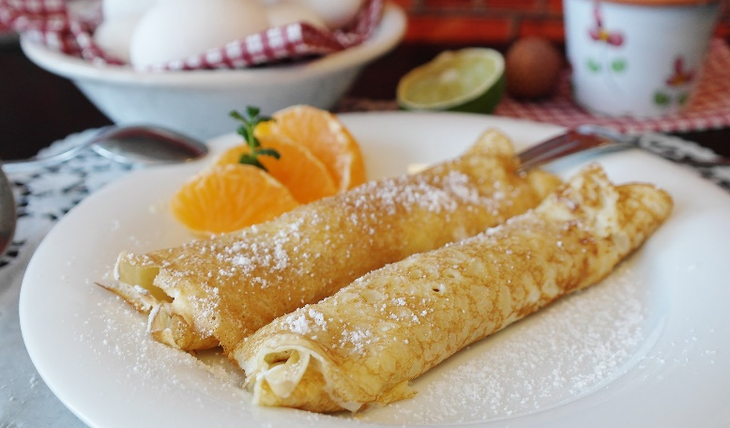
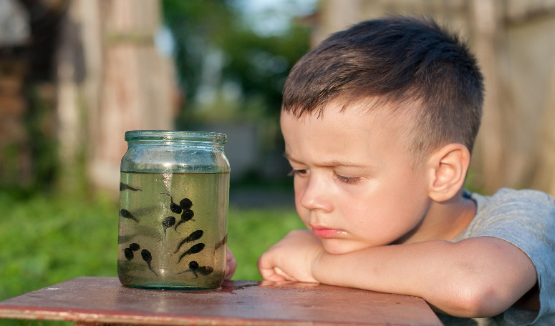
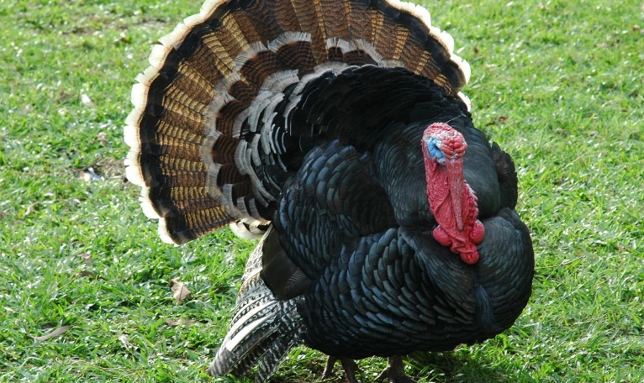
Phonétique
C’est la SSC [SFe] ou [--]?
écouter
1
2
crêpe
[pancake]
faux
[false]
[SFe]
[--]
3
4
têtard
[tadpole]
dinde
[turkey]
[--]
[SFe]
Notes:
Slide 1 of 2
Timing: 3 minutes for 2 slides
Aim: aural recognition of SSC [SFE]
Procedure:
1. Click the numbers to play the audio.
2. Students choose whether the words have a silent final e [SFE] or not [--].
Word frequency (1 is the most frequent word in French): crêpe [>5000], gâteaux [4845], têtard [>5000], dinde [>5000], sirop [>5000], fraise [>5000], escargot [>5000], crabe [>5000]
Source: Lonsdale, D., & Le Bras, Y. (2009). A Frequency Dictionary of French: Core vocabulary for learners London: Routledge.

Slide 7
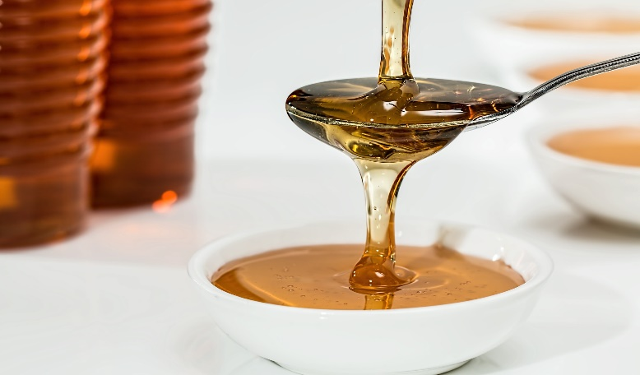
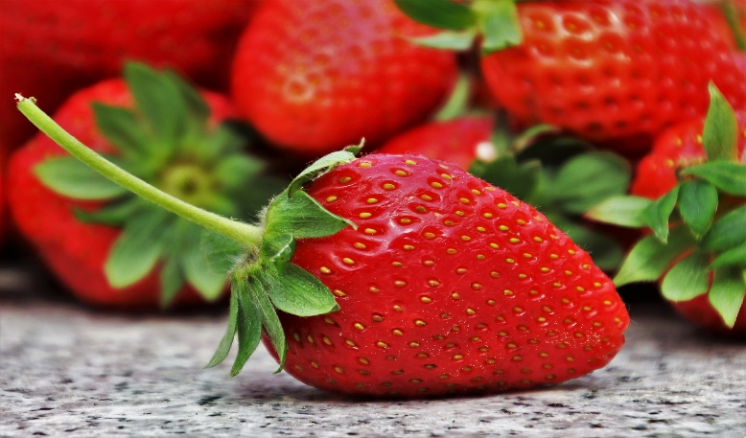
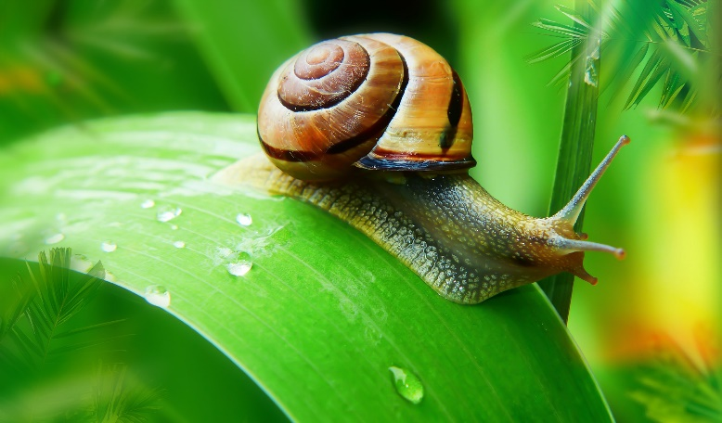
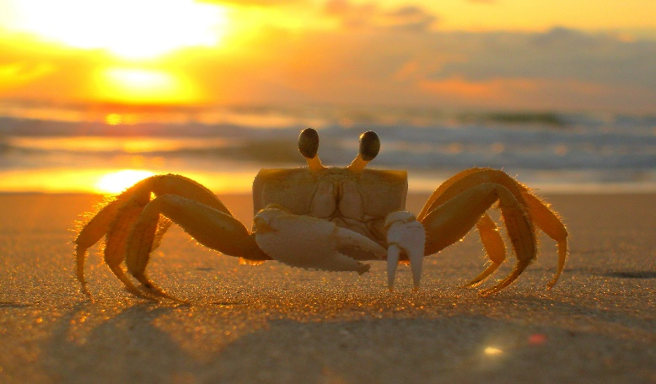
Phonétique
C’est la SSC [SFe] ou [--]?
écouter
1
2
sirop
[syrup]
fraise
[strawberry]
[--]
[SFe]
3
4
escargot
[snail]
crabe
[crab]
[--]
[SFe]
Notes:
Slide 2 of 2

Slide 8
Word patterns : -ate/-er
vocabulaire
Lots of English verbs end in –ate. Many of these verbs come from French verbs ending in –er. This knowledge can help us to work out the English for new French verbs.
français
anglais
anglais
français
éliminer
eliminate
evaluate
évaluer
intégrer
integrate
liberate
libérer
Notes:
Timing: 4 minutes
Aim: Introduction of word pattern: adding –r or –er to English verbs ending in -ate
Procedure:
1. Click to reveal explanations and first example.
2. Elicit the remaining translations.
3. Ensure understanding.
Word frequency of unknown words used (1 is the most frequent word in French): éliminer [1454], évaluer [1544], intégrer [1764], libérer [1190]
Source: Lonsdale, D., & Le Bras, Y. (2009). A Frequency Dictionary of French: Core vocabulary for learners London: Routledge.

Slide 9
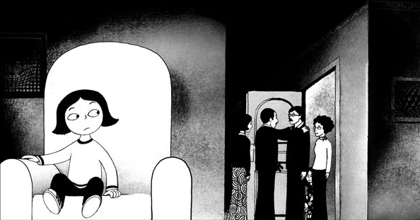
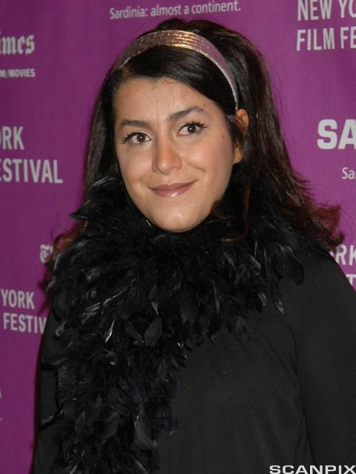
Persepolis
Traduis les verbes en gras en anglais.
vocabulaire
En 2000 Marjane Satrapi [1] crée une bande dessinée* pour [2] communiquer l’histoire de sa vie d’enfant en Iran pendant la révolution. Elle prend la décision d’[3] illustrer l’histoire pour [4] faciliter la compréhension. Elle [5] démontre l’idée de « lire » les images. Les images sont en noir et blanc pour ne pas [6] dominer la page : on peut [7] concentrer l’attention sur le texte et mieux [8] apprécier l’histoire. Elle ne veut pas [9] compliquer le roman. En 2007 elle [10] collabore avec Vincent Paronnaud pour faire un film du livre.
creates
communicate
illustrate
facilitate
demonstrates
dominate
concentrate
appreciate
complicate
collaborates
*la bande dessinée = comic, graphic novel
Notes:
Timing: 7 minutes
Aim: Written recognition of verbs that follow the –ate/-er word pattern
Procedure:
1. Students use the word pattern –ate/-er to help them translate the verbs in bold into English.
2. Click to reveal answers.
3. Elicit an oral translation of the text.
Word frequency of unknown words used (1 is the most frequent word in French): bande dessinée [977/2086]
Word frequency of cognates used (1 is the most frequent word in French):
communiquer [1514], Iran [>5000], révolution [1617], illustrer [1939], faciliter [1813], compréhension [2827], démontrer [1519], image [659], dominer [1648], page [434], concentrer [856], apprécier [1061], compliquer [1869], collaborer [2963]
Source: Lonsdale, D., & Le Bras, Y. (2009). A Frequency Dictionary of French: Core vocabulary for learners London: Routledge.
Persepolis by John Niedermeyer is licensed under CC BY-NC-SA 2.0
Marjane Satrapi is licensed under CC BY-NC-SA 4.0

Slide 10
Vocabulaire
vocabulaire
chez
la bibliothèque
cher
l’allemand
chez
la bibliothèque
cher
l’allemand
le marché
la lettre
l’anglais
dans
le marché
la lettre
l’anglais
dans
intéressant
le roman
mauvais
le journal
intéressant
le roman
mauvais
le journal
le texte
le français
drôle
vrai
le texte
le français
drôle
vrai
adjectifs
lieux
choses à lire
langues
prépositions
Notes:
Timing: 4 minutes
Aim: Written recognition and comprehension of revisited vocabulary
Procedure:
Students sort the words into the five categories at the bottom of the slide, either by writing five lists, or colour-coding a printout of the slide.
Click to reveal answers.

Slide 11
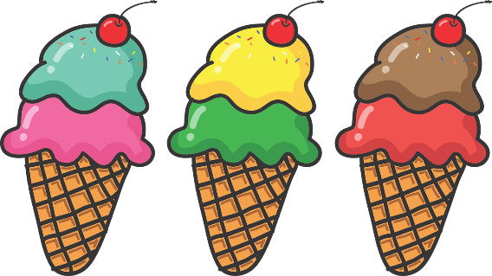
Saying ‘it’ and ‘they’
grammaire
Remember we can use il/elle to mean it (referring to a thing).
We use il for masculine nouns and elle for feminine nouns.
Le collège est grand.
Il est grand.
La fenêtre est nouvelle.
Elle est nouvelle.
We use ils/elles to mean they (referring to people and things).
Amir et Océane sont intelligents.
Ils sont intelligents.
Amir and Océane are intelligent.
They are intelligent.
Les glaces sont bonnes.
Elles sont bonnes.
The ice creams are good.
They are good.
Notes:
Timing: 2 minutes
Aim: Revision of il/elle meaning ‘it’ and introduction of ils/elles meaning ‘they’ for objects
Procedure:
1. Click to reveal explanations and examples.
2. Ensure understanding.

Slide 12
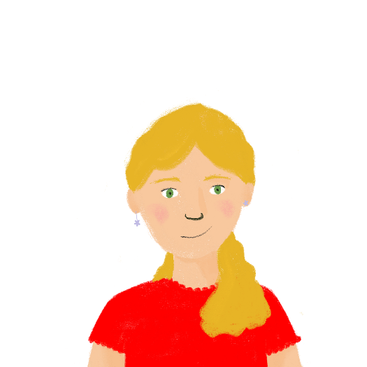
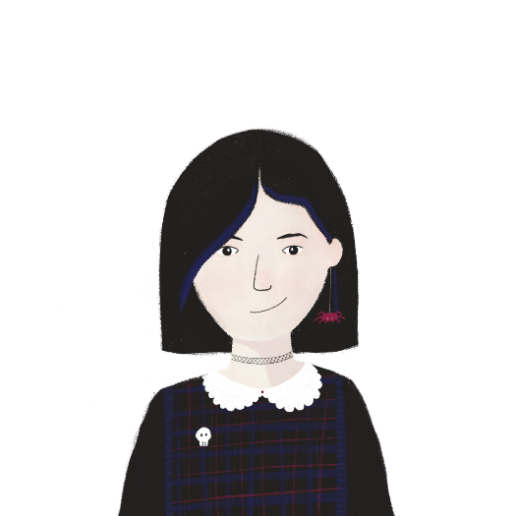
Dans la librairie*
grammaire
Q | A | B
 | le livre | l’histoire
 | le texte | la phrase
 | les romans | le texte
 | la phrase | les histoires
 | le poème | la phrase
 | le livre | la bande dessinée
 | les poèmes | les phrases
 | le roman | les bandes dessinées
 | les textes | le poème
 | les romans | les histoires
 | le journal | l’histoire
 | le roman | les livres
Léa et Sophie sont dans la librairie. De quoi parlent-elles ? Coche les bons mots.
1
2
3
4
*la librairie = bookshop
5
6
7
8
9
10
11
12
Notes:
Timing: 5 minutes
Aim: Aural recognition of il/elle meaning ‘it’ and ils/elles meaning ‘they’
Procedure:
1. Click buttons to play audio.
2. Students listen for il/elle/ils/elles and decide which object is being referred to. Since the singular and plural subject pronouns sound the same, they will also need to listen for the part of être for some questions.
3. Click to reveal answers.
4. Optional extension: listen again and transcribe the sentences, paying attention to the pronouns and the corresponding adjectival agreements.
Optional differentiation: Teachers could translate the answer options into English for a higher level of challenge.
Transcript:
Il est intéressant.
Elle est difficile.
Ils sont allemands.
Elles sont vraies.
Il est mauvais.
Elle est chère.
Ils sont faciles.
Elles sont petites.
Ils sont amusants.
Elles sont tristes.
Elle est vieille.
Il est idéal.
Word frequency of unknown words used(1 is the most frequent word in French): librairie [4380]
Source: Lonsdale, D., & Le Bras, Y. (2009). A Frequency Dictionary of French: Core vocabulary for learners London: Routledge.

Slide 13
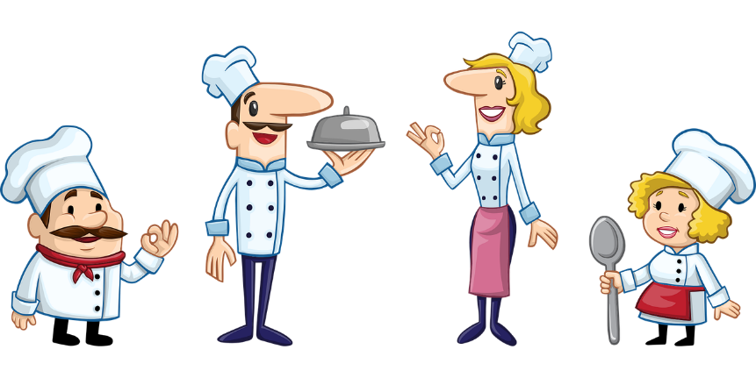
Faire
grammaire
Remember the verb faire:
I do, I make
je fais
we do, we make
nous faisons
you _{[sing.]} do, you _{[sing.]} make
tu fais
you _{[pl./fml]} do, you _{[pl./fml]} make
vous faites
he/she does, he/she makes
il/elle fait
they do, they make
ils/elles font
Notes:
Timing: 1 minute
Aim: Recap of the present tense of faire
Procedure:
1. Click to reveal each part of the verb.
2. Elicit the English where possible.

Slide 14
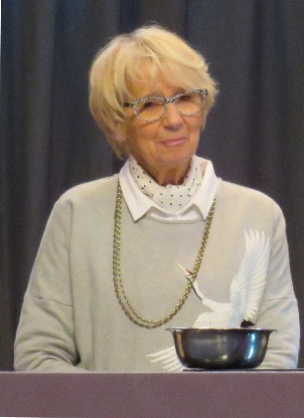
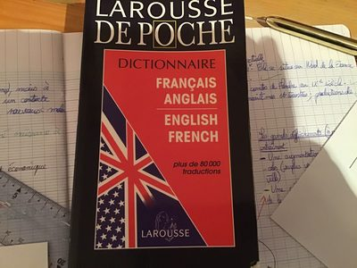
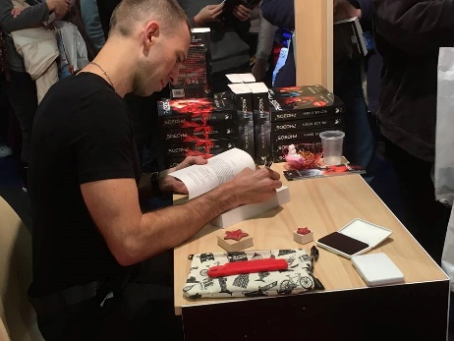
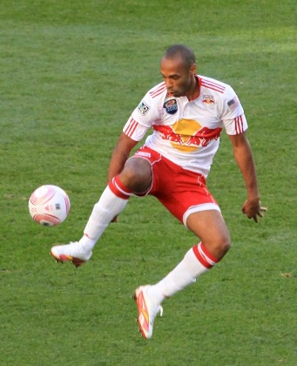
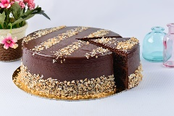
Les livres
Lis les descriptions des livres et choisis les bons mots. C’est quel livre ?
lire
Si [2] fais du sport, c’est un livre intéressant.
B
1. Il y a une femme qui fait des gâteaux d’anniversaire.
2. Si tu fais du sport, c’est un livre intéressant.
Il y a [1] qui fait des gâteaux d’anniversaire.
[3] faisons souvent des erreurs de vocabulaire, donc ce livre est très utile !
3. Nous faisons souvent des erreurs de vocabulaire, donc ce livre est très utile !
D
A
Il y a [5] qui font un voyage dans l’espace.
5. Il y a des gens qui font un voyage en espace.
4. Phileas Fogg et son assistant font un grand voyage en moins de trois mois.
C
[4] font un grand voyage en moins de trois mois.
E
tu une femme Phileas Fogg et son assistant nous des gens
A. Les grimoires de Mercotte
B. Le dictionnaire Larousse
C. La série Phobos de Victor Dixen
D. Seul au sommet – Thierry Henry
E. Le tour du monde en 80 jours – Jules Verne
Notes:
Timing: 8 minutes
Aim: Written recognition of present tense of faire
Procedure:
1. Students choose the missing subjects of each verb.
2. Click to reveal answers.
3. Students match reviews to book titles and pictures.
Word frequency of cognates used (1 is the most frequent word in French):
description [2779], gâteau [4845], vocabulaire [4159], assistant [3805] Source: Lonsdale, D., & Le Bras, Y. (2009). A Frequency Dictionary of French: Core vocabulary for learners London: Routledge.
Salon_chocolat_Paris_2017_Mercotte_3116c by Sukkoria is licensed under CC BY-SA 4.0
Dictionnaire - Larousse by openfoodfacts-contributors is licensed under CC BY-SA 3.0
Phobos de Victor Dixen by ActuaLitté is licensed under CC BY-SA 2.0
Thierry_Henry_control_New_York_Red_Bulls by Crashandspin is licensed under CC BY 2.0

Slide 15
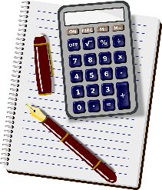
Qui fait quoi ?
parler
Partenaire A: Pose des questions avec le verbe faire.
Partenaire B: Réponds avec oui ou non et une phrase avec il/elle est ou ils/elles sont.
Fait-elle l’exercice de maths ?
Non, il est trop difficile.
[he]
no, too difficult
Notes:
Timing: 10 minutes
Aim: Oral production of present tense of faire and il/elle/ils/elles meaning ‘it’/’they’
Procedure:
Print rolecards from slide 16.
Students work in pairs.
Use this slide to model the task.
Partner A asks yes/no questions using the appropriate part of faire.
Partner B answers, using the corresponding form of il/elle est/ils/elles sont + adjective with agreement.
Partners swap roles.
Word frequency of cognates used (1 is the most frequent word in French):
verbe [>5000] Source: Lonsdale, D., & Le Bras, Y. (2009). A Frequency Dictionary of French: Core vocabulary for learners London: Routledge.

Slide 16
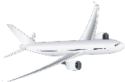
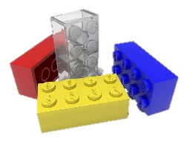
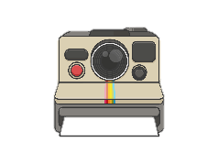
Qui fait quoi ?
parler
Pose des questions à ton/ta partenaire avec le verbe faire:
[he]
[you [pl./fml]]
[you [sing.]] [the model]
[we]
[you [sing.]] [a visit of]
Réponds aux questions de ton/ta partenaire:
yes, difficult
no, too expensive
yes, beautiful
yes, important
yes, but bad
Pose des questions à ton/ta partenaire avec le verbe faire:
[you [pl./fml]] [homework]
[he] [a journey]
[you [sing.]]
[we] [work experience]
[she]
Réponds aux questions de ton/ta partenaire:
yes, good
no, not open
yes, big
yes, long
yes, beautiful
Notes:
ROLECARDS FOR PRINTING

Slide 17
Qui fait quoi ?
parler
Partenaire A
Fait-il des gâteaux ?
Faites-vous les magasins ?
Fais-tu le modèle ?
Faisons-nous une promenade ?
Fais-tu une visite de l’église ?
Oui, ils sont difficiles.
Non, il est trop cher.
Oui, elle est belle !
Oui, il est important.
Oui, mais elles sont mauvaises !
Partenaire B
Faites-vous les devoirs ?
Fait-il un voyage aux États-Unis ?
Fais-tu la photo ?
Faisons-nous un stage ?
Fait-elle des glaces ?
Oui, ils sont bons.
Non, ils ne sont pas ouverts.
Oui, il est grand.
Oui, elle est longue.
Oui, elle est belle.
Notes:
SUGGESTED ANSWERS

Slide 18
Talking about what you read
Verbs like prendre and lire (present) (all persons)
Verbs with direct objects
Y9 French
Term 3.1 - Week 1 - Lesson 48
Author name(s): Catherine Salkeld / Louise Bibbey
Artwork by: Chloé Motard
Date updated: 04/07/22
Notes:
Artwork by Chloé Motard. All additional pictures selected are available under a Creative Commons license, no attribution required.
Native teacher feedback provided by Sarah Brichory.
Learning outcomes (lesson 2):
Revision of verbs like prendre and verbs like lire
Revision of verbs with direct objects
Word frequency (1 is the most frequent word in French):
coûter [984], je dis [37], tu dis [37], il dit [37], elle dit [37], vous dites [37], dit [37], je fais [25], tu fais [25], il fait [25], elle fait [25], nous faisons [25], vous faites [25], ils font [25], elles font [25], fait [25], fermer [757], interdire [533], prendre [43], je prends [43], tu prends [43], il prend [43], elle prend [43], pris [43], tuer [591], elle veut [57], allemand [844], anglais2 [784], anniversaire [2043], bibliothèque [2511], effort [388], fenêtre [1604], français2 [251], journal [520], lettre [480], marché [280], modèle [958], photo [1412], phrase [2074], roman [1262], texte [631], vérité [907], cher [803], intéressant [1244], drôle [2166], mauvais [274], moins [62], vrai [292], chez [206], dans [11], faire les magasins [25/3/1/1736], il fait beau [13/25/393], il fait mauvais [13/25/274], la [1], le [1], les [1], puisque [528], si1 [34]
Source: Lonsdale, D., & Le Bras, Y. (2009). A Frequency Dictionary of French: Core vocabulary for learners London: Routledge.
The frequency rankings for words that occur in this PowerPoint which have been previously introduced in NCELP resources are given in the NCELP SOW and in the resources that first introduced and formally re-visited those words.
For any other words that occur incidentally in this PowerPoint, frequency rankings will be provided in the notes field wherever possible.

Slide 19
Les habitudes de lecture*
Lis le message de Sophie et réponds aux questions en anglais.
vocabulaire
Je fais l’effort de lire tous les jours. Quand il fait beau, je lis dans le jardin, mais s’il fait mauvais, je lis à côté de la fenêtre de ma chambre. J’achète beaucoup de romans parce qu’ils ne coûtent pas trop cher. J’emprunte les bandes dessinées de la bibliothèque puisqu’elles sont chères. Ma mère interdit les livres de crime, parce qu’elle trouve qu’ils sont trop violents, mais j’aime savoir la vérité derrière ces histoires.
1. every day
2. when it’s nice weather
3. next to her bedroom window
4. She buys a lot because they don’t cost too much
5. She borrows them from the library because they’re expensive.
6. Books about crime, because her mother thinks they’re too violent, but Sophie likes to know the truth.
How often does Sophie read?
When does she read in the garden?
Which part of the house does she read in?
What does she say about novels? (two details)
How does she get graphic novels? Why?
What is she not allowed to read? Why? Does she agree?
*la lecture = reading
*la bande dessinée = comic, graphic novel
Notes:
Timing: 4 minutes
Aim: Written comprehension of revisited vocabulary
Procedure:
Students read the text and answer the questions in English.
Click to reveal answers.
Discuss where the answers were found in the text.
Word frequency of unknown words (1 is the most frequent word in French):
bande dessinée [977/2086], lecture [1016]
Source: Lonsdale, D., & Le Bras, Y. (2009). A Frequency Dictionary of French: Core vocabulary for learners London: Routledge.
Word frequency of cognates used (1 is the most frequent word in French):
violent [1119] Source: Lonsdale, D., & Le Bras, Y. (2009). A Frequency Dictionary of French: Core vocabulary for learners London: Routledge.

Slide 20
Les opinions
vocabulaire
Use the context of these sentences to work out whether the word in bold is positive or negative.
J’aime bien ce livre. Il est génial !
Je ne veux pas finir cette histoire. Elle est ennuyeuse.
Tu vas aimer ce roman. Il est merveilleux.
Ma mère n’aime pas ce poème. Elle pense qu’il est bête.
J’ai envie de lire ce texte. Ma sœur dit qu’il est divertissant.
Je ne vais pas acheter ce journal. Je pense qu’il est nul.
Je peux emprunter cette bande dessinée ? Je pense qu’elle est sensass !
Mon frère aime cette histoire, mais je pense qu’elle est pourrie.
Je ne peux pas fermer ce livre ! Il est palpitant !
Je ne veux pas lire cette histoire de vampires. Elle est trop effrayante.
great
boring
marvellous
stupid
entertaining
rubbish
sensational
rotten
exciting
scary
Notes:
Timing: 8 minutes
Aim: Lexical inference of positive/negative meanings of unknown adjectives based on comprehension of known vocabulary and structures; holistic written recognition and comprehension of il/elle/ils/elles meaning ‘it’/’they’.
Procedure:
Students read the sentences and decide whether the word in bold is positive or negative.
Click to reveal answers.
Click to reveal English translations.
Discuss what helped students to know whether the adjectives were positive or negative.
Word frequency of unknown words (1 is the most frequent word in French):
génial [3872], ennuyeux [>5000], merveilleux [2209], bête [2591], divertissant [>5000], nul [801], sensass [>5000], pourri [>5000], palpitant [>5000], effrayant [>5000]
Source: Lonsdale, D., & Le Bras, Y. (2009). A Frequency Dictionary of French: Core vocabulary for learners London: Routledge.
Word frequency of cognates used (1 is the most frequent word in French):
vampire [>5000] Source: Lonsdale, D., & Le Bras, Y. (2009). A Frequency Dictionary of French: Core vocabulary for learners London: Routledge.

Slide 21
Verbs like prendre and lire
grammaire
Remember verbs like prendre (comprendre, apprendre):
I take
you _{[sing.]} understand
he/she learns
je prends
tu comprends
il/elle apprend
we take
you _{[pl./fml]} understand
they learn
nous prenons
vous comprenez
ils/elles comprennent
Remember verbs like lire (dire, conduire, interdire, construire, traduire):
I read
you _{[sing.]} drive
he/she bans
je lis
tu conduis
il/elle interdit
we build
you _{[pl./fml]} translate
they read
nous construisons
vous traduisez
ils/elles lisent
Notes:
Timing: 3 minutes
Aim: Recap of verbs like prendre and verbs like lire
Procedure:
1. Click to reveal examples.
2. Elicit French where possible.

Slide 22
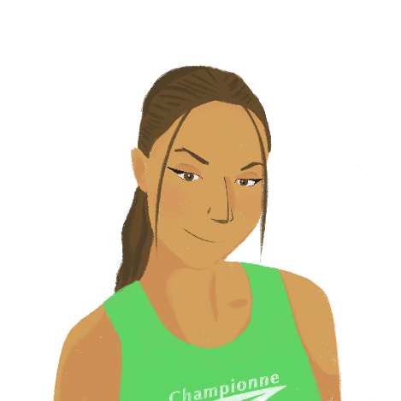
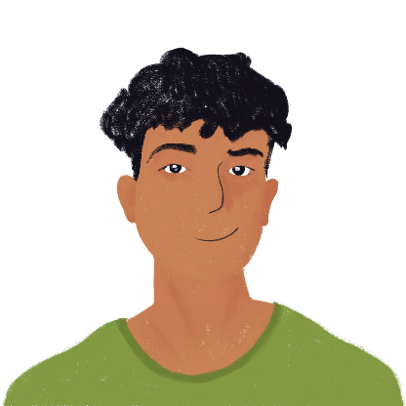
À la bibliothèque
grammaire
Amir et Océane sont à la bibliothèque. De qui parle Amir ? Coche je (Amir), nous (Amir et Océane), ou ils (les parents d’Amir).
Q | je | nous | ils | activité | R
 |  |  |  | learn Italian
 |  |  |  | understand English easily
 |  |  |  | take books of poems
 |  |  |  | translate a poem into English
 |  |  |  | read lots of novels
 |  |  |  | say sentences in English
 |  |  |  | translate sentences into French
 |  |  |  | read the newspaper in Italian
 |  |  |  | translate the difficult words
 |  |  |  | read funny stories
1
1
2
2
3
3
4
4
5
5
6
6
7
7
8
8
9
9
10
10
Notes:
Timing: 10 minutes
Aim: Aural recognition of verbs like prendre and lire
Procedure:
1. Click buttons on the left to play audio.
2. Students listen and tick je, nous, or ils according to the verb ending they hear.
3. Click to reveal answers.
4. Students listen again and makes notes in English.
5. Click to reveal answers.
6. Click buttons on the right to play full audio.
Transcript:
[Nous] apprenons l’italien.
[Ils] comprennent l’anglais facilement.
Cette fois, [je] prends des livres de poèmes.
[Nous] traduisons un poème en anglais.
[Ils] lisent beaucoup de romans.
[Ils] disent parfois des phrases en anglais.
[Je] traduis les phrases en français pour pratiquer.
[Je] lis souvent le journal en italien.
[Je] traduis les mots difficiles.
Normalement, [nous] lisons des histoires amusantes.

Slide 23
Verbs with direct objects
grammaire
Some verbs need a direct object to follow them.
Je prends un livre.
I take a book.
Some verbs can take a direct object, but also make sense on their own.
Il lit un journal.
He reads a newspaper.
Il lit.
He reads.
Some verbs can’t take a direct object.
Nous dormons.
We sleep.
Notes:
Timing: 3 minutes
Aim: Recap of verbs with direct objects
Procedure:
1. Click to reveal explanations and examples.
2. Ensure understanding.

Slide 24
Les livres
Amir choisit un livre pour étudier. Écris les bons verbes dans la bonne forme.
lire/écrire
cherche
Le Gone du Chaâba : Un garçon algérien ____________ son identité culturelle. Il ____________ à deux mondes. (chercher, penser)
Les mains sales : Un homme ____________ à un groupe politique. Il ____________ un politicien. (tuer, parler)
Thérèse Desqueyroux : Une femme ____________ son partenaire et ___________ à un crime. (regarder, penser)
Une si longue lettre : Une femme ____________ à un événement triste. Elle ____________ une longue lettre. (réagir, écrire)
Un sac de billes : Deux garçons juifs _____________ la liberté pendant la guerre. Ils ____________. (chercher, partir)
Bonjour Tristesse : Une fille ____________ les vacances à la plage. Elle _____________ beaucoup à un beau garçon. (passer, penser)
Kiffe Kiffe Demain : Une fille franco-marocaine* _____________ à Paris. Elle ____________ sa vie familiale. (décrire, habiter)
Boule de Suif : Dix personnes __________.__ Une femme __________ son repas avec les autres. (partager, voyager)
pense
parle
tue
*franco-marocain = French-Moroccan
regarde
pense
réagit
écrit
cherchent
partent
passe
pense
habite
décrit
voyagent
partage
Notes:
Timing: 10 minutes
Aim: Written recognition and comprehension of verbs with direct objects
Procedure:
Students use their knowledge of direct objects to help them decide which verb goes in which gap.
Students conjugate the verbs and write them in the appropriate place.
Click to reveal answers.
Oral translation of book summaries if time allows, and discussion of which book they might like to read.
Word frequency of unknown words (1 is the most frequent word in French):
franco-marocain [>5000/3469]
Source: Lonsdale, D., & Le Bras, Y. (2009). A Frequency Dictionary of French: Core vocabulary for learners London: Routledge.
Word frequency of cognates used (1 is the most frequent word in French):
identité [1437], politicien [3371] Source: Lonsdale, D., & Le Bras, Y. (2009). A Frequency Dictionary of French: Core vocabulary for learners London: Routledge.

Slide 25
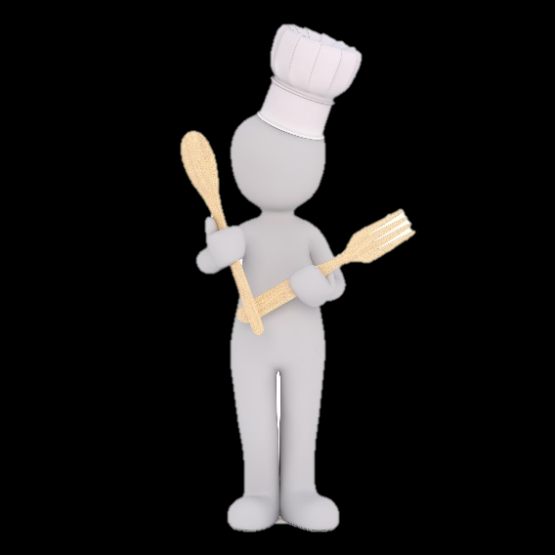
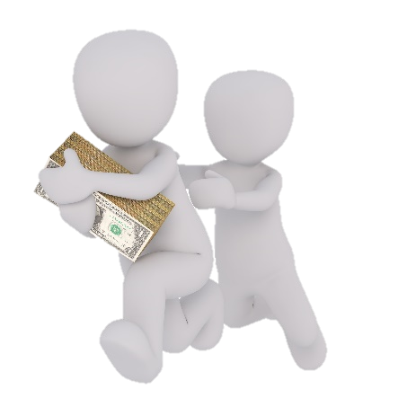
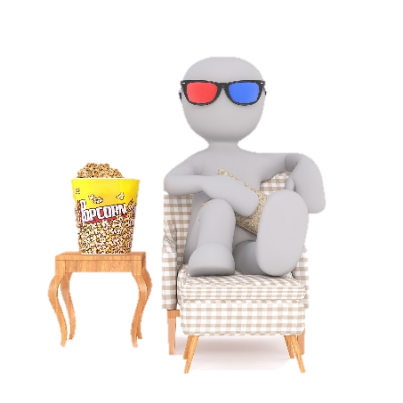
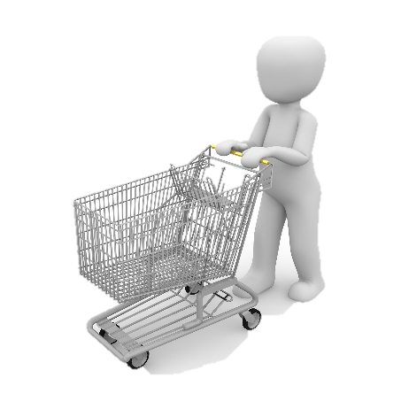
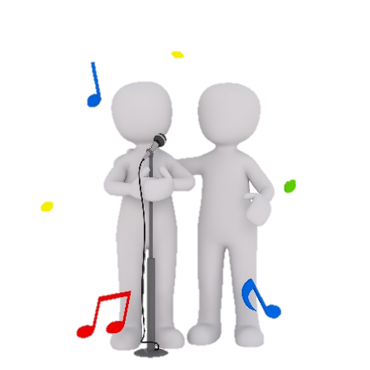
Une histoire
Choisis cinq images et écris une histoire. Tu peux chercher des noms* dans le dictionnaire si tu veux.
écrire
[to write]
[to give]
[to study]
[to win]
[to say]
[to borrow]
[to study]
[to do cooking]
[to learn ]
[to steal]
[to build]
[to watch]
[to buy]
[to look for]
[to sing]
*le nom = noun
[to read]
Notes:
Timing: 12 minutes
Aim: Written production of verbs with direct objects
Procedure:
Display this slide, give the instructions, and show the next slide to model the task. Click back to this slide.
Students choose five pictures.
Students write at least one sentence for each picture to create a story.
Students can use dictionaries to find new nouns.
If time allows, students could read their stories to a partner, and the partner could guess which pictures were used.
Optional differentiation: teachers could provide extra support by giving the infinitives in French and/or providing gapped sentences.
Word frequency of unknown words used (1 is the most frequent word in French):
nom [171] (meaning ‘noun’)
Word frequency of cognates used (1 is the most frequent word in French):
image [659], dictionnaire [4094] Source: Lonsdale, D., & Le Bras, Y. (2009). A Frequency Dictionary of French: Core vocabulary for learners London: Routledge.

Slide 26
Une histoire
Choisis cinq images et écris une histoire. Tu peux chercher des noms dans le dictionnaire si tu veux.
écrire
[to learn]
[to borrow]
[to buy]
[to do cooking]
[to win]
Sandrine apprend de nouvelles compétences. Elle emprunte beaucoup de livres à la bibliothèque. Elle achète des ingrédients au supermarché*. Elle gagne une trophée* !
*le supermarché = supermarket
*la trophée = trophy
Notes:
USE THIS SLIDE TO MODEL THE TASK
Word frequency of unknown words used (1 is the most frequent word in French):
supermarché [>5000], trophée [>5000]
Word frequency of cognates used (1 is the most frequent word in French):
image [659], dictionnaire [4094], ingredient [>5000] Source: Lonsdale, D., & Le Bras, Y. (2009). A Frequency Dictionary of French: Core vocabulary for learners London: Routledge.

Slide 27
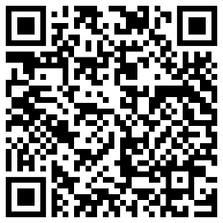
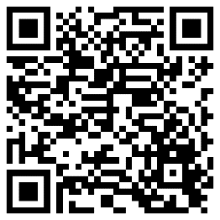
Devoirs
Vocabulary Learning Homework (Y9, Term 3.1, Week 2)
Audio file
Audio file QR code:
Student worksheet link
Quizlet link
Quizlet QR code
Notes:
The answer sheet for the 9.3.1.2 vocabulary learning homework is here: Resource | French SOW Y9 Term 3.1 Week 2 - vocabulary learning homework answers | ID: n009w409p | NCELP

