Slide 1
Meanings that matter
12 January 2022
Presenter: Rachel Hawkes

Slide 2
NCELP (Centre for Excellence for Language Pedagogy)
MFL Pedagogy Review (Teaching Schools Council, 2016)
National Centre for Excellence (2018 -)
Notes:
It’s probably useful to give just a very brief context to the Centre for Excellence (NCELP). In 2016, the Teaching Schools Council published the MFL Pedagogy Review. It presents evidence about current teaching practice of foreign languages at secondary school level, primarily KS3, and make recommendations for effective pedagogy. Set up in December 2018, the National Centre is funded by the Department for Education to work with researchers, teacher educators and specialist teacher practitioners to support the recommendations for teaching in the review, for teaching of vocabulary, grammar the phonics, or the sound-spelling correspondences of the new language. And the long term aim of the centre, as you can see from the mission statement here from our website, is to improve language curriculum design and pedagogy, leading to a higher uptake and greater success at GCSE.
For the first three years (we just started Year 4), we have been working intensively with a group of 45 partner secondary schools across 9 small hubs. In addition, we have been running CPD and dissemination from the Centre whenever capacity has permitted, and to date, between 6500 and 7000 teachers have attended NCELP CPD sessions (though there may be some overlap in this feature). However, from now (January 2022), over three terms, we will be running a national CPD programme for teachers with a course of five sessions, run by 12 of our specialist teachers.
I work as Co-Director of NCELP – I’m seconded for four days a week from my school Comberton Village College, where my role is Director of International and Language Education across The Cam Academy Trust.

Slide 3
Meanings that matter: session overview
Curriculum Design principles
Revisiting principle (umbrella architecture)
Frequency principle (aka the communication principle)
Depth of word knowledge principle
Explicit grammar principle (aka levelling the playing field)
Practice principle
Culture principle
Personalisation principle
Themes and topics (aka the ‘build it, they will come’ principle)
Three knowledge strands
Resources and activities
Notes:
So, I’ve organised this session into two parts; in the first part I’m going to outline the set of principles that underpin languages curriculum design at NCELP and how these relate to the reality of language learning in the classroom context in England. It looks like a lot (and it is) but I’ve kept it to one slide per principle. In the second part we’re going to look at a few resources and practical activity ideas that put these principles into action in the classroom.

Slide 4
Revisiting principle (umbrella architecture)
Multiple exposures and use are important to consolidate knowledge and develop fluency, anywhere between 5 – 20 encounters. (Nation, 2001:81)
How many words can you know by GCSE?
Curriculum time available = 168 weeks (36 weeks/year over 5 years, minus one term in year 11)
Based on acquisition of ca. 10 new words/week (e.g. Schmitt 2004), ca. 1680 words if all are retained and can be both understood and produced
Informing suggestion of 1700 target for top of Higher tier
Spaced repetition, 10+ encounters (e.g., Webb, 2007)
‘Recycling is necessary, and if it is neglected, many partially learned words will be forgotten, wasting all the effort already put into learning them ... Recycling has to be consciously built into vocabulary learning programs, and teachers must guard against presenting lexical items once and then forgetting about them, or else their students will likely do the same.’ (Schmitt, 2008:343)
‘the 1500 words contained in the GCSE specification would, if learned, bring these learners of this exam to a level of threshold understanding and put them somewhere near B1 level French learners in other countries’. (Milton, 2015: 117)
Notes:
To know words – to fix them in long-term memory – we have to revisit them, a lot. They do not stick otherwise.
This is what vocabulary experts say: [cue animation x 4] If we accept this, then it follows that we → have to prioritise high-frequency words in our curriculum planning/teaching as these are the words that occur in many contexts – otherwise you would just be revisiting the same topic or couple of topics every 3-4 weeks, every term, every year – if you choose rarer words your contexts are more limited, if you choose from the most common words then you find many different contexts in which they are routinely used. (As it is we revisit school, holidays several times over KS3 and KS4 – such that students do find topics repetitive – however we don’t revisit the words enough for them to really learn them, so we currently have the worst of both worlds – as Barry Jones’ work with KS3 learners found in the 80s/early 90s – students find languages boring and difficult – boring as they repeat topics, difficult because they don’t revisit words enough to actually retain them).
[cue animation] So, how many words can you realistically know by GCSE? And isn’t it interesting that this is a question I hadn’t heard during the first 25 years of my teaching career? It just didn’t come up. [cue animation] If we take the total curriculum time over KS3 and KS4 [cue animation] and base the number of new words per week on a recommendation by Schmitt (which is also mentioned in the Pedagogy Review) which is 10 words per week
[cue animation] we get a 1700 target for top of higher tier, which is what informed the suggestion for the proposed new GCSE content
Nation, I. S. P. (2001). Learning Vocabulary in Another Language. Cambridge: Cambridge University Press.
Schmitt, N. (2008). Review Article. Instructed second language vocabulary learning. Language Teaching Research, 12(3), 329–363. https://doi.org/10.1177/1362168808089921
Milton, J (2015) "French lexis and formal exams in the British foreign language classroom", Revue française de linguistique appliquée, 2015/1 (Vol. XX), p. 107-119. DOI: 10.3917/rfla.201.0107
Webb, S. (2007) The Effects of Repetition on Vocabulary Knowledge, Applied Linguistics, 28 (1) 46–65, https://doi.org/10.1093/applin/aml048

Slide 5
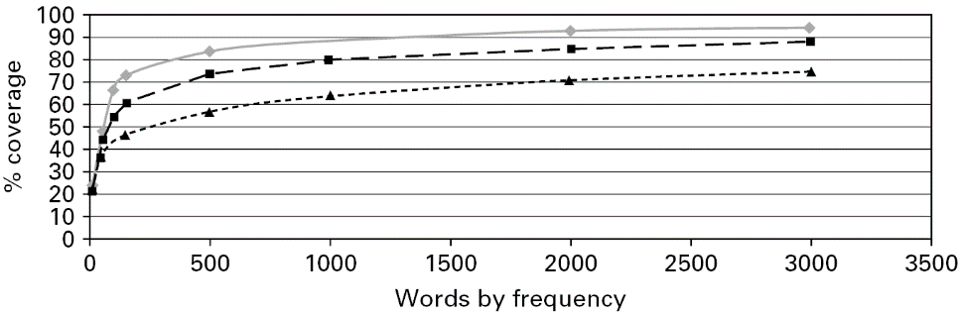
Frequency principle (aka the communication principle)
2,000 most common words cover 80-87% all written text and 90+% of words in all informal conversation (Nation, 2001)
◆ General conversation  More formal speech – e.g. lectures  Written language
Work by Paul Nation, cited by Milton, J. (2009) Measuring second language vocabulary acquisition (p. 58). Multilingual Matters.
Notes:
This is the principle that says that in a time-limited classroom foreign language learning context where there are only so many words we can learn (as we have just seen), we need to prioritise the most useful words. What are the most useful words? the most useful words are the most used words, the words that are demonstrably used more often than other words, in general conversation.
[cue animation]
We know that the 2,000 most common words cover 80-87% of all written text (Nation, 2001; Nation & Waring, 1997) and 90+% of words in all informal conversation (Nation, 2001). This is a very important thing to know!
We want our students to be able to communicate well – and generally what we and our students have in mind is ‘informal conversation’. That means they will be best served by knowing as many of the 2,000 most common words as possible. Prioritising the most common words underpins the development of communication, it doesn’t undermine it.
There is no conflict between high-frequency words and developing communicative competence. One directly supports the other. The HF words are the meanings that matter for everyday communication.
[cue animation]
This visual demonstrates the importance of high frequency words. It is based on data about English.
The findings come 100 million of words collected from a wide range of texts from different contexts. The information was reproduced in a book by Jim Milton.
The x axis along the bottom is ‘words by frequency’ – so, 1,000 means the most frequent 1000 words in a language.
The y axis is called ‘coverage’ – this is the proportion of word families in a text (from a conversation, formal speech, or written language) that you will understand if you know the 500, 1,000, 1,500, or 2,000 most frequent words etc.
The top grey line is the estimation for general conversation – very high frequency vocabulary is the most important for this
The middle line is the estimation for more formal speech – the media, educational contexts,
The bottom line is the estimation for written language – you tend to get rarer words being used in written texts – though this massively varies according to context and genre (type of text)
Let’s highlight three things about this visual: [cue animation]
First – you will see that knowing just the most frequent 200-300 words gives you a massive boost – you can see a really, really steep curve here – knowing these words gives you access to between 50% and 75% of any input you hear or read [cue animation]
Second – If you know somewhere around 1,700 of the most frequent words you can probably understand between 70% and 92% of things you read and hear.
[cue animation]
Third - This very clear value of knowing really high frequency words tends to almost completely plateau after about the 1,700 to 2,000 most frequent words; but this plateauing *starts* even earlier, at between 1,000 and 1,500 most frequent words. So, after knowing about the 1,500 most frequent words, how much you understand depends on whether you happen to know those other, rarer words. We need to know A LOT of words to be able to be sure that we will understand any more of a text.
To date, the choice of which words we teach has had to be driven by intuition about which topics might come up in a child’s experience. Now, with the use of large corpora and the frequency information derived from them, we have hard evidence that can guide these choices.
But of course, we don’t need to stick to this slavishly. We still need to add in some words about the kinds of things that we *think* might be of special interest and use to our kinds of learners. It is hard to know which ‘rarer words’ a learner might need to know.
When time is limited and we have to make hard choices about the words we teach and revisit to ensure they are really known, then we are in with a good shout of motivating children, by showing them that they can ‘crack’ a language, if we provide them with a booster pack of ‘super-vocabulary’.
Nation, I. S. P. (2001). Learning Vocabulary in Another Language. Cambridge: Cambridge University Press.
Nation, P. and Waring, R. (1997) Vocabulary Size, Text Coverage and Word Lists. In: Schmitt, N. and McCarthy, M., Eds., Vocabulary: Description, Acquisition, and Pedagogy, Cambridge University Press, Cambridge, 6-19.

Slide 6
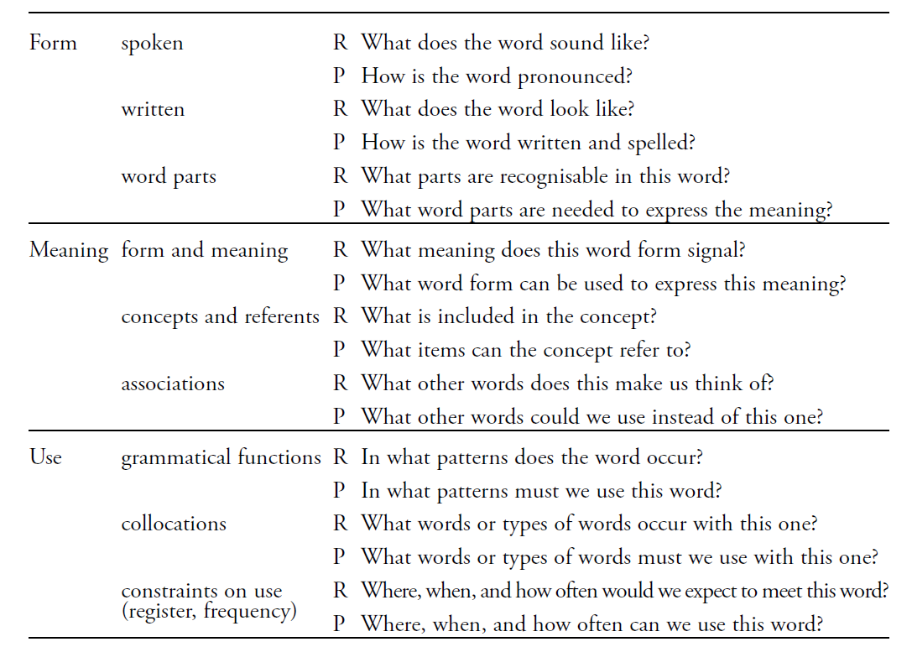
Depth of word knowledge principle
(Nation, 2001:27)
“The nearest thing we have to a definitive list of what it means to know a word”
(Milton, 2013:59)
learning and knowing words better
teaching more aspects of word knowledge
teaching mainly individual words
careful curriculum planning
Notes:
[cue animation] So, we are talking about learning and knowing words better, and not necessarily fewer words. This means teaching more aspects of word knowledge. This checklist from Nation is a very comprehensive list of what we need to know about a word.
[cue animation] To develop this level of knowledge, we need to teach the words individually, and alongside the words we need to teach the grammar features that glue the words together, so that students can manipulate language independently from the start, building up the knowledge gradually, so that each time they re-encounter a word they can do more with it.
[cue animation]
This takes careful, analytical planning of the curriculum – a weaving together of vocabulary and grammar features. And the third knowledge strand is phonics, of course, which is heavily implicated is several of the aspects of word knowledge listed here. We mustn’t forget either that many of the most common words carry multiple meanings - and this is all part of knowing a word.
Additional info:
The act of defining the words for GCSE should result in a higher overall vocabulary knowledge for the vast majority of students – currently you can pass a GCSE with between 500-800 words, and there is a lot of guessing as so many unknown words are used in the exams. Textbooks and GCSE courses focus on teaching all/most of the words from the current GCSE word list, 49% of which have never been in an exam.

Slide 7
Explicit grammar principle
Even after 100s of hours of exposure to an L2, learners still struggle with certain grammar
Lots of evidence that explicitly teaching grammar can be beneficial
Explicitly teaching grammar tends to be more effective than waiting for learners to pick up grammatical patterns themselves
Brief description of the grammar before practice can speed up the rate of learning and…
Levels the playing field by supporting all learners (rather than inductive methods which favour the naturally analytical
(e.g., Kasprowicz & Marsden, 2018; Lichtman, 2016; Marsden, 2006; Norris & Ortega, 2001; Schmidt, 1990; Spada & Tomita, 2010; White, Spada, Lightbown, & Ranta, 1991)
Notes:
Evidence from research suggests that explicitly teaching grammar can be beneficial for learners and it is important to point this out because whether or not to teach grammar has been under debate for several decades in foreign language education and, as a result, messages have not always been clear in policy documents, in textbooks, or across different school and classroom contexts.
So, what do we know?
[Cue animation]
Well, we know from research studies with learners in immersion contexts that even after hundreds of hours of exposure to a second or foreign language learners can still struggle with certain bits of grammar.
Such studies therefore suggest that exposure to the language alone is not always sufficient for learners to develop reliable and accurate grammatical knowledge.
[Cue animation]
In addition, there is lots of evidence from a wide range of research studies with different learners, different languages, and different grammar features, which have demonstrated that explicit grammar teaching can be beneficial, both for learners’ comprehension of difficult grammar features and also for their accuracy in producing those bits of grammar.
[Cue animation]
Such studies have also shown that explicit grammar teaching (so explaining the grammatical rule and providing the opportunity for focused practice using the new bit of grammar), this type of instruction does tend to be more effective and more reliable that waiting for learners to spot grammatical patterns themselves.
[Cue animation]
Further, providing that brief description of the grammar before practice can help learners to pick up that new bit of grammar much more quickly. Studies show that learners from Y3 onwards can benefit from this sort of short explicit explanation that leads into practice.
[Cue animation]
Explicit grammar explanation also has the benefit of levelling the playing field – a short explicit explanation of each feature before the practice supports all learners, rather than using inductive methods which favour the naturally analytical.
At the bottom of the slide here, we have references to a number of research studies which support these observations and the 4 references in bold are all included in the one-page OASIS summaries that accompany this presentation. These are a good place to start, if you would like to know more about the research evidence relating to these points about grammar teaching and learning

Slide 8
Practice principle
Use a range of types of practice that revisit the same language in different contexts
Provide practice in ‘input language’ (listening and reading) that makes the form-meaning connection task essential
Practise producing the new language in scaffolded writing and speaking activities with small, incremental steps
Involve an element of struggle
Use multi-modal activities
See a gradual move towards freer production
(DeKeyser, 2005; DeKeyser, 2015; Ellis, 2006; Mitchell, Myles, & Marsden, 2019; VanPatten, 2004)
Notes:
The practice principle is the cornerstone of the language learning journey and it is the type or types of practice that determine how successful learners are. [Cue animation]
Learners need a range of types of practice that revisit the same language in different contexts.
[Cue animation]
Initially, learners benefit from plentiful practice in listening and reading, through structured tasks that require learners to connect a sound-symbol correspondence, word or structure to its meaning or function. This kind of practice establishes knowledge receptively, before expecting learners to produce it in writing or speaking.
[Cue animation]
Next, learners benefit from ample practice in producing the new language in writing and speaking activities. Note that the progress from supported to unscripted, authentic communication is gradual.
The practice at this stage is carefully scaffolded to relieve pressure on working memory and allow the automatization of new language. The ‘meaningful’ aspect of this practice is the fact that the student cannot complete the task without fully understanding (connecting form with meaning) what s/he is saying.
[Cue animation] Learning is usually most successful at this stage when manipulation of language is required to fill a genuine information gap. Furthermore, it is often preferable for learners to need to (struggle to) retrieve the key language from memory than to have it clearly in view (e.g., in prompt word lists or full speaking/writing frames).
[Cue animation]
Integrating modes (comprehension and production) and modalities (oral and written) in practice strengthens memory and facilitates more flexible language use. Tasks that involve different combinations of input and output (e.g., reading plus speaking or listening plus writing) are therefore beneficial to learners.
Over time and after sufficient practice, language stored in memory is accessed more rapidly and with less conscious effort. This process facilitates a gradual move towards freer, meaningful production practice. (Skill-acquisition theory, DeKeyser).
Having realistic expectations about the amount and type of practice needed can guide teachers to limit the quantity of new language, in order to help pupils to eventually use language they have already encountered in different contexts more spontaneously, including under time and communicative pressure.

Slide 9
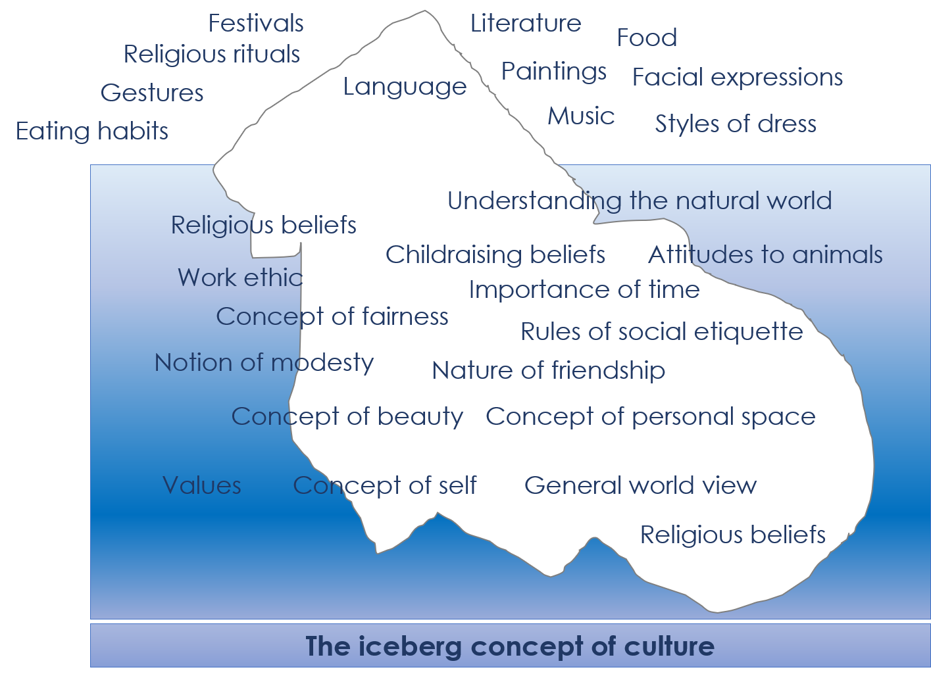
Cultural principle
Handball: Higher Am liebsten von allen Sportarten mag ich Handball. Seit zwei Jahren bin ich Mitglied im Verein. In Deutschland ist Fußball Sport Nummer 1 – aber direkt danach kommt Handball! Beim Handball hat man sieben Spieler pro Mannschaft. Nach zweimal dreißig Minuten hat das Team mit den meisten Toren gewonnen. THW Kiel heißt mein Lieblingsverein – zweiundzwanzig Mal hat er schon die Bundesliga gewonnen! Beim Sport ist mir Erfolg wichtig, aber teilnehmen ist noch wichtiger. Auf jeden Fall ist Sport gut für Körper und Seele. Aktiv sein ist immer von Vorteil. Mit unserem Trainer kämpfen wir um den Sieg, ja, und richtig glücklich sind wir dann, wenn wir unsere Gegner schlagen. Aber regelmäßig gewinnen ist nicht das Hauptziel – Bewegung, zusammen Spaß haben und im Team zusammenzuarbeiten ist die Hauptsache. Und du, was ist dein Lieblingssport und warum?
Handball: Foundation Am liebsten von allen Sportarten mag ich Handball. Schon zwei Jahre lang bin ich Mitglied im Verein. In Deutschland ist Fußball Sport Nummer 1 – aber direkt danach kommt Handball! Beim Handball hat man sieben Spieler pro Mannschaft. Nach zweimal dreißig Minuten hat das Team mit den meisten Toren gewonnen. THW Kiel heißt mein Lieblingsverein – zweiundzwanzig Mal hat er schon die Bundesliga gewonnen! Beim Sport ist mir Erfolg wichtig, aber teilnehmen ist noch wichtiger. Auf jeden Fall ist Sport gut für Körper und Seele. Aktiv sein ist immer von Vorteil. Mit unserem Trainer arbeiten wir hart, ja, und richtig glücklich sind wir dann, wenn wir das andere Team schlagen. Aber regelmäßig gewinnen ist nicht das Hauptziel – Bewegung, zusammen Spaß haben und mit anderen zusammenzuarbeiten ist die Hauptsache. Und du, was ist dein Lieblingssport und warum?
“Common attitudes, beliefs and values are reflected in the way members of the group use language - for example, what they choose to say or not to say and how they say it.” (Kramsch, 2001, p6).
Many words in the 2000 most frequent are culturally and thematically rich (about 60-65% of them)
Build from the words and the contexts will come
Find culture in…
the new language sounds
its words and
its structures.
Notes:
No teacher I know would say that culture isn’t important. So it’s great that culture is more, not less accessible when we follow the frequency principle. Freed up from a need to cover prescribed topics (many of which aren’t quintessentially cultural) we find we can draw on many aspects of culture that are typically underrepresented.
[Cue animation]
Many words (the majority in fact) in the 2000 most frequency are rich content words. [Cue animation]
So we can have confidence that if we build from the words the contexts will come.
[Cue animation]
And it’s worth thinking as broadly as possible about culture. We find it richly represented in the sounds of the language, its words and its structures, (so, as Kramsch says, culture is in the language itself) and this is one way we can access it in our teaching. But of course it’s also clearly visible in the content of texts.
NCELP German resource developers are currently creating texts (could be listening or reading, though they are currently in written form) using an example word list of 1200 / 1700 words developed to meet the requirements of the proposed new GCSE content, as a kind of proof of concept endeavour. Here is one example about Handball, but other themes that have already been written about, using the same list of words, are: Celebrations – 1st May, Christmas, Rosenmontag, Fettdonnerstag Locations – Wattenmeer, Bonn, Rothenburg, Badeschiff Berlin, Sächsischer Schweiz, Wuppertaler Schwebebahn Events – Frankfurt book fair People – Hannah Arendt, Milena Glimbovski, Influencers Traditions – Pfandsystem History – Checkpoint Charlie School – German school system, mental health in schools, pets in lessons Quirky news stories – horse that takes itself for a walk Current affairs – Veganism, Hartz IV (unemployment benefit), Social media detox Literature - Kleider machen Leute (Gottfried Keller) Science/Technology – Antibiotics, Clothes made from wood, foodstuffs etc.. Language – Saterfriesisch Jobs - Garnelen
Learning a foreign language is a liberation from insularity and provides an opening to other cultures.
(National Curriculum Programmes of Study KS2 and KS3)
The study of a modern foreign language at GCSE should also broaden students’ horizons, encourage them to step beyond familiar cultural boundaries and develop new ways of seeing the world.
(proposed GCSE subject content)
The content taught through the new language should be stimulating and widen pupils’ knowledge of the culture, history and literature of speakers of the new language, without compromising the necessary sequencing of vocabulary and grammar. (Pedagogy Review, 2016)

Slide 10
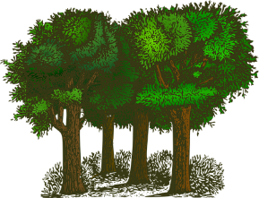
Themes and topics (‘build it and they will come’)
free-time activities?
many words in the top 2000 fit into a range of topics
important to connect new words in the L2 with more than one topic
a process of putting themes/topics to the most common 2000 words revealed that 1231 (Fr), 1248 (Sp) and 1318 (Gm) words had strong connections with themes
Many others are highly important, useful words which can be used to talk about a range of topics
The % of function words (pronouns, prepositions, conjunctions etc) is low (5-9%)
travel and tourism?
global issues?
la forêt [1274]
home, town, neighbourhood and region ?
social issues?
Notes:
And this is not so much a principle as further clarification about the sorts of words that are in the most common 2000, and the sorts of content they generate.
[Cue animation x 2]
So, as we just saw, the most common 2000 words include plenty of ‘content’ words – nouns, verbs and adjectives that we recognise as useful for plenty of topics.
[Cue animation] The range of topics they are useful for builds incrementally, meaning that lesson themes may seem very loose and generic in the initial stages of learning, but come Y8/Y9 and students find that words they learnt in Y7 can now be used within all sorts of contexts. [Cue animation x 3] Looked at another way, putting themes to words rather than words to themes, is probably a very helpful way to think about vocabulary development. When you start out on the learning journey and students have only a few tens of words the topics may be fuzzy but taking a list of 1200 or 1700 words and seeing which topics/themes naturally fall out of them is extremely reassuring. In the next part of the session, I’ll share some texts created using a 1200 / 1700 list so you can see this more clearly. And personally I’m not too concerned that Y7 will arrive to lessons and have their aspirations of learning schools subjects or pets dashed. I don’t think that this is what happens in reality. Students crave learning success, and this is what we aim to design the curriculum and pedagogy for.

Slide 11
The personalisation principle
A defined word list enables personalisation
Students can add their own ‘meanings that matter’
Equal credit in production
Communication opportunities (Comment dit-on XXX?)
Notes:
This leads on to the personalisation principle.
[cue animation] Knowing the full extent of the vocabulary expectations for the GCSE course means that course planners, teachers and students can make informed choices about building a personal repertoire. [cue animation] Students can be encouraged to add words that are important to them, their personal ‘meanings that matter’, knowing that they will be able to use them
[cue animation]
and gain credit for them in production. [cue animation] It’s not necessary for all other students to learn the same words – that is exactly what clarification strategies like ‘Comment dit-on’ are for. This again helps not hinders unscripted target language communication in the classroom.

Slide 12
The three knowledge strands
Revisiting principle means topics are not the main organising principle
The SOW is driven by the language itself
The three language knowledge strands are phonics, vocabulary and grammar
Logical sequencing
Cohesion of the three strands
Notes:
The consequence of the umbrella principle of revisiting is that we can’t start out with topics are the main organising principle of the languages curriculum. What therefore drives curriculum design?
[cue animation]
The SOW is driven by the language itself
[cue animation]
The three foundational aspects of language knowledge are phonics, vocabulary and grammar
[cue animation]
To achieve the most logical sequencing, grammar leads but vocabulary is closely interwoven with the grammar and vocabulary selection based on frequency. Vocabulary items are not chosen for their phonics (i.e. you wouldn’t refrain from introducing a HF word simply because pupils hadn’t explicitly learnt that sound), but phonics source and cluster words are chosen for their frequency.
[cue animation]
We use this this image frequently to represent the relationship between the strands, the braid signifying, amongst other things, that these strands of language knowledge are interconnected and, taught together in a joined up way, lead to more robust knowledge, much as a braid is stronger than a single thread.

Slide 13
Meanings that matter: session overview
Curriculum Design principles
Revisiting principle (umbrella architecture)
Frequency principle (aka the communication principle)
Depth of word knowledge principle
Explicit grammar principle (aka levelling the playing field)
Practice principle
Culture principle
Personalisation principle
Themes and topics (aka the ‘build it, they will come’ principle)
Three knowledge strands
Resources and activities
Notes:
Now, armed with the knowledge about the principles that underpin NCELP’s SOW design, it’s a useful moment to look at some resources and activities from lessons. Some will be unlike what we see currently in textbooks, others will look reassuringly familiar – but they’re all created based on the principles we have just explored.

Slide 14
Principles for teaching grammar in a foreign language
A succinct, explicit description of the grammar feature and its meaning.
Initial practice to reinforce knowledge of the grammatical form and its meaning in the ‘input’(i.e. when reading
and listening), contrasting pairs
of features.
The grammar feature is made task-essential during practice by removing as many other clues from the sentence as possible.
Pairs of meanings juxtaposed in different combinations, ensuring that features are revisited and reinforced.
Developing learners’ awareness of the relationship between English and the L2.
After extensive initial practice of pairs of features, very gradually, activities may incorporate more than two features.
Writing and speaking activities to help learners establish and practise accessing knowledge after the input practice.
Regularly re-visit the grammar feature, in different contexts, with different vocabulary.
Gradually move from scaffolded production practice to freer production practice.
Notes:
This is just a quick recap of what we’re expecting to see reflected in resources in terms of grammar:
pairs of grammar features are practised. For example, two verb endings with contrasting meanings (or functions) can be juxtaposed. Practising a whole new set of features together, e.g., a full range of verb endings, is unlikely to be effective, as it is beyond what most learners can pay attention to at any one time.
The practice itself should require attention to form and meaning. We might need to strip out other language in order to make attention to the grammar essential for task completion.
After a brief explanation, students are given plenty of practice, initially in reading and listening, with the new features before scaffolded production.
When features are revisited, they can be used more freely.
There is an emphasis on true manipulation of language (as opposed to chunks) as this gives students the best chance of being able to communicate meaning themselves.

Slide 15
Resources: grammar
practise with ‘pairs’ of features (not whole paradigms)
compels thinking about form and meaning
brief explanation followed by input practice, then scaffolded production
revisiting leads to freer production activities
promotes true manipulation of language, where possible
Notes:
This is just a quick recap of what we’re expecting to see reflected in resources in terms of grammar:
pairs of grammar features are practised. For example, two verb endings with contrasting meanings (or functions) can be juxtaposed. Practising a whole new set of features together, e.g., a full range of verb endings, is unlikely to be effective, as it is beyond what most learners can pay attention to at any one time.
The practice itself should require attention to form and meaning. We might need to strip out other language in order to make attention to the grammar essential for task completion.
After a brief explanation, students are given plenty of practice, initially in reading and listening, with the new features before scaffolded production.
When features are revisited, they can be used more freely.
There is an emphasis on true manipulation of language (as opposed to chunks) as this gives students the best chance of being able to communicate meaning themselves.

Slide 16
Talking about completed actions in the past: 3rd person singular (preterite)
A succinct, explicit description of the grammar feature and its meaning.
gramática
Remember that in Spanish the verb ending changes depending on who the verb refers to.
Developing learners’ awareness of the relationship between English and the L2.
Notice the position of the stress. In 3rd person singular present, it is on the penultimate syllable. In the 3rd person singular preterite, it is always on the final syllable.
Sufre = s/he or it suffers
Sufrió = s/he or it suffered
It also depends on when the action takes place.
To mean ‘s/he’ or ‘it’ in the present with an –er or –ir verb, remove –er or –ir and add _____.
–e
1
s/he or it offers
s/he or it knows, gets to know
Ofrece = _________________.
Conoce = _____________________________.
2
To mean ‘s/he’ or ‘it’ for a completed action in the past with an –er verb or –ir verb, remove –er or –ir and add –ió.
Romper
romp
rompió
(s/he or it broke)
Notes:
This resource is taken from Year 8 Spanish, Term 2.1, week 2, where we see we see the 3rd person singular preterite tense endings for –ER/-IR verbs being introduced for the first time.
Teachers go through the grammar explanation with students, revealing each new sentence on a mouse click.
[Click through the explanations]
Answers are elicited from students where the knowledge is already known, in this case, third person singular present tense and then the new knowledge is presented, here also with an additional note as regards rules on stress.
[Cue animation]
As you can see:
The grammatical rule is explained very briefly
The focus is on one pair of meanings
Problems the learner might encounter are explained.
When it comes to the content of the explanation, it is important to describe the meaning (or function) of the grammar (e.g. ‘to talk to more than one person, use …’ or ‘to talk about what someone else did in the past, use …), rather than just give information about forming the grammar. Here you can see on the slide ‘To mean s/he or it for a completed action in the past…’
It is also sometimes useful to explain why this grammar might be difficult.
Developing learners’ awareness of the relationship between English and the L2 is also beneficial, particularly for grammar features where the relationship is complex (e.g., when the L2 grammar feature exists in English but works differently in some way). Here we can see that a reminder is given at the very start of the explanation: Remember that in Spanish the verb ending changes depending on who the verb refers to.
Do please be aware, however, that importantly there is a strong body of research that suggests that, in any case, explicit grammar explanations (whether before or after practice, whether full paradigms or short explanations about a small number of features) are not very effective in and of themselves and are far less useful than the practice itself.
It is the amount and nature of practice that seem to have the biggest benefits for learning.
For this reason, the explanation is kept very brief.
Further notes: As regards timing, body of research suggests that, for most learners, for most of the time, and for several different grammar features, providing an explanation upfront, before practice, is more beneficial than waiting for or asking learners to spot patterns.
There are several reasons for this:
First, providing an explanation can help learners to ‘break down’ the language and notice particular features when they are listening and reading. This can speed up learning.
Second, although some learners are good at hearing or seeing patterns in language, many are not, and so providing an explanation may be fairer to help most learners in a class.
Third, if learners are left to work out the pattern themselves at the start, they can establish erroneous connections between the grammar and its meaning (or function).
Although errors can sometimes be useful, they can also make learning less accurate and slower, particularly in contexts with limited exposure to the language and limited opportunity to notice (‘undo’) the erroneous connection.
Fourth, being told about how grammar works enables learners to apply this ‘pattern spotting skill’ later, when they are more proficient or are learning other languages. But, they need plenty of information and guidance in the early stages, given that language is so complex.
………………………………………………………………………………………………………………………………………………
Original teacher notes
Timing: 2 minutes
Aim: to recap 3rd person singular form of present tense for –er/–ir verbs (-e) and introduce the 3rd person singular preterite (-ió)
Procedure:
Go through the grammar explanation with students, revealing each new sentence on a mouse click.

Slide 17
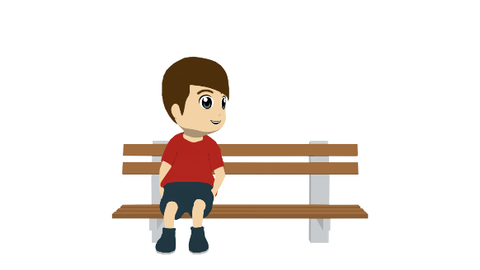
Daniel habla sobre las vacaciones de una amiga. Lee las frases. ¿Son las vacaciones de antes o son las vacaciones cada año? Elige la opción correcta y escribe la frase en inglés.
Initial practice to reinforce knowledge of the grammatical form and its meaning in the ‘input’(i.e. when reading
and listening), contrasting pairs
of features.
The grammar feature is made task-essential during practice by removing as many other clues from the sentence as possible.
leer
 | Cada año | Antes
En inglés
She decided to go to the United States.
1. Decidió ir a los Estados Unidos.
2. Conoció los lugares famosos del país.
She got to know the famous places in the country.
3. Comparte una casa con unos amigos.
She shares a house with some friends.
4. Apenas aprendió inglés.
She hardly/barely learned English.
5. Imprime los billetes antes del viaje.
She prints the tickets before the trip.
6. Descubre partes del mundo en el extranjero.
She discovers parts of the world abroad.
Notes:
……………………………………………………………………………………………………………………………………………………………………………………………………………..
Y8 Spanish Term 2.1 - Week 2 – Lesson 31
Original teacher notes
Timing: 7 minutes.
Aim: to consolidate understanding of the difference between 3rd person singular present (-e) and preterite (-ió) through reading. To consolidate understanding of vocabulary through translation.
Procedure:
Students read each sentence and decide whether it refers to the present or the past.
Students write each sentence in English.
Note: the use of ‘de’ for possession features in the first line of the instructions (‘Daniel habla sobre las vacaciones de una amiga’). This feature hasn’t yet been explicitly taught, but has appeared incidentally on occasions. If the meaning is unclear, it may be necessary to give this upfront.

Slide 18
Ahora Lucía habla de las vacaciones de un amigo, Enrique. Escucha las frases. ¿La acción pasa normalmente o ya pasó? También escribe el verbo en español y la actividad en inglés.
Initial practice to reinforce knowledge of the grammatical form and its meaning in the ‘input’(i.e. when reading
and listening), contrasting pairs
of features.
The grammar feature is made task-essential during practice by removing as many other clues from the sentence as possible.
escuchar
Where is the stress? Does it need an accent?
 | Pasa normalmente | Ya pasó en el pasado
El verbo en español
La actividad en inglés
1
vivió
lived for a year in Mexico
2
conoce
knows the border with the United States
3
sufrió
suffered a car accident there
4
ofrece
offers gifts to friends after the holidays
5
decide
decides to visit old villages/towns
6
aprende
learns things about the culture of the cities
7
rompió
broke the camera near a mountain
8
salió
went out with a friend
Notes:
……………………………………………………………………………………………………………………………………………………………………………………………………………..
Y8 Spanish Term 2.1 - Week 2 – Lesson 31
Original teacher notes
Timing: 8 minutes
Aim: 1) to consolidate understanding of the difference between 3rd person singular present (-e) and preterite (-ió) through listening; 2) to focus on the position of the stress and how this affects the use of the written accent.
Procedure:
Students listen to each recording.
They tick the correct column depending on whether the sentence refers to the present or to a completed action in the past.
Students listen again. This time, they write the verb in Spanish and the activity in English.
Note:
Some students may be able to complete the different parts in one go, rather than as separate steps.
Transcript
Vivió un año en México.
Conoce la frontera con Estados Unidos.
Sufrió un accidente de coche allí.
Ofrece regalos a los amigos después de las vacaciones .
Decide visitar pueblos antiguos.
Aprende cosas sobre la cultura de las ciudades.
Rompió la cámara cerca de una montaña.
Salió con un amigo.

Slide 19
Ahora escribe unas frases sobre los viajes de Enrique. ¿Son las vacaciones de antes o son las vacaciones cada año? Usa la forma correcta del verbo (‘–e’ o ‘–ió’), según la frase.
Writing and speaking activities to help learners establish and practise accessing knowledge after the input practice.
escribir
1. He got to know a famous church in Colombia.
Conoció una iglesias famosa en Colombia.
?
2. He always breaks something.
Siempre rompe algo.
?
3. He decided to travel up to/as far as the border with Ecuador.
Decidió viajar hasta la frontera con Ecuador.
?
4. He suffers many accidents during the holidays.
Sufre muchos accidentes durante las vacaciones.
?
5. He offers presents to some friends after the trips.
El Santuario de Las Lajas es una iglesia en el suroeste de Colombia. Está muy cerca de la frontera con Ecuador.
Ofrece regalos a unos amigos después de los viajes.
?
6. He barely learnt English in the United States.
Apenas aprendió inglés en los Estados Unidos.
?
Notes:
……………………………………………………………………………………………………………………………………………………………………………………………………………..
Y8 Spanish Term 2.1 - Week 2 – Lesson 31
Original teacher notes
Timing: 10 minutes
Aim: to produce the third person singular forms of –er/–ir verbs in present and preterite in writing; to produce vocabulary in writing
Procedure:
Students read the English sentences, paying particular attention to whether the verb refers to habitual present or to a completed action in the past.
They write the sentence in Spanish.
Notes:
Sentences 1 and 3 are based on real places in the Spanish-speaking world. A picture and caption are included as additional information about these.
The vast majority of the words in this activity have either been practised in the preceding activities or were taught in Y7 (e.g. iglesia). It may be worth recapping the word ‘hasta’ (taught in Year 8 Term 1) with students before the activity.

Slide 20
hablar / escuchar
Writing and speaking activities to help learners establish and practise accessing knowledge after the input practice.
Hablamos de las vacaciones.
Persona A lee cada tarjeta en inglés y habla en español.
Persona B mira las opciones con el mismo número y escucha: ¿es presente o pasado? Luego, escribe el nombre correcto, según el verbo.
Ejemplo:
Persona B escucha, mira las opciones y escribe el nombre correcto en una lista:
Persona A habla:
 | Nombres
1
2
3
4
5
6
7
8
Perdió una cámara.
Paula
1
loses a camera
[Marta]
lost a camera
[Paula]
1
Say: S/he lost a camera.
Después, Persona B habla y Persona A escucha.
Notes:
…………………………………………………………………………………………………………………………………………………………………………………………………………..
Y8 Spanish Term 2.1 - Week 2 – Lesson 31
Original teacher notes
Timing: 10 min.
Aim: to practise producing and understanding the 1st person singular present and 3rd person singular preterite forms of –ar verbs in the oral modality; to practise producing and understanding vocabulary
Procedure:
1. Person A says the card number and reads the question aloud in Spanish. (Saying the card number will help the partner to follow the order.)
2. Person B looks at the card displayed on the interactive whiteboard with the same number that s/he just heard. Depending on what Person A says, Person B writes the name of the person that the sentence corresponds to (e.g. 1. Paula).
Notes:
The cards for the person speaking are on the next slide. These need to be printed.
The cards for the person listening are on the following slide. These can be displayed on the board during the activity (no need to print).

Slide 21
HABLAR
Persona A
Persona B
1
2
1
2
Say: S/he suffered accidents.
Say: S/he broke a mobile.
Say: S/he suffers accidents.
Say: S/he broke a mobile.
3
4
3
4
Say: S/he learns about the culture.
Say: S/he shares an ice cream.
Say: S/he learnt about the culture.
Say: S/he shared an ice cream.
5
6
5
6
Say: S/he offers drinks.
Say: S/he printed the tickets.
Say: S/he prints the tickets.
Say: S/he offers drinks.
7
8
7
8
Say: S/he lives in the United States.
Say: S/he got to know France.
Say: S/he lived in the United States.
Say: S/he got to know France.
Notes:
Resource C
……………………………………………………………………………………………………………………………………………………………………………………………………………..
Y8 Spanish Term 2.1 - Week 2 – Lesson 31
Original teacher notes
DO NOT DISPLAY DURING ACTIVITY
A printer-friendly version of these speaking cards is available with the resource.

Slide 22
hablar
1
2
3
suffers accidents
[Marta]
suffered accidents
[Paula]
breaks a mobile
[Pablo]
broke a mobile
[Quique]
learns about the culture
[Irene]
learnt about the culture
[David]
4
5
6
shares an ice cream
[Alba]
shared an ice cream
[Adrián]
prints the tickets
[Pablo]
printed the tickets
[Marta]
offers drinks
[Nerea]
offered drinks
[Álvaro]
7
8
lives in the United Stated
[Irene]
lived in the United Stated
[Adrián]
gets to know France
[Alba]
got to know France
[Álvaro]
Notes:
Resource C
……………………………………………………………………………………………………………………………………………………………………………………………………………..
Y8 Spanish Term 2.1 - Week 2 – Lesson 31
Original teacher notes
DISPLAY TO CLASS DURING ACTIVITY
While the other student reads his/her sentences aloud (see previous slide), the other student will be looking at these on the interactive whiteboard, and will decide which person is referred to for each item.

Slide 23
Solución – Persona A
1
2
3
suffers accidents
[Marta]
suffered accidents
[Paula]
breaks a mobile
[Pablo]
broke a mobile
[Quique]
learns about the culture
[Irene]
learnt about the culture
[David]
4
5
6
shares an ice cream
[Alba]
shared an ice cream
[Adrián]
prints the tickets
[Pablo]
printed the tickets
[Marta]
offers drinks
[Nerea]
offered drinks
[Álvaro]
7
8
lives in the United Stated
[Irene]
lived in the United Stated
[Adrián]
gets to know France
[Alba]
got to know France
[Álvaro]
Notes:
Resource C
……………………………………………………………………………………………………………………………………………………………………………………………………………..
Y8 Spanish Term 2.1 - Week 2 – Lesson 31
Original teacher notes
DO NOT DISPLAY DURING ACTIVITY

Slide 24
The KS3 life of ‘tanzen’
“Vocabulary introduction and revision should be carefully planned.” (TSC)
wk 10
wk 13
pre-learning (wk 9)
spring test (wk 20)
summer test (wk 32)
wk 19
Celebrities
Notes:
It was tying me knots trying to work out how to cover as many of the principles as possible in one set of resources. I wanted to demonstrate a range of vocabulary activities, but also show how grammar, vocabulary, phonics are woven together, and how culture, themes and topics find their way in, and so eventually I had the idea of tracing the path of one word through a whole KS3 scheme of work, to see its journey over the three years.
I chose ‘tanzen’ (to dance in German) and did control F on the SOW and looked up all the times it appears.
It first appears in week 10 of Y7, in the context of activities you do at home. Three weeks later it recurs in a lesson about Christmas. And 6 weeks on, in week 19, the context is talking about other people, celebrities. In addition, I did the same search through the assessments and found tanzen in both the spring and summer tests.
As well as appearing in a variety of topics, it has also appeared with different grammar features. This sort of spaced repetition, together with the variety of thematic and grammatical uses of the word, present a strong model for deep vocabulary knowledge.
Let’s see what happens to tanzen in Y8.

Slide 25
the KS3 life of tanzen
Y8 spring test (wk 18)
pre-learning (wk 32)
Y8 summer test (wk 33)
wk 32
wk 15
Y9 autumn test (wk 12)
Y9 pre-learning (wk 14)
wk 21
Over KS3, learners have at least 15 planned encounters with tanzen.
wk 37
Notes:
In Y8 we see tanzen appear as part of a larger vocabulary set, together with a whole bunch of other words from Y7, and the context is narrating past events, so we see tanzen getting used here in the perfect tense. It is revisited the week before, too, in the pre-learning Quizlet homework.
Assessment-wise, tanzen is in both Y8 assessments.
Then in Y9, it is also in the autumn term assessment, and then in week 15 as part of a lesson on New Year’s resolutions, so we assume we will see it in the future tense. 6 weeks later we have a lesson focused on a poem by Adel Karasholi, Syrian immigrant to Germany who studied German at uni there and went on to be a poet.
Finally, in the penultimate week of Y9, we see tanzen appear again, in Grimm brothers’ fairy tale der Rattenfänger. This instance is incidental, as the word just happens to be in the text for that week, so it is a bonus. There are doubtless several other lessons where ‘tanzen’ crops up incidentally without being part of the vocabulary sets for that week. But over KS3 we can see that this word is encountered at least 15 times in a whole range of different contexts, more than we might have imagined, and also across the three main tenses for KS3, in different persons.
So, we don’t yet have any idea what this actually looks like so I’ve pulled out a selection of slides from these lessons, just so we can physically follow the KS3 journey of ‘tanzen’ from initial presentation, through many opportunities for practice, in receptive and productive modalities, and in spoken and written modes.

Slide 26
tanzen
[to dance | dancing]
tanzt
[dances | is dancing]
Notes:
Timing: 3 minutes for sequence of six slides
Aim: To introduce the verb tanzen more explicitly.
Note: Tanzen is one of the NCELP 15 prototypical verbs in German. Prototypical verbs are common verbs that illustrate the typical characteristics of a class of verb – the German prototypical verbs contain examples of regular/weak verbs, but also common examples of changes to the stem. All 15 prototypical verbs will be introduced early on using the same format. Both long form (infinitive) and short form (3rd person singular) are introduced in order to familiarise students with various forms of the same verb.
Procedure:
Bring up the word tanzen on its own, say it, students repeat it, and remind them of the phonics. Draw attention to the SSC [z].
Try to elicit the meaning from the students. Students have had explicit teaching that the present tense in German communicates two different present tense meanings in English. This reinforces that learning. Emphasise the two meanings for the short form, reminding students that German only has one form and does not have a direct equivalent of the grammar for ‘is + ing’, the continuous form (as covered in previous weeks).
Bring up the picture, and, if using gestures, a possible gesture would be to mime dancing.
Then bring up the English translations. Emphasise the two meanings for the infinitive.
Bring up the short form tanzt, say it, students repeat it. Draw attention to the SSC [z].
Try to elicit the meaning from the students. Emphasise the two meanings for the short form.

Slide 27
tanzen
[to dance | dancing]
tanzt
[dances | is dancing]
Notes:
Cycle through the long and short form again.

Slide 28
tanzt
[dances | is dancing]
Laura tanzt oft.
[Laura often dances.]
Notes:
Introduce the short form in a sentence.

Slide 29
tanzen
[to dance| dancing]
Laura lernt tanzen.
[Laura learns | is learning to dance.]
Notes:
Introduce the long form in a sentence.

Slide 30
tanzt
[dances | is dancing]
Laura _____ oft.
tanzt
[Laura often dances.]
Notes:
Cycle through the short form in context again.

Slide 31
tanzen
[to dance | dancing]
tanzen
Laura lernt _______.
[Laura learns | is learning to dance.]
Notes:
Cycle through the long form in context again.

Slide 32
Ich oder du?
hören
Mia is reading out a list of what she and Wolfgang do each week. Wer macht was? Schreib ich (I) oder du (you).
 | einmal die Woche tanzen gehen |  |  |  | manchmal Suppe kochen
 | kaum Hausaufgaben machen |  |  |  | jeden Tag eine Liste schreiben
 | sehr oft Computer spielen |  |  |  | sehr oft mit Freunden reden
 | jeden Tag in den Garten gehen |  |  |  | nie tanzen
ich
du
ich
du
A
E
B
F
C
G
D
H
Notes:
Timing: 2 minutes Aim: To present the answers to the activity on the previous slide.
Procedure: 1. Click on the audio buttons to play the full version of each recording (the pronouns were obscured by noises for the acitivity itself).
3. Click to reveal the answers one by one.
Note: All words in this exercise have been encountered previously, with the exception of Suppe which can be inferred from the English soup.
Transcript:
a. Du gehst einmal die Woche tanzen.
b. Du machst kaum Hausaufgaben.
c. Du spielst sehr oft Computer.
d. Ich gehe jeden Tag in den Garten.
e. Du kochst manchmal Suppe.
f. Ich schreibe jeden Tag eine Liste.
g. Ich rede sehr oft mit Freunden.
h. Ich tanze nie.
Word frequency (1 is the most frequent word in German):
die Suppe [>4037]
Source: Jones, R.L. & Tschirner, E. (2011). A frequency dictionary of German: core vocabulary for learners. Routledge

Slide 33
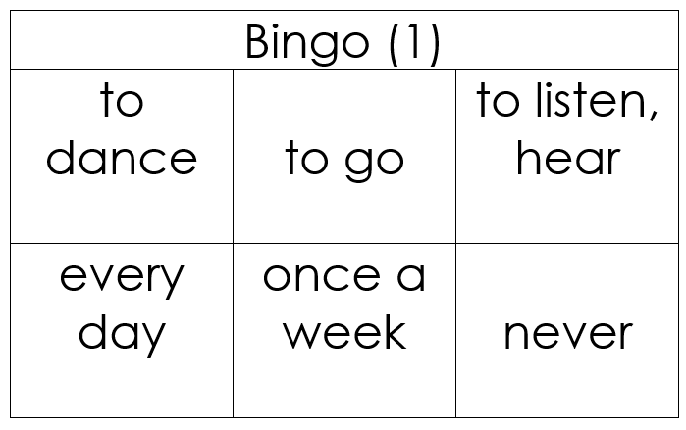
Vokabeln
hören / lesen
Ich gewinne!
Ich gewinne!
Notes:
Timing: 3 minutes Aim: To explain the rules of the Bingo game (English-German version, for additional vocabulary practice).
Procedure: 1. Teacher distributes the Bingo cards included as supplementary materials this week. (The cards are double-sided, and there are three cards per page, so each printed sheet must be folded as instructed and cut into three). If teachers prefer, they can give students scrap paper, they can draw three 3x2 tables (for 3 rounds of the game) and select their own words from the vocabulary set, writing the English on one side and replicate the 3 x 2 tables with German words on the reverse.
2. Depending on the class ability, teachers may choose to display or not to display the German words in the list. (The final slide in this lesson gives a list of the vocabulary from this week with the option to obscure the German words).
3. Tell students to begin with the English side up. The teacher reads German words at random from this week’s vocabulary list.
4. Students cross off the words they hear. When a student has crossed of all of his/her words, they use the German interjection ‘Ich gewinne!’ to indicate that they win. Gewinnen (infinitive) is a cluster word from 1.1.5, recycled here, in the first person singular. Ensure that students are clear about the meaning and that they can explain the verb ending change.
Note: As there are only 10 words on this week’s vocabulary list, the game will not last very long! It is highly like that one or more students will win after only 6 words have been called. For that reason, it is suggested that at least three rounds are played for additional practice.

Slide 34
Frage oder Satz?
hören
Zorg is making observations about Wolfgang. He can produce a lot of words, but lacks intonation (and manners!)
Is Zorg asking a question or making a statement? Write ? or .
?
.
C
?
A
B
.
.
?
D
E
F
.
?
I
?
G
H
Transcript: d) Du tanzt nicht so gut
Notes:
Timing: 5 minutes
Aim: To revisit the VSO syntax of questions vs SVO of statements.
Note: This slide is the full task slide.
Procedure: 1. Click on the audio buttons to play each recording. The voice is robotic and has flat intonation, to remove this clue as to whether each sentence is a question or a statement.
2. Students can complete the activity by writing e.g. A) ?/ . in their exercise books.
3. Click to bring up the answers one by one. Teacher elicits responses by asking ‘Ist A eine Frage oder ein Satz?’ (‘A ist eine Frage … B ist ein Satz …’)
Transcript:
a) Hörst du jeden Tag das Lied
b) Du arbeitest kaum im Garten
c) Putzt du manchmal das Auto
d) Du tanzt nicht so gut
e) Du sitzt oft zu Hause am Computer
f) Gehst du nie in den Garten
g) Du redest sehr oft im Unterricht
h) Lernst du manchmal in der Schule
i) Spielst du nie mit Freunden Fußball

Slide 35
Wie oft machst du das?
Oft, kaum, nicht etc. are adverbs. They come directly after the verb.
sprechen
Frag einen Partner oder eine Partnerin!
Beispiel: “Wie oft spielst du am Computer?” “Ich spiele kaum am Computer.”
oft
manchmal
kaum
nie
einmal die Woche
jeden Tag
Notes:
Timing: 6 minutes Aim: To practise distiguishing between the first and second person singular forms of the verb (speaking).
Note: This version of the speaking task expects students to generate the correct question with no verbal support at all. There is an alternative version on the next slide, which gives the infinitive phrase. That version still requires students to use the correct verb form and question syntax.
Procedure: 1. This slide can be printed and given to pupils, or they can quickly sketch a table in their workbooks.
2. Students know the noun Frage (1.2.6), but have not encountered the verb form, fragen. Teacher to ask students what they think the instruction means and make the connection with Frage.
3. In this oral exercise, students ask a partner how often they do the pictured activities, and tick the appropriate box. 3. On completion, first, second and third person forms can be brought together through teacher elicitation of responses, e.g. ‘Wie oft spielt Mary Computer? Mary spielt kaum Computer’. ‘Wer kocht manchmal?’ ‘Sally kocht manchmal’ etc.

Slide 36
Fragen
schreiben
You now know a lot of verbs! Here they are on one slide.
What questions could you ask German students (about home or school) using these verbs? Schreib 5 Fragen.
schreiben
machen
singen
hören
haben
putzen
sein
spielen
gehen
kochen
reden
sitzen
wohnen
sagen
arbeiten
lernen
tanzen
Notes:
Timing: 20 minutes Aim: To revise the infinitive form of all verbs learned so far.
Procedure: 1. Click to bring up the verbs one by one, eliciting the English meaning of each from the students. The final click brings up the main task instruction.
2. Students prepare a survey with questions that they could send to a partner school (where there is a partner school, they should actually do this). First each student writes 5 questions individually.
3. Then they pair up and ensure that they have 10 different ones between them.
4. Then they join with another pair, and decide on the best 10 questions overall, eliminating those they think aren't as interesting.
5. On the slide that follows, the teacher gathers 20 different questions to put as survey to a German class (real or hypothetical).

Slide 37
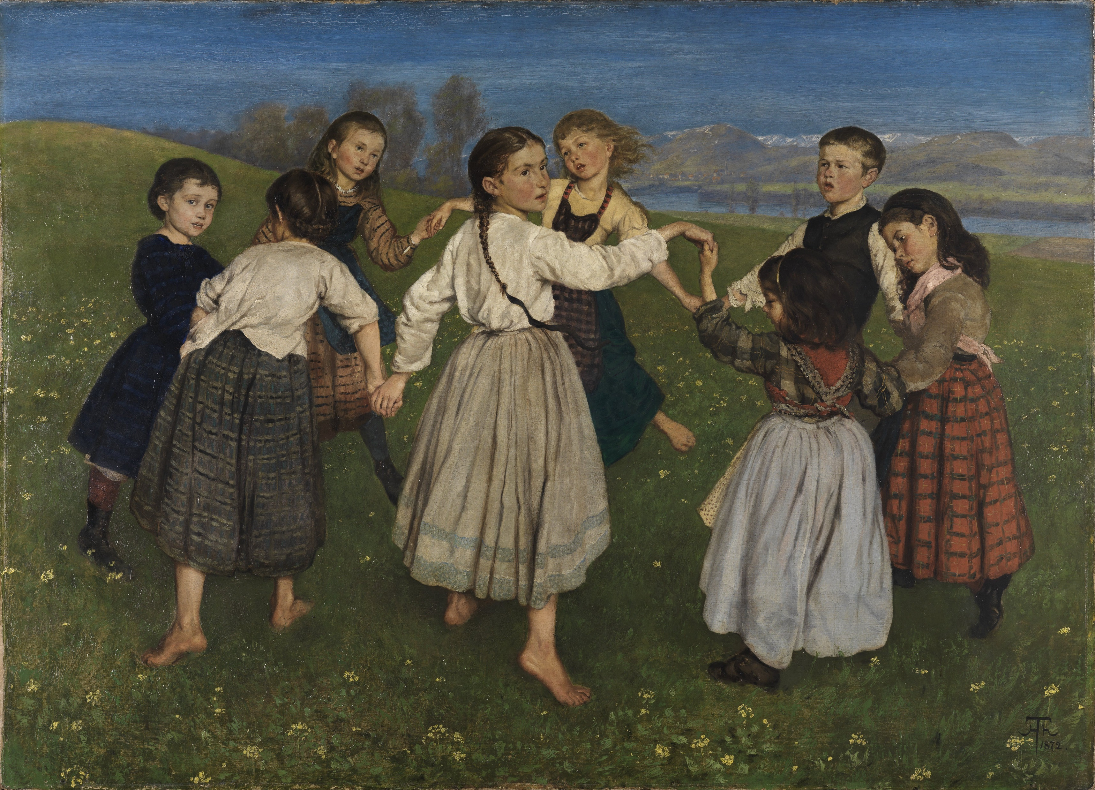
Schmückt den Saal mit grünen Zweigen! Fa-la-la-la-la-la-la-la-la!
sprechen
schmücken – to decorate der Saal – the hall
Tretet an zum bunten Reigen!
Fa-la-la-la-la-la-la-la-la!
Auf und nieder, immer wieder!
Fa-la-la-la-la-la-la-la-la!
Singt die alten Weihnachtslieder!
Fa-la-la-la-la-la-la-la-la!
der Reigen
Was ist das?
Was sind Weihnachtslieder?
Notes:
Here a lesson about Christmas-themed plural nouns. The phonics focus is [ei] and [ie] a pair of phonemes that are often contrasted for practice.
We use the opportunity to revisit and elicit orally the verb ‘tanzen’ in this content.
ii. Click again to bring up the picture of a Reigen (circle dance) and ask Was ist das? Tanzen is a previously taught word that we are revisiting this week, so if students automatically say ‘dance, or dancing’ then prompt them again to provide the German word. …………………………….
Timing: 3 minutes Aim: Practising phonics [ei] and [ie] in an authentic text.
Note: lesson two includes a more detailed Christmas song covering the same SSCs. Depending on available time and how the students are getting on with these particular SSCs this activity could be left out.
Procedure: 1. Highlight the 'ei’ / 'ie’ SSCs in the text lines by line.
2. Students repeat out loud. 3. Now sing the song together (Melody is Deck the Halls):
Schmückt den Saal mit grünen Zweigen! Fa-la-la-la-la-la-la-la-la!
Tretet an zum bunten Reigen!
Fa-la-la-la-la-la-la-la-la!
Auf und nieder, immer wieder!
Fa-la-la-la-la-la-la-la-la!
Singt die alten Weihnachtslieder!
Fa-la-la-la-la-la-la-la-la!
4. Provide further cultural and linguistic information about the song. i. Click once to provide the glosses for the first line and elicit the meaning of the first line of the song. Decorate the hall with green branches. Compare briefly with the English original: Deck the halls with boughs of holly. If students know this carol they may never have thought about the meaning of these quite archaic words! ii. Click again to bring up the picture of a Reigen (circle dance) and ask Was ist das? Tanzen is a previously taught word that we are revisiting this week, so if students automatically say ‘dance, or dancing’ then prompt them again to provide the German word. You might want to add that many western cultures (Germany and England, included) have traditional folk circle dances that originate from Greece. iii. Click for the 3rd call out and prompt students to tell you the meaning of Weihnachtslieder. They were introduced to the word Weihnachten, and several Weihnachts- compounds at the start of the lesson. They know Lied from 7.1.1.7. Although –er plurals are not a focus this week, it is likely that students will recognise the singular form and realise that it is plural, here. You can tell them that this is a different plural ending that they will learn later.
Picture attribution: Hans Thoma, Public domain, via Wikimedia Commons
Origin of the song Deck the Halls:
1866. Other “Nos Galan” lyrics were written by John Ceiriog Hughes (1832-1887), ca. 1873. Tune: Nos Galan (“New Year's Eve”) from John Thomas's Welsh Melodies with Welsh and English Poetry; this series by Thomas was a collaboration with John Talhaiarn Jones and Thomas Oliphant.

Slide 38
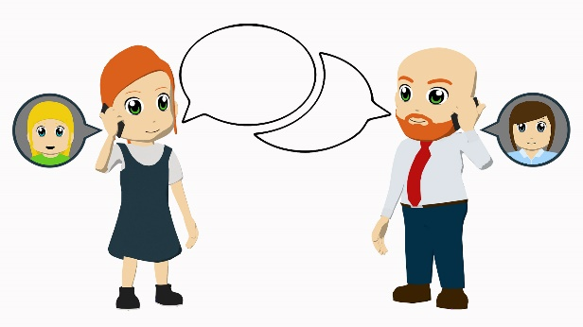
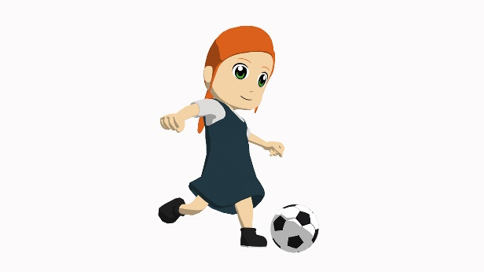
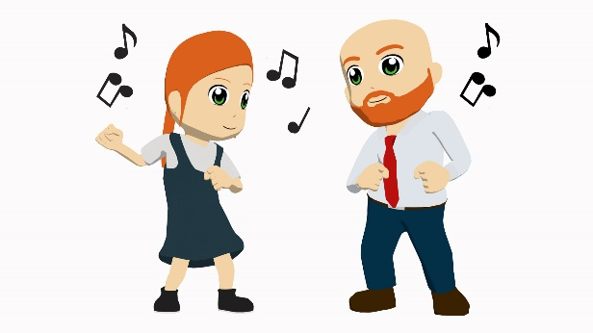
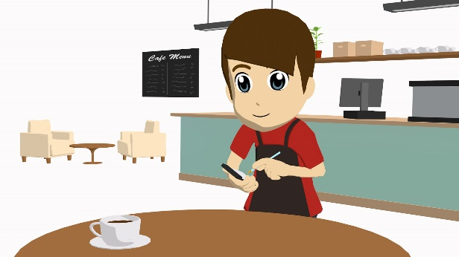
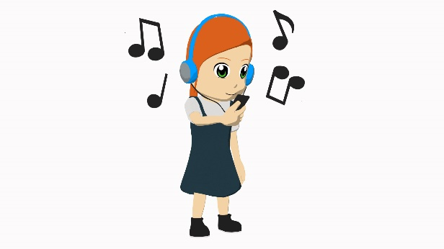
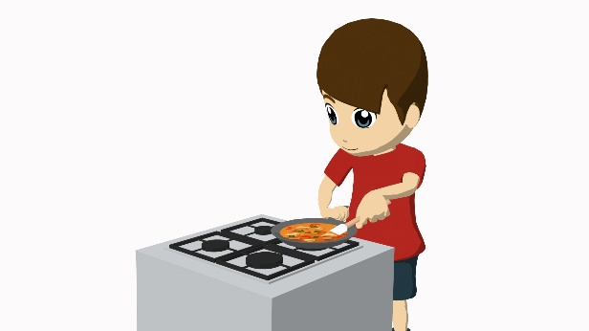
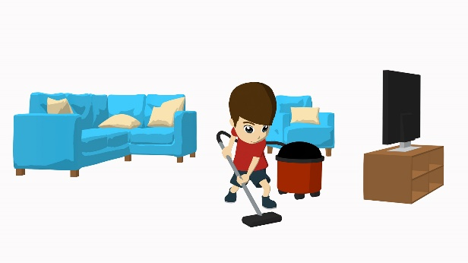
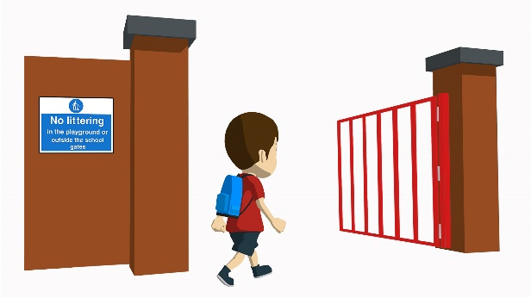
Vokabeln
lesen
hören
tanzen
spielen
arbeiten
schreiben
reden
kochen
putzen
gehen
lernen
Notes:
Timing: 5 minutes
Aim: To revisit weak verbs in first, second, and third person singular.
Note: This starter refreshes 10 of the weak verbs they already know and can be used in the question generating activity in lesson 2.
Procedure: 1. Click to bring up the pictures, one at a time.
2. Students say which verb from the list corresponds to the picture.
3. Click to confirm, by crossing out that verb.
4. Continue until all verbs/pictures have been used.

Slide 39
Hedy Lamarr
lesen / sprechen
Mein Name ist Hedy Lamarr. Ich komme aus Österreich, aber ich lebe in den USA. Ich spiele und tanze in Filmen und habe einen Stern auf dem Hollywood Walk of Fame. 2014 bekomme ich auch einen Platz in der National Inventors Hall of Fame.
Ich mag Technik und man benutzt* meine Technologien im WLan und Bluetooth.
*benutzen - to use
Notes:
Hedy Lamarr - https://en.wikipedia.org/wiki/Hedy_Lamarr
Word frequency (1 is the most frequent word in German):
benutzen [872]
Source: Jones, R.L & Tschirner, E. (2011). A frequency dictionary of German: Core vocabulary for learners. London: Routledge.

Slide 40
Who never dances?
Schreib auf Deutsch
schreiben
Wie can mean how:
Wie geht’s? Gut, danke.
Wie can mean what like:
Wie ist der Mann? Er ist groß.
Here we get wie instead of was:
Wie heißt du? (What are you called?)
1
Wer tanzt nie?
2
How do you write that?
Wie schreibt man das?
3
Are you going home?
Gehst du nach Hause?
4
What do you cook often?
Was kochst du oft?
5
Do you work every day?
Arbeitest du jeden Tag?
6
Where do you live now?
Wo wohnst du jetzt?
Fill in the correct question word:
Wie heißt du?
7
___
Notes:
Timing: 10 minutes
Aim: To provide translation practice (English to German).
Note: In this activity we revisit asking open and closed questions using the words revisited in the vocab starter. Students translate the English questions into German. They practise question formation as well as producing second person singular (du) verb forms. Du-questions will come back in the dictagloss task that follows. Translation is useful to draw attention to the do-auxiliary in English, which does not exist in German.
Procedure: 1. Click to bring up the English sentences for translation into German, one by one.
2. Students attempt to translate each sentence into German.
3. The second round of clicks brings up a suggested translation for each sentence.
4. The final round of clicks brings up an additional question, eliciting the question word ‘wie?’ – see note below.
Note: heißen – now that we have introduced this verb, it would be usual for students to learn how to use to ask others’ names. They haven’t yet done this, so won’t know that the question is ‘Wie’ not ‘Was’ We flag this explicitly, here, with a note that recaps the prototypical meaning of ‘wie’ and how students have used it, plus the ‘what like’ meaning:
Ie. Wie geht’s ? Gut, danke Wie ist der Mann? Er is groß. Then we add a further meaning – Wie instead of Was, to mean ‘what’. Wie heißt du? What are you called? (literally ‘how (do) you call you?’).

Slide 41
Exklusives Interview!
hören / schreiben / sprechen
PAPA SCHLUMPF: “ICH LERNE JAPANISCH”
Hör jetzt das exklusive Interview an!
Notes:
Timing: 25 minutes
Aim: To provide a dictagloss – Interview mit Papa Schlumpf.
Note: This is a dictagloss activity where students reconstruct a text from notes about an interview they have listened to. The text is designed to practise verbs forms in the first, second, and third person singular beyond sentence level. The vocabulary items have been encountered before or are cognates. The vocab starters and content of lesson one will have refreshed students’ memory. An alternative version using slightly more complex language is available on the NCELP Resource Portal.
Procedure:
Students write 1-10 in their notebooks with plenty of space for each point.
Students listen to the interview and take notes about each question and answer.
Play the interview again if necessary. How many times is up depends on the class and ability level and is up to the teacher’s judgment.
Based on the notes students reconstruct the dialogue (could be done in pairs).
In pairs students perform the dialogue, as read aloud from their own script.
A transcript is provided over the next two slides, for checking.

Slide 42
Transcript
hören
Was sind deine Hobbys?
Ich mag reisen und ich reise oft. Ich sitze oder liege auch manchmal im Wald und denke an das Leben.
Hast du Familie?
Ja. Ich habe auch einen Freund. Er heißt Hiro. Er wohnt leider in Japan, aber wir reden oft.
Was ist deine Lieblingsfarbe?
Es gibt viel Blau in meiner Welt. Aber Blau ist langweilig. Ich mag Schwarz sehr!
Wie viele Schlümpfe gibt es?
Ich glaube, es gibt rund eine Million, aber ich weiß es nicht! Ein Schlumpf kocht, ein Schlumpf putzt, ein Schlumpf tanzt...
Arbeitest du jeden Tag?
Ja, ich arbeite viel, aber ich mag das. Es gibt viele Schlümpfe und sie haben viele Fragen.
Notes:
Transcript dictagloss for checking.

Slide 43
Transcript
hören
Was magst du nicht?
Ich mag Hunde nicht.
Was machst du jeden Tag?
Ich gehe jeden Tag in den Wald. Ich mache Yoga, ich tanze, und ich gehe wieder nach Hause.
Verstehst du Fremdsprachen?
Ich spreche Schlümpfisch, aber ich verstehe auch sehr gut Deutsch. Ich lerne jetzt Japanisch und ich gehe einmal die Woche in die Schule.
Hörst du Musik?
Ja, aber ich habe leider kaum Zeit.
Was gibt es auf deiner ‘Bucketliste’?
Ich denke manchmal: “Ich schreibe ein Buch!”, aber ich weiß nicht.
Notes:
Transcript dictagloss for checking.

Slide 44
Beschreib das Bild
sprechen
Wie sagt man das?
1. The five friends are at a concert. 2. They have already heard a great band. 3. The music was really good. 4. They danced and sang a lot. 5. A new band begins to play. 6. Heidi is going to dance again.
Notes:
Timing: 3 minutes
Aim: To practise oral production of a range of revisited structures, including present, future, perfect and imperfect tenses. Procedure: 1. Students describe the photo in German, translating the English sentences into German.
2. Suggested answers are on the next slide. Note: Some classes may need teacher scaffolding through this task.

Slide 45
Antworten
sprechen
Wie sagt man das?
1. The five friends are at a concert.
2. They have already heard a great band.
3. The music was really good.
4. They danced and sang a lot.
5. A new band begins to play.
6. Heidi is going to dance again.
1. Die fünf Freunde sind auf einem Konzert.
2. Sie haben schon eine tolle Band gehört.
3. Die Musik war wirklich/sehr gut.
4. Sie haben viel getanzt und gesungen.
5. Eine neue Band beginnt zu spielen.
6. Heidi wird noch einmal tanzen.
Notes:
Timing: 2 minutes
Aim: To provide the answers to the activity on the previous slide.
Procedure: 1. Click to bring up the suggested answers one by one.
Word frequency of unknown words (1 is the most frequent word in German):
Band [>5000] Source: Jones, R.L & Tschirner, E. (2019). A frequency dictionary of German: Core vocabulary for learners. London: Routledge.

Slide 46
Ein Interview mit Mia
lesen / schreiben
1
1: Hallo, wie geht’s?
Mia: Gut, danke.
2: Wie heißt du?
Mia: Ich heiße Mia.
3: Seit wann bist du hier?
Mia: Ich bin seit gestern Abend hier.
4: Welche Bands hast du schon gehört?
Mia: Ich habe schon die Bands Mondlicht und Terraforming gehört.
5: Wie hast du sie gefunden?
Mia: Ich habe sie ganz toll gefunden. Mondlicht ist meine Lieblingsband.
6: Spielst du ein Instrument?
Mia: Ja, ich spiele Klarinette und ich habe früher in einem Chor gesungen.
7: Wann hast du mit der Klarinette angefangen?
Mia: Ich habe vor drei Jahren mit der Klarinette angefangen.
8: Hörst du lieber klassische Musik oder Popmusik?
Mia: Ich höre lieber Popmusik, aber ich spiele lieber klassische Musik.
9: Was wirst du heute noch machen?
Mia: Heute werde ich noch viele Bands hören und vielleicht auch tanzen!
Was hat der Interviewer gefragt? Schreib die Fragen (1-9) auf.
2
3
4
5
6
7
8
9
Notes:
Timing: 6 minutes Aim: To practise question formation. Procedure:
1. Students read each answer and attempt to provide the question that would have elicited it.
2. Click to make the correct questions appear one by one. 3. For reinforcement, click the numbered buttons to hear the questions. Alternatively, take part in the full interview, using the player (bottom right of the slide). The questions are heard one by one, with a space for answering. Students can do this, chorally, to practise reading aloud for fluency.
Word frequency of cognate words (1 is the most frequent word in German):
Band [>5000]
Source: Jones, R.L & Tschirner, E. (2019). A frequency dictionary of German: Core vocabulary for learners. London: Routledge.

Slide 47
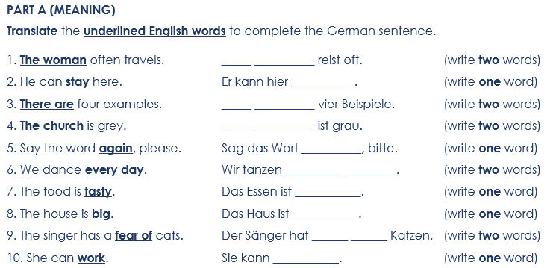
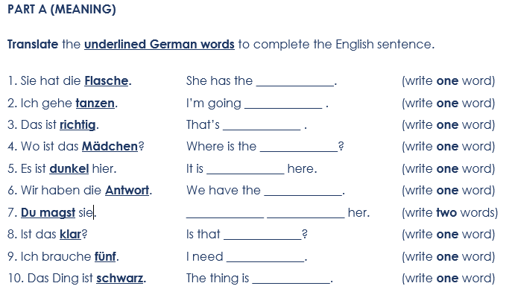
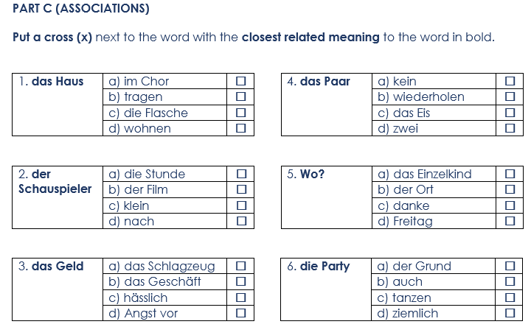
Assessments
7.2.1.6 achievement: vocab (R)
7.2.1.6 achievement: vocab (W)
7.3.2.2 achievement: vocab (R)

Slide 48
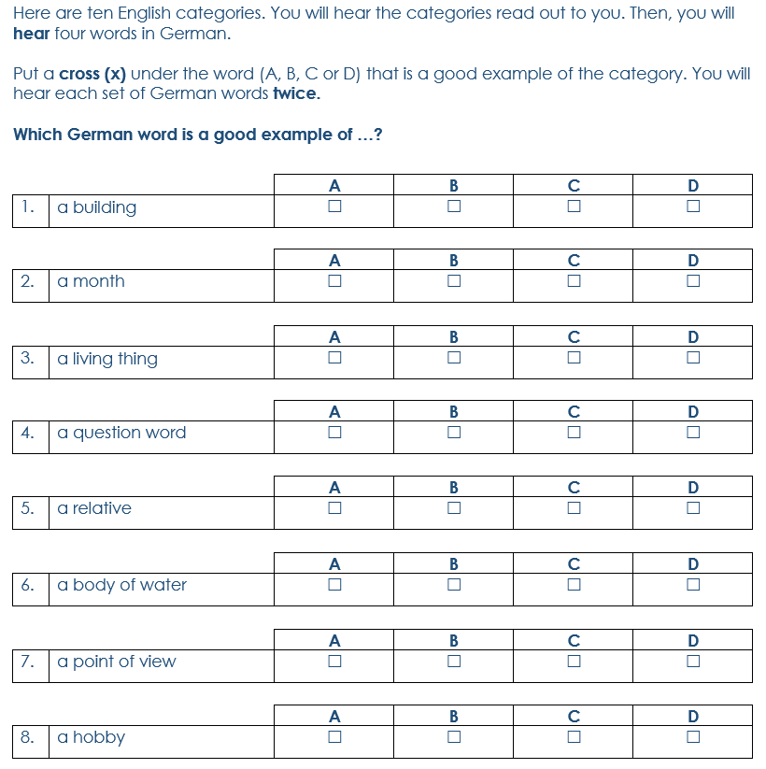
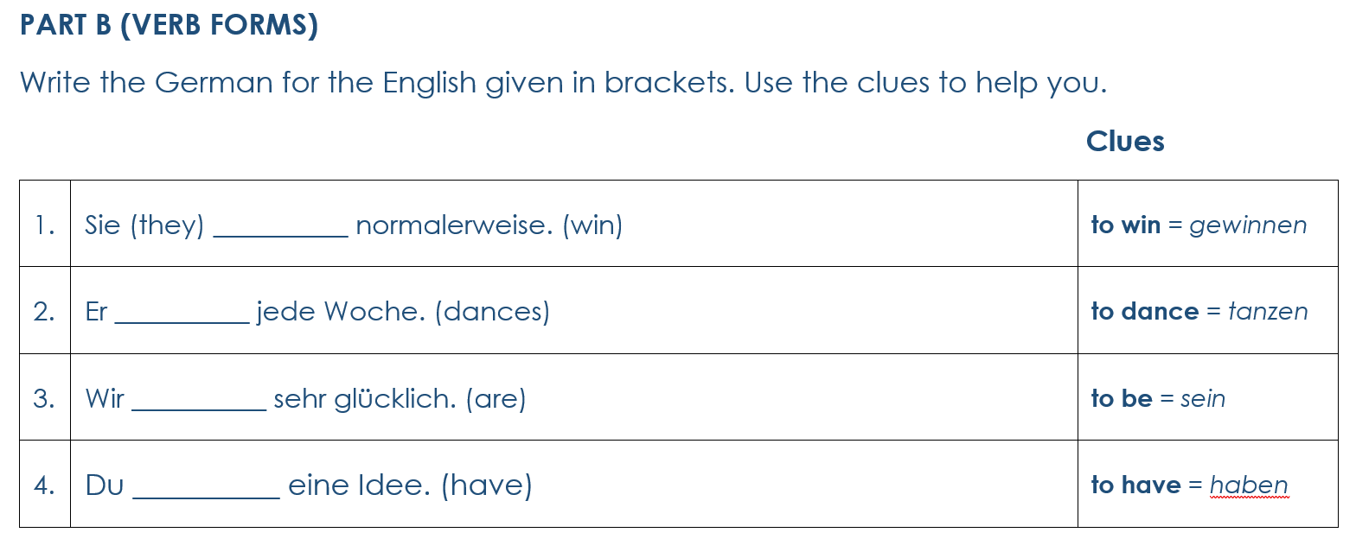
Assessments
8.2.1.4 achievement: grammar (W)
8.2.1.4 achievement: vocab (L)
Transcript: 8. A – wollen B – danken C – das Beispiel D – tanzen

Slide 49
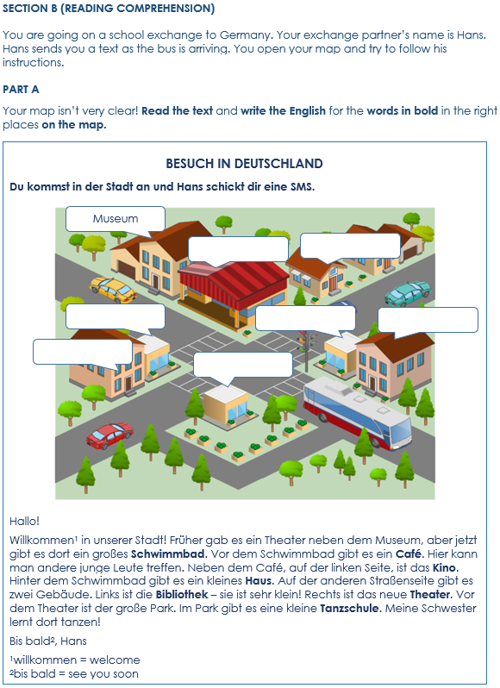
Assessments
8.3.2.3 applying knowledge (R)
8.3.2.3 achievement: grammar (S)

Slide 50
Assessments
9.1.2.5 achievement: grammar (R)

Slide 51
Phonetik
lesen / schreiben
Schreib 1-18 und ein Wort mit jeder SSC.
wenig
einkaufen
häufig
aussehen
[ig]
manchmal
wünschen
[ei]
[äu]
[au]
[ch]
viel
[w]
Start
[v]
Sport
Konzert
[sp]
anschauen
stattfinden
[z]
versprechen
studieren
[sch]
[ie]
[st]
kurzes [e]
aufstehen
Universität
planen
aufhören
kurzes [a]
langes [e]
langes[ä]
langes [a]
langes [ö]
Ziel
tanzen
häufig | versprechen | aufstehen | einkaufen | manchmal | studieren
anschauen | viel | Sport | stattfinden | aufhören | wenig
Universität | tanzen | aussehen | planen | wünschen | Konzert
Notes:
Note: Students can start this task without teacher input, as an Auftakt task.
Timing: 8 minutes, including feedback Aim: to consolidate knowledge of 18 different SSC within previously taught vocabulary, and additionally to recall further words with these SSC. Procedure: 1. Write 1-18 and a word from the table with that SSC.
2. Ensure that students know that they should try to use all the words just once each.
3. Challenge them to add a 2nd word with the same SSC from their own vocabulary knowledge.
4. Elicit the answers from students, providing a further opportunity to produce the words orally.

Slide 52
Welche Kategorie ist das?
lesen
What connects the following lists of words?
1. | Rad fahren | klettern | fangen
2. | oft | häufig | viel
3. | nicht | wenig | kaum
4. | gut | ich mag | ich wünsche mir
5. | zuhören | Konzert | tanzen
6. | bekommen | danken | Geschenk
Sport
a lot
not a lot
positive
music
gift giving
Notes:
Timing: 3 minutes
Aim: to categorise semantically 18 items from this week’s revisited vocabulary set.
Procedure:
Students use knowledge of meaning to identify a connecting theme, which they can state in English.
Click to reveal the answers. Note: there is more than one possible answer in each case. Accept any reasonable suggestion.

Slide 53
Neujahrsvorsätze
sprechen
Person A liest ihren Text vor. Person B macht Notizen. Welche Wörter sind anders?
annehmen
laufen x2
tanzen
schwer
einmal
lernen
Meine Schwester |wünscht sich|, nächstes Jahr Sport an der |Universität| zu studieren. Sie hat also eine Liste mit diesen |Neujahrsvorsätzen*| geschrieben.
Sie mag|Konzerte|, aber dieses Jahr wird sie wohl* |kaum| zu einem gehen. Sie wird lieber früh aufstehen und vor der Schule |Rad fahren|. Musik kann sie dann beim |Laufen| hören. Sie plant auch, |häufig|klettern| zu gehen - mindestens |zweimal| pro Woche. |Klettern| ist gut für die Muskeln, und sie |will|gesund aussehen! Sie verspricht, sie wird |aufhören so viel|Kaffee| zu trinken, obwohl sie das |relativ| schwierig finden wird! Das ist ganz schön*|viel|, aber sie will so gerne einen Platz an der |Universität|bekommen|.
Tee
Akademie x2
manchmal
will
sehr
nicht
möchte
weniger
Ideen
Museen
Which other words did you need to change?
*Neujahrsvorsätze – New Year’s Resolutions *wohl – probably |*ganz schön – quite
Notes:
Timing: 9 minutes (2 slides) Aim: i) to review the homework task.
ii) to develop fluency in decoding by reading aloud the student versions, adapted for homework. iii) to listen attentively, noting differences in the original text. iv) to make judgements about the replacements made by a peer, and engage in peer feedback. Procedure: 1. Student A reads his/her adapted HW text. 2. Student B follows along with the original and makes a note of any substituted words s/he hears (on his/her copy of the HW sheet)
3. Swap roles.
4. Compare and contrast the two versions. Scrutinise any differences and offer opinions about the correctness of the choices.
5. Move to the next slide, which has a possible answer version, using all of the viable words. Note: the HW task set a time limit and asked students to try to replace at least ten of the words, so it’s to be expected that they might not have got them all.

Slide 54
Vokabeln [4/4]
lesen / sprechen
Person B
Sie wird eine Liste…
Person A
anschauen
wünscht
suchen
magst
gefangen
bekommen
kaum schreiben
relativ gut finden
klettern
tanzt
Notes:
[4/4]

Slide 55
Bindewörter (conjunctions)
Grammatik
You know that some conjunctions kick the verb to the end of the clause:
Other conjunctions do not change the word order:
This is word order 3 (WO3).
This is word order 1 (WO1).
Wir feiern, weil es Spaß macht.
Wir feiern, denn es macht Spaß.
We celebrate because it’s fun.
We celebrate because it’s fun.
Wir kommen, obwohl es lange dauert.
Wir kommen, aber es dauert lange.
We are coming, although it takes a long time.
We are coming but it takes a long time.
Wir kochen, während wir uns unterhalten.
Wir kochen und wir unterhalten uns.
We cook whilst we chat.
We cook and we chat.
Wir glauben, dass es wichtig ist.
Wir glauben, [-] es ist wichtig.
We believe that it’s important.
We believe it’s important.
Wir tanzen, wenn es Musik gibt.
Wir tanzen, denn es gibt Musik.
We dance if/when there’s music.
We dance because/as there’s music.
Notes:
Timing: 2 minutes Aim: to recap some previously taught WO1 and WO3 conjunctions and compare the syntax.
Procedure: 1. Click to present the information. 2. Elicit English meanings.

Slide 56
Vokabeln
Wie heißen die Wörter auf Deutsch?
sprechen / schreiben
1
hardly
6
relatively
11
to search
16
concert
kaum
relativ
suchen
das Konzert
?
?
?
?
2
to catch
7
I wish for
12
to arrive
17
to dance
fangen
ich wünsche mir
ankommen
tanzen
?
?
?
?
3
to watch, look at
8
to appear, look
13
to climb
18
to promise
anschauen
aussehen
klettern
versprechen
?
?
?
?
4
to get up
9
to thank
14
to put, place
19
per
aufstehen
danken
stellen
pro
?
?
?
?
5
to take place
10
list
15
frequent
20
to accept
stattfinden
die Liste
häufig
annehmen
?
?
?
?
Notes:
Timing: 5 minutes (or fewer, depending on activities chosen) Aim: to revisit vocabulary from this week’s sets in spoken and/or written production. Procedure: 1. Elicit German for English words orally from the class. Note: the answer animations are triggers to allow feedback to be led by student responses.
2. If desired, then slide could be re-presented as a written activity, which could have a time limit. For example, students could be challenged to write as many German meanings as possible within one minute. This allows differentiation by outcome.

Slide 57
Ein neuer Start
schreiben
Beschreib deine Pläne und Ziele für das neue Jahr. Du kannst diese Ideen oder deine eigenen Ideen benutzen.
Schreib acht Sätze und benutze die Konjunktionen.
andere(-r,-s) Hobby suchen
denn etwas Neues lernen
Er/sie trinkt keinen Kaffee, weil….
Rad fahren oder tanzen lernen
Universität studieren wenn gut Schule möchte
obwohl Schokolade mag aufhören essen
WO3 | WO 1
weil | und
dass | denn
wenn | oder
obwohl | aber
Er/sie trinkt keinen Kaffee, weil….
gut Fragen stellen und Hausaufgaben machen
früh aufstehen aber versprechen mehr schlafen
denken dass häufig Sport machen
wenig Kaffee weil relativ ungesund
Try to use WO3 with some one-verb and two-verb structures.
Notes:
Timing: 15 mins (2 minutes to begin in class, finished at home). Aim: to practise the use of conjunctions in the written modality. A writing task where students can either create plans/goals from the suggested words or select their own words to complete a set of sentences using a different conjunction each time. Procedure:
1. Explain the two options for the task. 2. Ensure that the task is fully understood.

Slide 58
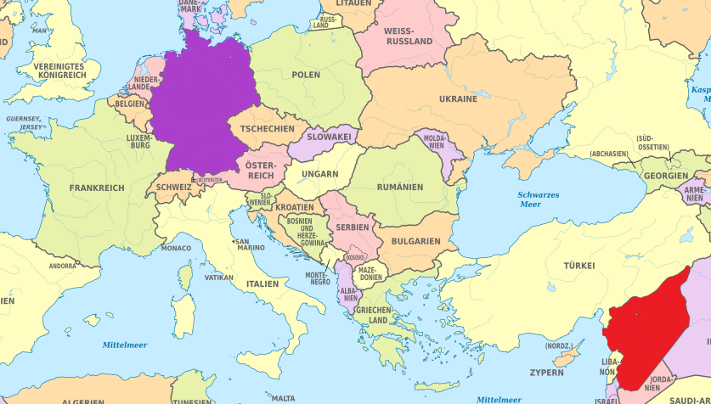
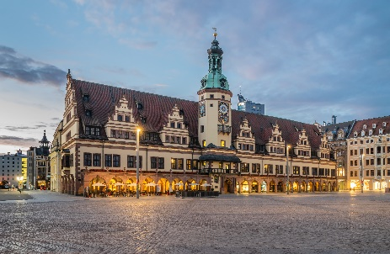
Adel Karasholi
*die Heimat – homeland
Deutschland
lesen / sprechen
Adel Karasholi ist ein Dichter aus Syrien. Seine Familie ist kurdisch. Er wurde 1936 in Syrien geboren. Als Dichter und Journalist hatte er in seiner Heimat* zu wenig Freiheit. 1961 ist er nach Leipzig in Deutschland gekommen. Er hat dort Deutsch studiert und eine Doktorarbeit geschrieben. Er schreibt Gedichte auf Deutsch.
Sein Gedicht ‘Seiltanz’ gehört zum Genre ‘Migrationsliteratur’.
1936
zu wenig Freiheit
1961
Leipzig
Deutsch
Syrien
Osten
1. Wo liegt Syrien – im Westen oder im Osten?
2. Wann wurde Adel Karasholi geboren?
3. Warum hat er Syrien verlassen?
4. Wie alt war er, als er nach Deutschland gefahren ist?
5. Wo und was hat er in Deutschland studiert?
6. In welcher Sprache schreibt er Gedichte?
7. Was ist „Migrationsliteratur“, deiner Meinung nach?
Deutsch
25 Jahre alt
Literatur mit dem Thema ‘Migration’
Notes:
Timing: 8 minutes
Aim: to practise written comprehension of the previous phonics text and to answer written questions orally.
Procedure: 1. Students check their phonics transcriptions against the full text on this slide.
2. Then students read the text and consider answers to the questions. 3. Teachers elicit responses to the questions from students, orally.
4. Teachers click to show answers within the text.
5. Teachers click to bring up a call out about Leipzig.
Attribution: Krzysztof Golik, CC BY-SA 4.0, via Wikimedia Commons
Word frequency of unknown words and cognates (1 is the most frequent word in German): Doktor [240] Genre [>5009] Heimat [1305] Journalist [1480] kurdisch [>5009] Literatur [913] Migration [4123] Source: Jones, R.L. & Tschirner, E. (2019). A frequency dictionary of German: core vocabulary for learners. Routledge

Slide 59
das Gedicht Seiltanz
das Seil – rope/tightrope
Bevor ihr das Gedicht Seiltanz lest, guckt diesen Kurzfilm an.
Was macht die Person auf dem Seil?
1 | fahren
2 | laufen
3 | tanzen
4 | gehen
Lyell Grunberg
Adi Holzer
Notes:
Timing: 2 minutes Aim: to establish the context for the poem students will read; to make students think about the central motif of the poem (tightrope walking) and to stimulate interest in it. Procedure: 1. Click to play the video clip from 1:00 to 1:30 to show high slacklining above a beach.
2. Establish that the activity is called Seiltanzen.
3. Use the multiple choice options to draw out the cross-linguistic difference between Seiltanzen and tightrope walking.
4. Ask students which verb they think better describes the activity, as they saw it in the film clip.
Video attribution: Lyell Grunberg. https://www.youtube.com/watch?v=6Qfj8Po9org
Image attribution: Adi Holzer, Attribution, via Wikimedia Commons

Slide 60
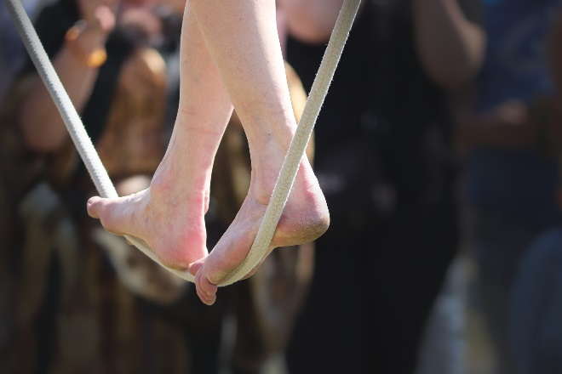
Seiltanz – Adel Karasholi
hören
Hör zu. Schreib die Wörter, die fehlen.
Und also sprach Abdulla zu mir Fremde ist zu deiner Rechten Und zu deiner Linken ist Fremde Denn du tanzt auf einem Seil Und er sprach Die Frage steht der Frage im Wege Die Antwort der Antwort desgleichen Denn du tanzt auf einem Seil
1
_______
2
_______
_______
Und er sprach Weder der Osten ist Osten Noch der Westen Westen in dir Denn du tanzt auf einem Seil Und er sprach Schließe deine Augen Und laufe so schnell du laufen kannst Denn du tanzt auf einem Seil
3
7
_______
8
______
4
_______
9
_______
5
_______
6
_____
10
_______
11
_______
12
_____
Notes:
Timing: 5 minutes Aim: to provide students with their first encounter with the poem text; to help students to connect the spoken and written forms of the language more securely; to practise transcribing a mixture of familiar and unfamiliar language. Procedure: 1. Students number 1-12.
2. Click to play audio.
3. Students transcribe the 12 missing words.
4. Click to check answers. 5. Note that the next two slides support students to unpack the meaning of the text.
Transcript: Und also sprach Abdulla zu mir Fremde ist zu deiner Rechten Und zu deiner Linken ist Fremde Denn du tanzt auf einem Seil Und er sprach Die Frage steht der Frage im Wege Die Antwort der Antwort desgleichen Denn du tanzt auf einem Seil
Und er sprach Weder der Osten ist Osten Noch der Westen Westen in dir Denn du tanzt auf einem Seil Und er sprach Schließe deine Augen Und laufe so schnell du laufen kannst Denn du tanzt auf einem Seil
Note: 94.4% of words used in this poem stem from word families with a high frequency. The only words not in top 2000 are das Seil and desgleichen (likewise).
Poem attribution: Permission to use this poem was granted by the author for a previous non-for-profit educational languages project. Multiple attempts were made to contact the author to obtain similar permissions for use of the poem in this resource but we have, to date, been unable to contact him.
Word frequency of unknown words and cognates (1 is the most frequent word in German): Seil [4925] desgleichen [>5009] Source: Jones, R.L. & Tschirner, E. (2019). A frequency dictionary of German: core vocabulary for learners. Routledge

Slide 61
Was symbolisiert Seiltanzen für den Dichter?
sprechen
Risiko
Wähle fünf Wörter aus. Vergleiche* sie mit einem/er Partner*in.
Schwierigkeit
Konflikt
Angst
Gefahr
Sicherheit
Balanceakt
Harmonie
Wirklichkeit
Freiheit
Freude
Glück
vergleichen – to compare
Lustigkeit
Adi Holzer
Notes:
Timing: 5 minutes Aim: to deepen vocabulary knowledge by considering word meanings for their symbolic association with tightrope walking; to consider and empathise with the experiences of the poet as expressed in the poem. Procedure: 1. Students first select the five words that in their view best capture the metaphor of tightrope walking for the poet. Make it clear that they need to be considering the poet’s life experiences and what he was trying to express.
2. In pairs, students compare their choices, reading aloud and working out the overlap. They should try to agree one final list between them. For this, they can use German: Ich denke, Risiko ist besser als Angst. Ja, ok. Nein, das ist nicht wahr, usw.
3. If time allows, students could select the five words that best represent tightrope walking for them personally. This list may be both different from the poet’s and from each other’s.
Word frequency of unknown words and cognates (1 is the most frequent word in German): Balanceakt [>5009] Harmonie [>5009] Konflikt [1414] Source: Jones, R.L. & Tschirner, E. (2019). A frequency dictionary of German: core vocabulary for learners. Routledge
Image attribution: Adi Holzer, Attribution, via Wikimedia Commons

Slide 62
Der Seiltanz von Migranten
lesen
Der Seiltanz symbolisiert ein Balanceakt zwischen zwei Welten. Kategorisiere die Wörter.
Syrien | Deutschland | Westen | Osten | Gegenwart | Vergangenheit | Freiheit | Krieg | Gefahr | Risiko | Sicherheit | Familie | Kindheit | Muttersprache | Fremdsprache | Zukunft |Arbeit | unbekannt | fremd | Freunde | frei |
Syrien
Deutschland
Osten
Westen
Gegenwart
Vergangenheit
Freiheit?
Sicherheit?
Krieg
Gefahr
Risiko
Fremdsprache
Familie
Kindheit
Zukunft
unbekannt
Arbeit
Muttersprache
fremd
frei?
Freunde
Notes:
OPTIONAL ADDITIONAL TASK
Timing: 7 minutes Aim: to reflect further on the symbolism of tightrope walking for the poet as a balancing act between two worlds, Syria and Germany; to use vocabulary knowledge to categorise the words accordingly. Procedure: 1. Remind students that they need to do this task from the point of view of the poem himself. Give them the option to categorise words in the middle, if applicable to both ‘worlds’.
2. Give students time to categorise the words.
3. Click to give feedback on likely allocations. Some words could be allocated differently. It is important for students to know that there are no absolutely correct answers.
Attribution: kevint3141, CC BY 2.0, via Wikimedia Commons

Slide 63
Seiltanz
lesen
Wie soll man das Gedicht übersetzen?
Deutsch | 1 | 2
Und also sprach Abdulla zu mir | And so Abdullah spoke to me | And thus spoke Abdullah to me
Fremde ist zu deiner Rechten | Foreignness is to your right | The foreign things are to your right
Und zu deiner Linken ist Fremde | And to your left is foreignness | And to your left the foreign things
Denn du tanzt auf einem Seil | As you are dancing on a tightrope | For you dance upon a tightrope
Und er sprach | And he spoke | And he spoke
Die Frage steht der Frage im Wege | The question stands in the way of the question | The question blocks the question
Die Antwort der Antwort desgleichen | The answer also stands in the way of the answer | Just as the answer blocks the answer
Denn du tanzt auf einem Seil | As you are dancing on a tightrope | For you dance upon a tightrope
Notes:
ALTERNATIVE TASK focusing on translations of the poem text itself.
Timing: 13 minutes (two slides) Aim: to consider different translations of the poem; to practise written translation of the second part of the poem, matching word choice and syntax patterns to decisions made about the first part.
Procedure: 1. In the first part of the task students consider which translation of each line of the poem is the best (or they generate their own translation). Note: two different possible translations for each line of the poem are reveal on each click.
2. There are no right answers, though teachers can focus students on the indication of formal proclamation (und also sprach Abdulla) that starts the poem, and the effect of the repeated line (denn du tanzt auf einem Seil) which lends solemnity and gravitas to its tone. Students could be encouraged to consider replicating these elements in their translation, e.g. the terms ‘thus’ and ‘for’ have a more solemn tone to them. 3. Students write their preferred translation of these lines.
4. Move to the next slide and ask students to complete the translation, in keeping with the choices they made about the first part.
5. Click to reveal how the two translations completed. However, it is important for students to realise that there is no one ‘right’ translation. They are choices to be made and it’s important to make those choices based on a rationale.
Attribution:
The second version of the translation is based on the following: http://poemsintranslation.blogspot.com/2010/03/adel-karasholi-rope-from-german.html
Word frequency of unknown words and cognates (1 is the most frequent word in German): Seil [4925] desgleichen [>5009] Source: Jones, R.L. & Tschirner, E. (2019). A frequency dictionary of German: core vocabulary for learners. Routledge

Slide 64
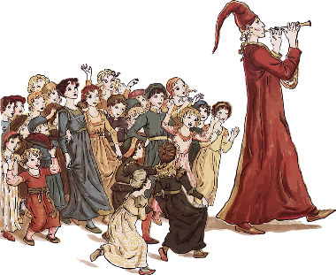
Märchen
*die Bestrafung – punishment
das Ergebnis - outcome
lesen
Der Rattenfänger enthält viele Elemente, die man oft in Märchen findet. Kannst du diese Elemente im Text finden?
Obwohl die Bürger von Hameln von den Ratten befreit waren, zahlten sie dem Rattenfänger die vereinbarte Geldsumme nicht. Er ging sehr böse aus der Stadt. Doch am 26. Juni des gleichen Jahres kam der Rattenfänger zurück: diesmal als Jäger mit einem roten Hut. Er ging mit seiner Pfeife durch die Straßen. Keine Ratten, sondern die Kinder der Stadt folgten ihm. Er führte sie aus der Stadt und auf einen Berg. Bis heute sind die hundertdreißig Kinder nicht zurückgekommen. Die Straße, die aus der Stadt führt, hieß für Jahrhunderte die „Stille-Straße“. Auf dieser Straße durfte man weder tanzen noch Musik machen.
Eine Bestrafung*
Eine Moral
Ein
Ergebnis*
Eine kurze Geschichte
Notes:
Timing: Aim: Procedure: 1.
2.
3.
4.
5.
Transcript: Word frequency (1 is the most frequent word in German): Source: Jones, R.L. & Tschirner, E. (2019). A frequency dictionary of German: core vocabulary for learners. Routledge

Slide 65
Target SSC in French
silent final consonant
a
i/y
eu
e
au/eau/closed o/ô
ou
u
silent final e
é (-er, -ez)
en/an/em/am
on/om
ain/in/aim/im
è/ê/ai
oi/oy
ch
ç (and soft 'c')
qu
j
-tion
-ien
s-liaison
t-liaison
n-liaison
x-liaison
h
um/un
-gn-
r
open eu/œu
open o
-s-
th
-ill-/-ille
-aill-/ail
-eille-/-eil
-euill-/-euil/-ueill-/-ueil/-œill-/-œil
-ouill-/ouil
Notes:
These are the SSC listed in the proposed GCSE Subject Content for French. As I mentioned, in my trust we have taught phonics explicitly since the early noughties. However, in the last three years we have developed our practice in the light of NCELP’s work in this area. Many things are the same. However, we now: i) stagger the roll out of phonics more evenly across the year ii) revisit systematically iii) plan practice activities that use unknown words iv) make use of minimal pairs (use words that only differ by one phoneme) v) assess phonics knowledge

Slide 66
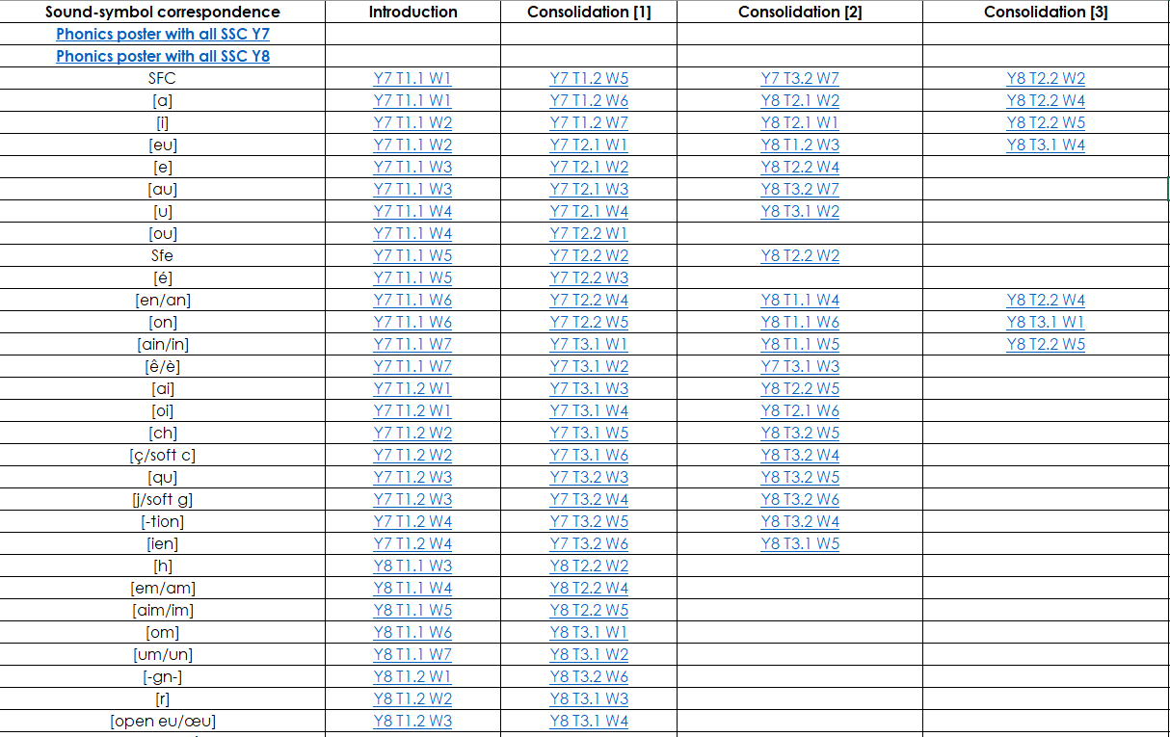
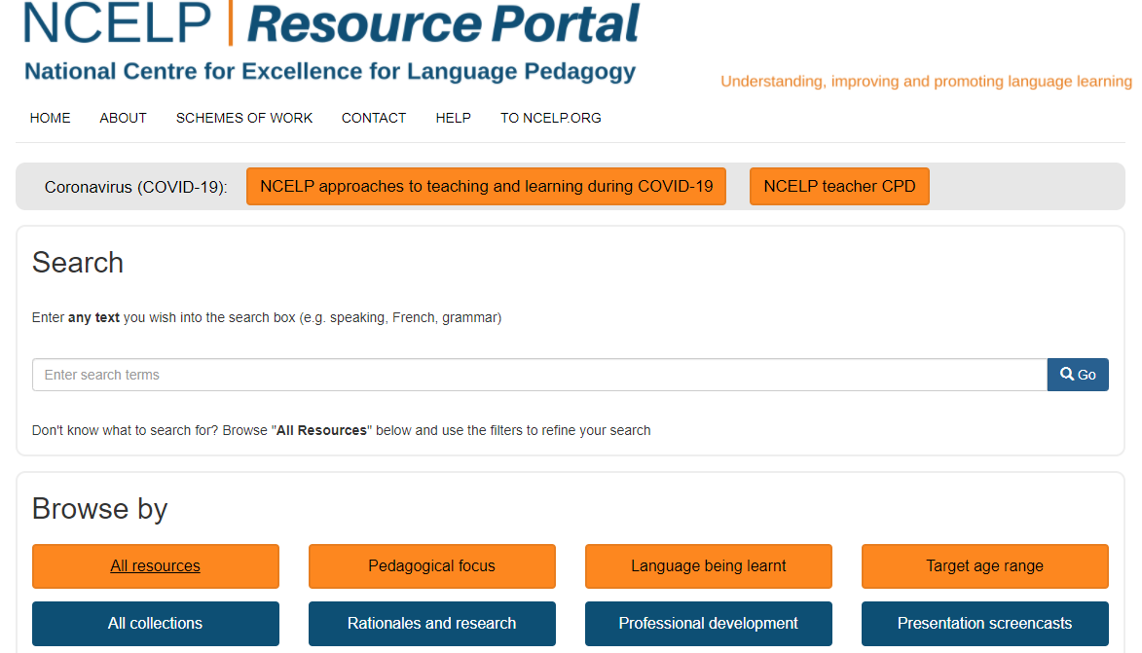
French phonics
phonétique
https://resources.ncelp.org/
Notes:
NCELP plans the initial teaching, practice and spaced revisiting of phonics with all of the identified sound-symbol correspondences into its SOW at KS3. Its assessments also test them. All of these materials are available in phonics collections, easily accessed from the homepage of the resource portal.

Slide 67
French phonics
phonétique
Notes:
I’m not sure I’d be confident that this would be as good for my students’ learning.

Slide 68
SSC [e] ou [ê/è] ?
phonétique
Je suis avec mon chat, Pacha
As you have already learned, some French words containing an unaccented ‘e’ are not pronounced like je.
Some sound like ê/è, such as in avec [with].
Listen to the difference here between the ‘e’ in je and the ‘e’ in avec.
Notes:
I just have time for one example and I chose it because when I was reviewing the resource it struck me as a really good example of something that I wouldn’t just have come up with on the spur of the moment, if I’d noticed in a lesson that pupils were struggling with these two sounds.
So, I am fairly confident in saying that my students would be better served by this sets of slides than my spontaneously drawing their attention to the issue and casting around in the moment for a few examples to help them practise.
Timing: 1 minute
Aim: Raising awareness of different sounds represented by the SSC [e].
Procedure:
Explain that an e without an accent is not always pronounced like je, giving the example of avec.
Listen to the audio, and students repeat the sentence, emphasizing the pronunciation of je and avec.
Transcript:
Je suis avec mon chat, Pacha

Slide 69
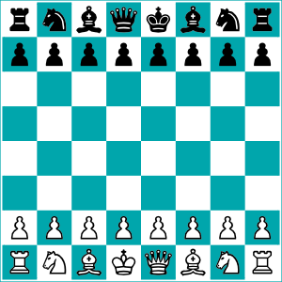
SSC [e] ou [ê/è] ?
Listen carefully to the pronunciation. Do you hear [e] or [ê/è]?
écouter
1
tunnel
2
chenille
[e] | [ê/è]
[e] | [ê/è]
3
melon
4
*échecs
[e] | [ê/è]
[e] | [ê/è]
*échecs = chess
Notes:
Timing: 8 minutes. Slide 1/3.
Aim: to practise aural recognition of SSCs [e/ê/è].
NB: unknown words
Procedure:
1. Click numbers to hear a word.
2. Students tick whether they hear the [e] or [ê/è] sound.
3. Click to reveal answers.
4. Listen again, this time drawing attention to the e sounds. Students repeat.
5. Students say the words one more time, emphasizing the correct e sound.
Transcript:
tunnel
chenille
melon
échecs
Word frequency of unknown words used (1 is the most frequent word in French):
chenille [>5000], échecs [>5000]
Source: Lonsdale, D., & Le Bras, Y. (2009). A Frequency Dictionary of French: Core vocabulary for learners London: Routledge.
Word frequency of cognates used (1 is the most frequent word in French): tunnel [3386], melon [>5000]
Source: Lonsdale, D., & Le Bras, Y. (2009). A Frequency Dictionary of French: Core vocabulary for learners London: Routledge.

Slide 70
SSC [e] ou [ê/è] ?
Listen carefully to the pronunciation. Do you hear [e] or [ê/è]?
écouter
1
renard
2
cheval
[e] | [ê/è]
[e] | [ê/è]
3
*bec
4
carrousel
[e] | [ê/è]
[e] | [ê/è]
*bec = beak
Notes:
Slide 2/3
Transcript:
renard
cheval
bec
carrousel
Word frequency of unknown words used (1 is the most frequent word in French): renard [>5000], cheval [2220], bec [>5000]
Source: Lonsdale, D., & Le Bras, Y. (2009). A Frequency Dictionary of French: Core vocabulary for learners London: Routledge.
Word frequency of cognates used (1 is the most frequent word in French): carrousel [>5000]
Source: Lonsdale, D., & Le Bras, Y. (2009). A Frequency Dictionary of French: Core vocabulary for learners London: Routledge.

Slide 71
SSC [e] ou [ê/è] ?
Have you noticed any spelling patterns which could help you identify whether to use the [e] or [ê/è] sound?
Listen carefully to the pronunciation. Do you hear [e] or [ê/è]?
écouter
caramel
chaussette
1
2
[e] | [ê/è]
[e] | [ê/è]
peluche
3
*vitesse
4
[e] | [ê/è]
[e] | [ê/è]
*vitesse = speed
Notes:
Slide 3/3
Differentiation option for higher level students: Do you notice any patterns emerging for words containing an e which is not pronounced like je?
Point out there is a rule in French for this: This pronunciation comes before double consonants e.g. –ette, and when it is a closed syllable (a syllable ending in a consonant sound), e.g. caramel, bec. Can use following slide for add-on activity.
Transcript:
caramel
chaussette
vitesse
peluche
Word frequency of unknown words used (1 is the most frequent word in French): chaussette [>5000], vitesse [1065], peluche [>5000]
Source: Lonsdale, D., & Le Bras, Y. (2009). A Frequency Dictionary of French: Core vocabulary for learners London: Routledge.
Word frequency of cognates used (1 is the most frequent word in French): caramel [>5000]
Source: Lonsdale, D., & Le Bras, Y. (2009). A Frequency Dictionary of French: Core vocabulary for learners London: Routledge.

Slide 72
SSC [e] ou [ê/è] ?
phonétique
In French, the e is usually pronounced as in avec [ê/è] when:
It comes before a double consonant, such as vitesse [speed]
It comes before a ‘c’ or ‘l’ in the last syllable, such as bec [beak]
Following this guide, decide whether the unaccented e makes the [e] or [ê/è] sound, and say the words. Check by listening to the native speaker.
1
assiette [plate]
repos [rest]
vaisselle [crockery]
verre [glass]
culturel [cultural]
première [first]
2
3
4
5
6
Notes:
[Optional] Timing: 3 minutes
Aim: Differentiation: additional slide for higher level students: Raising awareness of differences between different ‘e’ sounds.
Procedure:
In French, the e is usually pronounced as in avec [ê/è] when:
It comes before a double consonant, such as vitesse [speed]
It comes before a ‘c’ or ‘l’ in the last syllable, such as bec [beak]
Students say the words, applying the rule.
Listen to the native speaker to check.
Transcript:
assiette
verre
repos
culturel
vaisselle
première
Word frequency of unknown words used (1 is the most frequent word in French):
assiette [3756], verre [2174], repos [2731], vaisselle [>5000], première [56]
Source: Lonsdale, D., & Le Bras, Y. (2009). A Frequency Dictionary of French: Core vocabulary for learners London: Routledge.
Word frequency of cognates used (1 is the most frequent word in French): culturel [1495]
Source: Lonsdale, D., & Le Bras, Y. (2009). A Frequency Dictionary of French: Core vocabulary for learners London: Routledge.

Slide 73
Meanings that matter: session overview
Curriculum Design principles
Revisiting principle (umbrella architecture)
Frequency principle (aka the communication principle)
Depth of word knowledge principle
Explicit grammar principle (aka levelling the playing field)
Practice principle
Culture principle
Personalisation principle
Themes and topics (aka the ‘build it, they will come’ principle)
Three knowledge strands
Resources and activities
Notes:
That wasn’t much time to cover curriculum design principles and then show them in action but I hope you saw all of the principles reflected in the resources and activities that you’ve just seen. We had something from each of the three languages Fr, Gm and Sp, a focus on all three strands phonics, vocabulary and grammar, and some clear evidence of the revisiting, frequency, depth of word knowledge, practice, culture and thematic principles. Clearly, the personalisation principle is what happens organically in the classroom, in response to students’ own interests and search for individual meaning making, but I hope to have demonstrated that the prospect of a defined word list based on frequency paves the way for us as teachers to plan our teaching with a much greater degree of certainty about the connection between what we teach and what will be tested, and that removing the doubt and guesswork about which words to teach gives us all a firmer basis for freeing up students to personalise their vocabulary, too.

Slide 74
CPD offer
CPD course is free
Content is research-informed languages teaching at KS3 and KS4
5 remote learning sessions of 2.5 hours
Course leaders are NCELP Specialist Teachers
Additional online peer and instructor support
An online self-study version of the course will be available for anyone to access for free (and to facilitate a cascade model)
There is a link to register interest for the courses already, here: www.ncelp.org/cpd
Notes:
So, finally, just to say that I hope that the session has been interesting and useful.
Time in one session is obviously limited and there is a lot more I could have said, and a lot more interesting stuff to know about all this! I would therefore really strongly encourage you to sign up for the summer term CPD course.
It is free because it is DfE-funded. The first course starts next week and sign-up for that one closed in mid-December. There are two further opportunities to access the course (Summer Term this year and Autumn Term 22/23).
The content is research-informed languages teaching at KS3 and KS4. The central purpose of the Centre’s work is to bring teachers and teaching and researchers and research into closer collaboration. The Centre’s pedagogy also aligns strongly with the proposed new GCSE, the Ofsted Framework, the ECF and Rosenshine principles.
The five remote 2.5 hour sessions focus on the three knowledge strands of Phonics, Vocabulary, Grammar, there’s a session on curriculum design and assessment, and a final session on bringing it all together in meaningful practice.
As much as possible, participants will be assigned to courses regionally - led by an NCELP Specialist Teacher near them, with other participants from their region. This offers the potential to make the most of local networking and peer support, both online and potentially also face-to-face. The caveat here is that our hub locations do not provide even coverage across England and there may be further exceptions: eg places allocated from a waiting list (assuming we need one) will be to whichever course has availability.
We will also make available a self-study version of the course (with certification) for anyone who is unable to access a ‘live’ place. These sessions will also serve to facilitate a cascade model.

