Slide 1
Wir wollen ein Spielzimmer!
Prepositions with verbs of location and movement
Revisit determiners welcher, dieser, jeder
Revisit [u][ü]
Y9 German
Term 3.1 - Week 3 - Lesson 51
Heike Krüsemann / Rachel Hawkes
Artwork: Steve Clarke
Date updated: 06/01/22
Notes:
Note: Spielzimmer translates as both playroom (younger children) and games room (older children). Here we use the second meaning, as Wolfgang and Mia are now 14/15 years old.
Artwork by Steve Clarke. All additional pictures selected are available under a Creative Commons license, no attribution required.
Native-speaker teacher feedback provided by Stephanie Cross.
Learning outcomes (lesson 1):
Revisit SSC [u] [ü]
Revisit R2 (acc.) and R3 (dat.) prepositions with verbs of location and movement
Revisit determiners welcher, dieser, jeder (R3)
Word frequency (1 is the most frequent word in German):
Introduce: gestanden [85] gesessen [231] Dach [1812] Ecke [1376] Keller [1599] Kühlschrank [3804] Licht [436] linke(r,s) [871] rechte (r,s) [786] riesig [1075] draußen [848] über² [47] unter [89] zwischen [105]
Revisit 1: schließen [350] übersetzen [1766] Freude [1286] Gedicht [1897]Gefahr [841] Risiko [977] Sicherheit [776] Sprache [421] Syrien [1416] Weg [220] frei [289] fremd [859] weder…noch [766/33]
Revisit 2: einige [174] entwickeln [377] hoffen [689] üben [1928] verbessern [1194] verlangen [879] vorhaben [1922] Geist [1426] Leistung [646] Pflicht [2048] laut [773] meistens [1261] mindestens [605] obwohl [390]
Source: Jones, R.L & Tschirner, E. (2019). A frequency dictionary of German: Core vocabulary for learners. London: Routledge.
The frequency rankings for words that occur in this PowerPoint which have been previously introduced in NCELP resources are given in the NCELP SOW and in the resources that first introduced and formally re-visited those words.
For any other words that occur incidentally in this PowerPoint, frequency rankings will be provided in the notes field wherever possible.

Slide 2



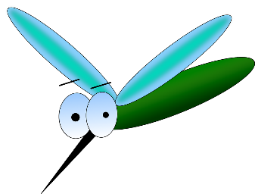
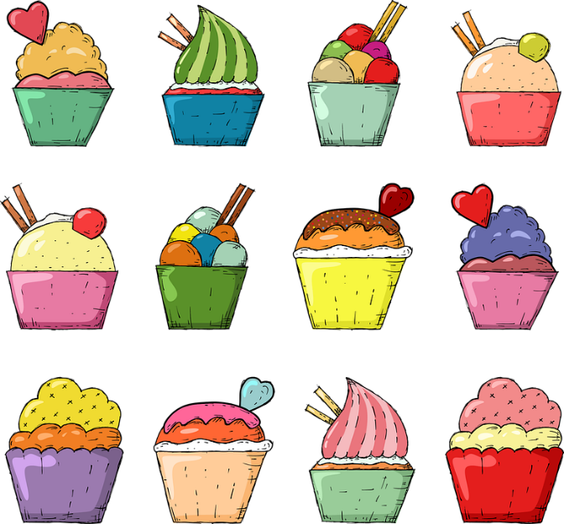
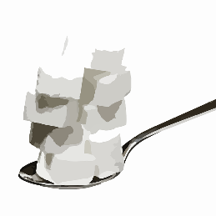

Phonetik
Zungenbrecher mit [u] und [ü]
hören / sprechen
Remember ! To say [ü] shape your mouth to say long ‘ee’ but round your lips to say ‘oo’.
Sag diese Sätze so schnell wie möglich.
*Mücken mögen müde Menschen,
müde Menschen mögen Mücken meistens nicht.
1
(Edeltraud Rudatzki)
2
Süßer Zucker, kühle Butter, bunte Kuchen
wirst du suchen.
*die Mücke – mosquito, midge
süß – sweet
Notes:
Timing: 5 minutes
Aim: to practise spoken pronunciation of the [u] and [ü] sounds.
Procedure:
1. Students listen to each other pronouncing these tongue twisters. They can make each other start again if they hear a wrong sound, so advise students not to start off too fast. They should say each one several times, improving speed and accuracy each time. (2 – 2.5 minutes)
2. Then swap roles (2 – 2.5 minutes).
3. Click to hear each one spoken by a native speaker.
Transcript:
Mücken mögen müde Menschen, müde Menschen mögen Mücken meistens nicht.
Süßer Zucker, kühle Butter, bunte Kuchen wirst du suchen.
Word frequency (1 is the most frequent word in German):
Butter [4960] kühl [2730] Mücke [>5009] Zucker {2559]
Source: Jones, R.L. & Tschirner, E. (2019). A frequency dictionary of German: core vocabulary for learners. Routledge

Slide 3
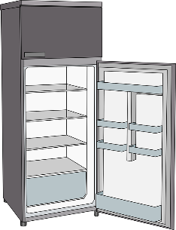


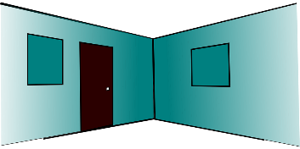
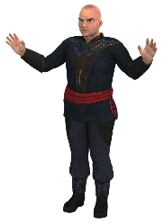


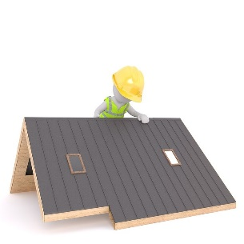


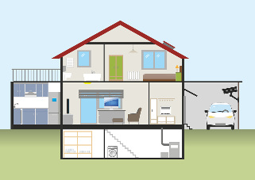



Vokabeln
Hör zu. Schreib 1-14 und den richtigen Buchstaben.
hören
gestanden is the past participle of stehen (to stand). It forms the past with haben.
A
R
H
W
1
Z
8
C
2
A
9
E
3
R
10
Q
[about,
over, above]
über
[stood]
Kühlschrank
gestanden
Ecke
[fridge]
[corner]
4
W
11
Y
I
Y
V
C
5
V
12
E
J
6
I
13
X
7
U
14
H
[huge, massive, enormous]
riesig
[outside]
[sat]
draußen
gesessen
Dach
[roof]
J
gesessen is the past participle of sitzen (to sit). It also forms the past with haben. Remember! To sit down is a different verb in German
(sich setzen).
Z
Q
U
X
E
[right]
unter
Keller
[light]
rechte (r,s)
[cellar]
[left]
Licht
[between]
zwischen
[under]
linke (r,s)
Notes:
Timing: 6 minutes
Aim: to practise aural comprehension of this week’s new vocabulary set.
Procedure:
1. Click to play the audio.
2. Students write the corresponding letter.
3. Click once to check responses.
4. Click again to bring up the German word for checking.
5. Teachers may then also seek to practise oral recall by using the letters, e.g. “Wie heißt ‘Q’ auf Deutsch?” “zwischen.” “Ja, richtig.”
Transcript:
1. das Licht
2. der Kühlschrank
3. gestanden
4. über
5. gesessen
6. riesig
7. unter
8. das Dach
9. linker, linke, linkes
10. zwischen
11. draußen
12. rechter, rechte, rechtes
13. der Keller
14. die Ecke

Slide 4
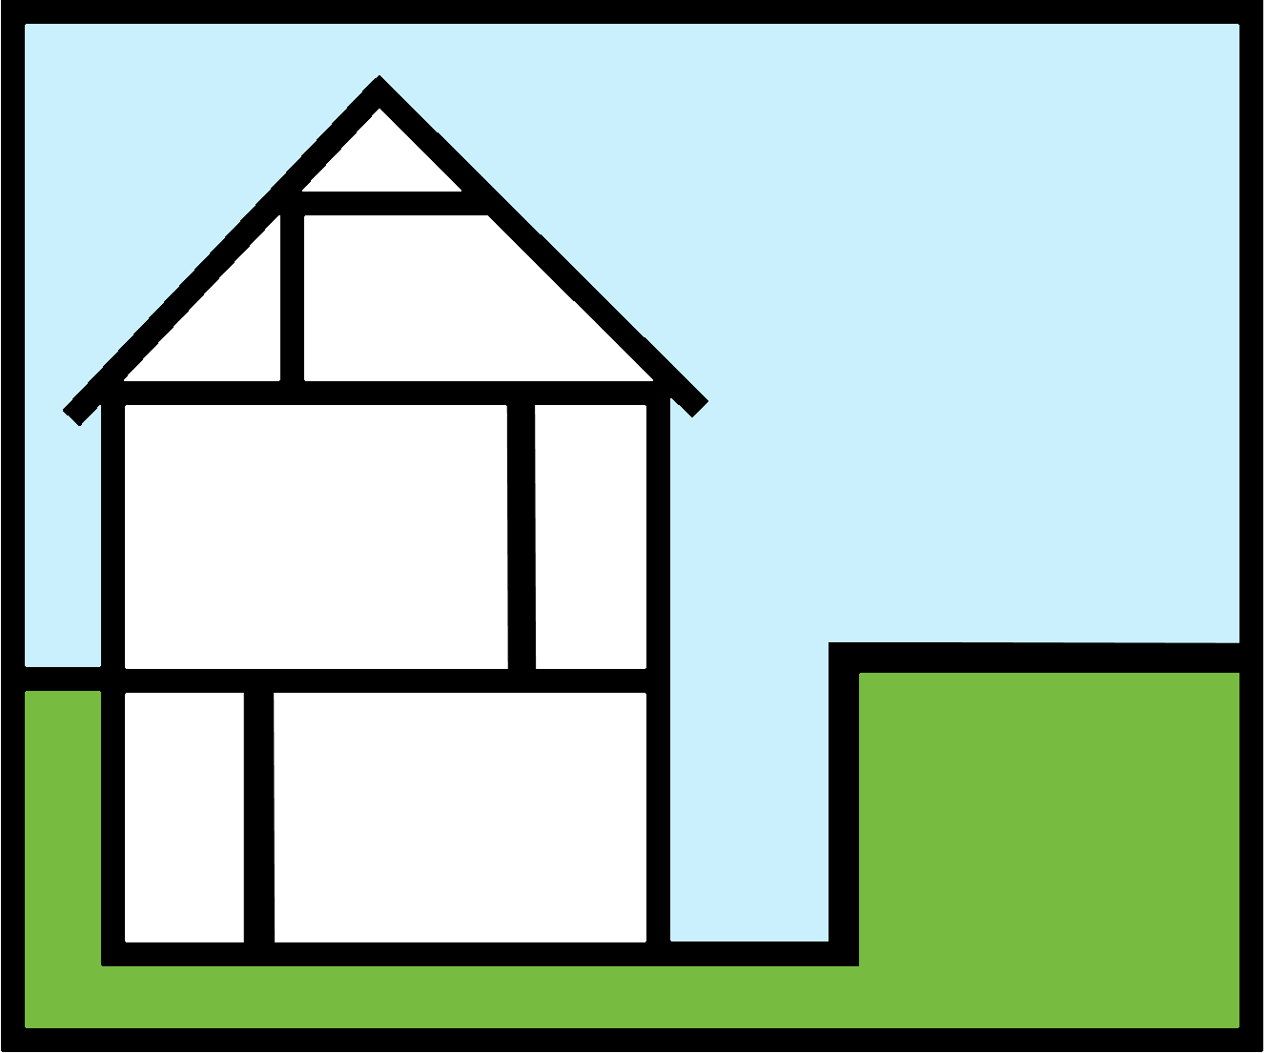

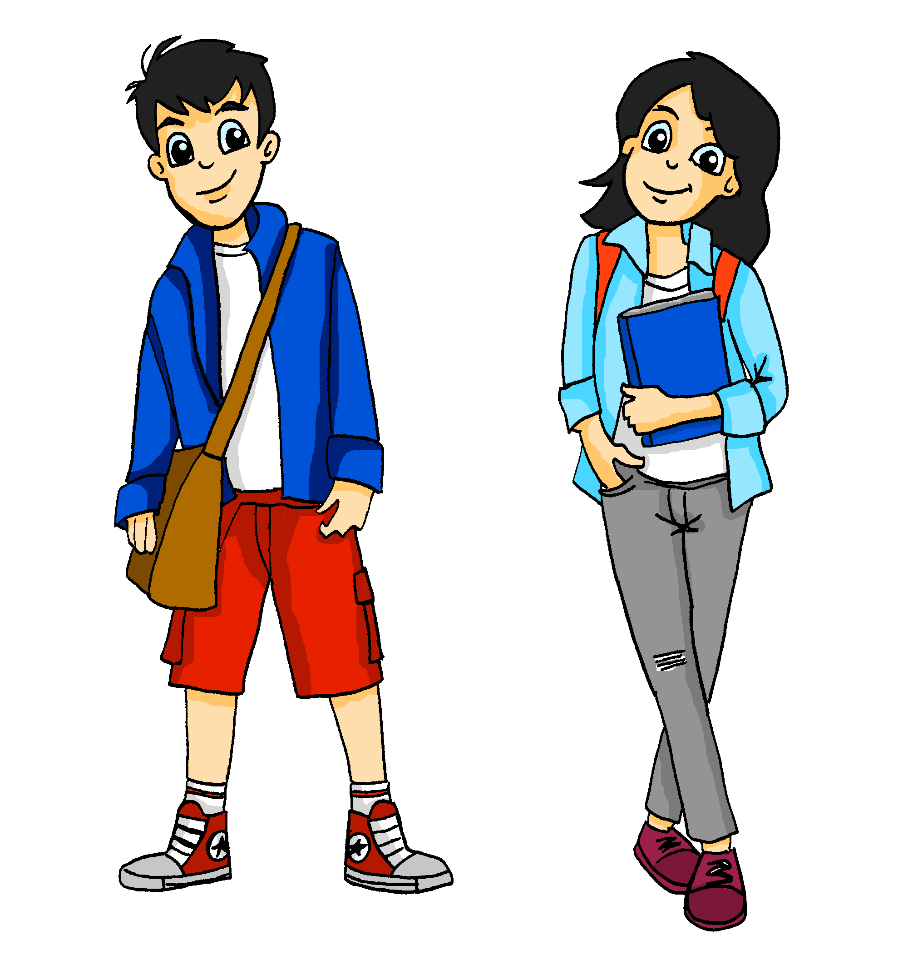

Was wird aus dem Keller?
lesen
Ein Spielzimmer für Mia und Wolfgang?
Ein Ruheraum für Mutti?
Notes:
Timing: 30 seconds
Aim: to provide the context for the lesson.
Procedure:
1. Read the title and questions with students.
2. Elicit the meanings of Keller, Spielzimmer and Ruheraum.
3. Ensure that students are clear about the scenario. Mia and Wolf want to convert the cellar into a games room and Mutti is keen on having a quiet room for herself.

Slide 5



Muttis Ruheraum
Mutti schreibt eine Email an Heinrich.
Wie heißen die fettgedruckten Wörter auf Englisch?
lesen
a few, some
1
2
3
4
5
6
7
8
9
10
11
12
Von: Katrin <katrinm@gmx.de>
An: heinrich51@gmail.com
a corner
at least
Lieber Heinrich,
Wie geht's in Liechtenstein? Mir geht's gut. Ich entwickle so einige Pläne! Ich habe vor, eine Ecke im Keller zu verbessern und einen Ruheraum einzurichten*. Ich hoffe, dass ich dort mindestens einmal am Tag die Tür hinter mir schließen, Yoga üben und Ruhe* für meinen Geist finden kann. Ein Raum, wo es weder Leistung noch Pflicht gibt, wo niemand von draußen laut etwas von mir verlangt. Ein Raum also, wo man frei von Gefahr und Risiko ist. Was meinst du? Ist diese Idee dir fremd, oder macht sie dir Freude? Obwohl ich weiß, dass du meistens wenig Zeit hast, hoffe ich, dass ich bald von dir höre.
Liebe Grüße,
deine Mutti
to close
mind
neither...nor
demands
danger
risk
foreign
joy
What would be a better translation of meistens in this sentence?
* einrichten – to set up, furnish *die Ruhe – silence, peace
mostly
Notes:
Timing: 6 minutes
Aim: to practise written comprehension of much of this week’s revisited vocabulary in a longer text.
Procedure:
1. Students read the text and translate the words in bold into English.
2. Elicit answers and click to bring up English meanings.
3. Click for the callout to prompt for a more natural translation of meistens in this context. (i.e. usually)
4. Use questions to probe orally for general and more detailed comprehension of the text, which contains the majority of this week’s two revisited vocabulary sets.
E.g. What does she says about plans? What? Where? What is she hoping for? How does she describe this room? What does she ask Heinrich?
Word frequency (1 is the most frequent word in German):
einrichten [2050] Gruß [4722] Ruhe [989]
Source: Jones, R.L. & Tschirner, E. (2019). A frequency dictionary of German: core vocabulary for learners. Routledge

Slide 6

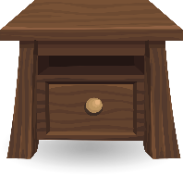
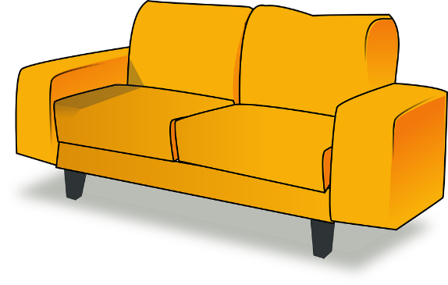


stellen, setzen, legen
Grammatik
As you know, in German we use three verbs for the English verb ‘to put’:
stellen = to make something stand (vertically)
R2 (accusative) always follows because these verbs imply movement; a change of position for the object.
Sie stellt die Lampe auf den Nachttisch.
She puts the lamp on(to) the night table.
Setzen is almost always used for people and animals (and toys that can sit!)
setzen = to make something sit
Sie setzt den Teddy auf das Sofa.
She puts the teddy on(to) the sofa.
Remember! In R2 (accusative) only the masculine article der changes (→ den).
Articles die and das stay the same.
legen = to make something lay down (horizontally)
Sie legt den Laptop auf den Boden.
She puts the laptop on(to) the floor.
Notes:
Timing: 2 minutes
Aim: to revisit the three placement verbs stellen / legen / setzen.
Procedure:
1. Cycle through the information on the slide using the animation sequence.
2. Elicit the English for the examples.
Word frequency (1 is the most frequent word in German):
Lampe [4144] Sofa [3752] Laptop [>5009]
Source: Jones, R.L. & Tschirner, E. (2019). A frequency dictionary of German: core vocabulary for learners. Routledge

Slide 7


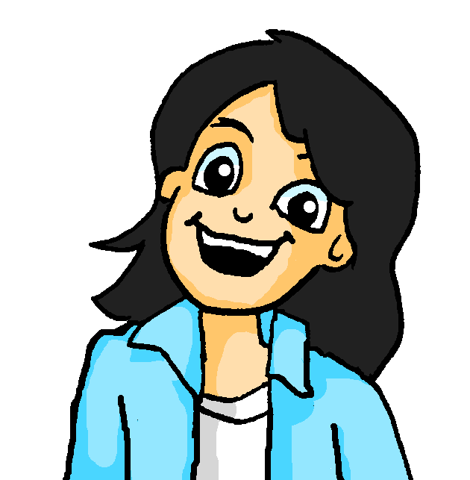



Mias Ideen
Mia erzählt Wolfgang von ihren Ideen für das Spielzimmer. Welches Verb ist das?
hören
gemütlich – cosy
die Kerze – candle
 | What goes where? | setzen | stellen | legen
 | Einstein on the chair
 | candle on the table
 | giant teddy on the sofa
 | lamp next to chair
 | newspaper under table
 | books on the desk
 | Ipad on the desk
 | Mieze on the sofa – it’s cosy!
1
Bücher stellen – to put
(stand books up)
Bücher legen – to put
(lay books down)
2
3
4
5
6
7
8
Notes:
Timing: 7 minutes
Aim: to identify the correct verb for ‘put’ from aural recognition of the noun and knowledge of the distinct uses of the three verbs setzen, stellen or legen.
Procedure:
1. Click audio button 1 to play audio. Students tick whether the verb is setzen, stellen, or legen.
2. Click for answer tick to appear.
3. Students say or write in English what Mia wants to go where, e.g. book on the table.
4. Click to reveal answer.
5. Continue for 2-8.
Note: depending on the class, teachers may choose to re-order the animations to listen once for the verbs and correct that stage, then listen twice to note the item and its position.
Transcript:
1. Also, Wolf, hier ist meine Idee. Wir [setzen] Einstein auf den Stuhl.
2. Wir [stellen] die Kerze auf den Tisch.
3. Wir [setzen] den riesigen Teddy auf das Sofa.
4. Wir [stellen] die Lampe neben den Stuhl.
5. Wir [legen] die Zeitung unter den Tisch.
6. Wir [stellen/legen] die Bücher auf den Schreibtisch.
7. Wir [legen] das IPad auf den Schreibtisch.
8. Wir [setzen] Mieze auf das Sofa – das ist gemütlich!
Note: both stellen and legen are possible for number 6, depending on how the books are ‚put‘. Click to reveal the callout about this to explain why both answers are possible.
Word frequency (1 is the most frequent word in German):
gemütlich [3872] Kerze [3917]
Source: Jones, R.L. & Tschirner, E. (2019). A frequency dictionary of German: core vocabulary for learners. Routledge

Slide 8
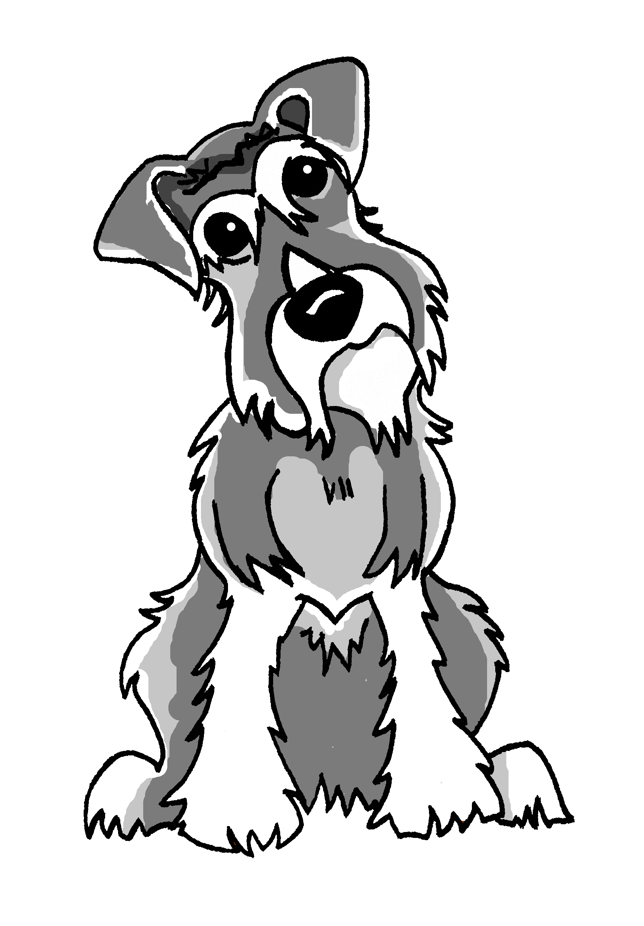

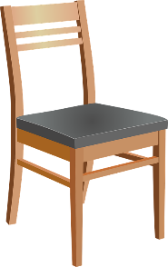
Wechselpräpositionen
Grammatik
You already know six prepositions that are followed by R2 (accusative) articles with movement verbs and R3 (dative) when there is no movement:
an | on(to) (vertical) | hinter | behind
auf | on(to) (horizontal) | vor | in front of
in | in(to) | neben | next to
über | above, over
unter | under
zwischen | between
?
?
?
?
?
?
?
?
?
Remember! Other determiners also change (as articles do) in R2 and R3:
 | m | f | nt | pl
R1 | der | die | das | die
R2 | den | die | das | die
R3 | dem | der | dem | den
Auf welchen Stuhl springt Einstein?
Onto which chair is Einstein jumping?
Auf welchem Stuhl sitzt Einstein?
On which chair is Einstein sitting?
Notes:
Timing: 2 minutes
Aim: to revisit the six R2/R3 prepositions that students have already been taught and introduce the three new prepositions for this week; to remind students that other determiners also follow the same patterns as the definite article and revisit welch-.
Procedure:
1. Click to present the information and elicit knowledge, step by step.
2. Students will have seen the three new prepositions in the pre-learning homework, and in the first vocabulary activity of this lesson, so here students can be prompted to recall the English meanings again.
3. Click to remind students that they know other determiners that also follow the same pattern of change after prepositions. Here we revisit welch- but students have also previously been taught dies- and jed-.
4. Click to present examples of welch- in R2 with movement verb springt, and in R3 with stative verb sitzt. Draw attention to the verbs, the different endings on welch- and the preposition auf with its two meanings ‘on’ and ‘onto’. Remind students that in English we do not always say the ‘to’ but it is implied.
5. Final click brings up a definite article table with all the words for ‘the’ in the three cases that students have previously been taught. Ensure that students are clear that these twelve forms all mean ‘the’.

Slide 9

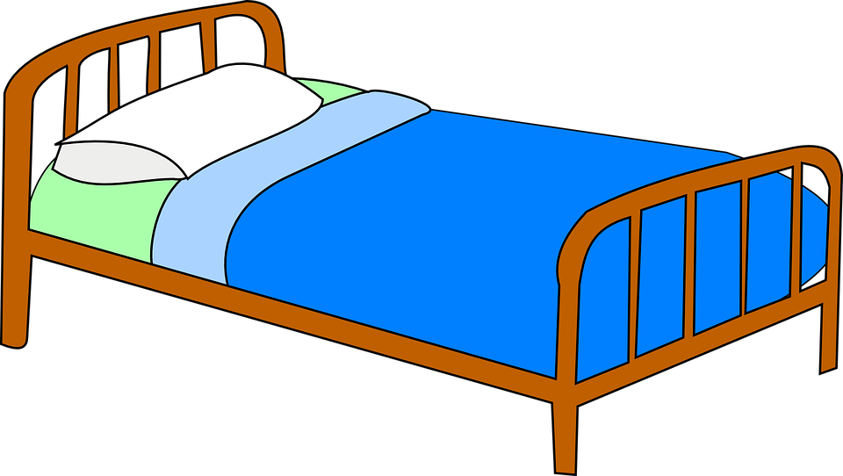

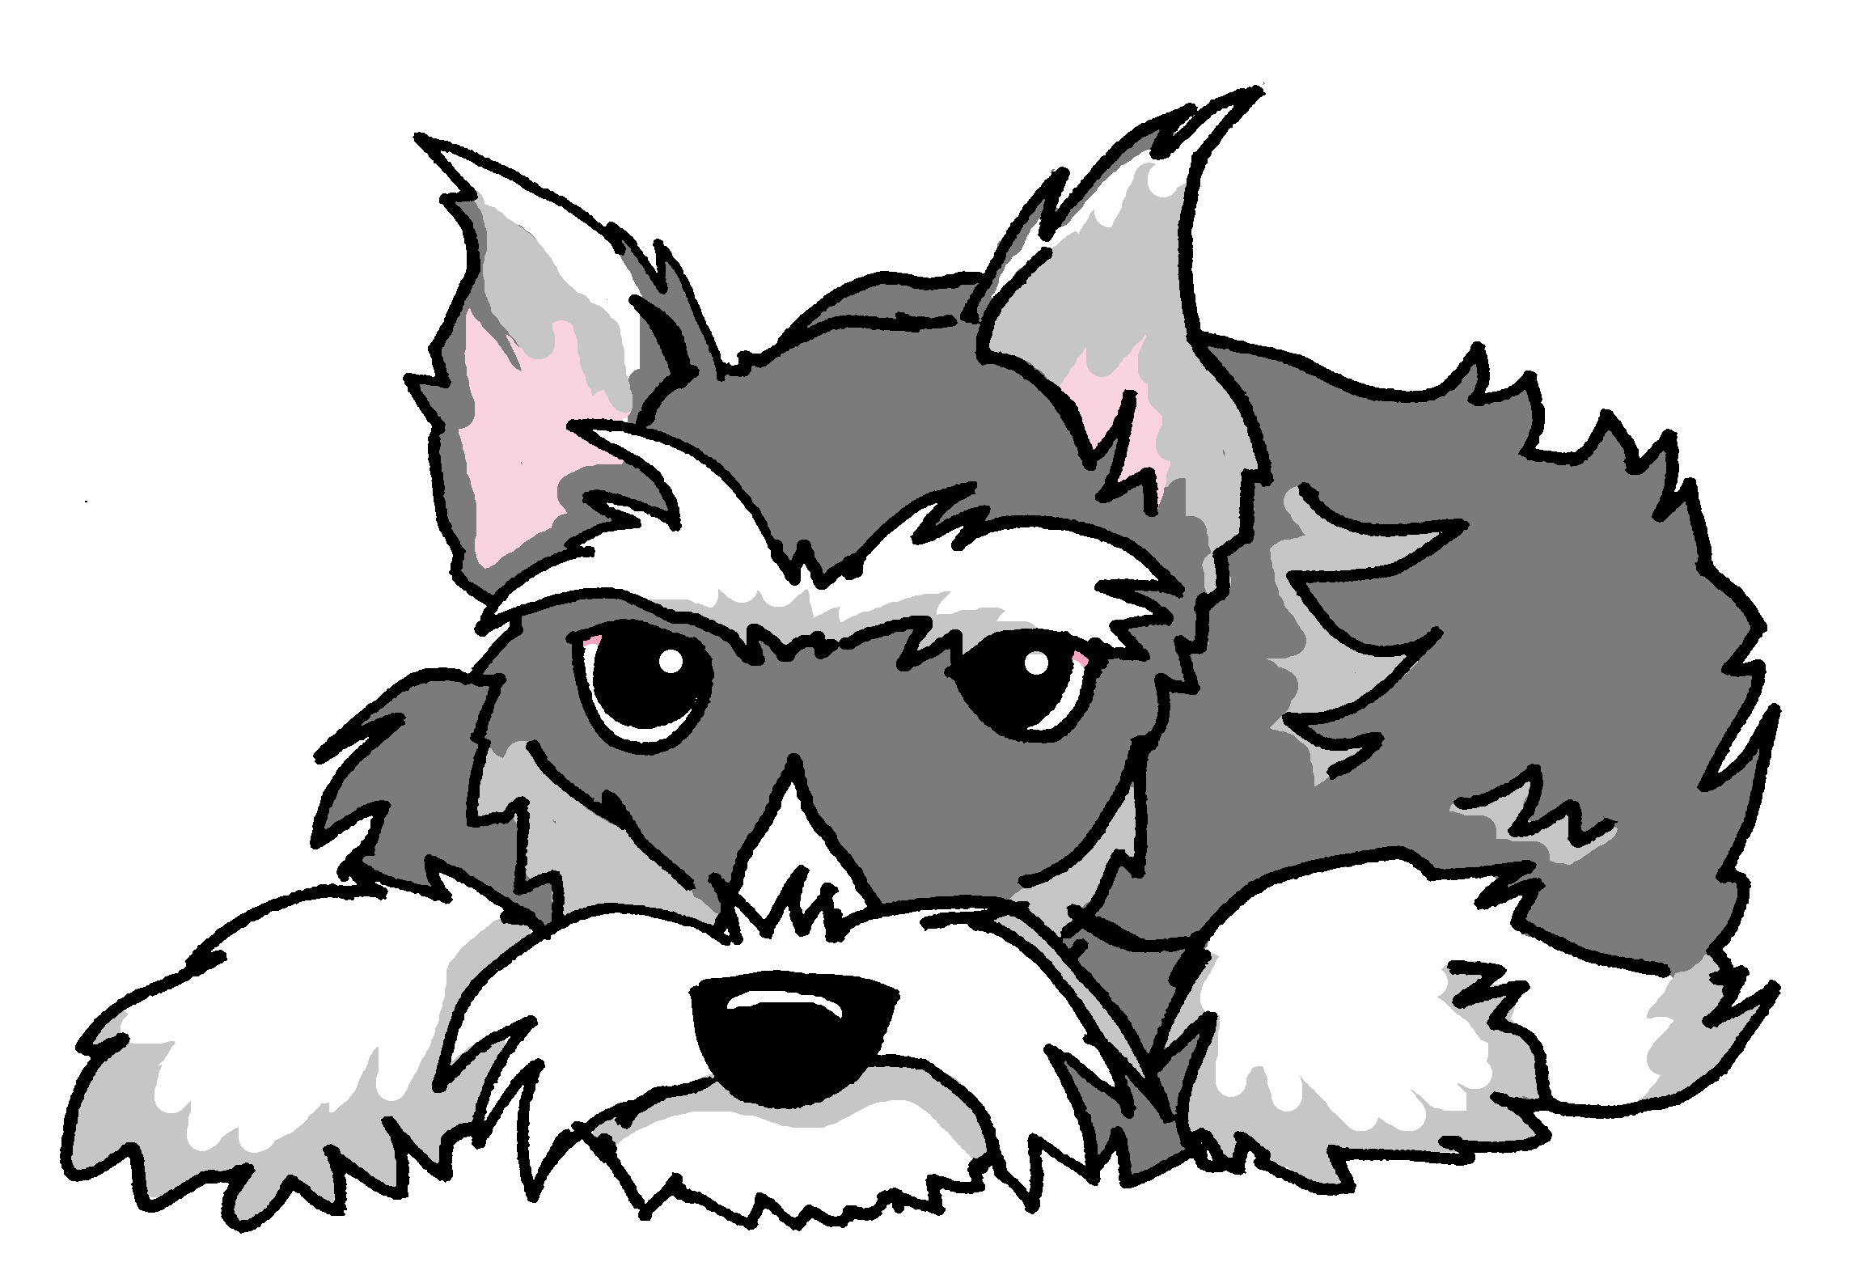
Was machen Mieze und Einstein? 1/8
hören
Lies und schreib A oder B.
Hör zu. Was war richtig?
1. Einstein liegt | springt auf das Bett.
1
Notes:
[1/8]
Timing: 5 minutes (eight slides)
Aim: to practise written comprehension of prepositions + R2 accusative or + R3 dative articles and use the information to select the correct verb and identify the correct pet position.
Procedure:
1. Students read the sentence and write the correct letter A or B.
2. Click to listen. The audio confirms the answer. A further click removes the incorrect verb and highlights the corrects position.
3. Continue on the following slides with items 2 – 8.
Note: the pictures and text are in the same order, to enable students to focus all of their attention on the article (case).
If teachers wanted to increase the cognitive challenge, they could alter the order of the text for some of the pictures.
Transcript:
1. Einstein springt auf das Bett.
2. Auf welchen Stuhl springt Mieze?
3. Einstein läuft hinter das Sofa.
4. Einstein liegt in dem Bett.
5. Mieze sitzt auf dem Stuhl.
6. Mieze springt auf das Kissen.
7. Einstein sitzt vor dem Kühlschrank.
8. Mieze sitzt auf dem Nachttisch.
Word frequency (1 is the most frequent word in German):
Kissen [4898]
Source: Jones, R.L. & Tschirner, E. (2019). A frequency dictionary of German: core vocabulary for learners. Routledge

Slide 10
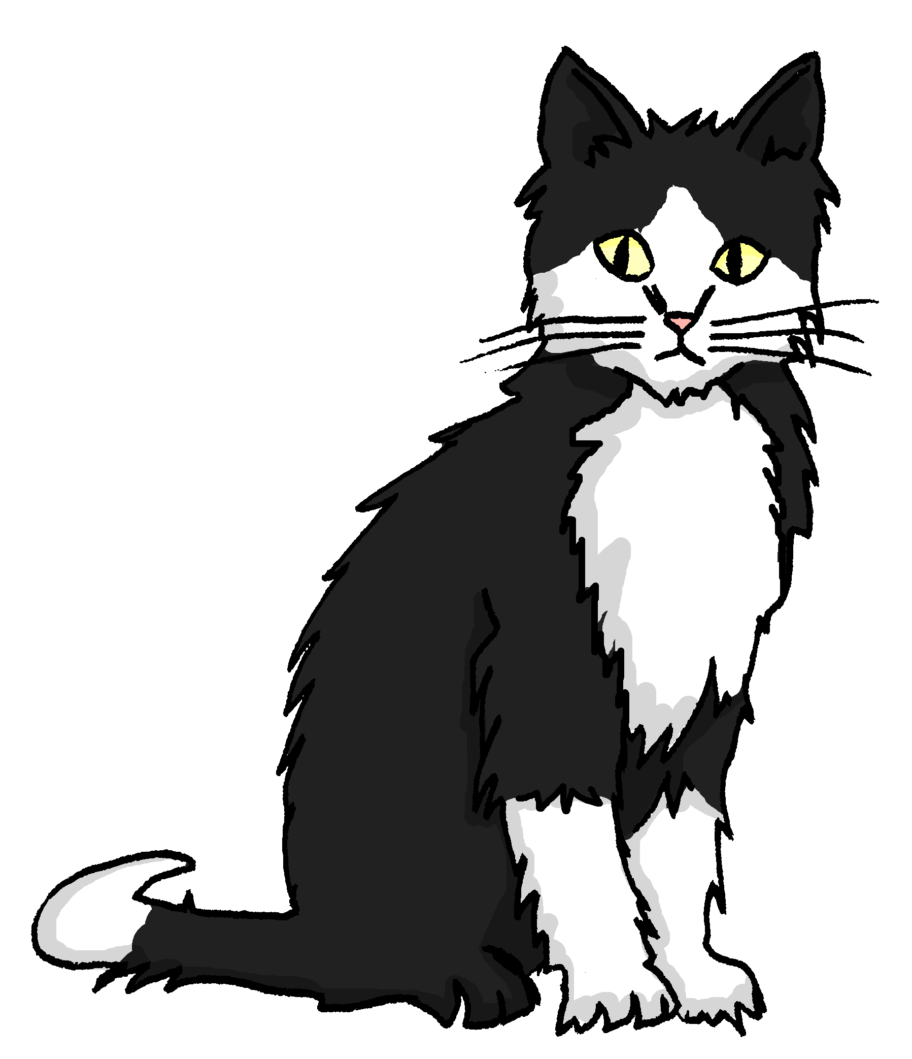


Was machen Mieze und Einstein? 2/8
hören
2. Mieze springt | sitzt auf dem Nachttisch.
2
Notes:
2/8
Transcript:
Mieze sitzt auf dem Nachttisch.

Slide 11

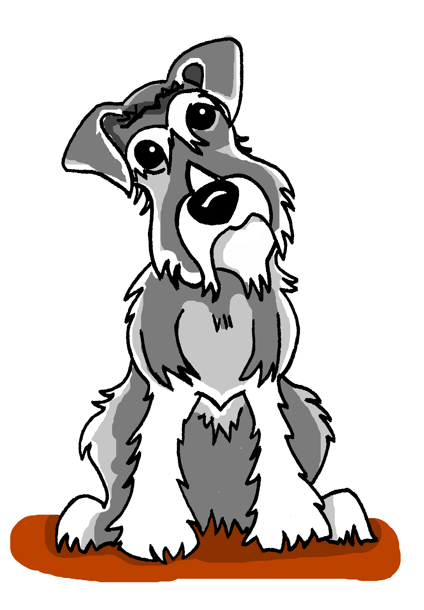

Was machen Mieze und Einstein? 3/8
hören
3. Einstein läuft | sitzt hinter das Sofa.
3
Notes:
3/8
Transcript:
Einstein läuft hinter das Sofa.
Word frequency (1 is the most frequent word in German):
Sofa [3572]
Source: Jones, R.L. & Tschirner, E. (2019). A frequency dictionary of German: core vocabulary for learners. Routledge

Slide 12
Was machen Mieze und Einstein? 4/8
hören
4. Einstein liegt | läuft im Bett.
4
Notes:
4/8
Transcript:
Einstein liegt in dem Bett.

Slide 13
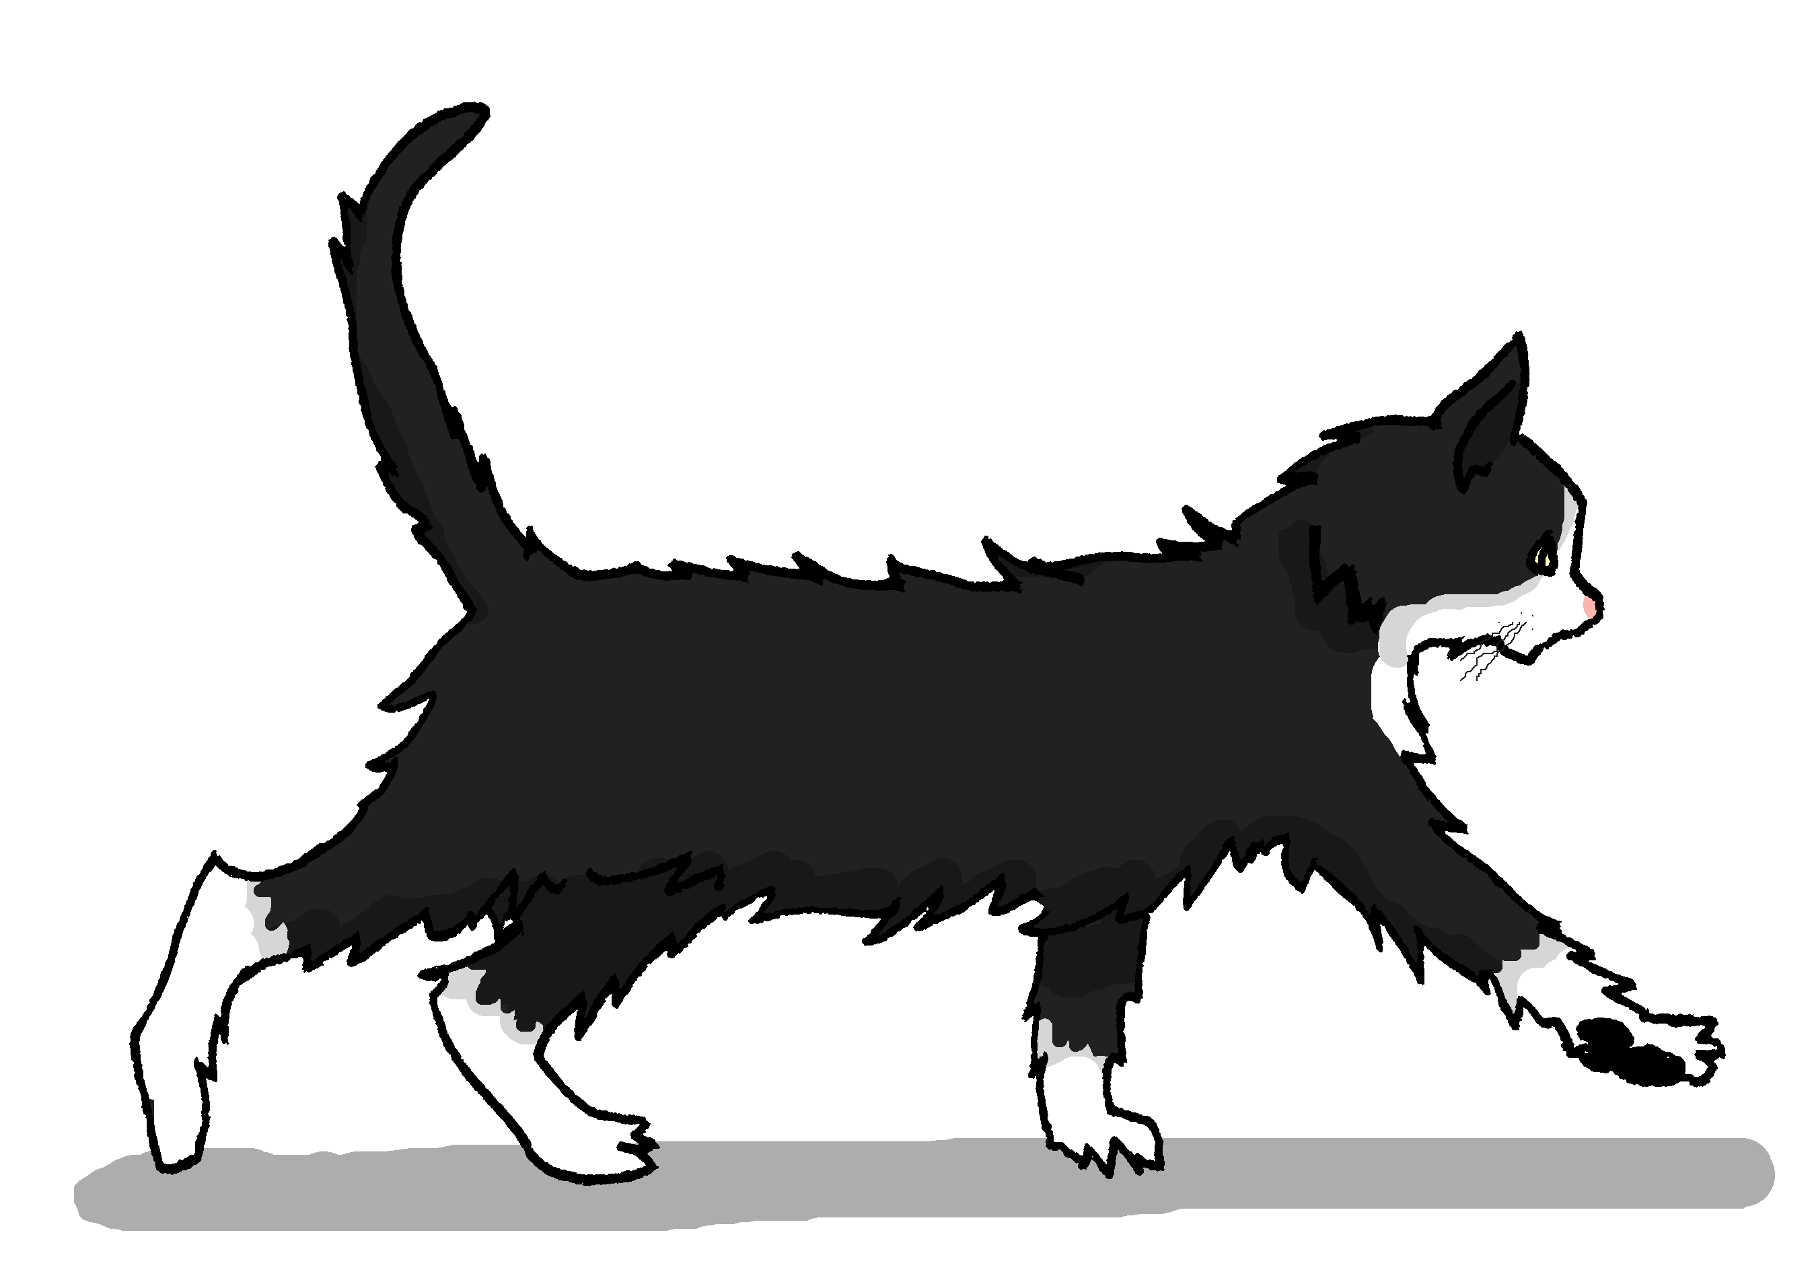
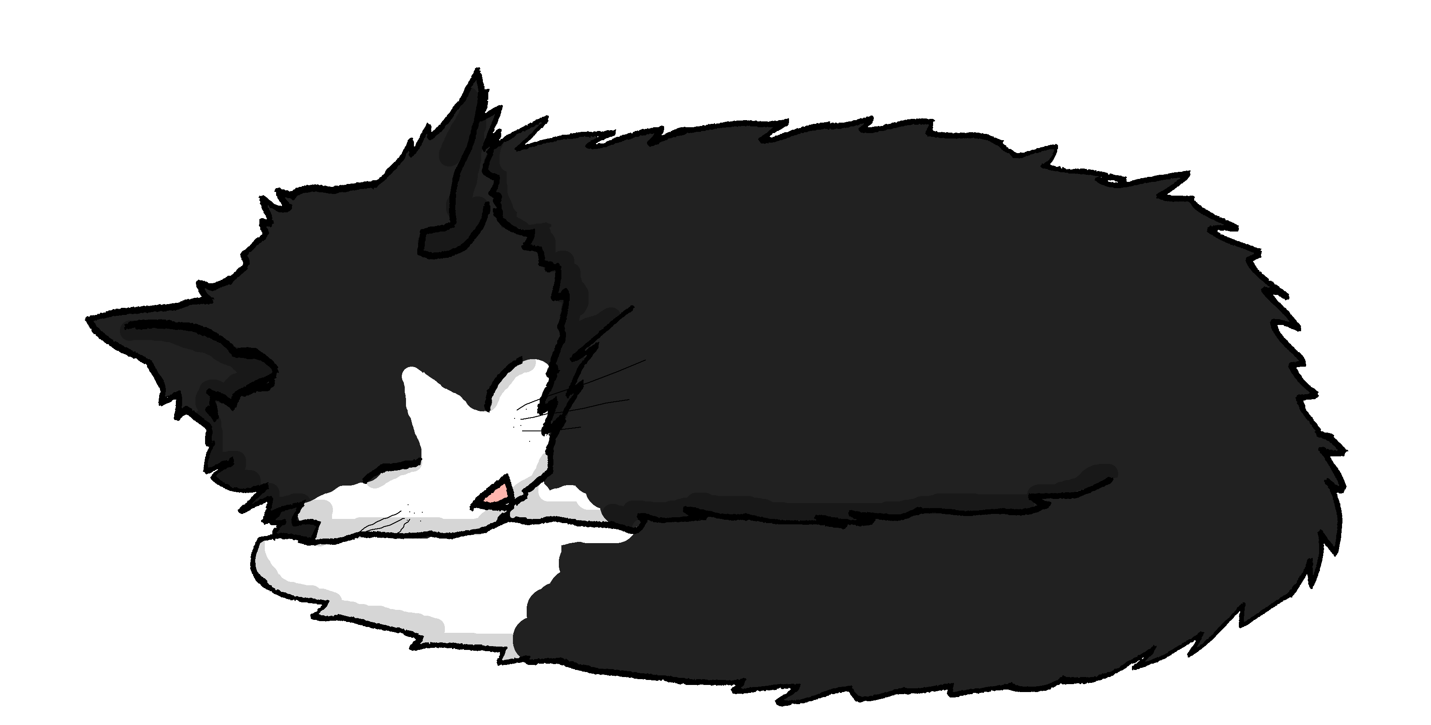
Was machen Mieze und Einstein? 5/8
hören
5. Mieze läuft | schläft unter den Tisch.
5
Notes:
5/8
Transcript:
Mieze läuft unter den Tisch.

Slide 14

Was machen Mieze und Einstein? 6/8
hören
6. Mieze sitzt | springt auf das Kissen.
6
Notes:
6/8
Transcript:
Mieze springt auf das Kissen.
Word frequency (1 is the most frequent word in German):
Kissen [4898]
Source: Jones, R.L. & Tschirner, E. (2019). A frequency dictionary of German: core vocabulary for learners. Routledge

Slide 15
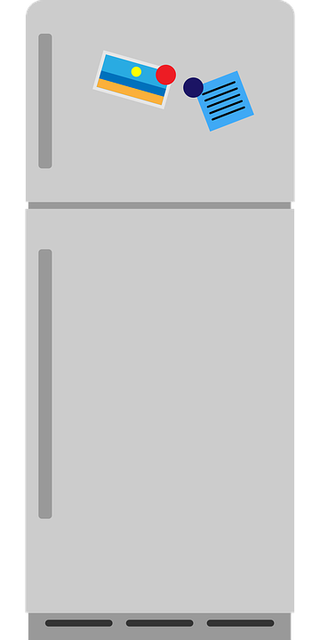

Was machen Mieze und Einstein? 7/8
hören
7. Einstein sitzt| läuft vor dem Kühlschrank.
7
Notes:
7/8
Transcript:
Einstein sitzt vor dem Kühlschrank.

Slide 16

Was machen Mieze und Einstein? 8/8
hören
8. Auf welchen Stuhl springt| sitzt Mieze?
8
Notes:
8/8
Transcript:
Auf welchen Stuhl springt Mieze?

Slide 17


Placement and position
English often just translates these three verbs as ‘be’.
Grammatik
Stellen, legen, and setzen are verbs that cause something to end up in a specific position.
To say what position something is in already, use stehen, liegen, and sitzen.
Placement verbs are followed by R2
Positional verbs are followed by R3.
placement
position
stellen
Sie stellt die Lampe auf den Nachttisch.
stehen
Die Lampe steht auf dem Nachttisch.
She puts the lamp on(to) the night table.
The lamp is/stands on the night table.
sitzen
Der Teddy sitzt auf dem Sofa.
setzen
Sie setzt den Teddy auf das Sofa.
She puts the teddy on(to) the sofa.
The teddy is/sits on the sofa.
legen
Sie legt den Laptop auf den Boden.
liegen
Der Laptop liegt auf dem Boden.
She puts the laptop on(to) the floor.
The laptop is/is lying on the floor.
Notes:
Timing: 2 minutes
Aim: to explain and illustrate placement verbs (stellen / legen / setzen) vs. positional verbs (stehen / liegen / sitzen)
Procedure:
1. Cycle through the information on the slide using the animation sequence.
2. Elicit the English for each example.
Note: the examples of stellen, setzen and legen are repeated examples for familiarity and to allow students to focus their attention on the contrast between each pair of placement / position verbs.

Slide 18
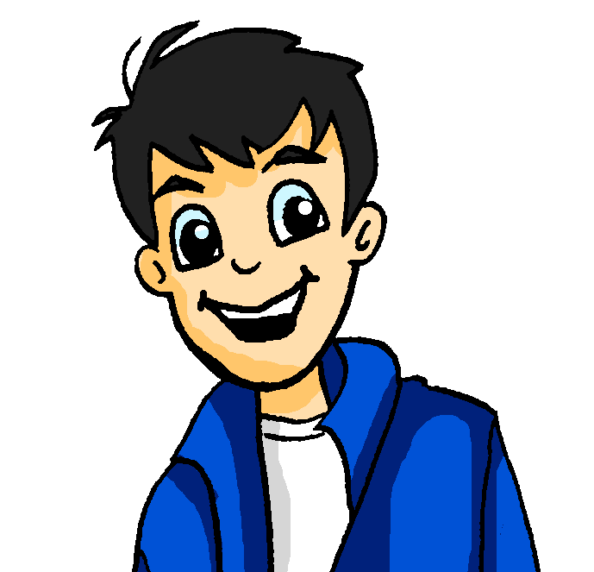
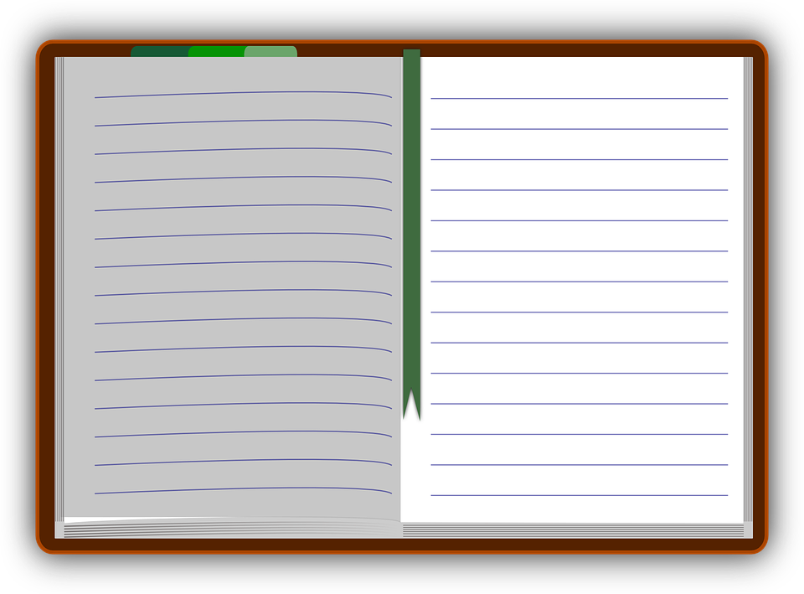

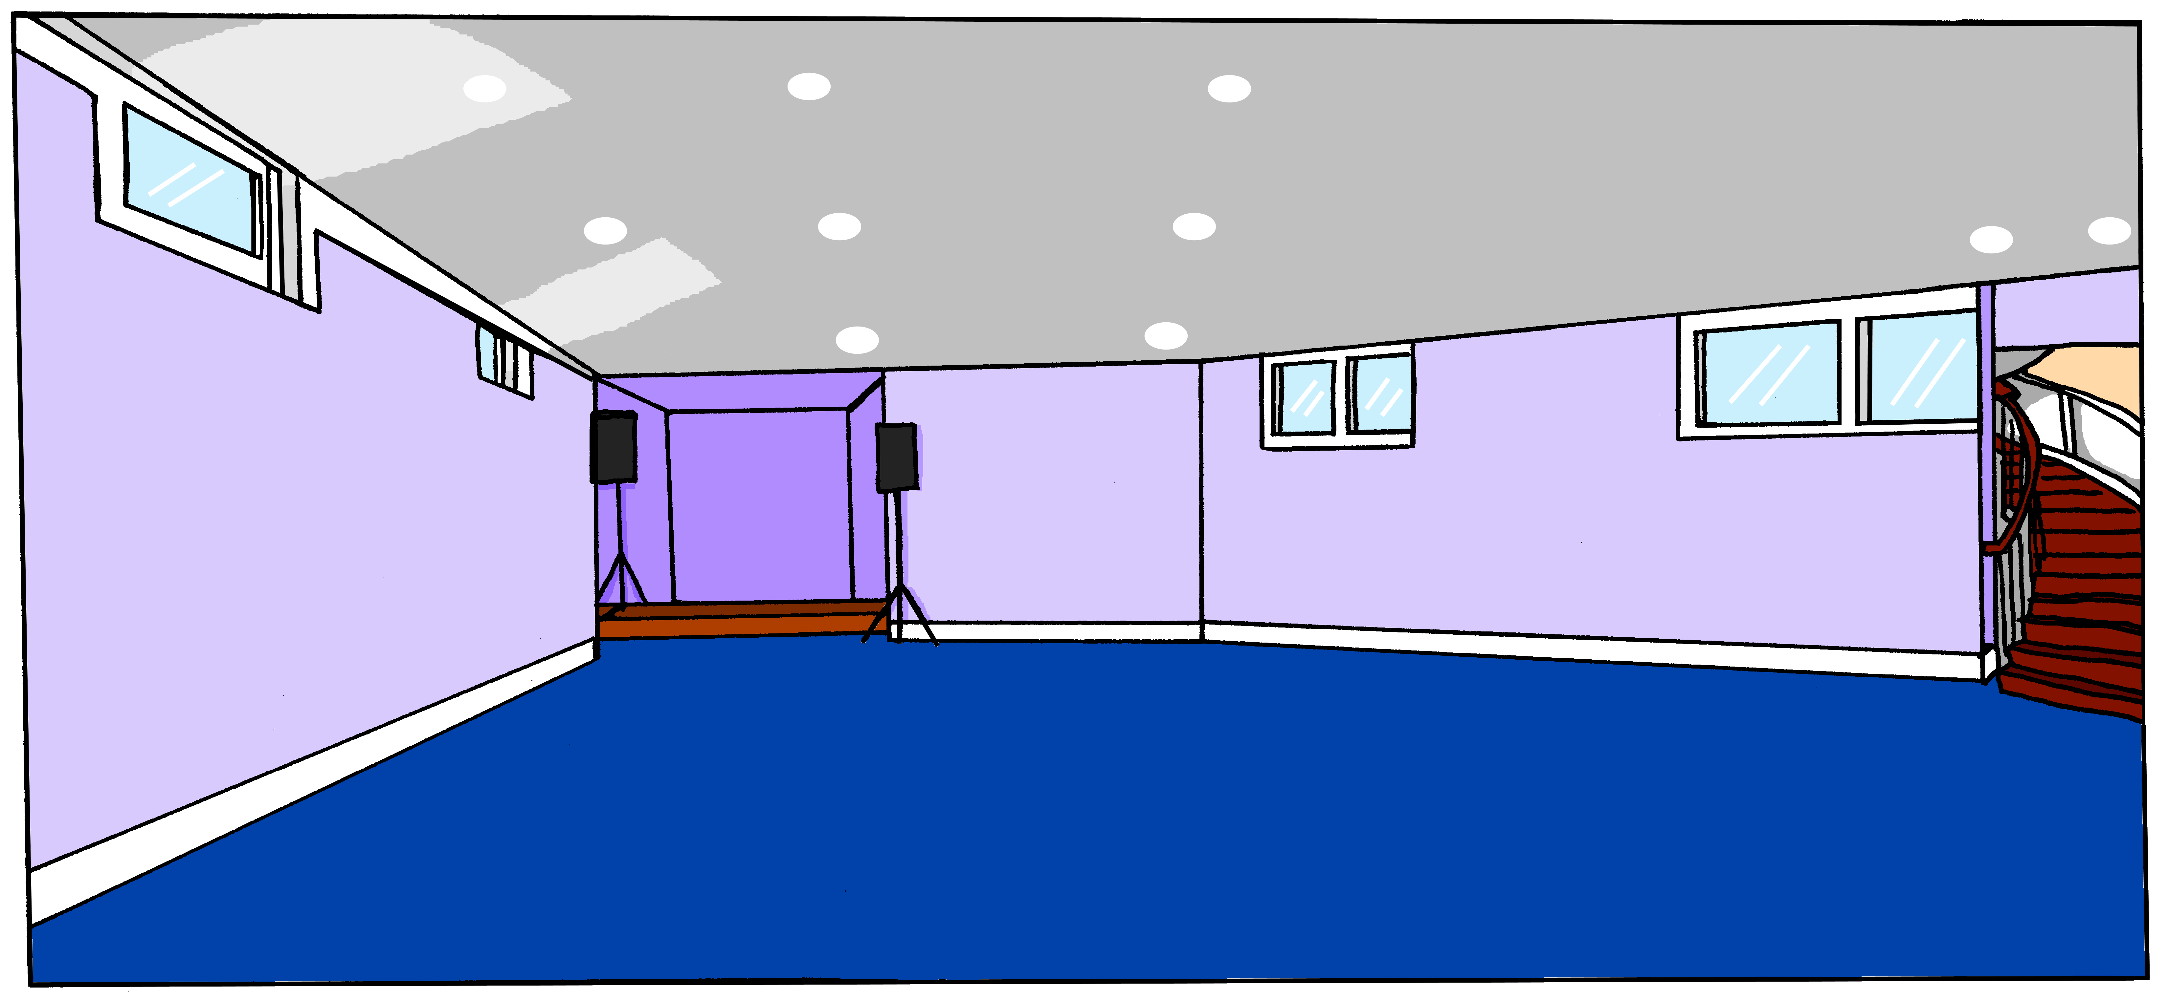
Wolfgangs Ideen
Wolfgang hat andere Ideen, die er in sein Tagebuch schreibt. Leider hat er seine heiße Schokolade verschüttet*!
lesen
verschütten
– to spill
Lies Wolfgangs Ideen.
Schreibe 1 – 8 und den Artikel.
Dann schreibe Notizen auf Englisch. Was ist wo?
1
Die Uhr hänge ich über die Tür.
2
Die Lampe steht auf dem Schreibtisch.
3
Das Ipad lege ich zwischen den Computer und die Bücher.
4
Mieze setze ich unter den Tisch.
5
Der Teddy sitzt neben dem Sofa.
6
Das Poster hängt an der Wand.
7
Die Zeitung lege ich vor die Lampe.
8
Einstein sitzt vor dem Fußballtisch.
Notes:
Timing: 5 minutes
Aim: to practise written production of correct articles after R2/3 prepositions, based on recognition of either static and movement verbs in the text, and knowledge of the gender of the nouns that follow the prepositions.
Procedure:
1. Students read each sentence. Based on the verb they decide the case (R2/acc. or R3/dat.).
2. Based on the noun that follows the preposition they write the correct article.
3. Encourage students to check genders if they have forgotten or those they may not know (Lampe, Sofa). (Frau/Herr XXX, ist es ‘die’ Lampe?)
4. Click to reveal answers.
5. Clarify any misunderstandings.
6. Students then make brief notes in English stating what is where, e.g. clock over door.
Note: these answers form part of the next task.
Word frequency (1 is the most frequent word in German):
Lampe [4144] Teddy [>5009] Sofa [3572] Poster [>5009]
Source: Jones, R.L. & Tschirner, E. (2019). A frequency dictionary of German: core vocabulary for learners. Routledge

Slide 19
Was wollen Wolf und Mia?
Imagine the scenario if Wolf and Mia get their way.
Where will each item be?
schreiben
Schreib auf Deutsch.
Was | Verb | Wolfgangs Spielzimmer | Mias Spielzimmer
1. der Teddy | sitzt | neben dem Sofa | auf dem Sofa
2. die Kerze | steht | --- | auf dem Tisch
3. die Lampe | steht | auf dem Schreibtisch | neben dem Stuhl
4. die Zeitung | liegt | vor der Lampe | unter dem Tisch
5. die Bücher | liegen | --- | auf dem Schreibtisch
6. das IPad | liegt | zwischen dem Computer und den Büchern | auf dem Schreibtisch
7. Mieze | sitzt | unter dem Tisch | auf dem Sofa
8. die Uhr | hängt | über der Tür | ---
9. das Poster | hängt | an der Wand | ---
10. Einstein | sitzt | vor dem Fußballtisch | auf dem Stuhl
Notes:
Timing: 10 minutes.
Aim: to practise written production by translating the English answers from Mia’s listening (on slide 7) and the English notes from Wolfgang’s ideas (on slide 18).
Procedure:
1. Teacher to ensure that students understand that the context refers to items that are all already in position. Elicit from students which case they will need to use after the prepositions (i.e., R3/dat.)
2. Do the first one with students to model the task.
3. Students go back over their notes from Wolf’s sentences and Mia’s and complete the table in German. If an item is not mentioned by Wolfgang or Mia, they write ---.
4. Teachers can decide if to require students to select and write the correct verbs as well or to click to reveal them first to allow students to focus only on practising the dative articles, the prepositions and the nouns.
5. Elicit answers and click to reveal the written versions.
6. Teacher to ensure comprehension, e.g. by asking students to work in pairs to summarise in English for 30 seconds either Wolf or Mia and then to swap roles.
7. Teacher could also follow up with further questions, e.g. “Wo steht die Lampe in Mias Spielzimmer?”
Word frequency (1 is the most frequent word in German):
Lampe [4144] Kerze [3917] Teddy [>5009] Sofa [3572] Poster [>5009]
Source: Jones, R.L. & Tschirner, E. (2019). A frequency dictionary of German: core vocabulary for learners. Routledge

Slide 20
Wir wollen ein Spielzimmer!
Prepositions with verbs of location and movement
Revisit determiners welcher, dieser, jeder
Revisit [u][ü]
Y9 German
Term 3.1 - Week 3 - Lesson 52
Heike Krüsemann / Rachel Hawkes
Artwork: Steve Clarke
Date updated: 04/10/21
Notes:
Artwork by Steve Clarke. All additional pictures selected are available under a Creative Commons license, no attribution required.
Native-speaker teacher feedback provided by Stephanie Cross.
Learning outcomes (lesson 2):
Revisit SSC [u] [ü]
Revisit R2 (acc.) and R3 (dat.) prepositions with verbs of location and movement
Revisit determiners welcher, dieser, jeder (R3)
Word frequency (1 is the most frequent word in German):
Introduce: gestanden [85] gesessen [231] Dach [1812] Ecke [1376] Keller [1599] Kühlschrank [3804] Licht [436] linke(r,s) [871] rechte (r,s) [786] riesig [1075] draußen [848] über2 [47] unter [89] zwischen [105]
Revisit 1: schließen [350] übersetzen [1766] Freude [1286] Gedicht [1897]Gefahr [841] Risiko [977] Sicherheit [776] Sprache [421] Syrien [1416] Weg [220] frei [289] fremd [859] weder…noch [766/33]
Revisit 2: einige [174] entwickeln [377] hoffen [689] üben [1928] verbessern [1194] verlangen [879] vorhaben [1922] Geist [1426] Leistung [646] Pflicht [2048] laut [773] meistens [1261] mindestens [605] obwohl [390]
Source: Jones, R.L & Tschirner, E. (2019). A frequency dictionary of German: Core vocabulary for learners. London: Routledge.
The frequency rankings for words that occur in this PowerPoint which have been previously introduced in NCELP resources are given in the NCELP SOW and in the resources that first introduced and formally re-visited those words.
For any other words that occur incidentally in this PowerPoint, frequency rankings will be provided in the notes field wherever possible.

Slide 21
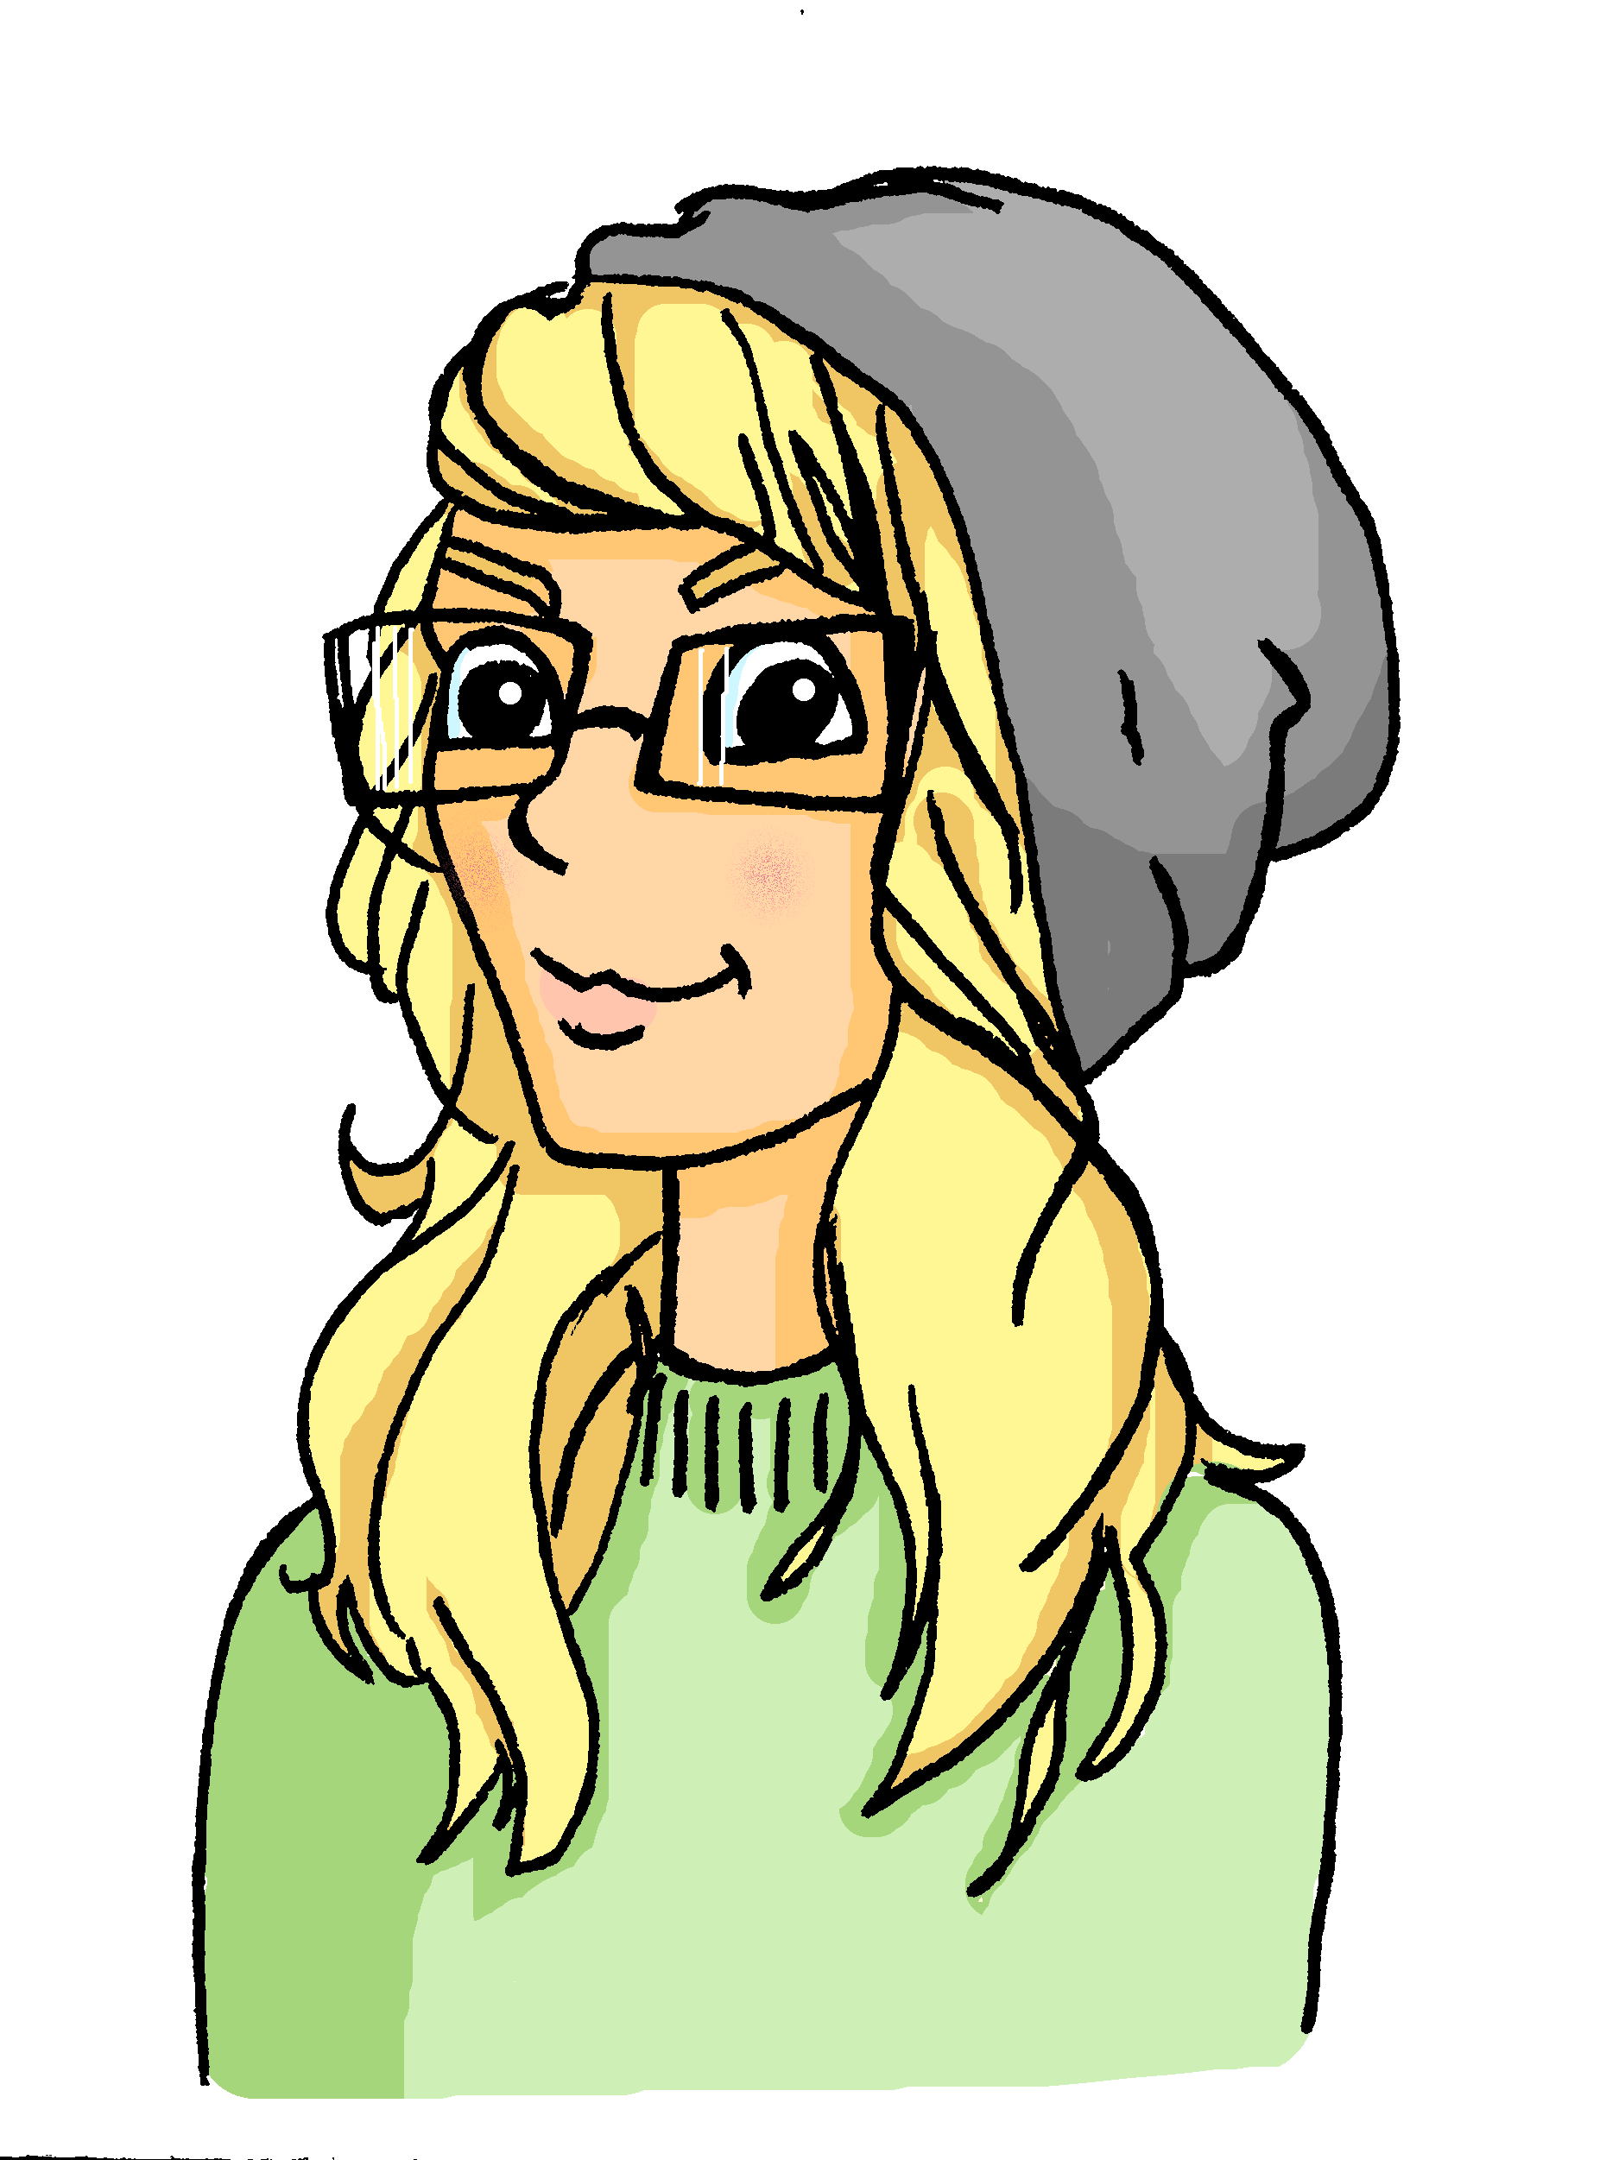
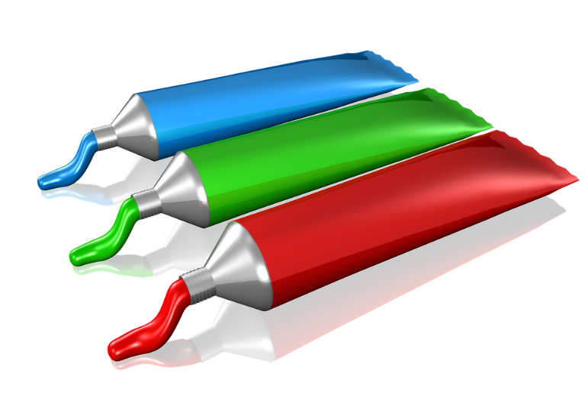
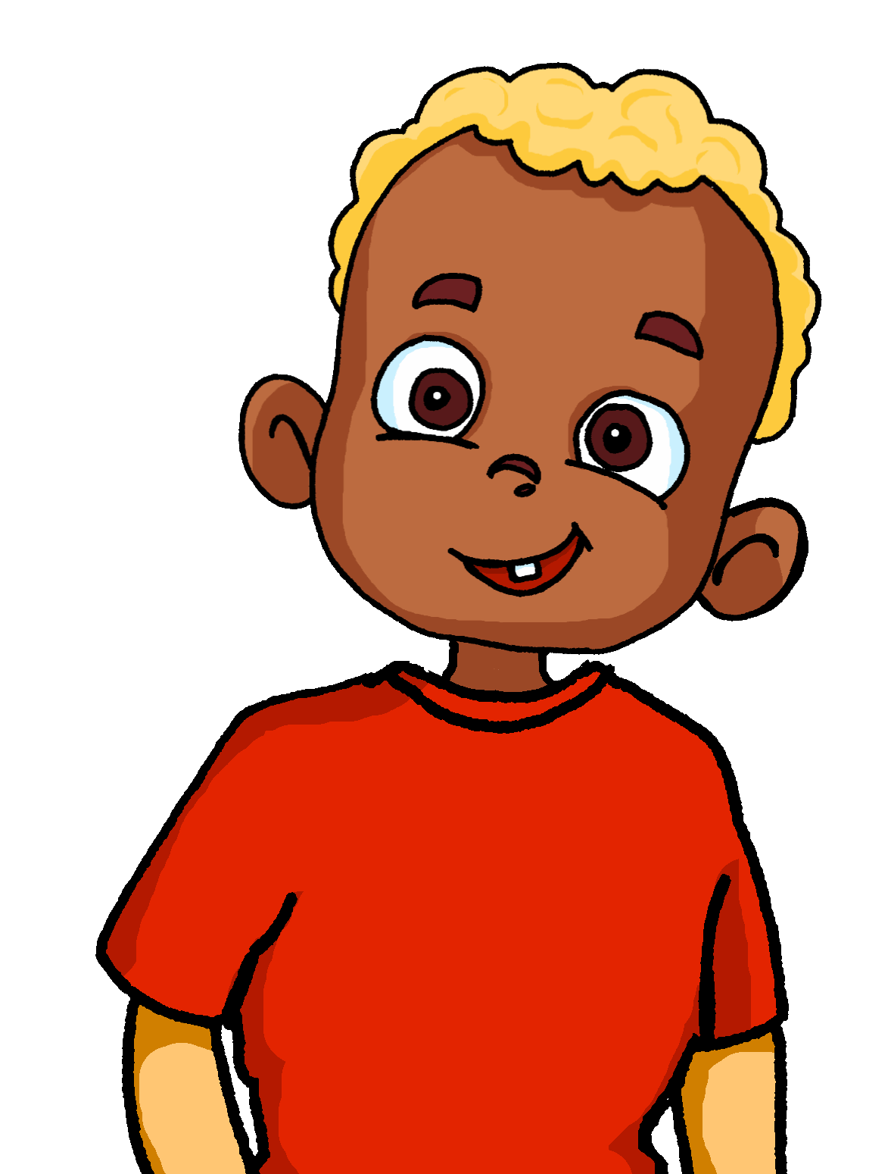





Phonetik 1/2
Heidi bemalt die Wände im Zimmer von ihrem kleinen Bruder. Er will immer eins mehr als sie! Person A ist Heidi, Person B der Bruder.
lesen / sprechen
60
1. Ein Zug?
1. Zwei Züge!
2. Ein Stuhl?
2. Zwei Stühle!
Sekunden
3. Ein Buch?
3. Zwei Bücher!
6. Eine Nuss?
6. Zwei Nüsse!
4. Ein Fluss?
4. Zwei Flüsse!
7. Ein Kuss?
7. Zwei Küsse!
5. Ein Sturm?
5. Zwei Stürme!
8. Ein Turm?
8. Zwei Türme!
0
LOS!
Notes:
Timing: 10 minutes (two slides)
Aim: to practise oral production of [u] and [ü] sounds in a set of mostly unfamiliar singular and plural nouns.
Procedure:
1. Ensure students understand that Heidi is painting her younger brother’s walls with pictures. She makes a suggestion but he always wants two of what she suggests.
2. Remind students that many masculine and neuter nouns (and a few feminine nouns) form their plurals by adding –e and an umlaut over the vowel.
3. Student A is Heidi and makes the singular noun suggestions. Student B is the brother who replies ‘two XXX’! to each suggestion.
4. Click to start timer.
5. Move to the next slide and swap roles.
Word frequency (1 is the most frequent word in German):
Kuss [>5009] Nuss [>5009] Sturm [2913] Turm [3118]
Source: Jones, R.L. & Tschirner, E. (2019). A frequency dictionary of German: core vocabulary for learners. Routledge

Slide 22
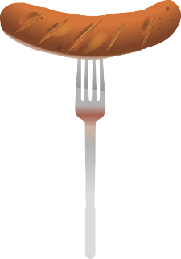



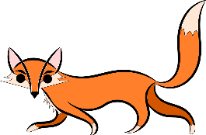


Phonetik 2/2
lesen / sprechen
Tauscht die Rollen.
60
1. Eine Wurst?
1. Zwei Würste!
2. Ein Hut?
2. Zwei Hüte!
6. Eine Kuh?
6. Zwei Kühe!
Sekunden
3. Eine Frucht?
3. Zwei Früchte!
7. Ein Fuß?
7. Zwei Füße!
4. Ein Fuchs?
4. zwei Füchse!
8. Eine Schnur?
6. Zwei Schnüre!
5. Ein Wunsch?
5. Zwei Wünsche!
0
LOS!
Notes:
Word frequency (1 is the most frequent word in German):
Frucht [3323] Fuchs [>5009] Fuß [573] Kuh [2935] Schnur [>5009] Wunsch [1072] Wurst [3923]
Source: Jones, R.L. & Tschirner, E. (2019). A frequency dictionary of German: core vocabulary for learners. Routledge

Slide 23
Vokabeln [1/2]
schreiben
Schreib die Wörter auf Deutsch.
g
e
s
e
s
s
e
n
S
p
r
a
c
h
e
u
n
t
e
r
d
r
a
u
ß
e
n
sat
language
under
outside
L
e
i
s
t
u
n
g
v
o
r
h
a
b
e
n
v
e
r
l
a
n
g
e
n
l
a
u
t
performance
to plan
to demand
loud
W
e
g
m
e
i
s
t
e
n
s
m
i
n
d
e
s
t
e
n
s
f
r
e
m
d
way
mostly
at least
foreign, strange
r
i
e
s
i
g
ü
b
e
n
huge, massive, enormous
to practise
Notes:
Timing: 6 minutes (two slides)
Aim: to practise written production of some of this week’s new and revisited vocabulary. The first and last letters prompt recall of the word in German.
Procedure:
1. Give students 4 minutes in pairs to write the German word for the English translation.
2. Click to reveal the answers sequentially from left to right.

Slide 24


Vokabeln [2/2]
sprechen
Wie heißt … auf Deutsch?
g
e
s
e
s
s
e
n
S
p
r
a
c
h
e
u
n
t
e
r
d
r
a
u
ß
e
n
sat
language
under
outside
L
e
i
s
t
u
n
g
v
o
r
h
a
b
e
n
v
e
r
l
a
n
g
e
n
l
a
u
t
performance
to plan
to demand
loud
W
e
g
m
e
i
s
t
e
n
s
m
i
n
d
e
s
t
e
n
s
f
r
e
m
d
way
mostly
at least
foreign, strange
r
i
e
s
i
g
ü
b
e
n
huge, massive, enormous
to practise
Notes:
Aim: to practise oral production of vocabulary from this week’s sets.
Procedure:
Partner A turns away from the board.
Partner B asks partner A for the German for the 14 words. Partner B chooses the order in which to ask.
Encourage use of target language, ‘Ja, richtig!’, ‘fast’ ,‘leider nicht’ , ‘noch mal’.
Partners swap roles and repeat the task.

Slide 25
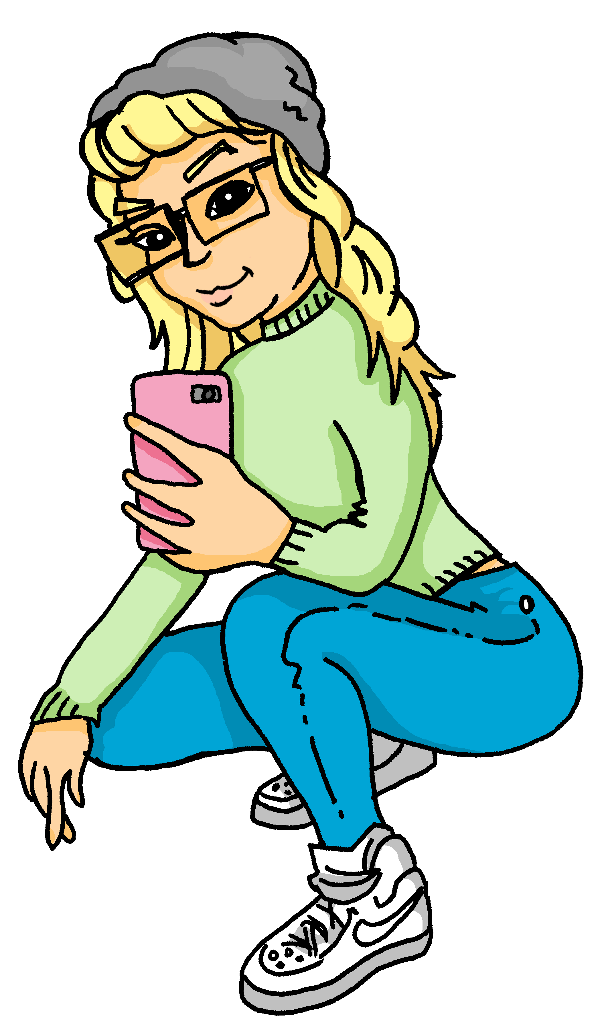



Using verbs reflexively
Grammatik
As you know, many verbs can be used reflexively; this is when the subject and object (receiver of the action) are the same.
English doesn’t always use the reflexive pronoun, but it is needed in German.
Compare:
stellen
Sie stellt die Lampe auf den Nachttisch.
Sie stellt sich auf den Nachttisch.
She puts the lamp on(to) the night table.
She stands (herself up) on the table.
setzen
Sie setzt den Hund auf das Sofa.
Der Hund setzt sich auf das Sofa.
She puts the dog on(to) the sofa.
The dog sits (itself down) on the sofa.
legen
Sie legt den Hamster auf das Bett.
Der Hamster legt sich auf das Bett.
She puts the hamster on(to) the bed.
The hamster lays (itself down) on the bed.
Of course, only animate objects (people and animals) can move themselves like this.
Notes:
Timing: 2 minutes
Aim: to revisit the reflexive use of placement verbs (taught in term 1 – 9.2.1.5 and 9.2.1.6).
Procedure:
1. Cycle through the information on the slide using the animation sequence.
2. Elicit the English for each example.

Slide 26
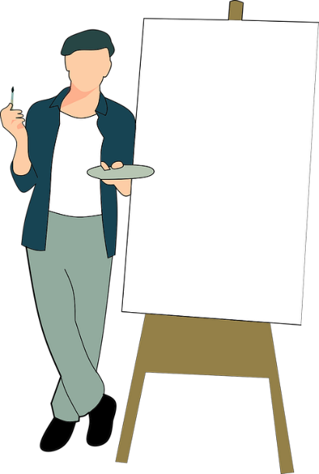
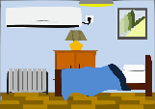
Ein Expertentermin
Mia und Wolfgang haben einen Termin mit einem Zimmer-Makeover-Experten gewonnen. Was sagt der Experte?
hören
 | what goes/ stays where? | movement | no movement
 | plant next to sofa
 | Mieze on the bed
 | plant on the desk
 | Mieze in the corner
 | Mia in corner
 | poster on the wall
 | candle on the table
 | Einstein on the bed
 | light above the desk
 | book under the lamp
Spiel-
zimmer
1
2
3
4
So yes, is it movement or no movement, and we also want a callout to elicit the sentences where people or animals are moving themselves.
5
Q: What is different about 4, 5, and 8?
6
7
A: The pets/ people are moving themselves!
8
9
10
Notes:
Timing: 10 minutes
Aim: to identify from the verb whether there is movement (R2, Accusative) or no movement (R3, Dative)
Procedure:
1. Play recording of item 1 by clicking audio button.
2. Students tick whether there is movement or no movement, and what item goes or stays where (in English)
3. Click to bring up answer tick.
4. Click again to bring up English notes on what time goes/stays where. (To differentiate this activity, you may want to play the audio again for the second step.)
5. Continue for items 2-10.
6. At the end of the table filling, click again to bring up callout question about items 4, 5, 8. Elicit answer: Here, the pets and Mia (person) are moving themselves, as opposed to an object being moved by someone. Click again to bring up the answer.
Transcript:
Die Pflanze hat neben [dem] Sofa gestanden.
Mieze hat auf [dem] Bett gesessen.
Aber jetzt: Die Pflanze stelle ich auf [den] Schreibtisch.
Mieze legt sich in [die] Ecke.
Mia stellt sich in [die Ecke], um zu helfen.
Das Poster hängt an [der] Wand.
Die Kerze steht auf [dem] Tisch.
Einstein setzt sich auf [das] Bett.
Das Licht hängt über [dem] Schreibtisch.
Das Buch lege ich unter die [Lampe].
Word frequency (1 is the most frequent word in German):
Experte [1437] Kerze [3917] Termin [2213]
Source: Jones, R.L. & Tschirner, E. (2019). A frequency dictionary of German: core vocabulary for learners. Routledge

Slide 27
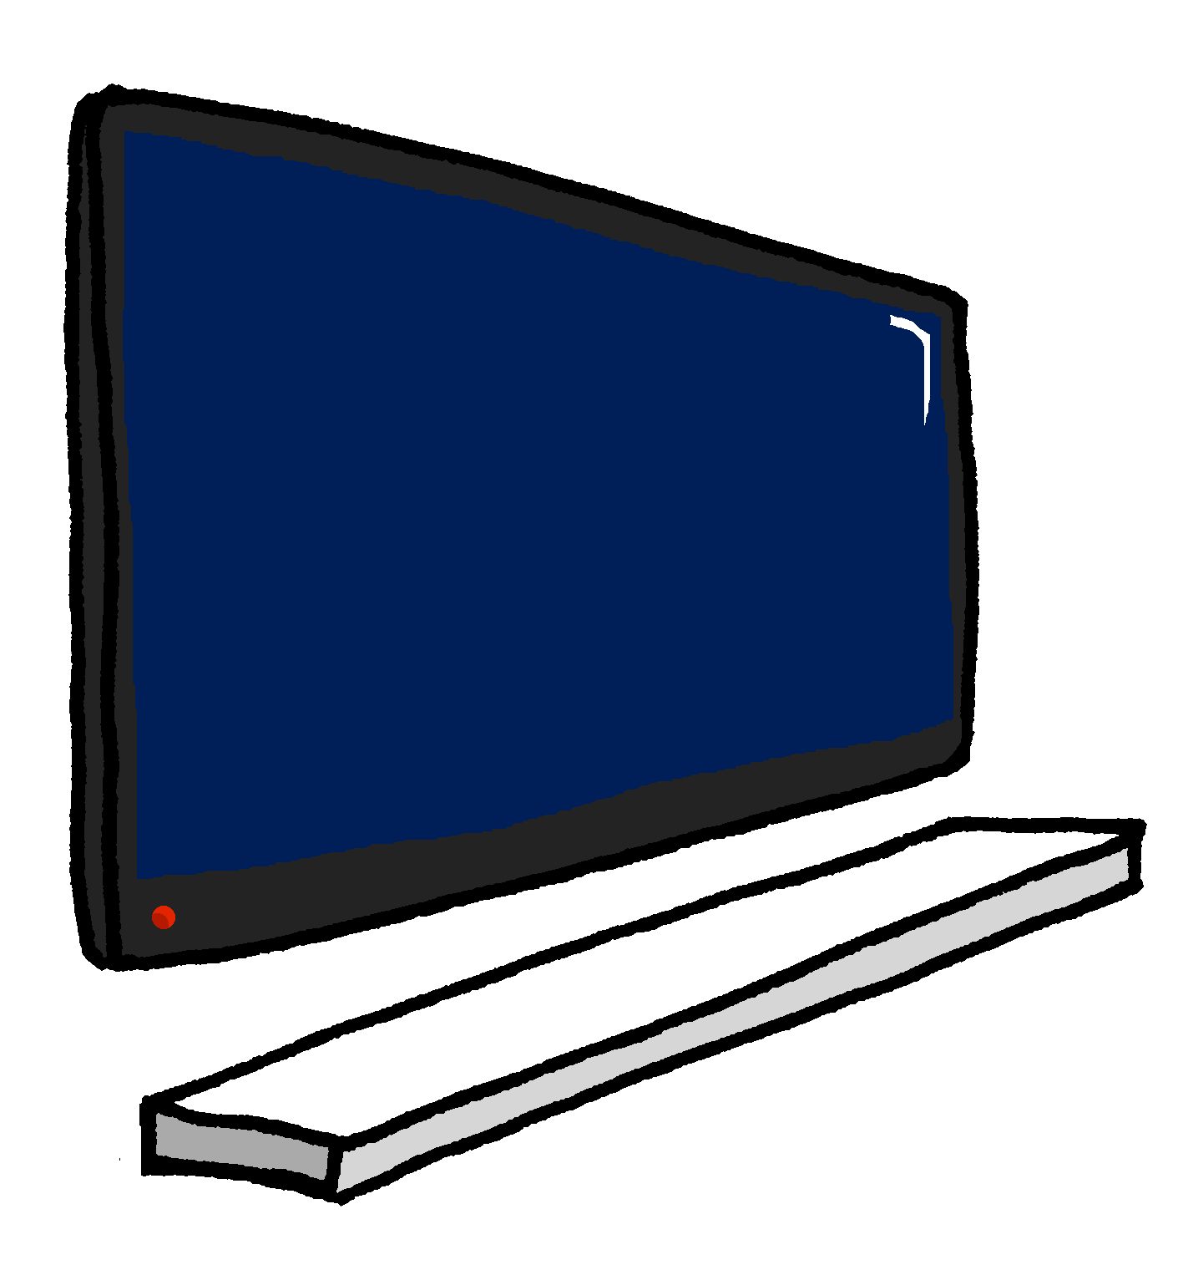

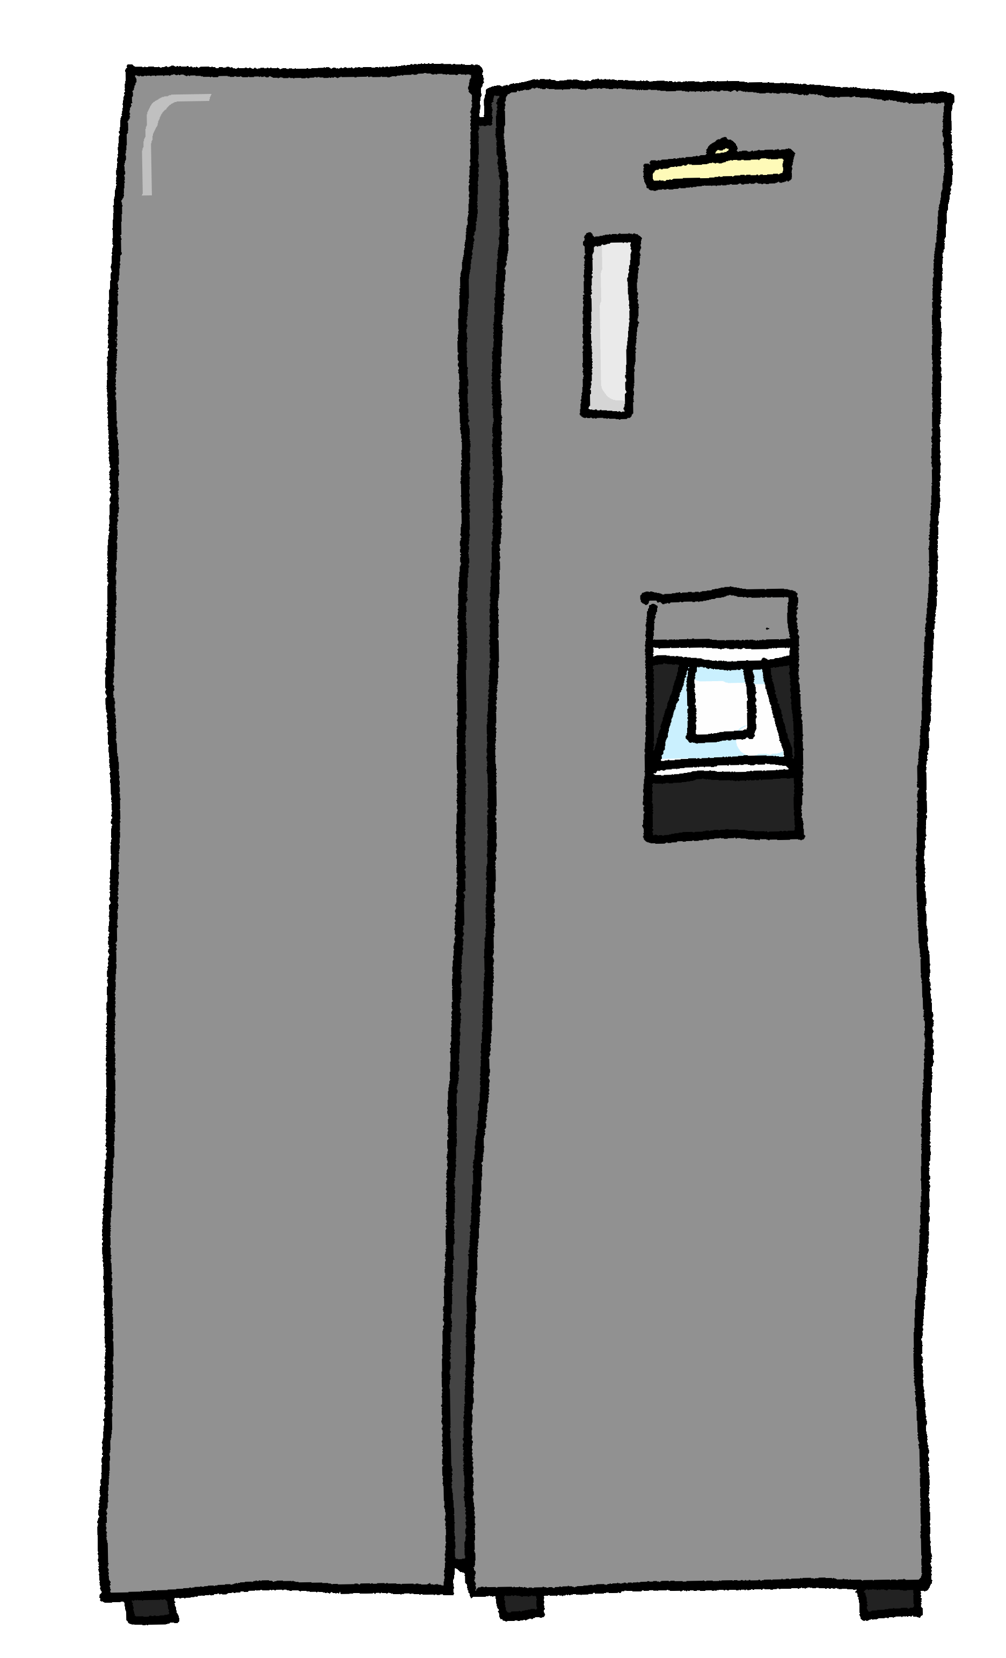


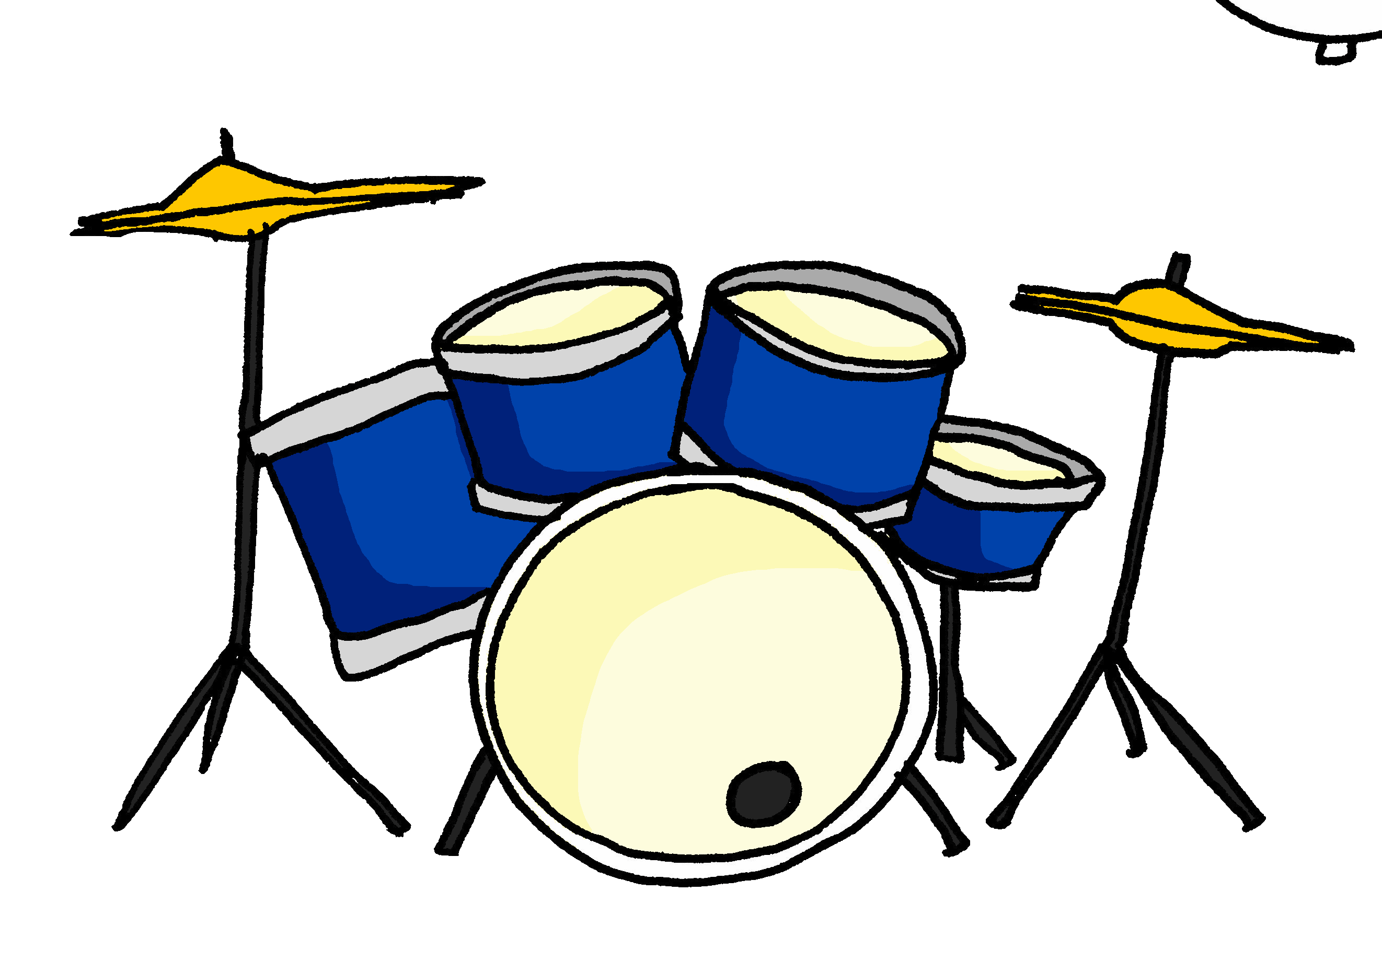
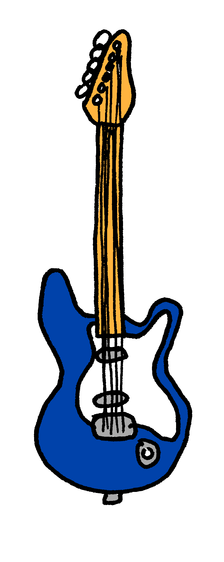
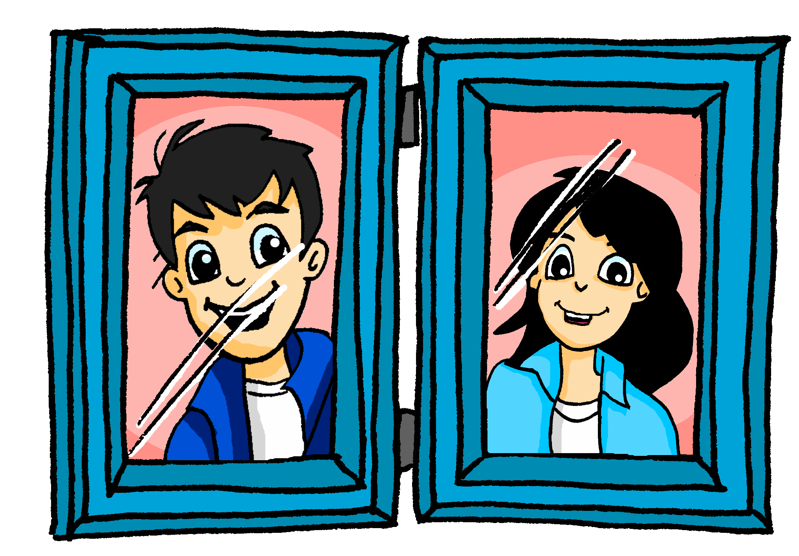
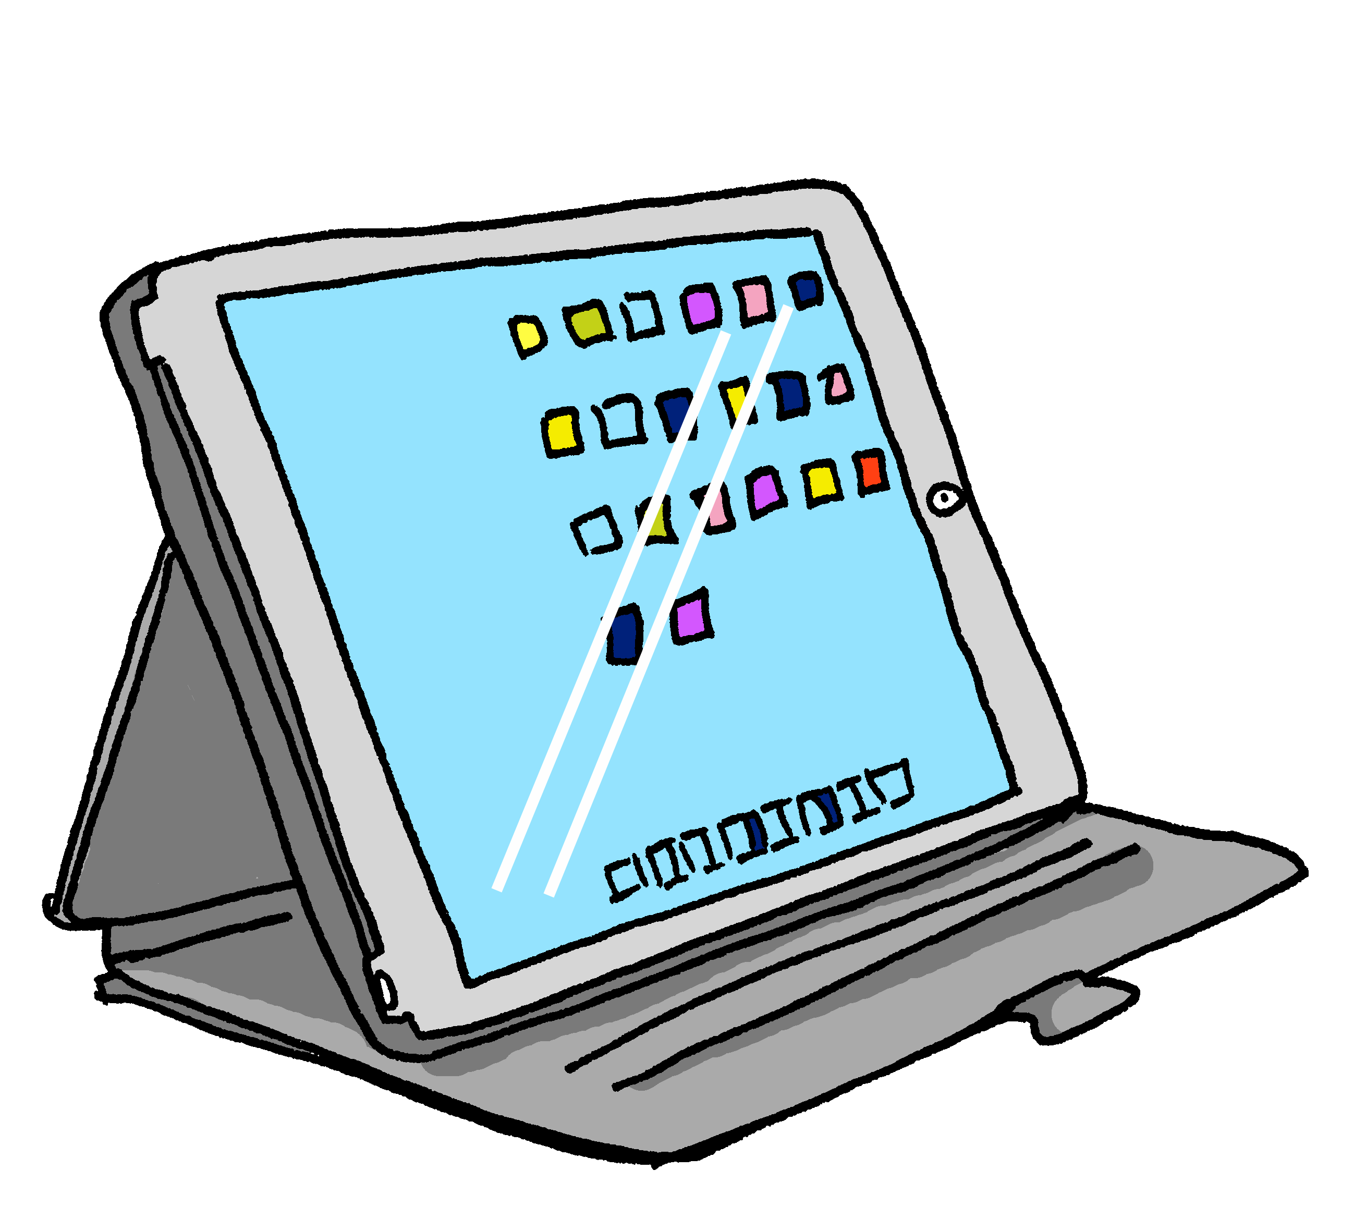

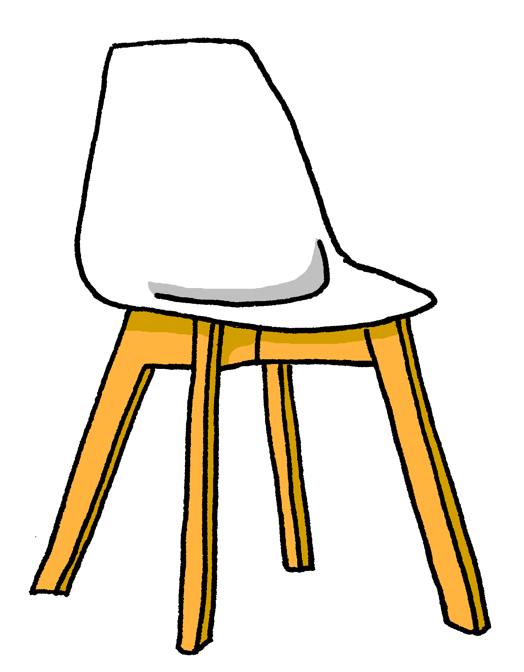
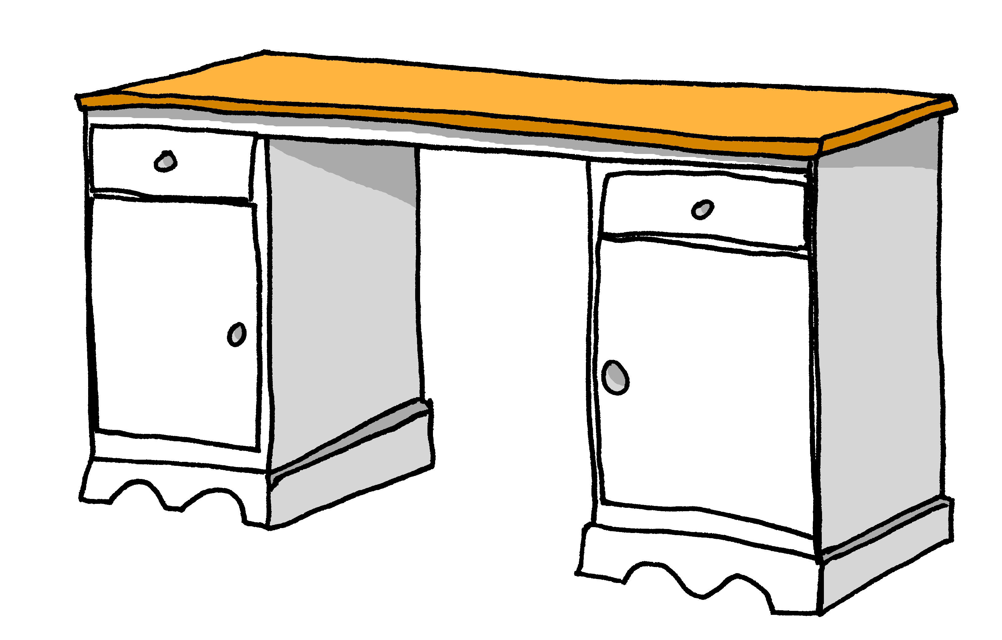
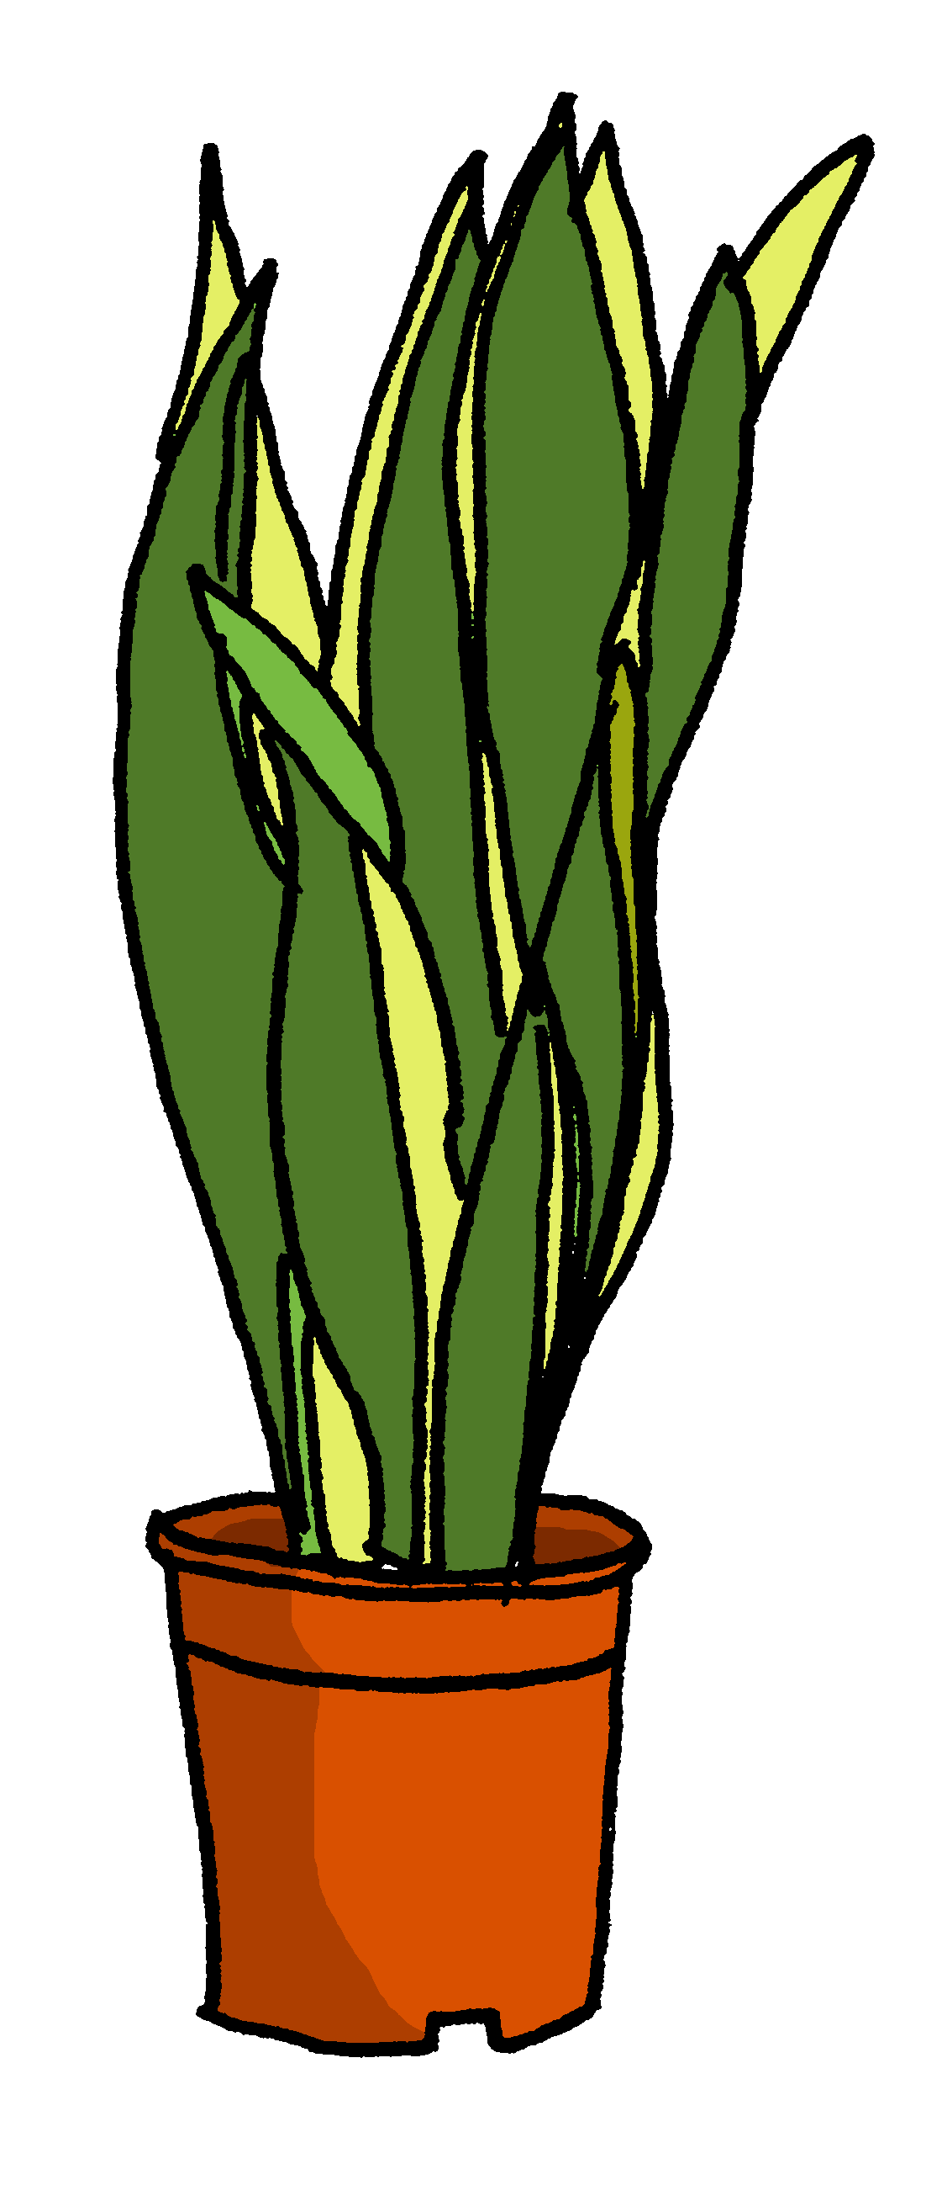
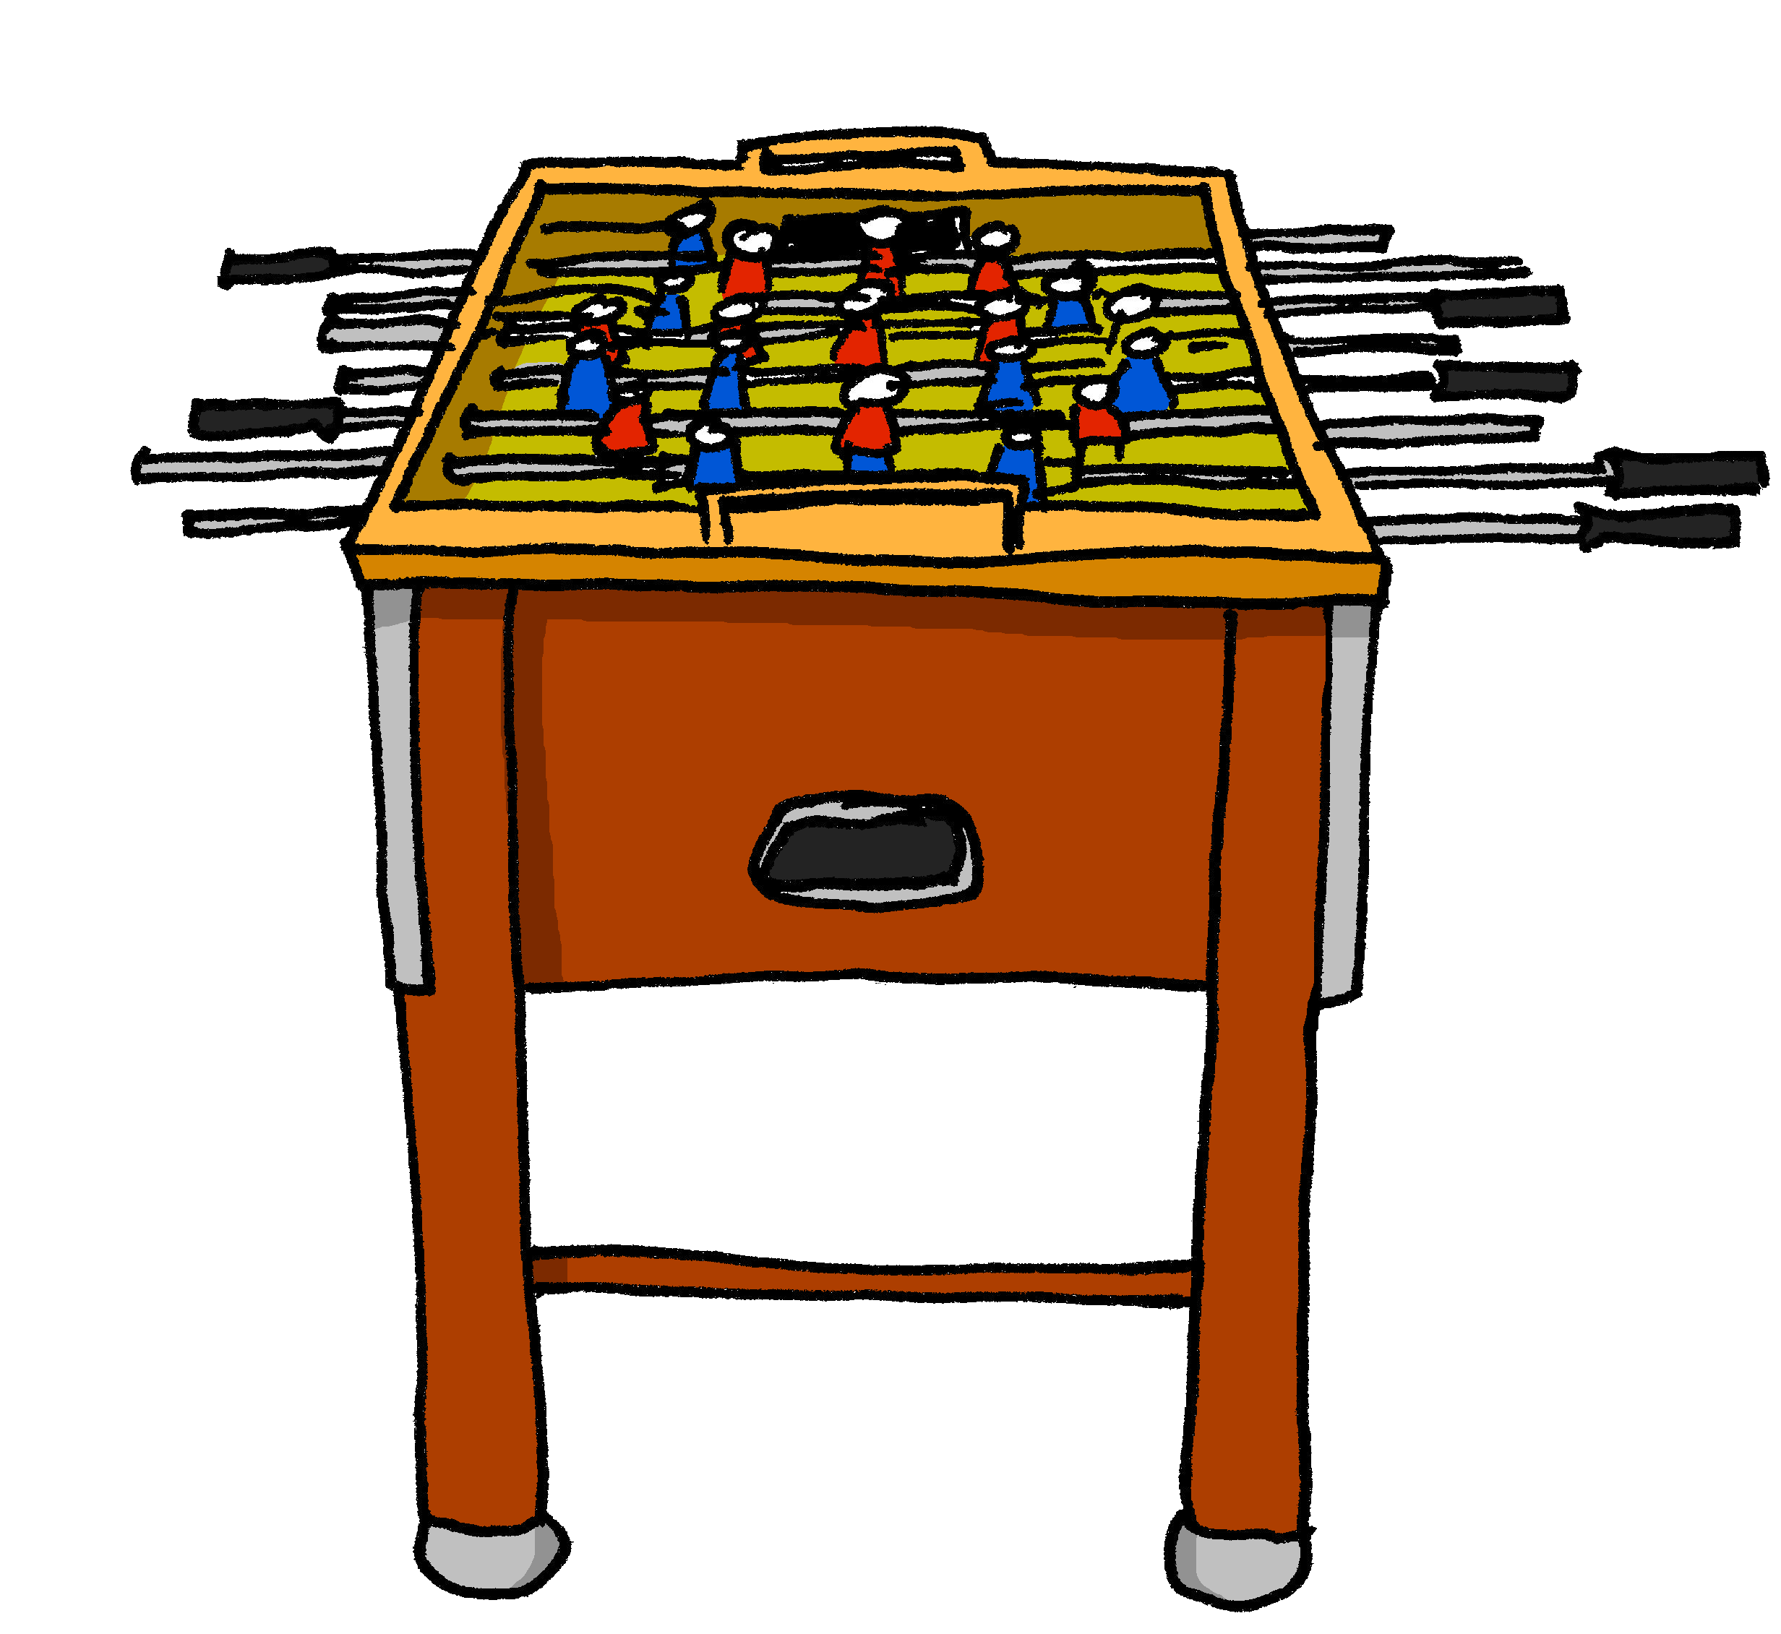
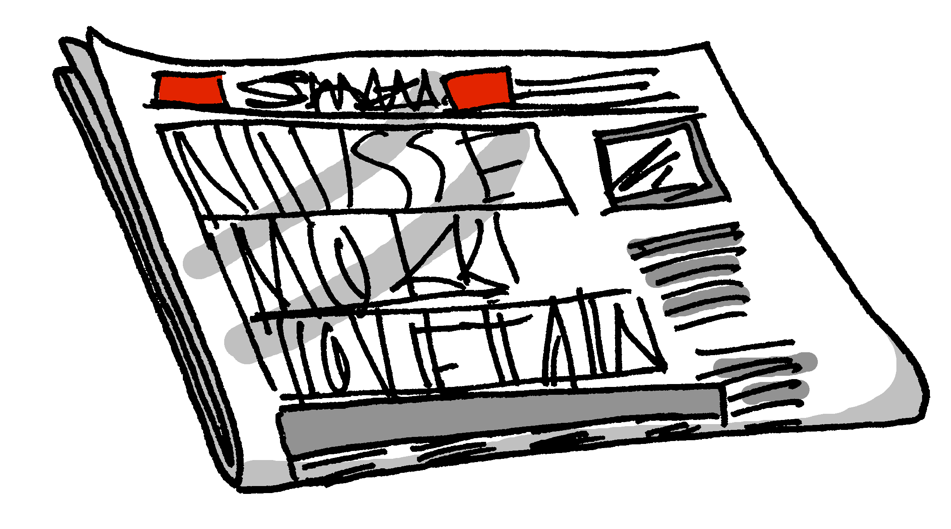

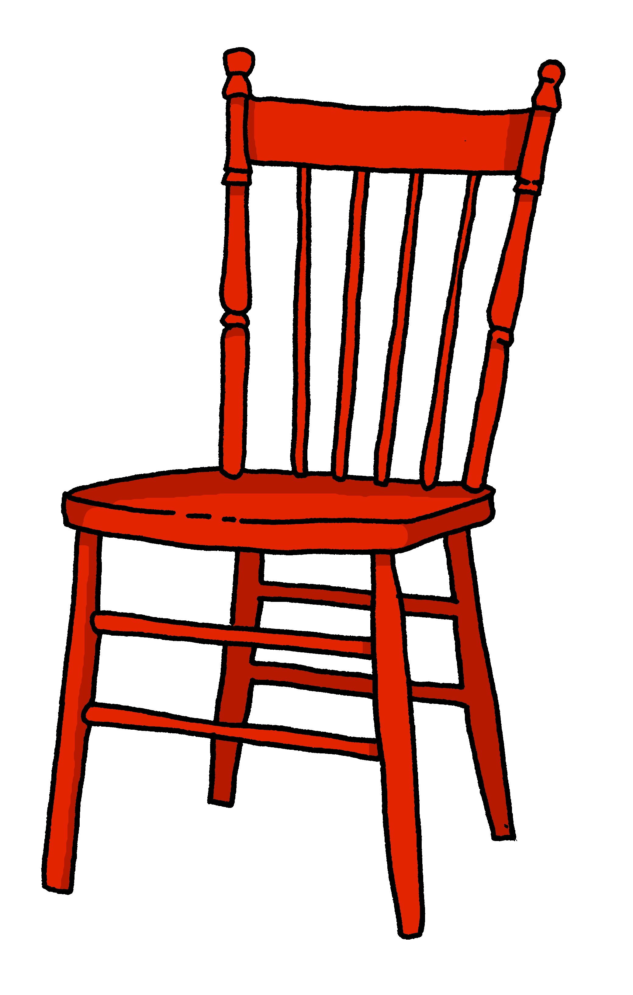
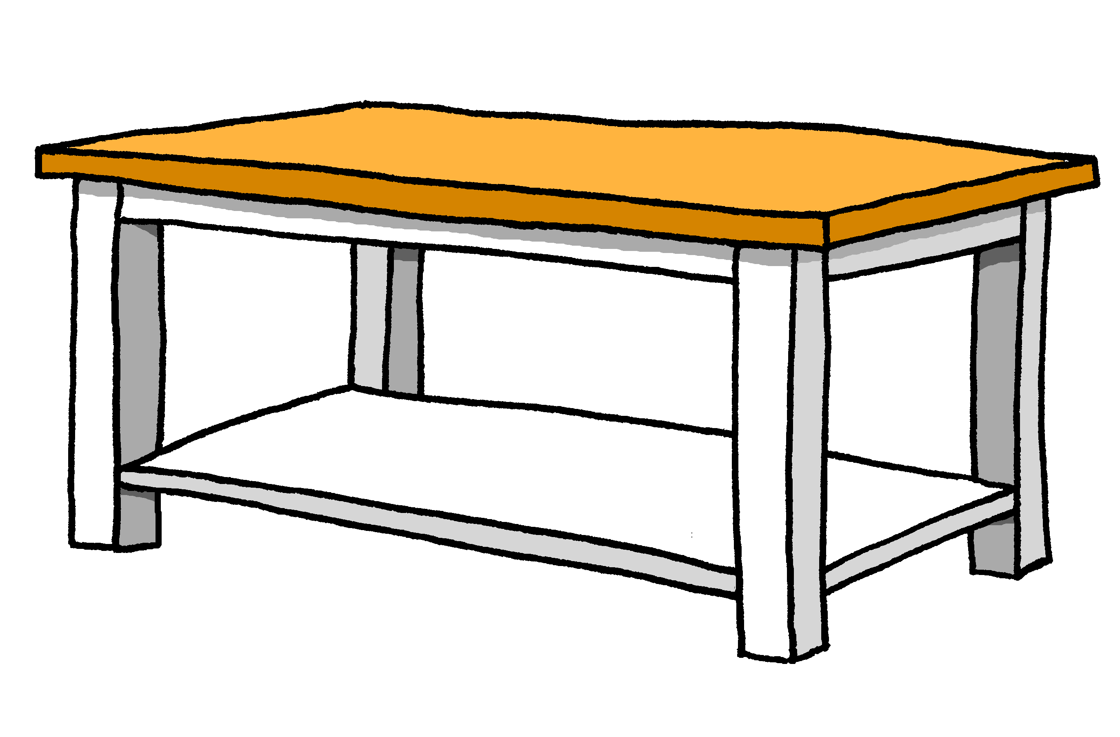
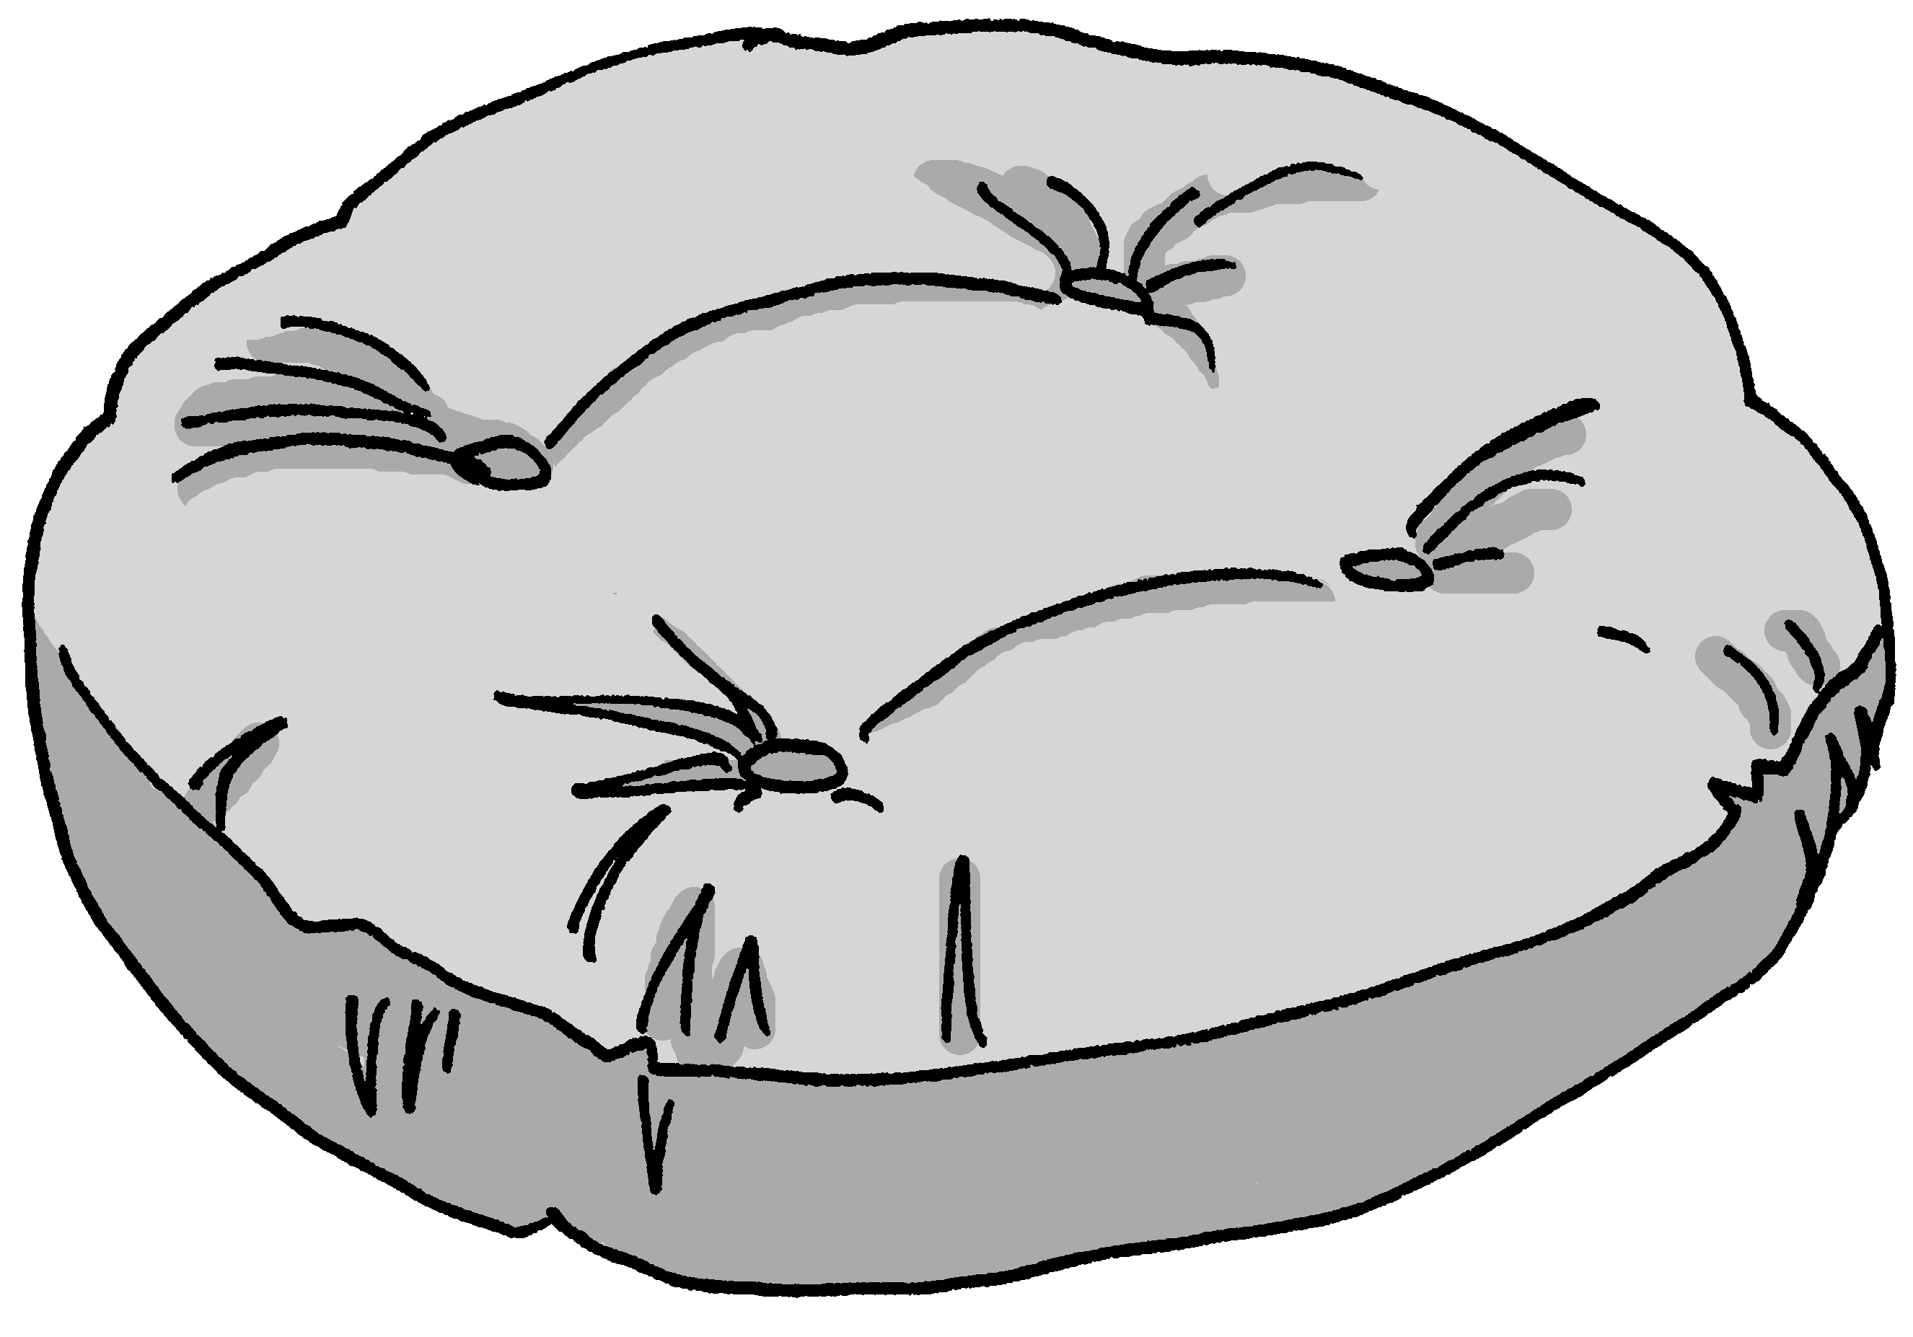
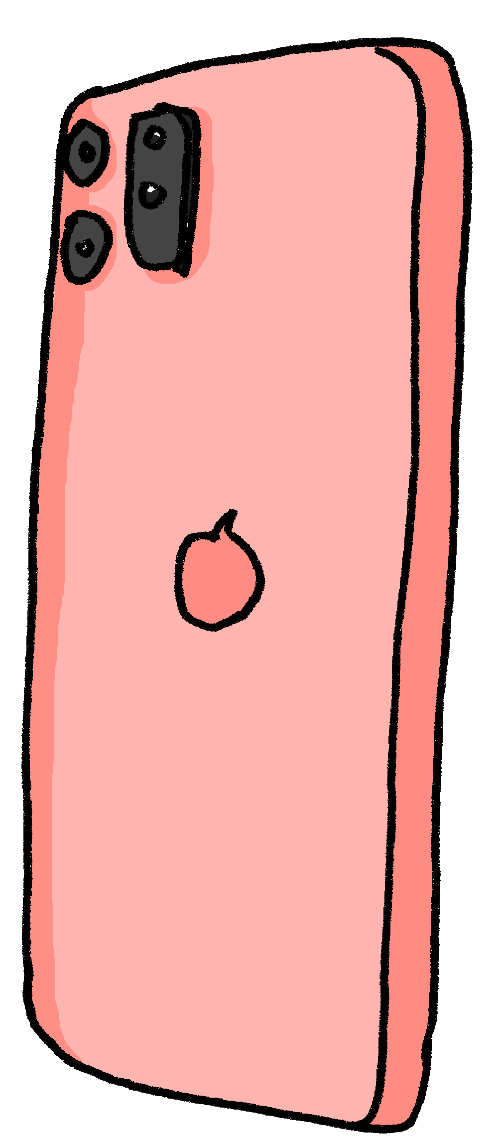
Was ist anders?
Person A: Arbeite mit einem Partner / einer Partnerin.
sprechen
Was sind die Unterschiede* zwischen den zwei Bildern?
Locate the following items:
plant – phone – books – drum kit – fridge – newspaper – white chair – photo – guitar – football table
Locate the following items:
plant – phone – books – drum kit – fridge – newspaper – white chair – photo – guitar – football table
* der Unterschied - difference
Notes:
There is a separate handouts document, with two different versions of the task, as described below.
Timing: 10 minutes
Aim: to practise oral production of nouns, prepositions and articles (R3, dative) in a ‘spot the difference’ room description task.
Procedure 1 (spot the difference):
1. Person A begins and describes the position of one of the items in the room, e.g. “Der Kühlschrank ist neben dem Sofa.”
2. Person B notes the position, compares with his/her version of the picture and states the position of the same item on his/her picture, which either confirms that it is the same or notes that it is different. (E.g. “Ja, der Kühlschrank ist auch neben dem Sofa” OR “Der Kühlschrank ist neben dem Schlagzeug.”) It might be the case that several sentences are needed for students to be sure that the position is the same.
3. Students continue to take it in turns to describe the items’ locations until all 10 items are located.
4. Then they check their pictures against these two slides.
Procedure 2 (information gap):
Note: this is a more straightforward version of the task
1. Person A has an almost empty version of the room and has to ask the whereabouts of the 10 items.
2. Person B has the completed room and has to tell Person A where each of the items is.
3. Person A draws them in on his sheet.
4. Swap roles and use the 2nd set of pictures.
Note: these two slides have the correct answer versions, irrespective of the version of the task chosen.
Word frequency (1 is the most frequent word in German):
Fernseher [2827] Kerze [3917] Kissen [4898] Poster [>5009] Sofa [3572]
Source: Jones, R.L. & Tschirner, E. (2019). A frequency dictionary of German: core vocabulary for learners. Routledge

Slide 28
Was ist anders?
Person B: Arbeite mit einem Partner / einer Partnerin.
sprechen
Was sind die Unterschiede* zwischen den zwei Bildern?
Locate the following items:
plant – phone – books – drum kit – fridge – newspaper – white chair – photo – guitar – football table
* der Unterschied - difference
Notes:
ANSWERS for Person B
Word frequency (1 is the most frequent word in German):
Fernseher [2827] Kerze [3917] Kissen [4898] Poster [>5009] Sofa [3572]
Source: Jones, R.L. & Tschirner, E. (2019). A frequency dictionary of German: core vocabulary for learners. Routledge

Slide 29
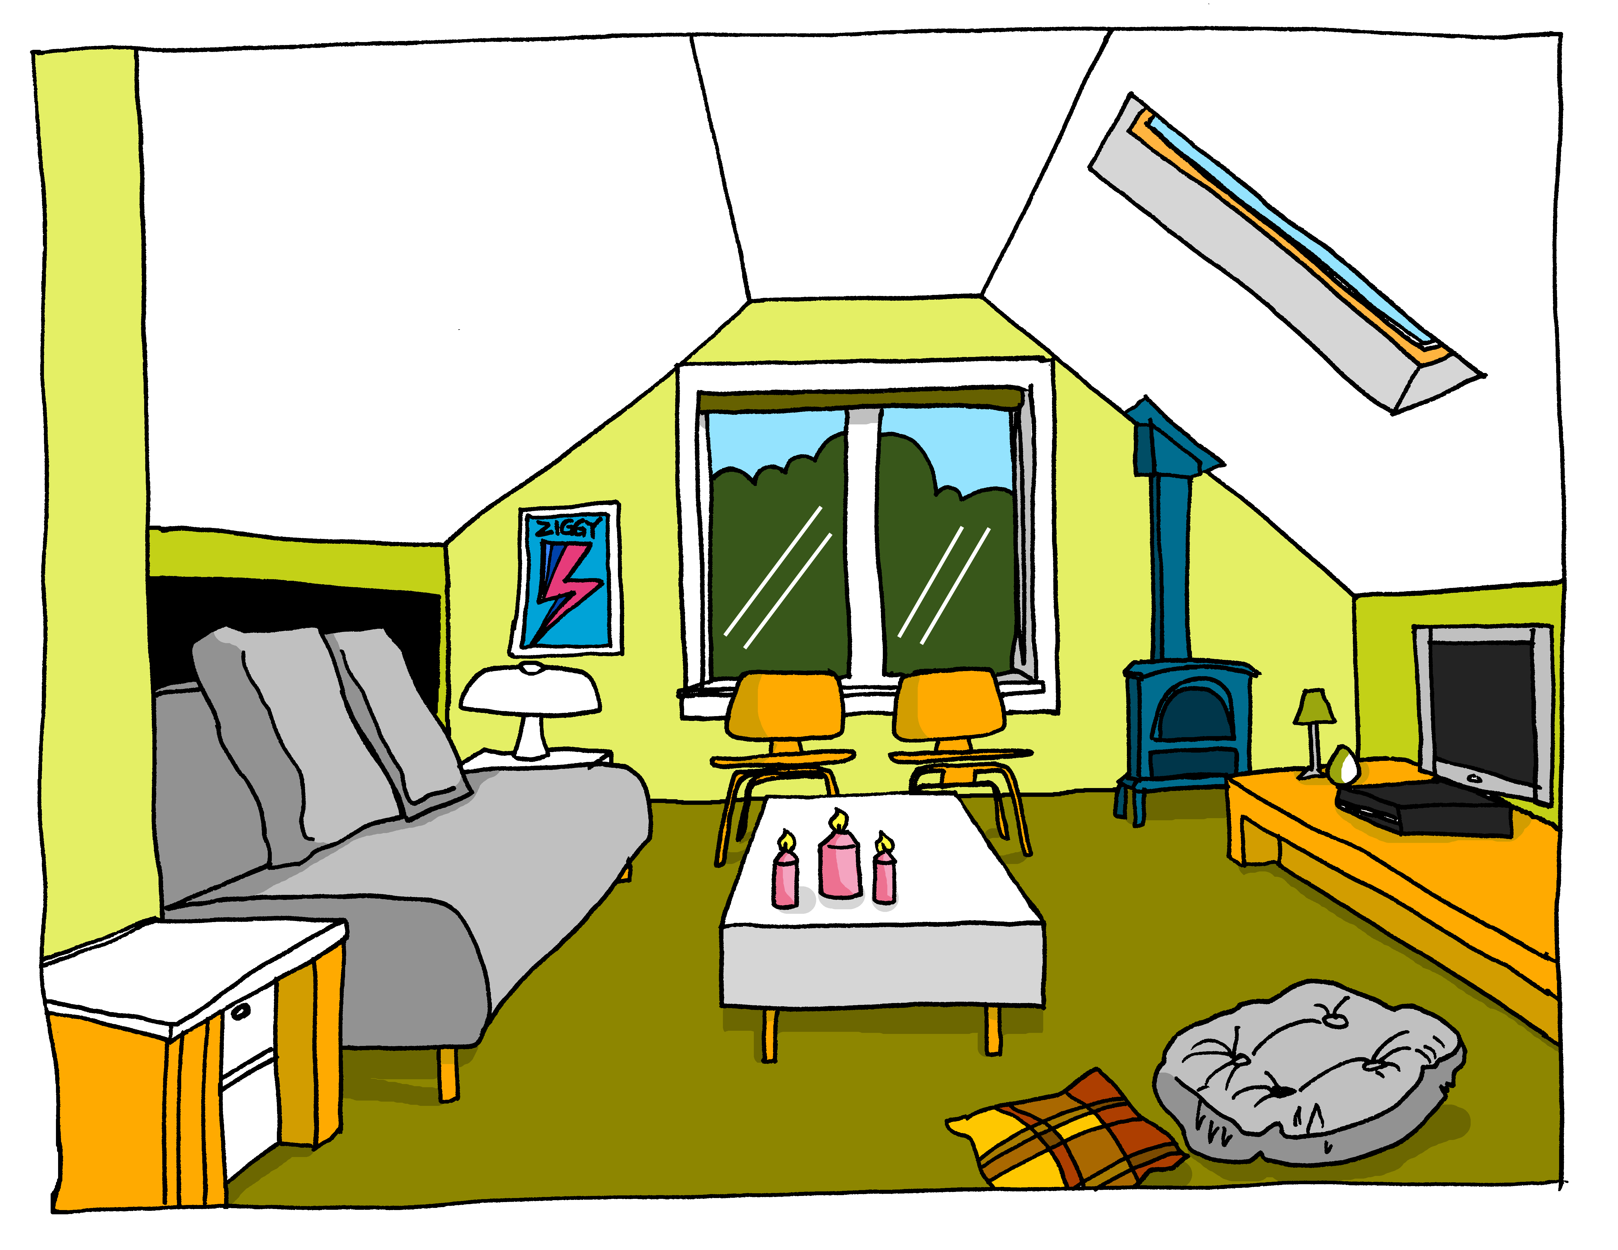
Muttis Ruheraum
Mutti ist auch glücklich.
Sie hat sich oben einen Ruheraum gemacht.
schreiben
Beschreibe Muttis Ruheraum.
Benutze diese Wörter:
das Dach
die Ecke
linke(r,s)
rechte(r,s)
draußen
gesessen
üben
verbessern
entwickeln
über
unter
zwischen
auf
an
in
hinter
vor
neben
der Fernseher – TV
die Kerze – candle
das Kissen – cushion
das Poster – poster
das Sofa – sofa
Notes:
Timing: 10 minutes
Aim: to practise written production of sentences using nouns and prepositions in R3 (dative) in a loosely structured task.
Procedure:
1. Explain the task to students. They will describe the picture in writing, trying to include (at least once) the 18 words provided. They may additionally use the glossed words.
2. For additional challenge, students can be prompted to add in further ideas, e.g. Katrin’s opinions.
Notes: focus correction on the use of prepositions and the correct spelling of articles that follow them, rather than correcting every error, as this feature has been the focus of teaching in this sequence. It makes sense to provide direct corrections for these errors. A suitable follow up task could ask students to produce a new sentence using the same preposition.
Word frequency (1 is the most frequent word in German):
Fernseher [2827] Kerze [3917] Kissen [4898] Poster [>5009] Sofa [3572]
Source: Jones, R.L. & Tschirner, E. (2019). A frequency dictionary of German: core vocabulary for learners. Routledge

Slide 30



Hausaufgaben
Vocabulary Learning Homework (Y9, Term 3.1, Week 4)
Student worksheet
Quizlet QR code:
Quizlet link

