Slide 1
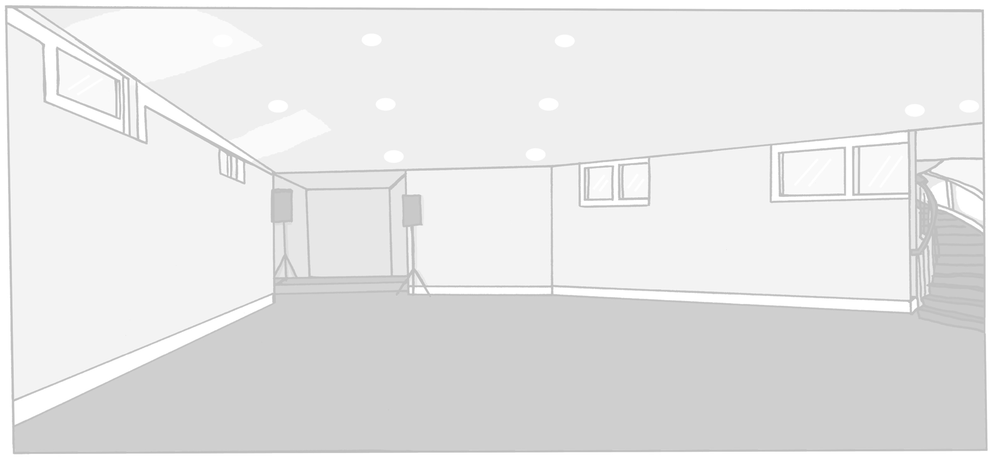
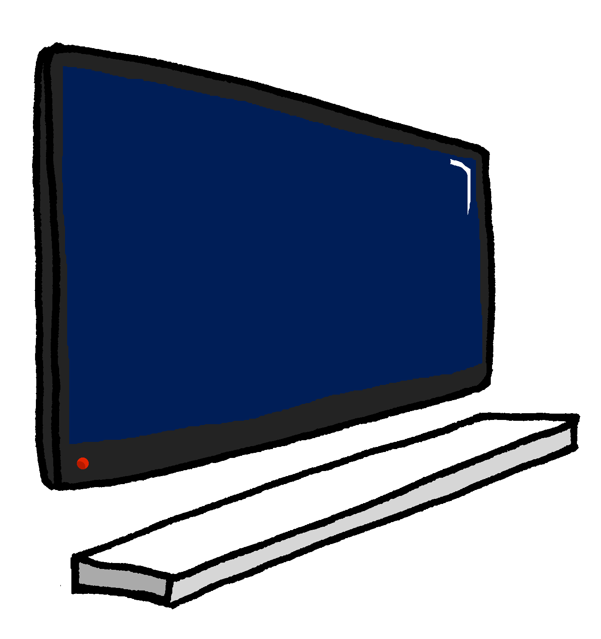
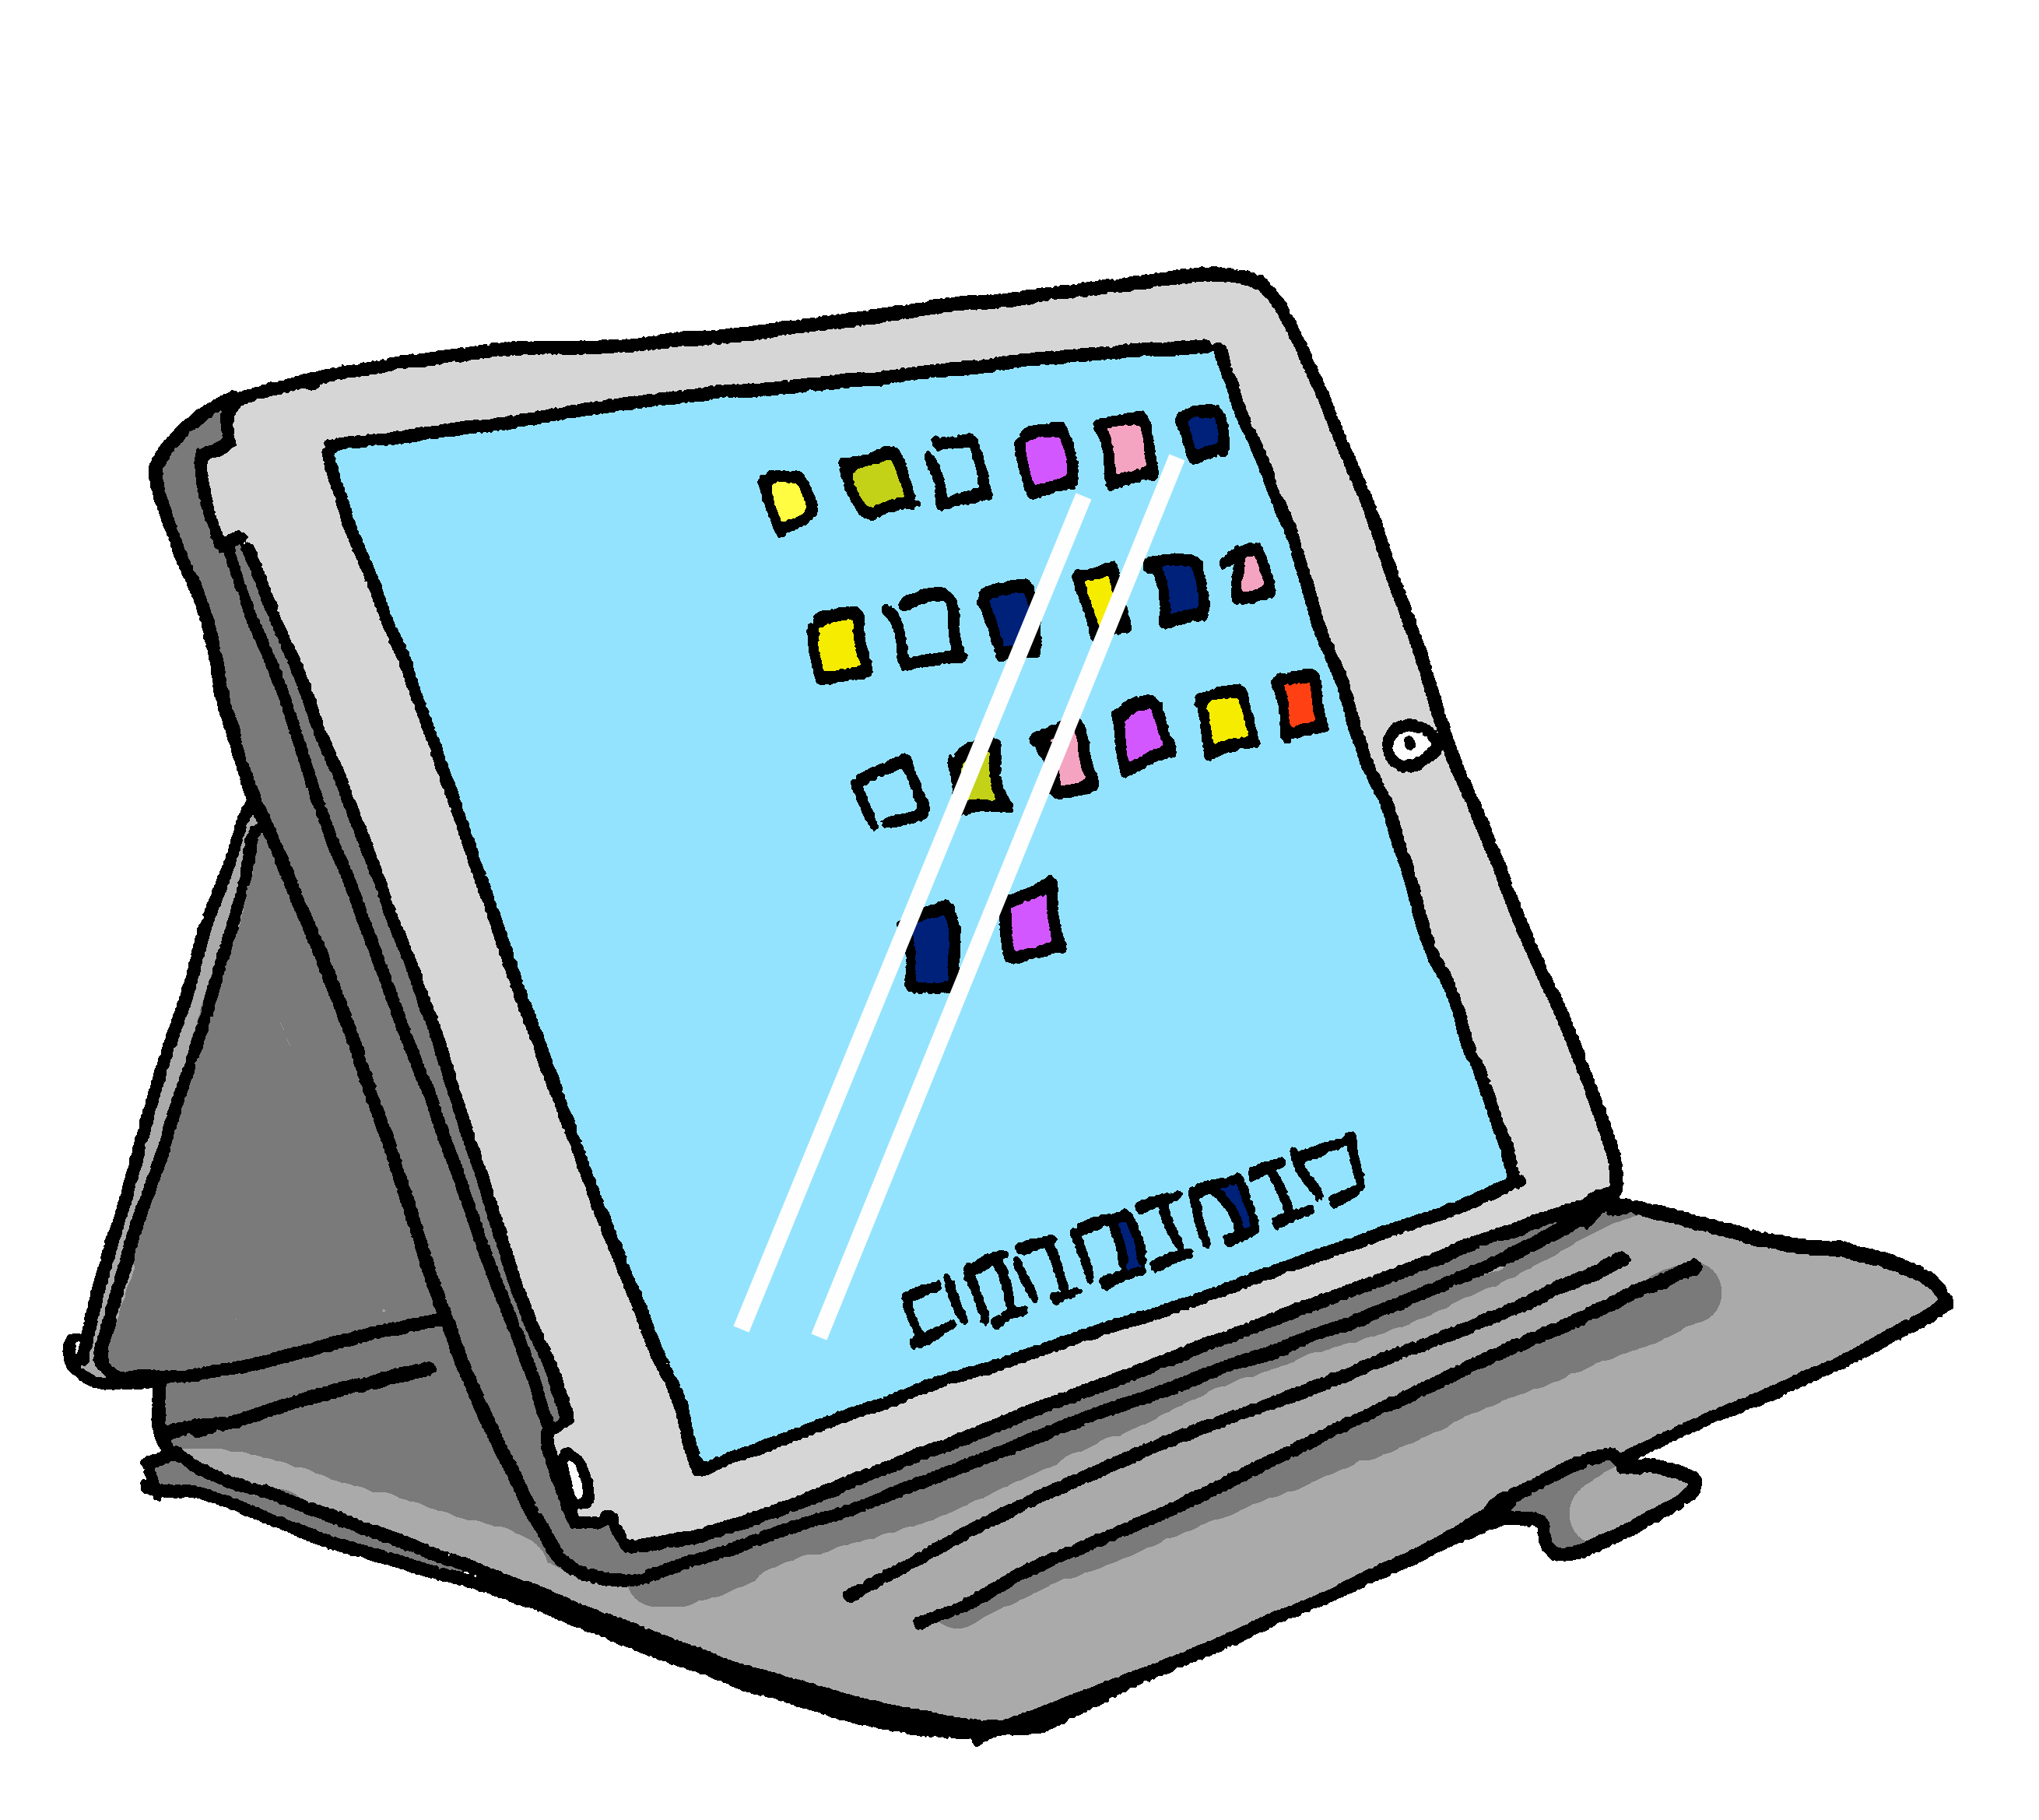
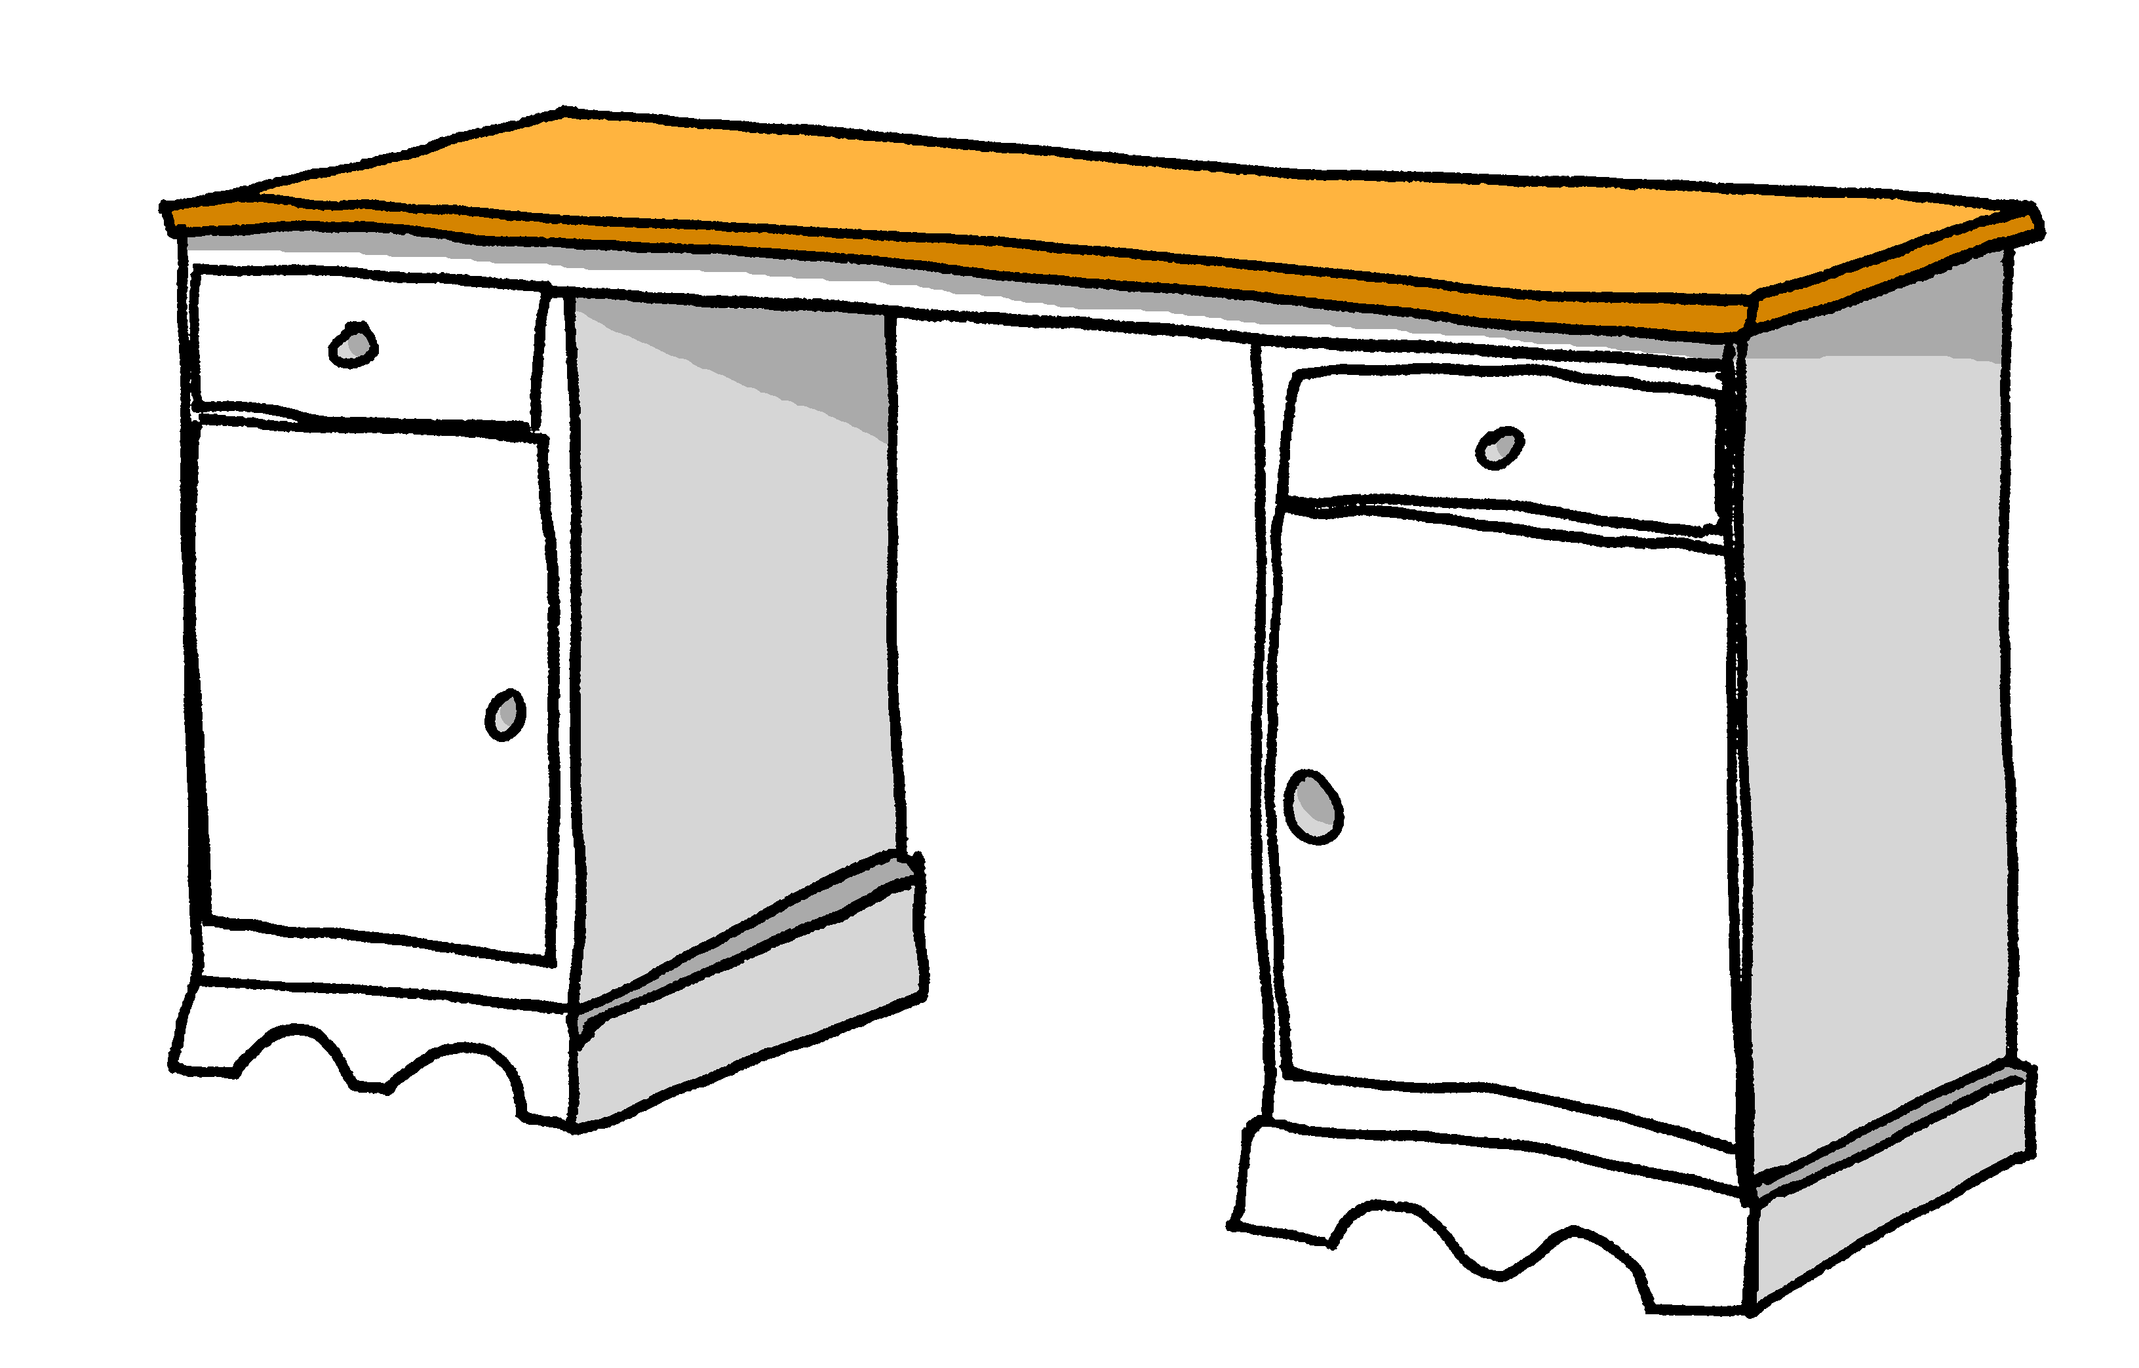
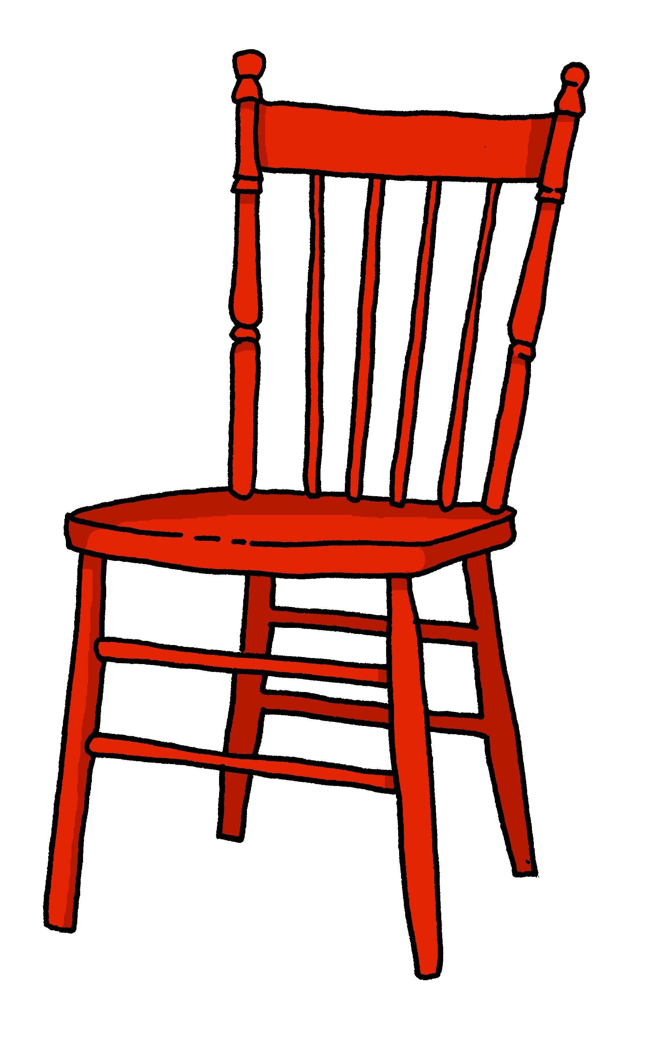
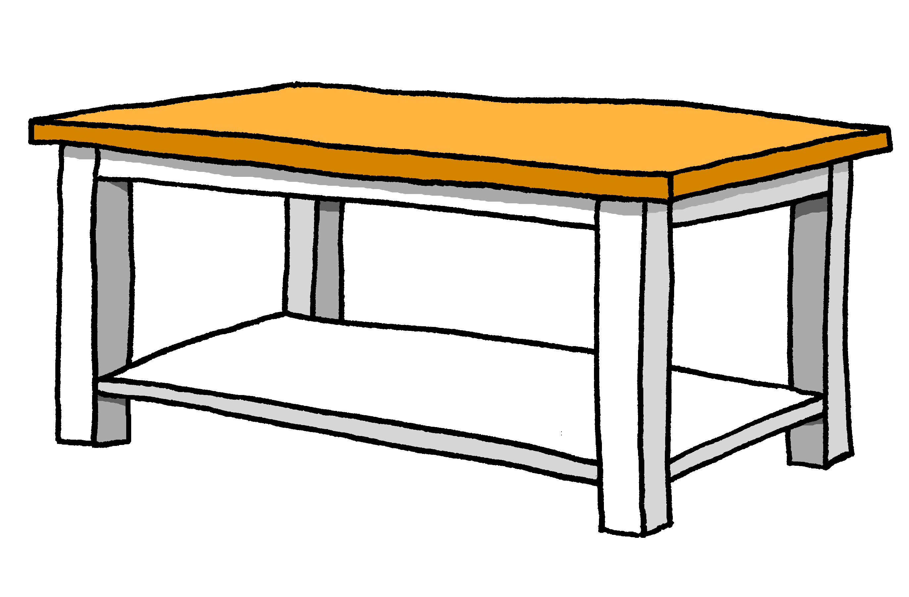
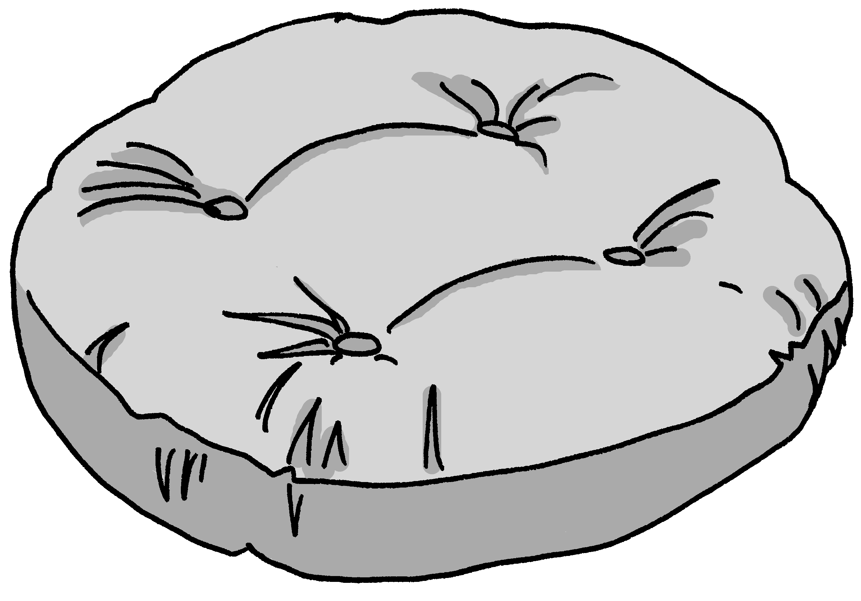
Was ist wo?
Person A: Frag deinen/deine Partner*in.
sprechen
Wo sind die Dinge?
Locate the following items: plant – phone – books – drum kit – fridge – newspaper – white chair – photo – guitar – football table
Notes:
Timing: 10 minutes Aim: to practise oral production of nouns, prepositions and articles (R3, dative) in a ‘spot the difference’ room description task. Procedure: 1. Person A begins and describes the position of one of the items in the room, e.g. “Der Külschrank ist neben dem Sofa.”
2. Person B notes the position, compares with his/her version of the picture and states the position of the same item on his/her picture, which either confirms that it is the same or different. (E.g. Ja, der Kühlschrank ist auch neben dem Sofa. OR Der Kühlschrank ist neben dem Schlagzeug.) It might be the case that several sentences are needed for students to be sure that the position is the same.
3. Students continue to take it in turns to describe the items’ locations until all 10 items are located.
4. Then they check their pictures against these two slides. Word frequency (1 is the most frequent word in German): Fernseher [2827] Kerze [3917] Kissen [4898] Poster [>5009] Sofa [3572] Source: Jones, R.L. & Tschirner, E. (2019). A frequency dictionary of German: core vocabulary for learners. Routledge

Slide 2
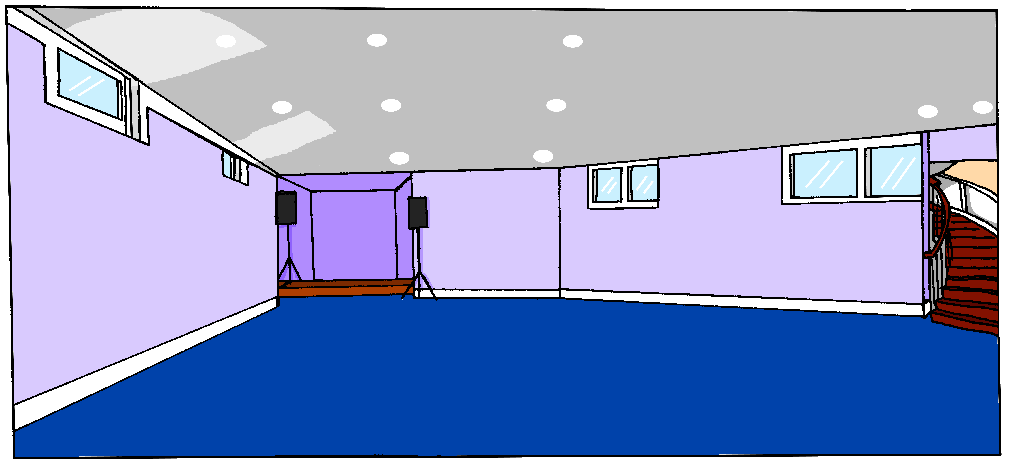
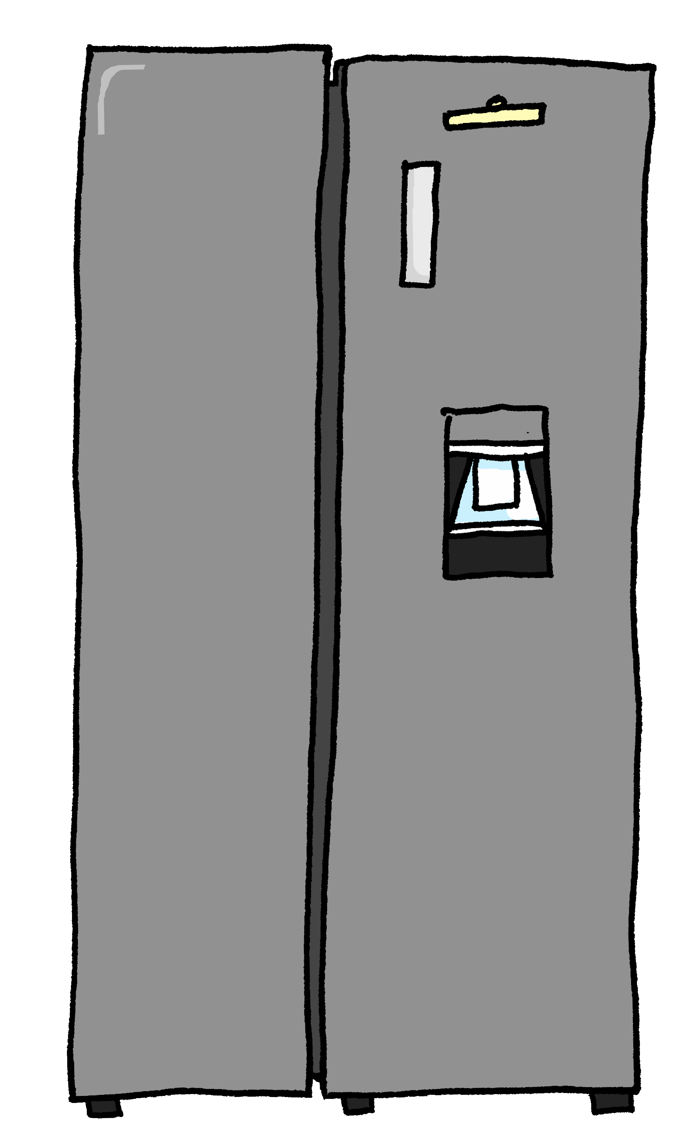
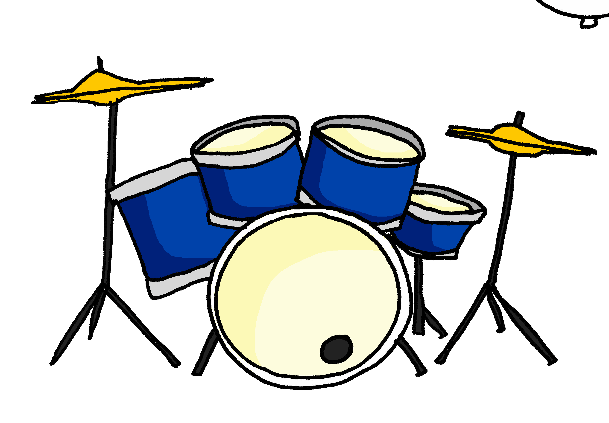
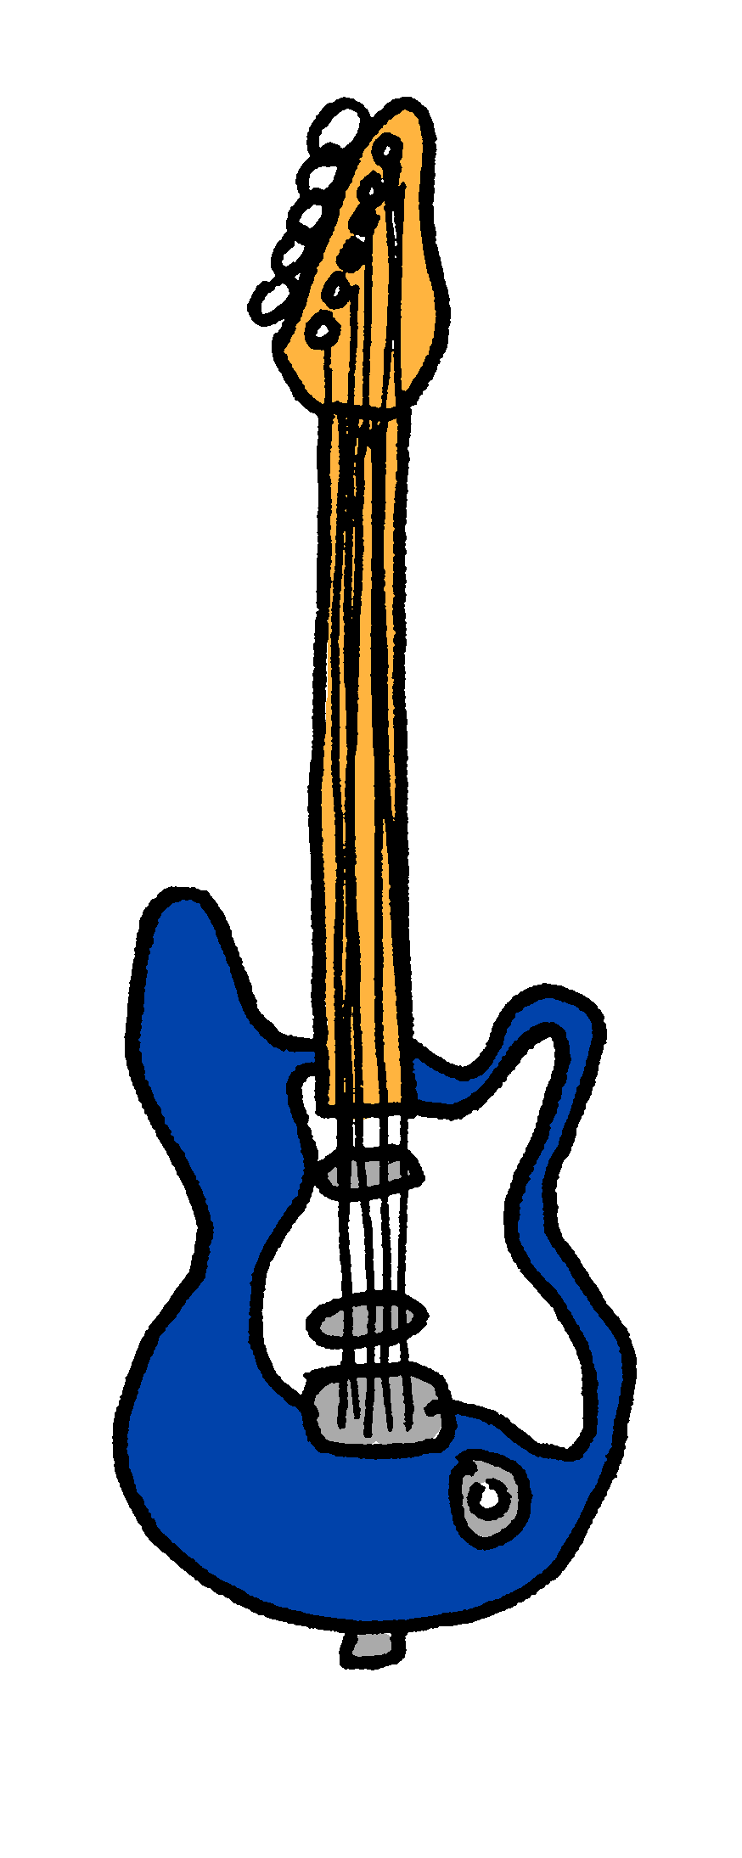
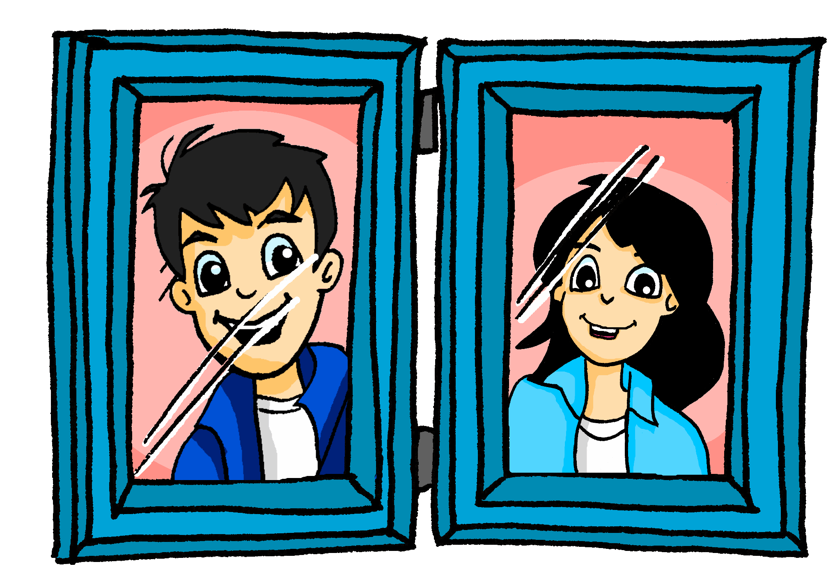
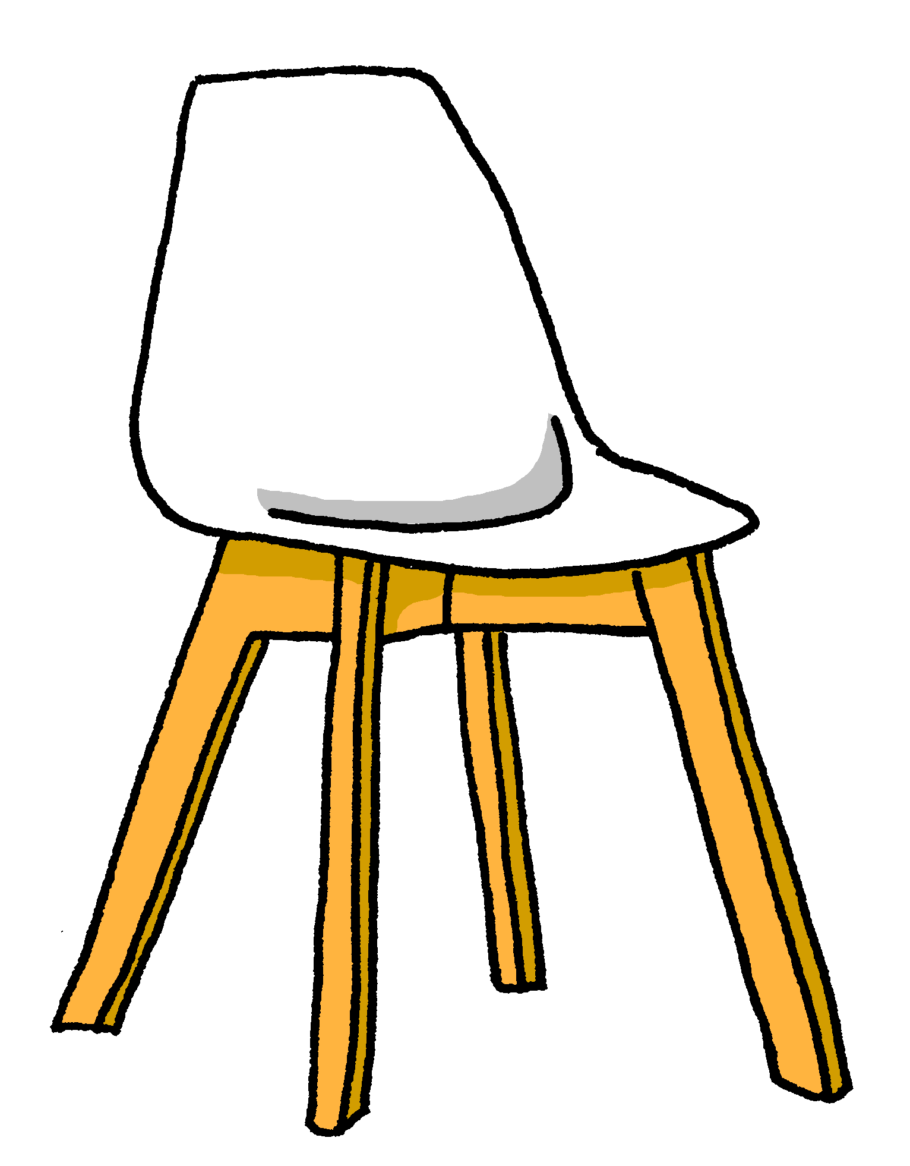
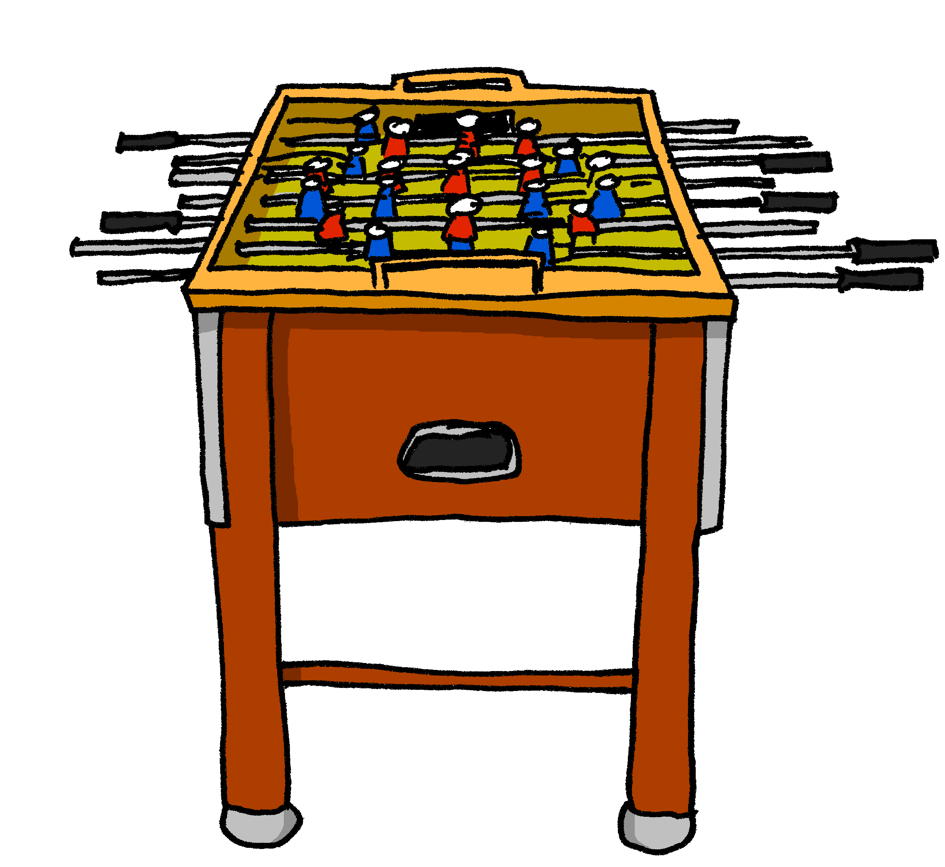
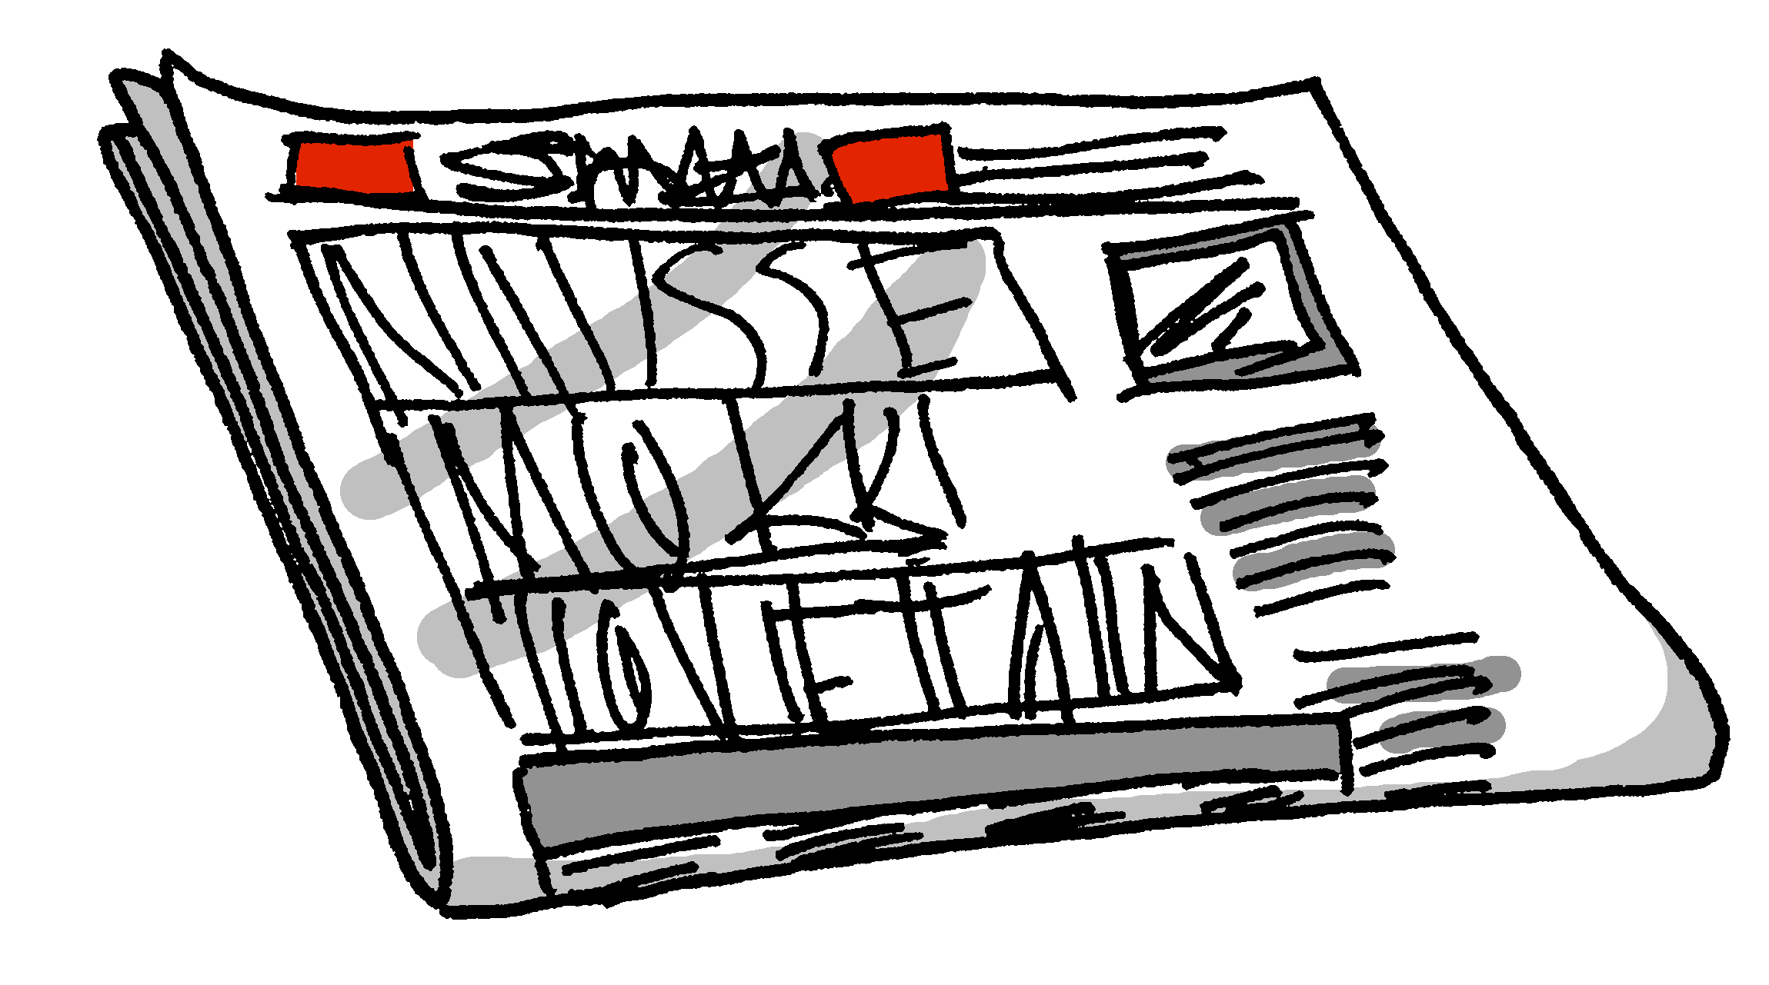
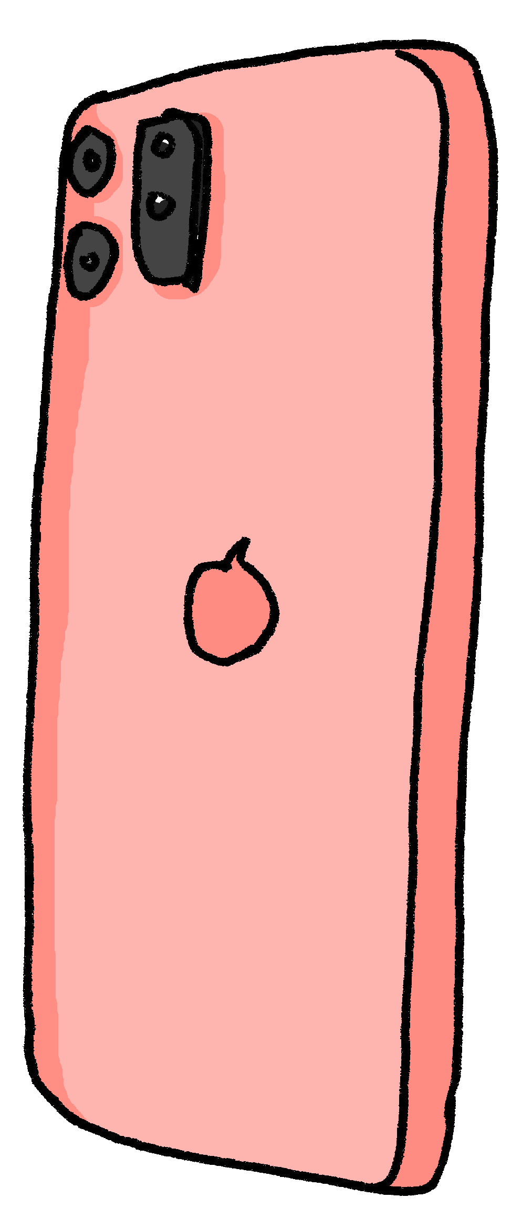
Was ist wo?
Person B: Dein(e) Partner*in fragt dich.
sprechen
Sag deinem/deiner Partner*in wo die Dinge sind.
Notes:
Timing: 10 minutes Aim: to practise oral production of nouns, prepositions and articles (R3, dative) in a ‘spot the difference’ room description task. Procedure: 1. Person A begins and describes the position of one of the items in the room, e.g. “Der Külschrank ist neben dem Sofa.”
2. Person B notes the position, compares with his/her version of the picture and states the position of the same item on his/her picture, which either confirms that it is the same or different. (E.g. Ja, der Kühlschrank ist auch neben dem Sofa. OR Der Kühlschrank ist neben dem Schlagzeug.) It might be the case that several sentences are needed for students to be sure that the position is the same.
3. Students continue to take it in turns to describe the items’ locations until all 10 items are located.
4. Then they check their pictures against these two slides. Word frequency (1 is the most frequent word in German): Fernseher [2827] Kerze [3917] Kissen [4898] Poster [>5009] Sofa [3572] Source: Jones, R.L. & Tschirner, E. (2019). A frequency dictionary of German: core vocabulary for learners. Routledge

Slide 3
Was ist wo?
Person A: Dein(e) Partner*in fragt dich.
sprechen
Sag deinem/deiner Partner*in wo die Dinge sind.
Notes:
Partner B handout
Word frequency (1 is the most frequent word in German): Fernseher [2827] Kerze [3917] Kissen [4898] Poster [>5009] Sofa [3572] Source: Jones, R.L. & Tschirner, E. (2019). A frequency dictionary of German: core vocabulary for learners. Routledge

Slide 4
Was ist wo?
Person B: Frag deinen/deine Partner*in.
sprechen
Wo sind die Dinge?
Locate the following items: plant – phone – books – drum kit – fridge – newspaper – red chair – photo – guitar – football table
Notes:
Partner B handout
Word frequency (1 is the most frequent word in German): Fernseher [2827] Kerze [3917] Kissen [4898] Poster [>5009] Sofa [3572] Source: Jones, R.L. & Tschirner, E. (2019). A frequency dictionary of German: core vocabulary for learners. Routledge

Slide 5
Was ist anders?
Person A: Arbeite mit einem/einer Partner*in.
sprechen
Was sind die Unterschiede* zwischen den zwei Bildern?
Locate the following items: plant – phone – books – drum kit – fridge – newspaper – white chair – photo – guitar – football table
der Unterschied - difference
Notes:
Timing: 10 minutes Aim: to practise oral production of nouns, prepositions and articles (R3, dative) in a ‘spot the difference’ room description task. Procedure: 1. Person A begins and describes the position of one of the items in the room, e.g. “Der Külschrank ist neben dem Sofa.”
2. Person B notes the position, compares with his/her version of the picture and states the position of the same item on his/her picture, which either confirms that it is the same or different. (E.g. Ja, der Kühlschrank ist auch neben dem Sofa. OR Der Kühlschrank ist neben dem Schlagzeug.) It might be the case that several sentences are needed for students to be sure that the position is the same.
3. Students continue to take it in turns to describe the items’ locations until all 10 items are located.
4. Then they check their pictures against these two slides. Word frequency (1 is the most frequent word in German): Fernseher [2827] Kerze [3917] Kissen [4898] Poster [>5009] Sofa [3572] Source: Jones, R.L. & Tschirner, E. (2019). A frequency dictionary of German: core vocabulary for learners. Routledge

Slide 6
Was ist anders?
Person B: Arbeite mit einem/einer Partner*in.
sprechen
Was sind die Unterschiede* zwischen den zwei Bildern?
Locate the following items: plant – phone – books – drum kit – fridge – newspaper – white chair – photo – guitar – football table
der Unterschied - difference
Notes:
Partner B handout
Word frequency (1 is the most frequent word in German): Fernseher [2827] Kerze [3917] Kissen [4898] Poster [>5009] Sofa [3572] Source: Jones, R.L. & Tschirner, E. (2019). A frequency dictionary of German: core vocabulary for learners. Routledge

