Slide 1
National Centre for Excellence in Language Pedagogy
Supporting MFL curriculum, resources, and pedagogy
Emma Marsden and all NCELP colleagues
Date updated: 02/02/2021
Notes:
I am presenting today on behalf of a very industrious and incredibly smart and open-minded team, including, of course, Dr Rachel Hawkes who you will hear from this afternoon. I also give a special mention to Nick Avery and Natalie Finlayson who are coordinating the development of the schemes of work and resources in Spanish and French, respectively.

Slide 2
Outline of the talk
1/ A snapshot of NCELP’s activities: CPD & resources
2/ Alignment between NCELP & Ofsted’s Framework
3/ Making grammar matter through reading & listening
4/ Assessments: phonics, vocabulary & grammar
and bringing them together
Emma Marsden and all NCELP colleagues

Slide 3
1/ A snapshot of NCELP’s activities: CPD and resources
All materials shown in this presentation are freely available from
https://resources.ncelp.org/

Slide 4
Professional Development Freely available https://resources.ncelp.org/
Monthly Teacher Research Groups: Run by nine Lead Schools, for their four Hub schools, supported by NCELP content, for example:
Drawing on KS2 English grammar knowledge for FL at KS3
KS2-3 transition
Year 8 Schemes Of Work that systematically revisit P, V, G
Assessments
CPD delivered directly by NCELP:
Webinar in July to NCELP Hub and their invited schools.
Effective approaches to error correction
“Gaming Grammar” – online app to be launched December 2020
Drawing on evidence from research
How teaching methods can help pupils who are less naturally analytical
Good research designs that can answer questions about ‘what is effective’

Slide 5
What about beyond the NCELP network?
Over 860 materials https://resources.ncelp.org/
Fully resourced SOW + materials for 300 Spanish, French, German lessons
For year 7 and year 8 term 1
Complete to end of year 9 by Sept 2020
Including audio files, homeworks, tests with mark schemes
Oak online national academy videoed lessons
All year 7 and ongoing year 8; using NCELP resources
Years 9, 10, 11; informed by pedagogy review and NCELP principles
useful for teacher training?
BBC Bitesize
NCELP teachers talking about grammar and phonics!
https://www.bbc.co.uk/teach/teacher-support/mfl-teaching-aids/zjfckmn
New content focusing on vocab, phonics, grammar:
French: https://www.bbc.co.uk/bitesize/subjects/zgdqxnb
German: https://www.bbc.co.uk/bitesize/subjects/zcj2tfr
Spanish: https://www.bbc.co.uk/bitesize/subjects/zfckjxs

Slide 6
2/ Alignment between NCELP and Ofsted framework of “Intent, Implementation, Impact…”
For handout, audio presentation, and more, see:
https://resources.ncelp.org/catalog?utf8=%E2%9C%93&search_field=all_fields&q=ofsted
Notes:
I encourage you to download the documents as I am only going to dwell on Intent and Implementation, due to the time constraints.

Slide 7
Ofsted framework and NCELP
NCELP curriculum planning
Ofsted - Intent
Learning is carefully planned to support progression for the vast majority of learners at KS3 within our low exposure foreign language setting.
Progression is determined by the functions of grammar, and the frequency and usefulness of vocabulary and phonics, and avoids introducing too much too fast.
Phonics – reading and producing the key Sound-Symbol Correspondences by end KS3.
Vocabulary – approx. 380 high frequency words per year at KS3 and KS4.
Grammar – core grammar taught and revisited several times over KS3 and KS4: morphology (person, number, tense, aspect, gender) and syntax (negation, interrogatives)
NC or curriculum of similar breadth and ambition
careful thinking about what students will know and be able to do at the end points
Note: intent means ‘everything up to the point of implementation.’
Notes:
Here you can see the direct links between the Ofsted inspection framework focusing on curriculum Intent, Implementation, and Impact and Personal Development.
An example of careful progression planning is to avoid introducing AVOIR first with ages, which introduces an aspect of cross-linguistic difference that continues to trip students up as it is likely to give them the impression that ‘j’ai’ might mean ‘I am’. Instead, at NCELP, AVOIR is introduced with high-frequency nouns and thoroughly practised and embedded with its meaning of ‘HAVE’ before more idiomatic, less straightforward uses of the verb are encountered.

Slide 8
Ofsted Intent
Ofsted - Intent
NCELP curriculum planning
Across KS3:
Phonics – sequenced explicit teaching of new sound-symbol correspondences (SSC) initially in Y7, followed by revisiting and consolidation throughout KS3
Vocabulary – teaching of ten new words, on average, per week (assuming two lessons per week), in sets of words from different parts of speech, including the most common verbs, and selected on the basis of word frequency and additionally informed by scrutiny of the awarding body vocabulary lists, learner choice, context appropriateness
Grammar – no more than one new substantial grammar function every two weeks.
curriculum sequencing to build knowledge and skills towards the identified end points
subject content that has been identified as most useful
logical progression, systematic and sufficiently explicit teaching to enable all pupils to acquire the intended knowledge and skills (p.44, Ofsted, 2019b).

Slide 9
Ofsted Implementation
NCELP pedagogy
Ofsted - Implementation
The pedagogy is research- and practice-informed and engagement with it therefore strengthens teachers’ subject knowledge.
Systematic, explicit, and clear teaching (of PVG)
Long-term retention by revisiting vocabulary within a week, about a month, about a term, about a year
Effective checking of learning
item-by-item initially in input practice tasks
careful selection of TL ensures meaning is consistently clear
L1 translations often provided, where images and gestures are ambiguous
NCELP provides full resources for its SOW
Teachers:
have expert knowledge of the subject(s) …
enable students to understand key concepts, presenting information clearly and encourage appropriate discussion
check learners’ understanding effectively, and identify and correct misunderstandings.
ensure that students embed key concepts in their long-term memory and apply them fluently.
use assessment well, for example to help learners embed and use knowledge fluently
select resources and materials – in a way that does not create unnecessary workload for staff – that … support the intent of a coherently planned curriculum, sequenced towards cumulatively sufficient knowledge and skills

Slide 10
Ofsted Impact
Ofsted - Impact
NCELP
learners develop detailed knowledge and skills across the curriculum and, as a result, achieve well. Learners are ready for the next stage of education, employment or training.
Judgements about impact will come from the following sources:
the progress that students make in terms of knowing more, remembering more and being able to do more
discussions with students about what they remember from the content they have studied
at KS4, relevant outcomes in national tests will be considered
Assessment of learner progress is regular, via careful programme of revisiting
Every lesson students are prompted to apply PVG knowledge, to understand and produce language without relying on guesswork or piecing sentences together by pick and mix ‘frames’
Summative assessments in February and June
testing newly learnt knowledge and knowledge from previous terms and years
Notes:
For time reasons, I’m going to skip past Impact and Personal development, but they are similarly well matched.

Slide 11
Ofsted Personal Development
Ofsted - Personal development
NCELP pedagogy
the curriculum extends beyond the academic, technical or vocational. It provides for learners’ broader development, enabling them to develop and discover their interests and talents
the curriculum and the provider’s wider work support learners to develop their character – including their resilience, confidence and independence…
the provider prepares learners for life in modern Britain by:
equipping them to be responsible, respectful, active citizens who contribute positively to society
developing their understanding of fundamental British values
developing their understanding and appreciation of diversity
celebrating what we have in common and promoting respect for the different protected characteristics as defined in law
Understanding and expressing meaning is based on a robust foundation of language knowledge
Opportunities to personalise vocabulary
Rich text resources (L & R), combining cognitive and affective dimensions
Resources promote:
character development (resilience, confidence and independence)
global citizenship
understanding & appreciation of diversity
openness towards and acceptance of others and otherness

Slide 12
3/ Making grammar matter through listening and reading
And see Rachel Hawkes’s presentation this afternoon!
Notes:
In part 3 of the talk, I will focus on just one core element of our curriculum planning and resources: Grammar!

Slide 13
Grammar
50+ experimental studies, including:
French verb inflections with 11 to 14 yr olds (Marsden, 2006)
German case marking with 9 to 11 yr olds (Kasprowicz & Marsden, 2017)
Short, brief grammar explanation prior to practice
can speed up learning
help learners who are not naturally analytical
Introduce and practice parts of paradigms
Learners only pay attention to so much at any one time
Establish accurate & reliable knowledge of one form juxtaposed with another (e.g. joue vs. jouons)
Make pupils attend to feature by having to understand their meaning
Remove other ‘cues’ e.g., le weekend dernier, j’ai mangé (past or now?); maintenant, je mange (past or now?)
Give plenty of practice for each pair of grammatical forms/meanings
In reading and listening
In speaking and writing
Revisit features in different combinations
->Gradually builds up to fuller systems
Notes:
Underpinning our work on grammar pedagogy is research by Robert DeKeyser, Yuichi Suzuki, Bill VanPatten, Teresa Cadierno, Emma Marsden, Rowena Kasprowicz, Kevin McManus, across many languages, many different grammar features, proficiencies, and contexts.
Here are some of the key principles guiding the work of our SOW and resource developers.

Slide 14
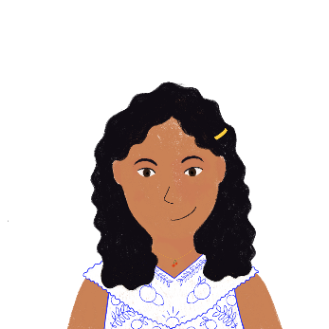
C’est qui ?
lire
Noura parle avec Océane. Elle parle à Océane (tu), ou d’Amir (il) ?
tu | il
En hiver, tu comprends pourquoi habiter à Nice est sympa.
Il prend le train pour la montagne pendant les vacances.
Tu prends le déjeuner à la cantine aujourd’hui?
Tu apprends deux langues en ce moment ?
Maintenant il comprend la musique anglaise à la radio.
Il apprend un nouveau rap chaque mois ?
Il dit que vous êtes en couple maintenant ?
Tu dis des choses intéressantes ce week-end !
_
_
_
_
_
_
_
_
Translate the sentences into English.
Think about whether to use the present simple (he says) or continuous (he is saying).
Notes:
This is from a lesson in Year 8, in week 6 of the 2nd half term
It focuses on high frequency irregular verbs re verbs – in the tu and il forms
Students have covered -er verbs in year 7, so the ‘s’ inflection on verbs is now being revisited but with a new lexicon.
They were also revising that the French present tense can be translated by English present simple and continuous.

Slide 15
C’est quoi ?
écouter
...
Abdel parle de sa vie. Que dit-il ? Écris a ou b.
 | a | b
 | mon chien | ma vie
 | mon pays | ma ville
 | ma grand-mère | mon grand-père
 | mon lit | ma chambre
 | ma famille | mon directeur
 | a | b
 | ma cuisine | mon déjeuner
 | mon médecin | ma professeure
 | mon frère | ma sœur
 | mon ordinateur | ma radio
 | ma guitare | mon piano
1
6
2
7
3
8
4
9
5
10
Pupils have said:
“Now I see why all those sounds matter”
“It has made me hear differences in the words”
Notes:
Teacher Notes:
Aim: practising aural recognition of adjective gender agreement
The beginnings of the sentences are obscured by beeps – this simulates moments in real life where we cannot hear every detail of speech – and we have to use small sounds to make sense of what we hear (parts of language can be hidden by interference such as cars passing, the internet glitching on a zoom, a chair scraping).
Transcript:
[…] est heureuse.
[…] est grand.
[…] est vieille.
[…] est verte.
[…] est français.
Some of our specialist teachers have interviewed their pupils and recorded their responses to the new kind of class activities and some of them said things like this.

Slide 16
Un samedi en ville
lire
Bilal et Amandine font les magasins. Que font-ils ? Écris a ou b.
 |  | a | b
1. | Bilal et Amandine vont dans une boutique chère. | un magasin | une boutique
2. | Amandine a un style naturel. | un style | une élégance
3. | Bilal veut une chemise noire. | un tee-shirt | une chemise
4. | Amandine porte normalement des vêtements rouges. | un uniforme | des vêtements
5. | Bilal trouve un cadeau sympa pour Amandine. | un cadeau | des choses
_________
_____
_________
__________
_______
Pupils have said…
“It has made me understand better”
Notes:
This was a revision of adjectival agreement, bringing together recognition of written adjectival gender and number agreement
Some of these words are not in our lists of highly frequency words to be learnt (Lonsdale & LeBras) - they are actually quite rare, so probably not very useful in many contexts - but we include them in activities like this because they are clear cognates – same form and same meaning as English. So, we think it is reasonable to use them as a ‘vehicle’, on which to ‘peg’ new grammar.

Slide 17
Écris en français !
écrire
Amir écrit un email à Abdel en anglais. Écris le texte en français.
>> Sujet: I like writing in English!!!
Hello Abdel,
I have a little question: how many languages do you speak? I have a very intelligent teacher at school – he understands six languages! My teacher says that I’m a good student. I understand that languages are important, and I take my time in class. Next week, two English girls are going to stay at my place. I will speak English because I don’t know if they speak French.
I sometimes say English sentences at home. My father is happy. He often takes the plane to England for work. Noura is learning a new language too. Are you learning interesting things at university?
Goodbye, Amir
Notes:
And so, at the end of one year and one term, the pupils will have revisited the vocabulary and grammar so that they can reasonably be asked to write this in French. This translation is carefully constructed to trap particular grammatical features: written production of irregular –RE verbs, adjective agreement, adjective placement and adverb placement
This is from a lesson from our SOW from year 8, term 1, 2nd half term, week 6.

Slide 18
4/ The first NCELP assessments, launched in 2020
For more on the principles of assessment and how it aligns with NCELP SOW, see short CPD sessions with voiceovers from NCELP specialists:
Phonics
Vocabulary
Grammar

Slide 19
SOW screenshot
phonics practice every lesson
‘Context’: purpose of the language e.g., “Describing a thing or person”
Systematic revisiting of vocabulary every 3 weeks and 9 weeks
Grammar sequencing is language specific
Extremely high frequency (irregular!) verbs at start
Then highly regular & frequent verbs
Weeks set aside for work on ‘rich texts’
Notes:
First a quick glimpse at an NCELP scheme of work.
So, after following this, what do pupils actually know at the end? How could we check their knowledge and progression?

Slide 20
‘Achievement tests’ and ‘Applying your knowledge tests’
The ‘achievement’ tests (February & June each year)
Tests to what extent students have learnt everything up to test
Assesses a principled sample of P,V, and G
The 'applying your knowledge’ test (June each year)
Brings together PVG in more holistic assessments
As ‘knowledge’ turns to ‘skill’: More recognisable listening, reading, writing and speaking tasks.
Assesses ability to apply knowledge in context through:
listening comprehension,
oral picture description,
short translation tasks.
Notes:
The test development involved many people from NCELP, and in particular I acknowledge here the work of Rowena Kasprowicz from the University of Reading for her work on the grammar tests, Robert Woore from the University of Reading on the phonics tests, and Natalie Finlayson, University of York, on the vocabulary tests.

Slide 21
Vocab testing principles
Achievement test – Vocabulary
Objectives
Test breadth - the number of words known
Test depth - how well the words are known
up to a particular point in the scheme of work
Characteristics
Syllabus-based achievement test
Productive and receptive knowledge
Oral and written modalities
Coverage of content by end of year 7: French: 43% Spanish: 35% German: 35%
Balance of parts of speech: 2 nouns to every 1 verb to every 2 ‘others’ (adj, adv)
Cumulative retention: Half tests new material since last test; half tests material by sampling from everything before the last test
Notes:
So, to start with vocabulary – how can we check whether the vocabulary is really known – not just known in one fixed sentence, but really known to understand and produce in different kinds of contexts? What do good tests of vocabulary look like?

Slide 22
Depth of vocab knowledge
Achievement test – Vocabulary
Recognition tests
learners select or guess the response from fixed alternatives given
can strengthen any existing memory traces (McDaniel & Mason, 1985)
Recall
demands the production of responses from memory
more difficult than recognition because learners must search for the correct response from within their own mental representation (Cariana & Lee, 2001; Glover, 1989; McDaniel & Mason, 1985).
Definitions adapted from Jones (2004)

Slide 23
Vocab question types
Achievement test – Vocabulary
80 x test items
Listening
20 x spoken meaning recognition
Reading
20 x written
meaning recall
Writing
20 x written
form recall
Speaking
20 x spoken
form recall
40 x receptive
40 x productive
Notes:
So, in the time we allocated – about 12 minutes for testing vocabulary - we worked out 1 vocab question could be given every 9 seconds, and we could have 80 test questions

Slide 24
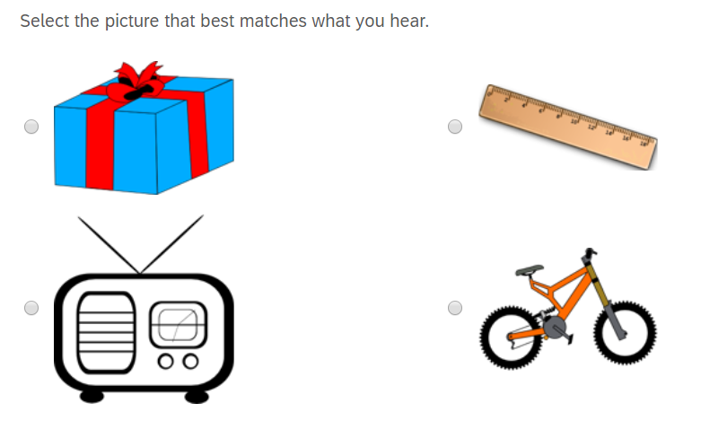
Question type 1
Achievement test – Vocabulary
Modality/mode
Oral/comprehension
Type of activity
Spoken meaning recognition
Knowledge tested
Meaning (definition)
Read (2000)
Notes:
In the next few slides you can see an example of the kind of question type, and on the right the test characteristics that we systematically worked through, making sure we tested the different types of knowledge of a word, but across a sample of words they had met so far up to the point of that test.

Slide 25
Question type 2
Achievement test – Vocabulary
Listen to the word.
Modality/mode
Oral/comprehension
Type of activity
Spoken meaning recognition
Knowledge tested
Meaning (definition) Meaning (association)
Notes:
Une voiture
As their vocabulary expands, we can, in year 8 onwards, begin to create these ‘category tests’ all in the target language – but not in the one you see here, because this was just in February of year 7

Slide 26
Question type 3
Achievement test – Vocabulary
Read 2000, p. 163
Type of activity
Written meaning recall
Knowledge tested
Meaning (definition)
Notes:
Just a straight translation into English

Slide 27
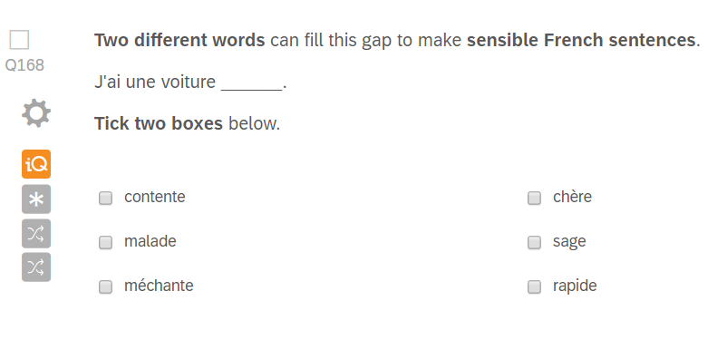
Question type 4
Achievement test – Vocabulary
Type of activity
Written meaning recall
Knowledge tested
Meaning (definition)
Use (collocation)

Slide 28
Question type 5
Achievement test – Vocabulary
Type of activity
Written form recall
Knowledge tested
Form (written)
Meaning (definition)

Slide 29
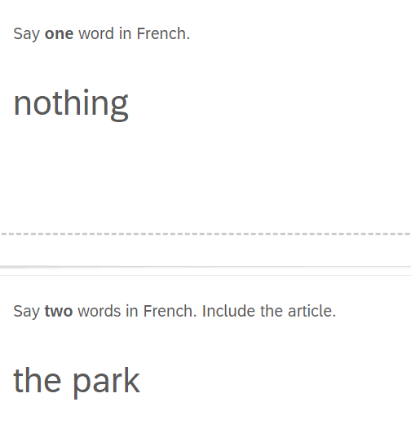
Question type 6
Achievement test – Vocabulary
Type of activity
Spoken form recall
Knowledge tested
Form (spoken)
Meaning (definition)

Slide 30
Achievement test – Phonics Listening -> writing
You will hear 15 Spanish words. You will hear each word twice.
Complete the spelling of each word by filling in the missing letters.
There may be more than one way of spelling them. Just type in any one possible spelling for each word.
You won’t know these words. Don’t worry – just do your best!
_ mbral
_ _ ma
_ _ mba
_ _ rafa
_ _ na
a _ _ oba
Notes:
This test is about half way through year 7, in February, so, in the 2nd term of learning Spanish. This tests knowledge of how sounds are written… This is really important knowledge for learning new vocabulary that students might hear.
umbral
cima
gamba
jirafa
cuna
arroba

Slide 31
Achievement test – Phonics Reading -> speaking
Read the following list of Spanish words aloud.
You won't know these words. Just say them as you think they should sound in Spanish.
You will get marks for pronouncing the bold, underlined parts of each word.
If you’re not sure, don’t worry – just have a go and do your best.
amparar
jinete
quico
gilar
valla
cerner
Notes:
Of course phonics works two ways. Now we look at reading the letters and turning them to sounds…this is really important knowledge that underpins the ability to read new words and know how they sound. This is important for learning *new* vocabulary through *wider reading* (reading for pleasure, richer texts) as learners progress – so that they will know how new words sound without having to hear every single word! This is core literacy, which drives reading development.

Slide 32
Achievement test – Grammar! Listening
Listen to the sentences.
Choose who the verb is referring to. Circle your answer.
I you he/she they we
I you he/she they we
I you he/she they we
I you he/she they we
Notes:
And finally on to the tests that assess the body of grammar knowledge that had been taught.
I will show just three examples of test question types.
Uso un teléfono.
Tenemos una bolsa.
Lleva unos zapatos rojos
Tengo cinco hermanos.

Slide 33
Achievement test – Grammar! Reading
Choose which word could replace the underlined word. Circle your answer.
1. Compra una casa. el la los las
2. Quiero el bolígrafo. un una unos unas

Slide 34
Achievement test – Grammar! Writing
Complete the Spanish sentences using the correct form of the word in brackets.
1. ___________ en clase. (he asks) preguntar = to ask
2. ___________ en un museo. (you work) trabajar = to work
3. ¿ ___________ bien? (do I dance) bailar = to dance
4. ¿ ___________ un teléfono? (do you use) usar = to use
Notes:
In items 3 and 4, you can see English ‘do’. Students often have difficulty with the cross-linguistic complexity that English has ‘do’ auxiliaries for questions, but this ‘do’ auxiliary just doesn’t exist in the foreign language. One way of testing this knowledge is asking them to work from English to the target language.
Notice the use of high frequency and highly regular verbs
You can see that we give the infinitives – we provide the verb lexicon for this test. This is because in the early stages, this helps us ensure we are really testing grammar (not vocabulary). So, in these year 7 tests, we give the verbs so we know we are testing whether they are beginning to develop an inflectional system around the verbs.
This issue (i.e., the question of giving vocab in a grammar test) is a challenge for us because in NCELP materials you will rarely see unanalyzed chunks of language (unless they are fixed expressions like s’il vous plaît). You can test ‘whole questions’’ if you have taught them as holistic phrases (how do you say ‘what’s your name?’; ask your friend ‘where do you live?’). But… if you want to test whether learners can *create questions from scratch*, then it is necessary to give them vocabulary and see if they can manipulate it to make a question.

Slide 35
Applying your Knowledge test - Reading
Notes:
Now I am going to show you three extracts from the Applying Your Knowledge tests- these are more holistic assessments, but still drawing carefully - very systematically – from the words, sounds, grammar that have been covered up to this point.
Each item of vocabulary has been actively practised at least three times in learning homeworks, spaced at 3 and 9 weeks after it was first encountered,
and incorporated into three separate lessons.
Each grammar point has been revisited with different vocabulary. This revisiting of grammar is carefully tracked on the Grammar Tracker tab on the SOW.

Slide 36
Applying your Knowledge test: Speaking!
Before you start the test, please go to: vocaroo.com. It will open in a new tab.
Click the red record button, then come back to this test.
Look at the picture.
Describe it to a friend by saying these sentences in French:
1. Amir is wearing a green shirt.
2. It is nice weather in England today.
3. Three dogs are playing in the park.
4. There is an island and there are two bridges, but there is no café.
5. The church is in front of the big buildings.
To work out what to say, try to break each sentence into groups of words.
Notes:
This is the French test from the end of year 7

Slide 37
Speaking
Applying your Knowledge:
Look at the picture.
It is now Saturday in the city centre.
Describe it to a friend
by saying these sentences in French:
1. Voici le musée.
2. Le bâtiment est très grand.
1. Here is the museum.
2. The building is very big.
For meaning (per sentence):
2 marks awarded where the meaning of the sentence is fully communicated with little effort required
on the part of the listener.
1 mark awarded where the meaning of the sentence is fully communicated with some effort required
on the part of the listener.
0 marks awarded where the meaning of the sentence is not communicated.
For accuracy (per sentence):
2 marks awarded where all or most of the features tested are accurately produced.
1 mark awarded where some of the features tested are accurately produced.
0 marks awarded where few or none of the features tested are accurately produced.
Take up to one minute to think about what to say each time, but don’t write your sentences down. To help you work out what to say,
try to break each sentence down into groups of words in your head.
It doesn’t matter if you make a mistake - just have a go!
It doesn’t matter if you speak slowly - just keep going!

Slide 38
Want to give a flavour of the tests to pupils?
ppts and videos of teachers delivering a lesson to prepare pupils for the test
French | 1. Achievement test video prep lesson | 2. Applying your knowledge test video prep lesson
German | 1. Achievement test video prep lesson | 2. Applying your knowledge test video prep lesson
Spanish | 1. Achievement test video prep lesson | 2. Applying your knowledge test video prep lesson

Slide 39
Links to tests, audio files, mark schemes
Tests, including audio, transcripts and scorings spreadsheets are available in the
French, German & Spanish “test collections” on the NCELP Resource Portal.
 | Achievement | Mark Scheme | Applying Your Knowledge | Mark Scheme
French | Link | Link | Link | Link
German | Link | Link | Link | Link
Spanish | Link | Link | Link | Link

Slide 40
The talk covered…
1/ A snapshot of NCELP’s activities: CPD & resources
2/ Alignment between NCELP & Ofsted’s Framework
3/ Making grammar matter through reading & listening
4/ Assessments: phonics, vocabulary & grammar
and bringing them together
Author name(s)

Slide 41
Want to hear more from NCELP?
Join our online “Introduction to NCELP” conference!
20th November:
Delivered by our specialist teachers, sessions on:
phonics;
vocabulary;
the lexical profiler to check out whether texts use high frequency words or rare words;
grammar;
NCELP SOW & our programme of computer-assisted vocab practice
Join the mailing list, email: enquiries@ncelp.org for regular bulletins of new research-informed resources arriving on the portal
To get monthly alerts to summaries of new research, visit https://oasis-database.org/ and sign up in 10 seconds!

