Slide 1
Vocabulary
Y7 French
Term 3.1 - Week 2
Stephen Owen / Kirsten Somerville / Adeline Charlton
Date updated: 15/04/20
Notes:
Frequency rankings of vocabulary introduced this week (1 is the most common word in French):
3.1.2 - dire [37], dis [37], dit [37], sortir [309], sors [309], sort [309], venir [88], viens [88], vient [88], vérité [907], important [215], de [2]
Source: Londsale, D., & Le Bras, Y. (2009). A Frequency Dictionary of French: Core vocabulary for learners London: Routledge.

Slide 2
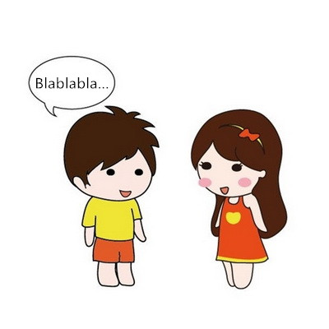
vocabulaire: verbes
dire
[to say/tell | saying/telling]
dit
[says/tells| is saying/telling]
Notes:
Introducing the verb dire more explicitly. Dire is one of the 25 most frequently used verbs in French. All 25 most frequent verbs will be introduced early on using the same format. Both long form (infinitive) and short form (3rd person singular) are introduced in order to familiarise students with the various forms of the same verb.
1. Bring up the word dire on its own, say it, students repeat it (remind them of the phonics).
2. Try to elicit the meaning from the students. 3. Bring up the picture, and establish the meaning of the word in English, clearly, i.e., ‘to say, tell’. 4. Bring up the short form dit, say it, students repeat it. Try to elicit the meaning from the students.

Slide 3
vocabulaire: verbes
dire
[to say/tell | saying/telling]
dit
[says/tells| is saying/telling]
Notes:
Cycle through the long and short form again.

Slide 4
vocabulaire: verbes
dit
[says/tells| is saying/telling]
Il dit la vérité.
[He tells|is telling the truth.]
Notes:
Introduce the short form in a sentence.

Slide 5
vocabulaire: verbes
dire
[to say/tell | saying/telling]
Dire la vérité est important.
[Telling the truth is important.]
Notes:
Introduce the long form in a sentence.

Slide 6
vocabulaire: verbes
dit
[says/tells| is saying/telling]
dit
Il ____ la vérité.
[He tells|is telling the truth.]
Notes:
Cycle through the short form in context again.

Slide 7
vocabulaire: verbes
dire
[to say/tell | saying/telling]
_____ la vérité est important.
.
Dire
[Telling the truth is important.]
Notes:
Cycle through the long form in context again.

Slide 8
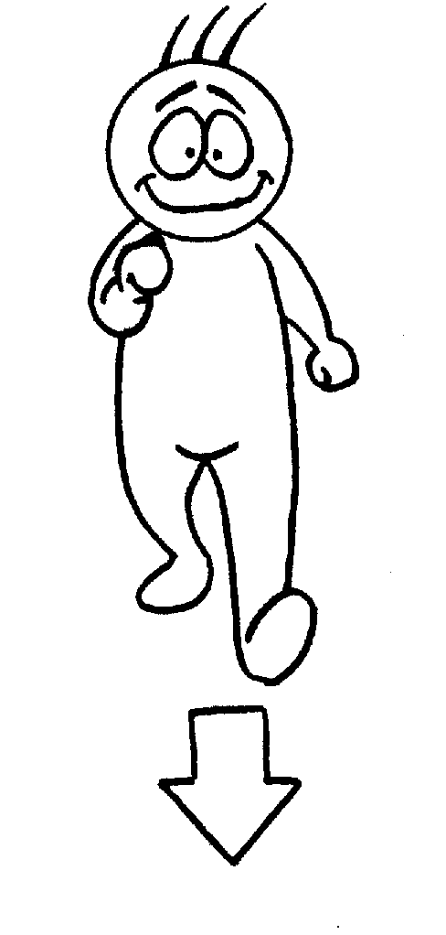
vocabulaire: verbes
venir
[to come | coming]
vient
[comes | is coming]
http://clipart-library.com/
Notes:
Repeat as for the verb dire.

Slide 9
vocabulaire: verbes
venir
[to come | coming]
vient
[comes | is coming]
Notes:
Repeat as for the verb dire.

Slide 10
vocabulaire: verbes
vient
[comes | is coming]
Elle vient ici.
[She comes here | She is coming here.]
Notes:
Repeat as for the verb dire.

Slide 11
vocabulaire: verbes
venir
[to come | coming]
Elle aime venir ici.
[She likes coming here.]
Notes:
Repeat as for the verb dire.

Slide 12
vocabulaire: verbes
vient
[comes | is coming]
Elle _____ ici.
vient
[She comes here| She is coming here.]
Notes:
Repeat as for the verb dire.

Slide 13
vocabulaire: verbes
venir
[to come | coming]
Elle aime _____ ici.
venir
[She likes coming here.]
Notes:
Repeat as for the verb dire.

Slide 14
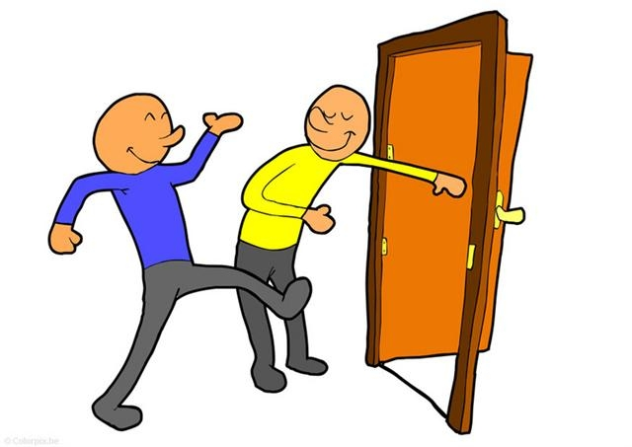
vocabulaire: verbes
sortir
[to go out | going out]
sort
http://clipart-library.com/
[goes out | is going out]
Notes:
Repeat as for the verb dire.

Slide 15
vocabulaire: verbes
sortir
[to go out | going out]
sort
[goes out | is going out]
Notes:
Repeat as for the verb dire.

Slide 16
vocabulaire: verbes
sort
[goes out | is going out]
Il sort avec des amis.
[He goes out | is going out with friends.]
Notes:
Repeat as for the verb dire.

Slide 17
vocabulaire: verbes
sortir
[to go out | going out]
Il aime sortir en ville.
[He likes going out into town.]
Notes:
Repeat as for the verb dire.

Slide 18
vocabulaire: verbes
sort
[goes out | is going out]
Il ___ avec des amis.
sort
[He goes out | is going out with friends.]
Notes:
Repeat as for the verb dire.

Slide 19
vocabulaire: verbes
sortir
[to go out | going out]
Il aime ____ en ville.
sortir
[He likes to go out into town.]
Notes:
Repeat as for the verb dire.

Slide 20
The verb ‘dire’ – to say
grammaire
This is the pattern of endings for the first, second and third person singular forms of dire:
je dis
I say / I am saying
tu dis
you say / you are saying
il dit
he says / he is saying
These verb forms all sound the same!
The –s on the je and tu forms is a silent final consonant (SFC)
elle dit
she says / she is saying
Notes:
The first three persons singular of the verb dire are now presented. As with the verbs presented last lesson, make students aware of the fact that the three forms here all sound the same in French.

Slide 21
The verb ‘venir’ – to come
grammaire
The pattern of endings is the same for venir:
Notice also the change from e to ie in the stem (first part of the verb)
je viens
I come / I am coming
tu viens
you come / you are coming
il vient
he comes / he is coming
These verb forms all sound the same!
The –s on the je and tu forms is a silent final consonant (SFC)
elle vient
she comes / she is coming
Notes:
The first three persons singular of the verb venir are now presented.
Point out to students that all three of these verb forms sound the same in French.

Slide 22
The verb ‘sortir’ – to go out
grammaire
The pattern of endings is also the same for sortir:
This -s, -s, -t pattern for je, tu and il/elle is common in irregular French verbs!
je sors
I say / I am saying
tu sors
you say / you are saying
il sort
he says / he is saying
These verb forms all sound the same!
The –s on the je and tu forms is a silent final consonant (SFC)
elle sort
she says / she is saying
Notes:
The first three persons singular of the verb sortir are now presented.
Point out to students that all three of these verb forms sound the same in French.

Slide 23
Vocabulaire: révisions [1]
écrire
Replace the pictures with a suitable word to complete the sentences.
1. Il en ville.
2. Vous allez en chaque année ?
3. Je des choses importantes.
4. Tu viens en ?
dis | sort | vient | vacances | Angleterre | Écosse | Londres | chez
Notes:
This slide, and the next, incorporate some words from the first vocabulary set to be revisited in this week, together with the newly-presented verbs from this week. The answers appear on the slides following the activity. The sentences use the new verbs from this week in a range of 1st, 2nd, 3rd person singular forms. As such, it makes sense for students to take the time to translate them into English as part of this task.
Frequency rankings of vocabulary introduced this week (1 is the most common word in French):
3.1.2 - dire [37], dis [37], dit [37], sortir [309], sors [309], sort [309], venir [88], viens [88], vient [88], vérité [907], de [2], important [215]
Frequency rankings of vocabulary revisited this week (1 is the most common word in French):
2.2.4 - allons [53], allez [53], vont [53], année [102], mois [178], vacances [1726], ville [260], Écosse [n/a], Angleterre [n/a], Londres [n/a], chez [206]
2.1.3 - avons [8], avez [8], ont [8], enfant [126], famille [172], problème [188], difficile [296], ici [167], très [66], aussi [44], pour [10]

Slide 24
Vocabulaire: révisions [2]
écrire
Replace the pictures with a suitable word to complete the sentences.
5. Nous allons en pour un mois ?
6. Elle de Paris.
7. Ils vont Amir ?
8. Je sors à .
dis | sort | vient | vacances | Angleterre | Écosse | Londres | chez
Notes:
This slide continues the gap-fill activity. The answers are on the next two slides.
Frequency rankings of vocabulary introduced this week (1 is the most common word in French):
3.1.2 - dire [37], dis [37], dit [37], sortir [309], sors [309], sort [309], venir [88], viens [88], vient [88], vérité [907], de [2], important [215]
Frequency rankings of vocabulary revisited this week (1 is the most common word in French):
2.2.4 - allons [53], allez [53], vont [53], année [102], mois [178], vacances [1726], ville [260], Écosse [n/a], Angleterre [n/a], Londres [n/a], chez [206]
2.1.3 - avons [8], avez [8], ont [8], enfant [126], famille [172], problème [188], difficile [296], ici [167], très [66], aussi [44], pour [10]

Slide 25
Vocabulaire: réponses [1]
écrire
1. Il sort en ville.
2. Vous allez en vacances chaque année ?
3. Je dis des choses importantes.
4. Tu viens en Angleterre ?
Notes:
These are the answers to 1-4 in French.
Teacher to elicit the English translations from students, too. As always, students can be prompted to consider whether there is more than one possible English translation: E.g., what would need to be added to ‘Il sort en ville’ for ‘He goes out / is going out’ to be an appropriate translation? → chaque jour / aujourd’hui.

Slide 26
Vocabulaire: réponses [2]
écrire
5. Nous allons en Écosse pour un mois ?
6. Elle vient de Paris.
7. Ils vont chez Amir ?
8. Je sors à Londres.
Notes:
These are the answers to 5-8.

Slide 27
Vocabulaire
écrire, écouter et parler
de Londres
ici
souvent
Écris 5 phrases différentes.
bonjour
en Écosse
la vérité
chaque mois
en ville
Use a different verb each time
en Angleterre
de Paris
chez Léa
chaque année
oui
aujourd’hui
Use each pronoun
dis
chez Amir
venir
dit
une chose importante
sortir
je
vient
rarement
tu
sors
en vacances
il
dire
sort
j’aime
le weekend
viens
elle
Use at least one of these words in each sentence
Notes:
This slide practises the different forms of the irregular verbs introduced in lesson 1, in combination with some of this week’s new and revisited vocabulary. Some relevant vocabulary from previous weeks is also included. This activity is designed to reinforce the difference between transitive and intransitive verbs.
Students compose 5 sentences by picking from the three word pools. They then read their sentences to a partner, who translates them into English. When eliciting answers from the class, highlight that ‘dire’ needs an object to make a complete sentence, while ‘venir’ and ‘sortir’ do not.
Frequency rankings of vocabulary introduced this week (1 is the most common word in French):
3.1.2 - dire [37], dis [37], dit [37], sortir [309], sors [309], sort [309], venir [88], viens [88], vient [88], vérité [907], de [2], important [215]
Frequency rankings of vocabulary revisited this week (1 is the most common word in French):
2.2.4 - allons [53], allez [53], vont [53], année [102], mois [178], vacances [1726], ville [260], Écosse [n/a], Angleterre [n/a], Londres [n/a], chez [206]
2.1.3 - avons [8], avez [8], ont [8], enfant [126], famille [172], problème [188], difficile [296], ici [167], très [66], aussi [44], pour [10]
Source: Londsale, D., & Le Bras, Y. (2009). A Frequency Dictionary of French: Core vocabulary for learners London: Routledge.

