Slide 1
NCELP Phonics Assessments Principles, design, creation
NCELP Residential 3
Robert Woore
Date updated: 02/03/20

Slide 2
Phonics assessment team effort!
Nick Avery
Rachel Hawkes
Giulia Bovolenta
Robert Woore
Inge Alferink
Native speakers (checking & audio)
Natalie Finlayson
All the NCELP team!
Emma Marsden

Slide 3
Outline
Principles of Phonics assessment
1.1 What are we trying to test?
1.2 How can we test it, validly and practically?
2. Question types
2.1 Task design
2.2 Item selection
Scoring
3.1 What do we mean by ‘accurate’ decoding?
3.2 How the scoring works

Slide 4
1. Principles of Phonics assessment
Objectives
To test knowledge of Symbol-Sound Correspondences (SSC) covered to date in Y7 (i.e. a syllabus-based achievement test)
Why are we testing this?
SSC knowledge is used
when reading aloud (including ‘inner voice’) – linked to reading comprehension, vocabulary acquisition (inter alia)
when listening (segmentation) and writing (spelling)
Testing is bidirectional: both sound → print and print → sound
transcription reading aloud

Slide 5
Skill acquisition theory
Practice with control, with awareness.
Errors happen, speed is variable.
Practice requires less awareness
Less error, faster, less variability in speed.
Declarative knowledge may be lost.
proceduralisation
automatisation
Declarative knowledge
Procedural knowledge
Automatised knowledge
Ultimate goal!
Fluent, accurate decoding

Slide 6
Accuracy and fluency
< Wagen >
/ v ɑː ɡ ə n /
Fluency and accuracy – both are important in L2 learning
Accuracy: allows correct spoken and written forms of words to be learnt and used effectively in communication
Fluency: reduces burden on working memory, thus allowing other ‘higher-level’ processes to be carried out more easily (e.g. inferencing when reading; conceptualizing ideas and formulating language when writing).
BUT fluency presupposes accuracy. There is no point automatizing incorrect knowledge!
→ Primacy of accuracy at this stage

Slide 7
Accuracy and fluency
<w> → / v /
<a> → / ɑ ː /
/ v ɑː ɡ ə n /
L1 ‘interference’ and its impact on fluency / accuracy:
< Wagen >
/ w a ɡ ə n /
More accurate L2 decoding associated with longer response times: Erler, 2003 (Year 7 learners of French in the UK); Li, 2019 (Chinese university students learning English)
Speeded tests may make pupils more likely to fall back on L1 knowledge
Main target of our phonics testing in Year 7 = accuracy
Ideally, untimed (‘unspeeded’) tests. But practical constraints → time limit

Slide 8
a. Print to sound
A number of different formats have been used to measure print-to-sound decoding
Rhyme judgment task (Erler & Macaro, 2012); Sound-Alike Task (SALT) (Woore et al., 2018 – but French only)
We believe the most valid method of assessing this is a ‘reading aloud task’ (RAT) (Woore 2006)
Cf. Year 1 ‘Phonics Screening Check’ (DfE)
But – trade-off between validity and ease of administration and scoring!
Screenshot from Phonics Screening Check training video, DfE. www.youtube.com/watch?v=IPJ_ZEBh1Bk
Scales image: by scott_kirkwood, openclipart.org.

Slide 9
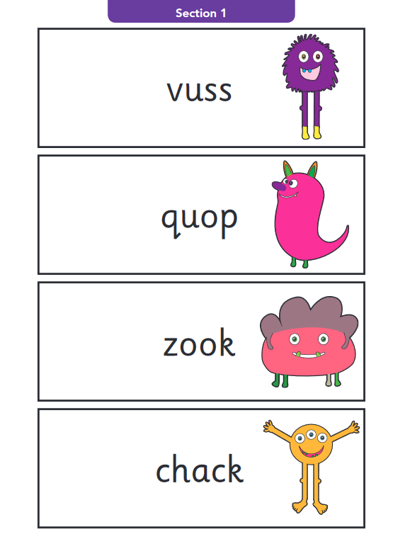
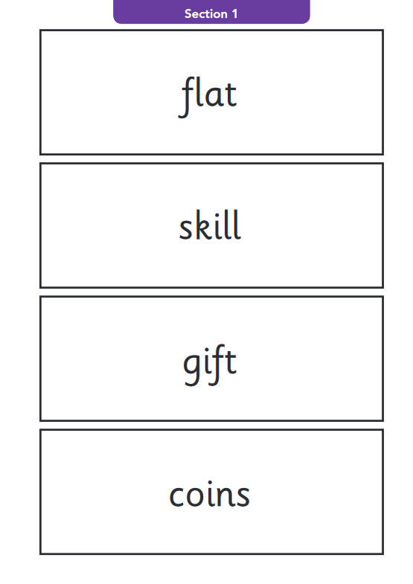
a. Print to sound
Standards and Testing Agency, 2018: 2018 key stage 1 phonics screening check: pupils’ materials
Year 1 ‘Phonics Screening Check’ (DfE):
Real words and pseudowords
What’s the difference? Why include pseudowords?
Pseudowords:
By definition, unknown to the learners
Learners cannot draw on existing knowledge of the words’ pronunciations
→ A ‘pure’ measure of their knowledge of symbol-sound correspondences
Unfamiliar real words
Low frequency
Not in SoW to date
However, we considered pseudowords problematic:
Ethically / pedagogically
In terms of validity (Papagno, Valentine & Baddeley, 1991)

Slide 10
a. Print to sound
Familiar versus unfamiliar words
Woore (2018) – compared Y10 MFL pupils’ pronunciation of familiar / unfamiliar French words
For each participant, a set of orthographically matched word pairs was created. On average, 14 words pairs per participant.
Each pair consisted of 1 word they knew and 1 word they didn’t know (as shown by a vocab test), sharing the same spelling body
Unit of analysis = spelling body (phonological rime)
…thus controlling for word-level variables
pain
grain
trois
chois

Slide 11
a. Print to sound
p < .001, d = 0.33
<pain> - /pæ̃/
<grain> - /ɡɹɛɪn/
<chat> - /ʃa/
<fat> - /fat/

Slide 12
a. Print to sound
Summary so far
Reading Aloud Test
Administered individually
Unfamiliar words to test SSC knowledge (to stop them using existing knowledge of whole word pronunciations)

Slide 13
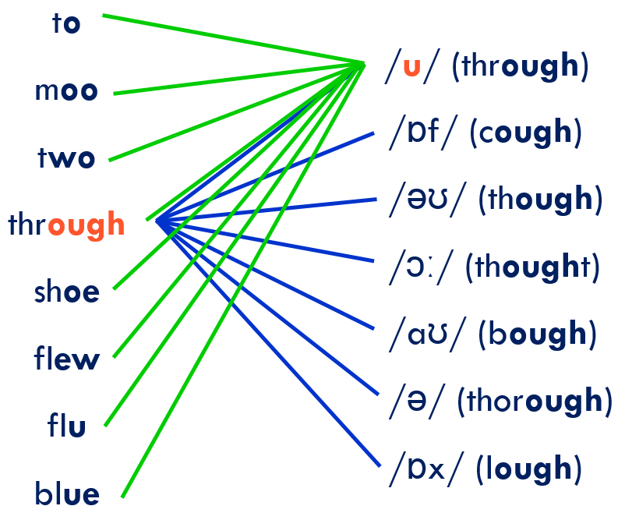
b. Sound to print
Transcription task – can they write what they hear?
However… languages vary in “orthographic depth”:

Slide 14
a. Print to sound
So, in French particularly → multiple possible spellings for a given sound
For unfamiliar words: proliferation of ‘correct’ answers
ver, vers, verre, verres, vert, verts, vair
* vaire, * vaires, * verd, * verds, * vère, * vères, * vaîre, * vaîres …
So, we tweaked the response format to constrain possible responses
Blanks for individual letters.
E.g. “ v _ _ ”

Slide 15
2. Item selection
For each language:
We listed all the target SSC covered in the SoW
For each SSC, we identified 3 low-frequency words (>5000 frequency ranking for French and Spanish, >4037 for German) and ensured not covered in SoW
Therefore, pupils very unlikely to know them!
Where possible, we controlled for orthographic and phonological length – i.e. short monosyllabic words (French and German) or mostly 2 syllables (Spanish)
We tried to avoid words that look like English words (interlingual homographs), taboo words, etc.!

Slide 16
SSC in French
SSC | French 1 | French 2 | French 3
SFC –x | toux | poux | houx
SFC -d | jard | lard | dard
SFC –t | prit | vit | mit
SFC –s | bris | gis | spis
a | nase | prase | jase
i | brime | cime | trime
eu | yeuse | beuse | Meuse
e | reloge | remous | recel
o | lot | plot | trot
eau | veau | seau | sceau
au | chaule | gaule | taule
u | cossu | cornu | crépu
ou | zou | clou | flou
é | pré | dé | ré
en | ment | sent | gent
French SSC | French 1 | French 2 | French 3
an | flan | cran | ban
on | pond | tond | gond
SFe | rame | crame | lame
in | crin | clin | pin
ain | tain | nain | zain
è | sème | pèse | sève
ê | vête | blême | bêche
ai | daine | raine | gaine
oi | aloi | coi | aboi
ch | croche | hoche | loche
ç | glaçon | maçon | pinçon
qu | quinte | quine | quille
j | jauge | jonc | joug
-tion | dation | rection | brution
-ien | salien | jovien | danien

Slide 17
2. Item selection
How many items in the test?
Completeness of coverage for individual pupils – diagnostic feedback
Testing burden and time demands – aim to fit tests within a single lesson!
We don’t want assessment to soak up too much teaching and learning time!
Scales image: by scott_kirkwood, openclipart.org.

Slide 18
2. Item selection
15 items per pupil
On-line test: random selection of SSC for both the reading aloud and dictation components. Random selection (1 of three items) for each SSC
Class as a whole should cover all the SSC, but individual pupils do not
✓
Takes less time for individuals to complete
Prevents copying – all individuals have a different selection of items
Diagnostic feedback (to inform teaching) at whole class level
✗
Incomplete diagnostic feedback for individuals
But – these are summative tests.
Diagnostic tests are already available – teacher- / self- / peer-assessment

Slide 19
Sample items – reading aloud

Slide 20
Sample items – reading aloud
→ Time limit = compromise!

Slide 21
Sample items – reading aloud
t
15 items to read aloud

Slide 22
Sample items – dictation
→ Time limit = compromise!
Number of items?

Slide 23
Sample items – dictation

Slide 24
Examples of tests
Pen-and-paper tests:
Pre-selection of 15 items

Slide 25
3. Scoring – reading aloud
This is our focus for the phonics assessment!
A note on ‘foreign accent’. Two dimensions to accuracy in reading aloud:
Accuracy of SSC knowledge: how graphemes / symbols are mapped onto L2 phonemes / sounds
Accuracy of pronunciation of L2 phonemes / sounds.
< v e a u >
/ vjʉ / / viː əʊ /
✗
✓
✓
/ vəʊ /
/ vo /
A foreign accent is hard to shift even for the most dedicated learner (even if they want to)
You can be intelligible (and comprehensible) with a foreign accent.
We are testing SSC knowledge (phonics) rather than native-like pronunciation (phonetics).

Slide 26
3. Scoring – reading aloud
1 mark / item = max. 15 marks in total
0 marks: Incorrect pronunciation based on English SSC. 1 mark: Correct knowledge of target SSC, but pronunciation with an English accent. 1 mark: Correct pronunciation of target SSC Notes: Give marks for correct pronunciation of target SSC in bold even if other parts of the word are mispronounced / not attempted. Be lenient when scoring. If you think the students have decoded the symbol (graphemes) to the correct sound (phonemes), then you can allow for some degree of foreign accent in pupils’ pronunciation of the target sounds. A foreign accent is hard to shift even for the most dedicated learner after years of practice; and people are perfectly intelligible with a foreign accent. In our teaching and in our phonics, we are targeting SSC knowledge (phonics) rather than native-like pronunciation (phonetics).

Slide 27
3. Scoring
Dictation task – automatically scored by the software platform ☺
Reading aloud task – marked individually by teachers (☹?)
Workload implications – need to make individual decisions about this.
One option would be to sit with individuals as they complete the speaking part of the test, and mark it in ‘real time’ as they go along.

