Slide 1
Helping each other at school
direct object pronouns / (me, te) (preverbal position) / with -ER verbs (present)
Contraction of pronouns (me ➜ m’, te ➜ t’) before a vowel or h muet
SSC: [h]
Y9 French
Term 3.1 - Week 2 - Lesson 49
Author name(s): Catherine Salkeld / Louise Bibbey
Artwork by: Chloé Motard
Date updated: 08/08/22
Notes:
Artwork by Chloé Motard. All additional pictures selected are available under a Creative Commons license, no attribution required.
Native teacher feedback provided by Sarah Brichory.
With thanks to Rachel Hawkes for her input on the lesson material.
Learning outcomes (lesson 1):
Consolidation of SSC [h]
Introduction of direct object pronouns me and te in the preverbal position with –er verbs
Word frequency (1 is the most frequent word in French):
encourager [1434], obliger [499], me [61], te [207], difficulté [564], objectif [518], recherche [357], résultat [428], clair [335], supplémentaire [1267], presque [481]
Source: Lonsdale, D., & Le Bras, Y. (2009). A Frequency Dictionary of French: Core vocabulary for learners London: Routledge.
The frequency rankings for words that occur in this PowerPoint which have been previously introduced in NCELP resources are given in the NCELP SOW and in the resources that first introduced and formally re-visited those words.
For any other words that occur incidentally in this PowerPoint, frequency rankings will be provided in the notes field wherever possible.
The additional English meanings of the following words have been added to Quizlet since the creation of this resource:
presque – almost, nearly

Slide 2
h
heure
Notes:
Timing: 1 minute
Aim: To introduce SSC [h]
Procedure: 1. Present the letter(s) and the [h] first, on its own. As there is no sound, put a finger to your lips instead. 2. Bring up the word ”heure” on its own, say it, students repeat it, so that they have the opportunity to focus all of their attention on the connection between the written word and its sound.
3. A possible gesture for this would be to tap a watch/wrist. 4. Roll back the animations and work through 1-3 again, but this time, dropping your voice completely to listen carefully to the students saying the [h] sound, pronouncing ”heure” and, if using, doing the gesture.
Word frequency (1 is the most frequent word in French):
heure [99]
Source: Lonsdale, D., & Le Bras, Y. (2009). A Frequency Dictionary of French: Core vocabulary for learners London: Routledge.

Slide 3
h
hôtel
huit
8
hôpital
hiver
heure
[winter]
histoire
[history, story]
Notes:
Timing: 2 minutes
Aim: To introduce SSC [h]
Procedure:
Introduce and elicit the pronunciation of the individual SSC [h] and then the source word again ‘heure’ (with gesture, if using). Then present and elicit the pronunciation of the five cluster words. The cluster words have been chosen for their high-frequency, from a range of word classes, with the SSC (where possible) positioned within a variety of syllables within the words (e.g. initial, 2nd, final etc.). Additionally, we have tried to use words that build cumulatively on previously taught SSCs (see the Phonics Teaching Sequence document) and do not include new SSCs. Where new SSCs are used, they are often consonants which have a similar symbol-sound correspondence in English.
Word frequency (1 is the most frequent word in French): histoire [263]; huit [877]; hôpital [1308]; hôtel [1774]; hiver [1586]; heure [99]. Source: Lonsdale, D., & Le Bras, Y. (2009). A Frequency Dictionary of French: Core vocabulary for learners London: Routledge.

Slide 4
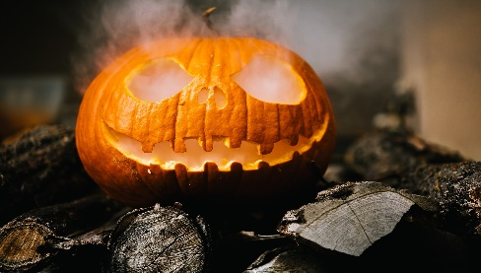
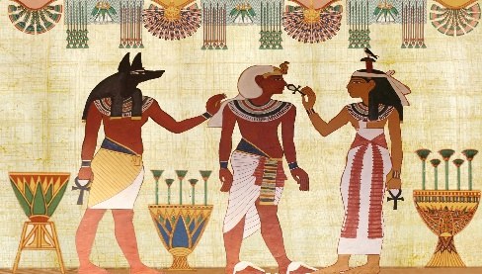
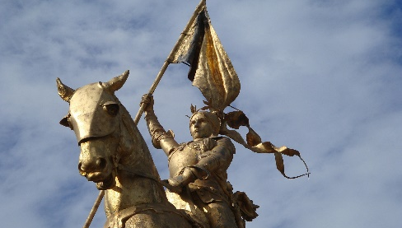
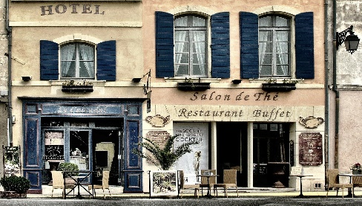
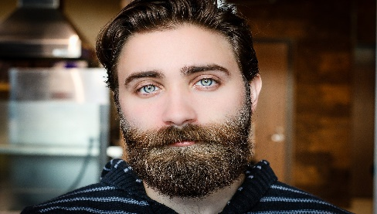
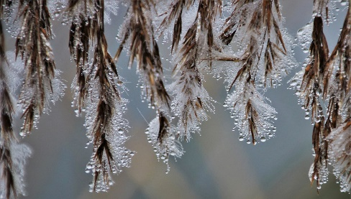
Phonétique [h-] muet
parler
Remember [h-] is normally silent.
This means it follows the pronunciation rules of the vowel that comes after it.
Practise this rule by saying these words.
hiver
herbe
halloween
hélicoptère
histoire
harmonie
héroïne
hôtel
horizon
homme
humidité
horloge
Notes:
Timing: 1 minute
Aim: To practise pronunciation of words beginning with silent [h].
Procedure:
1. Elicit pronunciation from students, reminding them of the silent [h].
2. Click on the pictures to hear the words said by a native speaker.
Transcript:
hiver
herbe
halloween
hélicoptère
histoire
harmonie
héroïne
hôtel
horizon
homme
humidité
horloge
Word frequency (1 is the most frequent word in French): herbe [3562], horloge [>50000], horreur [2565], histoire [263]
Source: Lonsdale, D., & Le Bras, Y. (2009). A Frequency Dictionary of French: Core vocabulary for learners London: Routledge.
Word frequency of cognates (1 is the most frequent word in French):
hélicoptère [2978], harmonie [4584], héroïne [3467], horizon [2502], humidité [>5000] Source: Lonsdale, D., & Le Bras, Y. (2009). A Frequency Dictionary of French: Core vocabulary for learners London: Routledge.

Slide 5
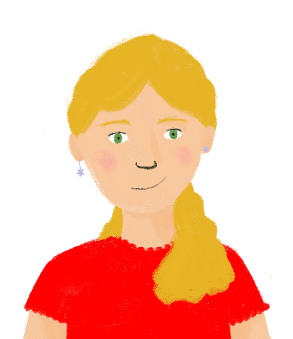
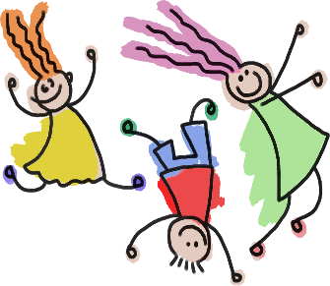
La liaison avec le [h-] muet
parler
Remember that when a word with a Silent Final Consonant
comes before a word beginning with [h-] muet, there is a liaison.
Look at the example. How is the last letter in c’est pronounced?
C’est triste !
C’est horrible !
C’est triste !
C’est horrible !
Tu voyages dans ton hélicoptère.
Il a acheté
mes horloges.
Tu voyages dans ton hélicoptère.
Il a acheté
mes horloges.
Now try saying these sentences…
Elles chantent en harmonie.
Les enfants
sont heureux.
Elles chantent
en harmonie.
Les enfants
sont heureux.
Notes:
Timing: 2 minutes
Aim: To practise pronouncing sentences with [h-] muet and liaisons.
Procedure:
Click through the example to hear the native speaker say the two sentences, one with a liaison, one without.
Ask students to say the sentences, following the pronunciation rules.
Click on the images to hear the native speaker.
Transcript:
C’est triste!
C’est horrible!
Tu voyages dans ton hélicoptère.
Il a acheté mes horloges.
Elles chantant en harmonie.
Les enfants sont heureux.

Slide 6
La liaison avec le [h-] muet
parler
Remember that words like le, la, je, de, ne and que replace their final letter with an apostrophe before a word beginning with [h]. This is called elision.
J’habite à Paris.
Il n’y a pas d’humains dans l’espace.
Hugo est plus grand qu’Henri.
Il n’y a pas d’humains dans l’espace.
Hugo est plus grand qu’Henri.
Now try saying these sentences…
Le soleil est sur l’horizon.
Le soleil est sur l’horizon.
Je n’habite pas en France.
Je n’habite pas en France.
Notes:
Timing: 2 minutes
Aim: To practise pronouncing sentences with [h-] muet and elision/liaison
Procedure:
Click through the example to hear the native speaker say the sentence with an elision and liaison.
Ask students to say the sentences, following the pronunciation rules.
Click on the images to hear the native speaker.
Transcript:
J’habite à Paris.
Il n’y a pas d’humains dans l’espace.
Hugo est plus grand qu’Henri.
Le soleil est sur l’horizon.
Je n’habite pas en France.
Word frequency of cognates (1 is the most frequent word in French):
humain [286] Source: Lonsdale, D., & Le Bras, Y. (2009). A Frequency Dictionary of French: Core vocabulary for learners London: Routledge.

Slide 7
Vocabulaire
Devoirs
écouter
D
E
A
[result]
E
[clear]
1
7
I
2
K
8
J
[objective]
H
9
C
B
[research]
F
[you]
3
4
I
10
G
J
[almost/
nearly]
C
[extra]
G
[me]
5
B
11
F
6
A
[to encourage]
D
H
[difficulty]
K
[to force]
Notes:
Timing: 6 minutes Aim: to practise aural comprehension of this week’s new vocabulary set. Procedure: 1. Click to play the audio.
2. Students write the corresponding letter.
3. Click to check responses.
4. Teachers may then also seek to practise oral recall by using the letters, e.g. “Comment dit-on C en français?” “Supplémentaire.” “Oui, c’est ça!’
Transcript: 1. encourager 2. obliger 3. rappeler 4. difficulté
5. objectif 6. recherche 7. résultat 8. clair 9. nécessaire 10. presque 11. supplémentaire 12. tard
13. me
14. te

Slide 8
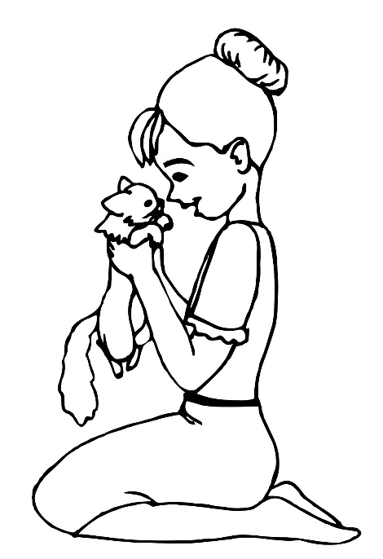
Direct object pronouns
grammaire
Remember, some verbs take direct objects.
Je regarde le chat.
I look at the cat.
When the direct object is ‘me’, we use the direct object pronoun me.
Il me cherche.
He looks for me.
When the direct object is ‘you’, we use the direct object pronoun te.
Je te respecte.
I respect you.
Direct object pronouns go before the verb.
Notes:
Timing: 4 minutes
Aim: Introduction of direct object pronouns me and te
Procedure:
Click to reveal explanations and examples, eliciting English translations where possible.
Ensure understanding.

Slide 9
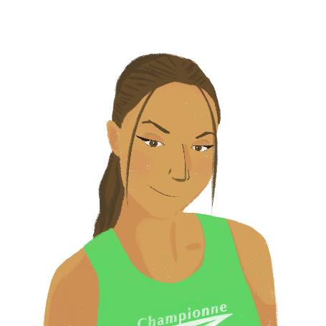
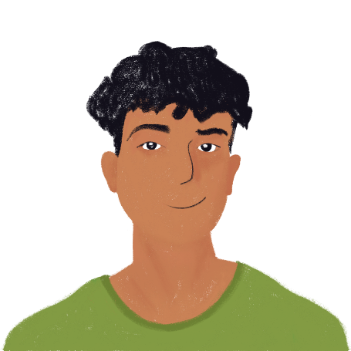
Au collège
écouter
Océane aide Amir au collège. Il décrit les choses qu’elle fait. Écoute et coche la bonne phrase en anglais.
Q | A | B | C
 | You stay with me after lessons. | You stay at school after lessons. | You stay in my lessons.
 | At 12 I find you in the library. | At 12 you find me in the library. | At 12 you find my books in the library.
 | I look for you when I must study. | You look for my books when I must study. | You look for me when I must study.
 | I look at my homework. | You look at my homework. | You look at me.
 | You correct my work. | I correct your work. | You correct me.
1
2
3
4
5
Notes:
Timing: 10 minutes [slide 1/2]
Aim: Aural recognition of the direct object pronouns me and te and connecting these with meaning.
Procedure:
Click the buttons on the left to play audio.
Students listen and tick the correct translation.
Click to reveal answers.
Repeat for numbers 6-10 on next slide.
Transcript:
Tu […] restes au collège après les cours.
À midi je [te] trouve dans la bibliothèque.
Tu [me] cherches quand je dois étudier.
Tu […] regardes mes devoirs.
Tu [me] corriges.
Tu […] sais toujours les réponses.
Tu ne [me] laisses pas seul quand j’ai besoin de toi.
Tu […] comprends tous les exercices supplémentaires.
Je [te] respecte beaucoup.
Tu [me] connais très bien.

Slide 10
Au collège
écouter
Océane aide Amir au collège. Il décrit les choses qu’elle fait. Écoute et coche la bonne phrase en anglais.
Q | A | B | C
 | I always know the answers. | You always know the answers. | You often know my answers.
 | You don’t leave me alone when I need you. | You don’t leave me alone when you need me. | I don’t leave you alone when you need me.
 | I understand all the extra exercises. | You understand me. | You understand all the extra exercises.
 | You respect me a lot. | I respect you a lot. | I respect your knowledge.
 | You know me very well. | I know you very well. | You know my skills very well.
6
7
8
9
10
Notes:
Slide 2/2

Slide 11
Un message pour une professeure
Amir écrit un message pour dire merci à sa professeure de maths.
lire
On a besoin du complément d’objet direct me ? Sinon, où est l’objet direct ?
Madame Dubois,
Quand vous expliquez mes devoirs, les réponses sont claires. Les élèves comprennent les exercices très bien. Vous changez la vie de tous les élèves. Vous me cherchez si j’arrive en retard. Vous regardez souvent mes cahiers. C’est très utile quand vous corrigez mes erreurs. Vous me préparez très bien pour les examens. Vous me trouvez travailleur ? Vous me respectez toujours et c’est très gentil. Vous ne me laissez jamais en difficulté.
Merci pour tout !
Amir
1
2
3
4
5
6
7
8
9
10
Notes:
Timing: 8 minutes
Aim: Written recognition of direct objects and direct object pronouns
Procedure:
Students write 1-10 and tick which boxes cover me.
For the phrases that don’t require me, students find the direct object in the sentences.
Click to reveal answers.
Ensure understanding.
Word frequency of unknown words (1 is the most frequent word in French):
sinon [1170]
Source: Lonsdale, D., & Le Bras, Y. (2009). A Frequency Dictionary of French: Core vocabulary for learners London: Routledge.

Slide 12
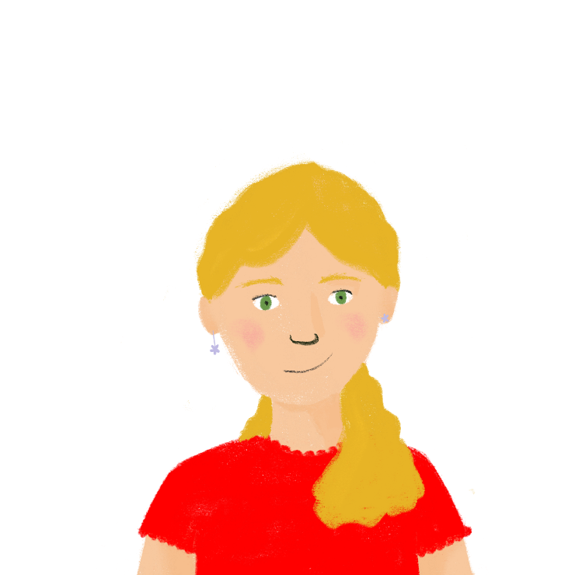
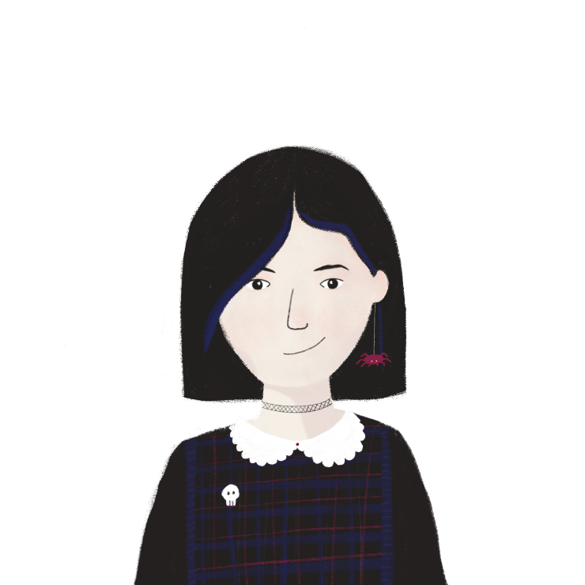
Les promesses* de l’amitié*
*la promesse = promise
*l’amitié (f.) = friendship
parler
Tu parles de comment tu peux aider ton/ta partenaire.
J’ai soif.
[thirsty]
[drive you to the café]
Je te conduis au café.
Notes:
Timing: 10 minutes
Aim: Oral production of direct object pronoun te
Procedure:
Print rolecards from next slide.
Model task with this slide.
Students work in pairs.
Partner A describes their situation.
Partner B chooses a suitable response.
Partners swop roles.
Suggested answers on slide 13.
Word frequency of unknown words (1 is the most frequent word in French):
promesse [1184], amitié [2272]
Source: Lonsdale, D., & Le Bras, Y. (2009). A Frequency Dictionary of French: Core vocabulary for learners London: Routledge.

Slide 13
Les promesses de l’amitié
parler
PARTENAIRE A
Décris ta situation à ton/ta partenaire.
1. [hungry]
2. [right]
3. [don’t know where I am]
4. [scared of exams]
Écoute ton/ta partenaire et choisis une réponse.
[drive you to the doctor]
[watch you]
[don’t leave you alone]
[correct you]
PARTENAIRE B
Décris ta situation à ton/ta partenaire.
[backache]
[doing a show]
[wrong]
[studying at midnight]
Écoute ton/ta partenaire et choisis une réponse.
[prepare you]
[find you]
[feed you]
[don’t correct you]
Notes:
ROLECARDS FOR PRINTING

Slide 14
Les promesses de l’amitié
parler
J’ai faim - je te nourris
J’ai raison – je ne te corrige pas
Je ne sais pas où je suis – je te trouve
J’ai peur des examens – je te prépare
J’ai mal au dos – je te conduis au médecin
Je fais un spectacle – je te regarde
J’ai tort – je te corrige
J’étudie à minuit – je ne te laisse pas seul(e)
Notes:
SUGGESTED ANSWERS

Slide 15
Helping each other at school
direct object pronouns / (me, te) (preverbal position) / with -ER verbs (present)
Contraction of pronouns (me ➜ m’, te ➜ t’) before a vowel or h muet
SSC: [h]
Y9 French
Term 3.1 - Week 2 - Lesson 50
Author name(s): Catherine Salkeld / Louise Bibbey
Artwork by: Chloé Motard
Date updated: 08/08/22
Notes:
Artwork by Chloé Motard. All additional pictures selected are available under a Creative Commons license, no attribution required.
Native teacher feedback provided by Sarah Brichory.
With thanks to Rachel Hawkes for her input on the lesson material.
Learning outcomes (lesson 2):
Consolidation of SSC [h]
Introduction of contractions of direct object pronouns me and te in the preverbal position with –er verbs
Word frequency (1 is the most frequent word in French):
encourager [1434], obliger [499], me [61], te [207], difficulté [564], objectif [518], recherche [357], résultat [428], clair [335], supplémentaire [1267], presque [481]
Source: Lonsdale, D., & Le Bras, Y. (2009). A Frequency Dictionary of French: Core vocabulary for learners London: Routledge.
The frequency rankings for words that occur in this PowerPoint which have been previously introduced in NCELP resources are given in the NCELP SOW and in the resources that first introduced and formally re-visited those words.
For any other words that occur incidentally in this PowerPoint, frequency rankings will be provided in the notes field wherever possible.
The additional English meanings of the following words have been added to Quizlet since the creation of this resource:
presque – almost, nearly

Slide 16
Me → m’ and te → t’
grammaire
When me is before a verb beginning with a vowel, it becomes m’.
Tu m’encourages dans les cours de sport.
You encourage me in sport lessons.
When te is before a verb beginning with a vowel, it becomes t’.
Elle t’envoie au directeur.
She sends you to the headteacher.
Notes:
Timing: 2 minutes
Aim: Introduction of contraction of me and te before a verb beginning with a vowel
Procedure:
Click to reveal explanations and examples, eliciting English translations where possible.
Ensure understanding.

Slide 17
Le collège
lire
Noura écrit un message à Léa. Choisis me/m’/te/t’.
Salut Léa !
C’est presque la fin* de l’école primaire, donc j’ai peur ! Je vais au collège en septembre, et je veux poser beaucoup de questions ! Amir ne m’/me aide pas beaucoup, mais tu m’/me écoutes toujours. Je t’/te respecte, parce que tu as toujours raison. Être en quatrième t’/te change ? Je t’/te trouve très intelligente et responsable. Les professeurs t’/te aident beaucoup ? Ils t’/te corrigent souvent, ou ils t’/te laissent travailler seule ? Les contrôles sont difficiles ? Le directeur t’/te empêche de continuer si tu n’as pas de bonnes notes ? Que font-ils si le comportement des élèves est mauvais ? Il y a un système clair qui t’/te encourage à travailler dur ?
Merci, Noura
*la fin = end
Notes:
Timing: 12 minutes [slide 1/2]
Aim: Written recognition of where contractions of me and te are required before verbs beginning with a vowel
Procedure:
Students choose the contracted or uncontracted form of the direct object pronouns.
Click to reveal answers.
Students re-read the text on the next slide and complete the sentences in English.
Click to reveal the answers.
Word frequency of unknown words (1 is the most frequent word in French):
fin [111]
Source: Lonsdale, D., & Le Bras, Y. (2009). A Frequency Dictionary of French: Core vocabulary for learners London: Routledge.
Word frequency of cognates used (1 is the most frequent word in French):
continuer [113] Source: Lonsdale, D., & Le Bras, Y. (2009). A Frequency Dictionary of French: Core vocabulary for learners London: Routledge.

Slide 18
Le collège
lire
Complète les phrases en anglais.
Salut Léa !
C’est presque la fin de l’école primaire, donc j’ai peur ! Je vais au collège en septembre, et je veux poser beaucoup de questions ! Amir ne m’aide pas beaucoup, mais tu m’écoutes toujours. Je te respecte, parce que tu as toujours raison. Être en quatrième te change ? Je te trouve très intelligente et responsable. Les professeurs t’aident beaucoup ? Ils te corrigent souvent, ou ils te laissent travailler seule ? Les contrôles sont difficiles ? Le directeur t’empêche de continuer si tu n’as pas de bonnes notes ? Que font-ils si le comportement des élèves est mauvais ? Il y a un bon système qui t’encourage à travailler dur ?
Merci, Noura
In September, Noura will…
Amir doesn’t…
Noura thinks Léa is… (3 details)
Noura asks if Léa’s teachers… (3 details)
Noura wants to know what the headteacher does if…
She asks what the teachers do if…
In September, Noura will start secondary school.
Amir doesn’t help Noura much.
Noura thinks Léa is always right, very intelligent, and responsible.
Noura asks if Léa’s teachers help her a lot, correct her often, leave her to work alone.
Noura wants to know what the headteacher does if you don’t have good marks.
She asks what the teachers do if the behaviour is bad.
Notes:
Timing: 12 minutes [slide 2/2]

Slide 19
La mère de Sophie
écouter
Sophie parle de sa mère avec Léa. Écoute et coche me, m’, te ou t’.
Q | me | m’ | te | t’ | anglais | R
 |  |  |  |  | finds me very intelligent
 |  |  |  |  | listens if I have difficulties
 |  |  |  |  | prepare you for exams
 |  |  |  |  | helps me with the necessary research
 |  |  |  |  | force you to do extra exercises
 |  |  |  |  | encourages me to work hard
 |  |  |  |  | prevent you from going out
 |  |  |  |  | doesn’t let me return late
*nécessaire = necessary
1
1
2
2
3
3
4
4
5
5
6
6
7
7
8
8
Notes:
Timing: 8 minutes
Aim: Aural recognition of where contractions of me and te are required
Procedure:
Click buttons on the left to play audio.
Students listen and choose whether the beep is covering me, m’, te, or t’. Each item is a choice between me/m’ OR te/t’ – the greyed out boxes are not part of the corresponding questions.
Click to reveal answers.
Click buttons on the right to play full audio.
Students make notes in English.
Click to reveal English.
Transcript:
[Sophie]: Ma mère [me] trouve très intelligente.
[Sophie]: Elle [m’]écoute si j’ai des difficultés.
[Léa]: Elle [te] prépare pour les examens ?
[Sophie]: Elle [m’]aide avec la recherche nécessaire.
[Léa]: Elle [t’]oblige à faire des exercices supplémentaires ?
[Sophie]: Elle [m’]encourage à travailler dur.
[Léa]: Elle [t’]empêche de sortir ?
[Sophie]: Non, mais elle ne [me] laisse pas revenir tard.

Slide 20
Léa répond aux questions de Noura
lire
Léa répond au message
de Noura. Trouve le
français pour les mots sur la liste.
Salut, Noura !
Tu vas bientôt être en sixième ! Et je vais être en troisième ! Le collège est différent, mais tu ne dois pas avoir peur. Faire une rédaction, c’est difficile, mais tu peux apprendre de nouvelles compétences et connaissances. On reste au collège plus longtemps, parce que la pause-déjeuner dure une heure et quarante minutes, et on a des heures de permanence où on travaille sans parler aux autres. Il y a un surveillant qui te regarde, mais il ne t’aide pas avec les exercices. S’il y a des mauvais comportements, le surveillant peut gronder l’élève et donner une retenue de cinquante minutes après les cours. Si ton comportement est très mauvais, il t’envoie au CPE. Les contrôles sont difficiles, et il ne faut pas tricher ! Il faut travailler dur, parce que si tu ne réussis pas les examens, ils t’obligent à redoubler. Mais je sais que tu vas travailler dur ! Tu vas continuer à la deuxième année – la cinquième - sans difficulté ! À bientôt, Léa
detention
to cheat
essay
head of behaviour
to tell off
to repeat a year
study periods
supervisor
The CPE (Conseiller/Conseillère Principal(e) d’Éducation) is in charge of behaviour, attendance, and student welfare in French secondary schools. Their role is similar to a head of year in a UK school, but there’s only one for the whole school.
une retenue
tricher
une rédaction
le/la CPE
gronder
redoubler
les heures de permanence
le surveillant
Notes:
Timing: 12 minutes
Aim: Written recognition of direct object pronoun te in context and comprehension of unknown vocabulary in context
Procedure:
Students read the text and find the French for the words listed.
Click to reveal answers.
Students make notes in English.
Discuss differences between their school and Léa’s school.
Word frequency of unknown words (1 is the most frequent word in French):
redaction [2225], permanence [2808], surveillant [>5000], gronder [>5000], retenue [4762], CPE (conseiller [970], principal [458], éducation [995], tricher [>5000], redoubler [>5000]
Source: Lonsdale, D., & Le Bras, Y. (2009). A Frequency Dictionary of French: Core vocabulary for learners London: Routledge.
Word frequency of cognates used (1 is the most frequent word in French):
pause [2647] Source: Lonsdale, D., & Le Bras, Y. (2009). A Frequency Dictionary of French: Core vocabulary for learners London: Routledge.

Slide 21
La vie à l’université
écrire
Écris un message à Abdel pour poser des questions sur la vie à l’université.
Ask:
if the lessons always last sixty minutes
how the teachers encourage him to work hard
if the teachers listen to him when he has difficulties
if the university forces him to wear a uniform
if the university prevents him from eating in lessons
if he finds you hardworking
if he encourages you to go to university
Notes:
Timing: 12 minutes
Aim: Written production of direct object pronouns
Procedure:
Students write a message to ask for the information listed. Students are likely to use intonation questions rather than attempting inversion.
Suggested answers on the next slide.

Slide 22
La vie à l’université
écrire
Salut Abdel!
J’ai des questions sur l’université. Les cours durent toujours soixante minutes ? Comment les professeurs t’encouragent à travailler dur ? Ils t’écoutent quand tu as des difficultés ? L’université t’oblige à porter un uniforme ? Elle t’empêche de manger dans les cours ? Tu me trouves travailleur/travailleuse ? Tu m’encourages à aller à l’université ?
Merci !
Notes:
SUGGESTED ANSWER

Slide 23
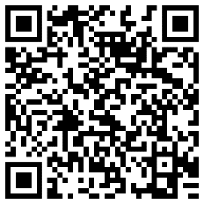
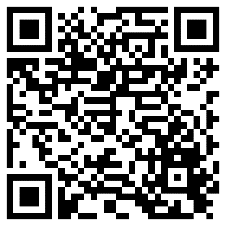
Devoirs
Vocabulary Learning Homework (Y9, Term 3.1, Week 3)
Audio file
Audio file QR code:
Student worksheet link
Quizlet link
Quizlet QR code
Notes:
The answer sheet for the 9.3.1.3 vocabulary learning homework is here: Resource | French SOW Y9 Term 3.1 Week 3 - vocabulary learning homework answers | ID: 5712m861h | NCELP

