Slide 1
Eine Geburtstagsparty
Separable verbs in the present tense
long and short [o] and [ö]
Y8 German
Term 1.2 - Week 7 - Lesson 27
Author name(s): Inge Alferink / Rachel Hawkes / Ciaran Morris
Artwork: Steve Clarke
Date updated: 9/11/20
Notes:
Artwork by Steve Clarke. All additional pictures selected are available under a Creative Commons license, no attribution required.
Learning outcomes (lesson 1):
Consolidation of SSC [o] and [ö]
Introduction of separable verbs in the present tense: 1st, 2nd, 3rd person singular.
Word frequency (1 is the most frequent word in German):
8.1.2.7 (introduce) anfangen [497] ankommen [653] anrufen [1146] einkaufen [2877] mitbringen [1828] setzen [228] stattfinden [652] stellen [135] vorbereiten [1421] Geburtstag [1766] weiterer, weitere, weiteres [182] für [17] während [173]
8.1.2.3 (revisit) gegangen [66] gefahren [215] fliegen [824] geflogen [824] Bahn [1415] Flugzeug [1776] Geschichte [262] Norden [1516] Onkel [1832] Osten [1208] Polen [2023] Süden [1771] Tante [1826] Schiff [1176] Westen [1010] polnisch [3237]
8.1.1.3 (revisit) gefunden [103] Sie [10] Bad [1577] Brief [813] Hunger [2097] Kaffee [1299] Küche [960] Lust [1407] Schmerz [1483] Wohnung [418] müde [2000] noch1 [33] oben [100] unten [590]
The frequency rankings for words that occur in this PowerPoint which have been previously introduced in NCELP resources are given in the NCELP SOW and in the resources that first introduced and formally re-visited those words.
For any other words that occur incidentally in this PowerPoint, frequency rankings will be provided in the notes field wherever possible.

Slide 2
Phonetik
hören / sagen
o
o
wo?
Kopf
ö
ö
schön
plötzlich
Notes:
Timing: 1 minute Aim: To introduce/consolidate SSC long and short [o] and [ö] Procedure: 1. Present the letter(s) and say the [o] sound first, on its own. Students repeat it with you. 2. Bring up the source word ”wo?” on its own, say it, students repeat it, so that they have the opportunity to focus all of their attention on the connection between the written word and its sound.
3. A possible gesture for this would be to point out directly in front of you.
4. Repeat for the other three source words, with gesture suggestions as follows: short [o] – .
long [ö] – .
short [ö] - .
Word frequency (1 is the most frequent word in German): schön [164] zwölf [882] wo? [94] holen [640] Source: Jones, R.L. & Tschirner, E. (2006). A frequency dictionary of German: core vocabulary for learners. Routledge

Slide 3
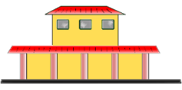
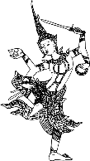
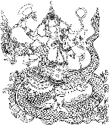
Phonetik
lesen / sprechen
Sag die Wörter.
 | Singular | Plural
1 | Wort | Wörter
2 | Chor | Chöre
3 | Bahnhof | Bahnhöfe
4 | Dorf | Dörfer
5 | Boden | Böden
6 | Kopf | Köpfe
7 | Gott | Götter
8 | Sohn | Söhne
1
[word]
_________
[words]
2
_________
3
_________
4
[village]
_________
[villages]
5
[floor]
_________
[floors]
6
_________
7
_________
8
_________
Notes:
Timing: 5 minutes Aim: Practise the phonetics of plural o → ö. Procedure: 1. Students can initially be asked to fill in the grid without any audio.
2. Clicking the buttons plays both the singular and plural words. Students write and/or check their written versions of the singular nouns.
3. Clicking reveals the singular nouns. 4. Students read aloud/pronounce all of the nouns in pairs, taking it in turns to say whichever the ‘matching’ plural or singular, depending on the word their partner says first.
Transcript:
1. Wort – Wörter
2. Chor – Chöre
3. Bahnhof – Bahnhöfe
4. Dorf – Dörfer
5. Boden – Böden
6. Kopf – Köpfe
7. Gott – Götter
8. Sohn - Söhne
Word frequency (1 is the most frequent word in German): Wort [194], Chor [>5000], Bahnhof [2027], Dorf [959], Boden [536], Kopf [250], Gott [514], Sohn [596] Source: Jones, R.L. & Tschirner, E. (2006). A frequency dictionary of German: core vocabulary for learners. Routledge

Slide 4
vorbereiten
[to prepare | preparing]
bereitet … vor
[prepares | is preparing]
Notes:
Timing: 3 minutes for sequence of six verb slides
Aim: To present one of the separable verbs from this week’s new vocabulary. Both long form (infinitive) and short form (3rd person singular) are introduced in order to familiarise students with various forms of the same verb.
Procedure
Bring up the word [vorbereiten] on its own, say it, students repeat it, and remind them of the phonics. Draw attention to [ei] and [v] and [r] as key SSC present in the word.
Try to elicit the meaning from the students. Students have had explicit teaching that the present tense in German communicates two different present tense meanings in English. This reinforces that learning. Emphasise the two meanings for the short form, reminding students that German only has one form and does not have a direct equivalent of the grammar for ‘is + ing’, the continuous form (as covered in previous weeks).
Then bring up the English translations. Emphasise the two meanings for the infinitive.
Bring up the short form [bereitet …vor], say it, students repeat it. Draw attention to the fact that because the stem ends in –t, an addition ‘e’ is added to the short form, to make it easier to say.
Try to elicit the meaning from the students. Emphasise the two meanings for the short form.

Slide 5
vorbereiten
[to prepare| preparing]
bereitet … vor
[prepares| is preparing]
Notes:
Cycle through the long and short form again.

Slide 6
bereitet … vor
[prepares | is preparing]
Sie bereitet eine Party vor.
[She prepares | is preparing a party.]
Notes:
Introduce the short form in a sentence.

Slide 7
vorbereiten
[to prepare | preparing]
Sie will eine Party vorbereiten.
[She wants to prepare a party.]
Notes:
Introduce the long form in a sentence.

Slide 8
bereitet… vor
[prepares | is preparing]
______________________
_________
Sie bereitet eine Party vor.
[She prepares | is preparing a party.]
Notes:
Cycle through the short form in context again.

Slide 9
vorbereiten
[to prepare | preparing]
___________________________________
Sie will eine Party vorbereiten.
[She wants to prepare a party.]
Notes:
Cycle through the long form in context again.

Slide 10
eine Geschichte
hören / sprechen
Welcher Satz ist richtig?
 | A party is taking place upstairs in my flat. | A birthday party is taking place downstairs in my house. | A birthday party is taking place upstairs in my flat.
 | Mia is hungry and she is coming later. | Mia is tired and she is coming later. | Mia hat a headache and she is coming later.
 | Mehmet flew by plane from Poland. | Mehmet travelled by train from Switzerland. | Mehmet flew by plane from the south.
 | Katja’s aunt and uncle live in Poland and are bringing Polish food. | Katja’s aunt and uncle are flying from Poland and like eating Polish food. | Katja’s aunt and uncle are coming from Poland and can’t travel by boat.
 | Katja is preparing the food, but she hasn’t found the kitchen. | Katja is preparing the food, but she hasn’t found the coffee. | Katja is preparing the party, but she hasn’t found the food.
 | We walked to town, but we still want to dance with Mia! | We went shopping, but now we want to dance with Mia! | We went shopping, but we still want to dance with Mia.
1
2
3
4
5
6
Notes:
Timing: 5 minutes Aim: To practise comprehension and production of most of this week’s revisited vocabulary in sentences. Procedure: 1. Encourage students to recall the vocabulary to predict what they will hear. In number one words that differentiate one sentence from another have been put in bold to facilitate task modelling.
2. Click the action buttons to play each sentence. Students pick which column (A, B or C) is correct.
3. Clicking reveals the answers. 4. Elicit the German for the other two answers each time, to practise productive recall of the vocabulary.
Transcript: 1. Oben in meiner Wohnung findet eine Geburtstagsparty statt.
2. Mia ist müde, und sie kommt später.
3. Mehmet ist mit dem Flugzeug vom Süden aus losgeflogen.
4. Katjas Tante und Onkel fliegen von Polen aus los und essen gern polnisches Essen.
5. Katja bereitet das Essen vor, aber sie hat die Küche nicht gefunden.
6. Wir sind einkaufen gegangen, aber wir haben noch Lust, mit Mia zu tanzen!
Word frequency (1 is the most frequent word in German):
einkaufen [2877] mitbringen [1828] stattfinden [652] vorbereiten [1421] Geburtstag [1766] gegangen [66] gefahren [215] fliegen [824] geflogen [824] Bahn [1415] Flugzeug [1776] Geschichte [262] Onkel [1832] Polen [2023] Süden [1771] Tante [1826] Schiff [1176] polnisch [3237]
gefunden [103] Hunger [2097] Kaffee [1299] Küche [960] Lust [1407] Schmerz [1483] Wohnung [418] müde [2000] noch1 [33] oben [100] unten [590]
Source: Jones, R.L. & Tschirner, E. (2006). A frequency dictionary of German: core vocabulary for learners. Routledge

Slide 11
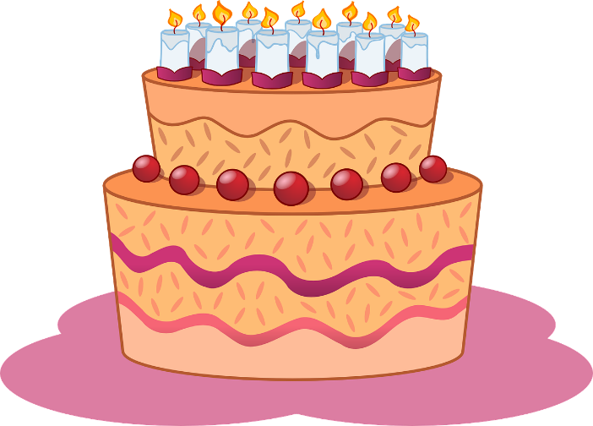
Separable verbs
Grammatik
These verbs are called separable verbs.
In German some verbs are made up of two parts: a particle and the main verb.
vor
bereiten
an
kommen
mit
bringen
The particle often changes the meaning of the verb slightly.
In the present tense the particle moves to the end of the clause:
Mia
bereitet
eine Party
vor.
Mia is preparing a party.
Ich
komme
früh
an.
I’m arriving early.
Wir
bringen
Kuchen
mit.
We’re bringing cake (with us).
Notes:
Timing: 3 minutes Aim: To introduce and illustrate separable verbs. Procedure: 1. Cycle through the information on the slide using the animation sequence. Word frequency (1 is the most frequent word in German):
ankommen [653] mitbringen [1828] vorbereiten [1421] Source: Jones, R.L. & Tschirner, E. (2006). A frequency dictionary of German: core vocabulary for learners. Routledge

Slide 12
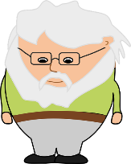
Opa wird 70!
lesen
Schreib 1-8. Is the verb separable or not? Schreib das Verb auf Englisch.
Mia plant selber eine Geburtstagsparty für Opa. Sie schreibt eine Liste.
 |  | separable | not separable | English
1. | Ich bereite die Gästeliste vor |  |  | prepare
2. | Ich schreibe Emails |  |  | write
3. | Ich rufe die Gäste an |  |  | call
4. | Ich brauche einen DJ |  |  | need
5. | Ich suche Rezepte im Internet |  |  | look for
6. | Ich kaufe im Supermarket ein |  |  | shop
7. | Ich komme sehr früh an |  |  | arrive
8. | Ich bringe alles mit |  |  | bring
____
____
_____
_______
____
_______
_____
______
Notes:
Timing: 5 minutes Aim: To practise separable and inseparable verbs. Procedure: 1. Read the items on Mia’s list. For each item say whether the verb is separable or not.
2. Click to reveal and check answers.
3. For each item write the English translation of the verb.
4. Click to reveal and check answers.
Full sentences: Ich bereite die Gästeliste vor. Ich rufe die Gäste an. Ich schreibe Emails.
Ich finde einen DJ. Ich suche Rezepte im Internet. Ich kaufe im Supermarket ein. Ich komme sehr früh an. Ich bringe alles mit. Word frequency (1 is the most frequent word in German): ankommen [653] anrufen [1146] einkaufen [2877] mitbringen [1828] vorbereiten [1421] Geburtstag [1766]
Source: Jones, R.L. & Tschirner, E. (2006). A frequency dictionary of German: core vocabulary for learners. Routledge

Slide 13
Wer macht was?
hören
 |  | Wolfgang (du) | Frau Nowak (Sie)
 | shop online
 | shop in the shop
 | bake the cake
te | prepare recipes
 | organise music
 | arrive at 2 o’clock
 | ring the DJ
 | bring the banner
 | prepare the deco
 | bring the presents
Mia kann das alles nicht selber machen! Sie redet mit Wolfgang und Frau Nowak (Katjas Mutter) über Zoom.
1
2
3
4
5
Redet sie mit Wolfgang (du) oder mit Frau Nowak (Sie)?
6
7
8
9
10
Notes:
Timing: 5 minutes Aim: To practise listening for and attending to du and formal Sie verb endings. This activity uses separable verbs in sentences. Procedure: 1. Click on a number to play the sound. For each item say whether Mia is talking to Wolfgang (du) or Frau Nowak (Sie).
2. Click to reveal and check answers.
Transcript: 1. [Sie] kaufen online ein.
2. [Du] kaufst im Geschäft ein. 3. [Sie] backen den Kuchen. 4. [Du] bereitest die anderen Rezepte vor. 5. [Du] organisierst die Musik.
6. [Sie] kommen um zwei Uhr an. 7. [Sie] rufen den DJ an. 8. [Du] bringst das Banner mit. 9. [Sie] bereiten die Dekoration vor. 10. [Sie] bringen die Geschenke mit. Word frequency (1 is the most frequent word in German):
ankommen [653] anrufen [1146] einkaufen [2877] mitbringen [1828] vorbereiten [1421] Sie [10]
The frequency rankings for words that occur in this PowerPoint which have been previously introduced in NCELP resources are given in the NCELP SOW and in the resources that first introduced and formally re-visited those words.
For any other words that occur incidentally in this PowerPoint, frequency rankings will be provided in the notes field wherever possible.
Source: Jones, R.L. & Tschirner, E. (2006). A frequency dictionary of German: core vocabulary for learners. Routledge

Slide 14
Antworten
hören
 |  | Wolfgang (du) | Frau Nowak (Sie)
 | shop online
 | shop in the shop
 | bake the cake
 | prepare recipes
 | organise music
 | arrive at 2 o’clock
 | ring the DJ
 | bring the banner
 | prepare the deco
 | bring the presents
Mia kann das alles nicht selber machen! Sie redet mit Wolfgang und Frau Nowak (Katjas Mutter) über Zoom.
1
2
3
4
Redet sie mit Wolfgang (du) oder mit Frau Nowak (Sie)?
5
6
7
8
9
10
Notes:
Optional - full audio to use when checking answers
Transcript: 1. Sie kaufen online ein.
2. Du kaufst im Geschäft ein. 3. Sie backen den Kuchen. 4. Du bereitest die anderen Rezepte vor. 5. Du organisierst die Musik.
6. Sie kommen um zwei Uhr an. 7. Sie rufen den DJ an. 8. Du bringst das Banner mit. 9. Sie bereiten die Dekoration vor. 10. Sie bringen die Geschenke mit. Word frequency (1 is the most frequent word in German):
ankommen [653] anrufen [1146] einkaufen [2877] mitbringen [1828] vorbereiten [1421] Sie [10]
The frequency rankings for words that occur in this PowerPoint which have been previously introduced in NCELP resources are given in the NCELP SOW and in the resources that first introduced and formally re-visited those words.
For any other words that occur incidentally in this PowerPoint, frequency rankings will be provided in the notes field wherever possible.
Source: Jones, R.L. & Tschirner, E. (2006). A frequency dictionary of German: core vocabulary for learners. Routledge

Slide 15
Using nicht
Grammatik
You know that to negate the whole sentence, nicht usually goes at the end:
Wolfgang backt den Kuchen nicht.
Wolfgang is not baking the cake.
To negate a separable verb put nicht in front of the particle:
Wolfgang ruft die Gäste nicht an.
Wolfgang is not calling the guests.
Notes:
Timing: 2 minutes Aim: Explain and illustrate whole sentence negation with separable and non-separable verbs (in neutral sentences). Procedure: 1. Cycle through the information on the slide using the animation sequence.

Slide 16
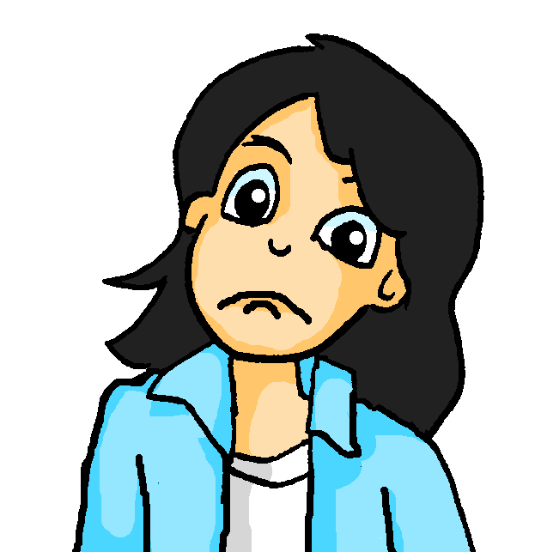
Wolfgang hilft nicht!
lesen
Mia braucht Wolfgangs Hilfe mit der Party. Wo kommt das ‘nicht’ hin? Schreib Wolfgangs Antworten richtig.
08:30
09:30
10:00
Mia: Kannst du um 9 Uhr das Restaurant anrufen?
Mia: Kannst du den Garten vorbereiten?
Mia: Kannst du im Restaurant die Musik organisieren?
08:32
09:31
11:00
Wolfgang: Nein, ich bereite den Garten _______ vor ________
Wolfgang: Nein! Ich organisiere ____ die Musik ________
Wolfgang: Nein, ich rufe das Restaurant ______ an _______
nicht
.
nicht.
nicht
.
Notes:
Timing: 3 minutes Aim: To practise understanding the placement of nicht in sentence negation in the written modality with separable and non-separable verbs. Procedure: 1. Remind students that nicht comes before the particle with separable verbs and at the end of the sentence with non-separable verbs.
2. Students write 1-3 and Wolfgang’s reply with the nicht in the correct position. 3. Click to reveal answers.

Slide 17
Wer macht was? [1/2]
Mia vergisst alles! Du oder Sie?
sprechen
1. einkaufen
2. um 2 Uhr ankommen
3. Opa und Oma mitbringen
4. die Gäste anrufen
5. die Geschenke mitbringen
6. die Musik organisieren
Partner A
Kaufen Sie ein?
Ja, ich kaufe ein.
Partner B
Notes:
Timing: 8 minutes Aim: To practise asking questions with formal and informal you, and to practise using separable verbs with questions and answers in the affirmative and negative. Procedure: 1. Partner A decides that s/he is talking to an older person or a friend, and uses the formal or informal form of the verbs to ask the question. 2. Partner B listens and responds according to the indicated answer, as in the example modelled here. 3. Then do the same process with the other five sets of pictures. Note that the infinitive phrases are provided to scaffold the task and enable students to focus their full attention on forming questions with separable verbs in the ‘du’ and ‘Sie’ forms, and responding with affirmative and negative answers.
On the next slide students swap roles. Word frequency (1 is the most frequent word in German): Source: Jones, R.L. & Tschirner, E. (2006). A frequency dictionary of German: core vocabulary for learners. Routledge

Slide 18
Wer macht was? [2/2]
Mia vergisst alles! Du oder Sie?
sprechen
1. das Essen kaufen
2. das Banner mitbringen
3. um 5 Uhr ankommen
4. die Dekoration vorbereiten
5. den Kuchen backen
6. die weiteren Rezepte vorbereiten
Kaufst du das Essen?
Nein, ich kaufe das Essen nicht.
Partner B
Partner A

Slide 19
Mia schreibt ein Email.
schreiben / lesen
Mia sitzt oben und schreibt ein Email. Ihr Laptop ist kaputt! Schreib die Wörter auf Deutsch.
An:
FrauNowak@hallo.de
Betreffs:
Party!
Haben Sie _________ [the letter] vom Restaurant bekommen?
Wir müssen __________ [the kitchen] benutzen.
Wann kommen Katjas ________ [Uncle] und _______ [Aunt] an?
Sie _________ _________ [they feel like], zu helfen, nicht wahr?
Das Restaurant ist toll. Es hat alles: __________ [a bathroom] und _________ [further] Zimmer.
Ich habe dieses Hotel in ganz Berlin gesucht; ___ ________ [in the north], im Süden, ___ _________ [in the east] und im Westen von der Stadt.
Es ist eine sehr lange ___________ [story]
den Brief
die Küche
Onkel
Tante
haben Lust
ein Bad
weitere
im Norden
im Osten
Geschichte!
Notes:
Timing: 5 minutes Aim: To produce in written form some revisited vocabulary from this week’s sets. Procedure: 1. Write 1-7 and the missing German words. 2. Click to reveal answers. 3. If time, elicit English sentence meanings orally. Word frequency of cognates used (1 is the most frequent word in German): E-Mail [2172],
Word frequency (1 is the most frequent word in German):
Geschichte [262] Norden [1516] Onkel [1832] Osten [1208] Tante [1826] Westen [1010]
Sie [10] Bad [1577] Brief [813] Küche [960] Lust [1407]
Source: Jones, R.L. & Tschirner, E. (2006). A frequency dictionary of German: core vocabulary for learners. Routledge

Slide 20
Eine Geburtstagsparty
The verbs ‘to put’: stellen, setzen, legen
long and short [o] and [ö]
Y8 German
Term 1.2 - Week 7 - Lesson 28
Author name(s): Inge Alferink / Rachel Hawkes / Ciaran Morris
Artwork: Steve Clarke
Date updated: 9/11/20
Notes:
Artwork by Steve Clarke. All additional pictures selected are available under a Creative Commons license, no attribution required.
Learning outcomes (lesson 1):
Consolidation of SSC [o] and [ö]
Consolidation of separable verbs in the present tense Introduction to three verbs ‘to put’: stellen, setzen, legen
Word frequency (1 is the most frequent word in German):
8.1.2.7 (introduce) anfangen [497] ankommen [653] anrufen [1146] einkaufen [2877] mitbringen [1828] setzen [228] stattfinden [652] stellen [135] vorbereiten [1421] Geburtstag [1766] weiterer, weitere, weiteres [182] für [17] während [173]
8.1.2.3 (revisit) gegangen [66] gefahren [215] fliegen [824] geflogen [824] Bahn [1415] Flugzeug [1776] Geschichte [262] Norden [1516] Onkel [1832] Osten [1208] Polen [2023] Süden [1771] Tante [1826] Schiff [1176] Westen [1010] polnisch [3237]
8.1.1.3 (revisit) gefunden [103] Sie [10] Bad [1577] Brief [813] Hunger [2097] Kaffee [1299] Küche [960] Lust [1407] Schmerz [1483] Wohnung [418] müde [2000] noch1 [33] oben [100] unten [590]
The frequency rankings for words that occur in this PowerPoint which have been previously introduced in NCELP resources are given in the NCELP SOW and in the resources that first introduced and formally re-visited those words.
For any other words that occur incidentally in this PowerPoint, frequency rankings will be provided in the notes field wherever possible.

Slide 21
Phonetik
hören / sprechen
Welches Wort ist das? Schreib a-f und 1,2 oder 2,1.
[o]
[ö]
1 fordern [to encourage]
2 fördern [to promote]
a
__
__
2 Osten [East]
1 östlich [easterly]
b
__
__
2 Polen [Poland]
1 Pönale [penalty]
c
__
__
1 noch [still]
2 Nöck [water sprite]
d
__
__
2 flott [quick]
1 Flöte [flute]
e
__
__
1 Kode [code]
2 Köder [bait]
f
__
__
Notes:
Phonics Timing: 5 minutes Aim: To differentiate between pairs of words that differ primarily by one phoneme (one SSC that changes the meaning). These words are near-minimal pairs. Procedure: 1. Click to listen. 2. Write 1, 2 or 2, 1 depending on the order in which the words are spoken. 3. Click to see the answers.
4. Students can then partner up. Partner A reads one side aloud while partner B reads the other, word-by-word. They can then switch.
Transcript
fordern, fördern
östlich, Osten
Pönale, Polen
Noch, Nock
Flöte, flott
Kode, Köder
Word frequency (1 is the most frequent word in German): fordern [599], fördern [1089], Osten [1208], östlich [4883], Polen [2023], Pönale [>5000], noch [33], Nöck [>5000], flott [>5000], Flöte [>5000], Code [>5000], Köder [>5000] Source: Jones, R.L. & Tschirner, E. (2006). A frequency dictionary of German: core vocabulary for learners. Routledge

Slide 22
stattfinden
[to take place | taking place]
findet … statt
[takes place | is taking place]
Notes:
Timing: 3 minutes for sequence of six verb slides
Aim: To present one of the separable verbs from this week’s new vocabulary. Both long form (infinitive) and short form (3rd person singular) are introduced in order to familiarise students with various forms of the same verb.
Procedure
Bring up the word [stattfinden] on its own, say it, students repeat it, and remind them of the phonics. Draw attention to [st-] as a key SSC.
Try to elicit the meaning from the students. Students have had explicit teaching that the present tense in German communicates two different present tense meanings in English. This reinforces that learning. Emphasise the two meanings for the short form, reminding students that German only has one form and does not have a direct equivalent of the grammar for ‘is + ing’, the continuous form (as covered in previous weeks).
Then bring up the English translations. Emphasise the two meanings for the infinitive.
Bring up the short form [findet …statt], say it, students repeat it. Draw attention to the fact that because the stem ends in –t, an addition ‘e’ is added to the short form, to make it easier to say.
Try to elicit the meaning from the students. Emphasise the two meanings for the short form.

Slide 23
stattfinden
[to take place | taking place]
findet … statt
[takes place | is taking place]
Notes:
Cycle through the long and short form again.

Slide 24
findet … statt
[takes place | is taking place]
Das Fest findet in der Schweiz statt.
[The festival takes place | is taking place in Switzerland.]
Notes:
Introduce the short form in a sentence.

Slide 25
stattfinden
[to take place | taking place]
Das Fest muss im Januar stattfinden.
[The festival must take place in January.]
Notes:
Introduce the long form in a sentence.

Slide 26
findet … statt
[takes place | is taking place]
____________
Das Fest findet in der Schweiz statt.
______________
[The festival takes place | is taking place in Switzerland.]
Notes:
Cycle through the short form in context again.

Slide 27
stattfinden
[to take place | taking place]
__________________________
Das Fest muss im Januar stattfinden.
[The festival must take place in January.]
Notes:
Cycle through the long form in context again.

Slide 28
Das internationale Ballonfestival
lesen
anmachen – to switch on das Feuerwerk – firework display
Welche Wörter passen in die Lücken?
Das internationale Ballonfestival findet jedes Jahr im Januar in der Schweiz statt. Menschen aus rund zwanzig Ländern kommen in Château-d’Oex an. Das Festival fängt am 23. Januar an und dauert neun Tage. Ballonfahrer bringen viele Heißluftballone mit . Rund100 Heißluftballone fliegen in die Luft.
Ein Highlight ist die Night Glow. Piloten bereiten eine Show vor . Sie setzen die Ballone auf den Berg und *machen in der Nacht das Feuer an. Sie spielen Musik dazu und man kann auch das Feuerwerk anschauen.
1_
2
Balloons has two forms in German: Ballons = Ballone =
3
_4_
5
6
Notes:
https://www.chateau-doex.ch/de/P1152/das-internationale-ballonfestival
Timing: 5 minutes Aim: To practise separable verbs in context. Procedure: 1. Read the text and fill in fitting particles.
2. Click to reveal answers.
Word frequency (1 is the most frequent word in German):
anfangen [497] ankommen [653] mitbringen [1828] stattfinden [652] stellen [135] vorbereiten [1421]
fliegen [824]
Source: Jones, R.L. & Tschirner, E. (2006). A frequency dictionary of German: core vocabulary for learners. Routledge

Slide 29
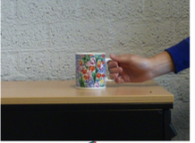
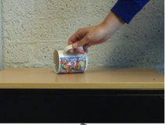
stellen, setzen, legen
Grammatik
In German, we separate the English verb ‘to put’ into three verbs:
stellen = to make something stand (vertically).
R2 (accusative) always follows because they imply movement / a change of position for the object.
setzen = to make something sit
legen = to make something lay down (horizontally).
Ich stelle die Tasse auf den Tisch.
Er stellt die Bücher auf das Regal.
I put the cup onto the table.
He puts the books onto the shelf.
Ich lege die Tasse auf den Tisch.
Er legt die Bücher auf das Regal.
I put the cup onto the table.
He puts the books onto the shelf.
Sie setzt den Ball auf den Stuhl.
Sie puts the ball onto the chair.
Notes:
Timing: 3 minutes Aim: To explain and illustrate placement verbs stellen / legen / setzen. Procedure: 1. Cycle through the information on the slide using the animation sequence.

Slide 30
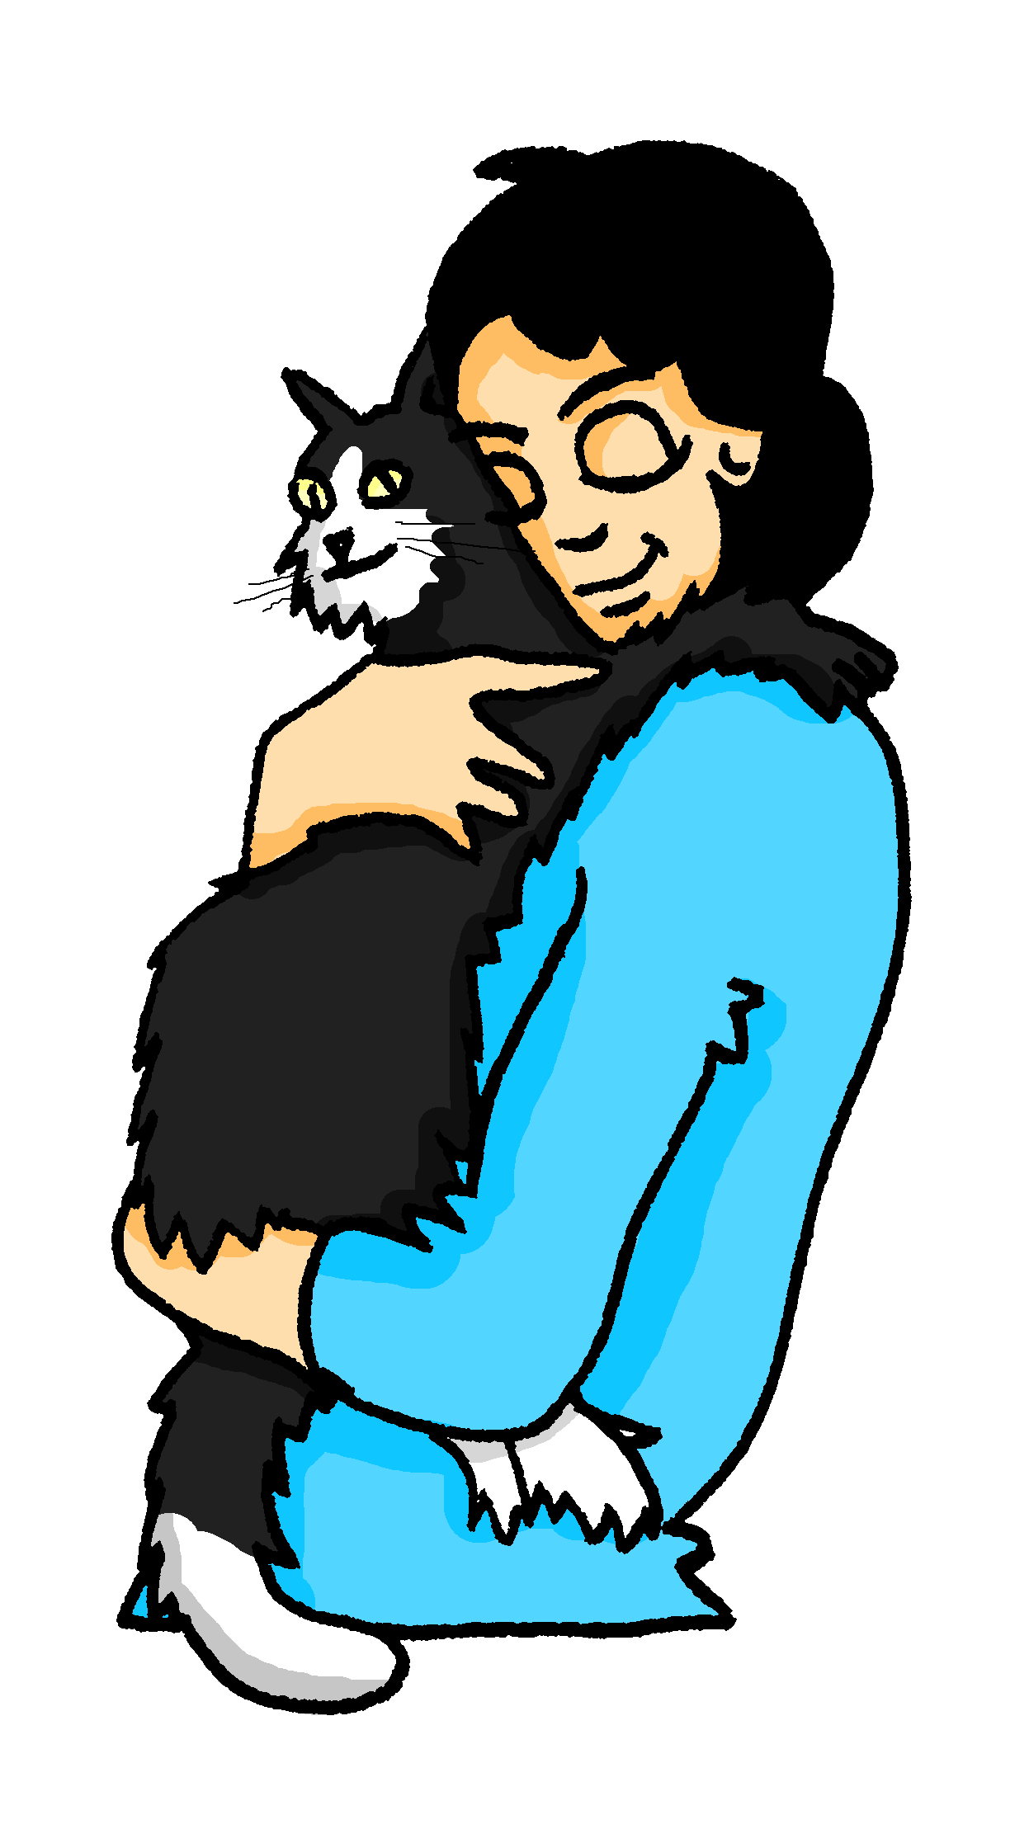
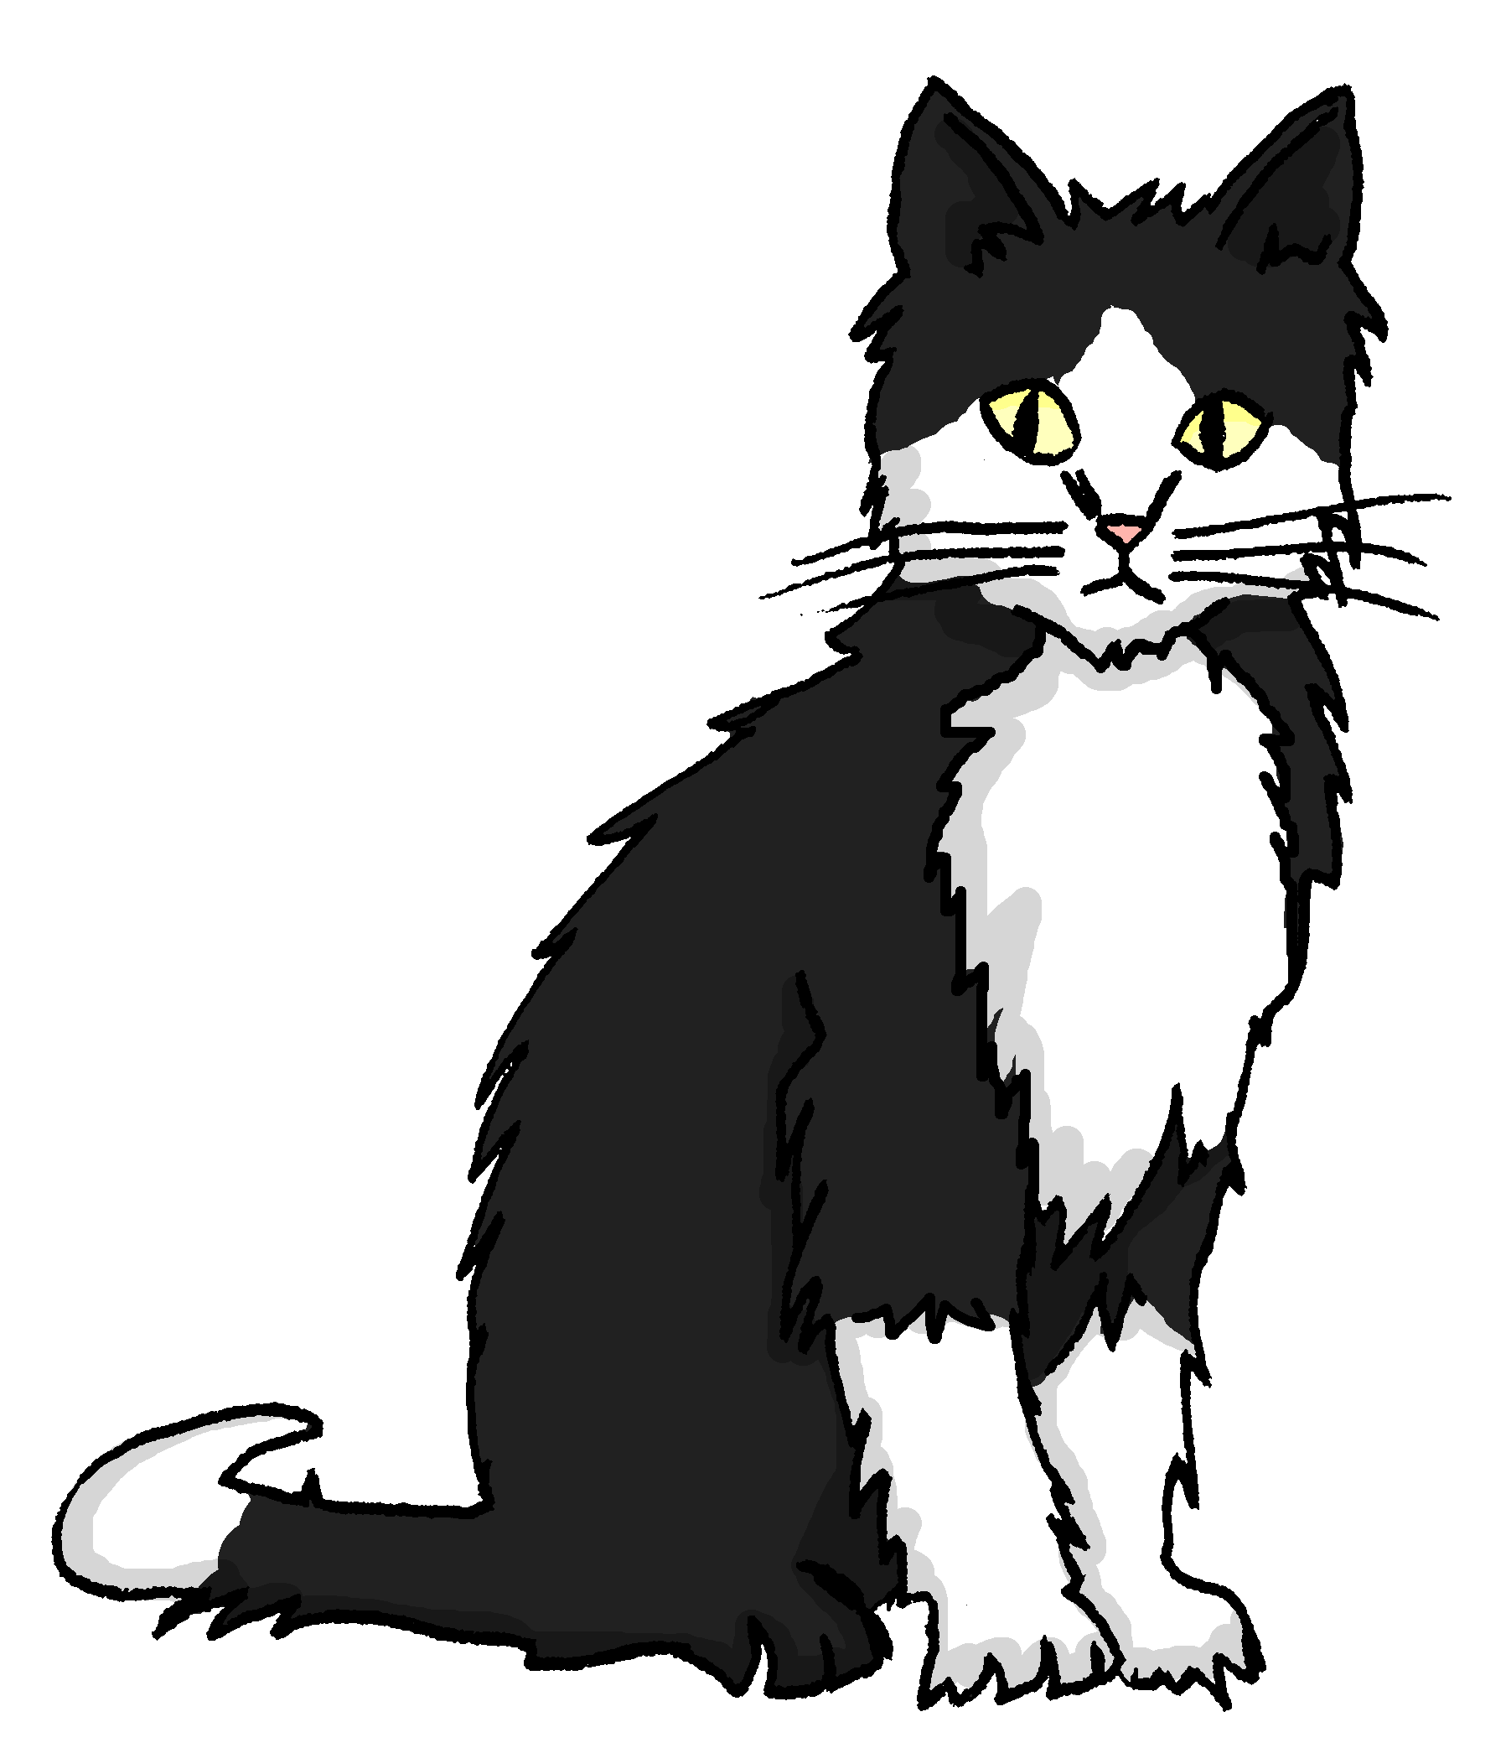
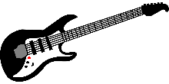
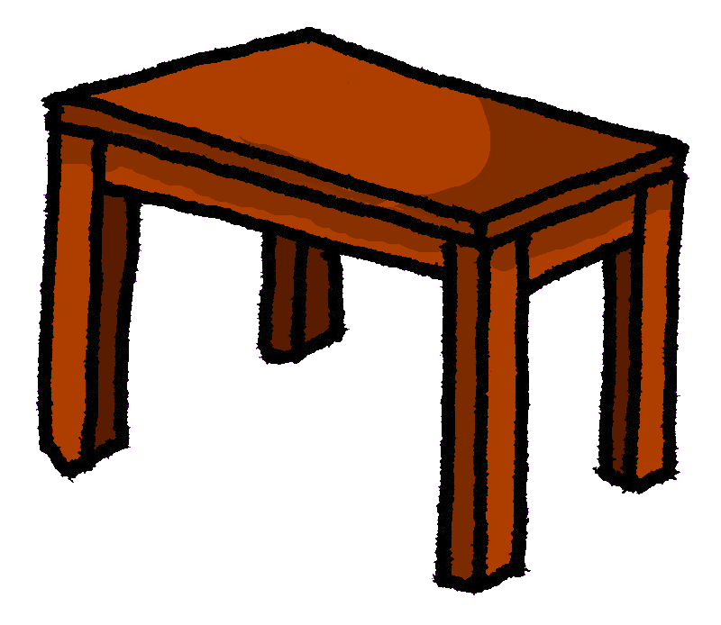
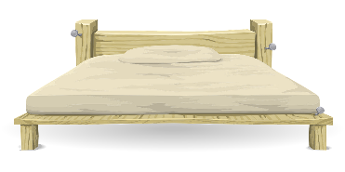
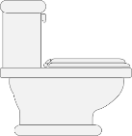
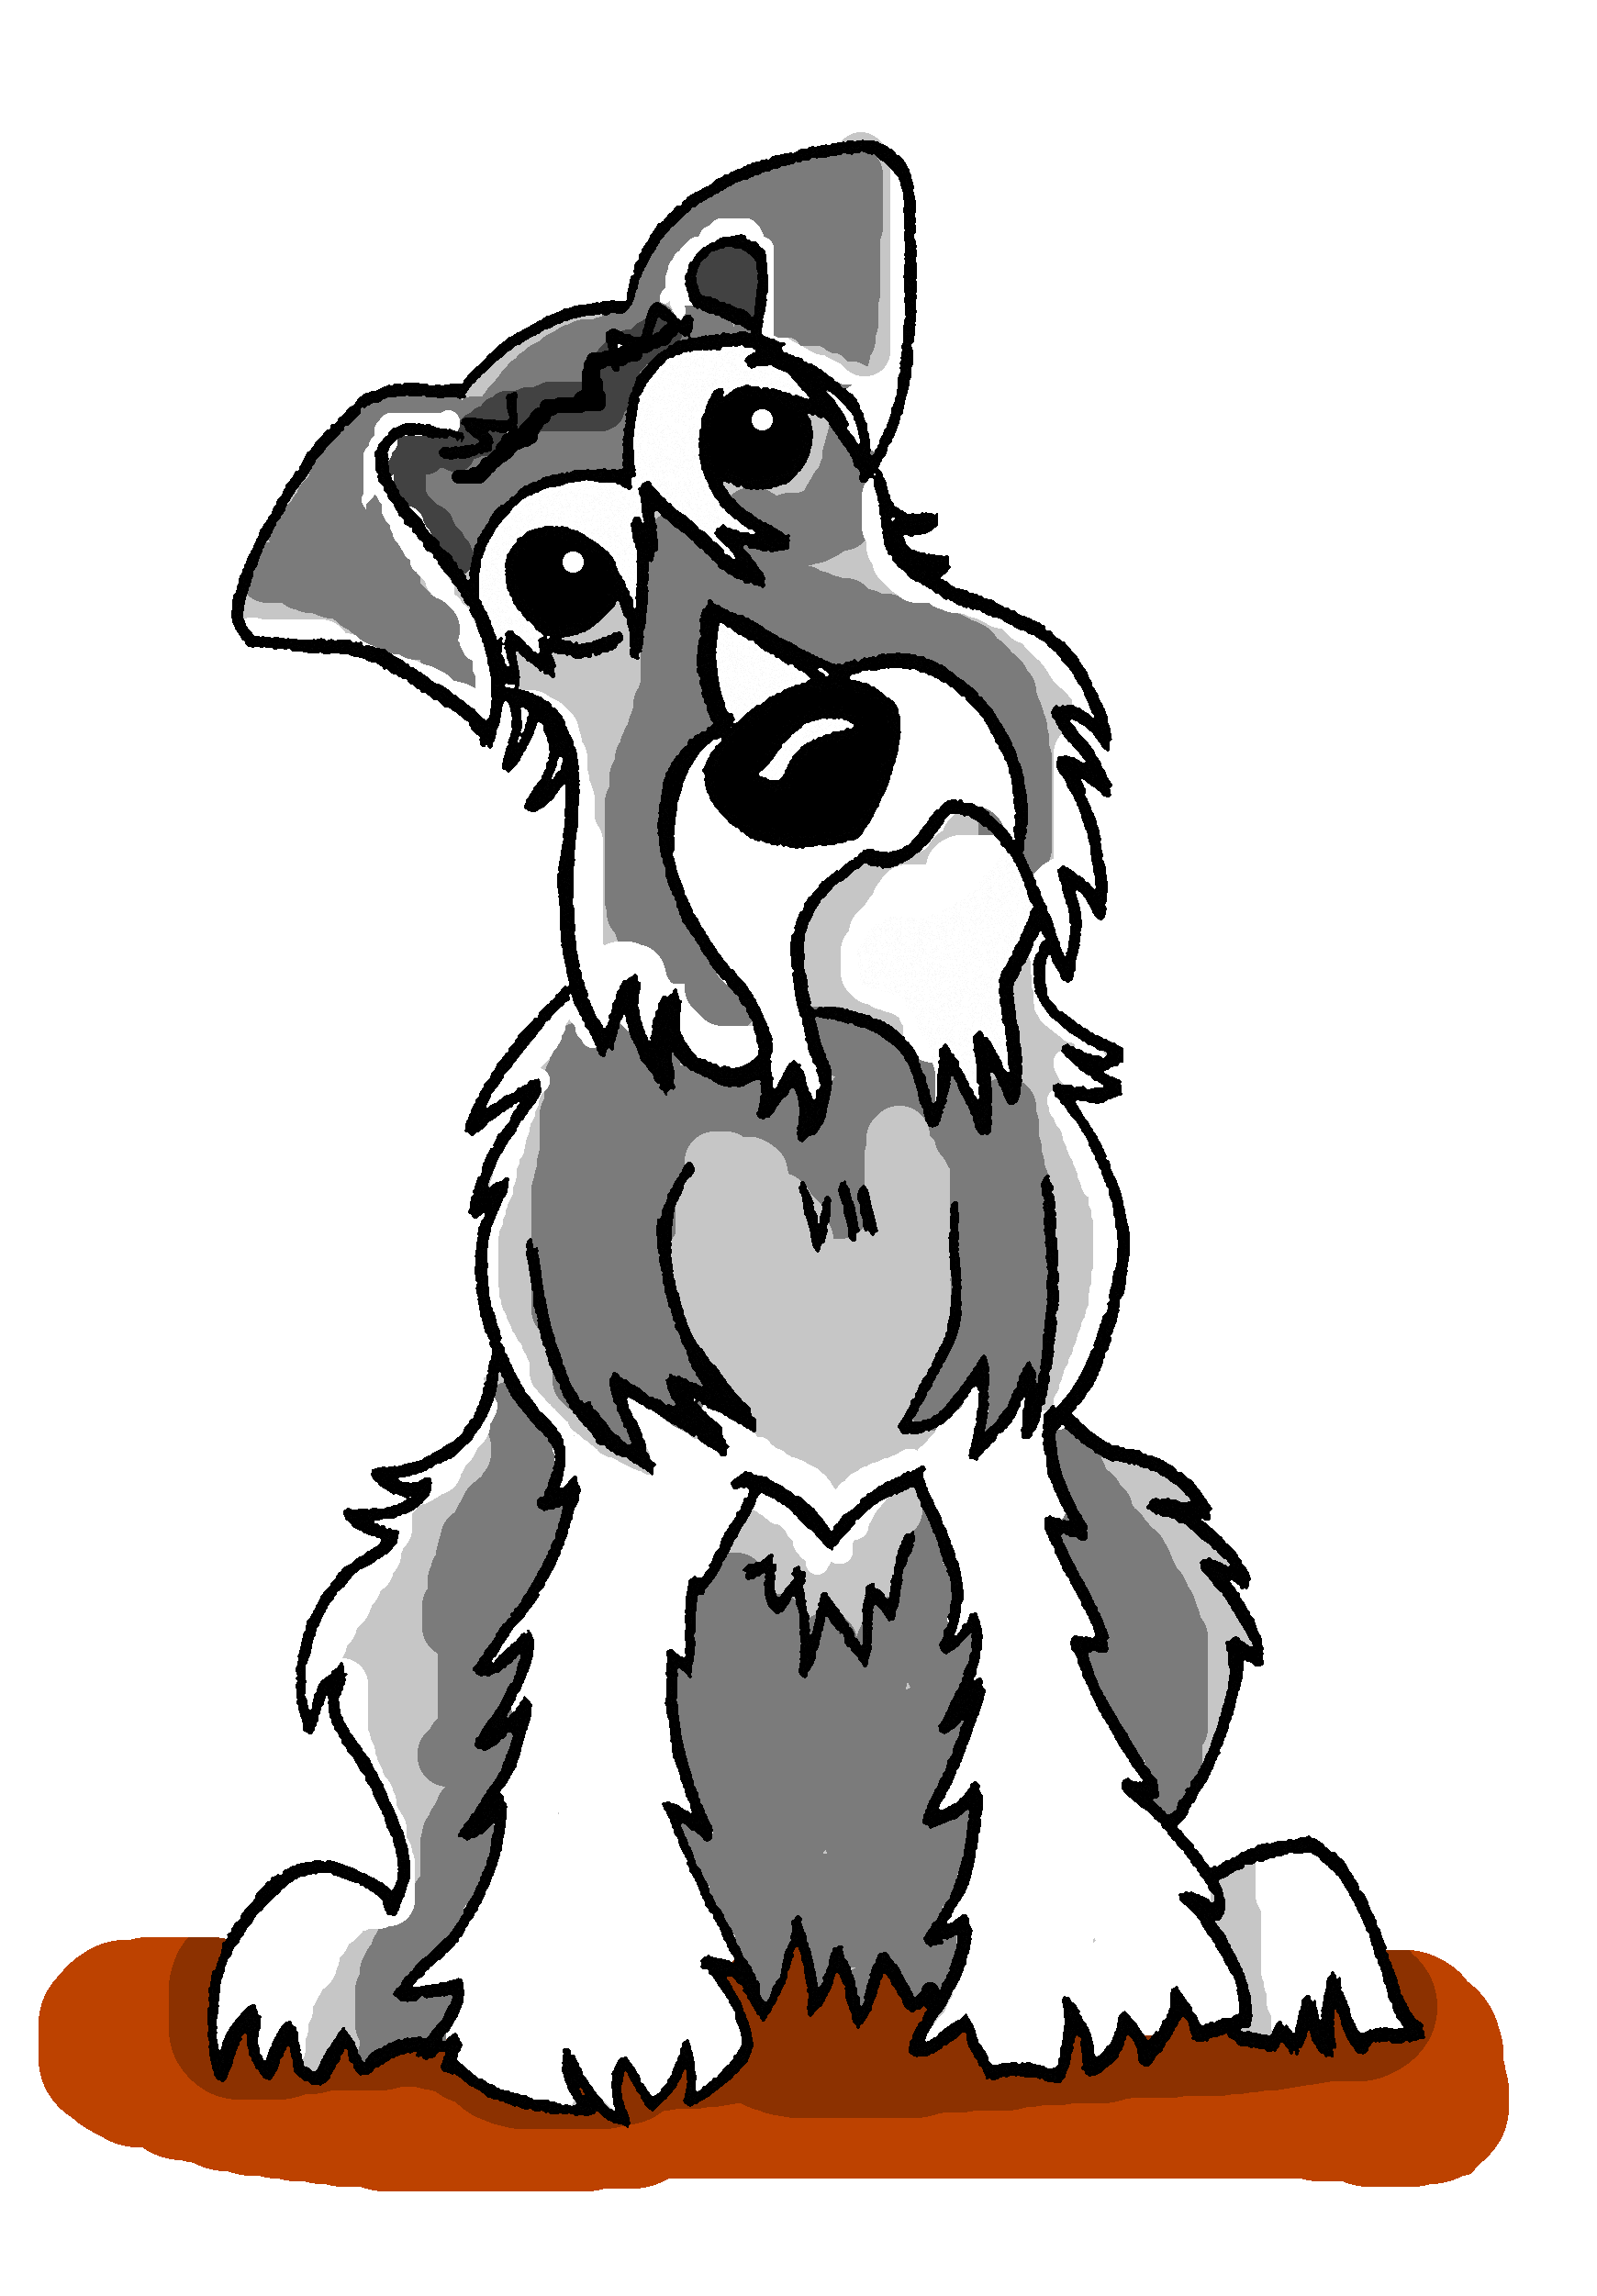
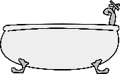
stellen, setzen, legen
lesen / schreiben
 |  | stellen | setzen | legen
1. | Ich __________ [put] Mieze auf das Sofa.
2. | Wolfgang __________ [puts] die Gitarre auf den Tisch.
3. | Ich __________ [put] das Geschenk auf den Sessel.
4. | Opa __________ [puts] die Zeitung auf das Bett.
5. | ‘Frau Nowak, Sie _______________ [put] die Flaschen in die Küche, nicht wahr?
6. | ‘Wolfgang, _________ [put] du das *Klopapier auf die Toilette?
7. | Ich _________ [put] den Laptop auf den Boden.
8. | Oma _________ [puts] Einstein ins Bad.
Was sagt Mia? Schreib 1-8 und das richtige Verb auf Deutsch.
setze
legt
stelle
legt
stellen
stellst
setze/lege
setzt
*das Klo - toilet
Notes:
Timing: 5 minutes Aim: to reinforce understanding of the differences in meaning between the three verbs meaning ‘put’, and to provide the additional challenge to produce the verbs in writing. Procedure: 1. Students write 1-8. They either identify the verb infinitive, or write the missing form (taking their cue from the subject (pronoun)).
2. Click to trigger a picture clue as to the choice of verb (Some students will find it easier to identify which verb to choose when they see a picture of the position).
3. Click again to reveal the answer for each.
Note: If the laptop is closed, we would say ‘legen’. If the laptop has the lid open, then we could also say ‘setzen’.
Word frequency (1 is the most frequent word in German):
setzen [228] stellen [135]
Source: Jones, R.L. & Tschirner, E. (2006). A frequency dictionary of German: core vocabulary for learners. Routledge

Slide 31
Ich mache alles!
der Teller – plate der Kühlschrank - fridge
hören
Mia spricht mit Katja. Hör dir Mia‘s Sätze an. Schreib das richtige Verb[1-8].
 |  | stellen | legen | setzen
 | …a big table in the garden…
 | …the serviettes on the plates…
 | …extra chairs in the kitchen…
 | …the cake into the oven…
 | …the guest book open onto the table…
 | …a new pen onto the table, too…
 | …the cat onto her favourite chair…
 | …the bottles into the door of the fridge…
1
2
3
4
5
6
7
8
Notes:
Timing: 5 minutes Aim: Practise stellen / legen / setzen in sentence context in the oral modality. Procedure: 1. Click on a number to hear the recording.
2. Decide which verb fits. 3. Optional – listen again and note the additional details in English.
4. Click to reveal and check answers. Note: the following slide also has the answers, and full version of the audio for each sentence, if preferred.
Transcript: 1. Ich [stelle] einen großen Tisch in den Garten...
2. Ich [lege] die Servietten auf die Teller...
3. Ich [stelle] Extra-stühle in die Küche...
4. Ich [setze] den Kuchen in den Ofen...
5. Ich [lege] das Gästebuch offen auf den Tisch...
6. Ich [lege] auch einen neuen Kuli auf den Tisch...
7. Ich [setze] die Katze auf ihren Lieblingsstuhl...
8. Ich [stelle] die Flaschen in die Tür vom Kühlschrank...

Slide 32
Antworten
der Teller – plate der Kühlschrank - fridge
hören
Mia spricht mit Katja. Hör dir Mias Sätze an. Schreib das richtige Verb[1-8].
 |  | stellen | legen | setzen
 | …a big table in the garden…
 | …the serviettes on the plates…
 | …extra chairs in the kitchen…
 | …the cake into the oven…
 | …the guest book open onto the table…
 | …a new pen onto the table, too…
 | …the cat onto her favourite chair…
 | …the bottles into the door of the fridge…
1
2
3
4
5
6
7
8
Notes:
Optional additional slides with full audio for the sentences
Transcript: 1. Ich stelle einen großen Tisch in den Garten...
2. Ich lege die Servietten auf die Teller...
3. Ich stelle Extra-stühle in die Küche...
4. Ich setze den Kuchen in den Ofen...
5. Ich lege das Gästebuch offen auf den Tisch...
6. Ich lege auch einen neuen Kuli auf den Tisch...
7. Ich setze die Katze auf ihren Lieblingsstuhl...
8. Ich stelle die Flaschen in die Tür vom Kühlschrank... Word frequency (1 is the most frequent word in German): Source: Jones, R.L. & Tschirner, E. (2006). A frequency dictionary of German: core vocabulary for learners. Routledge

Slide 33
stellen vs stehen, setzen vs sitzen, legen vs liegen
Grammatik
Stellen, legen, and setzen are verbs that cause something to end up in a specific position.
To say what position something is in already, use stehen, liegen, and sitzen.
English often just translates these three verbs as ‘be’.
Placement verbs are followed by R2 and positional verbs are followed by R3.
placement
position
stellen
stehen
Mia stellt den Kuchen auf den Tisch, während Wolfgang auf dem Boden steht.
Mia puts the present on the table, while Wolfgang is (stands) on the floor.
setzten
sitzen
Mia setzt den Hund auf den Boden, während Wolfgang auf dem Stuhl sitzt.
Mia puts the dog on the floor, while Wolfgang is (sits) on the chair.
legen
liegen
Mia legt den Löffel auf den Tisch, während Wolfgang auf dem Bett liegt.
Mia puts the spoon on the table, while Wolfgang is (lies) on the bed.
Während means whilst and can be used to contrast two people’s actions. Use WO3 after it, as with ‘weil’ (because).
Notes:
Timing: 3 minutes Aim: To explain and illustrate placement verbs (stellen / legen / setzen) vs positional verbs (stehen / liegen / sitzen) Procedure: 1. Cycle through the information on the slide using the animation sequence.

Slide 34
Sie organisieren zuhause
*das Kissen = cushion
lesen
*der Ofen = oven
1. Das Buch liegt… 1. Mia legt das Buch… …auf dem Tisch.
2. Der Stuhl steht… 2. Wolfgang stellt den Stuhl… …in die Wohnung.
3. Die Katze sitzt… 3. Mia setzt die Katze …im Garten.
4. Das Kissen* liegt… 4. Wolfgang legt das Kissen*… …auf den Stuhl.
5. Der Hund sitzt … 5. Tante Laura setzt den Hund… …auf dem Boden.
6. Der Ofen* steht… 6. Oma stellt den Ofen* … …in der Küche.
7. Das Kind sitzt… 7. Ihr Onkel setzt das Kind… …im Bad.
8. Das Heft liegt… 8. Mia legt das Heft… …auf den Tisch.
Notes:
Timing: 5 minutes Aim: To practise positional verbs (stehen / leigen / sitzen) and placement verbs (stellen / legen / setzen) and R2/R3 prepositional phrases. Procedure: 1. For each sentence say whether the positional verb or the placement verb fits. Remember to look at the R2 / R3 prepositions to decide which one fits.
2. Click to reveal and check the answers.
3. The first item can be done as example.
4. Check understanding of the meaning.
Word frequency (1 is the most frequent word in German): setzen [228] stellen [135] Onkel [1832] Tante [1826] Bad [1577] Küche [960] Wohnung [418]
Source: Jones, R.L. & Tschirner, E. (2006). A frequency dictionary of German: core vocabulary for learners. Routledge

Slide 35
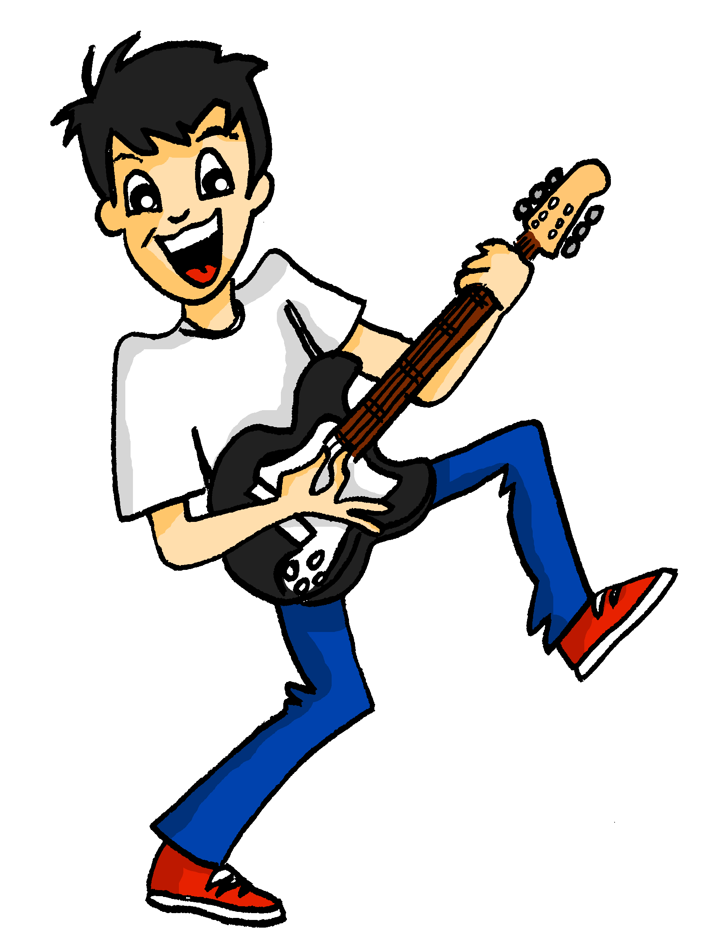
Ach, Wolfgang!
hören
Remember, denn is followed by WO1.
Mia ist frustriert, denn Wolfgang hilft nicht.
Do Mia’s actions happen because of Wolfgang’s (denn) or at the same time as Wolfgang’s (während)?
 | Wolfgangs Aktivität (auf Englisch) | denn | während
 | is playing guitar
 | is taking a bath
 | doesn’t feel like it
te | is writing Heidi a text
 | has forgotten
 | is writing with the other pen
 | is calling Mehmet
 | has put them in the sun
1
1
2
2
3
3
4
4
5
5
6
6
7
7
8
8
Notes:
Timing: 5 minutes Aim: Practise während and denn in sentence context. Note: this task re-uses the first halves of sentences students have already heard and understood. This will help them to focus more of their attention on the second halves of the sentences. Procedure: 1. Click on a number to hear the recording.
2. Decide which word fits in the gap, using the word order to help decide. 3. Listen again to write down what Wolfgang is doing. Note: the actions buttons on the left have the full sentences without beeps, which can be used here.
4. Click to reveal and check answers.
Transcript: 1. Ich stelle einen großen Tisch in den Garten, [während] Wolfgang Gitarre spielt.
2. Ich lege die Servietten auf die Teller, [während] Wolfgang ein Bad nimmt.
3. Ich stelle Extra-stühle in die Küche, [denn] Wolfgang hat keine Lust.
4. Ich setze den Kuchen in den Ofen, [während] Wolfgang Heidi eine SMS schreibt.
5. Ich lege das Gästebuch offen auf den Tisch, [denn] Wolfgang hat das vergessen.
6. Ich lege auch einen neuen Kuli auf den Tisch, [während] Wolfgang mit dem anderen Kuli schreibt.
7. Ich setze die Katze auf ihren Lieblingsstuhl, [denn] Wolfgang ruft Mehmet an.
8. Ich stelle die Flaschen in die Tür vom Kühlschrank, [denn] Wolfgang hat sie in die Sonne gesetzt.
Word frequency (1 is the most frequent word in German): setzen [228] stellen [135] vorbereiten [1421] während [173] Küche [960] Bad [1577] Lust [1407] Source: Jones, R.L. & Tschirner, E. (2006). A frequency dictionary of German: core vocabulary for learners. Routledge

Slide 36
Wie enden die Sätze?
sprechen
Person A fängt an. Person B sagt das richtige Satzende.
She puts (lays) her mobile…
Person A
Sie legt ihr Handy….
…auf dem Tisch. / …auf den Tisch.
Person B
…auf den Tisch.
Notes:
Timing: 5 minutes
Aim: To practice
Procedure:
Person a starts the sentence (cued in English)
Person B chooses which ending fits and completes the sentence.
For round 2 person A and B swap roles.
Transcript: Word frequency (1 is the most frequent word in German):
Brief [813] setzen [228] stellen [135] Wohnung [418] Flugzeug [1776]
Source: Jones, R.L. & Tschirner, E. (2006). A frequency dictionary of German: core vocabulary for learners. Routledge

Slide 37
Person A
sprechen
Round 1
Round 2
1. He puts (stands) the bike…
1. …auf das / auf dem Sofa.
2. The car is (stands)….
2. …auf dem / auf den Tisch.
3. She puts (sets) the hat …
3. …auf den / auf dem Boden.
4. He puts (lays) the newspaper…
4. …in die / in der Wohnung.
5. The little plane stands…
5. ….auf dem / auf den Teller.
Notes:
DO NOT DISPLAY (There is a handout for this task)
Cues for person A

Slide 38
Person B
sprechen
Round 1
Round 2
1. …in den / im Garten.
1. The siblings are sitting…
2. …auf die / auf der Straße.
2. The letter is (lies)….
3. …auf den / auf dem Kopf.
3. The shoes are (standing)…
4. …auf das / auf dem Bett.
4. He brings the cake…
5. ….auf dem / auf den Boden
5. She puts (lays) the bananas…
Notes:
DO NOT DISPLAY (There is a handout for this task)
Cues for person B

Slide 39
Antworten
sprechen
Round 1
Round 2
1. Er stellt das Fahrrad in den Garten.
1. Die Geschwister sitzen auf dem Sofa.
2. Das Auto steht auf der Straße.
2. Der Brief liegt auf dem Tisch.
3. Sie setzt den Hut auf den Kopf.
3. Die Schuhe stehen auf dem Boden.
4. Er legt die Zeitung auf das Bett.
4. Er bringt den Kuchen in die Wohnung.
5. Das kleine Flugzeug steht auf dem Boden.
5. Sie legt die Banane auf den Teller.
Notes:
Antworten

Slide 40
Mia schreibt Mutti
schreiben
Schreib die SMS auf Deutsch.
10:00
13:46
19:50
Oh Mutti! We are preparing the party, but Wolfgang isn’t helping!
I’m putting the tables in the garden, while Wolfgang plays guitar!
And the party starts at 20:00, but he is still in the bathroom!
11:32
17:13
23:05
I’m doing the shopping, because Wolfgang is phoning his friends.
Frau Nowak is bringing the bread, because Wolfgang doesn’t feel like going to the shop.
Ugh, I’ve eaten too much cake and have a headache!
Remember: to (not) feel like = (keine) Lust haben After it, use ‘zu’ plus an infinitive verb: Mia hat keine Lust, Kuchen zu essen! Mia doesn’t feel like eating cake!
Notes:
OPTIONAL ADDITIONAL ACTIVITY OR HOMEWORK
Timing: 10 minutes Aim: To practise producing in writing the vocabulary and grammar introduced. Procedure: 1. Write Mia’s messages in German.
2. Check answers on the next slide.
Word frequency (1 is the most frequent word in German):
anfangen [497] einkaufen [2877] mitbringen [1828] stellen [135] vorbereiten [1421] während [173]
Bad [1577] Schmerz [1483]
Source: Jones, R.L. & Tschirner, E. (2006). A frequency dictionary of German: core vocabulary for learners. Routledge

Slide 41
Mia schreibt Mutti
schreiben
Schreib auf Deutsch.
10:07
13:46
19:50
Ach Mutti, wir bereiten die Party vor, aber Wolfgang hilft nicht!
Ich stelle die Tische in den Garten, während Wolfgang Gitarre spielt!
Die Party fängt um 20:00 an, aber er ist immer noch im Bad!
11:32
17:13
23:05
Ich kaufe ein, denn Wolfgang ruft seine Freunde an.
Frau Nowak bringt das Brot mit, denn Wolfgang hat keine Lust, ins Geschäft zu gehen.
Ugh, Ich habe zu viel Kuchen gegessen und ich habe Kopfschmerzen!
Notes:
Antworten

Slide 42
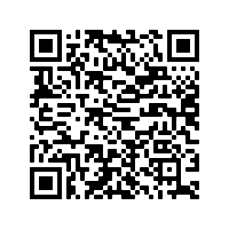
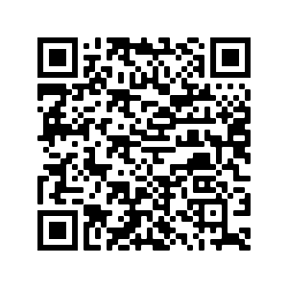
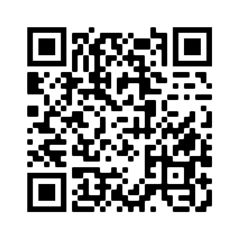
Hausaufgaben
Pre-learning for lesson: Year 8 German Term 2.1 Week 1
Revisit 1: [Year 8 German Term 1.2 Week 3]
Revisit 2: [Year 7 German Term 1.1 Week 3]

Slide 43
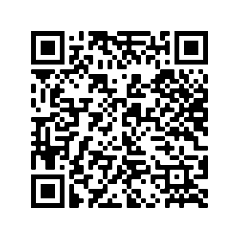
Hausaufgaben
Vocabulary Learning Homework (Y8, Term 2.1, Week 1)
Audio file
Audio file QR code:
Student worksheet
Quizlet link
In addition, revisit: Year 8 Term 1.2 Week 3
Year 8 Term 1.1 Week 3
Notes:
Link to Student Worksheet answers: https://resources.ncelp.org/concern/resources/sq87bv25s?locale=en

