Slide 1
Was, wann und wie
Present tense, Word Order 1 and 2 [revisited]
SSC [g]
Y7 German
Term 1.2 - Week 6 - Lesson 25
Author name(s): Rachel Hawkes
Artwork: Steve Clarke
Date updated: 20/12/2021
Notes:
Artwork by Steve Clarke. All additional pictures selected are available under a Creative Commons license, no attribution required.
Learning outcomes (lesson 1):
Introduction of SSC [g]
Revisit present tense Revisit Word Order 1 and 2
Word frequency (1 is the most frequent word in German):
erreichen [309] erhalten [287] gewinnen [372] werfen [718] machen [58] reden [368] sitzen [231] sprechen [161] stehen [85] wünschen [630] bekommen [212] [110] bleiben [113] heißen [126] sehen [79] tragen [271] Rad fahren [n/a] nehmen [142] halten [155] dauern [744] fahren [215] wiederholen [988] kommen [62] springen [1431] liegen [107] du [54] ich [10] er [15] sie [7] es [12] wir [26] Handy [1693] Zug [675] Tag [111] Erste [95] Punkt [248] Spiel [328] Ziel [320] mit Freunden [n/a] Platz [326] Stück [511] Gutschein [>5009] Mitte [711] Liste [1792] Kopf [250] Körper [488] ich wünsche mir [n/a] nochmal [1984] richtig [177] falsch [524] freiwillig [1652] wichtig [144] schwierig [580] langweilig [3019] ruhig [991] traurig [1752]
The frequency rankings for words that occur in this PowerPoint which have been previously introduced in NCELP resources are given in the NCELP SOW and in the resources that first introduced and formally re-visited those words.
For any other words that occur incidentally in this PowerPoint, frequency rankings will be provided in the notes field wherever possible.

Slide 2
Phonetik
sprechen / hören
At the start or in the middle of words, German [g] is usually pronounced like the ‘g’ in English ‘go’, including in words that are similar to English words.
Sag die Wörter. Wie im Englischen oder anders?
anders
anders
 | Beginn
 | Energie
 | Organisation
 | Generation
 | Region
 | Gruppe
 | Integration
 | Strategie
1
5
2
6
3
7
4
8
Notes:
Here English has two pronunciations for ‘g’ where German has one.
Timing: 2 minutes Aim: This activity highlights similarities and differences in the English and German pronunciation of the SSC [g], using cognates and near-cognates which have not been previously taught. The activity aims to show that while the pronunciation of this SSC changes in English, it is consistent in German. Procedure: 1. Students say the words aloud in German, (following the rule that [g] at the start or in the middle of words sounds like ‘g’ in ‘go’)
2. They compare how the words sound with the pronunciation of their English equivalents.
3. They note down for each whether the [g] sound is the same as in English or different.
4. Click to listen and check the German pronunciation.
Transcript: Beginn Energie Organisation Generation Region Gruppe Integration Strategie Word frequency (1 is the most frequent word in German): Beginn [845] Energie [455] Organisation [1114] Generation [1153] Region [803] Gruppe [369] Integration [1282] Strategie [1477] Source: Jones, R.L. & Tschirner, E. (2006). A frequency dictionary of German: core vocabulary for learners. Routledge

Slide 3
Phonetik
hören / sprechen
When you say the German [g] at the start or in the middle of a word, your vocal chords vibrate.
However, when [g] is the final sound in the word, it sounds more like ‘k’, and you don’t use your vocal chords.
Compare:
Berg
Berge
Notes:
Timing: 1 minute Aim: To explain the different sound and physiology involved in the final [g] sound in German, comparing it to the initial and mid-word sound. This prepares for the pronunciation task on the next slide.
Procedure: 1. Students listen to each word.
2. They then touch their vocal chords and say the words again, hearing the difference between the two sounds, and feeling the difference between the voiced and unvoiced [g] sounds.
Transcript: Berg Berge Word frequency (1 is the most frequent word in German): Berg [934] Source: Jones, R.L. & Tschirner, E. (2006). A frequency dictionary of German: core vocabulary for learners. Routledge

Slide 4
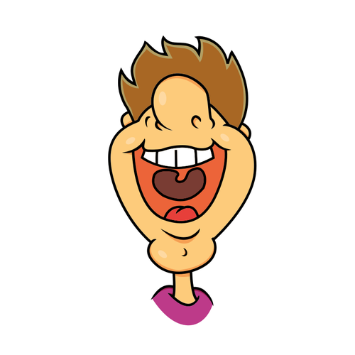
Phonetik
sprechen / hören
Sag die Wörter.
 | Singular | Plural
 | Tag | Tage
 | Zug | Züge
 | Flug | Flüge
 | Burg | Burgen
 | Spielzeug | Spielzeuge
 | Geburtstag | Geburtstage
 | Ausflug | Ausflüge
 | Fahrzeug | Fahrzeuge
1
________
2
__________
3
________
4
__________
5
________
6
__________
7
________
8
__________
Notes:
Timing: 2 minutes Aim: To practise pronunciation of two [g] sounds in German, consolidate knowledge of plural rule 1, and recall some known vocabulary. Picture prompts and/or English gloss are provided to support word recognition. Procedure: 1. Students work in pairs to pronounce / recall the words.
Transcript: Tag, Tage Zug, Züge Flug, Flüge Burg, Burgen Spielzeug, Spielzeuge Geburtstag, Geburtstage Ausflug, Ausflüge Fahrzeug, Fahrzeuge Word frequency (1 is the most frequent word in German): Beginn [845] Energie [455] Organisation [1114] Generation [1153] Region [803] Gruppe [369] Integration [1282] Strategie [1477] Source: Jones, R.L. & Tschirner, E. (2006). A frequency dictionary of German: core vocabulary for learners. Routledge

Slide 5
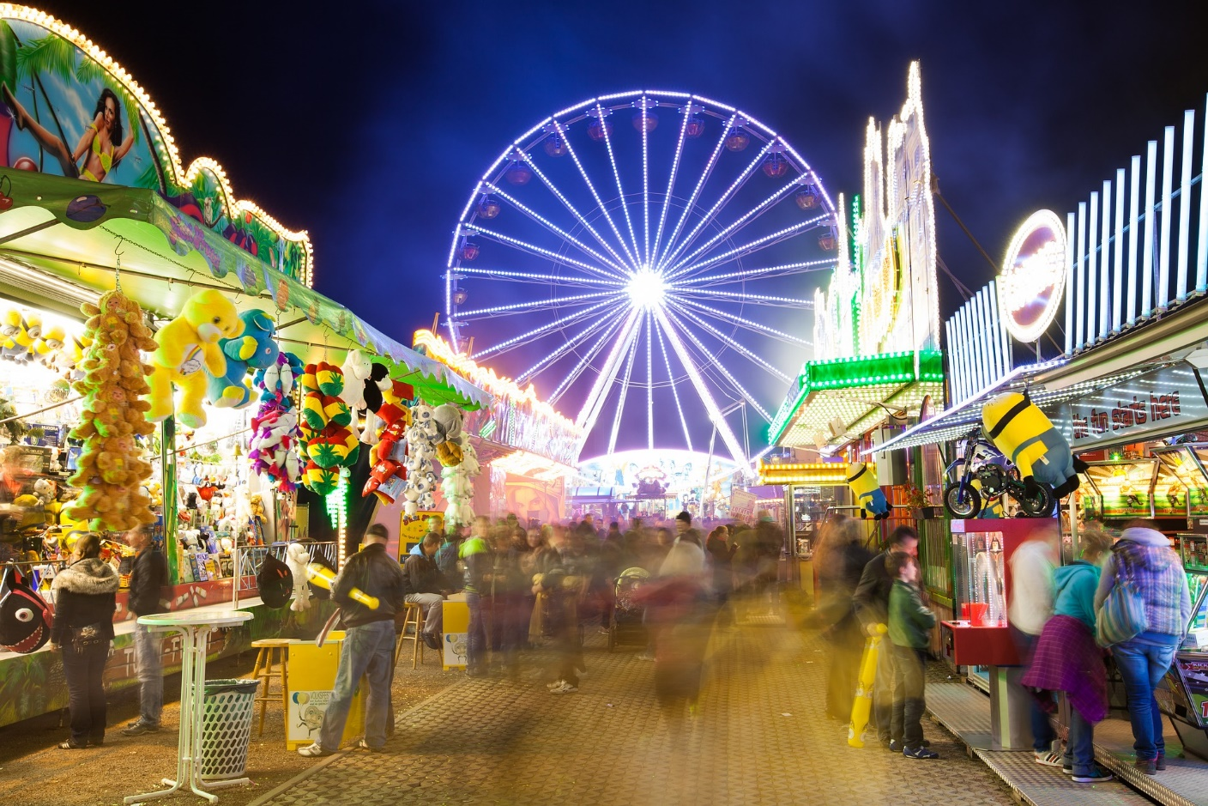
der Wurstelprater (seit* 1895)
seit = since nennen = to name riesig = huge Ihnen = (to) you (formal)
lesen
“Ich heiße der Wurstelprater, aber man nennt mich oft einfach ‘Prater’. Ich liege im Wiener Prater. Das ist ein riesiggroßer* Park in Wien. Ich bin ein Vergnügungspark, (vielleicht der erste Themenpark auf der Welt!). Ich wünsche Ihnen* einen wunderbaren Tag hier”
______
______
______
___
___
_____
_____
__________
ein | wünsche | liege | erste | heiße | mich | bin | Welt
Notes:
Timing: 5 minutes Aim: to revise key vocabulary and verbs in the first person. The short text sets the context for the lesson, a visit to Austria’s oldest and best known theme park, the Wurstelprater. Procedure: 1. Explain the title and the context – it is the theme park talking…
2. Students read the text and identify the position for the missing words.
3. Check answers and elicit the English meaning orally. Note: We didn’t gloss Vergnügungspark here. Teachers following the NCELP SOW will want to prompt students to make the connection with the Brecht poem title from 8.1.1.5 – Vergnügungen. Additional prompts could be to identify its synonym – Themenpark, a semi-cognate, and gesture towards the picture.
Transcript: Note: Erste has been learnt as a noun (der, die, das Erste). Students should have no difficulty understanding its meaning here. Later in Y8, students will learn about nominalisation of adjectives.
Word frequency (1 is the most frequent word in German): wünschen [684] Erste [91] Tag [108] heißen [123] liegen [118] Source: Jones, R.L. & Tschirner, E. (2006). A frequency dictionary of German: core vocabulary for learners. Routledge
Image source: https://upload.wikimedia.org/wikipedia/commons/3/3a/Karte_Prater_Wien.jpg - attribution not required

Slide 6
Who does what? Present tense
Grammatik
Remember: In German, the verb ending and the subject often tell us who is doing the action.
Remember: the infinitive is the dictionary form. It tells you ‘what’ but not ‘who’.
Infinitive
gewinnen
= to win
I
Ich gewinne
= I win
Remove –en from the infinitive to get the stem.
you
du gewinnst
= you win
s/he/it
sie / er / es gewinnt
= S/he/it wins
The wir (we) and sie (they) forms of the verb always have the same ending as the infinitive. ☺
we
wir gewinnen
= we win
they
sie gewinnen
= they win
Remember: Pronouns are like a shortcut to refer to a noun, e.g., ‘I, he, she, we, they’ instead of Mia, the dog, my friends and I, my grandma and grandad etc..
Notes:
Timing: 2 minutes Aim: to revisit regular (weak) verb endings and pronouns in the present tense Procedure: 1. Use the animation to elicit as many of the meanings from students as possible.
2. Ensure all information is understood.
Word frequency (1 is the most frequent word in German):
gewinnen [410]

Slide 7
Und auf Englisch?
Grammatik
Remember that the present tense in German has two meanings in English:
Ich besuche den Wurstelprater.
→ I visit the Wurstelprater
→ I am visiting the Wurstelprater
The English meaning we use often depends on information about when.
Regular events use the simple present.
Ongoing actions and future intentions use the present continuous.
Ich fahre am Montag nach Wien. → I am going to Vienna on Monday.
every year.
at the moment.
Notes:
Timing: 1 minute Aim: To remind students of the two different translations of the German present tense. Procedure: 1. Go through the information on the slide using the animation.

Slide 8
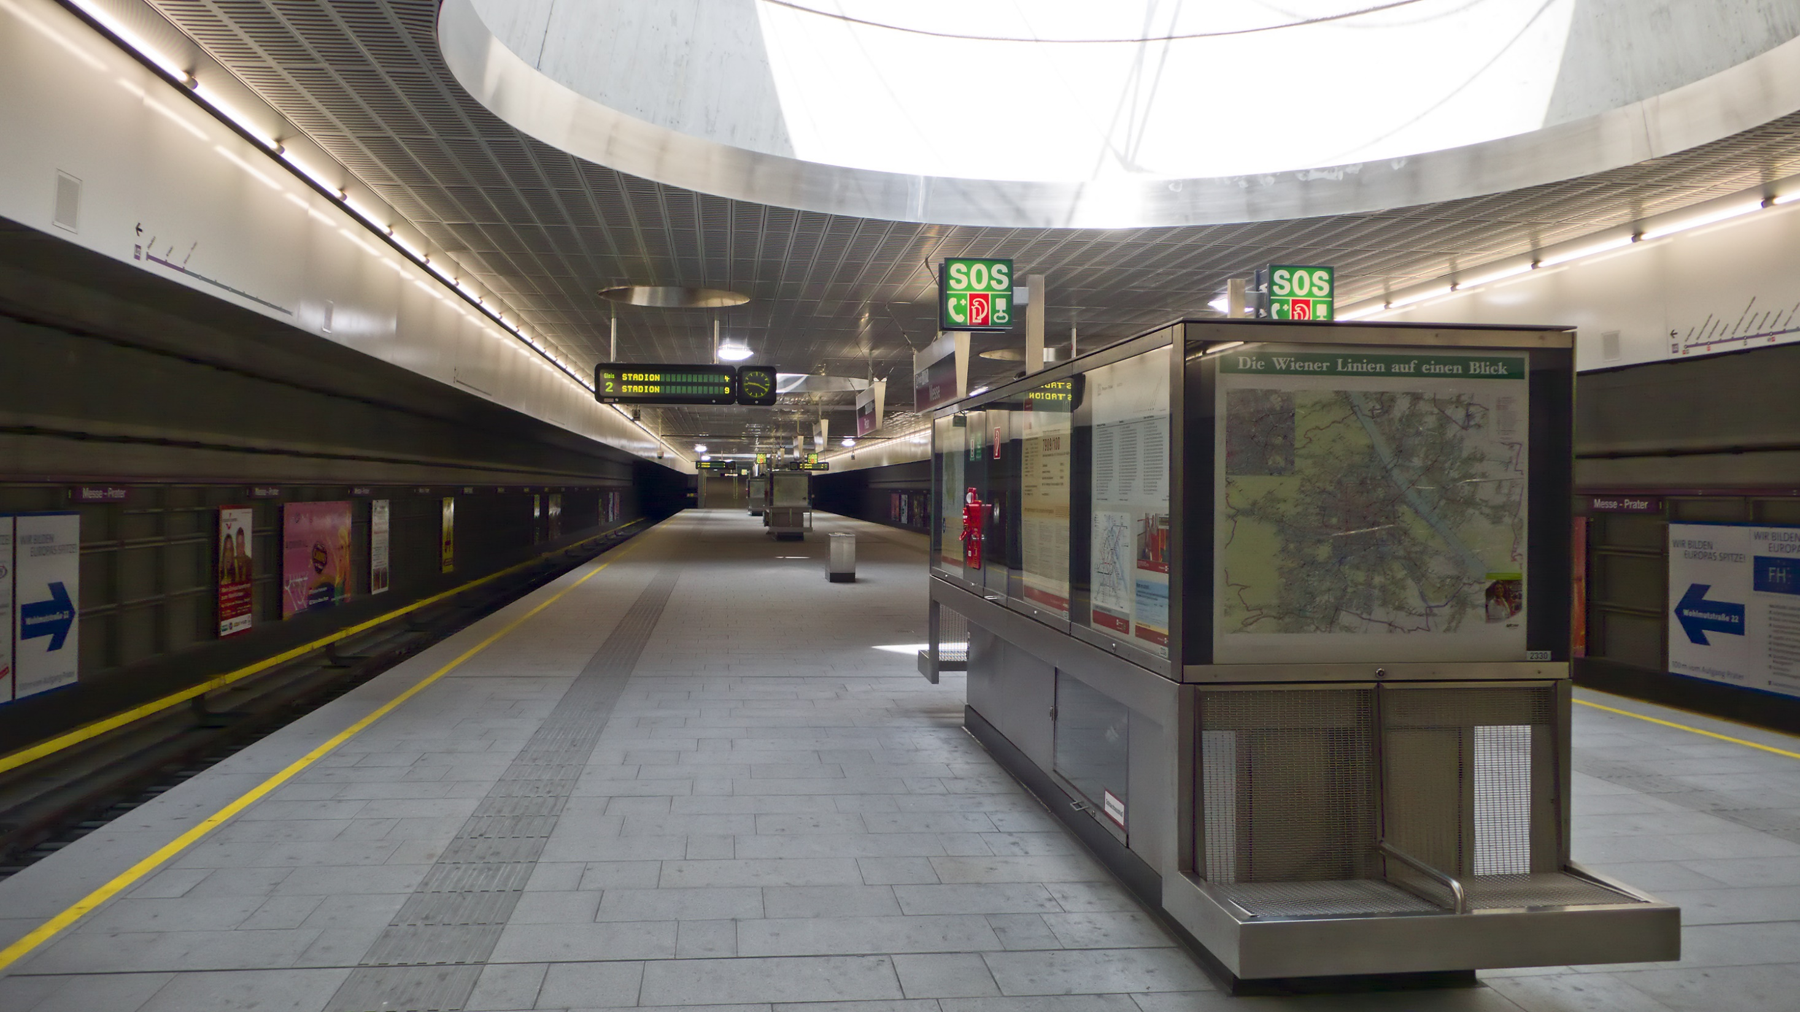
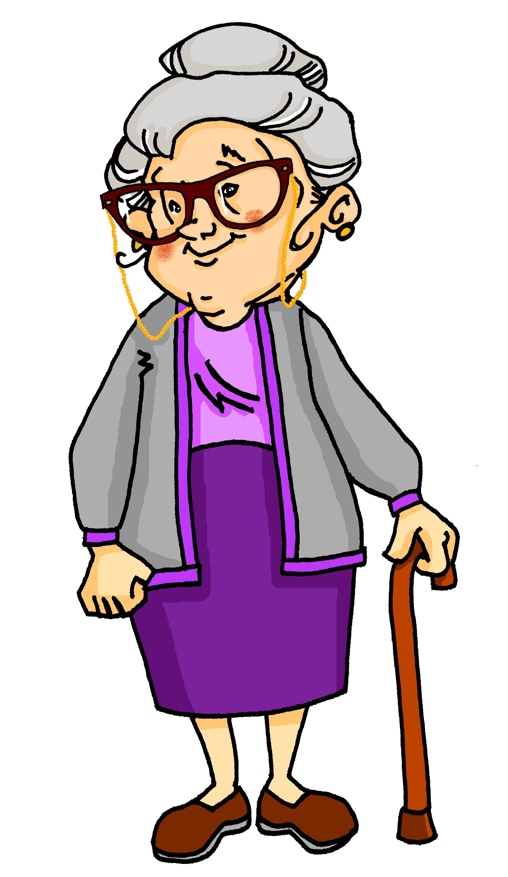
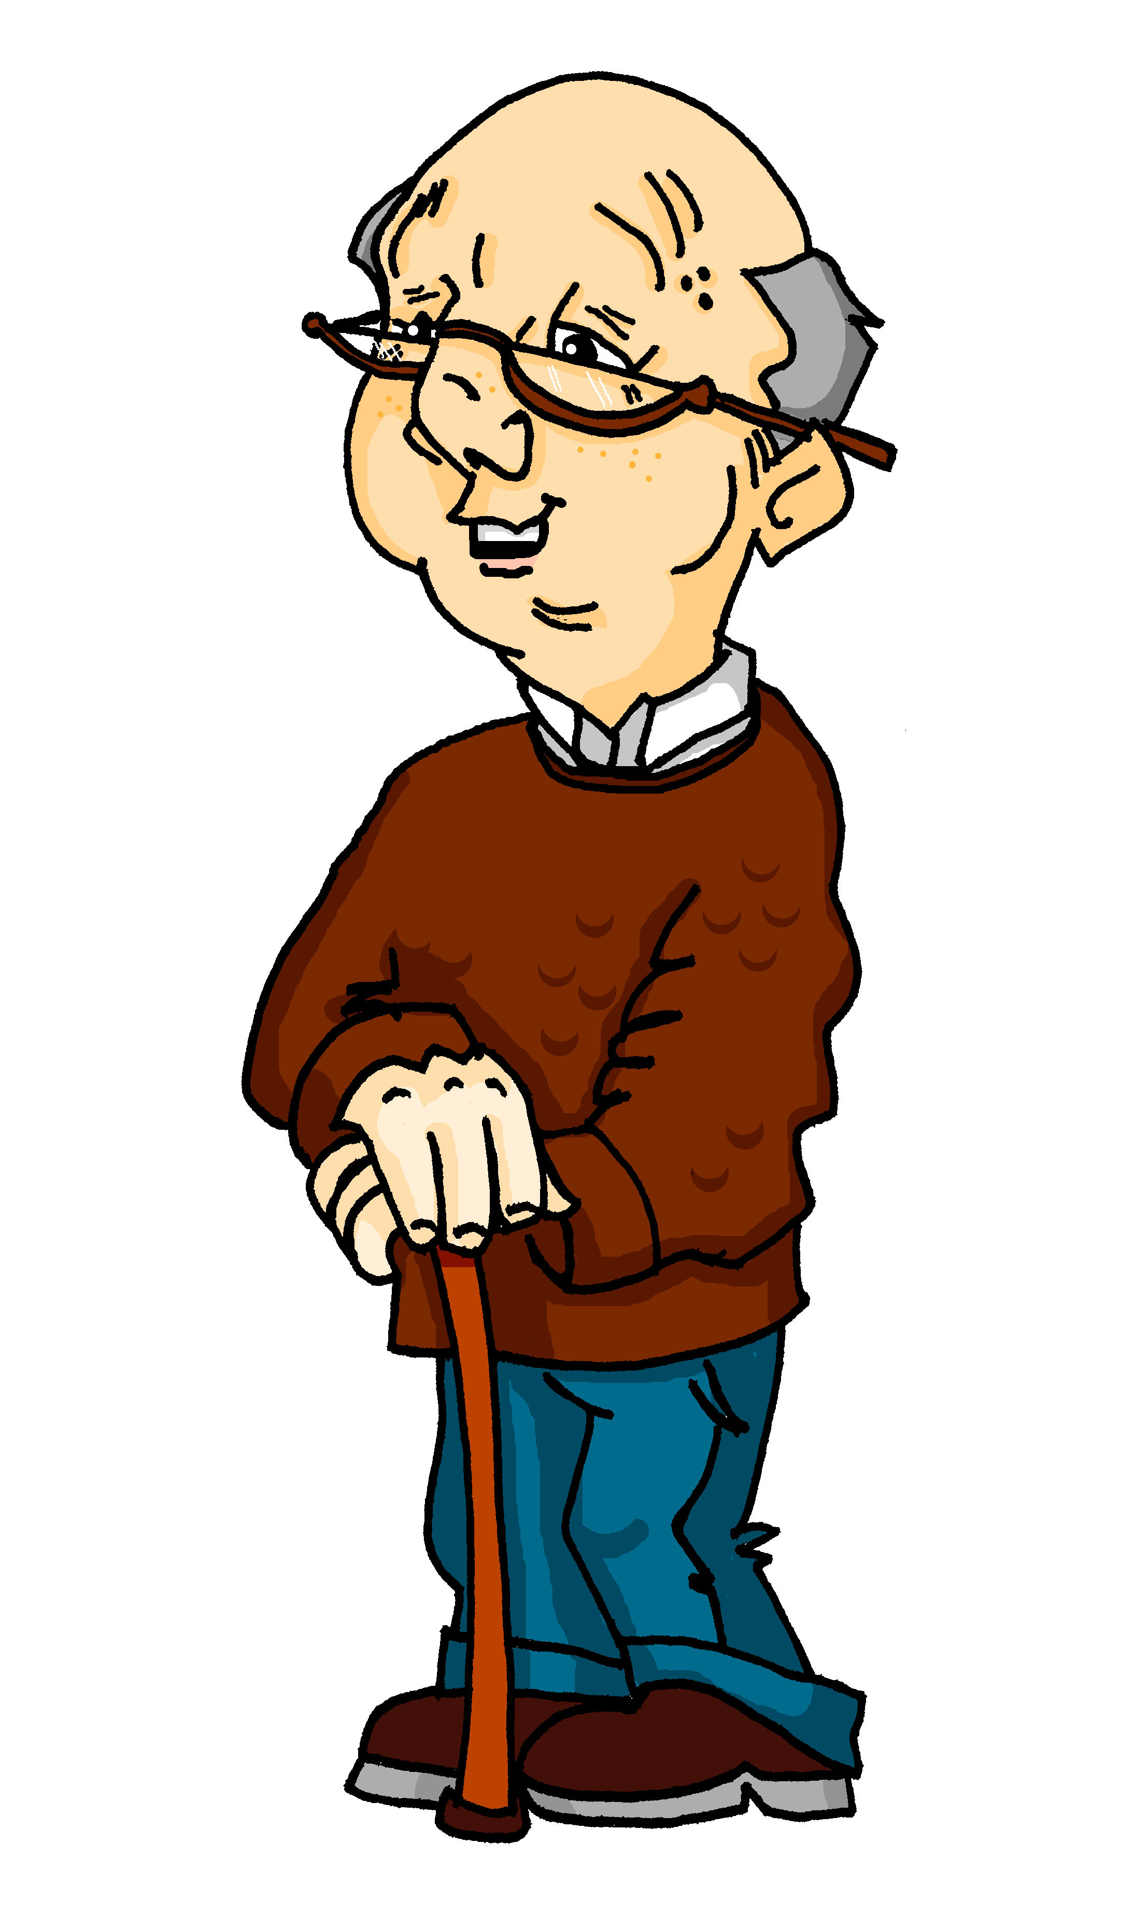
U-Bahn Messe Prater
lesen / schreiben
Wir nehmen die U-Bahn.
Sie sitzen im Zug.
Wir stehen, denn er ist voll.
Ich sehe eine Mutter und ihr Baby.
Sie redet am Handy.
Es trägt einen kleinen Ball.
Sie hält.
Wir sind da! Und du, kommst du mit?
Mia und Wolfgang sind mit Oma und Opan in Wien. Was denkt Mia? Schreib 1-6 und das richtige Pronomen.
Hurrah! Wir fahren zum Wurstelprater!
‘sie’ as it’s die U-Bahn. Or ‘er’ for der Zug.
Notes:
Timing: 5 minutes Aim: To practise written production of revisited personal pronouns, and comprehension in the written modality of present tense verb endings. The further requirement to translate into English consolidates knowledge of the two possible English translations for the German present tense, and vocabulary knowledge of eight verbs from this week’s revisiting. Procedure: 1. Ensure the context and task are clear. Mia and Wolfgang are in Wien with Oma and Opa. They are going to the theme park Wurstelprater for the day. They are on the U-Bahn.
2. Students write 1-8 and the missing German pronoun.
3. Click to reveal answers.
4. Ensure meanings are clear.
Word frequency (1 is the most frequent word in German): sehen [81] reden [356] sitzen [261] stehen [87] halten [144] tragen [308] nehmen [139] fahren [169] kommen [61] das Handy [2466] du [52] ich [8] er¹ [20] sie¹ [10] es [14] wir [31] Source: Jones, R.L. & Tschirner, E. (2006). A frequency dictionary of German: core vocabulary for learners. Routledge

Slide 9
Starke Verben
Grammatik
Remember that some verbs change their stem in the du and er/sie/es forms:
Welche Verben sind stark?. Schreib die Infinitive.
er fährt
du springst
sie steht
du nimmst
[fahren]
[nehmen]
er erhält
du redest
du trägst
sie liegt
[tragen]
[erhalten]
du kommst
du siehst
er erreicht
sie wirft
[sehen]
[werfen]
Notes:
Timing: 3 minutes Aim: To remind students about strong verbs and prompt recall of the strong verbs we are revisiting this week. Procedure: 1. Go through the information on the slide using the animation.
2. Students identify the strong verbs and write their infinitives.
3. Answers are highlighted and infinitives appear on mouse clicks. 4. English meanings should be elicited orally.
Word frequency (1 is the most frequent word in German): sehen [81] erhalten [283] fahren [169] springen [1468] stehen [87] nehmen [139] tragen [308] liegen [118] reden [356] kommen [61] erreichen [305] werfen [672]

Slide 10
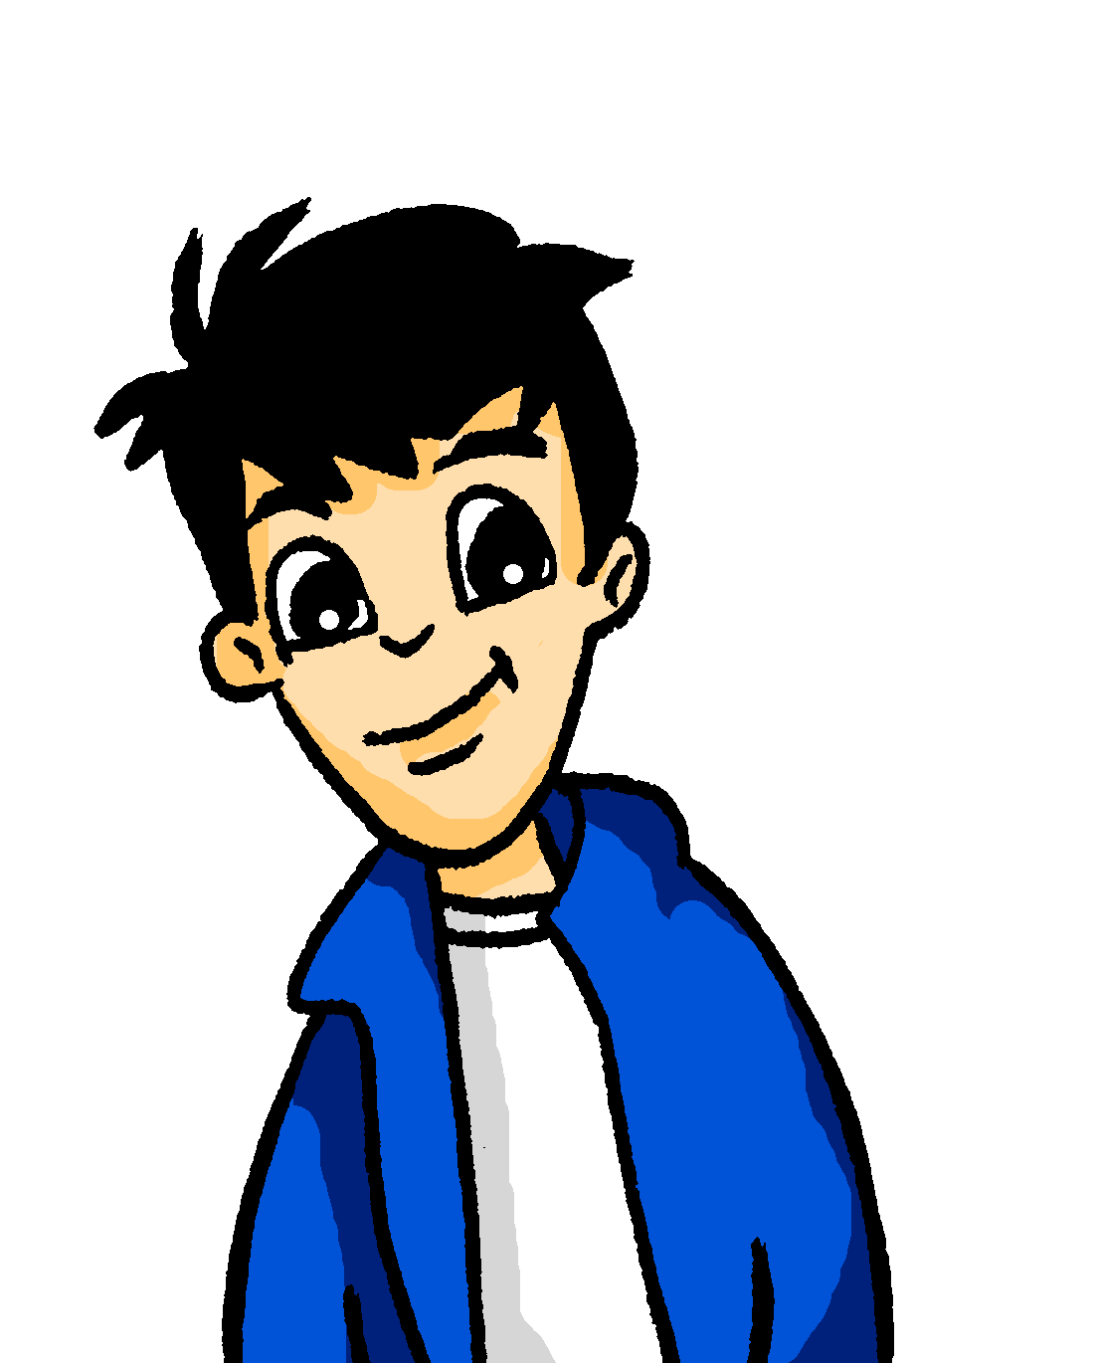
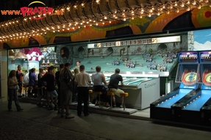
Wurstelprater Attraktionen
hören / schreiben / lesen
Full Text
Das ist Wolfgangs Lieblingsspiel am Wurstelprater.
Hör zu. Schreib 1-6 und die Wörter.
Rattenplage
1
2
3
4
5
Du wirfst den Ball und erhältst Punkte. Du willst das Ziel erreichen. Der oder die Erste im Ziel gewinnt einen Preis. Mit Freunden macht das Spiel viel Spaß.
1 ___
2 _____
3 _____
4 ___
5 _____
6 _____
“You throw the ball and receive points. You want to reach the destination. The first to the destination wins a prize. The game is a lot of fun with friends.”
prater.at
Notes:
Timing: 5 minutes Aim: To understand and transcribe 11 key verbs and other revisited vocabulary in a new context. To consolidate meanings through translation into English. Procedure: 1. Ask students to pronounce the name of the game: Rattenplage – if they pronounce the [g] correctly they may be able to get to the meaning ‘rats’ plague’ or ‘plague of rats’. This is a genuine attraction at the Wurstelprater.
2. Write 1-6. Listen and transcribe the verbs. Note – both the ‘full text’ and individual sentences are slow to allow for writing. Teacher to choose which version to use.
3. Check answers.
4. Translate the short text into English.
5. Click for possible translation.
Transcript: Du [wirfst] den Ball [pause] und [erhältst] Punkte. [pause] Du willst [das Ziel] erreichen . [pause] Der oder die [Erste] im Ziel gewinnt einen Preis. [pause] Mit Freunden macht [das Spiel] viel Spaß.
Word frequency (1 is the most frequent word in German): erhalten [283] erreichen [305] gewinnen [410] machen [49] werfen [672] du [52] Erste [91] Punkt [427] Spiel [500] Ziel [325] mit Freunden [13/327]
Source: Jones, R.L. & Tschirner, E. (2006). A frequency dictionary of German: core vocabulary for learners. Routledge
Image source: https://upload.wikimedia.org/wikipedia/commons/3/3a/Karte_Prater_Wien.jpg - attribution not required

Slide 11
Wer macht was im Wurstelprater?
sprechen
Du bist Mia, Wolfgang, Oma oder Opa. Beschreib was du machst, und was die Anderen machen.
die Achterbahn – rollercoaster die Schlange – snake, queue
machen kaufen essen stehen sitzen
spielen nehmen sagen erreichen gewinnen
bekommen
reden
Karten
im Park
eine Fahrkarte
ich er / sie wir sie
viel
*die Achterbahn
*an der Schlange
*den ‘Boomerang’
im Café
eine Currywurst
einen Preis
viele Fotos
ein Eis
Rattenplage
nicht viel
Notes:
Timing: 7 minutes Aim: Pairwork activity to develop more fluent production whilst still activating grammar knowledge and focusing on meaning. Students are aiming to use all the words on their sheets.
Procedure: 1. Partner A: Says an English sentence that can be made from a combination of the options given (using grammatical knowledge of verb endings, and lexical knowledge of vocabulary provided).
2. Partner B translates the sentence into German orally. Partner A crosses off the words used on his/her sheet. (Each word can can only be used once (apart from the pronouns).
3. This continues until the time limit (2.5 minutes) or until the student runs out of options.
4. Students swap roles and have 2 minutes for round 2.
5. This is not a competition, but they compare their sheets. It is likely that the 2nd round produced just as many as or more answers than the 1st.
Note: Verb forms can go with at least two options.
Alternative / additional option: Teachers can use this slide to create sentences in English for students to translate into German on mini whiteboards. (Alternatively, students can volunteer English sentences for the class to write in German)

Slide 12
Word order 1 and 2
Grammatik
As you know, the order of words in a simple German sentence is:
Mia spielt jeden Dienstag Klarinette.
Sometimes, we want to start the sentence with the adverb to emphasise it.
When we do this, the adverb and subject swap places.
Jeden Dienstag spielt Mia Klarinette.
The position of the verb does not change. It is always between the subject and the adverb.
Word order
1
SUBJECT
VERB
ADVERB
OBJECT
Word order
2
ADVERB
VERB
SUBJECT
OBJECT
Notes:
Timing: 2 minutes Aim: To remind students about word order 1 and 2 and prepare students for the practice task that follows.
Procedure: 1. Go through the information on the slide using the animation.

Slide 13
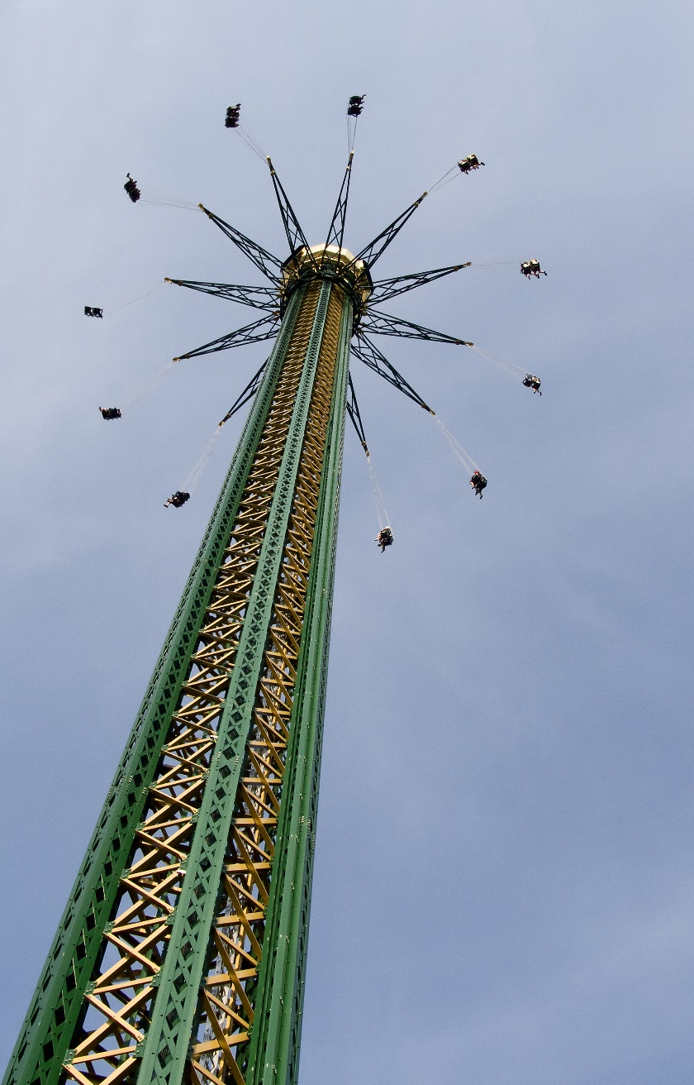
Wurstelprater Attraktionen [1/2]
lesen / schreiben
der Praterturm
Re-write the sentences to emphasise the meanings in bold. You will need to change the word order.
“Der Praterturm* ist eine von meinen 250 Attraktionen.”
“Der Praterturm ist mit 117 Metern eine Sensation.”
“Man bekommt von oben einen schönen Blick über ganz Wien. Eine Fahrt dauert 3-4 Minuten.”
der Turm - tower
Notes:
Timing: 5 minutes (two slides) Aim: To practise word order 2 in the written modality. Procedure: 1. Ensure that students know it is the still the voice of the Wurstelprater speaking.
2. Students rewrite the sentences.
3. Check answers after each sentence to consolidate understanding.
Word frequency (1 is the most frequent word in German): bekommen [234] dauern [696]
Unknown words: Turm [2715]
Source: Jones, R.L. & Tschirner, E. (2006). A frequency dictionary of German: core vocabulary for learners. Routledge
Image source: https://upload.wikimedia.org/wikipedia/commons/f/f6/Prater_Turm_03.jpg - attribution not required Peter Gugerell / Public domain

Slide 14
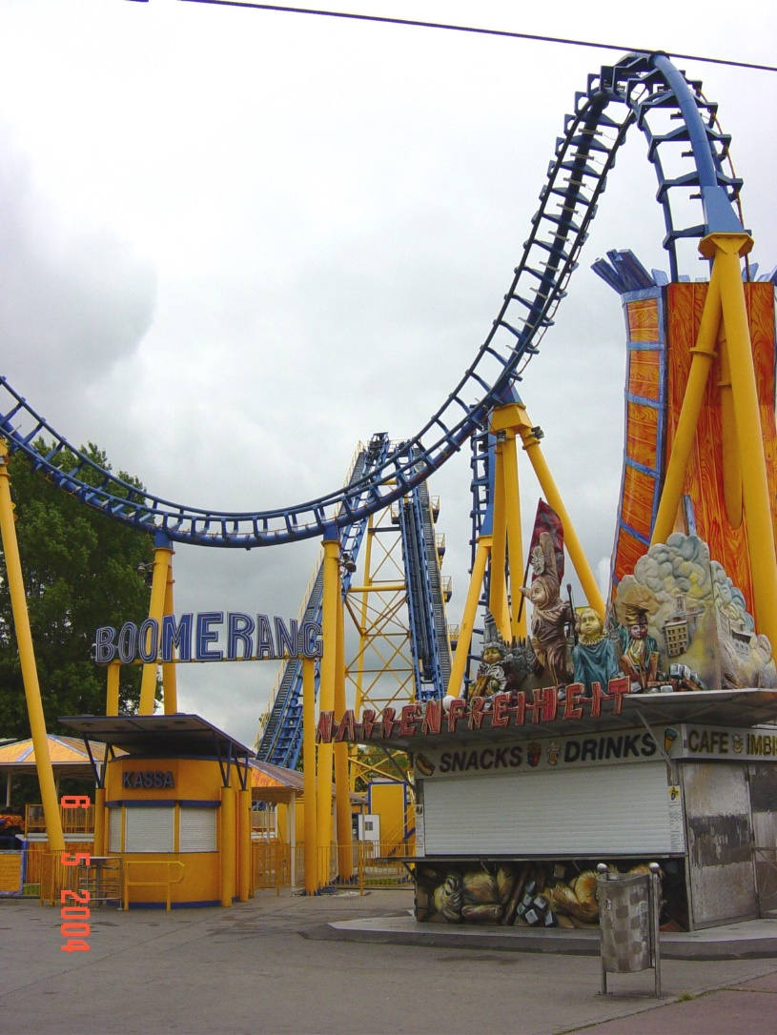
Wurstelprater Attraktionen [2/2]
lesen / schreiben
der Boomerang
“Diese Achterbahn* ist mit mehr als 85kmph für viele Besucher das absolute Highlight.”
*die Achterbahn - rollercoaster
cc-by-3.0|Nikolai Karaneschev
Notes:
Unknown words: Achterbahn [>5009] Note: Students have learnt ‘die Bahn’ [1392]
Source: Jones, R.L. & Tschirner, E. (2006). A frequency dictionary of German: core vocabulary for learners. Routledge
Image source: https://de.m.wikipedia.org/wiki/Datei:Wiener_Prater_-_panoramio_-_Nikolai_Karaneschev_(3).jpg
Attribution: cc-by-3.0|Nikolai Karaneschev

Slide 15
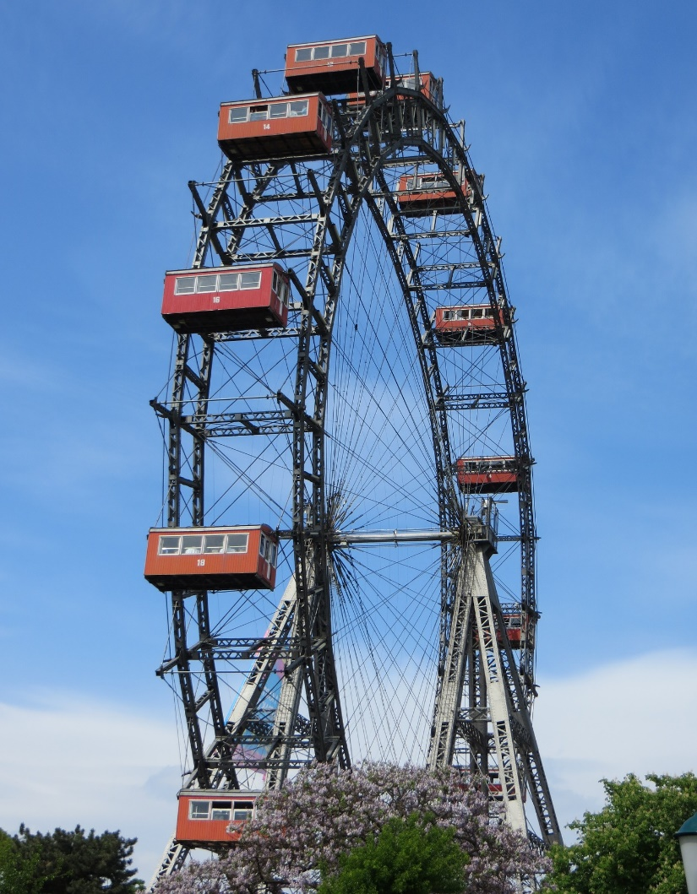
Postkarte aus Wien
Wolfgang schreibt Mutti eine Postkarte aus Wien. Schreib den Text auf Englisch.
lesen
*das Riesenrad - big wheel
Wir sind in Wien!
Heute ist es ziemlich kalt hier, aber wir bleiben nicht zu Hause.
Wir besuchen den Wurstelprater.
Mia fährt im Moment nochmal mit dem Boomerang, und dann fahren wir alle mit dem Riesenrad*. (Oma und Opa, auch!)
Viel Spaß in Berlin!
We’re in Vienna!
The weather is quite cold today but we aren’t staying at home.
We’re visiting the Wurstelprater.
Mia is riding the Boomerang again at the moment, and then we’re all going on the big wheel (Grandma and Grandad, too)
Have fun in Berlin!
Notes:
Timing: 5 minutes Aim: to consolidate understanding of word order 1 and 2, and the present continuous meaning of the present tense. Procedure: 1. Translate the text into English.
2. Click to reveal answers, sentence by sentence.

Slide 16
Was, wann und wie
Present tense, negation with nicht, question-forming [revisited]
SSC [-ig], [-ung], [-ing]
Y7 German
Term 1.2 - Week 6 - Lesson 26
Author name(s): Rachel Hawkes
Artwork: Steve Clarke
Date updated: 20/12/2021
Notes:
Artwork by Steve Clarke. All additional pictures selected are available under a Creative Commons license, no attribution required.
Learning outcomes (lesson 2):
Consolidation of SSC [-ig] Introduction of SSC [-ung, -ing]
Revisit present tense with negation Revisit present tense question-forming
Word frequency (1 is the most frequent word in German):
erreichen [309] erhalten [287] gewinnen [372] werfen [718] machen [58] reden [368] sitzen [231] sprechen [161] stehen [85] wünschen [630] bekommen [212] [110] bleiben [113] heißen [126] sehen [79] tragen [271] Rad fahren [n/a] nehmen [142] halten [155] dauern [744] fahren [215] wiederholen [988] kommen [62] springen [1431] liegen [107] du [54] ich [10] er [15] sie [7] es [12] wir [26] Handy [1693] Zug [675] Tag [111] Erste [95] Punkt [248] Spiel [328] Ziel [320] mit Freunden [n/a] Platz [326] Stück [511] Gutschein [>5009] Mitte [711] Liste [1792] Kopf [250] Körper [488] ich wünsche mir [n/a] nochmal [1984] richtig [177] falsch [524] freiwillig [1652] wichtig [144] schwierig [580] langweilig [3019] ruhig [991] traurig [1752]
The frequency rankings for words that occur in this PowerPoint which have been previously introduced in NCELP resources are given in the NCELP SOW and in the resources that first introduced and formally re-visited those words.
For any other words that occur incidentally in this PowerPoint, frequency rankings will be provided in the notes field wherever possible.

Slide 17
-ig
richtig
Notes:
Timing: 1 minute
Aim: To introduce/consolidate SSC [-ig]
Procedure: 1. Present the letter(s) and say the [-ig] sound first, on its own. Students repeat it with you. 2. Bring up the word ”richtig” on its own, say it, students repeat it, so that they have the opportunity to focus all of their attention on the connection between the written word and its sound.
3. A possible gesture for this would be to mime ‘correct’ by tracing a tick in the air with the index finger on your right hand.
4. Roll back the animations and work through 1-3 again, but this time, dropping your voice completely to listen carefully to the students saying the [-ig] sound, pronouncing ”richtigi” and, if using, doing the gesture. Word frequency (1 is the most frequent word in German): richtig [211]
Source: Jones, R.L. & Tschirner, E. (2006). A frequency dictionary of German: core vocabulary for learners. Routledge

Slide 18
-ig
richtig
Notes:
With sound and no pictures to focus all attention on the sound-symbol correspondence.

Slide 19
-ig
richtig
Notes:
Without sound to elicit pronunciation (without first hearing the teacher).
Teacher to elicit pronunciation by asking “Wie sagt man…”

Slide 20
-ig
notwendig
wichtig
[necessary]
[important]
richtig
fertig
wenig
[ready, finished]
Schwierigkeit
[little / not very much]
[difficulty]
Notes:
Timing: 2 minutes
Aim: To introduce/consolidate SSC [-ig]
Procedure:
Introduce and elicit the pronunciation of the individual SSC [-ig] and then the source word again ‘richtig’ (with gesture, if using).
Then present and elicit the pronunciation of the five cluster words.
The cluster words have been chosen for their high-frequency, from a range of word classes, with the SSC (where possible) positioned within a variety of syllables within the words (e.g. initial, 2nd, final etc.). Additionally, we have tried to use words that build cumulatively on previously taught SSCs (see the Phonics Teaching Sequence document) and do not include new SSCs. Where new SSCs are used, they are often consonants which have a similar symbol-sound correspondence in English.
Word frequency (1 is the most frequent word in German): richtig [211]; notwendig [168] wichtig [177]; fertig [717]; Schwierigkeit [866]; wenig [102]. Source: Jones, R.L. & Tschirner, E. (2006). A frequency dictionary of German: core vocabulary for learners. Routledge

Slide 21
-ig
notwendig
wichtig
richtig
fertig
wenig
Schwierigkeit
Notes:
With sound and no pictures to focus all attention on the sound-symbol correspondence.

Slide 22
-ig
notwendig
wichtig
richtig
fertig
wenig
Schwierigkeit
Notes:
Without sound to elicit pronunciation (without first hearing the teacher).
Teacher to elicit pronunciation by asking “Wie sagt man…”

Slide 23
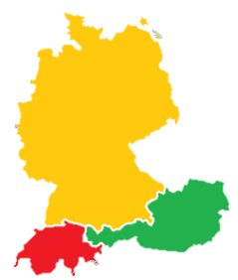
Phonetik [–ig] [1/3]
hören
Es gibt viele Dialekte in Deutschland, Österreich und der Schweiz!
In Norddeutschland
sagt man:
In Süddeutschland, Österreich und der Schweiz sagt man:
-ig wie [ich]
-ig wie [ik]
D
wichtig
wichtig
fertig
Ö
fertig
S
wenig
wenig
Notes:
Timing: 2 minutes Aim: A reminder to students of regional variation in the DACH countries, with respect to this SSC. It prepares the ground for the learning on the next slide, too.
Procedure: 1. Click through animations and play the sounds. Word frequency (1 is the most frequent word in German): Dialekt [2993], Nord- [1204], Süd- [1534]

Slide 24
Phonetik [–ig] [2/3]
Sag die Wörter.
hören
German [-ig] usually occurs at the end of a word. Whether you pronounce it with [ch] or [k] you don’t use your vocal chords.
However, adding additional letters to adjectives ending in [-ig] changes its sound to a voiced [g].
Compare:
1
Das ist richtig!
Das ist eine richtige Antwort!
2
Notes:
Timing: 30 seconds Aim: To explain the difference between [-ig] and [-ig-] and prepare students for the next practice task.

Slide 25
Phonetik [–ig] [3/3]
lesen / sprechen
Sag die Satzteile auf Deutsch.
Sag die Wörter.
richtig | eine richtige Idee | a right idea
wichtig | ein wichtiges Ziel | an important goal
schwierig | ein schwieriges Spiel | a difficult game
freiwillig | eine freiwillige Person | a willing person
ruhig | ein ruhiger Platz | a quiet square
langweilig | ein langweiliger Mann | a boring man
traurig | eine traurige Frau | a sad woman
riesig | ein riesiges Stück | a huge piece
_________
1
Remember! The adjective ending depends on the gender and case of the noun. (Here, R1-nominative)
_________
2
_________
3
_________
4
_________
5
_________
6
7
_________
8
_________
Notes:
Timing: 3 minutes Aim: Practise the different forms of [-ig] and recall adjective endings (R1 – nominative) with indefinite articles, together with revisited vocabulary from Y7. Procedure: 1. Students partner up and take turns to pronounce the words. First they pronounce the adjectives on their own, and then the phrases, inserting the adjective with the correct ending (which changes the sound of the [g]). The images appear to remind students that the [-ig] in adjectives alone are unvoiced (do not use the vocal chords) but the [-ig-] within a word, i.e. once there is an adjective ending as occurs with prenominal adjectives, the sound of the [g] changes to a voiced [g].
Transcript: eine richtige Idee ein wichtiges Ziel ein schwieriges Spiel eine freiwillige Person ein ruhiger Platz ein langweiliger Mann eine traurige Frau ein riesiges Stück Word frequency (1 is the most frequent word in German): Platz [344], Stück [417] Spiel [500] Ziel [325] richtig [211] freiwillig [1718] wichtig [177] schwierig [471] langweilig [2921] ruhig [905] traurig [1871]
riesig [1075] Source: Jones, R.L. & Tschirner, E. (2006). A frequency dictionary of German: core vocabulary for learners. Routledge

Slide 26
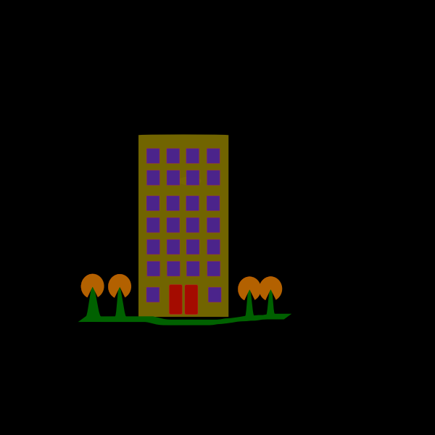
English → German → English
All German nouns ending in -ung are feminine.
Many German nouns end in -ung, meaning -tion OR –ment in English.
I have an apartment. I want to live there.
Ich habe eine Wohnung. Ich will dort wohnen.
Use these verbs to help you understand / create the nouns: bewegen – to move, entwickeln - to develop, verbinden - to connect, entscheiden – to decide, leisten- to achieve.
Translate these sentences.
1. Ich bin glücklich über diese Leistung!
2. The connection is not good.
What would the following nouns be in German?
development decision movement Choose one and write a sentence in German.
Notes:
Timing: 5 minutes Aim: To practise the noun pattern –ung and its connection with infinitive verbs in the written modality. Procedure: 1. Present the information, using the animations. 2. Students complete the word tasks. 3. Answers on the following slide.
Word frequency: die Wohnung [502] wohnen [560] die Leistung [646] leisten [693] die Bewegung [709] bewegen [562] die Entwicklung [347] entwickeln [377] die Verbindung [434] verbinden [452] die Entscheidung [449] entscheiden [414]
Source: Jones, R.L. & Tschirner, E. (2019). A frequency dictionary of German: core vocabulary for learners. Routledge
Note: There are many more nouns and verbs like this in the most frequent 2000 words.

Slide 27
ANTWORTEN
Ich bin glücklich über diese Leistung!
The connection is not good.
opinion
explanation
examination
I am happy about this achievement!
Die Verbindung ist nicht gut.
die Entwicklung
die Entscheidung
die Bewegung
What do you notice about the gender of these nouns?
They are all feminine!
Don’t forget to pronounce the words!

Slide 28
Synonyme
lesen / schreiben
Choose the verb with the most similar meaning to the verb in bold. Write the verb in the correct form.
1) Du fährst mit den Bus. Du ______ den Bus. | a) halten | ☐
 | b) kommen | ☐
 | c) nehmen | ☐
 | d) wiederholen | ☐
3) Sie bekommt einen Preis. Sie _________ einen Preis. | a) tragen | ☐
 | b) machen | ☐
 | c) erreichen | ☐
 | d) erhalten | ☐
nimmst
x
erhält
x
x
2) Der Park ist in Wien. Der Park _____ in Wien. | a) liegen | ☐
 | b) stehen | ☐
 | c) sitzen | ☐
 | d) heißen | ☐
4) Redest du mit mir? ______ du mit mir? | a) wünschen | ☐
 | b) sprechen | ☐
 | c) bleiben | ☐
 | d) werfen | ☐
liegt
Sprichst
x
Notes:
Timing: 3 minutes Aim: to revise in written modality the meaning of 20 verbs, and additionally to require students to produce in writing four verb forms (three of which are strong verbs including the stem change). Procedure: 1. Students identify the correct verb.
2. They write the verb form, if able. Teachers should reassure students who might struggle with this that identifying the correct infinitive is a significant part of the task.
3. Answers appear on mouse clicks.
Word frequency (1 is the most frequent word in German): erreichen [305] erhalten [283] werfen [672] machen [49] reden [356] sitzen [261] sprechen [157] stehen [87] wünschen [684] bekommen [234] bleiben [112] heißen [123] tragen [308] nehmen [139] halten [144] dauern [696] fahren [169] wiederholen [1044] kommen [61] liegen [118]
Source: Jones, R.L. & Tschirner, E. (2006). A frequency dictionary of German: core vocabulary for learners. Routledge

Slide 29
Antonyme
hören
Listen. You will hear four words. Choose the word with the opposite meaning to the word you see. Write the word in German.
1
richtig
falsch
3
leicht
schwierig
2
Fuß
Kopf
4
die Letzte
die Erste
Notes:
Timing: 3 minutes Aim: to revise in spoken modality the meaning of 20 words, and additionally to require students to transcribe/write four words. Procedure: 1. Students look at the written words.
2. They listen and identify the word with opposite meaning. 3. They write the word down in German.
4. Answers appear on mouse clicks. Teacher to elicit meanings of the prompt and other words.
Transcript: 1. schwierig, langweilig, wichtig, falsch 2. Körper, Punkt, Kopf, Stück 3. schwierig, ruhig, traurig, freiwillig
4. die Nächste, die Erste, die Andere, die Liste
Word frequency (1 is the most frequent word in German):
Liste [1975] Erste [91] Kopf [279] Körper [617]Stück [417] Punkt [427] richtig [211] falsch [638] freiwillig [1718] wichtig [177] schwierig [471] langweilig [2921] traurig [1871]

Slide 30
Kategorien
hören / schreiben
Which German word is a good example of…?
 | A | B | C | D | das Wort
a part of the body |  |  |  |  | Kopf
something you can win |  |  |  |  | Gutschein
something you do for joy |  |  |  |  | springen
something you do with a t-shirt |  |  |  |  | tragen
a word for you together with someone else |  |  |  |  | wir
something you can write |  |  |  |  | Liste
1
2
3
4
5
6
Notes:
Timing: 5 minutes Aim: to revise in the oral modality 24 words from this week’s revisited vocabulary. In addition, students can be encouraged to transcribe / write the correct German word in full. Procedure: 1. Spend a few seconds anticipating the words students know in each category. Preparing to listen in this way is a valuable strategy.
2. Listen and identify which word matches the category description (a,b,c,d).
3. If able, students write the German word.
4. Click to reveal answer ticks and written words.
Transcript: A Körper B Fahrrad C Tag D Kopf A Gutschein B Liste C wir D Zug A machen B erreichen C springen D heißen A wünschen B werfen C tragen D bleiben A sie B du C ich D wir A Tag B Mitte C Liste D Platz
Word frequency (1 is the most frequent word in German):
Körper [617] Tag [108] Fahrrad [1596] Kopf [279] Gutschein [78/3025] Liste [1975] wir [31] Zug [613] machen [49] erreichen [305] springen [1468] heißen [123] wünschen [684] werfen [672] tragen [308] bleiben [112] du [52] ich [8] sie [10] Mitte [756] Platz [344]

Slide 31
Fragen
Grammatik
Remember: there is no word for ‘do’ or ‘are’ in German questions. Just swap the verb and subject to create yes/no questions.
___
___
___
Statement
Du | besuchst | den Wurstelprater.
Question
Besuchst | du | den Wurstelprater?
1. Do you visit the Wurstelprater? (e.g., every year)
2. Are you visiting the Wurstelprater? (e.g., today)
Remember: the present tense in German has two meanings in English.
Note that when you hear questions, you usually get an extra clue from the intonation, and when you read, you see the question mark.
Notes:
Timing: 2 minutes Aim: To revisit Verb-Subject-Object word order in yes/no questions in German. Procedure: 1. Proceed through the explanation on the slide, using the animations.
2. Where appropriate, elicit the information from students. Gaps have been inserted into the information, as this is the 5th explicit revisit of this grammar feature.

Slide 32
Zorg redet mit Wolfgang
hören
Zorg ist in Berlin und redet mit Wolfgang am Telefon. Frage oder Satz? Schreib 1-8.
 |  | Frage | Satz
 | Macht es dort viel Spaß?
 | Wir bekommen viele Hausaufgaben.
 | Hörst du mich?
 | Ist est dort sehr kalt?
 | Bist du schon im Hotel?
 | Du gehst später mit Mia ins Kino.
 | Du nimmst jetzt die U-Bahn.
 | Dauert es lange?
1
2
3
4
5
6
7
8
Notes:
Timing: 5minutes Aim: To revisit word order in yes/no questions in the oral modality. Question intonation is absent from the audio to compel learners to attend to the word order in questions. Procedure: 1. Write 1-8.
2. Listen and write Frage or Satz for each utterance. Note: remind students that Zorg does not have human intonation when he speaks so all of his utterances are flat. To identify the questions, students will need to pay attention to the word order.
3. Check each answer. The full text (with correct punctuation) is revealed, too.
4. Ask students to pronounce each question with correct intonation.
5. Elicit English meanings.
Transcript: 1. Macht es dort viel Spaß. 2. Wir bekommen viele Hausaufgaben. 3. Hörst du mich. 4. Ist es dort sehr kalt. 5. Bist du schon im Hotel. 6. Du gehst später mit Mia ins Kino. 7. Du nimmst jetzt die U-Bahn. 8. Dauert es lange.
Word frequency (1 is the most frequent word in German):
machen [49] bekommen [234] nehmen [139] dauern [696]

Slide 33
Negation with nicht
Grammatik
Use nicht at the end of the sentence, to negate it:
Sie singt nicht.
She doesn’t sing. / She isn’t singing.
Sie singt morgen nicht.
She isn’t singing tomorrow.
Sie singt morgen in der Kirche nicht.
She isn’t singing in the church tomorrow.
Notes:
Timing: 4 minutes (2 slides) Aim: To revisit the placement of nicht in negative sentences. Procedure: 1. Present rules and examples, eliciting the English translations.

Slide 34
Negation with nicht
Grammatik
But use nicht …
1] between two verbs:
Sie will nicht singen.
She doesn’t want to sing.
Sie hat nicht gesungen.
She didn’t sing. / She hasn’t sung.
2] before most adverbs:
Sie singt nicht gut / oft / gern.
She doesn’t sing well / often / gladly (she doesn’t like singing).
3] after sein with everything except the indefinite article:
Ist das die Lehrerin? Nein, das ist nicht die Lehrerin.
Is that the teacher? No, that’s not the teacher.
Ist das dein Hund? Nein, das ist nicht mein Hund.
Is that your dog? No, that’s not my dog.

Slide 35
Eine Antwort von Mutti
lesen
Wo kommt das Wort ‘nicht’ hin?
Schreib die Sätze 1-6 richtig.
An:
Wolf2006@hallo.de
Betreffs:
Wien
Hallo Wolfgang, Ich bin 1] _________ oft ________ alleine zu Hause. Es macht keinen Spaß! Es ist aber 2] __________ so schlecht __________. Gestern habe ich 3] __________ gearbeitet __________. Ich muss morgen auch 4] _________ arbeiten ____________. Der Wurstelprater ist auch 5] ___________ mein Lieblingsort ___________, weil ich Angst vor Achterbahnen habe! Viel Spaß wünsche ich dir und MIa. Schreibt sie 6] _______ heute ________? Viele liebe Grüße, deine Mama. xx
nicht
nicht
nicht
nicht
nicht
nicht
Notes:
Timing: 5 minutes Aim: To practise the position of nicht in the written modality. Procedure: 1. Students write out sentences 1 – 6 deciding on the placement of nicht based on the rules just revisited.
2. Check answers, using animations.

Slide 36
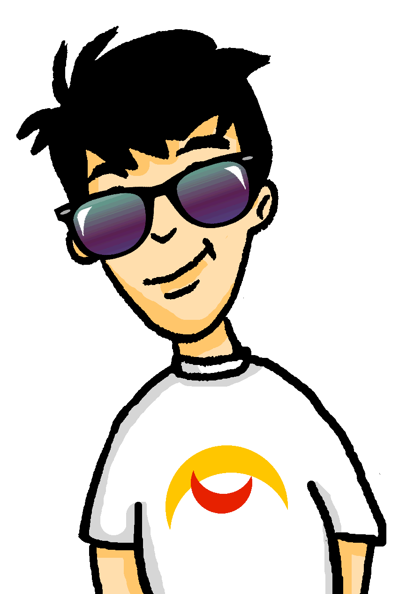
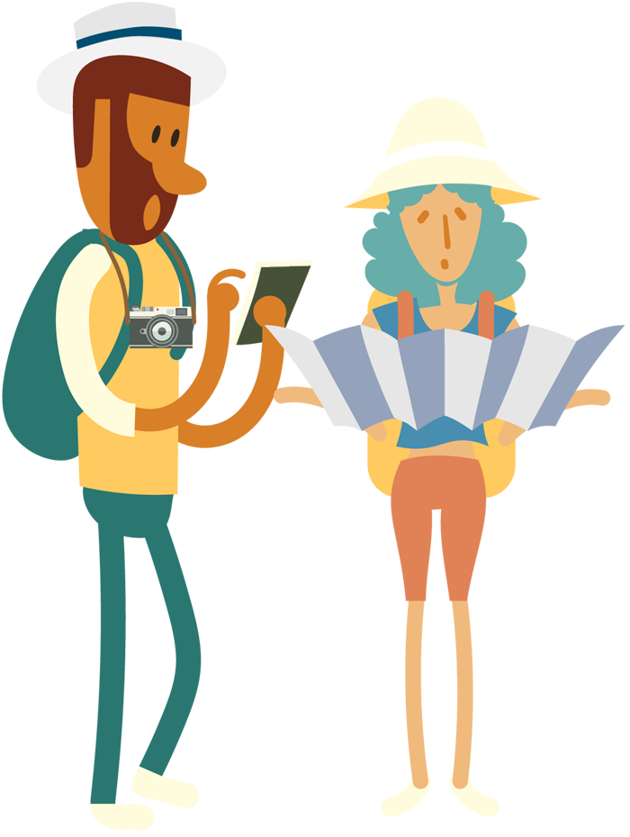
In der U-Bahn-Station
schreiben
Die Familie geht zum Hotel zurück.
Ein Paar englische Touristen stehen in der U-Bahn-Station. Schreib auf Deutsch.
He doesn’t speak German well.
Can you please repeat that slowly?
We like going to the museum(s).
Are we here?
This car is not my car. We don’t like travelling by bus.
Er spricht nicht gut Deutsch.
Können Sie das langsam wiederholen, bitte?
Wir gehen gern ins Museum.
Sind wir hier?
Dieses Auto ist nicht mein Auto.
Wir fahren nicht gern mit dem Bus.
Notes:
Timing: 10 minutes Aim: To practise production of the key language and structures revisited in this lesson, including question formation and placement of nicht. Procedure: 1. Students translate the statements / questions into German.
2. Click to reveal and check the answers.
Word frequency (1 is the most frequent word in German):
sprechen [157] wiederholen [1044] fahren [169] er [20] du [52] wir [31]

Slide 37
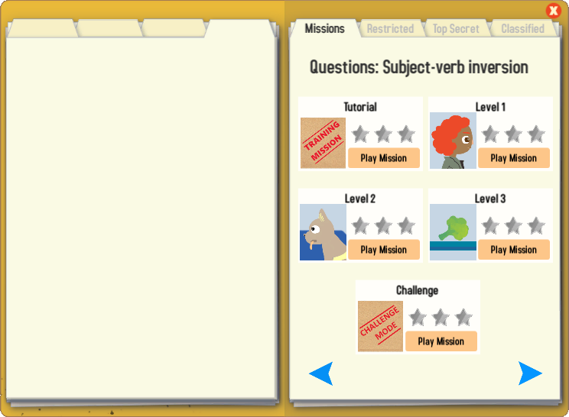
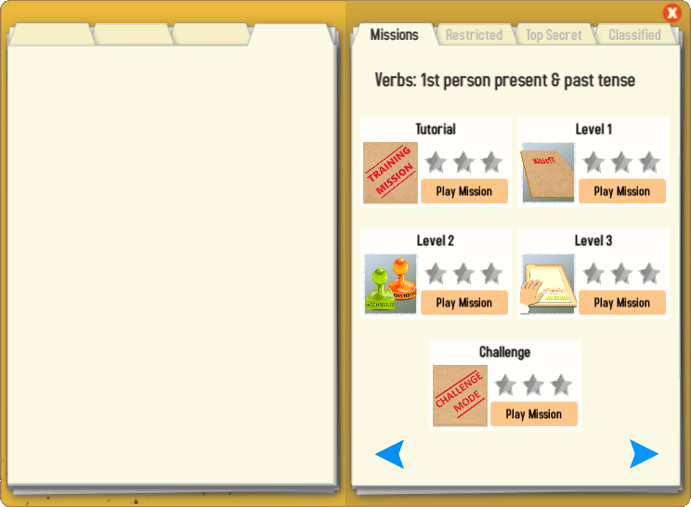
Gaming Grammar
Try the following Gaming Grammar missions to practise:

Slide 38
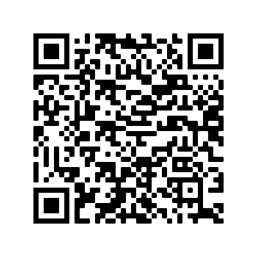
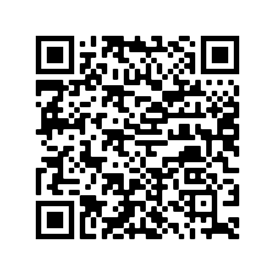
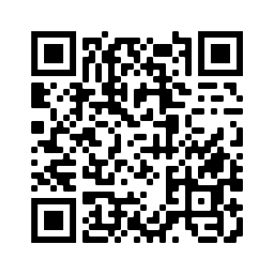
Hausaufgaben
Pre-learning for lesson: Year 8 German Term 1.2 Week 7
Revisit 1: [Year 8 German Term 1.2 Week 3]
Revisit 2: [Year 7 German Term 1.1 Week 3]

Slide 39
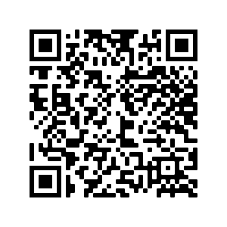
Hausaufgaben
Vocabulary Learning Homework (Y8, Term 1.2, Week 7)
Audio file
Audio file QR code:
Student worksheet
Quizlet link
In addition, revisit: Year 8 Term 1.2 Week 3
Year 8 Term 1.1 Week 3
Notes:
Link to Student Worksheet answers: https://resources.ncelp.org/concern/resources/sb397892m?locale=en

