Slide 1
Phonics
Year 7 French
Term 1.1 - Week 1
Stephen Owen / Rachel Hawkes
Date updated: 09/02/20
Notes:
Phonics learning aims for Term 1.1, Week 1:
Silent Final Consonant (SFC); ‘a’.
All pictures selected are available under a Creative Commons license; no attribution required.

Slide 2
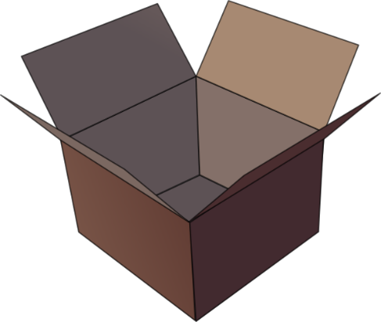
Silent final consonant
dans
X
Rachel Hawkes
Notes:
AUDIO x 2: on appearance of X and of the visual for ‘in’.
Explanation in English, if desired: Something that makes French sounds very different from English is that some consonants at the ends of words are silent. This means you don’t pronounce/sound them out at all. As in the word ‘dans’ in French. Say and repeat the word. Ensure pupils know the meaning (use usual routine for this – e.g. C’est quoi en anglais ‘dans’? ‘In’, oui, c’est ça. A possible gesture to accompany this SSC would be to hold ones finger to ones lips to indicate ‘Shhhh!’

Slide 3
Silence!
prix
petit
dans
X
mot
grand
mais
Rachel Hawkes
Notes:
Elicit pronunciation of ‘dans’ again before clicking to animate the ‘X’
Possible explanation, in English, if desired: Let’s see which other final consonants are silent in French. Lead class repetition of the five CLUSTER words.
Word frequency rankings (1 is the most common word in French): dans [11]; petit [138]; prix[310] mot [220]; grand [59]; mais [30] Source: Londsale, D., & Le Bras, Y. (2009). A Frequency Dictionary of French: Core vocabulary for learners London: Routledge.

Slide 4
petit
prix
grand
€15.95
mot
mais
Rachel Hawkes
Notes:
With this round of repetition, ensure that pupils are clear about the meaning of each of these high-frequency words. NB: pictures can, at best, only suggest meaning. Many high-frequency words less concrete than other words, and less easy to communicate unequivocally in pictures. Therefore, teachers should not shy away from giving the English meaning to students, to prevent any erroneous representations taking root in memory. With these words, however, it is expected that pupils will know several of them already. Lead class repetition of the five CLUSTER words.

Slide 5
60
petit
prix
Secondes
grand
mot
mais
0
DÉBUT
Rachel Hawkes
Notes:
Alphabetical read aloud Individually (but all at once) pupils read out the words but in alphabetical order. They keep going for one minute.
Teacher can circulate to listen into their SSC knowledge.

Slide 6
Silence!
petit
prix
dans
X
mot
grand
mais
Rachel Hawkes
Notes:
WITHOUT AUDIO Elicit pronunciation of ‘dans’ again before clicking to animate the ‘X’
Possible explanation, in English, if desired: Let’s see which other final consonants are silent in French. Lead class repetition of the five CLUSTER words.

Slide 7
petit grand mot mais prix
60
Secondes
0
DÉBUT
Rachel Hawkes
Notes:
Pair work: Pupils try to recall the words together, prompted just by the SFC Plenary: Elicit the words chorally from the class, but listening in carefully

Slide 8
€15.95
Rachel Hawkes
Notes:
Elicit the words from pupils from picture prompts (NB – clearly this is NOT decoding the SFC SSC, but it is reinforcing the explicit knowledge of the cluster words – remember these are high-frequency words)

Slide 9
a
animal
Stephen Owen / Rachel Hawkes
Notes:
Introduce and elicit the pronunciation of the individual SSC ‘a’ and then present and practise the pronunciation of the source word ‘animal’. A possible gesture for this source word would be to mimic an animal’s motion, perhaps holding ones arms and hands close to the chest as ‘paws’

Slide 10
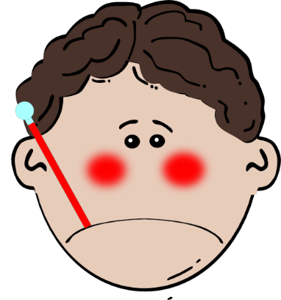
a
ça va ?
table
animal
malade
sac
mal
Stephen Owen / Rachel Hawkes
Notes:
Introduce and elicit the pronunciation of the individual SSC ‘a’ and then the source word ‘animal’ again (with gesture, if using). Then present and elicit the pronunciation of the five cluster words. The cluster words have been chosen for their high-frequency, from a range of word classes, with the SSC (where possible) positioned within a variety of syllables within the words(e.g. initial, 2nd, final etc..) and additionally, we have tried to use words that build cumulatively on previously taught SSCs (see the Phonics Teaching Sequence document) and do not include new SSCs. Where new SSCs are used, they are often consonants which have a similar symbol-sound correspondence in English.
Word frequency rankings (1 is the most common word in French): ça va?[54 (cela), 53 (aller)]; malade [1066] mal [277]; table [1019]; sac [2343]; animal [1002]. Source: Londsale, D., & Le Bras, Y. (2009). A Frequency Dictionary of French: Core vocabulary for learners London: Routledge.

Slide 11
a
ça va ?
table
animal
malade
sac
mal
Stephen Owen / Rachel Hawkes
Notes:
Introduce and elicit the pronunciation of the individual SSC ‘a’ and then the source word ‘animal’ again (with gesture, if using). Then present and elicit the pronunciation of the five cluster words. The cluster words have been chosen for their high-frequency, from a range of word classes, with the SSC (where possible) positioned within a variety of syllables within the words(e.g. initial, 2nd, final etc..) and additionally, we have tried to use words that build cumulatively on previously taught SSCs (see the Phonics Teaching Sequence document) and do not include new SSCs. Where new SSCs are used, they are often consonants which have a similar symbol-sound correspondence in English.
Word frequency rankings (1 is the most common word in French): ça va?[54 (cela), 53 (aller)]; malade [1066] mal [277]; table [1019]; sac [2343]; animal [1002]. Source: Londsale, D., & Le Bras, Y. (2009). A Frequency Dictionary of French: Core vocabulary for learners London: Routledge.

Slide 12
a
a
ça va ?
table
animal
malade
sac
mal
Stephen Owen / Rachel Hawkes
Notes:
Slide with words only – no audio.
Elicit the pronunciation from students.

