Slide 1
Who does what? Manipulating infinitive verbs
Present tense weak verbs: 1st, 2nd, 3rd persons singular
SSC [ch] (revisited)
Y7 German
Term 1.2 - Week 4 - Lesson 21
Natalie Finlayson / Rachel Hawkes
Artwork: Steve Clarke
Date updated: 15/12/21
Notes:
Artwork by Steve Clarke. All additional pictures selected are available under a Creative Common license; no attribution required.
Learning outcomes (lesson 1):
Introduction of SSC – long and short [ch] (revisited)
Consolidation of present tense weak verbs: 1st, 2nd, 3rd persons singular
Word frequency (1 is the most frequent word in German):
7.1.2.4 (introduce) lesen [305] sprechen [161] wiederholen [988] zeigen [136] zuhören [1629] Antwort [522] freiwillig [1652]
(Antworten) zeigen! Zuhören! Sprechen! Lesen! Schreiben! Wiederholen!
7.1.2.1 (revisit) lernen [288] machen [58] reden [368] schreiben [184] spielen [205] wohnen [560] Aufgabe [256] Klassenzimmer [>5009] Montag [794] Unterricht1 [1823] mit1 [13] im Klassenzimmer [n/a] im Unterricht [n/a] in der Schule [n/a] mit Freunden [n/a]
7.1.1.2 (revisit) sagen, sagt [40] was?[38] Klasse [961] Mann [121] Paar [241] Tag [111] falsch [524] richtig [177] oder [35] ja1 [45] nein [148] nicht [11] Ist das klar? [n/a]
Source: Jones, R.L. & Tschirner, E. (2019). A frequency dictionary of German: core vocabulary for learners. Routledge

Slide 2
ch
ich
Notes:
Timing: 1 minute
Aim: To introduce/consolidate SSC [ch]
Procedure: 1. Present the letter(s) and say the [ch] sound first, on its own. Students repeat it with you. 2. Bring up the word ”ich” on its own, say it, students repeat it, so that they have the opportunity to focus all of their attention on the connection between the written word and its sound.
3. A possible gesture for this would be to do an exaggerated gesture of pointing to yourself.
4. Roll back the animations and work through 1-3 again, but this time, dropping your voice completely to listen carefully to the students saying the [ch] sound, pronouncing ”ich” and, if using, doing the gesture. Word frequency (1 is the most frequent word in German): ich [8]
Source: Jones, R.L. & Tschirner, E. (2006). A frequency dictionary of German: core vocabulary for learners. Routledge

Slide 3
ch
ich
Notes:
With sound and no pictures to focus all attention on the sound-symbol correspondence.

Slide 4
ch
ich
Notes:
Without sound to elicit pronunciation (without first hearing the teacher).
Teacher to elicit pronunciation by asking “Wie sagt man…”

Slide 5
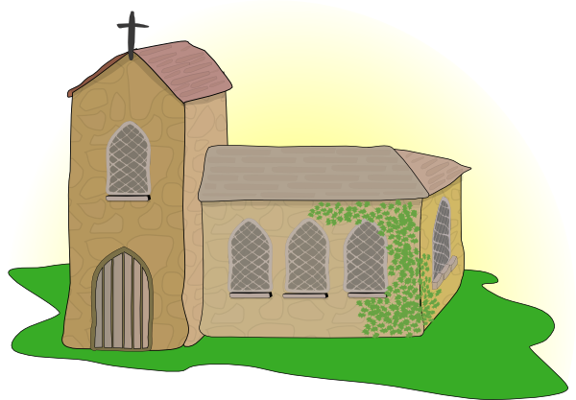
ch
Licht
Kirche
ich
nicht
endlich
[finally]
manchmal
[sometimes]
Notes:
Timing: 2 minutes
Aim: To introduce/consolidate SSC [ch]
Procedure:
Introduce and elicit the pronunciation of the individual SSC [ch] and then the source word again ‘ich’ (with gesture, if using).
Then present and elicit the pronunciation of the five cluster words.
The cluster words have been chosen for their high-frequency, from a range of word classes, with the SSC (where possible) positioned within a variety of syllables within the words (e.g. initial, 2nd, final etc.). Additionally, we have tried to use words that build cumulatively on previously taught SSCs (see the Phonics Teaching Sequence document) and do not include new SSCs. Where new SSCs are used, they are often consonants which have a similar symbol-sound correspondence in English.
Word frequency (1 is the most frequent word in German): ich [8]; Licht [503] Kirche [519]; endlich [496]; manchmal [394]; nicht [12]
Source: Jones, R.L. & Tschirner, E. (2006). A frequency dictionary of German: core vocabulary for learners. Routledge

Slide 6
ch
Licht
Kirche
ich
nicht
endlich
manchmal
Notes:
With sound and no pictures to focus all attention on the sound-symbol correspondence.

Slide 7
ch
Licht
Kirche
ich
nicht
endlich
manchmal
Notes:
Without sound to elicit pronunciation (without first hearing the teacher).
Teacher to elicit pronunciation by asking “Wie sagt man…”

Slide 8
ch
Buch
Notes:
Timing: 1 minute
Aim: To introduce/consolidate SSC [ch]
Procedure: 1. Present the letter(s) and say the [ch] sound first, on its own. Students repeat it with you. 2. Bring up the word ”Buch” on its own, say it, students repeat it, so that they have the opportunity to focus all of their attention on the connection between the written word and its sound.
3. A possible gesture for this would be to mime opening the pages of a book with both hands.
4. Roll back the animations and work through 1-3 again, but this time, dropping your voice completely to listen carefully to the students saying the [ch] sound, pronouncing ”Buch” and, if using, doing the gesture. Word frequency (1 is the most frequent word in German): Buch [195]
Source: Jones, R.L. & Tschirner, E. (2006). A frequency dictionary of German: core vocabulary for learners. Routledge

Slide 9
ch
Buch
Notes:
With sound and no pictures to focus all attention on the sound-symbol correspondence.

Slide 10
ch
Buch
Notes:
Without sound to elicit pronunciation (without first hearing the teacher).
Teacher to elicit pronunciation by asking “Wie sagt man…”

Slide 11
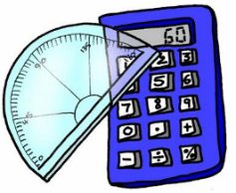
ch
machen
nochmal
Buch
acht
Nacht
Fach
Notes:
Timing: 2 minutes
Aim: To introduce/consolidate SSC [ch]
Procedure:
Introduce and elicit the pronunciation of the individual SSC [ch] and then the source word again ‘Buch’ (with gesture, if using).
Then present and elicit the pronunciation of the five cluster words.
The cluster words have been chosen for their high-frequency, from a range of word classes, with the SSC (where possible) positioned within a variety of syllables within the words (e.g. initial, 2nd, final etc.). Additionally, we have tried to use words that build cumulatively on previously taught SSCs (see the Phonics Teaching Sequence document) and do not include new SSCs. Where new SSCs are used, they are often consonants which have a similar symbol-sound correspondence in English.
Word frequency (1 is the most frequent word in German): Buch [195]; machen [49] nochmal [773]; acht [458]; Fach [698]; Nacht [335]. Source: Jones, R.L. & Tschirner, E. (2006). A frequency dictionary of German: core vocabulary for learners. Routledge

Slide 12
ch
machen
nochmal
Buch
acht
Nacht
Fach
Notes:
With sound and no pictures to focus all attention on the sound-symbol correspondence.

Slide 13
ch
machen
nochmal
Buch
acht
Nacht
Fach
Notes:
Without sound to elicit pronunciation (without first hearing the teacher).
Teacher to elicit pronunciation by asking “Wie sagt man…”

Slide 14
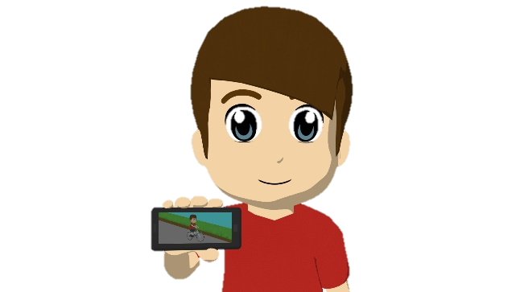
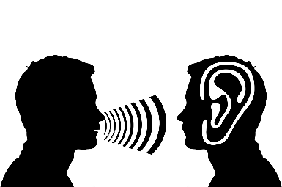
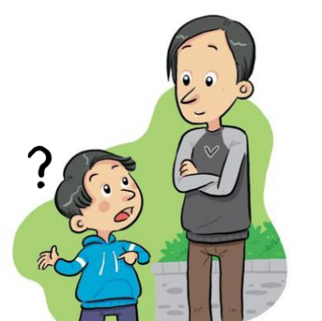
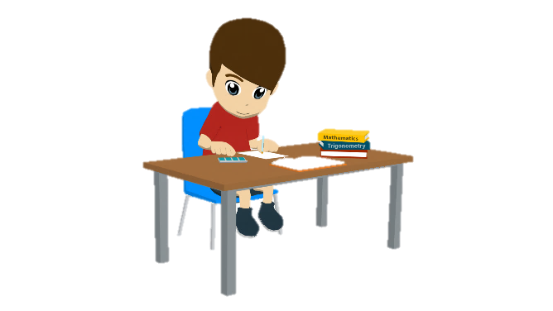
Vokabeln
lesen / schreiben
schreiben
Hallo!
Hallo!
Hallo!
antworten
sprechen
wiederholen
lesen
zeigen
zuhören
wiederholen
zeigen
…
lesen
fragen
sprechen
fragen
schreiben
antworten
zuhören
Notes:
Timing: 5 minutes Aim: To revise the infinitive form of all verbs which can be used to give classroom instructions.
Note: Students have not yet learnt /ö/, /s-/ or /sp-/ as an SSC and may therefore need some help/practice with these.
Procedure: 1. Students read the choices and choose the one that best fits each picture.
2. Teacher elicits answers by pointing at the picture and asking ‘Was ist das?’ to elicit a choral response.
3. Answers appear on your click.
4. Teacher should highlight that simple instructions will be given in German from now on, and so it is important that students can understand the meaning in spoken and written form.

Slide 15
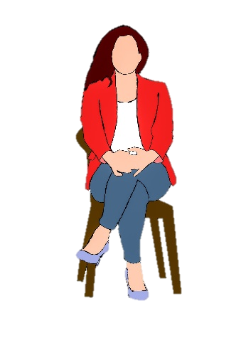
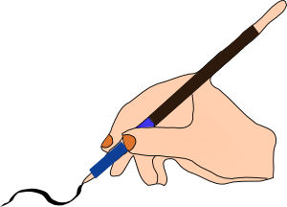
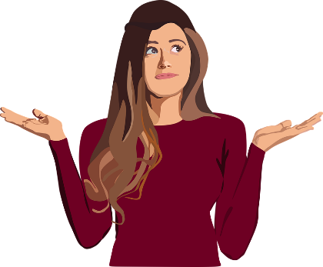
Du bist dran!
hören / sprechen
Schreiben!
Zuhören!
Sitzen!
Lesen!
Zeigen!
Sprechen!
Fragen!
Antworten!
Notes:
OPTIONAL
Timing: 5 minutes
Aim: To provide additional practice for classroom verbs. Procedure: 1. Teacher first brings up the vocabulary items one by one, and asks students to perform a gesture/mime to represent the meaning. The slide provides example gestures.
2. Once gestures have been agreed, a Simon Says-type game can be played. The students stand up and the teacher hides the slide. The teacher then lists the verbs in a random order. Students must perform the action which corresponds to the word they hear. If they perform the wrong action, or take too long to decide, they are out of the game and must sit down. The last student standing is the winner.

Slide 16
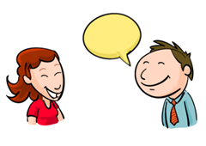
sprechen
[to speak | speaking]
spricht
[speaks | is speaking]
Notes:
Timing: 3 minutes for sequence of six slides
Aim: To introduce the verb sprechen more explicitly.
Note: Sprechen is one of the NCELP 15 prototypical verbs in German. Prototypical verbs are common verbs that illustrate the typical characteristics of a class of verb – the German prototypical verbs contain examples of regular/weak verbs, but also common examples of changes to the stem. All 15 prototypical verbs will be introduced early on using the same format. Both long form (infinitive) and short form (3rd person singular) are introduced in order to familiarise students with various forms of the same verb.
Procedure:
Bring up the word sprechen on its own, say it, students repeat it, and remind them of the phonics. Draw attention to [ch]
Try to elicit the meaning from the students. Students have had explicit teaching that the present tense in German communicates two different present tense meanings in English. This reinforces that learning. Emphasise the two meanings for the short form, reminding students that German only has one form and does not have a direct equivalent of the grammar for ‘is + ing’, the continuous form (as covered in previous weeks).
Bring up the picture, and, if using gestures, a possible gesture would be [to put hand in front of mouth and make speaking gesture].
Then bring up the English translations. Emphasise the two meanings for the infinitive.
Bring up the short form spricht, say it, students repeat it. Draw attention to [ch].
Try to elicit the meaning from the students. Emphasise the two meanings for the short form.

Slide 17
sprechen
[to speak | speaking]
spricht
[speaks | is speaking]
Notes:
Cycle through the long and short form again.

Slide 18
spricht
[speaks | is speaking]
Er spricht Deutsch.
[He speaks | is speaking German.]
Notes:
Introduce the short form in a sentence.

Slide 19
sprechen
[to speak | speaking]
Er muss Deutsch sprechen.
[He must speak German.]
Notes:
Introduce the long form in a sentence.

Slide 20
spricht
[speaks | is speaking]
spricht
Er ______ Deutsch.
[He speaks | is speaking German.]
Notes:
Cycle through the short form in context again.

Slide 21
sprechen
[to speak | speaking]
sprechen
Er muss Deutsch _________.
[He must speak German.]
Notes:
Cycle through the long form in context again.

Slide 22
lesen
[to read | reading]
liest
[reads | is reading]
Notes:
Timing: 3 minutes for sequence of six slides
Aim: To introduce the verb lesen more explicitly.
Note: Lesen is one of the NCELP 15 prototypical verbs in German. Prototypical verbs are common verbs that illustrate the typical characteristics of a class of verb – the German prototypical verbs contain examples of regular/weak verbs, but also common examples of changes to the stem. All 15 prototypical verbs will be introduced early on using the same format. Both long form (infinitive) and short form (3rd person singular) are introduced in order to familiarise students with various forms of the same verb.
Procedure:
Bring up the word lesen on its own, say it, students repeat it, and remind them of the phonics. Draw attention to long [e]
Try to elicit the meaning from the students. Students have had explicit teaching that the present tense in German communicates two different present tense meanings in English. This reinforces that learning. Emphasise the two meanings for the short form, reminding students that German only has one form and does not have a direct equivalent of the grammar for ‘is + ing’, the continuous form (as covered in previous weeks).
Bring up the picture, and, if using gestures, a possible gesture would be [to mime holding an open book in front of self, and reading it].
Then bring up the English translations. Emphasise the two meanings for the infinitive.
Bring up the short form liest, say it, students repeat it. Draw attention to the stem change to [ie].
Try to elicit the meaning from the students. Emphasise the two meanings for the short form.

Slide 23
lesen
[to read | reading]
liest
[reads | is reading]
Notes:
Cycle through the long and short form again.

Slide 24
liest
[reads | is reading]
Sie liest ein Buch.
[She reads | is reading a book.]
Notes:
Introduce the short form in a sentence.

Slide 25
liest
[reads | is reading]
liest
Sie ____ ein Buch.
[She reads | is reading a book.]
Notes:
Cycle through the short form in context again.

Slide 26
lesen
[to read | reading]
Sie kann ein Buch lesen.
[She can read a book.]
Notes:
Introduce the long form in a sentence.

Slide 27
lesen
[to read | reading]
lesen
Sie kann ein Buch ______.
[She can read a book.]
Notes:
Cycle through the long form in context again.

Slide 28
Order of words in a sentence
Grammatik
A simple German sentence contains a subject and a verb with an ending.
Ich spiele.
Du spielst.
Mia spielt.
I play/am playing.
You play/are playing.
Mia plays/is playing.
We can make the sentence more interesting by adding a noun after the verb.
So, if a sentence contains an adverb, the word order is different from English.
Ich spiele Fußball.
Du spielst Gitarre.
Mia spielt Tennis.
I play/am playing football.
You play/are playing guitar.
Mia plays/is playing Tennis.
An adverb adds information about when, how or where something happens.
The adverb normally comes after the verb. It splits up the verb and noun.
Ich spiele mit Freunden Fußball.
Du spielst zu Hause Gitarre.
Mia spielt manchmal Tennis.
I am playing football with friends.
You are playing guitar at home.
Mia sometimes plays Tennis.
Notes:
Timing: 2 minutes Aim: To provide a reminder of the order and formation of sentence components.
Procedure: 1. Click to animate the explanation.
2. Teacher to pay special attention to the word order with adverbs, highlighting that a word-for-word translation from English will result in incorrect word order: if the sentence contains a time, manner or place, this must come after the verb and before the noun.
Note: At this point we are teaching the word order in a sentence with ONE adverb only. We are not aiming to introduce the time, manner, place rule for multiple adverbs.
3. Ensure students’ understanding at each stage.

Slide 29
Bausteine (building blocks)
lesen / schreiben [1/4]
Schreib Sätze.
du
in der Schule
Mathe
spielen
nie
Gitarre
er
lernen
Du
lernst
in der Schule
Er
spielt
nie
Gitarre
Mathe
Notes:
Timing: 2 minutes Aim: To practise using correct word order in sentence formation (writing).
Procedure: 1. Students rearrange the jigsaw pieces to produce sentences with correct word order. Teacher to remind students to think about word order and verb endings.
2. Click to reveal the answers piece by piece.

Slide 30
Bausteine (building blocks)
lesen / schreiben [2/4]
Schreib Sätze.
sie
hören
sehr
oft
lesen
ich
ein Buch
oft
Musik
Sie
hört
sehr
oft
Musik
Ich
lese
oft
ein Buch
Notes:
Timing: 2 minutes Aim: To practise using correct word order in sentence formation (writing).
Procedure: 1. Students rearrange the jigsaw pieces to produce sentences with correct word order. Teacher to remind students to think about word order and verb endings.
2. Click to reveal the answers piece by piece.

Slide 31
Order of words in a question
Grammatik
Sentences are turned into questions by swapping the verb and subject.
Du spielst zu Hause Gitarre.
Spielst du zu Hause Gitarre?
You play/are playing guitar at home.
Do you play / Are you playing guitar at home?
To ask an open question, place a question word in front of the verb.
Only the verb and subject swap places. The adverb and noun stay in the same position.
Wie oft spielst du zu Hause Gitarre?
How often do you play guitar at home?
Wer spielt zu Hause Gitarre?
Who plays / is playing guitar at home?
Notes:
Timing: 2 minutes Aim: To revisit the topic of word order in questions.
Procedure: 1. Click to animate the explanation.
2. Draw attention to word order: VSO for closed questions, Question word + VSO or VO for open questions. Teacher to pay special attention to the word order with adverbs, highlighting that a word-for-word translation from English will result in incorrect word order.
3. Ensure students’ understanding at each stage. Animations allow teachers to elicit the du and er/sie forms of the sentences, as well as the English translations.

Slide 32
Bausteine (building blocks)
lesen / schreiben [3/4]
Schreib Fragen.
sie
putzen
den Boden
kochen
du
Suppe
oft
zu
Hause
Putzt
sie
zu
Hause
den Boden?
Kochst
du
oft
Suppe?
Notes:
Timing: 2 minutes Aim: To practise using correct word order in sentence formation (writing).
Procedure: 1. Students rearrange the jigsaw pieces to produce sentences with correct word order. Teacher to remind students to think about word order and verb endings.
2. Click to reveal the answers piece by piece.

Slide 33
Bausteine (building blocks)
lesen / schreiben [4/4]
Schreib Fragen.
ich
gehen
jeden
Tag
machen
nie
das Bett
er
in die Schule
jeden
Tag
in die Schule?
Macht
er
nie
das Bett?
Gehe
ich
Notes:
Timing: 2 minutes Aim: To practise using correct word order in sentence formation (writing).
Procedure: 1. Students rearrange the jigsaw pieces to produce sentences with correct word order. Teacher to remind students to think about word order and verb endings.
2. Click to reveal the answers piece by piece.

Slide 34
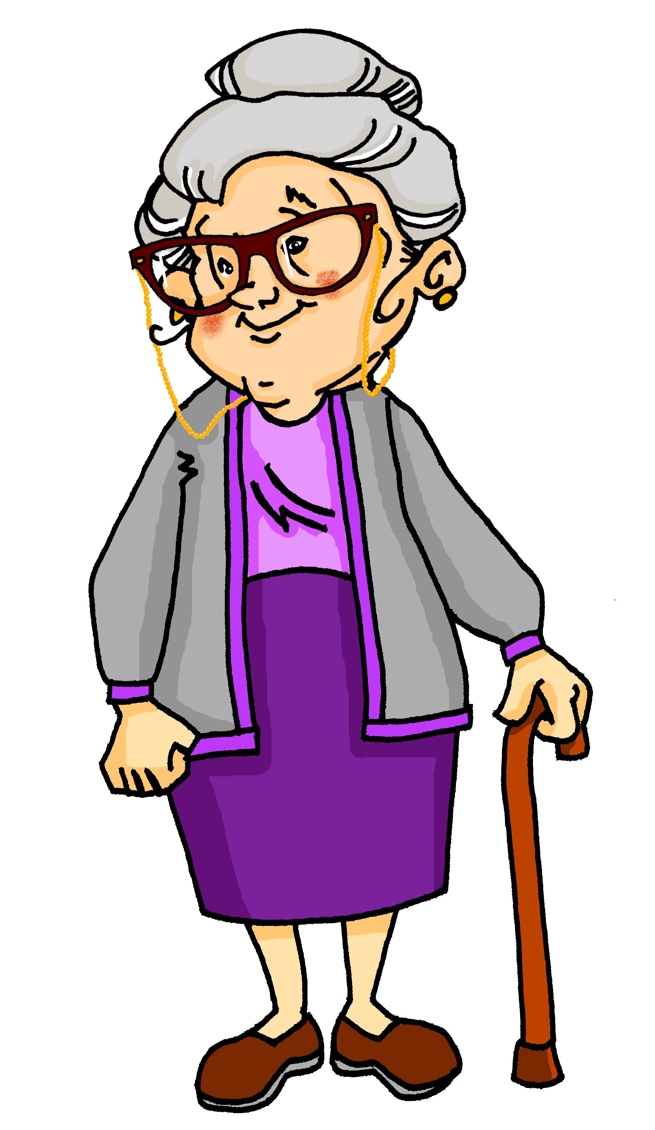
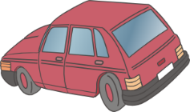
Am Telefon
hören [1/2]
Mia und Oma telefonieren. Oma hat Fragen. Wer macht was? Schreib M (Mia) oder W (Wolfgang).
Notes:
Timing: 5 minutes
Aim: To practise distinguishing between the first and third person singular forms of verbs (listening).
Procedure: 1. Audio plays on clicking the button on the top right. Students hear a full dialogue rather than individual sentences. Pronouns are obscured so students must listen to the verb ending to decide who is doing what. The dialogue contains negated verbs as well as some red herrings, so students will need to listen carefully to the context to understand the meaning. They may need to hear the audio two or three times.
2. Students can complete the exercise by sketching a 2x4 grid in their workbooks, and writing M or W in each square.
3. Click to advance to the next slide, which displays the answers.
Note: students learned die Frage in 1.1.6 Explain that Fragen is the plural form. Students will learn plural rules in two weeks’ time. Ach so! can be introduced as a conversational filler to mean ‘right!’ ‘okay!’ ‘I see!’
Transcript:
PHONE RINGS
Mia: Hallo?
Oma: Hallo Mia! Hier ist Oma.
Mia: Hallo Oma! Wie gehts?
Oma: Gut, danke! Was machst du? Und was macht Wolfgang?
Mia: [beep] spielt Frisbee und [beep] spiele Computer.
Oma: Was?! Bist du nicht im Garten?
Mia: [beep] ist im Garten. [beep] sitze im Zimmer.
Oma: Du machst Hausaufgaben, nicht wahr? Und Wolfgang?
Mia: [beep] habe eine Matheaufgabe. [beep] hat eine Englischaufgabe.
Oma: Ach so! Putzt Wolfgang den Boden?
Mia: Ich weiß nicht. [beep] putze das Auto. [beep] kocht Spagetti.
Oma: Okay, ich verstehe.

Slide 35
Am Telefon
hören [1/2]
Mia und Oma telefonieren. Oma hat Fragen. Wer macht was? Schreib M (Mia) oder W (Wolfgang).
W
M
W
M
M
W
M
W
Notes:
Timing: 2 minutes
Aim: To provide the answers to the exercise on the previous slide.
Procedure: 1. Audio plays on clicking the button on the top right. Students hear the full audio this time (i.e. including pronouns).
2. Teacher uses questions in the third person to elicit answers from students: ‘Wer spielt Tennis? Wolfgang spielt Tennis…’ etc.
3. Click to display the answers one by one.
Transcript:
PHONE RINGS
Mia: Hallo?
Oma: Hallo Mia! Hier ist Oma.
Mia: Hallo Oma! Wie gehts?
Oma: Gut, danke! Was machst du? Und was macht Wolfgang?
Mia: Wolfgang spielt Frisbee und ich spiele Computer.
Oma: Was?! Bist du nicht im Garten?
Mia: Wolfgang ist im Garten. Ich sitze im Zimmer.
Oma: Du machst Hausaufgaben, nicht wahr? Und Wolfgang?
Mia: Ich habe eine Matheaufgabe. Wolfgang hat eine Englischaufgabe.
Oma: Ach so! Putzt Wolfgang den Boden?
Mia: Ich weiß nicht. Ich putze das Auto. Wolfgang kocht Spagetti.
Oma: Okay, ich verstehe.

Slide 36
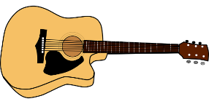
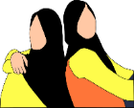
Am Telefon
hören [2/2]
Mia hat Fragen. Wer macht was? Schreib Opa oder Oma.
@
Notes:
Timing: 5 minutes
Aim: To provide further practice in distinguishing between the first and third person singular forms of verbs (listening).
Procedure: 1. Audio plays on clicking the button on the top right. Students hear a full dialogue rather than individual sentences. Pronouns are obscured so students must listen to the verb ending to decide who is doing what. The dialogue contains negated verbs as well as some red herrings, so students will need to listen carefully to the context to understand the meaning. They may need to hear the audio two or three times.
2. Students can complete the exercise by sketching a 2x4 grid in their workbooks, and writing Oma or Opa in each square.
3. Click to advance to the next slide, which displays the answers.
Transcript:
Mia: Und was machst du, Oma? Was macht Opa?
Oma: [beep] lese mein Buch und lerne Spanisch. [beep] spielt Gitarre.
Mia: Redest du nicht mit Freunden?
Oma: [beep] redet mit Freunden und [beep] schreibe E-mails.
Mia: Arbeitet Opa zu Hause?
Oma: [beep] arbeite im Garten und [beep] kocht Suppe. [beep] habe Tanzunterricht, Mia. Tschüss!
Mia. Okay Oma! Tschüss!

Slide 37
Am Telefon
hören [2/2]
Mia hat Fragen. Wer macht was? Schreib Opa oder Oma.
Oma
Oma
Opa
Opa
@
Oma
Oma
Opa
Oma
Notes:
Timing: 2 minutes
Aim: To provide the answers to the exercise on the previous slide.
Procedure: 1. Audio plays on clicking the button on the top right. Students hear the full audio this time (i.e. including pronouns).
2. Teacher uses questions in the third person to elicit answers from students: ‘Wer spielt Gitarre? Opa spielt Gitarre…’ etc.
3. Click to display the answers one by one.
Transcript:
Mia: Und was machst du, Oma? Was macht Opa?
Oma: Ich lese mein Buch und lerne Spanisch. Opa spielt Gitarre.
Mia: Redest du nicht mit Freunden?
Oma: Opa redet mit Freunden und ich schreibe E-mails.
Mia: Arbeitet Opa zu Hause?
Oma: Ich arbeite im Garten und Opa kocht Suppe. Ich habe Tanzunterricht, Mia. Tschüss!
Mia. Okay Oma! Tschüss!

Slide 38
Am Telefon
hören / sprechen
Person A
dein(e) Partner(in) (Mia) | dein(e) Partner(in) (Oma)
Hallo? | Hallo Mia! Hier ist Oma.
Hallo Oma! Wie gehts? | Gut, danke! Was machst du? Und was macht Wolfgang?
Wolfgang spielt Frisbee und ich spiele Computer. | Was?! Bist du nicht im Garten?
Wolfgang ist im Garten. Ich sitze im Zimmer. | Du machst Hausaufgaben, nicht wahr? Und Wolfgang?
Person B
dein(e) Partner(in) (Mia) | dein(e) Partner(in) (Oma)
Hallo? | Hallo Mia! Hier ist Oma.
Hallo Oma! Wie gehts? | Gut, danke! Was machst du? Und was macht Wolfgang?
Wolfgang spielt Frisbee und ich spiele Computer. | Was?! Bist du nicht im Garten?
Wolfgang ist im Garten. Ich sitze im Zimmer. | Du machst Hausaufgaben, nicht wahr? Und Wolfgang?
machst
macht
spielt
spiele
machst
sitze
Notes:
Timing: 5 minutes Aim: To practise use of the correct form of the verb – first or third person singular (speaking).
Note: In this spoken gap-fill activity, students are presented with transcripts of the audio they have just heard, with the verb endings missing.
A more challenging version of this activity, in which the whole verb is missing, rather than just the ending, is found on the next slide.
Procedure: 1. Teacher distributes the role cards included as supplementary material this week. (For this version of the activity, the role cards entitled ‘1.2.4 - role cards with verbs’ is needed.)
2. To prepare students for this activity, teachers use this animated slide to work through the first four examples with the whole class. As each solution is revealed on clicks, an underline appears on the other card to draw students attention to the location answer. Teacher explains to students that they are doing two tasks, 1) completing their own dialogue, and 2) correcting their partner’s dialogue.
3. Teachers should also draw attention to the following:
a/ Students will have to add verb endings in all three forms: ich, du and er/sie, each of which needs a different ending.
b/ Some verbs (reden, arbeiten) have a stem ending in –d or –t. Students need to remember to add the extra -e- in the du and er/sie forms: (redest, arbeitet)
c/ One irregular verb (haben) appears. Students may need a reminder of the irregular conjugation pattern.
4. Students work in pairs. Student A takes the role of Mia, and is given the role card on the left. Student B takes the role of Oma, and is given the role card on the right. Students role-play the dialogue, filling the verb endings orally as they go. The students have their partner’s full scripts with answers on their role card. This way, students can take part in peer correction when listening to their partner’s part of the dialogue, which raises awareness of common errors. Students should be encouraged to point out errors, explaining to their partner what the correct answer is and why.

Slide 39
Am Telefon
hören / sprechen
Person A
dein(e) Partner(in) (Mia) | dein(e) Partner(in) (Oma)
Hallo? | Hallo Mia! Hier ist Oma.
Hallo Oma! Wie gehts? | Gut, danke! Was machst du? Und was macht Wolfgang?
Wolfgang spielt Frisbee und ich spiele Computer. | Was?! Bist du nicht im Garten?
Wolfgang ist im Garten. Ich sitze im Zimmer. | Du machst Hausaufgaben, nicht wahr? Und Wolfgang?
Person B
dein(e) Partner(in) (Mia) | dein(e) Partner(in) (Oma)
Hallo? | Hallo Mia! Hier ist Oma.
Hallo Oma! Wie gehts? | Gut, danke! Was machst du? Und was macht Wolfgang?
Wolfgang spielt Frisbee und ich spiele Computer. | Was?! Bist du nicht im Garten?
Wolfgang ist im Garten. Ich sitze im Zimmer. | Du machst Hausaufgaben, nicht wahr? Und Wolfgang?
macht
Bist
spielt
spiele
machst
sitze
Notes:
MORE CHALLENGING VERSION
Timing: 5 minutes Aim: To practise use of the correct form of the verb – first or third person singular (speaking).
Note: In this spoken gap-fill activity, students are presented with transcripts of the audio they have just heard, with the verbs missing.
A less challenging version of this activity, in which only the verb endings are missing, rather than the whole verb, is found on the previous slide.
Procedure: 1. Teacher distributes the role cards included as supplementary material this week. (For this version of the activity, the role cards entitled ‘1.2.4 - role cards without verbs’ is needed.)
2. To prepare students for this activity, teachers use this animated slide to work through the first four examples with the whole class. As each solution is revealed on clicks, an underline appears on the other card to draw students attention to the location answer. Teacher explains to students that they are doing two tasks, 1) completing their own dialogue, and 2) correcting their partner’s dialogue.
3. Teachers should also draw attention to the following:
a/ Students will have to add verb endings in all three forms: ich, du and er/sie, each of which needs a different ending.
b/ Some verbs (reden, arbeiten) have a stem ending in –d or –t. Students need to remember to add the extra -e- in the du and er/sie forms: (redest, arbeitet)
c/ One irregular verb (haben) appears. Students may need a reminder of the irregular conjugation pattern.
4. Students work in pairs. Student A takes the role of Mia, and is given the role card on the left. Student B takes the role of Oma, and is given the role card on the right. Students role-play the dialogue, filling the verb endings orally as they go. The students have their partner’s full scripts with answers on their role card. This way, students can take part in peer correction when listening to their partner’s part of the dialogue, which raises awareness of common errors. Students should be encouraged to point out errors, explaining to their partner what the correct answer is and why.

Slide 40
Who does what? Manipulating infinitive verbs
Present tense weak verbs: 1st, 2nd, 3rd persons singular
SSC [ch] (revisited)
Y7 German
Term 1.2 - Week 4 - Lesson 22
Natalie Finlayson / Rachel Hawkes
Artwork: Steve Clarke
Date updated: 15/12/21
Notes:
Artwork by Steve Clarke. All additional pictures selected are available under a Creative Common license; no attribution required.
Learning outcomes (lesson 2):
Consolidation of SSC – long and short [ch] (revisited)
Consolidation of present tense weak verbs: 1st, 2nd, 3rd persons singular
Word frequency (1 is the most frequent word in German):
7.1.2.4 (introduce) lesen [305] sprechen [161] wiederholen [988] zeigen [136] zuhören [1629] Antwort [522] freiwillig [1652]
(Antworten) zeigen! Zuhören! Sprechen! Lesen! Schreiben! Wiederholen!
7.1.2.1 (revisit) lernen [288] machen [58] reden [368] schreiben [184] spielen [205] wohnen [560] Aufgabe [256] Klassenzimmer [>5009] Montag [794] Unterricht1 [1823] mit1 [13] im Klassenzimmer [n/a] im Unterricht [n/a] in der Schule [n/a] mit Freunden [n/a]
7.1.1.2 (revisit) sagen, sagt [40] was?[38] Klasse [961] Mann [121] Paar [241] Tag [111] falsch [524] richtig [177] oder [35] ja1 [45] nein [148] nicht [11] Ist das klar? [n/a]
Source: Jones, R.L. & Tschirner, E. (2019). A frequency dictionary of German: core vocabulary for learners. Routledge

Slide 41
Soft or hard /ch/?
Phonetik
The German /ch/ can be soft or hard.
It is hard after these sounds:
/a/ (machen, acht, Sachen)
/o/ (die Woche, kochen, nochmal)
/u/ (das Buch)
/au/ (auch)
It is soft after other sounds: (manchmal, nicht, richtig).
Notes:
Timing: 2 minutes Aim: To provide a reminder of the pronunciation rules for [ch].
Procedure: 1. Click to animate the explanation.
2. Notes: hard and soft here refer to the physiological differences in sound production, i.e. whether the air is forced through the soft palette (‘soft’) or from a place lower in the throat (‘hard’). Students have encountered all words used as examples here with the exception of auch.
3. Ensure students’ understanding at each stage.
Word frequency (1 is the most frequent word in German):
auch [16]
Source: Jones, R.L. & Tschirner, E. (2011). A frequency dictionary of German: core vocabulary for learners. Routledge

Slide 42
Soft or hard /ch/?
Phonetik
lesen / sprechen
Consider the words below. Is the /ch/ is soft or hard?
 | soft | hard |  | soft | hard
leicht (light, easy) |  |  | ziemlich (quite, fairly)
brauchen (to need) |  |  | ein bisschen (a bit)
danach (afterwards) |  |  | die Fremdsprache (foreign language)
schlecht (bad) |  |  | lachen (to laugh)
Notes:
Timing: 4 minutes Aim: To practise sounding out new words and recognising the different versions of the SSC [ch] that result from the different mouth positions.
Note: Unknown words have been chosen so that students must focus on the sound. The words are all highly frequent and will be introduced over the coming weeks.
Procedure: 1. First, students read the words and decide based on spelling with the [ch] is soft or hard.
2. The teacher then reads the words out loud. Students check their answers based on what they hear.
3. Answers revealed on clicks. Teacher elicits oral pronunciation of the words. The words are comprised of previously studied SSCs and transferable consonants with the exception of [au] brauchen and [sp] in Fremdsprache.
Word frequency (1 is the most frequent word in German):
leicht [285]; danach [437]; brauchen [201]; ziemlich [443]; schlecht [332]; lachen [561]; Fremdsprache [1791]
Source: Jones, R.L. & Tschirner, E. (2011). A frequency dictionary of German: core vocabulary for learners. Routledge

Slide 43
Vokabeln
lesen und schreiben
?
A. Was machst du in England?
B. Nicht falsch.
C. Wo bist du?
D. Was ist das? →
E. Was machst du in der Schule?
F. Wo ist das Klassenzimmer?
G. Nicht richtig.
H. Das ist ein Tag.
I. Was machst du mit einer Gitarre?
J. Du redest …
K. Er ist keine Frau.
L. Was machst du im Unterricht?
 |  |  |  |  |  |  |  | W | O | H | N | E | N
 |  |  |  |  |  |  | R | I | C | H | T | I | G
I | M | - | K | L | A | S | S | E | N | Z | I | M | M | E | R
 |  |  |  |  |  |  |  | D | A | S | - | P | A | A | R
 |  |  |  |  |  |  | L | E | R | N | E | N
 |  |  | I | N | - | D | E | R |  | S | C | H | U | L | E
 |  |  | F | A | L | S | C | H
 |  |  |  |  |  |  | M | O | N | T | A | G
 |  |  |  | S | P | I | E | L | E | N
 | M | I | T | - | F | R | E | U | N | D | E | N
 |  | D | E | R | - | M | A | N | N
 | D | I | E | - | A | U | F | G | A | B | E
Notes:
Timing: 10 minutes Aim: To share the grammar learning objective for the lesson, whilst revising previously-met vocabulary.
Note: A more complex version of this task, in which only the first letter of each word is given, can be found on the next slide.
Procedure: 1. Teacher asks question / gives clue in German as per A – L on slide. 2. Student(s) volunteer(s) the answer (e.g. wohnen).
3. Teacher asks ‘wie schreibt man das?’ 4. Students in chorus (slowly and steadily) respond to spell out the answer: W – O – H – N – E – N. 5. As students spell the word, teacher reveals each letter on a click. This will enable the teacher to pick up on any of the trickier letters, and do some remedial practice in the moment.
Note: Students should have pre-learned the verb ‘wiederholen’ as part of their audio and Quizlet homework, so teacher should explain that this is the noun form.

Slide 44
Vokabeln
lesen und schreiben
?
A. Was machst du in England?
B. Nicht falsch.
C. Wo bist du?
D. Was ist das? →
E. Was machst du in der Schule?
F. Wo ist das Klassenzimmer?
G. Nicht richtig.
H. Das ist ein Tag.
I. Was machst du mit einer Gitarre?
J. Du redest …
K. Er ist keine Frau.
L. Was machst du im Unterricht?
 |  |  |  |  |  |  |  | W | O | H | N | E | N
 |  |  |  |  |  |  | R | I | C | H | T | I | G
I | M | - | K | L | A | S | S | E | N | Z | I | M | M | E | R
 |  |  |  |  |  |  |  | D | A | S | - | P | A | A | R
 |  |  |  |  |  |  | L | E | R | N | E | N
 |  |  | I | N | - | D | E | R |  | S | C | H | U | L | E
 |  |  | F | A | L | S | C | H
 |  |  |  |  |  |  | M | O | N | T | A | G
 |  |  |  | S | P | I | E | L | E | N
 | M | I | T | - | F | R | E | U | N | D | E | N
 |  | D | E | R | - | M | A | N | N
 | D | I | E | - | A | U | F | G | A | B | E
Notes:
MORE CHALLENGING VERSION
Timing: 10 minutes Aim: To share the grammar learning objective for the lesson, whilst revising previously-met vocabulary.
Note: A less complex version of this task, in which more letters of each word are given, can be found on the previous slide.
Procedure: 1. Teacher asks question / gives clue in German as per A – L on slide. 2. Student(s) volunteer(s) the answer (e.g. wohnen).
3. Teacher asks ‘wie schreibt man das?’ 4. Students in chorus (slowly and steadily) respond to spell out the answer: W – O – H – N – E – N. 5. As students spell the word, teacher reveals each letter on a click. This will enable the teacher to pick up on any of the trickier letters, and do some remedial practice in the moment.
Note: Students should have pre-learned the verb ‘wiederholen’ as part of their audio and Quizlet homework, so teacher should explain that this is the noun form.

Slide 45
Verben
Grammatik
Which word is the verb in the following sentence? How do you know?
Mia kauft oft Bonbons.
‘Bonbons’ cannot be a verb because it does not end in –en, –e, –st or –t. It also begins with a capital letter, which tells you it is a noun.
‘oft’ ends in –t and does not begin with a capital letter. But it cannot be a verb because it does not appear next to the subject. ‘oft’ is an adverb. It usually comes after the verb.
The verb is ‘kauft’. It ends in –t, is not capitalised and appears next to the subject.
To find out the meaning of ‘kauft’, look up the infinitive form in the dictionary.
To form the infinitive, remove –t and add –en:
Mia kauft →
kauf- →
kaufen →
to buy, buying
Notes:
Timing: 3 minutes Aim: To revisit the topic of verbs, to prepare students for the dictionary work in the coming slides.
Procedure: 1. Click to animate the explanation.
2. Remind students how to recognise regular verbs, and how to convert them into infinitive forms to look up in a dictionary
3. Ensure students’ understanding at each stage.

Slide 46
Mias Tagebuch
lesen
Mia schreibt ein Tagebuch. Finde 28 Verben im Text!
Meine Traumwoche 21. November 2019
Ich bleibe jeden Tag zu Hause und gehe nicht in die Schule. Wolfgang hat Unterricht und lernt Englisch aber ich sitze im Garten und rede mit Freunden. Die Sonne scheint jeden Tag und ich trinke Limonade und kaufe im Supermarkt Bonbons. Ich besuche manchmal Nina, meine beste Freundin. Ich gehe mit Nina einkaufen oder schwimmen.
Meine Traumwoche 21. November 2019
Ich bleibe jeden Tag zu Hause und gehe nicht in die Schule. Wolfgang hat Unterricht und lernt Englisch aber ich sitze im Garten und rede mit Freunden. Die Sonne scheint jeden Tag und ich trinke Limonade und kaufe im Supermarkt Bonbons. Ich besuche manchmal Nina, meine beste Freundin. Ich gehe mit Nina einkaufen oder schwimmen.
Wolfgang macht Hausaufgaben, kocht und putzt den Boden. Ich schreibe ein Buch, spiele am Computer oder zeichne. Ich singe oft ein Lied und höre jeden Tag
Mark Forster. Mark Forster ist mein
Lieblingssänger. Ich liebe Mark Forster!
Ich putze nicht aber ich arbeite freiwillig im Garten.
Ich spiele mit Opa Fußball und zeige Oma Fotos.
Und … ja, das ist meine Traumwoche ☺
Wolfgang macht Hausaufgaben, kocht und putzt den Boden. Ich schreibe ein Buch, spiele am Computer oder zeichne. Ich singe oft ein Lied und höre jeden Tag Mark Forster. Mark Forster ist mein
Lieblingssänger. Ich liebe Mark Forster!
Ich putze nicht aber ich arbeite freiwillig im Garten. Ich spiele mit Opa Fußball und zeige Oma Fotos.
Und … ja, das ist meine Traumwoche ☺
Notes:
Timing: 5 minutes Aim: To practise recognising the verbs in a text (reading).
Procedure: 1. Students identify all examples of verbs. They can do this by circling/underlining on a printed copy, or by writing a list in their workbooks.
2. Remind students that the verbs could occur in the short form (ending in –e, -st or –t) or the long form (-en), and that haben and sein are also verbs. All verbs included are regular in the present tense, with the exception of haben and sein which students have learned.
3. All the verbs are highlighted in one go upon clicking the mouse.
Notes:
1) The majority of these verbs have been encountered before, but seven unfamiliar high-frequency verbs are included in preparation for the dictionary work on the next slide:
bleiben [112]; scheinen [276]; besuchen [703]; einkaufen [1789]; schwimmen [1832]; zeichnen [1808]; lieben [816].
Source: Jones, R.L. & Tschirner, E. (2011). A frequency dictionary of German: core vocabulary for learners. Routledge
2)In terms of other unfamiliar items:
a/ Students have not met Tagebuch, but they know ‘Tag’ and ‘Buch’. This is a good opportunity to introduce students to the concept of compounds. Teacher to explain that as students know the gender of Buch, they also know the gender of any word ending in Buch, as the gender of compound nouns agrees with the final stem. Same with Traumwoche. Teachers to ensure that Tagebuch and Traumwoche are understood by students before starting the task.
b/ Sonne, Limonade, Bonbons, beste and Fotos are all new words, but can be inferred from the English translations.
c/ Teacher to point out the convention for writing dates – with a full stop after the number.
d/ Mark Forster – a German singer/songwriter and TV personality.

Slide 47
Wörterbucharbeit
übersetzen
Wie ist Mias Traumwoche? Schreib Sätze auf Englisch.
Meine Traumwoche 21. November 2019
Ich bleibe jeden Tag zu Hause und gehe nicht in die Schule. Wolfgang hat Unterricht und lernt Englisch aber ich sitze im Garten und rede mit Freunden. Die Sonne scheint jeden Tag und ich trinke Limonade und kaufe im Supermarkt Bonbons. Ich besuche manchmal Nina, meine beste Freundin. Ich gehe mit Nina einkaufen oder spazieren.
Wolfgang macht Hausaufgaben, kocht und putzt den Boden. Ich schreibe ein Buch, spiele am Computer oder zeichne. Ich singe oft ein Lied und höre jeden Tag Mark Forster. Mark Forster ist mein
Lieblingssänger. Ich liebe Mark Forster!
Ich putze nicht aber ich arbeite freiwillig im Garten. Ich spiele mit Opa Fußball und zeige Oma Fotos.
Und … ja, das ist meine Traumwoche ☺
Notes:
Timing: 10 minutes Aim: To provide practice in the use of dictionaries to look up unfamiliar verbs.
Procedure: 1. Tell students that they have already learnt the meanings of 20 of the 28 verbs in this text, but that some new verbs have been included, which they might need to look up.
2. As a reminder, elicit the process that they would need to go to to find the meaning of ‘bleibe’ in the dictionary, i.e. remove the ending –e, add –en, to form the infinitive –bleiben, then look up its meaning in the dictionary.
3. Also remind students of the word order rules discussed in the ‘building blocks’ section of the previous lesson – where does the adverb go?
4. Students can attempt this translation individually at first, and then compare translations with a partner.

Slide 48
Übersetzung
übersetzen
Eine Antwort:
Meine Traumwoche 21. November 2019
Ich bleibe jeden Tag zu Hause und gehe nicht in die Schule. Wolfgang hat Unterricht und lernt Englisch aber ich sitze im Garten und rede mit Freunden. Die Sonne scheint jeden Tag und ich trinke Limonade und kaufe im Supermarkt Bonbons. Ich besuche manchmal Nina, meine beste Freundin. Ich gehe mit Nina einkaufen oder schwimmen.
My dream week 21st November 2019
I stay at home every day and don‘t go to school. Wolfgang has class and learns English but I sit
in the garden and chat with friends.
The sun shines every day and I drink lemonade
and buy sweets in the supermarket.
I sometimes visit Nina, my best friend.
I go shopping or swimming with Nina..
Notes:
ANSWERS
Timing: 3 minutes Aim: To provide suggested English sentences for the first half of the translation exercise on the previous slide.
Note: This is answer slide 1 of 2.
Procedure: 1. The suggested English sentences appear one by one on clicks.
2. Teacher can present these suggested translations after eliciting suggestions from students.
3. Teacher may wish to collect ideas from the class and come up with a class translation on the board instead.
4. Teacher to stress that there could be several solutions, and to encourage and praise structurally sound alternative suggestions.

Slide 49
Übersetzung
übersetzen
Eine Antwort:
Wolfgang macht Hausaufgaben, kocht und putzt den Boden. Ich schreibe ein Buch, spiele am Computer oder zeichne. Ich singe oft ein Lied und höre jeden Tag Mark Forster. Mark Forster ist mein Lieblingssänger. Ich liebe Mark Forster! Ich putze nicht aber ich
arbeite freiwillig im Garten. Ich spiele mit Opa
Fußball und zeige Oma Fotos.
Und … ja, das ist meine Traumwoche ☺
Wolfgang does his homework, cooks and cleans the floor. I write a book, play on the computer or draw.
I often sing a song and I listen to Mark Forster every day. Mark Forster is my favourite singer.
I love Mark Forster!
I don’t clean, but I work voluntarily in the garden.
I play football with Opa and show Oma photos.
And … yes, that’s my dream week ☺
Notes:
ANSWERS
Timing: 3 minutes Aim: To provide suggested English sentences for the second half of the translation exercise on the previous slide.
Note: This is answer slide 2 of 2.
Procedure: 1. The suggested English sentences appear one by one on clicks.
2. Teacher can present these suggested translations after eliciting suggestions from students.
3. Teacher may wish to collect ideas from the class and come up with a class translation on the board instead.
4. Teacher to stress that there could be several solutions, and to encourage and praise structurally sound alternative suggestions.

Slide 50
Wolfgangs Tagebuch
schreiben
Now imagine you are telling the story from Wolfgang’s perspective. What changes?
Mias Traumwoche 21. November 2019
Ich bleibe jeden Tag zu Hause und gehe nicht in die Schule. Wolfgang hat Unterricht und lernt Englisch aber ich sitze im Garten und rede mit Freunden. Die Sonne scheint jeden Tag und ich trinke Limonade und kaufe im Supermarkt Bonbons. Ich besuche manchmal Nina, meine beste Freundin. Ich gehe mit Nina einkaufen or schwimmen.
Wolfgang macht Hausaufgaben, kocht und putzt den Boden. Ich schreibe ein Buch, spiele am Computer oder zeichne. Ich singe oft ein Lied und höre jeden Tag Mark Forster. Mark Forster ist mein
Lieblingssänger. Ich liebe Mark Forster!
Ich putze nicht aber ich arbeite freiwillig im Garten. Ich spiele mit Opa Fußball und zeige Oma Fotos.
Und … ja, das ist meine Traumwoche ☺
Ich mache
koche
putze
Mia schreibt
spielt
Mia bleibt
geht
zeichnet.
Sie singt
hört
Ich habe
lerne
Mias
Unfair!
Mia sitzt
redet
Sie liebt
Mia trinkt
Mia putzt
sie arbeitet
kauft
Sie besucht
Sie spielt
zeigt
Mias
Mia geht
Mias
☹
Notes:
OPTIONAL
Timing: 10 minutes Aim: To practise changing verbs and pronouns from 1st to 3rd person, and vice versa.
Note: This is intended as an additional task, time permitting / extension / homework.
Procedure: 1. Students write a list of the verb changes which are necessary when talking in the third person.
2. Teacher to acknowledge that Mia/sie are often interchangeable.
3. Answers are revealed one by one upon clicking the mouse.

Slide 51
Du bist dran!
schreiben
Und wie ist deine Traumwoche? Schreib 6-8 Sätze.
Meine Traumwoche
Notes:
ALTERNATIVE
Timing: 10 minutes Aim: To practise using verbs in the first and third person singular forms (writing).
Note: This is intended as an alternative (or an addition) to the previous activity. Procedure: 1. Students write sentences describing their dream week using at least 10 different verbs.
2. Encourage students to include references to what their siblings have to do, whilst they are having their dream week.
3. In higher-level classes students can be encouraged to build on the dictionary work by looking up some new verbs and conjugating them appropriately.
4. The teacher could ask students for examples of sentences and compile a text describing the students’ ‘dream week’ from these suggestions.

Slide 52
4 gewinnt!
sprechen
Hörst du Musik?
- Ja, ich höre oft Musik!
- Nein, ich höre nie Musik.
im Garten arbeiten
ein Haustier haben
das Auto putzen
Computer spielen
Gitarre spielen
Sport machen
im Garten sitzen
kochen
Ich gewinne!
das Zimmer putzen
das Bett
machen
singen
tanzen
Fußball
spielen
mit Freunden
reden
Musik
hören
Tennis spielen
Notes:
Timing: 10 minutes Aim: To practise (speaking) using second person singular verb forms (in questions) and first person singular forms (in answers).
Note: A more complex version of this activity, with picture prompts rather than verbs in the infinitive, can be found on the next slide.
Procedure: 1. Explain that ‘4 gewinnt’ is the German name for the board game ‘connect 4’. In this version of the game, students must interview each other to find classmates that do the things on the list. The winner is the first student to cross off four boxes in a row, either vertically, horizontally or diagonally.
2. Explain that the game can be played in groups, or as a whole-class activity. Students interview each other by forming yes or no questions from the prompts in the boxes, eg. ‘Hörst du Musik?’ If they find someone who answers ‘Ja, ich höre oft Musik!’ they may cross off that box on their card. If their partner answers ‘Nein, ich höre nie Musik!’ they will need to ask a different question, or move on!
3. Click to animate the examples on this slide to illustrate the game play.

Slide 53
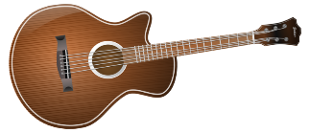
4 gewinnt!
sprechen
Hörst du Musik?
- Ja, ich höre oft Musik!
- Nein, ich höre nie Musik.
Ich gewinne!
Notes:
MORE CHALLENGING VERSION
Timing: 10 minutes Aim: To practise (speaking) using second person singular verb forms (in questions) and first person singular forms (in answers).
Note: In this more complex version of the activity, students are not given any vocabulary to help them. They must create questions and answers based on the picture prompts alone. A less complex version of this activity, with verbs in the infinitive instead of picture prompts, can be found on the previous slide.
Procedure: 1. Explain that ‘4 gewinnt’ is the German name for the board game ‘connect 4’. In this version of the game, students must interview each other to find classmates that do the things on the list. The winner is the first student to cross off four boxes in a row, either vertically, horizontally or diagonally.
2. Explain that the game can be played in groups, or as a whole-class activity. Students interview each other by forming yes or no questions from the prompts in the boxes, eg. ‘Hörst du Musik?’ If they find someone who answers ‘Ja, ich höre oft Musik!’ they may cross off that box on their card. If their partner answers ‘Nein, ich höre nie Musik!’ they will need to ask a different question, or move on!
3. Click to animate the examples on this slide to illustrate the game play.

Slide 54
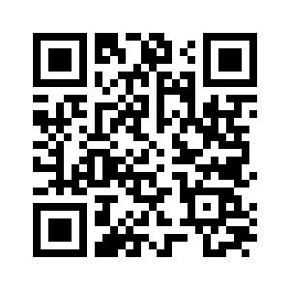
Hausaufgaben
Vocabulary Learning Homework (Term 1.2, Week 5)
Audio file
Audio file QR code:
Student worksheet
Quizlet
In addition, revisit: Term 1.2 Week 2
Term 1.1 Week 3
Notes:
Use this slide to set the homework
Icon made by Darius from www.flaticon.com (freely usable image).

