Slide 1
National Centre for Excellence for Language Pedagogy
Introduction to NCELP:
Understanding, improving and promoting language learning
Dr Heike Krüsemann
22 March 2021

Slide 2
Outline of the talk
1/ What is NCELP?
2/ The Scheme of Work
3/ Core language knowledge and resources
4/ How can I use NCELP?
https://ncelp.org/

Slide 3
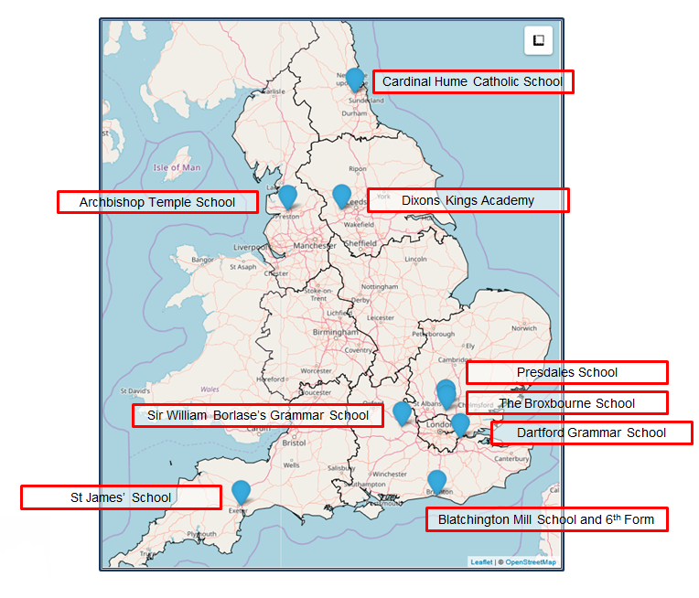
What is NCELP?
www.ncelp.org

Slide 4
Languages Pedagogy Review: 13 recommendations for schools:
Teaching Schools Council (2016), MFL Pedagogy Review.
vast majority should take GCSE (75% in Y10 by 2022, 90% by 2025; now in Ofsted framework)
phonics, vocabulary, grammar taught systematically, with extensive practice
stimulating content without compromising vocab and grammar
materials selected for how well they support a planned teaching of phonics, vocab and grammar
focus on detail through translation, extend vocabulary through short texts and literature, interact with native speakers
know and build on KS2 grammar

Slide 5
Languages Pedagogy Review, Recommendations (cont’d)
Teaching Schools Council (2016), MFL Pedagogy Review.
know and build on the KS2 languages teaching in feeder schools
plan own and students’ TL use carefully, to reinforce taught language
use errors to inform teaching, without discouragement
integrated teaching of L, S, R, W (they share common knowledge)
2-3 hrs teaching time, in lessons of 40-60 minutes (GCSE = 10% curriculum time)
meet needs of all learners across the ability range
assessment should focus specifically on Phonics, Vocabulary, Grammar taught (achievement tests), with some tasks to compose own sentences and give own oral presentations
Notes:
Today we can’t cover all of these. But you can now find resources on all of them on the ncelp resources portal.
There are professional development power points and there are documents explaining the research that underpins some of the decisions.

Slide 6
NCELP in Numbers
NCELP and beyond
Materials: https://resources.ncelp.org/
Fully resourced SOW + materials for nearly 400 Spanish, French, German lessons
For year 7 and year 8
Complete to end of year 9 by Sept 2021
Including audio files, homework, tests with mark schemes
Oak online national academy videoed lessons
All year 7 and ongoing year 8; using NCELP resources
Years 9, 10, 11; informed by pedagogy review and NCELP principles
BBC Bitesize
NCELP teachers talking about grammar and phonics!
New content focusing on vocab, phonics, grammar:
French German Spanish
Multilingual Profiler Lexical profiling tool for F, G, S https://www.multilingprofiler.net/
Gaming Grammar https://www.gaminggrammar.com (+apps)
OASIS Accessible Summaries of research freely available oasis-database.org

Slide 7
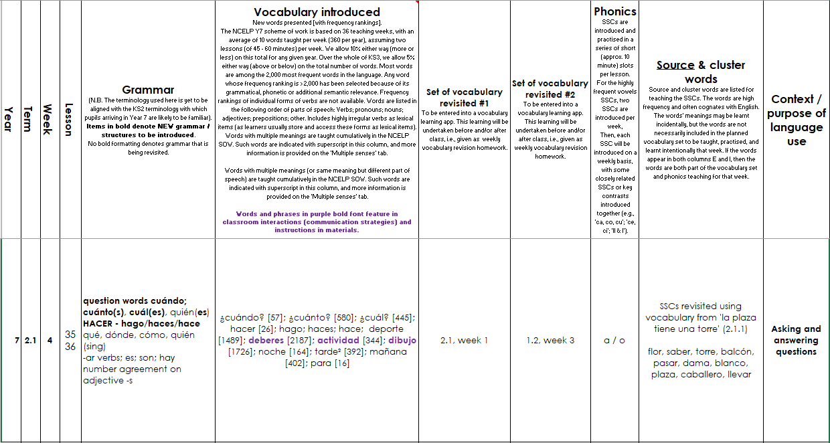
Screen shot of a SOW
Systematic revisiting of vocabulary every 3 weeks and 9 weeks
‘Context’: purpose of the language
e.g., “Asking / answering questions”
phonics practice every lesson
Grammar sequencing is language specific
Extremely high frequency (irregular!) verbs at start
Then highly regular and frequent verbs
Weeks set aside for work on ‘rich texts’
Notes:
This is what a page from Spanish SoW looks like –this is from week 4 of the Spring term
Starts with grammar introduced – question words and use of hacer – 1st 2nd and 3rd person – so high frequency , including high frequency irregular verbs – then we see new vocabulary introduced as well as vocabulary to be revisited – here we have new question words as well as revisited question words and there is also revisiting of previous vocab worked into lesson activities. Then the phonics practiced is laid out – here revisit of a/o . There is still a context – no topic but there is a context asking and answering questions.
At regular intervals there are weeks set aside for some revision and consolidation, assessment (in term 2 and 3) and also for work on “rich” texts or authentic text exploitation.

Slide 8
NCELP curriculum planning
Learning is carefully planned to support progression
Progression is determined by:
functions of grammar,
frequency and usefulness of vocabulary and phonics
Notes:
An example of careful progression planning is to avoid introducing AVOIR first with ages, which introduces an aspect of cross-linguistic difference that continues to trip students up as it is likely to give them the impression that ‘j’ai’ might mean ‘I am’. Instead, at NCELP, AVOIR is introduced with high-frequency nouns and thoroughly practised and embedded with its meaning of ‘HAVE’ before more idiomatic, less straightforward uses of the verb are encountered.

Slide 9
NCELP curriculum planning
Phonics – sequenced explicit teaching of new sound-symbol correspondences (SSC) followed by revisiting and consolidation throughout.
Vocabulary – teaching of ca. ten new words per week, sets of words from different parts of speech, most common verbs, selected on the basis of word frequency.
Grammar – no more than one new grammar function every two weeks. Core grammar taught and revisited several times over KS3 and KS4.

Slide 10
PHONICS
selection and order of Sound – Symbol - Correspondences (SSCs)
high-frequency ‘source’ words
staged roll out
practice activities
systematic revisiting
much more time for French – new SSCs in year 8
Erler, L. and Macaro, E. (2012) ‘Decoding Ability in French as a Foreign Language and Language Learning Motivation’. The Modern Language Journal, 95(4): 496-518.
Porter, A.M. (2014) An early start to French literacy: Learning the spoken and written word simultaneously in English primary schools. PhD thesis, University of Southampton.
Woore, R. (2007) ‘“Weisse Maus in Meinem Haus”: Using Poems and Learner Strategies to Help Learners Decode the Sounds of the L2’. Language Learning Journal, vol. 35, no. 2, pp. 175-188.
Woore, R. (2009) ‘Beginners’ progress in decoding L2 French: some longitudinal evidence from English Modern Foreign Languages classrooms’. Language Learning Journal, vol. 37, no. 1, pp. 3-18.
Woore, R. (2010) ‘Thinking aloud about L2 decoding: an exploration into the strategies used by beginner learners when pronouncing unfamiliar French words’. Language Learning Journal, vol. 38, no. 1, pp. 3-17.
Woore, R. (2011) Investigating and developing beginner learners’ decoding proficiency in second language French: an evaluation of two programmes of instruction. Unpublished PhD thesis, University of Oxford.
Woore, R. (2014) ‘Beginner learners’ progress in decoding L2 French: transfer effects in typologically similar L1-L2 writing systems’. Writing Systems Research, volume 4(2): 167-189.
Woore, R (2018) ‘Learners’ pronunciations of familiar and unfamiliar French words: what can they tell us about phonological decoding in an L2?’ The Language Learning Journal, 46(4):456-69.
Woore, R., Graham, S., Porter, A., Courtney, L. and Savory, C. (2018) Foreign Language Education: Unlocking Reading (FLEUR) - A study into the teaching of reading to beginner learners of French in secondary school. https://ora.ox.ac.uk/objects/uuid:4b0cb239-72f0-49e4-8f32-3672625884f0

Slide 11
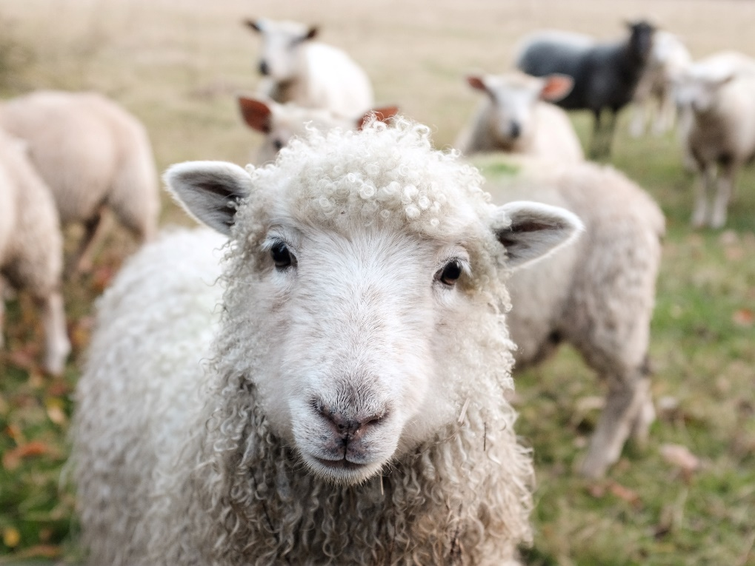
Minimal pairs
Minimal pairs are two similar sounding words that differ in only one phoneme and have distinct meanings.
sheep
ship
Notes:
[Ship] Photo by Peter Hansen on Unsplash [Sheep] Photo by Sam Carter on Unsplash

Slide 12
Pirates!
1
c
w
Riese
leider
Riese
One of the chests contains buried treasure. All the others contain poison!
Listen carefully to the secret code and follow the arrows to find the treasure.
Reise
Lieder
Reise
h
z
Wien
Biene
Feile
v
Wein
Beine
viele
Riese
Biene
Feile
leider
Riese
k
i
Reise
Beine
viele
Lieder
Reise
Riese
leider
Feile
leider
Riese
r
Reise
Lieder
viele
Lieder
Reise
y
Riese
j
q
Reise
Natalie Finlayson
Notes:
This task, created by Natalie Finlayson, one of NCELP’s resource developers, is one of my favourites!
Timing: 20-30 seconds per slide
Aim: This activity makes use of minimal pairs of unknown words to compel students to focus on a pair of SSC (sound-symbol correspondence) that often cause difficulty, both in pronunciation, reading aloud of written text, and also in spelling. (Unknown words are used so that pupils focus closely on the sound. Definitions are given on a later slide).
Procedure: Starting on the red square, pupils listen to the words and decide whether they hear /ei/ or /ei/. They follow the arrows indicated by their choice to finish at one of the chests. There is only one correct route per slide, so pupils must correctly identify all words to find the treasure. The order or /ei/ and /ie/ changes (i.e. sometimes /ei/ is on the white square and sometimes on the blue) so the pupils must read the spellings.
Pupils can follow the slide on the projector, or the slide can be printed so they can trace the route with a pen/finger.
Teacher asks ‘Wo bist du?’ Pupils respond ‘Z, W’ etc. to practise the alphabet. Teacher clicks on the chests they say to reveal treasure (or not!)
Audio plays on clicking play. Pupils will probably need to hear the audio at least three times.
Note: Each treasure chest is triggered to reveal what is underneath. You see a hand icon appear when you mouse over it – click and the chest disappears. Each slide only has one treasure chest – the rest reveal skulls.
Transcript:
Wein, Biene, Feile, Lieder, Riese
Treasure is located in chest r

Slide 13
En anglais et en français
lire / écouter
same [ch]
different [ch]
same [ch]
different [ch]
1
chef
6
champagne
2
avalanche
7
chocolat
3
touche
8
champion
4
brochure
9
moustache
5
charge
10
riche
Kirsten Somerville / St James’ Hub / Natalie Finlayson
Notes:
This is a slightly different angle, but I’ve included it to show the breadth and depth of NCELP’s phonics work as it’s developed through Y7. Here English has two pronunciations for ‘ch’ where French has one (there’s a reason for that, as where the English and French pronunciations overlap, those are words ‘borrowed’ form French).
Timing: 2 minutes Aim: This activity highlights similarities and differences in the English and French pronunciation of the SSC [ch], using near-cognates which have not been previously taught. Images are provided to aid recognition. The activity aims to show that while the pronunciation of this SSC changes in English, it is consistent in French. Teachers to highlight that, where the sound is ‘sh’ in English, these words are “borrowed” from French (chef, brochure, champagne, moustache).
Procedure: Students write 1-10 in their exercise books and decide if the [ch] in the French word sounds the same as in English, or different from the English. They then listen to the words and check their answers.
TRANSCRIPT:
chef
avalanche
touche
brochure
charge
champagne
chocolat
champion
moustache
riche
Frequency rankings of non-SOW (near-)cognates (1 is the most common word in French):
avalanche [4426], brochure [>5000], champagne [>5000], champion [2443], charge [849], chef [386], chocolat [4556], moustache [>5000], riche [599], touche [3775]
Source: Londsale, D., & Le Bras, Y. (2009). A Frequency Dictionary of French: Core vocabulary for learners London: Routledge

Slide 14
Remember ! Two pronunciations in English, one pronunciation in French!
parler
chef
champagne
avalanche
chocolat
touche
champion
brochure
moustache
charge
riche
Kirsten Somerville / St James’ Hub / Natalie Finlayson
Notes:
Timing: 1 minute Aim: To practise the same SSC [ch] in oral modality, productive mode. Procedure: Students now practise saying the words in pairs, each choosing a word from a different side, then swapping sides. Students check each others’ pronunciation, trying to get the longest ‘rally’ of correct pronunciations. The teacher circulates to check that students are drawing on their existing knowledge of French SSCs to pronounce the words accurately and avoid L1 interference.
Before beginning the task, teacher to remind students: two pronunciations in English, one pronunciation in French.

Slide 15
Using unknown words [phonics]
To practise applying SSC (symbol-sound correspondence) knowledge, we need to use unknown words. For example:
Place names
People’s names
Names of other things (e.g. games, bands)
Cognates (not previously-taught)

Slide 16
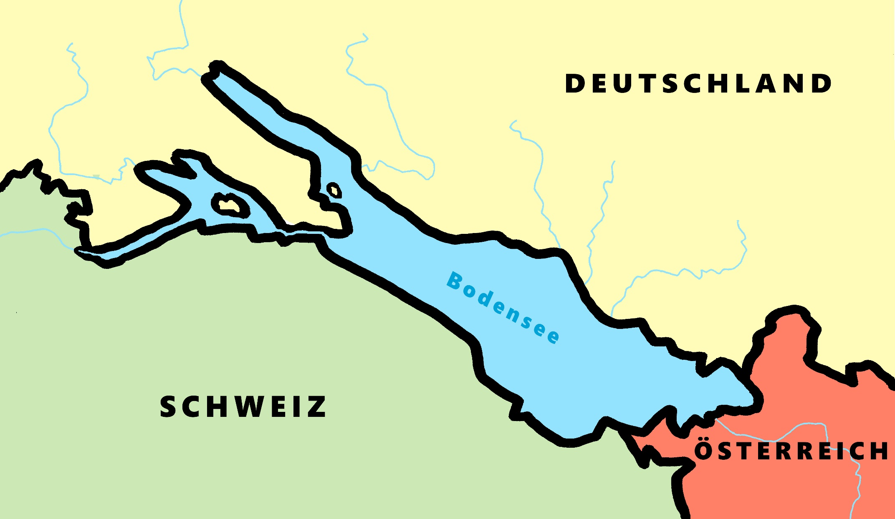
Phonetik - der Bodensee [1/2]
hören / schreiben
[4] Allensba_ _
ch
[5] _allhausen
4
W
5
z
[3] Radolf_ell
3
[6] Hagn_ _
6
au
ch
[7] Fr_ _dri_ _shafen
7
ie
S t
[2] _ _eckborn
eu
2
1
Kr_ _zlingen
[9] _omanshorn
R
9
ei
[8] Altenrh_ _n
8
Artwork: Steve Clarke
Notes:
Phonetik [1]
Time: 5 minutes Aim: To practise recognising and transcribing 10 previously taught SSC, in unknown words.
Procedure: 1. Click number to hear the full word. Students listen and transcribe only the missing letters. 2. Animations support item-by-item checking, as instant feedback on each SSC may be particularly helpful for students’ learning. 3. Teachers can additionally ask, Wo liegt [Hagnau]? Es liegt in [Deutschland]… Students have met the use of ‘in’ with die Schweiz. It will be helpful to focus their attention on the use of ‘in’ + der + Schweiz here, reminding them of the ‘in’ + movement (R2-accusative) or location (R3-dative) change. SSC revisited here: [eu] [st-] [z] [ch-hard] [w] [au] [ie] [ch-soft] [ei] [r] Transcript: 1 Kreuzlingen 2 Steckborn 3 Radolfzell 4 Allensbach 5 Wallhausen 6 Hagnau 7 Friedrichshafen 8 Altenrhein 9 Romanshorn

Slide 17
Phonétique
parler 1/8
lire / parler
Dis les noms.
Attention! C’est hard [g] ou [j]/soft [g] ?
Mon nom est …
1
Gérard
5
Gilles
9
Jacques
2
Gaelle
6
Julien
10
Jérôme
3
Angéline
7
Joséphine
11
Margaux
4
Agathe
8
Morgane
12
Georges
Adeline Charlton / Natalie Finlayson
Notes:
Timing: 8 minutes
Aim: To raise awareness of [j]/soft [g] and hard [g] by using known spelling rules to pronounce these correctly in unknown vocabulary items.
Procedure:
1. Explain that these are popular French names that look like names students may recognise from English, but are pronounced differently.
2. Give students four minutes to work with a partner to decide how to pronounce [j] or [g], and to have a go at sounding out the names. All other SSCs in the words are either known or transferable from English, with the exception of the [ô] in Jérôme.
3. Click on the numbers to hear the names pronounced. The voices indicate whether the name is traditionally a male or female one. Students repeat chorally.
4. Now, teachers encourage students to read the names in increasing speed intervals (30 seconds, 20 seconds, 10 seconds … may vary according to the individual needs of the class) to work on fluency.
Transcript
1. Gérard
2. Gaelle
3. Angéline
4. Agathe
5. Gilles
6. Julien
7. Joséphine
8. Morgane
9. Jacques
10. Jérôme
11. Margaux
12. Georges

Slide 18
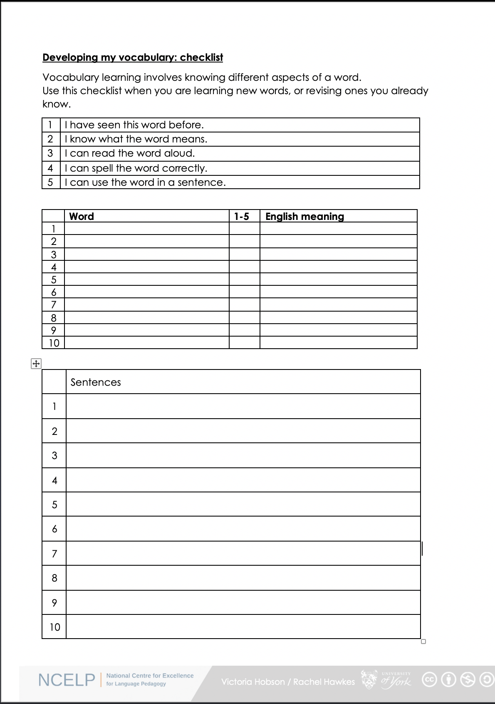
Vocabulary checklist
1. I have seen this word before.
2. I know what the word means.
3. I can read the word aloud.
4. I can spell the word correctly.
5. I can use the word in a sentence.
6. For nouns, I know the gender and the correct word for ‘the’
https://resources.ncelp.org/concern/resources/gf06g264k?locale=en
Notes:
This sheet could be part of a homework task for Week 7 vocabulary, if desired (or a previous week – In week 7 students should also be revisiting Week 3 vocabulary). Scroll down for the link to this resource.
Vocabulary learning involves knowing different aspects of a word. Students can use this checklist when to check what they know when they are learning new words, or revising ones they already know.
For each word the checklist asks students to asses whether the following statement apply:
1. I have seen this word before.
2. I know what the word means.
3. I can read the word aloud.
4. I can spell the word correctly.
5. I can use the word in a sentence.
Students then translate the word and try to use it in a sentence.
We suggest giving students a print out of the template they can refer to throughout the year.
A word template is available on the NCELP resource portal.
https://resources.ncelp.org/concern/resources/gf06g264k?locale=en

Slide 19
VOCABULARY
words that are very high-frequency → most useful!
a wide vocabulary of verbs (meanings)
mixed word class vocabulary sets: 10 per week
developing robust vocabulary knowledge
developing depth of knowledge
Davies, M, & Davies, K.H. (2018). A Frequency Dictionary of Spanish: Core Vocabulary for Learners. Routledge. Häcker, M. (2008). Eleven pets and 20 ways to express one's opinion: the vocabulary learners of German acquire at English secondary schools, The Language Learning Journal, 36:2, 215-226. Jones, R.L. & Tschirner, E. (2006). A frequency dictionary of German: core vocabulary for learners. Routledge. Lonsdale, D. & Le Bras, Y. (2009) A Frequency dictionary for French. Routledge. Marsden, E., & David, A. (2008). Vocabulary use during conversation: a cross-sectional study of development from year 9 to year 13 among learners of Spanish and French. Language Learning Journal, 36(2), 181-198.
Milton, J. (2006). Language Lite? Learning French Vocabulary in School. Journal of French Language Studies, 16,187-205. Milton, J. (2009). Measuring second language vocabulary acquisition. Multilingual Matters Milton, J. (2013). Measuring the contribution of vocabulary knowledge to proficiency in the four skills. Eurosla Monographs Series 2, 57-78. http://www.eurosla.org/monographs/EM02/Milton.pdf
Schmitt, N. (2008). Review Article. Instructed second language vocabulary learning. Language Teaching Research, 12(3), 329–363. https://doi.org/10.1177/1362168808089921 Swan, M. (2008). Talking Sense about Learning Strategies, RELC, Vol 39(2), 262-273.
Notes:
Decisions had to be made about vocabulary teaching
Which vocabulary is carefully selected from the highest frequency words according to a well constructed corpus of millions of words – the words that appear most are the most useful for communication across different situations
We know from research that you need to have a bank of verbs before you can create the sentences you want to create – the meaning of verbs is like the anchor in a sentence. We know that learning mixed sets of words allows you to create a number of sentences very quickly – but if you just know a set of nouns for sports or animals or types of television programmes, it is harder to be creative with what you can understand and say. Also we know that very closely semantically related words (sets of fruits or animals) can be confusing and more difficult to learn than more mixed sets. Research can also tell us what kinds of activities are most efficient for establishing robust knowledge that lasts and can be recalled fast and when under some pressure
And it can tell us about the kinds of activities that can help promote depth of vocabulary knowledge – knowing when to use a word, what its opposites are, which words often occur with it

Slide 20
vocabulario
Lee las frases. ¿Qué significan las palabras?
Write the meaning of the bold words.
 | ¿Qué significan las palabras?
1. Bianca no quiere cenar porque está mala. Solo quiere dormir.
2. Papá está triste, pero quizás su amigo no está así.
3. Según la gente la ciudad es muy bonita. Voy a ir a mediodía.
4. El parque está sucio y la calle está igual.
5. No está lista para escribir una carta.
6. La playa es preciosa, pero no está limpia.
mala =
ill, sick
triste =
sad
así =
like that
quizás =
maybe
según =
according to
gente =
people
sucio =
dirty
igual =
the same
lista =
ready
preciosa =
beautiful
limpia =
clean
Amanda Izquierdo / Nick Avery
Notes:
Timing: 5 minutes
Aim: To further embed the meaning of new vocabulary and present three new words from this week’s set in context.
Procedure:
Read the sentences and try to think of the meaning of the words in bold. Most of these have been presented and practised already this week.
Write the meaning of the bold words in English.
Three words (quizás, así, según) are new this week, so their meanings are given upfront. Teachers should draw students’ attention to these.
Words introduced this week: malo [368]; triste [1371]; quizás [346]; así [67]; según [237]; gente [137]; sucio [1855]; igual [263]; listo [1684]; seguro [407]; precioso [1777]; limpio [1710]
Words revisited from 3.2.6 [revisited in SoW this week]: cenar [3087]; dormir [403]. Other words from the poem are included for further exposure to words that have been previously encountered in the poem: playa [1475]; mediodía [2647]; papá [865]; su [12]
Words revisited from 3.1.5 [revisited in SoW this week]: parque [1354]; correr [343]; escribir [198]; carta [627]
From other Y7 weeks: querer [58]; porque [40]; pero [30]; ciudad [178]; muy [43]; bonito [891]; calle [269]
Source: Davies, M. & Davies, K. (2018). A frequency dictionary of Spanish: Core vocabulary for learners (2nd ed.). Routledge: London

Slide 21
Vokabeln
hören
Hör dir die Wörter an. Hast du diese Wörter auf Deutsch gehört?
x
1
first
zuerst
2
to receive / receiving
erhalten
3
goal
das Ziel
x
4
to mix / mixing
mischen
x
5
in the end
schließlich
Rachel Hawkes
Notes:
Timing: 3 minutes Aim: To practise vocabulary in the second revisited set for this week, in the spoken modality. Procedure: 1. Click for the English word to appear.
2. Click on the number to play the sound.
3. Listen to the German words. Was any of the four words the German for the English word shown? 4. On a click an English word will appear. Was the word included in the German set? 5. Click for answers. Note: Increase the challenge by listening first, revealing English word after listening to each set of four words.
Transcript: 1. Später – Danach – Schließlich – jetzt → First
2. Lassen – erhalten – halten – beginnen → To receive
3. das Ziel – die Mitte – der Punkt – der Spieler → the goal
4. Ziehen – nehmen – legen – werfen → to mix
5. deshalb – leider – aber – ziemlich → in the end
7.3.2.4 beginnen [239] erhalten [283] gewinnen [408] legen [296] mischen [2105] werfen [672] ziehen [266] die Mitte [756] der Punkt [427] das Ziel [325] jeder, jede, jedes [88]

Slide 22
escuchar
Escucha. Identifica la imagen correcta y escribe su letra.
1
2
3
4
5
6
7
8
9
10
11
12
F
J
A
G
E
H
B
I
D
L
C
K
A
B
C
D
E
F
[to make an effort]
[to make
noise]
[to go on a long trip]
[to make a
funny gesture]
[to make a great change]
[long hair]
G
H
I
J
K
L
[to go on a short trip]
[a long dialogue]
[to have dinner alone]
[to sleep alone]
[short hair]
[blue sky]
Victoria Hobson / Nick Avery
Notes:
Timing: 6 minutes
Aim: to recap vocabulary from this lesson and sets Y8 1.1.5 and Y7 3.2.6 as per the SoW cycle of revisiting.
Procedure:
1. Give students a minute in pairs to try to anticipate the vocabulary items they hear. This gives the teacher a chance to gauge students’ understanding of the pictures and offer help where necessary.
2. Click the number triggers to play the audio.
3. Go through the answers drawing attention to the vocabulary items.
Transcript:
hacer un cambio genial
cenar solo
el pelo largo
hacer un viaje corto
hacer un gesto gracioso
el pelo corto
hacer un esfuerzo
un diálogo largo
hacer un viaje largo
el cielo azul
11) hacer ruido
12) dormir solo
Vocabulary from revisited sets
8.1.1.5: cambio [319]; ruido [1034]; esfuerzo [601]; viaje [519]; gesto [928]; gracioso [3874]; genial [2890];
7.3.2.6: cielo [620]; pelo [873]; cenar [3087]; dormir [403]

Slide 23
eine Geschichte
hören / sprechen
Welcher Satz ist richtig?
 | A party is taking place upstairs in my flat. | A birthday party is taking place downstairs in my house. | A birthday party is taking place upstairs in my flat.
 | Mia is hungry and she is coming later. | Mia is tired and she is coming later. | Mia hat a headache and she is coming later.
 | Mehmet flew by plane from Poland. | Mehmet travelled by train from Switzerland. | Mehmet flew by plane from the south.
 | Katja’s aunt and uncle live in Poland and are bringing Polish food. | Katja’s aunt and uncle are flying from Poland and like eating Polish food. | Katja’s aunt and uncle are coming from Poland and can’t travel by boat.
 | Katja is preparing the food, but she hasn’t found the Küche. | Katja is preparing the food, but she hasn’t found the coffee. | Katja is preparing the party, but she hasn’t found the food.
 | We walked to town, but we still want to dance with Mia! | We went shopping, but now we want to dance with Mia! | We went shopping, but we still want to dance with Mia.
1
2
3
4
5
6
Rachel Hawkes
Notes:
Timing: 5 minutes Aim: To practise comprehension and production of most of this week’s revisited vocabulary in sentences. Procedure: 1. Encourage students to recall the vocabulary to predict what they will hear. In number one words that differentiate one sentence from another have been put in bold to facilitate task modelling.
2. Click the action buttons to play each sentence. Students pick which column (A, B or C) is correct.
3. Clicking reveals the answers. 4. Elicit the German for the other two answers each time, to practise productive recall of the vocabulary.
Transcript: 1. Oben in meiner Wohnung findet eine Geburtstagsparty statt.
2. Mia ist müde, und sie kommt später.
3. Mehmet ist mit dem Flugzeug vom Süden aus losgeflogen.
4. Katjas Tante und Onkel fliegen von Polen aus los und essen gern polnisches Essen.
5. Katja bereitet das Essen vor, aber sie hat die Küche nicht gefunden.
6. Wir sind einkaufen gegangen, aber wir haben noch Lust, mit Mia zu tanzen!
Word frequency (1 is the most frequent word in German):
einkaufen [2877] mitbringen [1828] stattfinden [652] vorbereiten [1421] Geburtstag [1766] gegangen [66] gefahren [215] fliegen [824] geflogen [824] Bahn [1415] Flugzeug [1776] Geschichte [262] Onkel [1832] Polen [2023] Süden [1771] Tante [1826] Schiff [1176] polnisch [3237]
gefunden [103] Hunger [2097] Kaffee [1299] Küche [960] Lust [1407] Schmerz [1483] Wohnung [418] müde [2000] noch1 [33] oben [100] unten [590]
Source: Jones, R.L. & Tschirner, E. (2006). A frequency dictionary of German: core vocabulary for learners. Routledge

Slide 24
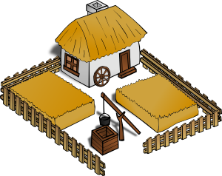
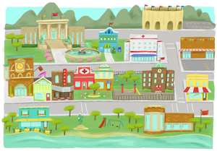
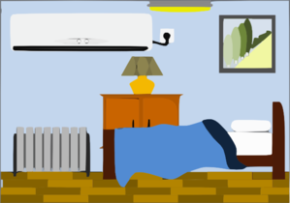
Vocabulary introduction
Vocabulaire
Trouve l’intrus!
1.
4.
le
le
la
le
la
la
??
2.
5.
le
la
le
la
le
le
3.
6.
der
la
la
le
la
la
le
Victoria Hobson / Emma Marsden
Notes:
Presentation/introduction to the nouns from the tasks that follow.
Here, pupils find the odd one out by identifying the gender of each noun.

Slide 25
Grammar
Avoid working with whole paradigms
Learner’s attention is a limited resource!
Focus on one form juxtaposed with another
Provide plenty of practice for each pair of forms
‘Trap the form’: Remove ‘cues’ so learners focus on the target feature
Gradually build up wider system
Rowena Kasprowicz / Emma Marsden
Notes:
Building on the work of Bill VanPatten, (e.g., https://oasis-database.org/concern/summaries/9019s2443?locale=en), researchers have experimented by practising in the input (L & R) many ‘harder to reach’ grammar features, which learners typically don’t just pick up by being asked to understand the main details of a text containing the target feature. Evidence suggests benefits for:
Improving analysis of language
‘Training the ear’ to notice small phonemic differences (e.g. je / j’ai)
Improving comprehension and production
A range of ages, proficiencies, languages, grammar features

Slide 26
GRAMMAR
Upfront explanation of one feature
force students to attach meaning to feature
contrasting pairs of grammar features
activities that make feature ‘essential’
DeKeyser, R. (2005). What makes second-language grammar learning difficult? A review of issues. Language Learning, 55, 1-25. https://doi.org/10.1111/j.0023-8333.2005.00294.x
DeKeyser, R. (2015). Skill acquisition theory. In B. VanPatten & J. Williams (Eds.), Theories in second language acquisition: An introduction (pp. 94–112). London, UK: Routledge.
DeKeyser, R., & Prieto Botana, G. (2015). The effectiveness of processing instruction in L2 grammar acquisition: A narrative review. Applied Linguistics, 36, 290–305. Ellis, N. (2006). Selective attention, and transfer phenomena in L2 acquisition: Contingency, cue competition, salience, interference, overshadowing, blocking, and perceptual learning. Applied Linguistics, 27(2), 164-194. Lichtman, K. (2016). Age and learning environment: Are children implicit second language learners? Journal of Child Language, 43, 707-730. https://doi.org/10.1017/S0305000915000598 Marsden, E. (2006). Exploring input processing in the classroom: An experimental comparison of processing instruction and enriched input. Language Learning, 56, 507–566. Norris, J. & Ortega, L. (2001). Does type of instruction make a difference? Substantive findings from a meta-analytic review. Language Learning, 51, 157-213. https://doi.org/10.1111/j.1467-1770.2001.tb00017.x VanPatten, B. (2002). Processing instruction: An update. Language Learning, 52(4), 755-803.

Slide 27
You are getting to know some French students online. But @usernames don’t tell you if the person is male or female. Look carefully at the adjective. Write 1-8 and M (male) or F (female).
Lire
1)
je suis francais et grand
@fortnightmegafan
5)
je suis petite et française
@booboo456
Bella
Paul
Elodie
je suis anglaise et petite
@moviestar
je suis anglais et petit
@fashionista
2)
6)
Isobella
Ludovic
Chloe
Martin
3)
je suis grand et anglais
@coolkat
je suis anglaise et grande
@luvtoshop
7)
Didier
Coco
Emilie
Eddie
4)
je suis petit et français
@sportster91
je suis grande et française
@crazeeTee
8)
David
Amie
Toby
Thalia
Victoria Hobson
Notes:
Instructions
You and your friends are getting to know some French students online. But @usernames don’t tell you if the person is male or female. Work out who has written each message. Look carefully at the adjective. Write 1-8 and M or F.

Slide 28
Lire
A French blog writer interviews you and your friends by email about teenage life in England. But the email got corrupted. Decide if the sentences could be statements about something they know already (write S) or have to be questions (write Q), so you can reply with your answers. Remember that when the verb and subject swap, it must be a question. For all questions, answer with ‘oui’ or ‘non’ to say whether this is something you and your friends do.
.
 |  | Q/S | oui/non |  |  | Q/S | oui/non
1 | Jouez - vous au foot |  |  | 7 | Parlez - vous français
2 | Vous pensez que c’est vrai |  |  | 8 | Comprenez - vous la question
3 | Vous demandez la raison |  |  | 9 | Vous mangez des fruits
4 | Allez - vous en ville |  |  | 10 | Vous préparez le dîner
5 | Avez - vous un animal |  |  | 11 | Vous sortez ce weekend
6 | Vous aimez le chocolat |  |  | 12 | Voulez - vous sortir ce weekend
Q
Q
S
Q
S
S
Q
S
Q
S
S
Q
Victoria Hobson / Emma Marsden
Notes:
Punctuation has been removed here so that students have no other clue apart from the verb. Asking learners to write ‘oui’ or ‘non’ where the sentence is a question adds the element of reading for meaning at this stage, as well as identifying the statement or question.
To complete the task, students can work from the board, writing 1-12, Q or S, Oui / Non. Alternatively, the following two slides can be used to print student A5 copies.
Verb frequency rankings (1 is the most common word in French): jouer (219); penser (116); demander (80); aller (53); aimer (242); parler (106); comprendre (95); manger (1338); préparer (368); sortir (309); vouloir (57).
Source: Londsale, D., & Le Bras, Y. (2009). A Frequency Dictionary of French: Core vocabulary for learners London: Routledge.

Slide 29
Hören
Im Zoo
You are visiting the zoo. The zookeeper is telling you all about
the animals they have. But the animals are noisy!
Can you tell whether the zookeeper is talking about one or more than one of the animals?
Remember to pay attention to the ending of the verb.
Inge Alferink
Notes:
The script is a tour around a zoo. The zookeeper / tour guide provides a set of statements about different animals.
The start of the sentence (i.e. the noun phrase) is obscured by animal sounds.
The students circle a picture of a single animal or multiple animals depending on whether the statement is singular or plural.
Any strong verbs are plural, so as not to overcomplicate at this stage.
Verb frequency rankings (1 is the most common word in German): essen (655); spielen (197); rennen (2558); schlafen (787); trinken (609)
Source: Jones, R.L., & Tschirner, E. (2006 ). A Frequency Dictionary of German. Routledge
Transcript
Eins. Die Affen essen gern Bananen.
Zwei. Die Elefanten spielen gern Fußball.
Drei. Das Zebra rennt ganz schnell.
Vier. Die Giraffen schlafen viel.
Fünf. Der Löwe trinkt Wasser.

Slide 30
Hören
1
A
B
Inge Alferink
Notes:
Eins. [general zoo background noise] [BLEEP] essen gern Bananen.
[TRANSCRIPT: Die Affen essen gern Bananen]

Slide 31
Hören
2
A
B
Inge Alferink
Notes:
Zwei. [general zoo background noise] [BLEEP] spielen gern Fußball.
[TRANSCRIPT: Die Elefanten spielen gern Fußball]

Slide 32
Hören
3
A
B
Inge Alferink
Notes:
Drei. [general zoo background noise] [BLEEP] rennt ganz schnell.
[TRANSCIPT: Das Zebra rennt ganz schnell]

Slide 33
Hören
4
A
B
Inge Alferink
Notes:
Vier. [general zoo background noise] [BLEEP] schlafen viel.
[TRANSCRIPT: Die Giraffen schlafen viel.

Slide 34
Hören
5
A
B
Inge Alferink
Notes:
Fünf. [general zoo background noise] [BLEEP] trinkt Wasser.
[TRANSCRIPT: Der Löwe trinkt Wasser.]

Slide 35
The talk covered…
1/ What is NCELP?
2/ The Scheme of Work
3/ Core language knowledge and resources
4/ How can I use NCELP?

Slide 36
Your next steps?
Reflect upon what NCELP could offer your context. Have follow up discussions with other trainees, and in your school with colleagues and management. Share recordings from Introduction to NCELP online conference?
Succinct A4 overview flyer available (for SLT!)?
Explore our website and our Resource Portal – SoW, Resources and CPD sessions including screencasts?
Explore www.thenational.academy video lessons?
Join the NCELP mailing list for regular bulletins of new research-informed resources arriving on the portal?
Sign up to get monthly alerts to summaries of new research, from OASIS at https://oasis-database.org?
Get in touch with enquiries@ncelp.org for any questions!

Slide 37
Questions and comments
Any questions and comments?

