Slide 1
Talking about a thing or person
definite article (le, la)
s-liaison
SSC [en/an]
Y7 French
Term 1.1 - Week 6 - Lesson 11
Victoria Hobson / Rachel Hawkes / Catherine Morris
Artwork by: Chloé Motard
Date updated: 28/07/21
Notes:
Learning outcomes (lesson 1):
Introduction of SSC [en/an]
Introduction of definite articles le and la
Introduction of s-liaison
Word frequency (1 is the most frequent word in French):
7.1.1.6 (introduce) acteur [1152], actrice [1152], anglais² [784], fille¹ [629], français² [251], garçon [1599], médecin [827], mot [220], personne¹ [84], phrase [2074], le [1], la [1], les [1], en¹ [7]
7.1.1.2 (revisit) est [5], il1 [13], elle1 [38], amusant [4695], calme [1731], content [1841], intelligent [2509], malade [1066], méchant [3184], triste [1843], mais [30], ou [33], merci [1070]
Source: Londsale, D., & Le Bras, Y. (2009). A Frequency Dictionary of French: Core vocabulary for learners London: Routledge.

Slide 2
en/an
enfant
Notes:
Timing: 1 minute
Aim: To introduce SSC [en/an]
Procedure: 1. Present the letter(s) and say the [en/an] sound first, on its own. Students repeat it with you. 2. Bring up the word ”enfant” on its own, say it, students repeat it, so that they have the opportunity to focus all of their attention on the connection between the written word and its sound.
3. A possible gesture for this would be to mime patting a child on the head/back 4. Roll back the animations and work through 1-3 again, but this time, dropping your voice completely to listen carefully to the students saying the [en/an] sound, pronouncing ”enfant” and, if using, doing the gesture.
Word frequency (1 is the most frequent word in French):
enfant [126]. Source: Londsale, D., & Le Bras, Y. (2009). A Frequency Dictionary of French: Core vocabulary for learners London: Routledge.

Slide 3
en/an
enfant
Notes:
With sound and no pictures to focus all attention on the sound-symbol correspondence.

Slide 4
en/an
enfant
Notes:
Without sound to elicit pronunciation (without first hearing the teacher).
Teacher to elicit pronunciation by asking “Comment dit-on …"

Slide 5
en/an
grand
quand ?
?
enfant
penser
encore
prendre
[to take]
Notes:
Timing: 2 minutes
Aim: To introduce SSC [en/an]
Procedure:
1. Introduce and elicit the pronunciation of the individual SSC [en/an] and then the source word again ‘enfant’ (with gesture, if using). 2. Then present and elicit the pronunciation of the five cluster words.
The cluster words have been chosen for their high-frequency, from a range of word classes, with the SSC (where possible) positioned within a variety of syllables within the words (e.g. initial, 2nd, final etc.). Additionally, we have tried to use words that build cumulatively on previously taught SSCs (see the Phonics Teaching Sequence document) and do not include new SSCs. Where new SSCs are used, they are often consonants which have a similar symbol-sound correspondence in English.
Word frequency (1 is the most frequent word in French): grand [59]; quand [119] penser [116]; prendre[43]; encore [51]; enfant [126]. Source: Londsale, D., & Le Bras, Y. (2009). A Frequency Dictionary of French: Core vocabulary for learners London: Routledge.

Slide 6
en/an
grand
quand ?
enfant
penser
encore
prendre
Notes:
With sound and no pictures to focus all attention on the sound-symbol correspondence.

Slide 7
en/an
grand
quand ?
enfant
penser
encore
prendre
Notes:
Without sound to elicit pronunciation (without first hearing the teacher).
Teacher to elicit pronunciation by asking “Comment dit-on …"

Slide 8
Phonétique
écouter
Tally how many times you hear SSC [en/an].
 |  | C’est un grand enfant.
 |  | La fille anglaise aime les enfants.
 |  | Tu vas chez le médecin quand ?
 |  | Je fais attention quand je mange
a
[That’s a tall child.]
b
[the English girl likes the children]
c
[when are you going to the doctor?]
d
[I’m careful when I eat.]
Notes:
Timing: 3 minutes
Aim: Aural identification of SSC [en/an] in sentences.
Procedure:
Click on the numbers to play audio. Tell students they won’t understand the meaning of the sentences, they just need to listen out for the sound.
Students tally the number of times they hear the SSC [en/an].
On clicks, transcriptions of the sentences appear. Students use these to check their answers.
On a final round of clicks, English translations appear.
Transcript
a) C’est un grand enfant.
b) La fille anglaise aime les enfants.
c) Tu vas chez le médecin quand ?
d) Je fais attention quand je mange.
Word frequency of unknown words used (1 is the most frequent word in French): enfant [126], aimer [242], aller [53], chez [206], médecin [827], quand [119], faire [25], attention [482], quand [119], manger [1338]
Source: Londsale, D., & Le Bras, Y. (2009). A Frequency Dictionary of French: Core vocabulary for learners London: Routledge.

Slide 9
Phonétique
SFC
lire / parler
dangereux
60
sentiment
client
danse
performance
existence
probablement
défense
secondes
parent
influence
plan
tendance
document
0
transparent
central
DÉBUT
Notes:
Timing: 5 minutes for 3 slides
Aim: To correctly pronounce unknown words containing [en/an] in decreasing amounts of time, helping automisation of SSC production. Awareness raising of cross-linguistic pronunciation differences. The words chosen are cognates which otherwise contain sounds that are equivalent (or very similar) to English SSCs, as well as known SSCs, so that students can focus fully on [en/an] (allowances are made for English pronunciation of [r], which is covered in year 8).
Procedure:
1. Students pair up.
2. Teacher starts timer.
3. Student A tries to say the words without pronouncing [en/am] the English way.
4. Student B listens and makes speaker pause for 3 seconds every time an English pronunciation creeps in!
5. Swap roles.
6. The student who says the most words correctly is the winner!
7. Click on the word to hear pronunciation by a native speaker. Students repeat.
8. Check understanding of words.
9. Move onto the next slide.
Transcript and word frequency (1 is the most frequent word in French): sentiment [886], probablement [903], client [917], défense [938], transparent [2953], central [992], document [997], influence [1083], parent [546], existence [1153], tendance [1158], plan [164], dangereux [713], danse [2964], performance [2559]
Source: Londsale, D., & Le Bras, Y. (2009). A Frequency Dictionary of French: Core vocabulary for learners London: Routledge.

Slide 10
Phonétique
SFC
lire / parler
dangereux
45
sentiment
client
danse
performance
existence
probablement
défense
secondes
parent
influence
plan
tendance
document
0
transparent
central
DÉBUT
Notes:
As previous but with 15 fewer seconds on the timer.

Slide 11
Phonétique
SFC
lire / parler
dangereux
30
sentiment
client
danse
performance
existence
probablement
défense
secondes
parent
influence
plan
tendance
document
0
transparent
central
DÉBUT
Notes:
As previous but with 15 fewer seconds on the timer again.

Slide 12
Vocabulaire
The word for actor has a different feminine form:
un acteur, une actrice
The word for doctor doesn’t change:
un médecin, une médecin
Vocabulaire
écouter
Lis les phrases en anglais. Écoute. Écris A, B ou C.
A | B | C
The male actor speaks English | The female actor speaks English | She is an English actor
The word ‘girl’ is feminine | The word ‘person’ is feminine | The word ‘sentence’ is feminine
The female doctor listens to the boy | The male doctor listens to the boy | The girl listens to the boy
The girl is speaking in English | The girl speaks English | The person is speaking in English
1
v
2
3
4
Notes:
Timing: 3 minutes
Aim: To aurally identify sentences containing words from this week’s vocabulary set.
Procedure:
1. Click on a number to hear a French sentence read out. They have seen the short forms of parler and écouter in the written form in previous task instructions but have not yet encountered the spoken form. You may wish to present these before beginning the exercise.
2. Students write 1-4 and A, B, or C.
3. Ask: ‘C’est phrase A, B ou C?’
4. Click to reveal answers.
5. Click to display an info bubble drawing attention to the male and female forms of job titles introduced this week.
6. Optional extension for advanced levels: translated some of the distractor sentences into English. Students will need some extra help with the short forms of verbs, and with the near cognate féminin.
Transcript:
1. L’actrice parle anglais.
2. Le mot 'phrase' est féminin.
3. La médecin écoute le garçon.
4. La fille parle en anglais.
Word frequency of unknown near-cognates used (1 is the most frequent word in French): féminin [2381]
Source: Londsale, D., & Le Bras, Y. (2009). A Frequency Dictionary of French: Core vocabulary for learners London: Routledge.

Slide 13
Gender in French
grammaire
We already know that all nouns (e.g., words for things, people, countries) have a gender in French. All nouns are either masculine or feminine.
Masculine
Feminine
a dog
la
chambre
un
chien
the dog
une
a bedroom
le
the bedroom
un
a book
la
the thing
le
chose
the book
a thing
livre
une
un
le
portable
the mobile
a mobile
une
the ruler
règle
la
a ruler
To say a or an in French before a noun, you use un or une, according to whether the noun is masculine or feminine.
To say the in French before a noun, you use le or la, according to whether the noun is masculine or feminine.
Stephen Owen
Notes:
Timing: 2 minutes
Aim: To the definite articles with the indefinite forms, and to understand the usage of each.

Slide 14
Vocabulaire
Le ou la ?
lire
fille
voiture
médecin
professeur
chose
règle
chambre
chanteur
chien
livre
personne
femme
vélo
garçon
le
la
Notes:
Timing: 3 minutes
Aim: Presentation/introduction to the definite articles for active nouns in the tasks that follow.
Procedure:
Click to reveal a word. Read it aloud. Students repeat.
Students predict to which word for ‘the’ each noun will fly to on a click – le or la? NB: it is anticipated that the meaning of many/most of these nouns will be known, as many are included as from previous vocab sets/for pre-learning for this lesson and will have been encountered and practised for pronunciation, meaning and gender, but not with the matching word for ‘the’.

Slide 15
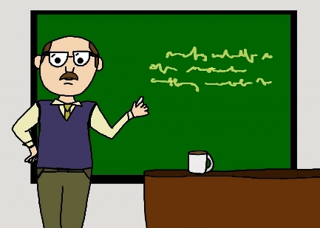
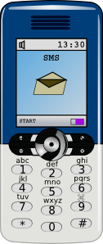
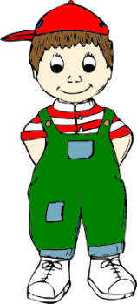
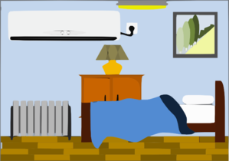
Vocabulaire
Le ou la ?
parler
Vocabulaire
le
le
la
Notes:
Timing: 3 minutes
Aim: Recall of vocabulary for the active nouns in the tasks that follow, revision of their definite articles.
Procedure:
Click to reveal a picture. Students say the French aloud.
Students predict to which word for ‘the’ each noun will fly to on a click – le or la? NB: it is anticipated that the meaning of many/most of these nouns will be known, as many are included as from previous vocab sets/for pre-learning for this lesson and will have been encountered and practised for pronunciation, meaning and gender, but not with the matching word for ‘the’.

Slide 16
Vocabulaire
Trouve l’intrus !
parler
A
D
le
le
la
le
la
la
B
E
le
la
le
la
le
le
C
F
der
la
la
le
la
la
le
Notes:
Timing: 3 minutes
Aim: To identify the odd one out by identifying the gender of each noun.
Procedure:
See if students can infer what to do from the near cognate intrus in the task instructions.
Call letters A-E and ask ‘C’est qui, l’intrus ?’
Students answer with the French word.
Click to reveal answers and articles.
Word frequency of unknown words used in title (1 is the most frequent word in French): trouver [83], intrus [>5000]
Source: Londsale, D., & Le Bras, Y. (2009). A Frequency Dictionary of French: Core vocabulary for learners London: Routledge.

Slide 17
Langue ou adjectif ?
grammaire
You have already met the words anglais and français, used to describe people:
J’ai un ami anglais. J’ai une amie française.
I have an English (male) friend. I have a French (female) friend.
We add –e to these adjectives to show whether they describe male or female people.
When used with a definite article, anglais and français are nouns, meaning languages:
L’anglais, c’est difficile ! Le français, c’est intéressant!
English is difficult! French is interesting!
We don’t use an article with languages in English, but we normally do in French.
Exception! no article after parler and en: Elle parle anglais. Écris en français.
Notes:
Timing: 23 minutes
Aim: To raise awareness of differences in the forms as uses of vocabulary items l’anglais, anglais(e), le français and française.
Word frequency of unknown near-cognates used (1 is the most frequent word in French): langue [712], adjectif [>5000], difficile [296]
Source: Londsale, D., & Le Bras, Y. (2009). A Frequency Dictionary of French: Core vocabulary for learners London: Routledge.

Slide 18
Le ou la
Masculin ou féminin ?
lire
Vocabulaire
Lis les phrases et choisis le mot correct. Look carefully at the word for ‘the’!
 |  | A | B
1 | La | chanteur | fille | parle français.
2 | Le | français | chose | , c’est intéressant !
3 | Le | vélo | voiture | est rapide.
4 | La | professeur | personne | a un chien
5 | La | chambre | chien | est calme.
6 | Le | fille | médecin | a une idée.
7 | La | voiture | livre | est moderne.
8 | Le | femme | garçon | parle anglais.
Notes:
Timing: 5 minutes
Aim: Written recognition of definite articles. Connecting written form with meaning.
Procedure:
1. Students write 1-8 in their books.
2. Students read the sentences and decide whether which noun is being described. Tell them they need to look at the definite article to get this information. As only adjectives which are identical in the masculine and feminine forms are included, they will not find any clues in the second half of the sentence!
3. Click to reveal answers.
4. Aske students for the meanings of the sentences in English.
Word frequency of unknown cognates used in task instructions (1 is the most frequent word in French): choisir [226], correct [2617], masculine [3741], féminin [2381]
Source: Londsale, D., & Le Bras, Y. (2009). A Frequency Dictionary of French: Core vocabulary for learners London: Routledge.

Slide 19
Le ou la
Masculin ou féminin ?
écouter
Vocabulaire
Écoute. Choisis le mot correct.
Le / La ? |  | Extra details
le / la | femme / professeur
le / la | chien /voiture
le / la | fille / médecin
le / la | fille / chien
le / la | garçon / fille
le / la | professeur / femme
le / la | chanteur / chambre
le / la | voiture / chien
1
is nice
2
is fast
3
speaks French
4
is ill
5
has a pet / animal
6
is English
7
has a computer
8
is fast
Notes:
Timing: 5 minutes
Aim: Aural recognition of definite articles. Connecting written form with meaning.
Procedure:
Click on a number to hear a sentence with the noun obscured.
Students write 1-8 and the word to which the article refers, along with any additional information they hear.
Click to reveal answers.
Transcript
1) La [femme] est sympa.
2) Le [chien] est rapide.
3) Le [médecin] parle français.
4) La [fille] est malade.
5) Le [garçon] a un animal.
6) Le [professeur] est anglaise.
7) La [chambre] a un ordinateur.
8) La [voiture] est rapide.
Word frequency of unknown cognates used in task instructions (1 is the most frequent word in French): choisir [226], correct [2617], masculine [3741], féminin [2381]
Source: Londsale, D., & Le Bras, Y. (2009). A Frequency Dictionary of French: Core vocabulary for learners London: Routledge.

Slide 20
Parler
Partenaire A - script
parler / écrire
Vocabulaire
[ The boy ] a un animal.
[ The woman ] parle anglais.
[ The bedroom ] est moderne.
[ The car ] est rapide.
[ The doctor ] est calme.
Notes:
Timing: 10 minutes
Aim: Oral production and aural recognition of definite articles.
Procedure:
1. Students pair up. Partner A faces the board, partner B turns away with a copy of their role card on paper or a separate screen (see the following slide).
2. Partner A reads each sentence to their partner but does not say out loud the word that is crossed out.
3. Partner B ticks the noun that matches the word for the that partner A said. They then write the rest of the sentence in the appropriate gaps.
4. Partner B turns back and checks their solution against the answer slide.
5. Students swap roles.

Slide 21
Parler
Partner B
parler / écrire
Vocabulaire
1.
2.
3.
4.
5.

Slide 22
Parler
Partenaire B - réponses
parler / écrire
Vocabulaire
1.
Le
garçon
a
un
animal.
2.
La
parle
femme
anglais.
3.
La
chambre
moderne.
est
4.
est
La
voiture
rapide.
5.
Le
médecin
est
calme.

Slide 23
Parler
Partenaire B - script
parler / écrire
Vocabulaire
[ The woman ] a un chien.
[ The boy ] est drôle.
[ The singer ] est sympa.
[ The girl ] parle français.
[ The dog ] est calme.

Slide 24
Parler
Partner A
parler / écrire
Vocabulaire
1.
2.
3.
4.
5.

Slide 25
Parler
Partenaire A - réponses
parler / écrire
Vocabulaire
1.
La
femme
a
un
chien.
2.
Le
garçon
est
drôle.
3.
Le
est
chanteur
sympa.
4.
La
fille
parle
français.
5.
Le
chien
est
calme.

Slide 26
Talking about a thing or person
definite article (l’, les)
plural marking on nouns (-s)
SSC [on]
Y7 French
Term 1.1 - Week 6 - Lesson 12
Victoria Hobson / Rachel Hawkes / Catherine Morris
Artwork by: Chloé Motard
Date updated: 06/11/21
Notes:
Learning outcomes (lesson 1):
Introduction of SSC [on]
Introduction of definite articles les and l’
Introduction of plural noun forms (-s)
Word frequency (1 is the most frequent word in French):
7.1.1.6 (introduce) acteur [1152], actrice [1152], anglais² [784], fille¹ [629], français² [251], garçon [1599], médecin [827], mot [220], personne¹ [84], phrase [2074], le [1], la [1], les [1], en¹ [7]
7.1.1.2 (revisit) est [5], il1 [13], elle1 [38], amusant [4695], calme [1731], content [1841], intelligent [2509], malade [1066], méchant [3184], triste [1843], mais [30], ou [33], merci [1070]
Source: Londsale, D., & Le Bras, Y. (2009). A Frequency Dictionary of French: Core vocabulary for learners London: Routledge.

Slide 27
on
non!
Notes:
Timing: 1 minute
Aim: To introduce SSC [on]
Procedure: 1. Present the letter(s) and say the [on] sound first, on its own. Students repeat it with you. 2. Bring up the word ”non” on its own, say it, students repeat it, so that they have the opportunity to focus all of their attention on the connection between the written word and its sound.
3. A possible gesture for this would be to shake ones head whilst waggling one’s index finger, to indicate ‘no!’ 4. Roll back the animations and work through 1-3 again, but this time, dropping your voice completely to listen carefully to the students saying the [on] sound, pronouncing ”non” and, if using, doing the gesture.
Word frequency (1 is the most frequent word in French):
onze [2447]
Source: Londsale, D., & Le Bras, Y. (2009). A Frequency Dictionary of French: Core vocabulary for learners London: Routledge.

Slide 28
on
non!
Notes:
With sound and no pictures to focus all attention on the sound-symbol correspondence.

Slide 29
on
non!
Notes:
Without sound to elicit pronunciation (without first hearing the teacher).
Teacher to elicit pronunciation by asking “Comment dit-on …"

Slide 30
on
onze
continuer
[to continue]
non!
monde
au fond
montrer
[at the back]
[to show]
Notes:
Timing: 2 minutes
Aim: To introduce SSC [on]
Procedure:
1. Introduce and elicit the pronunciation of the individual SSC [on] and then the source word again ‘non’ (with gesture, if using). 2. Then present and elicit the pronunciation of the five cluster words.
The cluster words have been chosen for their high-frequency, from a range of word classes, with the SSC (where possible) positioned within a variety of syllables within the words (e.g. initial, 2nd, final etc.). Additionally, we have tried to use words that build cumulatively on previously taught SSCs (see the Phonics Teaching Sequence document) and do not include new SSCs. Where new SSCs are used, they are often consonants which have a similar symbol-sound correspondence in English.
Word frequency (1 is the most frequent word in French): onze [2447]; continuer [113] monde [77]; montrer [108]; au fond [553]; non [72]. Source: Londsale, D., & Le Bras, Y. (2009). A Frequency Dictionary of French: Core vocabulary for learners London: Routledge.

Slide 31
on
onze
continuer
non!
monde
au fond
montrer
Notes:
With sound and no pictures to focus all attention on the sound-symbol correspondence.

Slide 32
on
onze
continuer
non!
monde
au fond
montrer
Notes:
Without sound to elicit pronunciation (without first hearing the teacher).
Teacher to elicit pronunciation by asking “Comment dit-on …"

Slide 33
Phonétique
écouter
In which order do you hear the words? Écris ‘1’ ou ‘2’.
e/an
on
__ cent 100
__ son sound
a
1
2
__ en in/by/to
__ on we/one
b
2
1
__ dans in
__ don gift
c
2
1
__ pan part
__ pont bridge
d
1
2
__ sans without
__ sont (they) are
e
1
2
Notes:
Timing: 3 minutes Aim: To differentiate between pairs of words that differ by one phoneme (one SSC that changes the meaning). These words are called minimal pairs. Procedure: 1. Click to listen. 2. Write 1 2 or 2 1 depending on the order in which the words are spoken. 3. Click to see the answers.
Transcript
cent...son
on...en
don...dans
pan...pont
sans...sont

Slide 34
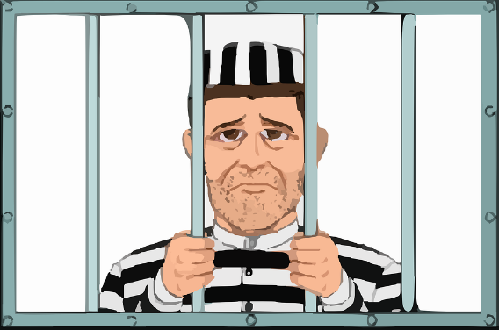
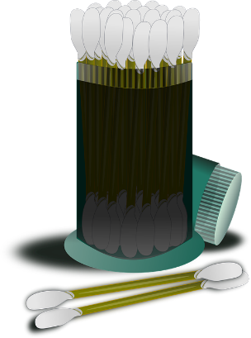
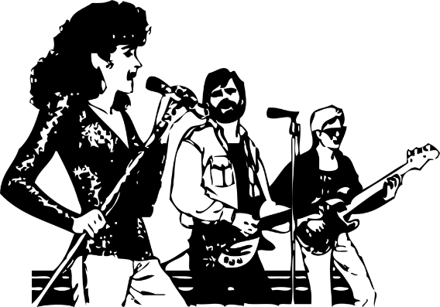
Phonétique
parler
30
These words look like English, but have SSC [on] in French. How do they sound?
prison
blond
contact
opinion
secondes
0
coton
concert
salon
révision
DÉBUT
Notes:
Timing: 3 minutes for 3 slides
Aim: To correctly pronounce cognates and near-cognates containing [on] in decreasing amounts of time, helping automisation of SSC production. Raising awareness of the difference in the English and French pronunciation of this SSC.
Procedure:
Students pair up, and take turns trying to say all the words in 30 seconds (run the timer twice).
Click on the pictures to hear the words pronounced by a native speaker. Students repeat.
Move on to the next slide.
Word frequency (1 is the most frequent word in French): prison [1010], blond [4585], contact [894], opinion [777], coton [4516], concert [1697], salon [2729], revision [2748]
Source: Londsale, D., & Le Bras, Y. (2009). A Frequency Dictionary of French:], Core vocabulary for learners London: Routledge.

Slide 35
Phonétique
parler
20
These words look like English, but have SSC [on] in French. How do they sound?
prison
blond
contact
opinion
secondes
0
coton
concert
salon
révision
DÉBUT
Notes:
As per previous slide, but with ten fewer seconds on the timer.

Slide 36
Phonétique
parler
10
These words look like English, but have SSC [on] in French. How do they sound?
prison
blond
contact
opinion
secondes
0
coton
concert
salon
révision
DÉBUT
Notes:
As per previous slide, but with ten fewer seconds on the timer still.

Slide 37
Vocabulaire
Vocabulaire
lire / parler
 | Word | English meaning
1 | le | the (m)
2 | la | the (f)
3 | les | the (pl)
4 | l’anglais | English language
5 | le français | French language
6 | en | in
7 | la personne | person
8 | la médecin | female doctor
9 | l’acteur | male actor
10 | la phrase | sentence
11 | le mot | word
12 | l’actrice | female actor
Notes:
Timing: 4 minutes Aim: To recall this week’s new vocabulary. Procedure: 1. Click to show the French, recall the English meanings, say them aloud. [1 minute] 2. Click to showthe English, recall the French meanings, saying them aloud. [1 minute] 3. Repeat for two further minutes, to speed up recall.

Slide 38
Making nouns and articles plural
grammaire
To make a noun plural when we are talking about more than one thing, we normally add an -s, like in English:
‘The’ changes to ‘les’, to match the plural noun. This is not like English. ‘Les’(the) is the same for both masculine and feminine nouns.
Masculine
Feminine
les
the
s
chien
s
dog
chambre
s
les
s
the
bedroom
the
livre
les
s
book
s
s
les
chose
s
the
thing
the
s
s
mobile
les
portable
ruler
les
the
s
règle
s
Stephen Owen
Notes:
Timing: 2 minutes
Aim: To highlight similarities and differences in plural noun formation between French and English.

Slide 39
Lire
Grammaire
lire
Vocabulaire
Here is Léa’s diary entry about her school trip to England.
What does she say? Look carefully at the word for ‘the’.
Le / est confortable.
Les / sont sympas.
Les / sont intéressants.
La / est calme.
Le / parle anglais.
La / est amusante.
Les / sont modernes.
Les / sont drôles.
lit
lits
professeurs
professeur
livres
livre
femmes
femme
médecin
médecins
filles
fille
chambres
chambre
chanteur
chanteurs
Notes:
Timing: 5 minutes
Aim: Written recognition of the singular and plural forms of definite articles and connecting form with meaning.
Procedure:
1. Students write 1-8 in their books.
2. Students read the sentences and decide whether which noun is being described. Tell them they need to look at the definite article to get this information. NB: It is recognised that the students could, if they notice, use the singular and plural forms of the verb or the plural adjectival agreement to decide which word would be missing (rather than the singular/plural marking on the article). However, as the article comes first and is the focus of the task, it is unlikely that they will attend to the verbs or adjectives or learn them. Some learners may ‘pick them up’ to some limited extent if they happen to notice them, but incidental exposure like this has been found to be largely ineffective for many learners. We do not recommend that teachers draw attention to these other features unless a student spontaneously notices it and mentions it.
3. Click to reveal answers.
4. Ask students for the meanings of the sentences in English.
Word frequency of unknown cognates used in task instructions (1 is the most frequent word in French): confortable [3964], Source: Londsale, D., & Le Bras, Y. (2009). A Frequency Dictionary of French: Core vocabulary for learners London: Routledge.

Slide 40
Écouter et écrire
Singular or plural
Vocabulaire
écouter / écrire
1
5
personne
médecin
2
6
chanteurs
livres
3
7
vélo
chambre
4
8
voitures
chiens
Notes:
Timing: 3 minutes
Aim: Aural recognition of the singular and plural forms of definite articles and connecting form with meaning.
Procedure:
Click on a number to hear an article said aloud.
Students write 1-8 and the word for what the article refers to in French.
Click to reveal answers and spelling.
Transcript:
la
les
le
les
le
les
la
Les

Slide 41
When a singular noun begins with a vowel or h-
grammaire
When a singular noun begins with a vowel or a h, the word for the (le or la) shortens to l’ (for both masculine and feminine):
Masculine
Feminine
l’
the
actor
acteur
l’
idée
the
idea
l’
enfant
the
child
amie
l’
the
friend
l’
homme
the
man
You don’t say the ‘h-’ at the start of words. It is silent.
So, you only hear the vowel ‘o’.
Stephen Owen
Notes:
Timing: 2 minutes

Slide 42
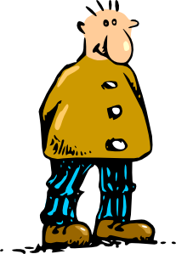
Prononciation
parler
l’animal
l’acteur
l’enfant
l’idée
l’ami
l’amie
l’ordinateur
l’homme
Notes:
Timing: 2 minutes
Aim: To practise the pronunciation of nouns students know so far where l’ is needed, in teacher-led, listen-and-repeat format.
Word frequency of unknown cognates used in title (1 is the most frequent word in French): pronunciation [>5000]
Source: Londsale, D., & Le Bras, Y. (2009). A Frequency Dictionary of French: Core vocabulary for learners London: Routledge.

Slide 43
Lire
Grammaire
lire
Vocabulaire
Lis les phrases et choisis le mot correct. Look carefully at the word for ‘the’!
 |  | A | B | C
1 | L’ | français | anglais | livre | est intéressant!
2 | Le | homme | femme | garçon | a une idée.
3 | La | amie | médecin | fille | est sympa.
4 | Le | chambre | portable | ordinateur | est moderne.
5 | L’ | professeur | acteur | femme | parle anglais.
6 | La | chien | ami | personne | est triste.
7 | L’ | enfant | fille | garçon | a un vélo.
8 | Le | animal | chien | fille | est calme.
Notes:
Timing: 5 minutes
Aim: Written recognition of definite articles and connecting form with meaning.
Procedure:
1. Students write 1-8 in their books.
2. Students read the sentences and decide whether which noun is being described. Tell them they need to look at the definite article to get this information. As only adjectives which are identical in the masculine and feminine forms are included, they will not find any clues in the second half of the sentence!
3. Click to reveal answers.
4. Aske students for the meanings of the sentences in English.
Word frequency of unknown cognates used in task instructions (1 is the most frequent word in French): choisir [226], correct [2617]
Source: Londsale, D., & Le Bras, Y. (2009). A Frequency Dictionary of French: Core vocabulary for learners London: Routledge.

Slide 44
Écris en français !
écrire
Write six sentences in French using these words.
Choose the words for the carefully.
médecin / est
enfant / a
voiture / est
homme / est
ami / a
femme / parle
Le médecin est calme.
L’enfant a un vélo.
La voiture est chère.
L’homme est sympa.
L’ami a une idée.
La femme parle français.
Notes:
Timing: 5 minutes
Aim: Structured writing exercise requiring written production of the definite article.
Procedure:
1. Students write sentences with the nouns and verbs given. At more advanced levels, encourage use of additional adjectives to add flavour (this will require a reminder of agreement rules).
2. Click to reveal a suggested solution.
3. Collect further solutions from students and add them to this slide.

Slide 45
Le, la, l’ ou les ? (1/12)
parler
___
la voiture
Notes:
Timing: 3 minutes for 12 slides.
Aim: To bring all the learning on the together through a series of quick production activities.
Procedure:
1. Explain to students that you are now going to practise all four words for the.
2. On this and the slides that follow, a mixture of singular and plural nouns are presented. Students decide which form of the definite article is needed and say it out loud with the noun.
3. The choral response allows the teacher to give immediate feedback. Reveal answer on a click.

Slide 46
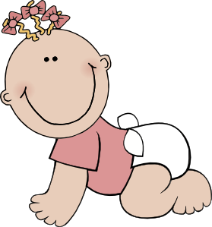
Le, la, l’ ou les ? (2/12)
parler
___
l’enfant

Slide 47
Le, la, l’ ou les ? (3/12)
parler
___
l’homme

Slide 48
Le, la, l’ ou les ? (4/12)
parler
___
les personnes

Slide 49
Le, la, l’ ou les ? (5/12)
parler
___
le chanteur

Slide 50
Le, la, l’ ou les ? (6/12)
parler
___
l’acteur

Slide 51
Le, la, l’ ou les ? (7/12)
parler
___
les vélos

Slide 52
Le, la, l’ ou les ? (8/12)
parler
Le, la, l’, les?
___
l’idée

Slide 53
Le, la, l’ ou les ? (9/12)
parler
___
la chambre

Slide 54
Le, la, l’ ou les ? (10/12)
parler
___
le portable

Slide 55
Le, la, l’ ou les ? (11/12)
parler
___
les règles

Slide 56
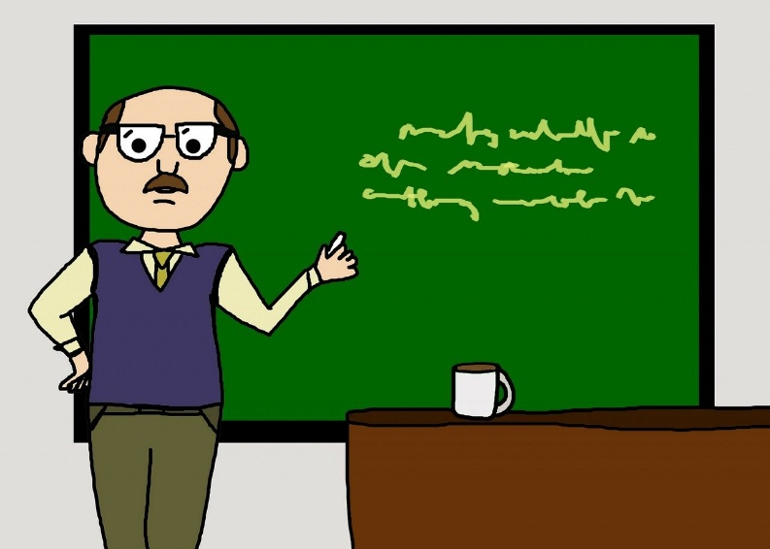
Le, la, l’ ou les ? (12/12)
parler
___
le professeur

Slide 57
La liaison
écouter
You have met liaison before, with c’est
C’est un ordinateur.
Voici les règles. Here are the rulers.
The final –s in les is a Silent Final Consonant.
But …
Voici les ordinateurs. Here are the computers.
This time, the final consonant in les is not an SFC!
Because the -s is followed by a vowel, it is pronounced.
This pronunciation change is known as liaison.
Notes:
Timing: 2 minutes
Aim: Introduction to the –s liaison.
You may wish to ask students where they have seen this phenomenon before, before revealing the final info bubble on a click.

Slide 58
La liaison
écouter
les garçons
the boys
Notes:
Listen and repeat.

Slide 59
La liaison
écouter
les actrices
the female actors
Notes:
Timing: 3 minutes for 10 slides [audio missing]
Aim: to introduce the concept of s-liaison before a vowel after les.
Procedure:
Listen and repeat.
Highlight that this sounds like one word, rather than two

Slide 60
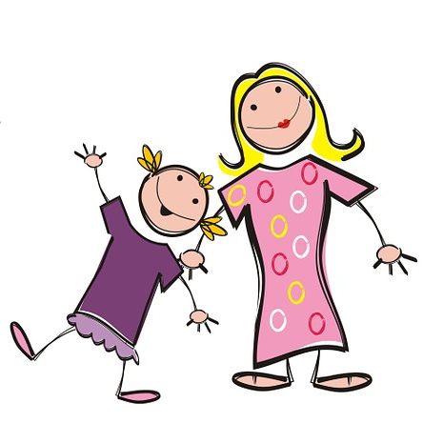
La liaison
La liaison
écouter
Les filles écoutent la radio.
The girls are listening to the radio.
Notes:
1. Listen and repeat.
2. Ask students to translate the sentence.
3. Reveal picture on a click, ask students to check their translations.
4. Reveal English translation on click.

Slide 61
La liaison
La liaison
écouter
Les amis écoutent la radio.
The friends are listening to the radio.
Notes:
1. Listen and repeat.
2. Ask students to translate the sentence.
3. Reveal picture on a click, ask students to check their translations.
4. Reveal English translation on click.

Slide 62
La liaison
La liaison
écouter
Les personnes parlent anglais.
The people speak English.
Notes:
1. Listen and repeat.
2. Ask students to translate the sentence.
3. Reveal picture on a click, ask students to check their translations.
4. Reveal English translation on click.

Slide 63
La liaison
La liaison
écouter
Les acteurs parlent anglais.
The actors speak English.
Notes:
1. Listen and repeat.
2. Ask students to translate the sentence.
3. Reveal picture on a click, ask students to check their translations.
4. Reveal English translation on click.

Slide 64
La liaison
La liaison
écouter
Voici les médecins.
Here are the doctors.
Notes:
1. Listen and repeat.
2. Ask students to translate the sentence.
3. Reveal picture on a click, ask students to check their translations.
4. Reveal English translation on click.

Slide 65
La liaison
La liaison
écouter
Voici les ordinateurs.
Here are the computers.
Notes:
1. Listen and repeat.
2. Ask students to translate the sentence.
3. Reveal picture on a click, ask students to check their translations.
4. Reveal English translation on click.

Slide 66
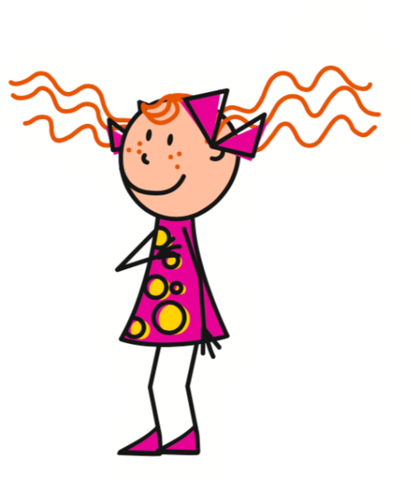
La liaison
La liaison
écouter
Elle a les livres.
She has the books.
Notes:
1. Listen and repeat.
2. Ask students to translate the sentence.
3. Reveal picture on a click, ask students to check their translations.
4. Reveal English translation on click.

Slide 67
La liaison
La liaison
écouter
Elle a les idées.
She has the ideas.
Notes:
1. Listen and repeat.
2. Ask students to translate the sentence.
3. Reveal picture on a click, ask students to check their translations.
4. Reveal English translation on click.

Slide 68
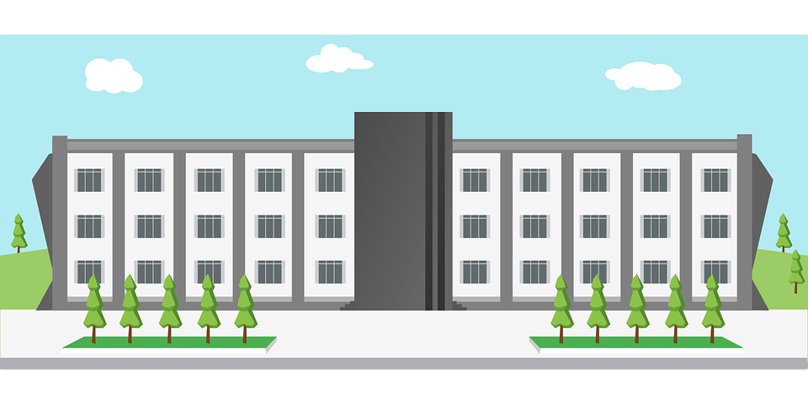
La liaison
écouter
Léa is giving you a tour of her school.
What is she showing you?
Écoute!
1
Voici les … garçons / ordinateurs.
2
Voici les … filles / acteurs.
3
Voici les … professeurs / actrices.
4
Voici les … ordinateurs / vélos.
5
Voici les … personnes / amies.
6
Voici les … livres / amis.
7
Voici les … chanteurs / actrices.
8
Voici les … règles / idées.
Notes:
Timing: 5 minutes
Aim: To detect the presence or absence of an s-liaison with les, and connect this with meaning.
Procedure:
Students write 1-8.
Click on a button to hear a form of ‘voici les’, followed by a beep.
Based on the presence or absence of a liaison, students decide what comes next. Remind them it is the presence or absence of a -s- sound that will give them this information.
Click to check.
Full audio can be found on the next slide.
Transcript
1. Voici les [garçons].
2. Voici les [acteurs].
3. Voici les [professeurs].
4. Voici les [ordinateurs].
5. Voici les [amies].
6. Voici les [livres].
7. Voici les [actrices].
8. Voici les [règles].

Slide 69
La liaison
écouter
Léa is giving you a tour of her school.
What is she showing you?
Écoute!
1
Voici les … garçons / ordinateurs.
2
Voici les … filles / acteurs.
3
Voici les … professeurs / actrices.
4
Voici les … ordinateurs / vélos.
5
Voici les … personnes / amies.
6
Voici les … livres / amis.
7
Voici les … chanteurs / actrices.
8
Voici les … règles / idées.
Notes:
Full audio for the exercise on the previous slide.
Transcript
1. Voici les garçons.
2. Voici les acteurs.
3. Voici les professeurs.
4. Voici les ordinateurs.
5. Voici les amies.
6. Voici les livres.
7. Voici les actrices.
8. Voici les règles.

Slide 70
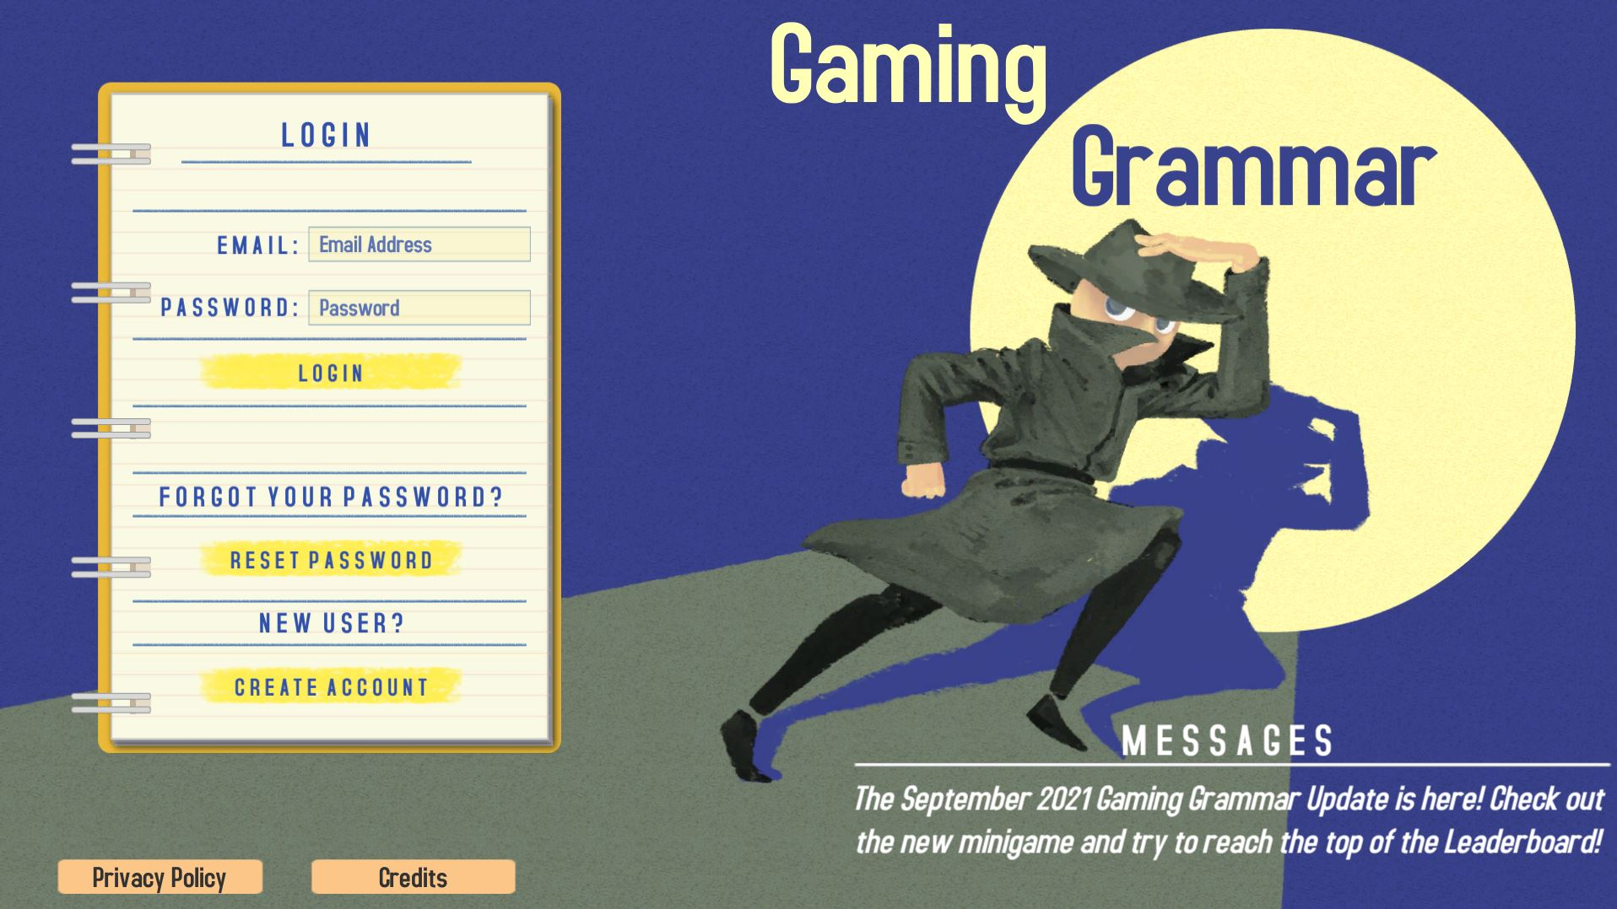
Gaming Grammar
Gaming Grammar
Relevant mini game(s):
Definite articles: Gender (Article Agreement)
Articles: Number (Article Agreement)
To have and to be: 1st person and 3rd person singular
Notes:
This slide links to Gaming Grammar login screen. The appropriate mission can then be selected from the menu page.
Students will progress through the game at their own rate; teachers should use the teacher interface to check progress. This will help to inform future lesson planning.

Slide 71
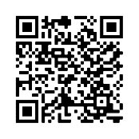
Devoirs
Vocabulary Learning Homework (Y7, Term 1.1, Week 7)
Audio file
Audio file QR code:
Student worksheet
Quizlet link
In addition, revisit: Term 1.1 Week 4

