Slide 1
Examples
Examples
production
Interpreting tasks (speaking)
Notes:
7.1.1.1
Speaking activity
Timing: 10 minutes
Aim: to use sentences with ‘estoy’ and ‘está’ in oral production
Procedure:
See separate set of cards (word doc) Students play the game as described below:
1 Separate the cards into two piles – verbs and cities.
2 Partner A picks a verb and then a city, says the Spanish sentence. 3 Partner B translates into English. 4 Players then swap roles. If pairs time themselves, they can then repeat the activity to see how quickly they can complete all the sentences and translations. With each new game, different sentences will be generated.
Note: Students could make these cards themselves i.e. fold A4 paper so it makes 12 rectangles - write 'I' x 3, he/she x 3, (this will be a cue/prompt to recall the correct verb in Spanish), then 6 cities that they remember. They could all do this so that they have 24 playing cards in total, when put together. This is good practice for spelling / memory / sounding out city names as they write them.

Slide 2
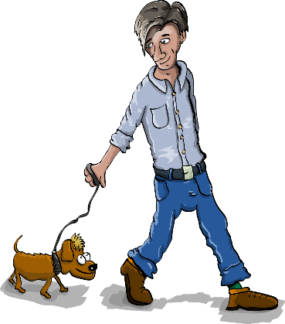
C’est qui ?
parler
Exemple:
A: Est-ce que c’est un garçon ?
B: Oui, c’est un garçon.
B: Oui, il est grand.
A: Est-ce qu’il est grand ?
B: Non, il a un chien !
A: Est-ce qu’il a un fruit ?
Jacques
B: Oui, c’est Jacques !
A: Est-ce que c’est Jacques ?
Notes:
8.1.1.2
Timing: 7 minutes
Aim: To practise production (spoken modality) of questions using est-ce que and 3rd person singular forms of avoir and être, in the context of a ‘guess who’ game. The slide following this one should be displayed during the activity.
Procedure:
1. Student B selects a character, without revealing their identity.
2. Student A asks a question such as that shown in the example on this slide. By asking questions about whether the character is a girl/boy, is big/small and has a dog/fruit or not, student a can try to home in on the identity of the chosen character.
3 Student B responds to the question.
4. Continue until the character is guessed correctly (N.B. students must ask at least 3 questions before making a guess, and cannot guess twice in a row).
5. Swap roles and play again.

Slide 3
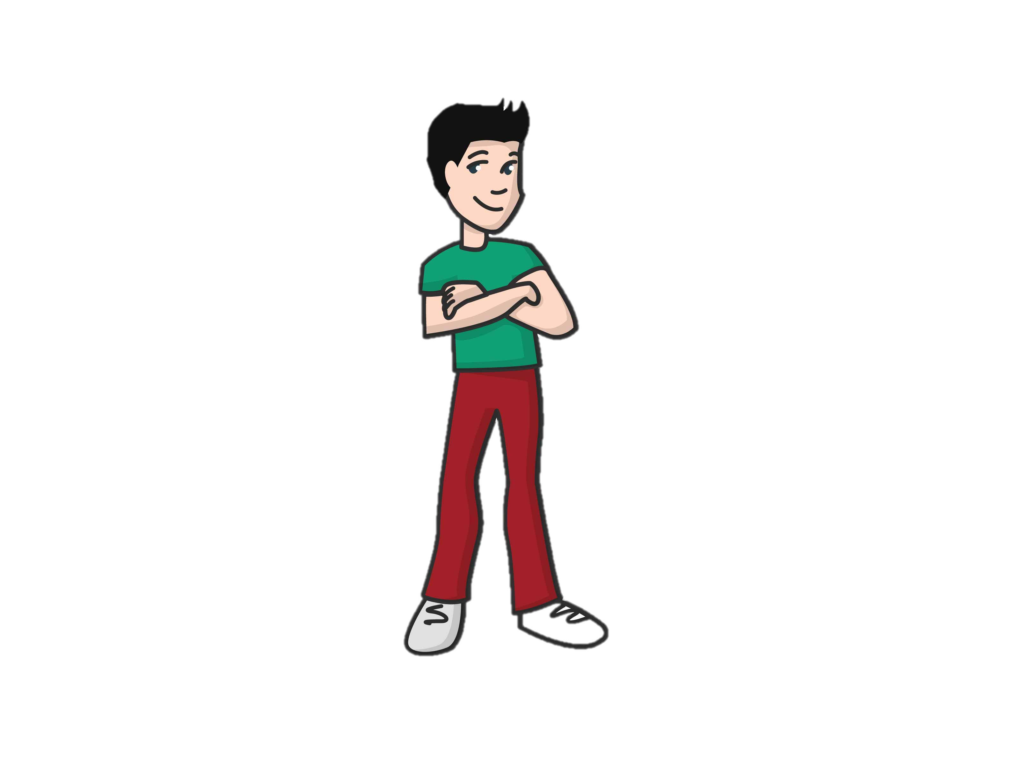
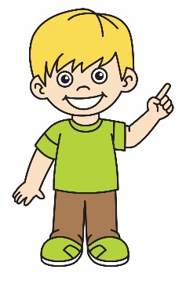
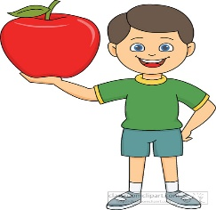
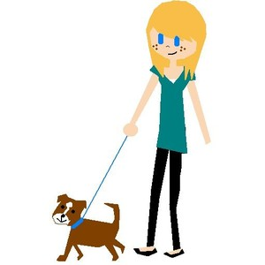
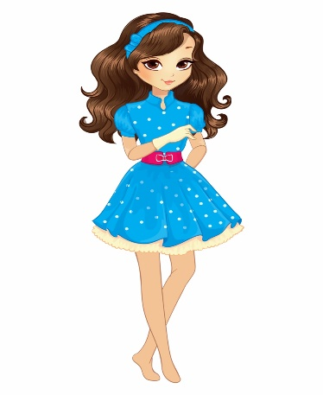
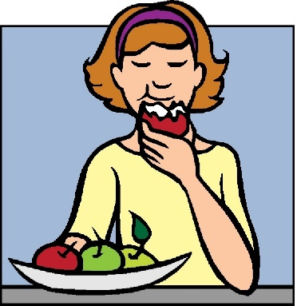
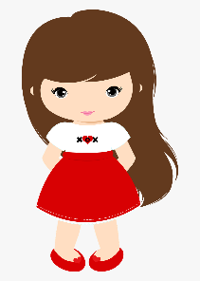
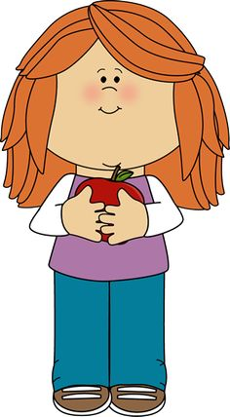
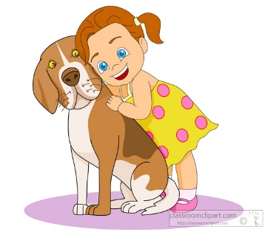
Jacques
Max
Pierre
Raoul
Hakim
Jean
Hélène
Chantale
Laetitia
Sophie
Maria
Chloë
Notes:
8.1.1.2
Display this slide during the activity.

Slide 4
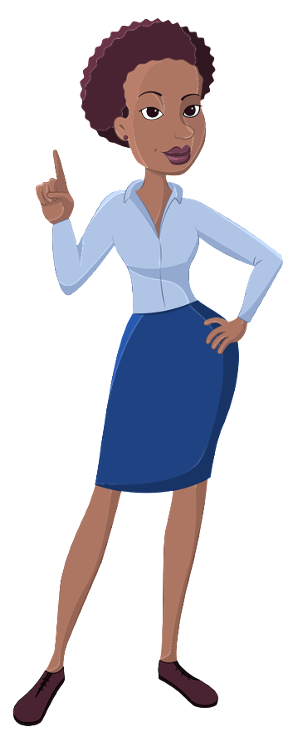
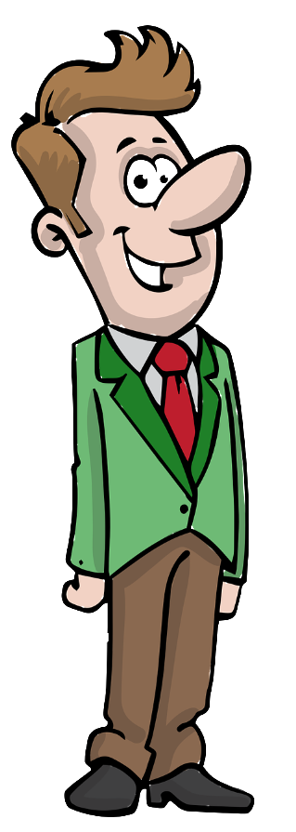
C’est à vous !
écouter / parler
C’est qui ?
Travaille avec un(e) partenaire.
Écoute et parle.
C’est quelle lettre?
hard-working
hard-working
careful
careful
A
B
C
D
E
F
G
H
Notes:
8.1.1.3
Timing: 5 minutes
Aim: To practise production (spoken modality) of the masculine and feminine forms presented on the previous slide.
Procedure:
Check students understand the task instructions. See if they can work out the idiomatic usage of à toi/à vous, meaning ‘your turn’.
Students take turns to narrate a pathway as for the previous listening exercise. Students can choose their pathways, or teachers can give out rolecards with letters on so that students do not ‘play it safe’/pick similar pathways each time!
Partners try to name the correct destination point.

Slide 5
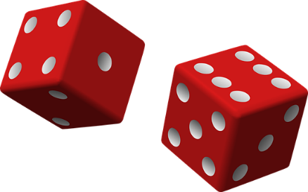
On célèbre comment ?
parler
dehors
à Pâques (Easter)
à Noël (Christmas)
au nouvel an (New Year)
à Halloween
à son anniversaire (birthday)
à la fin du semestre (end of term)
jouer
manger
célébrer
porter
regarder
chanter
des feux d’artifice*
ensemble
la parade
des vêtements rouges
des chocolats
la télé
des jeux de société*
beaucoup
des costumes
des films
des fruits
le feu d’artifice* = firework
les jeux de société* = board games
du jazz
des personnes
Notes:
8.1.1.5
Timing: 10 minutes
Aim: Oral production of sentences with on + verb in 3rd person singular to talk about what people in general do to celebrate.
Procedure:
1. Students take turns to roll two dice. The first roll determines the festival they must describe, and the second determines the verb they must use.
2. Students form a sentence with on, and finish it with one of the words on the right (or another appropriate noun or adjective).
e.g. 1 - à Pâques … 2 - on mange … des chocolats/ensemble/
Word frequency of unknown words used (1 is the most frequent word in French): feu [786], artifice [>5000], jeu [291], société [295], fin [111]
Source: Londsale, D., & Le Bras, Y. (2009). A Frequency Dictionary of French: Core vocabulary for learners London: Routledge.
Word frequency of cognates used (1 is the most frequent word in French): jazz [>5000], parade [>5000], chocolat [4556], costume [4419]
Source: Londsale, D., & Le Bras, Y. (2009). A Frequency Dictionary of French: Core vocabulary for learners London: Routledge.

Slide 6
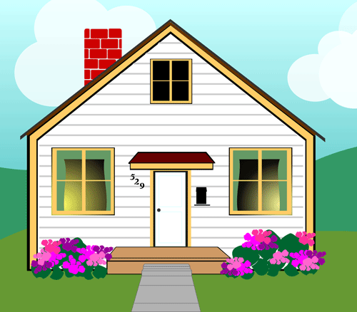
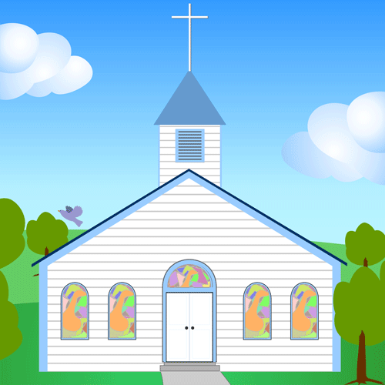
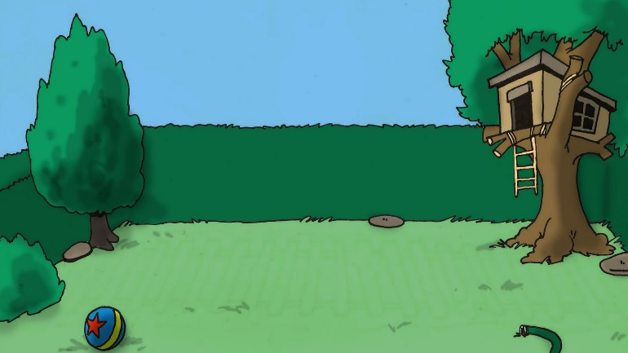
Dis le français !
parler
1. I’m staying in my house. | 2. Everyone is on their bridge. | 3. He’s going to his church.
4. She’s working in her garden | 5. We’re behind our buildings. | 6. You’re singing on your boat.
1. Je reste dans ma maison.
2. Chacun est sur son pont.
3. Il va à son église.
4. Elle travaille dans son jardin.
5. Nous sommes derrière nos bâtiments.
6. Tu chantes sur ton bateau.
Notes:
8.1.1.6
Timing: 5 minutes
Aim: practising aural production of agreement with possessive adjectives
Procedure:
1. Say the French for sentences 1-6.
2. Click to reveal answers.
Note: To extend the activity, students create their own sentences from the picture prompts by rolling a dice to choose the possessive adjective:
1 = my, 2 = your, 3 = his, 4 = her, 5 = everyone’s/their, 6 = our.

Slide 7
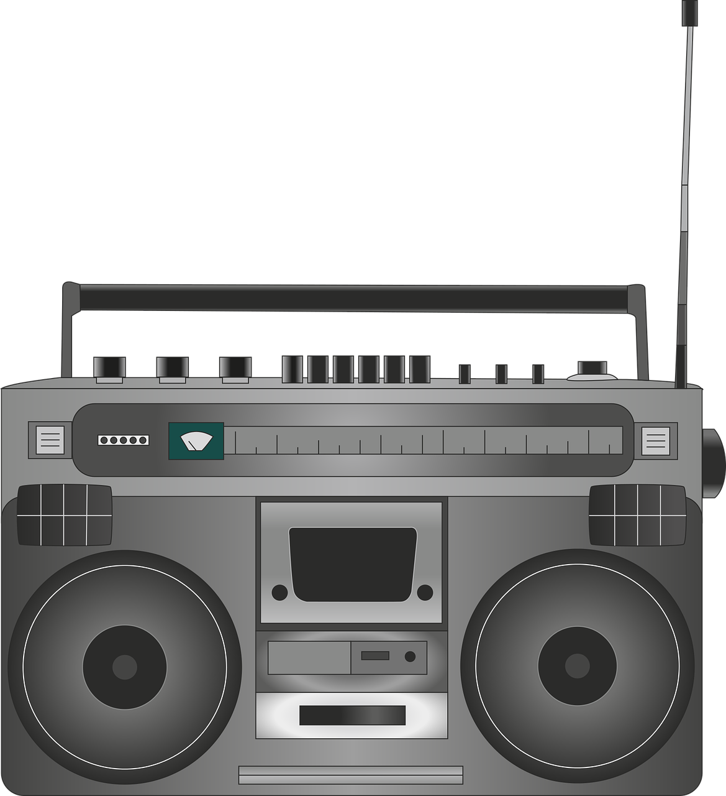
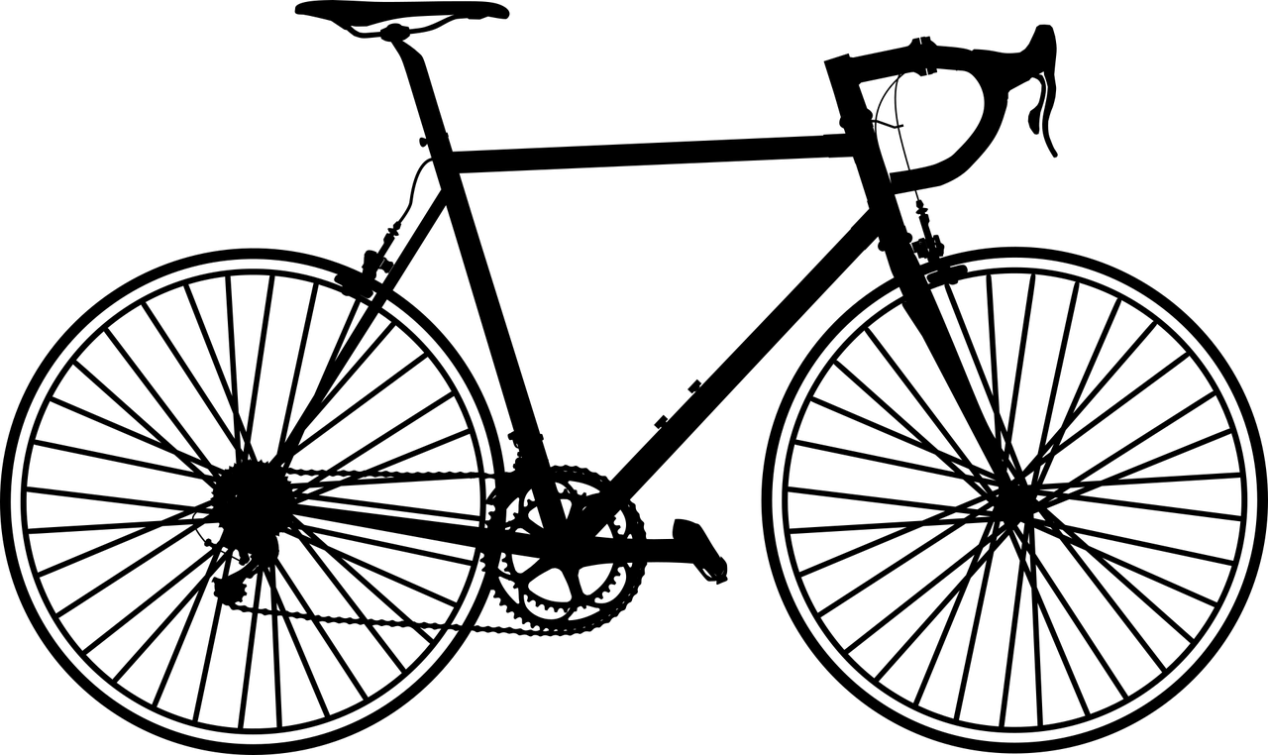
Jeu des différences (1/3)
écrire
Regarde les deux photos. Utilise les expressions « il y a » et « il y avait » pour faire des comparaisons.
dans le passé
aujourd’hui
« Il y avait une fenêtre dans le passé, mais il y a deux fenêtres maintenant »
« Il y avait une radio dans le passé, et il y a une radio aujourd’hui »
Notes:
8.1.2.3
Timing: 10 minutes
Aim: Oral production of sentences with il y a and il y avait. This is slide 1/3.
Procedure:
1. Explain that jeu des différences is the French title for the game ‘spot the difference’.
2. Teacher displays the before and after photos on the screen (see the next slide for larger versions).
3. Students write several sentences comparing the photos. Use this slide to provide examples.
Word frequency of cognates used (1 is the most frequent word in French): photo [1412], expression [952], comparaison [2244]
Source: Londsale, D., & Le Bras, Y. (2009). A Frequency Dictionary of French: Core vocabulary for learners London: Routledge.

Slide 8
Jeu des différences (2/3)
écrire
dans le passé
aujourd’hui
Notes:
Larger version of the pictures from the previous slide.
This is slide 2/3.

Slide 9
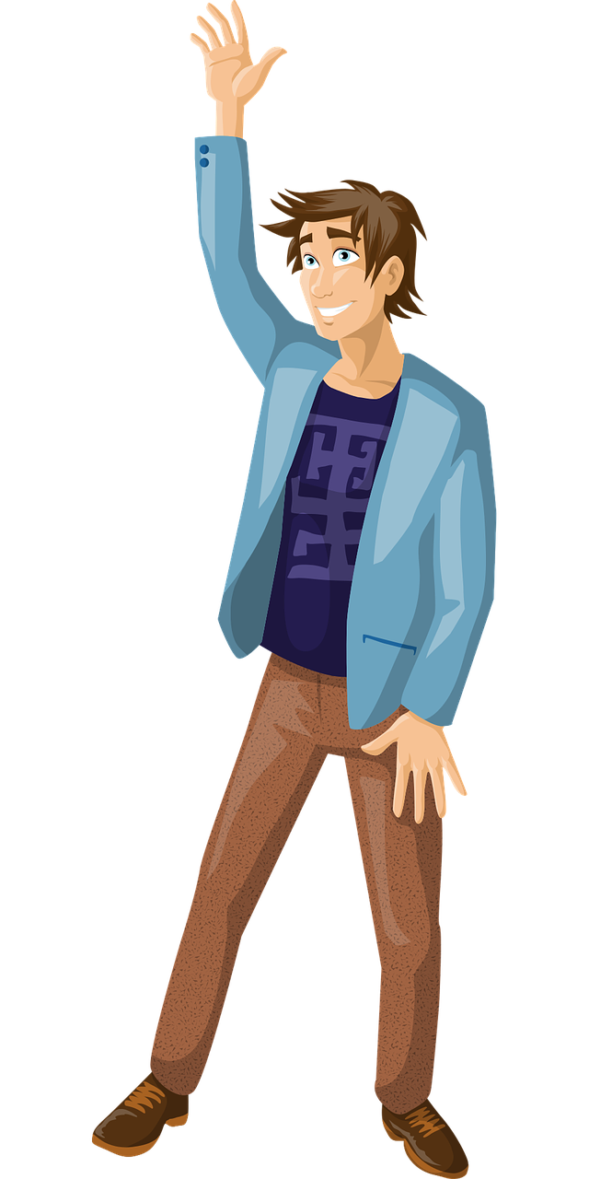
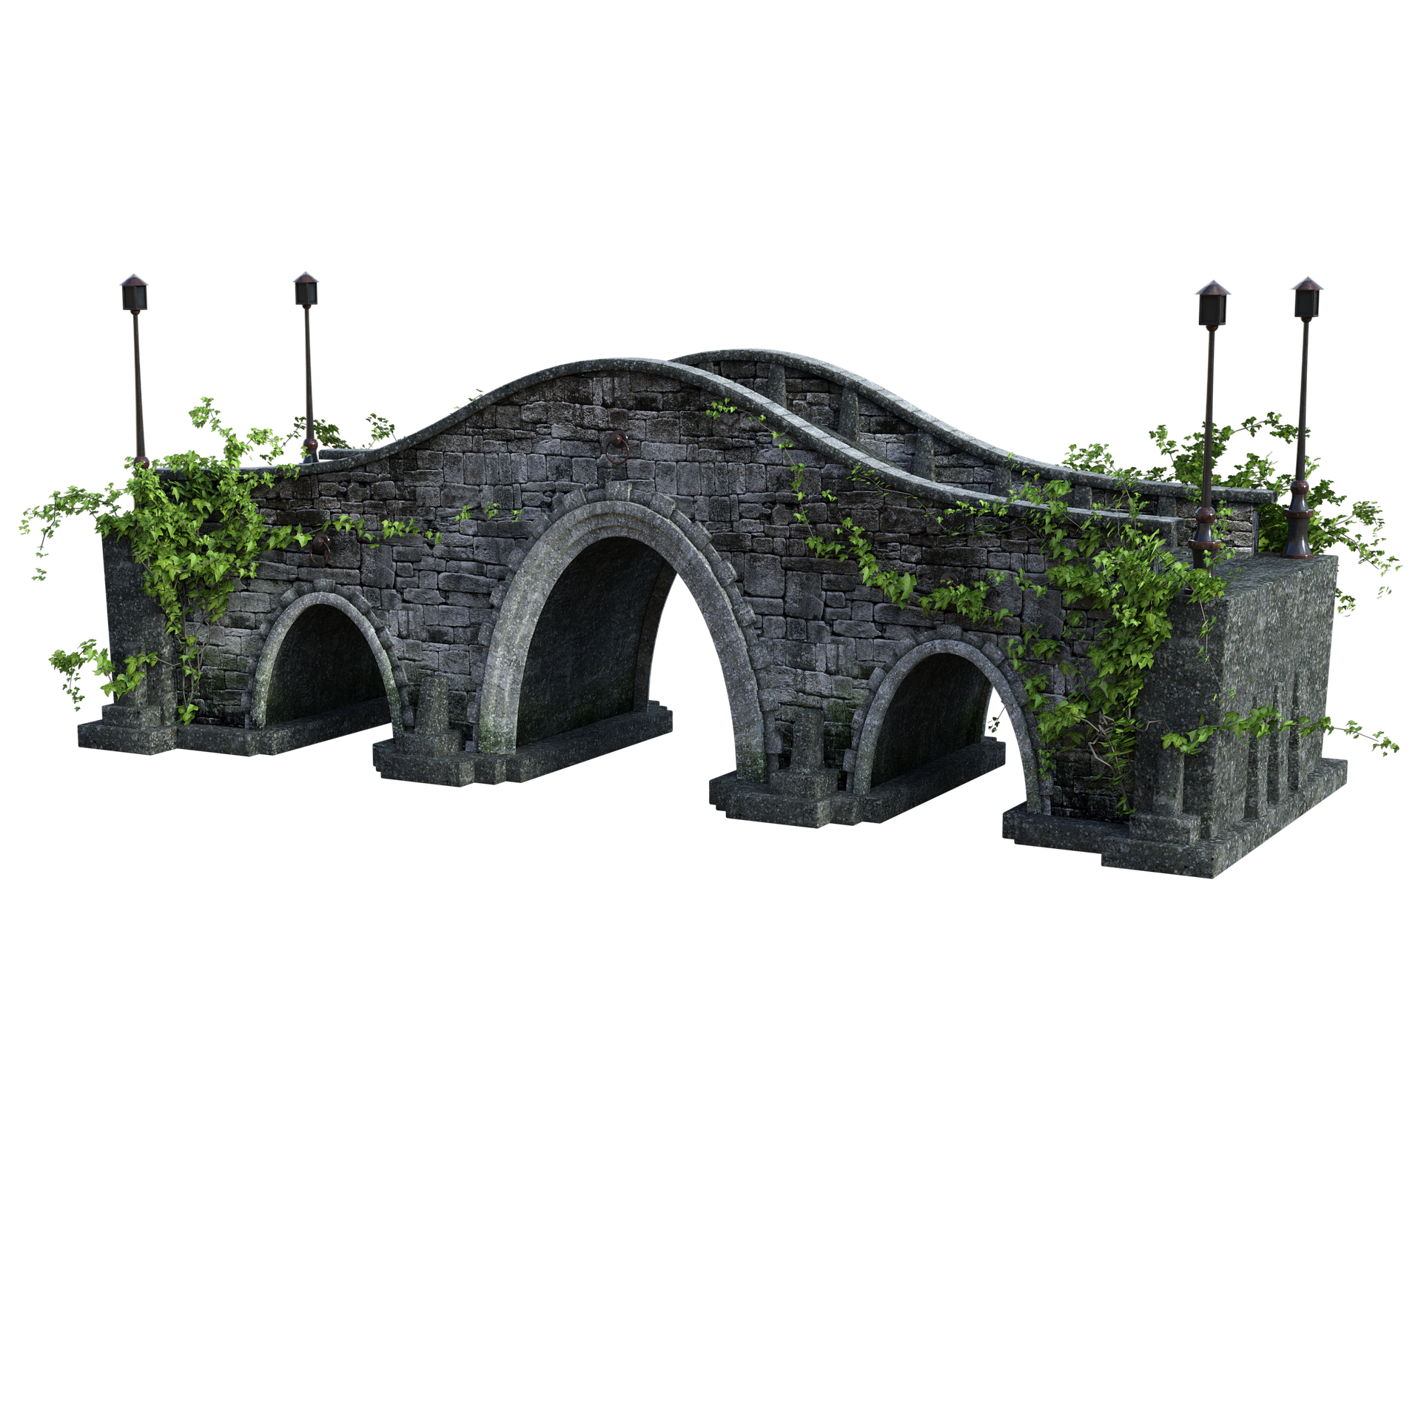
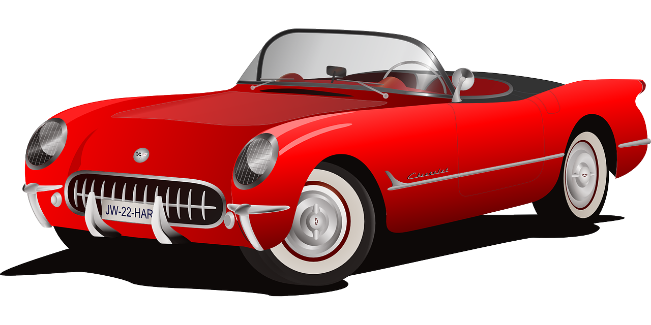
Jeu des différences (3/3)
écrire
dans le passé
aujourd’hui
Notes:
This is slide 3/3.

Slide 10
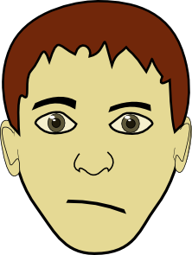
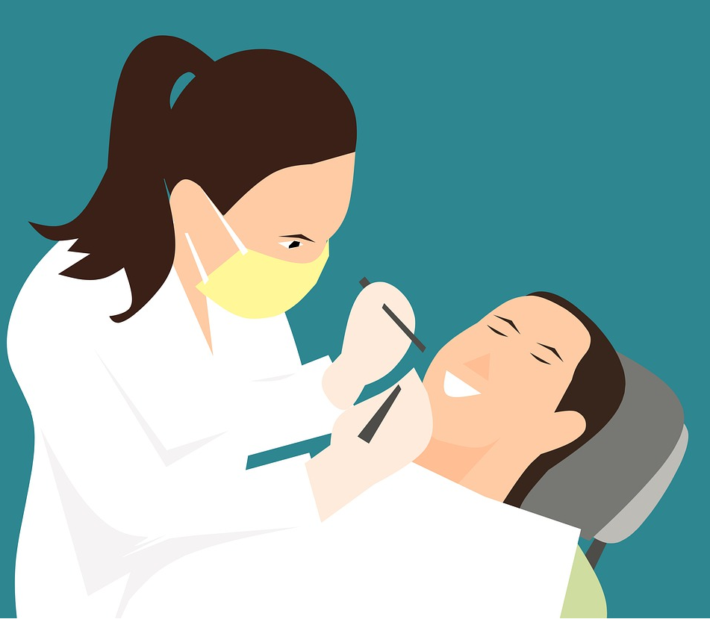
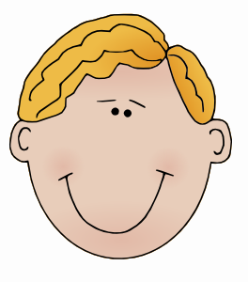
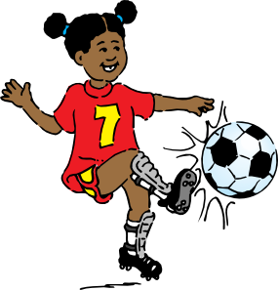
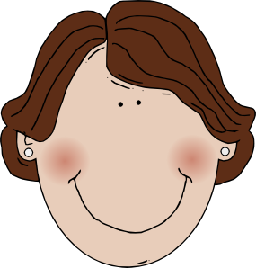
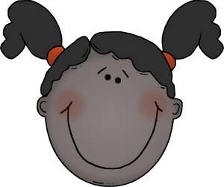
En ville
Natalie et Kirsten vont en ville. Elles parlent avec des personnes. Que demandent-ils ?
parler
M. Dupont,
le policier
aider / qui
Marine,
9 ans
sortir /
seule
Omar,
14 ans
jouer / à / la / pétanque
Mme Petit,
la pâtissière
avoir / des croissants
Mme Martin
la dentiste
manger / des bonbons
Stéphane,
12 ans
savoir / chanter
1
2
3
4
5
6
Sara et Jean,
10 ans
venir / au parc
Daphné,
15 ans
être / dans / une équipe
Émilie,
13 ans
habiter /
où
Mme. Dubois
55 ans
venir / de / Nice
M. Robert,
le serveur
partir / au travail / quand
M. Michel
le vétérinaire
sortir / le / chien /
7
8
9
10
11
12
Notes:
8.2.1.6
Timing: 10 minutes
Aim: oral production of questions with formal and informal ‘you’.
Procedure:
1. Check students understand which form of address they need to use for whom. Remind them of the full forms of M. / Mme.
2. Students tear a piece of paper into 12 and write numbers 1-12 on each. They then fold the pieces so the numbers are hidden.
3. Students take turns to choose a piece of paper form a question using the prompts (person bios and word sets) indicated by that number. At more advanced levels, students should be encouraged to alternate between question forms – intonation and est-ce que for informal address; inversion for formal address.
Suggested answers
Vous aidez qui ? / Qui aidez-vous ? / Qui est-ce que vous aidez ?
Tu sors seule ? / Sors-tu seule? / Est-ce que tu sors seule ?
Tu joues à la pétanque ? / Joues-tu à la pétanque ? / Est-ce que tu joues à la pétanque ?
Vous avez des croissants ? / Avez-vous des croissants ? / Est-ce que vouz avez des croissants ?
Vous mangez des bonbons ? / Mangez-vous des bonbons ? / Est-ce que vous mangez des bonbons ?
Tu sais chanter ? / Sais-tu chanter ? / Est-ce que tu sais chanter ?
Vous venez au parc ? / Venez-vous au parc ? / Est-ce que vous venez au parc ?
Tu es dans une équipe ? / Es-tu dans une équipe ? / Est-ce que tu es dans une équipe ?
Tu habites où ? / Où habites-tu ? / Où est-ce que tu habites ?
Vous venez de Nice ? / Venez-vous de Nice ? / Est-ce que vous venez de Nice ?
Vous partez au travail quand ? / Partez-vous au travail ? / Quand est-ce que vous partez au travail ?
Vous sortez le chien ? / Sortez-vous le chien ? / Est-ce que vous sortez le chien ?
Word frequency of cognates used (1 is the most frequent word in French): policier [1265], pâtissière [>5000], dentist [>5000], vétérinaire [>5000]
Source: Londsale, D., & Le Bras, Y. (2009). A Frequency Dictionary of French: Core vocabulary for learners London: Routledge.

Slide 11
À vous tous de parler !
écrire / parler
2. Amir / lire / le livre français
3. Noura / dire / bonjour au chat
4. Tu lis les informations.
1. Je / traduire / le programme
2. Amir lit le livre français.
3. Noura dit bonjour au chat.
4. Tu / lire / les informations
1. Je traduis le programme.
1. Amir / traduire / la conversation
2. Tu / lire / le programme
3. Je / traduire / le message
4. Noura / dire / au revoir à Amir
1. Amir traduit la conversation.
2. Tu lis le programme.
3. Je traduis le message.
4. Noura dit au revoir à Amir.
Notes:
8.3.1.5
Timing: 7 minutes
Aim: Spoken production of sentences containing verbs like lire in the singular form. Transcription.
Procedure:
1. Partner B turns to face away from the board where this slide is being displayed.
2. Click to bring up the first selection of four items (in blue). These are for Partner A. The subject, verb and object are indicated for each item.
3. Partner A produces the appropriate sentence in French for each item.
4. Partner B writes down the sentence that they hear, paying particular attention to the spelling of the verb.
5. Students swap roles so that Partner A now faces away from the board and Partner B says the next set of four items. which appear on the next click of the mouse (in orange).
6. Partner A writes down the sentence that they hear, paying particular attention to the spelling of the verb.
7. Click to reveal answers one by one. Both partners check their answers.

Slide 12
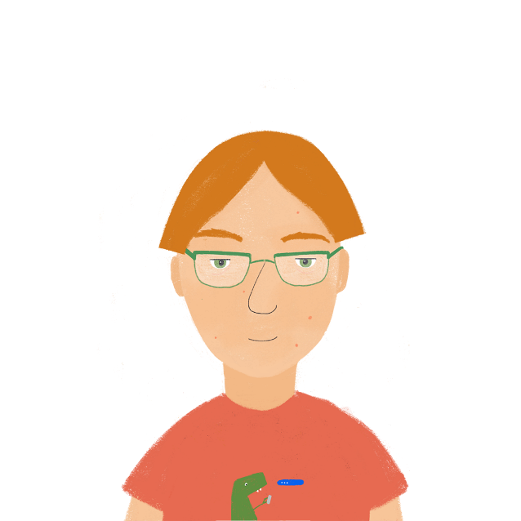
Complète la phrase !
parler
Partenaire A commence* la phrase. Il/elle ne dit pas l’article !
Puis, Partenaire B finit la phrase avec le bon nom.
Je décris toute …
… la culture
0 | I’m describing the whole | culture | schedule
Notes:
8.3.1.5
Timing: 5 minutes
Aim: Oral production of sentences containing forms of tout and singular forms of verbs like lire and écrire.
Procedure:
1. Use this slide to model the task. On a click, the beginning of the sentence appears. Ask students what the end of the sentence must be, using the form of tout to inform their choices.
2. Print and distribute the role cards found on slides 51-52 (print 4 per page). Partner A starts the sentences, finishing with the form of tout (before the definite article).
3. Partner B finishes the sentences using the noun indicated by the form of tout. Remind them that they need to say the article, too, as it comes directly after tout.
4. Partners swap roles after four sentences.
5. Model answers are provided on slide 53.
Word frequency (1 is the most frequent word in French):
commencer [139]; compléter [2034], article [604] Source: Londsale, D., & Le Bras, Y. (2009). A Frequency Dictionary of French: Core vocabulary for learners London: Routledge.

Slide 13
Partenaire A
Begin sentences 1-4. Don’t say ‘the’!
Complete sentences 5-8.
parler
1 | I am describing (the) whole | Spain
2 | He is writing (the) whole | the newspaper
3 | She is translating all | the information
4 | You read all | the conversations
5
6
7
8
story
Notes:
Partner A rolecard – DO NOT DISPLAY

Slide 14
Partenaire B
Complete sentences 1-4.
Begin sentences 5-8. Don’t say ‘the’!
parler
5 | I’m reading (the) whole | the book
6 | He’s reading (the) whole | the story
7 | She’s describing all | the products
8 | You are translating (the) whole | the menu
1
2
3
4
story
Notes:
Partner B rolecard – DO NOT DISPLAY

Slide 15
Complète la phrase !
parler
1 | Je décris toute l’Espagne.
2 | Il écrit tout le journal.
3 | Elle traduit toutes les informations.
4 | Tu lis toutes les conversations.
5 | Je lis tout le livre.
6 | Il dit toute la vérité.
7 | Elle décrit tous les produits.
8 | Tu traduis toute la carte.
story
Notes:
Procedure
1. Click to reveal model answers

Slide 16
Phonétique
écouter / écrire
Personne A lit la phrase. Personne B coche chaque fois qu’il/elle entend [th, [ch] ou [qu].
Charles va chez Thérèse chaque dimanche.
1
2
3
 | th | ch | qu | en anglais
1 |  |  |  | Charles goes to Thérèse’s place every Sunday.
2
3
4
Notes:
8.3.2.5
Timing: 8 minutes. This is slide 1/7.
Aim: Oral production and aural recognition of SSCs [th], [ch], [qu].
Procedure:
1. Students prepare for the activity by sketching the grid pictured on this slide. Use the sentence on this slide as an example to model steps 2-6 below.
2. Students work in pairs. Student A faces the board. Student B turns away.
3. Student A reads the sentence from the board. Student B has their back to the board and ticks the SSCs they hear.
4. Student B turns back to the board to check the answer, revealed on clicks.
5. Students use their knowledge of cognates to guess the English meaning of the sentence, revealed on a further click. At more advanced levels, the listening student could try to do this as part of step 3.
6. Both students practice saying the sentences at increasing speeds to increase fluency of production. Click on the numbers 1-3 to hear the sentences read aloud at different speeds. Students listen and repeat.
7. Repeat steps 2-7 for the remaining sentences.

Slide 17
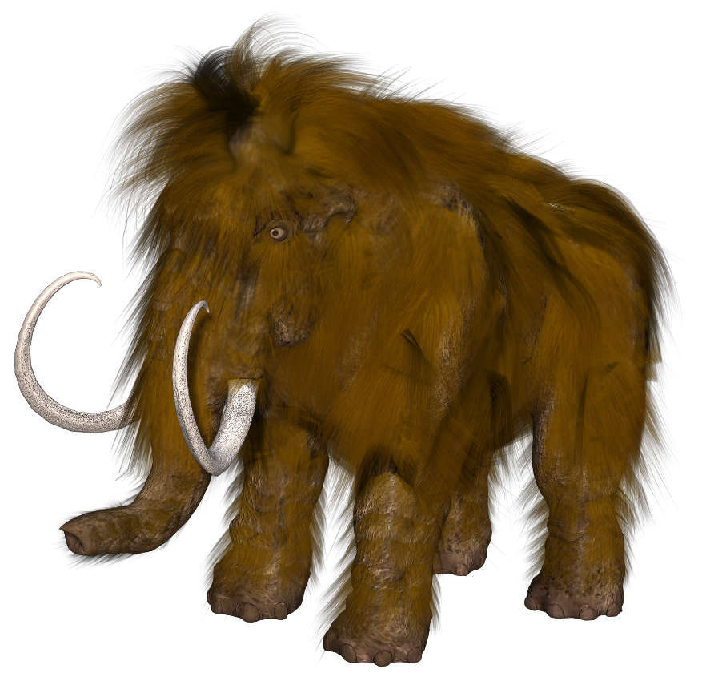
Phonétique
écouter / écrire
Michel le mammouth explique qu’il vient de Belgique.
Michel the mammoth explains that he comes from Belgium.
1
2
3
Notes:
This is slide 2/7
Word frequency of cognates used (1 is the most frequent word in French):
mammouth [<5000]
Source: Lonsdale, D., & Le Bras, Y. (2009). A Frequency Dictionary of French: Core vocabulary for learners London: Routledge.

Slide 18
Phonétique
écouter / écrire
Frédérique choisit la musique catholique.
Frédérique chooses Catholic music.
1
2
3
Notes:
This is slide 3/7
Word frequency of cognates used (1 is the most frequent word in French):
catholique [1578]
Source: Lonsdale, D., & Le Bras, Y. (2009). A Frequency Dictionary of French: Core vocabulary for learners London: Routledge.

Slide 19
Phonétique
écouter / écrire
Les quatre chats sympathiques cherchent quatre chaises chaudes.
The four nice cats are looking for four warm chairs.
1
2
3
Notes:
This is slide 4/7
Word frequency of unknown words used (1 is the most frequent word in French):
chaise [3419]
Source: Lonsdale, D., & Le Bras, Y. (2009). A Frequency Dictionary of French: Core vocabulary for learners London: Routledge.

Slide 20
Phonétique
écouter / écrire
Les dimanches, Agathe va au théâtre, aux champs, et à la bibliothèque.
On Sundays, Agathe goes to the theatre, to the fields, and to the library.
1
2
3
Notes:
This is slide 5/7
Word frequency of cognates used (1 is the most frequent word in French):
théâtre [1701]
Word frequency of unknown words used (1 is the most frequent word in French):
champ [847]
Source: Lonsdale, D., & Le Bras, Y. (2009). A Frequency Dictionary of French: Core vocabulary for learners London: Routledge.

Slide 21
Phonétique
écouter / écrire
Le chef fait des recherches sur le thé à la menthe.
The boss is doing research on mint tea.
1
2
3
Notes:
This is slide 6/7
Word frequency of unknown words used (1 is the most frequent word in French):
chef [386], recherche [357], menthe [>5000]
Source: Lonsdale, D., & Le Bras, Y. (2009). A Frequency Dictionary of French: Core vocabulary for learners London: Routledge.

Slide 22
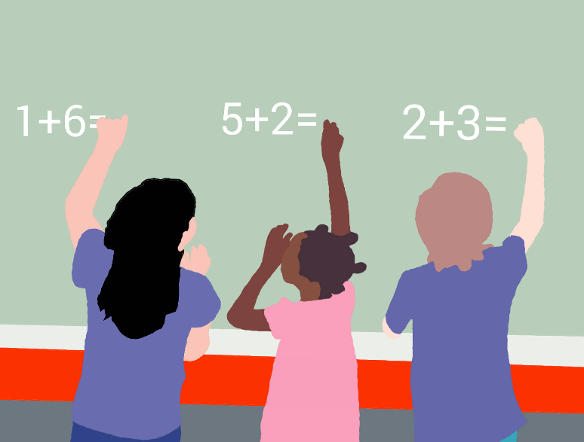
Phonétique
écouter / écrire
Dominique a des questions sur les méthodes chinoises de maths.
Dominique has some questions about Chinese maths methods.
1
2
3
Notes:
This is slide 7/7
Word frequency of cognates used (1 is the most frequent word in French):
méthode [1149], chinois [1914]
Source: Lonsdale, D., & Le Bras, Y. (2009). A Frequency Dictionary of French: Core vocabulary for learners London: Routledge.

