Slide 1
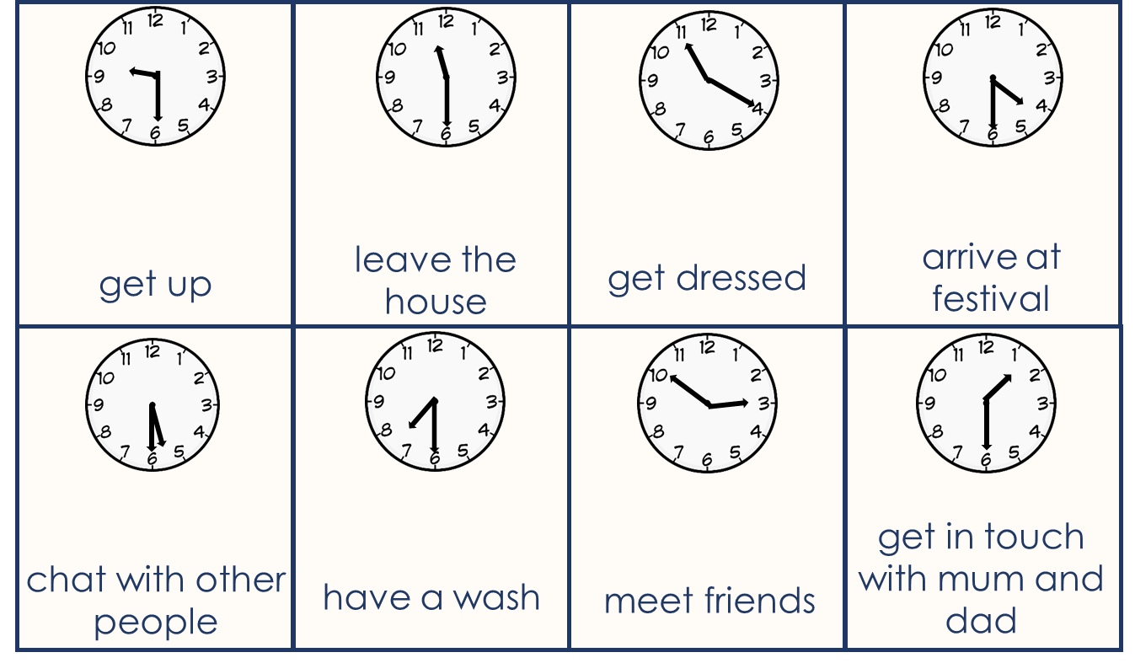
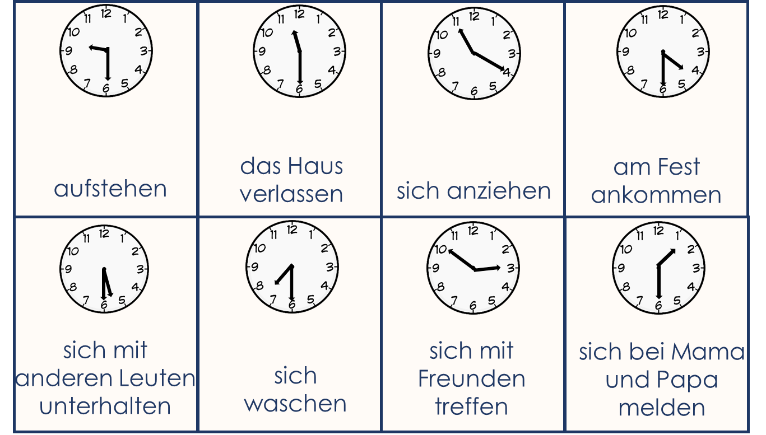
Partner(in) A
Fold your paper in half. Try to use the English cues, but refer to the German prompts if you need to.

Slide 2
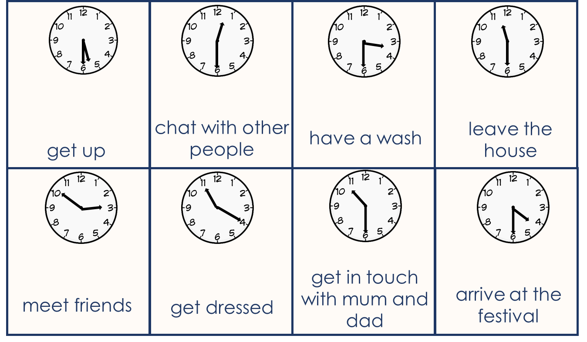
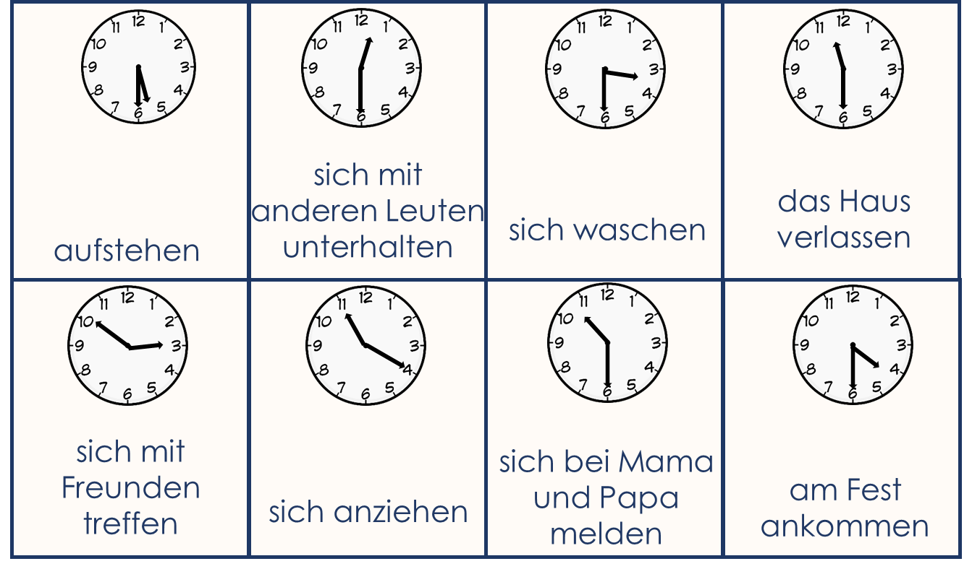
Partner(in) B
Fold your paper in half. Try to use the English cues, but refer to the German prompts if you need to.

