Slide 1
Phonics
SSC [au]
Y7 German
Term 2.1 - Week 1
Natalie Finlayson / Rachel Hawkes
17/01/20

Slide 2
ö
[ø:]
schön
Notes:
Source word: schön [164]
1. Present the letter and say the long /ö/ sound first, on its own. Students repeat it with you. 2. Bring up the word ‘‘schön” on its own, say it, students repeat it, so that they have the opportunity to focus all of their attention on the connection between the written word and its sound.
3. A possible gesture for this would be to mime an exaggerated exclamation of seeing / receiving something beautiful. As you say ‘‘schön” with an appropriate sigh, bring your hands to the rest on your cheeks, and smile! Establish the meaning of the word in English, clearly, i.e., ‘beautiful, pleasant, good’. 4. Roll back the animations and work through 1-3 again, but this time, dropping your voice completely to listen carefully to the students saying the long /ö/ sound, pronouncing ‘‘schön” and, if using, doing the gesture.

Slide 3
ö
[ø:]
schön
Notes:
Source word: schön [164]
With sound and no pictures to focus all attention on the sound-symbol correspondence.

Slide 4
ö
[ø:]
schön
Notes:
Source word: schön [164]
Without sound to elicit pronunciation (without first hearing the teacher).
Teacher can elicit pronunciation by asking Wie sagt man das?

Slide 5
ö
Lösung
mögen
[solution]
[to like]
schön
französisch
Körper
möglich
[possible]
Notes:
Introduce and elicit the pronunciation of the individual SSC ‘ö’ and then the source word again (with gesture, if using). Then present and elicit the pronunciation of the five cluster words. The cluster words have been chosen for their high-frequency, from a range of word classes, with the SSC (where possible) positioned within a variety of syllables within the words(e.g. initial, 2nd, final etc..) and additionally, we have tried to use words that build cumulatively on previously taught SSCs (see the Phonics Teaching Sequence document) and do not include new SSCs. Where new SSCs are used, they are often consonants which have a similar symbol-sound correspondence in English.
Word frequency rankings (1 is the most common word in German): schön [164]; Lösung [620] mögen [151]; französisch [644]; möglich [156]; Körper [617]. Source: Jones, R.L. & Tschirner, E. (2006). A frequency dictionary of German: core vocabulary for learners. Routledge

Slide 6
ö
Lösung
mögen
schön
französisch
Körper
möglich
Notes:
With sound and no pictures to focus all attention on the sound-symbol correspondence.
Word frequency rankings (1 is the most common word in German): schön [164]; Lösung [620] mögen [151]; französisch [644]; möglich [156]; Körper [617]. Source: Jones, R.L. & Tschirner, E. (2006). A frequency dictionary of German: core vocabulary for learners. Routledge

Slide 7
ö
Lösung
mögen
schön
französisch
Körper
möglich
Notes:
Without sound to elicit production from students.
Word frequency rankings (1 is the most common word in German): schön [164]; Lösung [620] mögen [151]; französisch [644]; möglich [156]; Körper [617]. Source: Jones, R.L. & Tschirner, E. (2006). A frequency dictionary of German: core vocabulary for learners. Routledge

Slide 8
ö
[ø]
plötzlich
Notes:
Source word: plötzlich [459]
1. Present the letter and say the short /ö/ sound first, on its own. Students repeat it with you. 2. Bring up the word ‘‘plötzlich” on its own, say it, students repeat it, so that they have the opportunity to focus all of their attention on the connection between the written word and its sound.
3. A possible gesture for this would be to mime a sudden shock that makes you jump backwards. Put your hands up and look shocked, as in the picture. Establish the meaning of the word in English, clearly, i.e., ‘suddenly’. 4. Roll back the animations and work through 1-3 again, but this time, dropping your voice completely to listen carefully to the students saying the short /ö/ sound, pronouncing “plötzlich” and, if using, doing the gesture.

Slide 9
ö
[ø]
plötzlich
Notes:
Source word: plötzlich [459]
With sound and no pictures to focus all attention on the sound-symbol correspondence.

Slide 10
ö
[ø]
plötzlich
Notes:
Source word: plötzlich [459]
Without sound to elicit pronunciation (without first hearing the teacher).
Teacher can elicit pronunciation by asking Wie sagt man das?

Slide 11
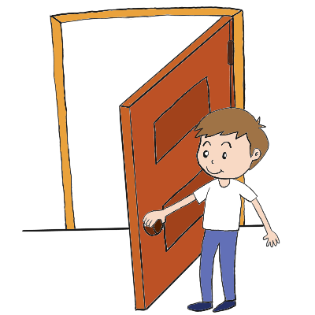
ö
Bevölkerung
zwölf
12
plötzlich
völlig
öffnen
%
öffentlich
[public]
Notes:
Introduce and elicit the pronunciation of the individual SSC ‘OU’ and then the source word again (with gesture, if using). Then present and elicit the pronunciation of the five cluster words. The cluster words have been chosen for their high-frequency, from a range of word classes, with the SSC (where possible) positioned within a variety of syllables within the words(e.g. initial, 2nd, final etc..) and additionally, we have tried to use words that build cumulatively on previously taught SSCs (see the Phonics Teaching Sequence document) and do not include new SSCs. Where new SSCs are used, they are often consonants which have a similar symbol-sound correspondence in English.
Word frequency rankings (1 is the most common word in German): plötzlich [459]; Bevölkerung [769] völlig [462]; öffentlich [399]; zwölf [882]; öffnen [538]. Source: Jones, R.L. & Tschirner, E. (2006). A frequency dictionary of German: core vocabulary for learners. Routledge

Slide 12
ö
Bevölkerung
zwölf
plötzlich
völlig
öffnen
öffentlich
Notes:
With sound and no pictures to focus all attention on the sound-symbol correspondence.
Word frequency rankings (1 is the most common word in German): plötzlich [459]; Bevölkerung [769] völlig [462]; öffentlich [399]; zwölf [882]; öffnen [538]. Source: Jones, R.L. & Tschirner, E. (2006). A frequency dictionary of German: core vocabulary for learners. Routledge

Slide 13
ö
Bevölkerung
zwölf
plötzlich
völlig
öffnen
öffentlich
Notes:
Without sound to elicit production from students.
Word frequency rankings (1 is the most common word in German): plötzlich [459]; Bevölkerung [769] völlig [462]; öffentlich [399]; zwölf [882]; öffnen [538]. Source: Jones, R.L. & Tschirner, E. (2006). A frequency dictionary of German: core vocabulary for learners. Routledge

Slide 14
Lang oder kurz?
hören / sprechen
 |  | lang wie schön | kurz wie plötzlich
 | Köln
 | das Vereinigte Königreich
 | Mönchen­gladbach
 | Görlitz
 | Österreich
 | Göttingen
 | Mödling
A
B
C
D
E
F
G
Notes:
These German names of cities and countries mainly consist of long and short /ö/, previously studied SSCs and transferable consonants. The only exceptions to this are the /v/ in Vereinigtes Königreich, and the /r/ in Vereinigtes Königreich, Görlitz and Österreich. Students will need some extra practice/support when pronouncing these sounds.
The names of the places are heard on individual letter clicks. Students listen to each word, and decide whether they hear long or short /ö/. To allow students to compare the sounds of the words, it is recommended that each recording (from A - G) is played twice in the first instance, and then once again before the answer is revealed.
Teacher elicits answers by pointing at the word and asking ‘Ist das ö lang oder kurz?’ Students respond ‘Das ö ist lang/kurz.’
Place names have been chosen for this exercise as they are unlikely to have been encountered before, so students must focus on the sound. Teacher to highlight the English translations of ‘Köln’, ‘das Vereinigte Königreich’ and ‘Österreich’ (‘Wie sagt man Köln auf Englisch?’) and explain the structure of ‘das Vereinigte Königreich’ (though make it clear that ‘Großbritannien’ is more commonly used).
Once answers have been revealed, students are asked to read the names aloud. They now have direct information about how to pronounce the ‘ö’ SSC. The exercise also provides an opportunity to apply previous SSC knowledge of soft and hard /ch/ (das Vereinigte Königreich, Mönchen­gladbach, Österreich) and /ei/ (das Vereinigte Königreich, Österreich).
NB: Should students ask why Österreich and Mödling are long ö despite being followed by two consonants, here are two possible responses, depending on who has asked and how much time you have! 1. Place names can often be exceptional - think of some strange ones in English e.g. Holborn doesn’t pronounce the ‘l’ at all, but in English we don’t have silent ‘l’ as a letter, generally. Towcester is pronounced ‘toaster’ etc.. 2. This is to do with the syllable separation - here Ös - ter - reich is made up of 3 syllables - the end of the first syllable is just a single consonant, and the ö pronunciation is driven by that. The same applies to Möd - ling. When the syllables are separated, the double consonants disappear.

Slide 15
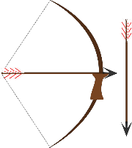
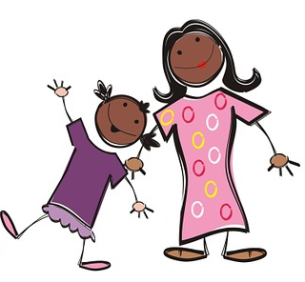
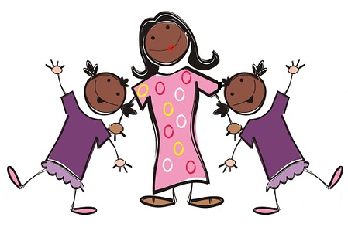
Minimal pairs
lesen / schreiben
As you know, many words containing /a/, /o/ and /u/ add an umlaut in the plural form. Words ending in –el, en and –er don’t add an ending in the plural form.
What is the plural form of the words below?
der Bogen | der Vogel | der Ofen | der Boden | die Tochter
die Bögen | die Vögel | die Öfen | die Böden | die Töchter
Notes:
This exercise recaps the rules about plural formation introduced in 1.2.6, and practises the difference between SSCs /o/ and /ö/. It also draws attention to the importance of sound in creating meaning by juxtaposing singular and plural forms of words which differ in terms of umlauts only.
Teacher to emphasise to students that mispronouncing the umlaut causes a change in meaning.
Note that the /ch/ becomes soft in Töchter.
Frequency values: der Bogen [3070]; der Vogel [1878]; der Ofen [3214]; der Boden [445]; die Tochter [514]

Slide 16
Minimal pairs
hören
Gibt es eine/einen oder viele?
 | eine / einen (o) | viele (ö)
A
Bogen
B
Vogel
C
Ofen
D
Boden
E
Tochter
Notes:
Audio plays on clicking individual letters. The article/quantifier is obscured in each case so students must listen to the sound.
Transcript
a) Es gibt [viele] Bögen im Museum.
b) Es gibt [einen] Vogel im Garten.
c) Herr Martin hat [einen] Ofen zu Hause.
d) Mia putzt jede Woche [die] Böden.
e) Die Frau hat [eine] Tochter.

Slide 17
Minimal pairs
hören
Gibt es eine/einen oder viele?
 | eine / einen (o) | viele (ö)
A
Bogen
B
Vogel
C
Ofen
D
Boden
E
Tochter
Notes:
Full audio (including articles/quantifiers) plays on clicking individual letters.
Answers revealed on clicks.
Transcript
a) Es gibt [viele] Bögen im Museum.
b) Es gibt [einen] Vogel im Garten.
c) Herr Martin hat [einen] Ofen zu Hause.
d) Mia putzt jede Woche [die] Böden.
e) Die Frau hat [eine] Tochter.

Slide 18
/o/ oder /ö/?
hören / sprechen / schreiben
Wie schreibt man das? Mit /o/ oder mit /ö/? Arbeite mit einem Partner/einer Partnerin.
Beispiel:
Person A
zuhören/schreiben | sprechen
Sch___ttland (kurz) | öffnen (kurz)
Person B
zuhören/schreiben | sprechen
Schottland (kurz) | ___ffnen (kurz)
o
ö
Person A fragt: „Wie sagt man Scotland?“
Person B antwortet: „Schottland“.
Person A schreibt „o”.
Person B fragt: „Wie sagt man to open?“
Person A antwortet: „öffnen“.
Person B schreibt „ö”.
Notes:
Note: the resource cards for this activity are found on the portal as a separate document entitled ‘pronunciation role cards’.
In this multi-modal activity, students must work in pairs to complete the spellings of unknown words. The role cards are printed and distributed amongst students. Each sheet contains two different cards, to be given to partner A and partner B, so must be cut in half. Each student has a list of complete words to read out to their partner, and a list of words with the /o/ or /ö/ missing, which they must complete by listening to their partners pronunciation of the words.
Unknown words have been chosen so that students must focus on the sound. These words consist of long and short /ö/, previously studied SSCs and transferable consonants. The only exceptions are the /sch/ in Schottland, which teachers can highlight in the example above, and the /r/ in Butterbrot, with which students might need some extra support. A hint about the pronunciation (long or short) is given.
All words used feature either on the NCELP vocabulary list for Year 7, or on the AQA vocabulary list.
This slide gives an example dialogue to present to students.
Students have met the nouns die Frage and die Antwort, but not the verb forms fragen and antworten. Teacher to highlight that many nouns may be turned into words by removing the capital letter and adding –en.

Slide 19
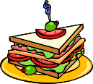
Lösungen - /o/ oder /ö/?
hören / sprechen / schreiben
__ffnen
Sch__ttland
öffnen
Schottland
t__t
zw__lf
tot
12
zwölf
unm__glich
das Butterbr__t
unmöglich
das Butterbrot
[impossible]
die P__mmes
ich m__chte
die Pommes
[I would like]
ich möchte
k__nnen
das Kin__
können
das Kino
[to be able to]
das __bst
__ffentlich
das Obst
[public]
öffentlich
ew__hnlich
das __l
[usual]
gewöhnlich
das Öl
Notes:
‘Lösung’ is one of this week’s SSC cluster words. Explain that ‘Lösungen’ is the plural form.
This slide reveals the complete spellings of each word in the task. Teacher points at a word, asks ‘Wie sagt man Scotland?’ to elicit ‘Schottland’, and then ‘/o/ oder /ö/?’ to elicit ‘/o/’.
Teacher then pronounces the word again, and gives English translation. Students repeat. Teachers also focus on the pronunciation of previously encountered SSCs, e.g. zwölf, unmöglich, ich möchte, öffentlich, gewöhnlich.
Teacher to draw attention to capitalisation at the beginning of nouns.
Note that Obst is designated ‘lang’ even though the ‘o’ is followed by 3 consonants! It may be considered an exception to the long/short vowel rule, although it is worth noting that there is considerable variability between speakers as to the length of the ‘o’. Listen to the two native speakers, here: https://www.dict.cc/?s=Obst

