Slide 1
TRG 3 - Assessment Part 2
Digital tools to support assessment
30 minutes
Author name: David Shanks
Date updated: 15/04/21
Notes:
Hello everyone, this is David Shanks, French teacher and NCELP Subject Specialist. I am going to follow on from Victoria’s TRG3 Part 1 on making assessment work for your context with a short look at some ideas for how you might use digital tools to support your assessment needs.
Firstly, we will briefly recap some key messages from our previous CPD and TRGs on the use of technology to support language learning.
Secondly, we will consider how we might carefully select and decide upon the suitability of any given technology/app/platform for MFL assessment purposes.
Finally, we will look at practical examples of digital tools that can support our assessment needs in the languages classroom. These will focus on the use of form creation tools and oral homework as these are perhaps 2 of the silver linings to come out of remote teaching that could be put to good use now that we have return to face-to-face teaching.

Slide 2
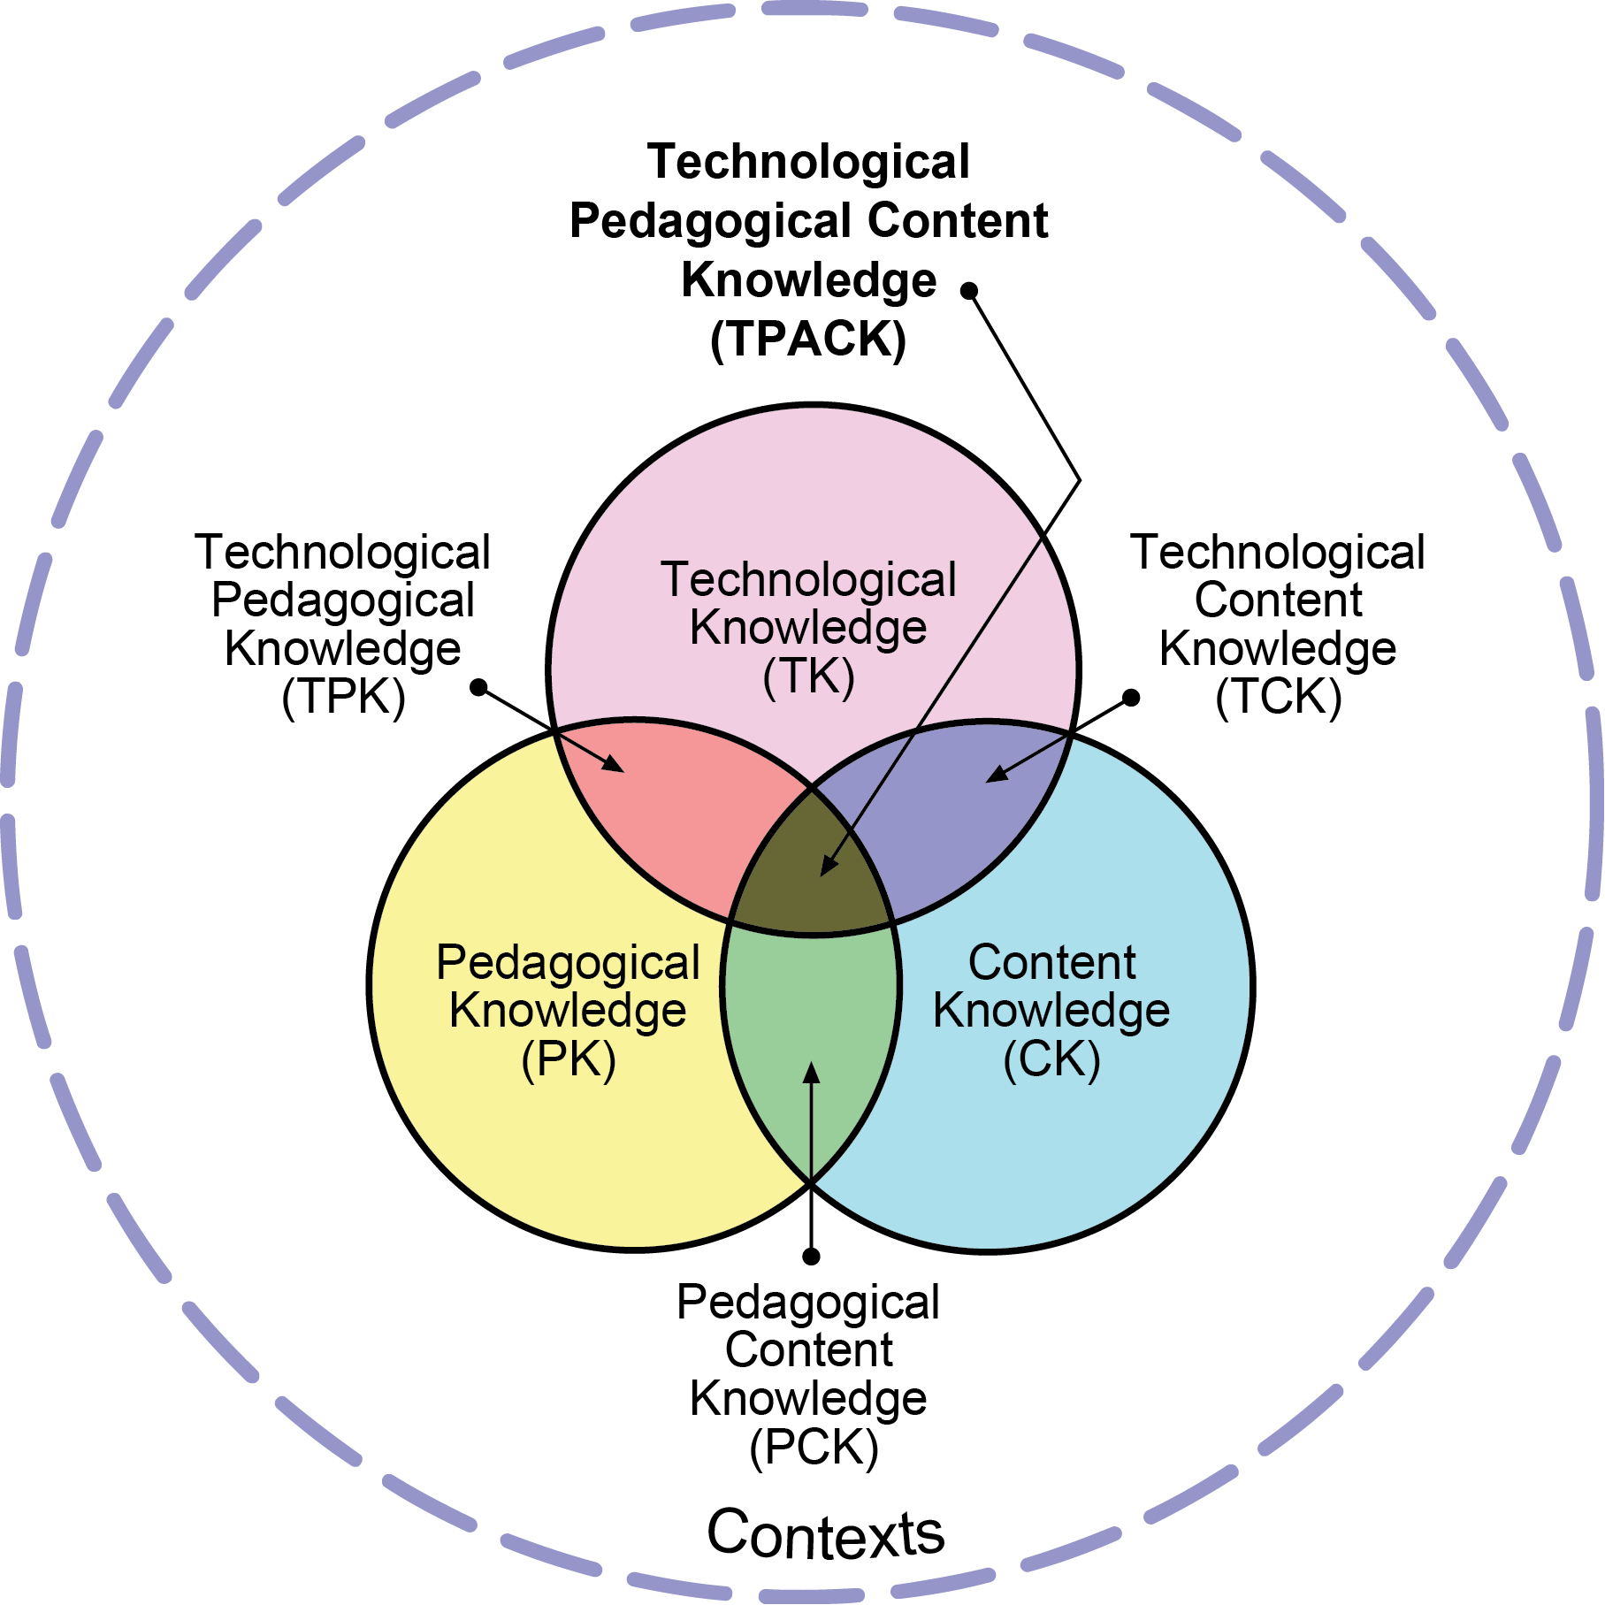
Using technology – the bigger picture
It improves and streamlines processes, facilitating the completion of tasks more effectively and easily. (Picardo, 2017)
It allows us to do things that would be inconceivable without the use of technology. (Picardo, 2017)
...stop asking "Does technology help?" and start asking "When does technology help? (Wiliam, 2019)
There are many potential benefits of tech for language learning
Be mindful of the latest shiny new app
Consider the interplay between the tech, the pedagogy and content? (TPACK, 2012)
Cost-benefit?
Digital equity?
Silver linings of remote teaching and learning due to pandemic?
Computer Assisted Language Learning (CALL) - Hub Day Webinar, 3 July 2020. Video
CALL TRG (Teacher Research Group)
Schemes of Work and Computer Assisted Language Learning (CALL), 20 Nov 2020. Video
Notes:
Let’s first model some spaced repetition and recap the bigger picture and key messages from our previous CPD sessions on Computer Assisted Language Learning (CALL). These can be found at the links at the bottom of this slide and on the NCELP Resource Portal.
So, why do we use technology in the first place? If (and it’s a big if!) technology is used effectively… - It improves and streamlines processes, facilitating the completion of tasks more effectively and easily. (Picardo, 2017)
- It allows us to do things that would be inconceivable without the use of technology. (Picardo, 2017)
If the technology is not making things easier or, more effective or does not bring something new and useful to the table, then you should strongly question why you are using technology at all.
We saw Dylan Wiliam’s sage advice to...stop asking "Does technology help?" and start asking "When does technology help? (Wiliam, 2019). This helps breaks down that unhelpful notion of there being a pitched battle between technophiles and technophobes and instead encourages us to be more reflective and to carefully consider context and our role in making tech work
There are many potential benefits of tech for language learning. Learning and exposure to the language outside the classroom, opportunities for differentiation, mixes of modes and modalities, automated marking and feedback, access to culture and native speakers to name just some
Be mindful of the latest shiny new app. Rather than rushing to use the latest app can we pause and reflect upon our use of tech, asking ourselves if there is a strong pedagogical rationale?
Consider the interplay between the tech, the pedagogy and content? (TPACK, 2012). This is neatly summarised by the TPACK model where we have this ideal sweet spot in the middle of our Venn diagram where the technology, the pedagogy and content combine or complement one another to support learning.
Cost-benefit – the financial cost is an obvious factor but also consider cost in terms of time for teachers and students. Training needs, roll out implications, degrees of gamification?
Digital equity – what steps can you take to ensure students have the requisite access to technology?
Silver linings of remote teaching and learning due to pandemic? Teachers and students upskilled, expediated the roll out of Virtual Learning Environment and ensuring student access, ways to continuing learning beyond the 4 walls of the classroom

Slide 3
What might we look for?
What might we consider when assessing the suitability of digital tools for assessment in language learning?
Assessment
Synchronous or asynchronous?
Question, response and activity types?
Functionality relating to mode & modality?
Item creation and organisation?
Feedback?
Scoring?
User experience?
Engagement?
Tech and access?
Cost?
Notes:
No digital tool is a perfect, complete solution and the next upgrade is always just around the corner –that’s the very nature of the fast-evolving edtech landscape. As a result, rather than rattling through an app a minute, it is perhaps more important to emphasise how it’s up to us to be discerning users and make well-informed decisions on when we should and when we should not employ technology in the support of our language teaching. Very much asking when does technology help as Dylan Wiliam said and linking it to our NCELP content and pedagogy. Since we are thinking of how technology could help our assessment needs, let’s first ask ourselves… What might we consider when assessing the suitability of digital tools for assessment in language learning?
Synchronous or asynchronous? Live in classroom/remote teaching with immediate formative feedback or as an assessment or assignment to be completed independently at home in in a computer lab
Question, response and activity types? MCQs? Short/long text input? Audio or video output/input? Is there a range of activities around a defined set of content? Matching? Dragging Dropping? Selecting? Is there any randomization of content?
Functionality relating to modality and mode?
can you just hear the sound without needing to have the written word displayed;
can you have the written word displayed without oral (that way around is highly likely, as most school subjects need that)
can you have written production scored and, critically, build in tolerance (computer can be told by a human to allow a letter both with and without an accent; or allows multiple answers as 'correct' when writing down words that could, in theory, be spelled in different ways; or allows grammar that could be correct 'either way') - but this is costly in terms of human effort, even for one word answers sometimes.
can it record voice and then send that to a teacher to be marked
Item creation and organisation? How easy is it to create individual questions or items, can these be saved, duplicated or shared in an easy and logical way? Can you access the content of others?
Feedback? Is the lynchpin of the formative assessment process. Immediate feedback for students in the moment or after completion? Level of detail in feedback? Ability for teacher to give bespoke written/oral feedback?
Scoring? Can this be automated? What degree of tolerance is or can be built in? How is individual and group scoring data presented to the teacher? Visual representations? Averages? Spreadsheet or data export options? Identifying poor item performance at an individual or group level?
User experience? Ease of use from both student and teacher admin end, visuals, speed, reliability?
Engagement? Gamification, elements of competition? Do these encourage or distract from learning?
Tech and access? What are the device and platform compatibility requirements? How and when do students access the tech – in lessons, at home, both? Synchronous or asynchronous?
Cost? Financial, training and time costs – do these investments make using the given technology worthwhile?

Slide 4
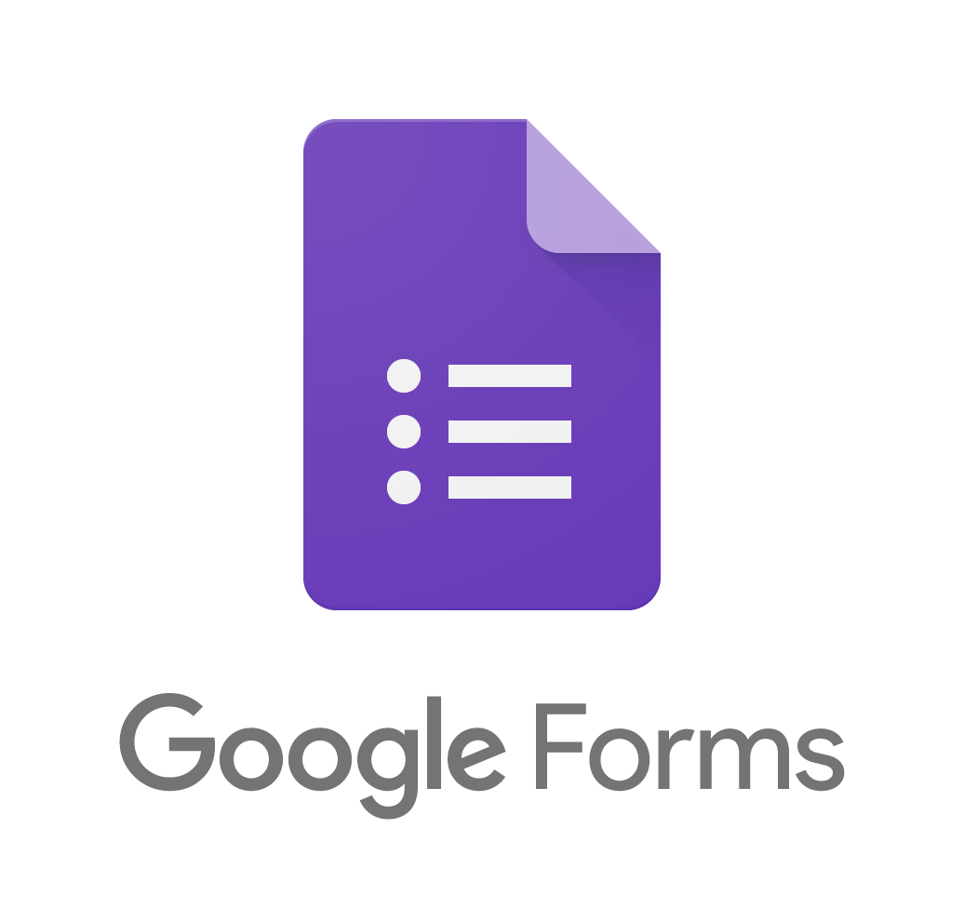
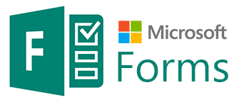
Form Creation Tools
Notes:
We are now to going to focus on Form creation tools. Many of you will no doubt be familiar with Google Forms, Microsoft Forms or similar. Forms allow you to create surveys and quizzes that allow you to digitally gather, collate and provide feedback to student responses.
The reason for focusing on forms is that:
They are free and the vast majority of schools have access to these tools or similar as part of their learning management system. There is already a good amount of knowledge and expertise in these tools within the network that can be drawn upon and shared.
Many assessment tools emerged during online teaching that were well suited to online synchronous teaching such as Blooket, Kahoot or Pear Deck. However, many of these have already become less relevant with the move back to the face-to-face classroom. However, the usefulness of forms is one that I believe can remain longer term as part of the MFL teacher’s toolkit, if implemented effectively.
Although far from perfect, these forms tools are customisable and tick a lot of the boxes discussed on the previous slide. They can likely be used relatively easily in a wide range of contexts, particularly for reading, grammar, listening and vocabulary activities.

Slide 5
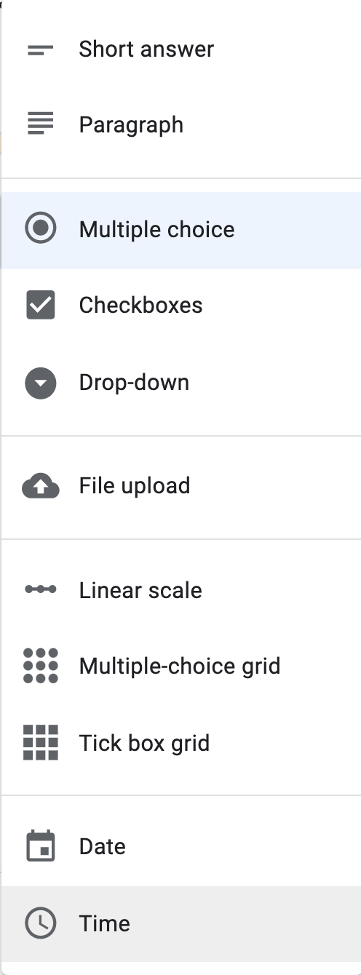
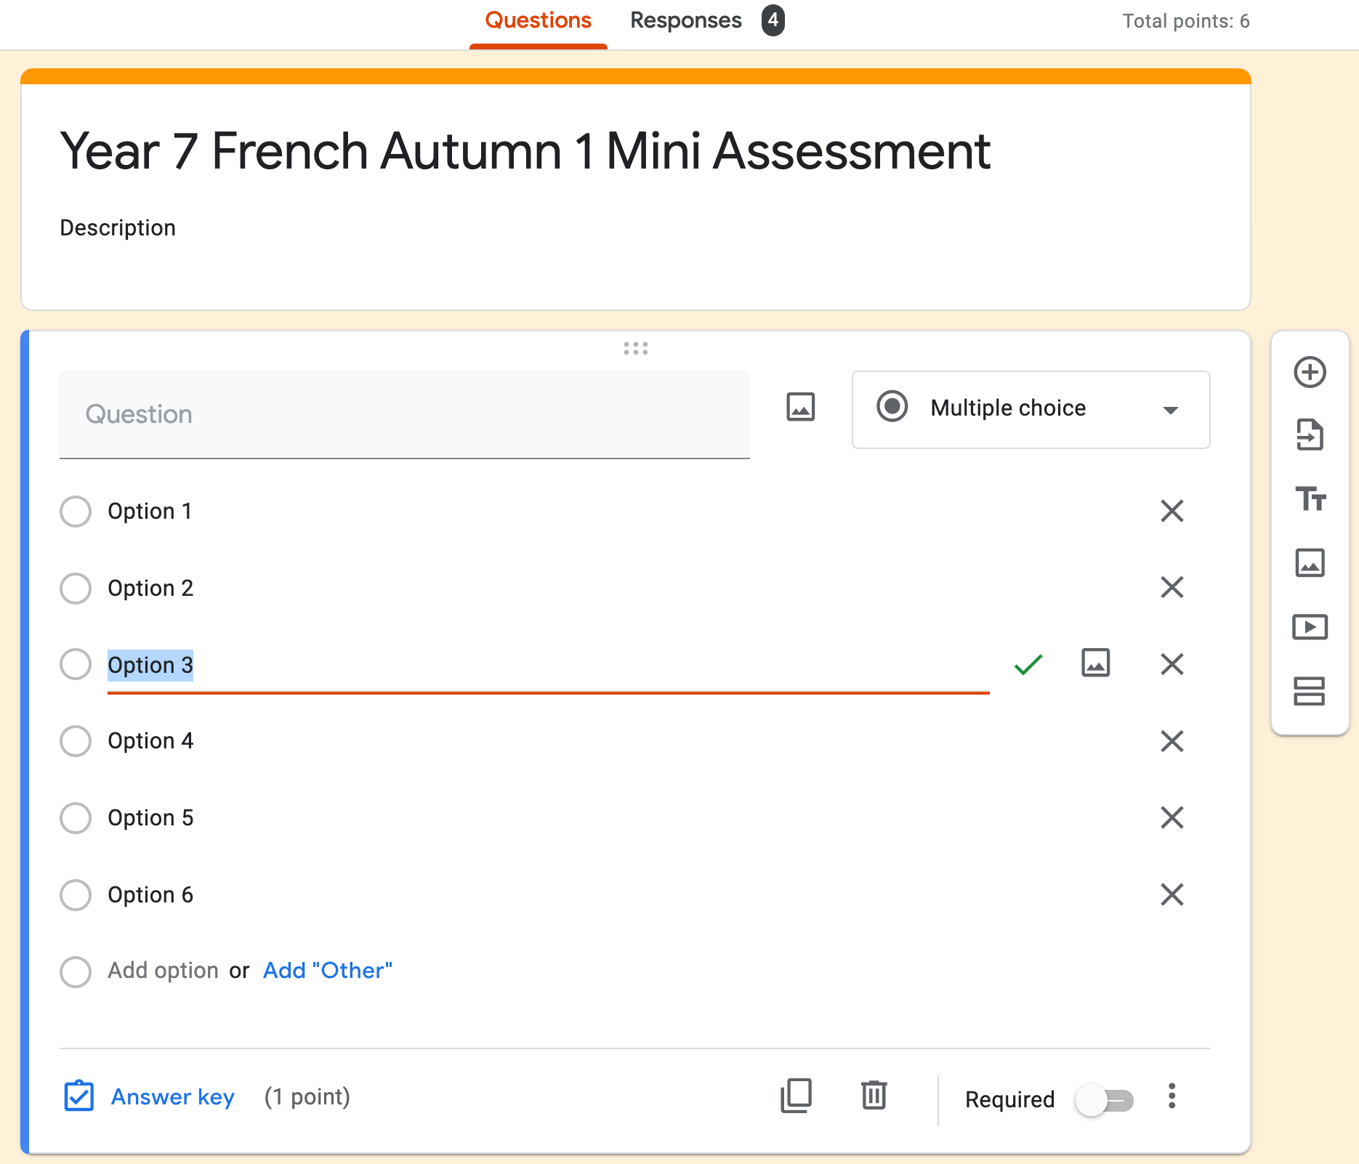
Google Forms
Notes:
Let’s have a brief overview tour of the Google Forms environment. We won’t look at MS Forms in this short session but it offers similar functionality.

Slide 6
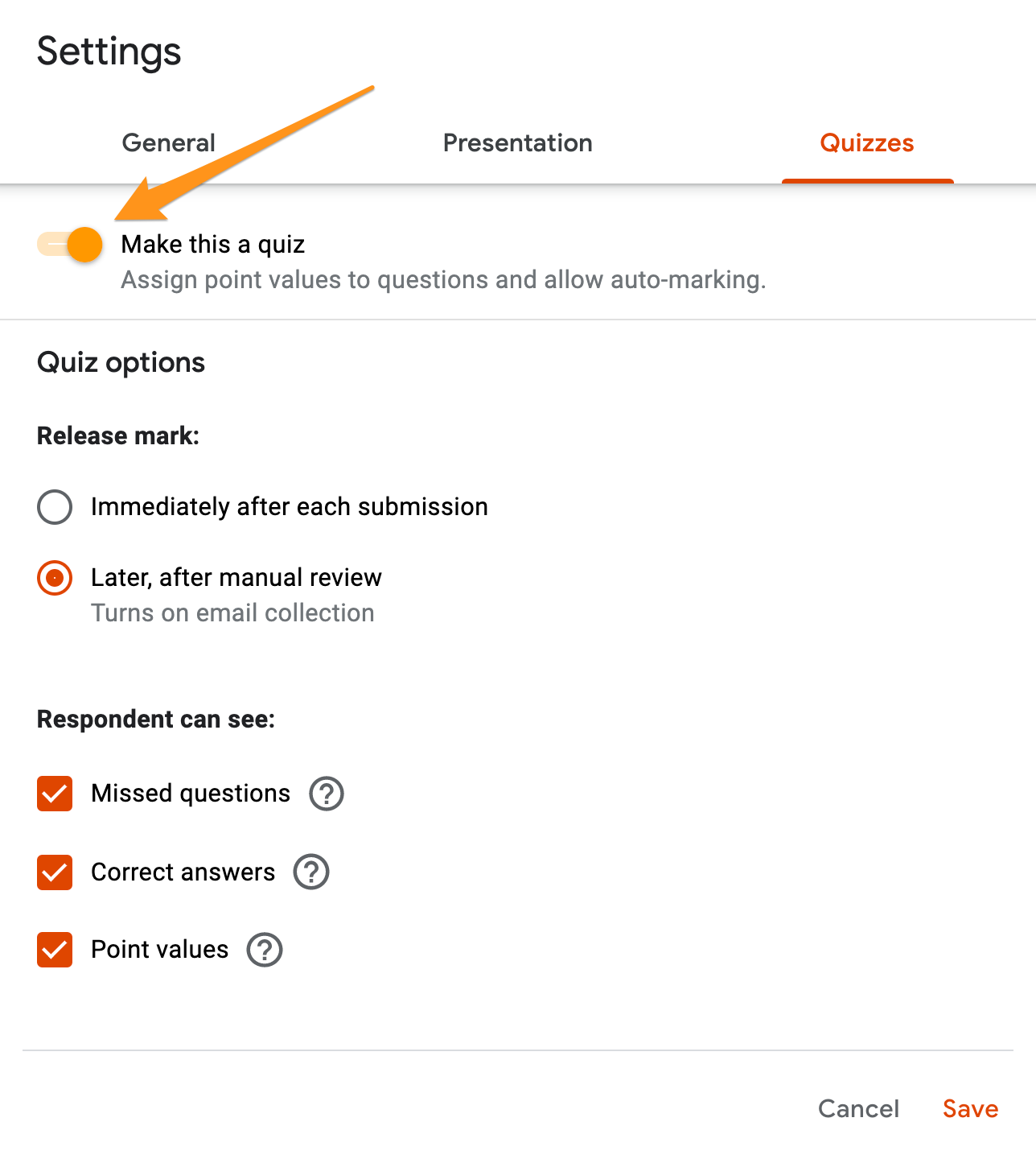
Google Forms
Notes:
In both Google and MS Forms, it is important to enable the quiz feature if you want to allow auto-marking. If not, you will miss out on many useful automated features and have a long and tedious job going through each submission and question! In the settings you can also control how marks and feedback are released, as well as what respondents can see.

Slide 7
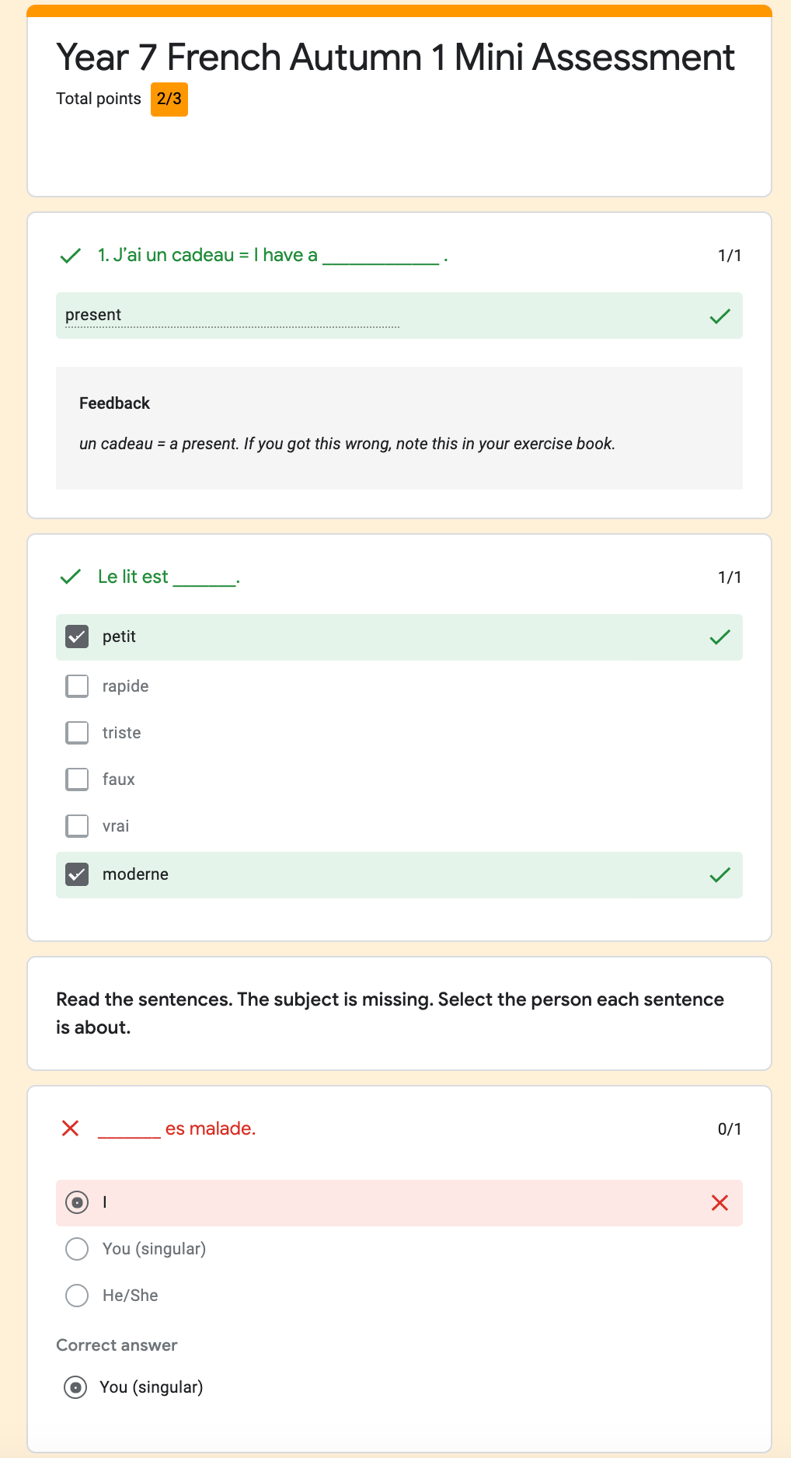
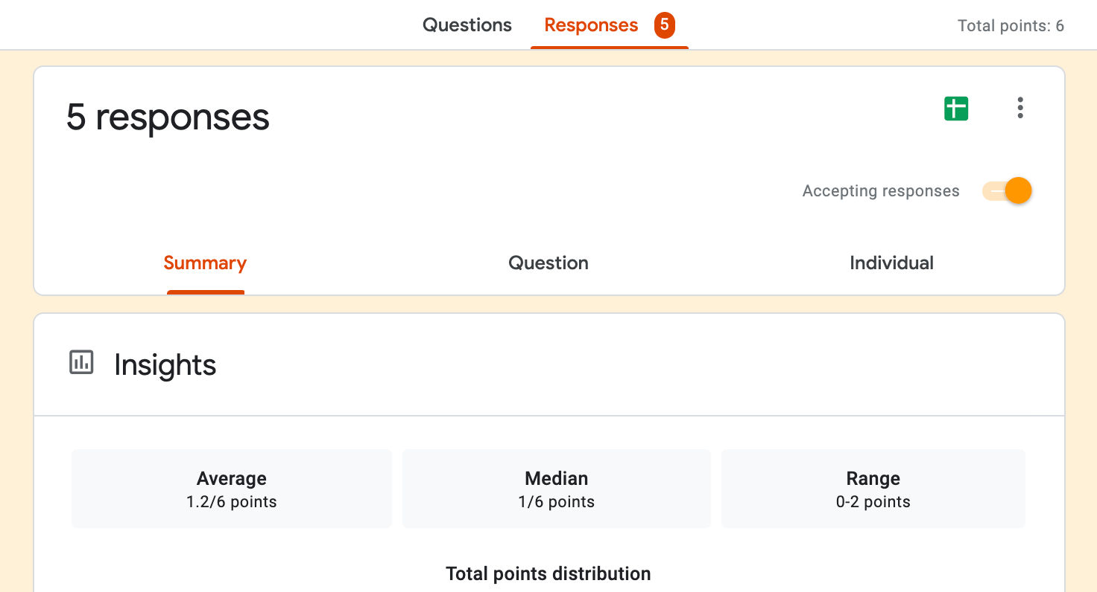
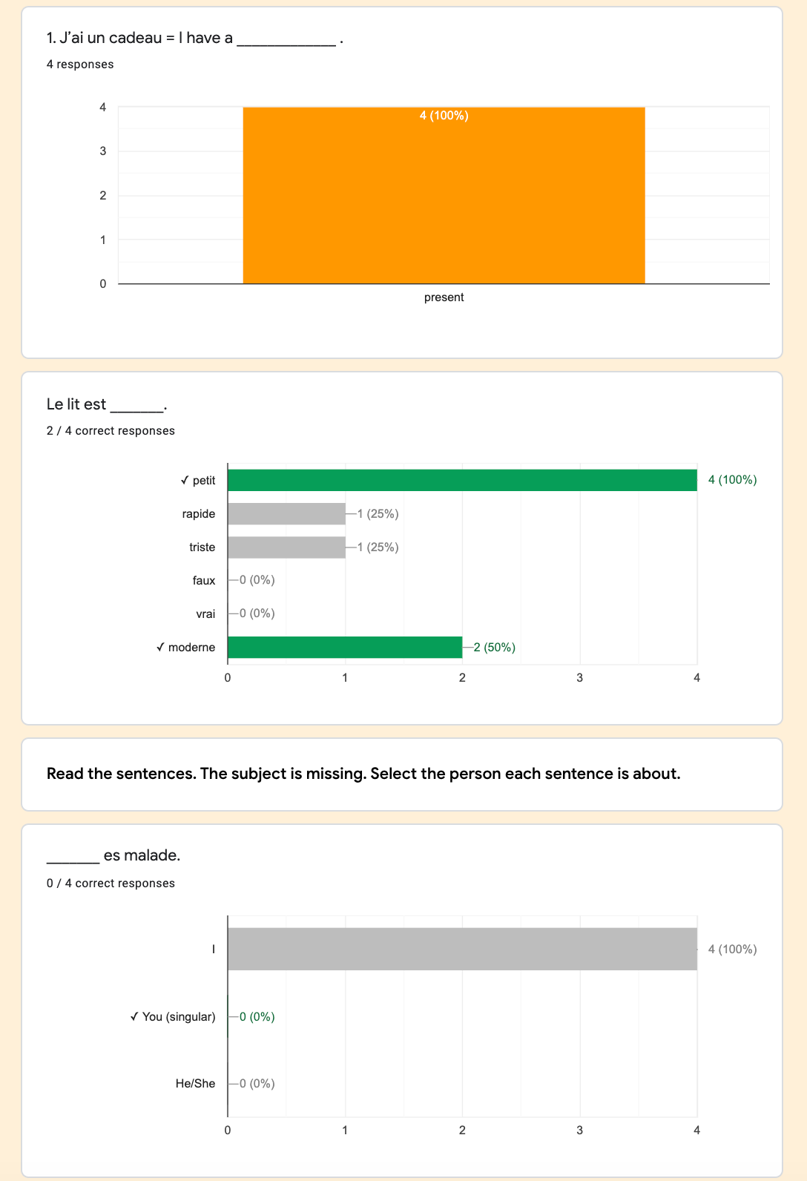
Student feedback
Teacher feedback
Notes:
Here we can see the type of auto marking and automated feedback students can receive.
The teacher has access to response data at a summary, question and individual level, as well as the spreadsheet export function.

Slide 8
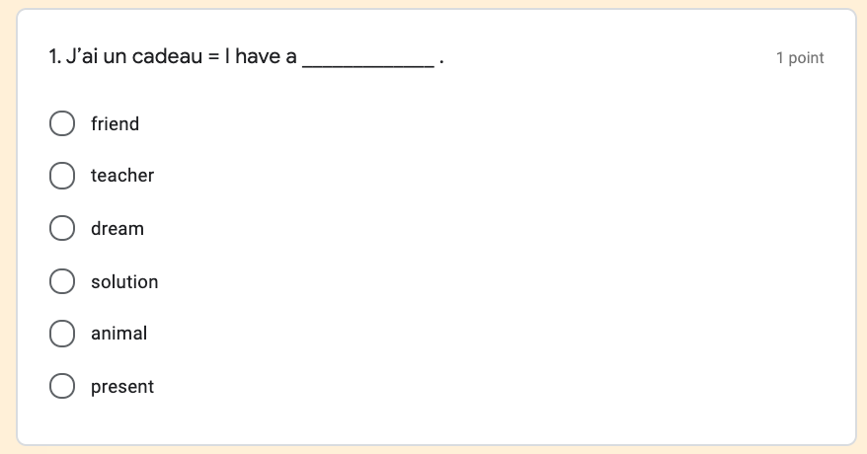
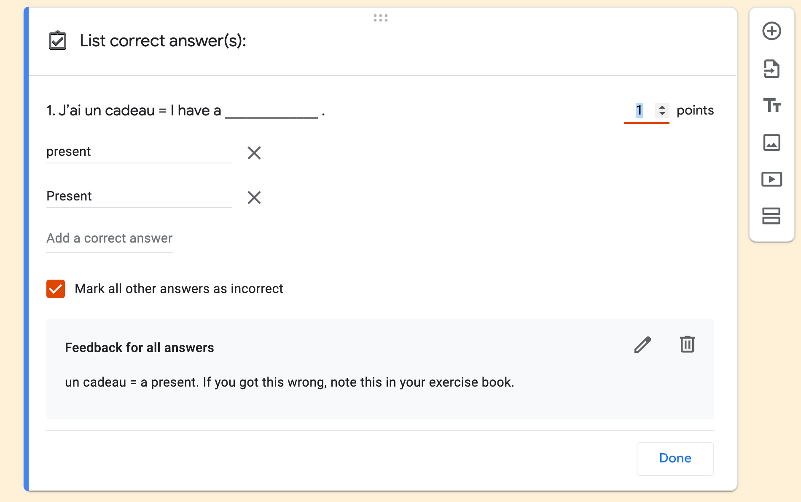
Reading. Vocabulary: meanings
Notes:
Now let’s look at some of the questions type you could use with your students. Here we see how vocabulary meaning knowledge can be very easily tested through forms as a L2 to L1 multiple choice question.
Notice the significant difference in the level of challenge with the second version - here the student has to retrieve and give the meaning rather than simply recognize it.
The final screen shot shows the bespoke feedback that can be created by the teacher and also the need to specify tolerance in this case regarding capiltalisation of the p. This would obviously get very quickly complicated when accents, punctuation or multiple words are involved. This may influence your question choices.

Slide 9
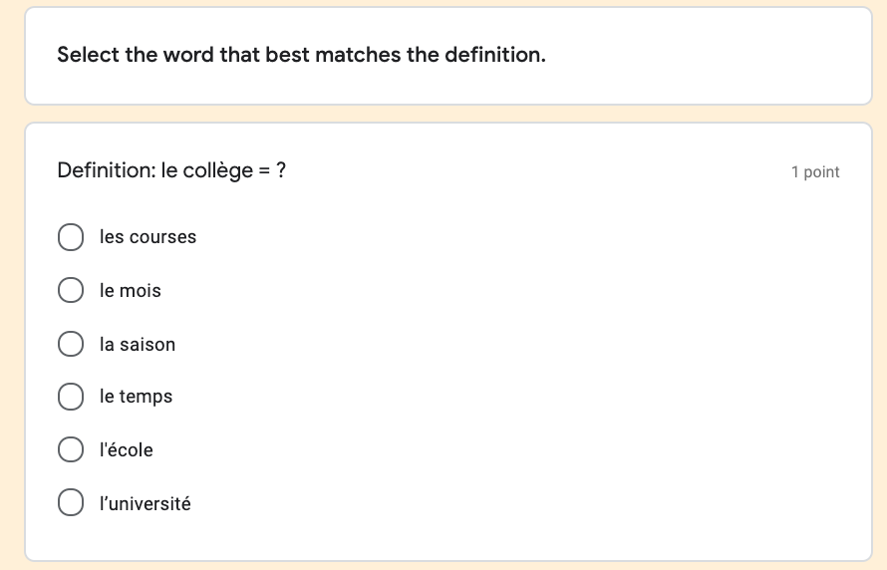
Reading. Vocabulary: synonyms
Notes:
This type of L2-L2 synonym task can be very easily created as a multiple choice question and is worth noting as it forces the revisiting of the meaning of a greater number of vocabulary items – something useful for when you need to revisit content.

Slide 10
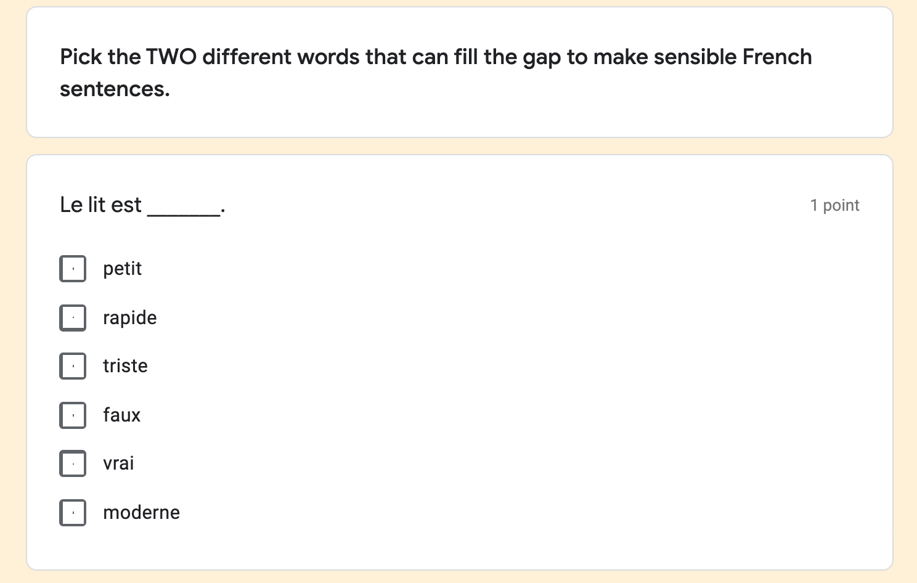
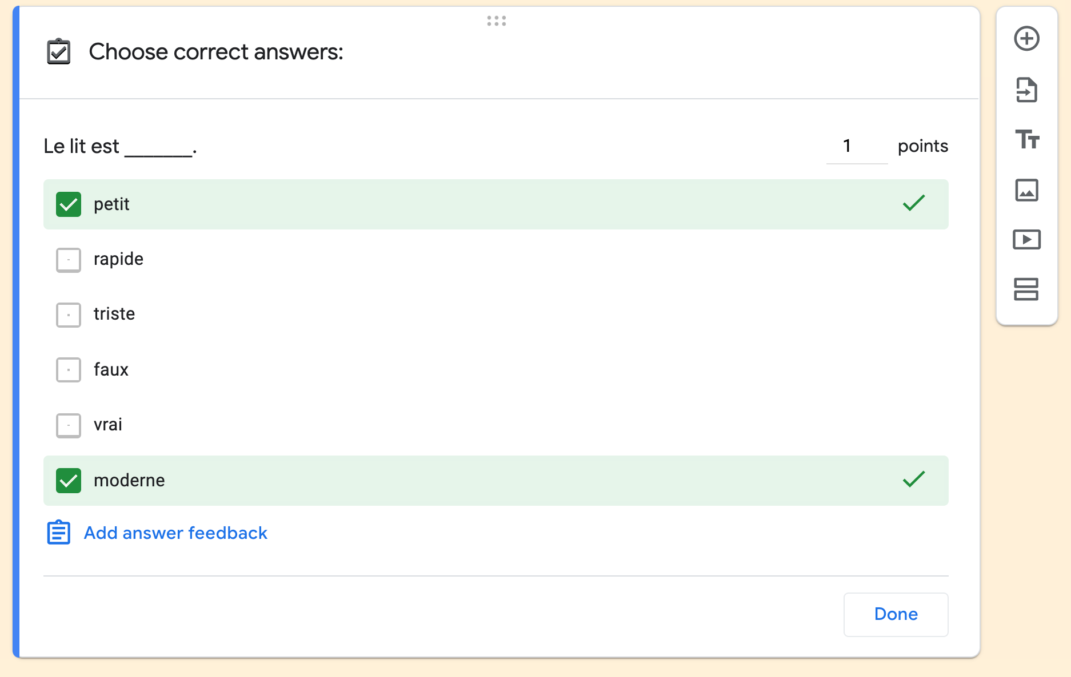
Reading. Vocabulary: collocation
Notes:
Check box type questions allow for the selection of multiple answers, which lend themselves to this type of NCELP vocabulary collocation question.
Note the limitation that if the student answers with 1 of 2 answers correct, they will not receive the mark. One work around could be to list pairs of possible answers e.g. petit, rapide // petit, moderne.

Slide 11
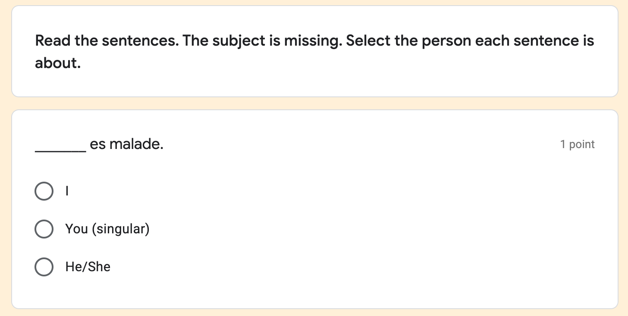
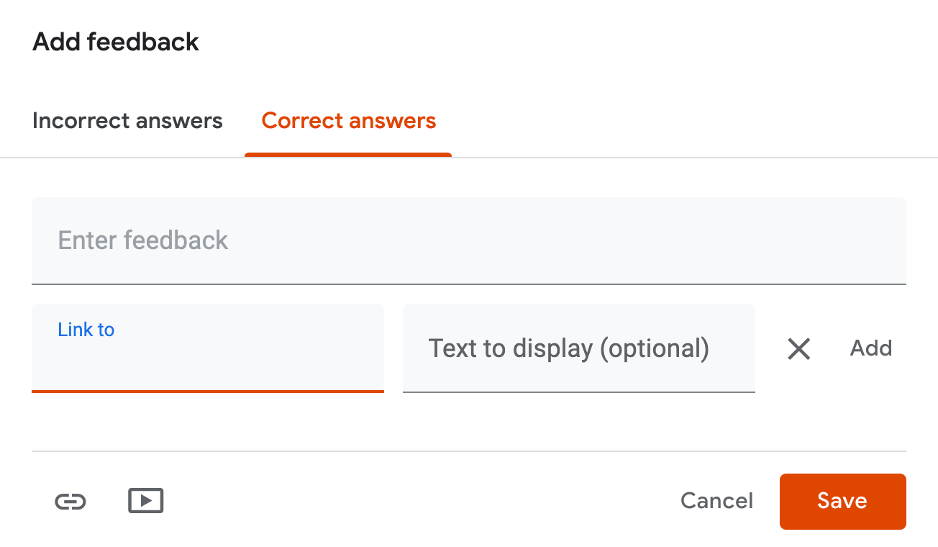
Reading. Grammar: verb forms
Notes:
A large number of the NCELP achievement and application of knowledge test reading and grammar question types can be delivered neatly through forms. This is an example of a recognition of grammar verb forms question that can be accompanied with feedback for each correct or incorrect answer or a link to a follow-up resource or video could be provided.

Slide 12
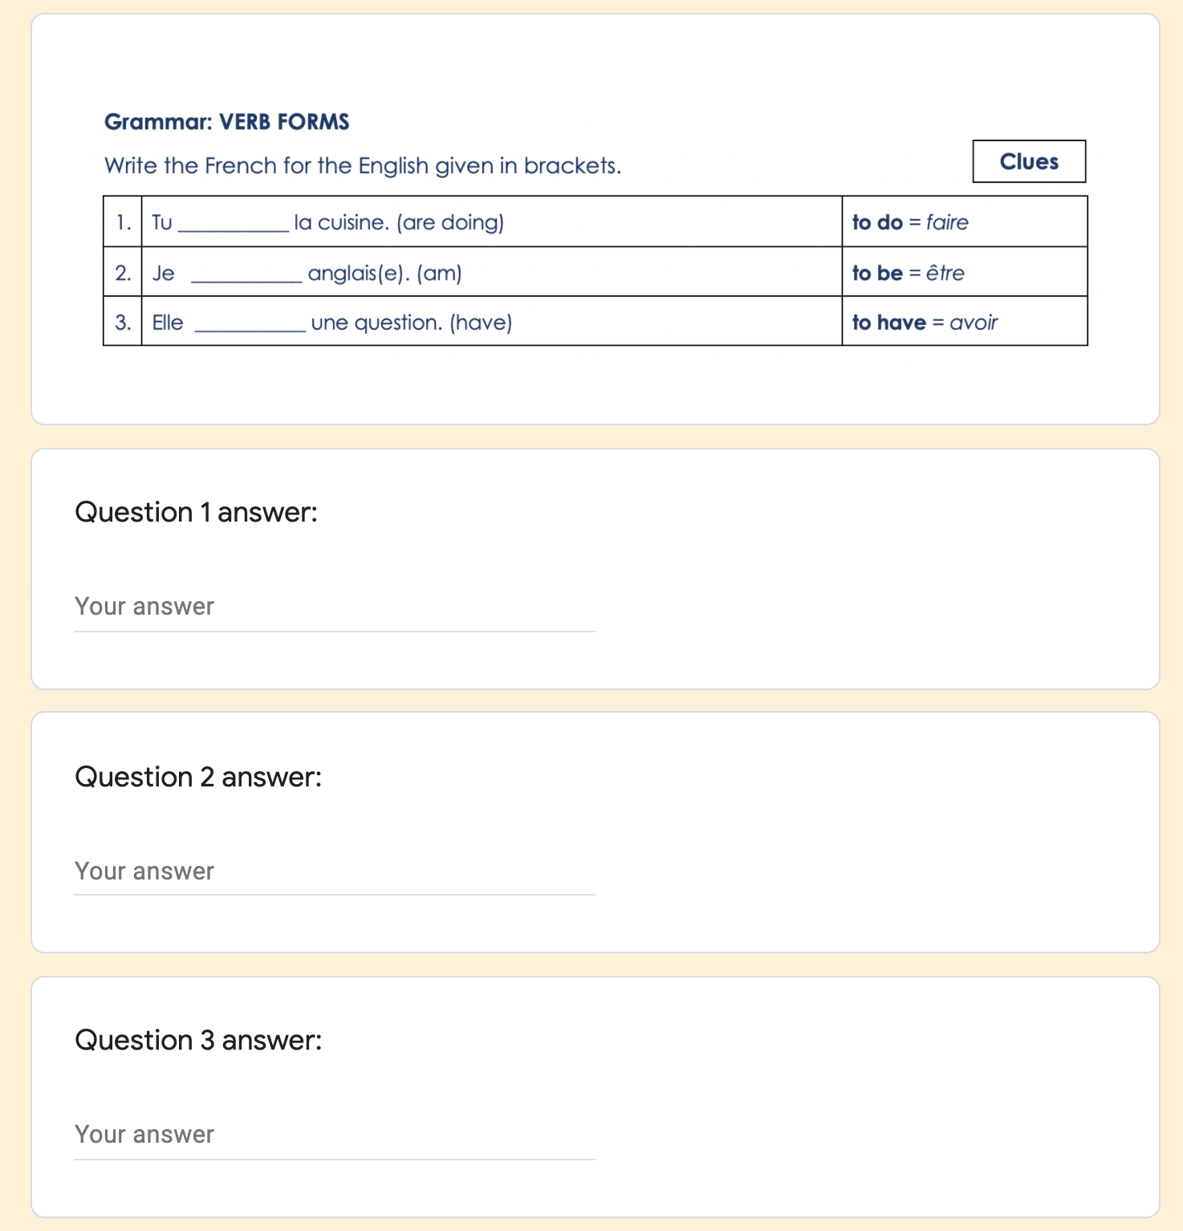
Writing. Grammar: verb forms
Notes:
This next example, again on grammar verb forms, shows how a screenshot image from an NCELP test, or a modified version of your own, could be uploaded into question fields or separately as part of the form. An advantage of this is that it’s not possible to copy/paste/select and translate and this method could potentially save time. The short text input answers can be easily auto-marked by the computer.
Notice the drawback in this example is the splitting of the test taker’s attention between the question and where the answer is typed which is not ideal.

Slide 13
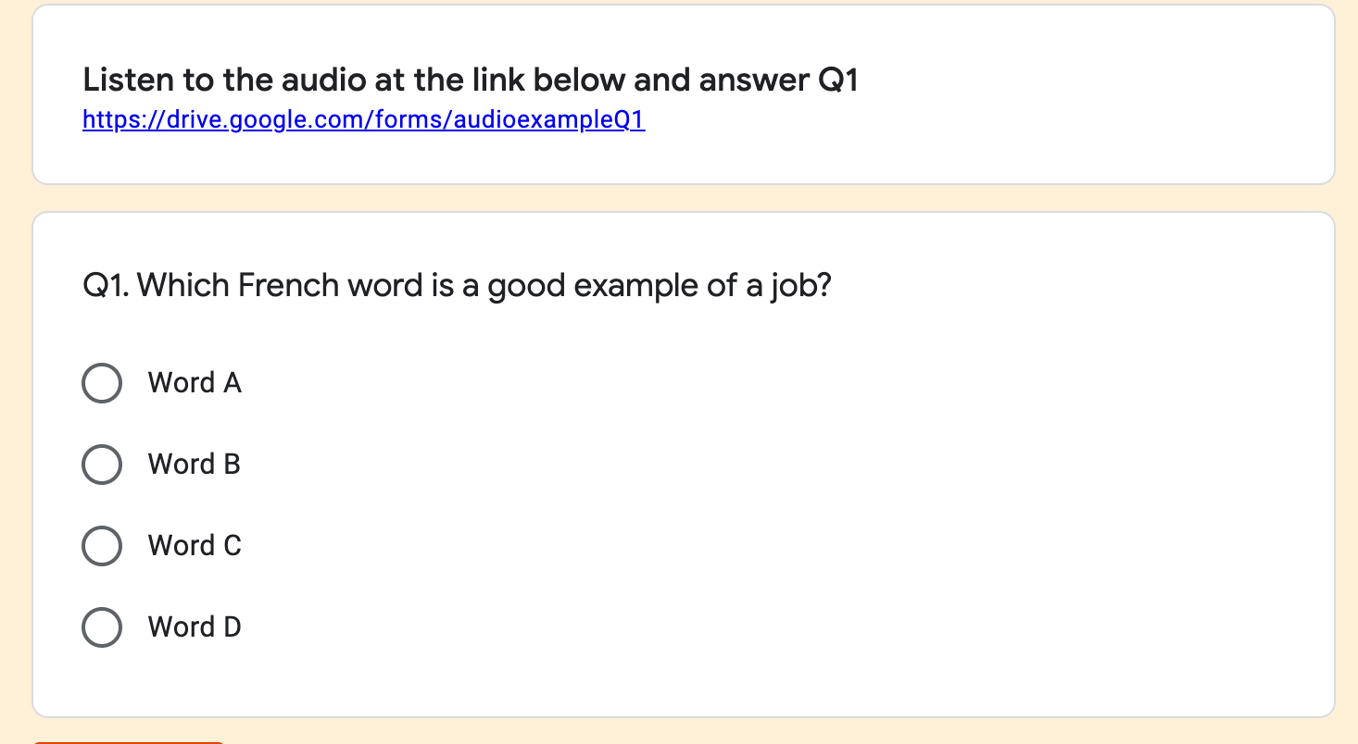
Listening examples (paste link into description or question fields)
Notes:
Neither Google or MS forms are designed for audio output but there are a couple of workarounds that would allow you to set listening questions.
One is to link to your hosted audio file and provide a link in the question description or question field. Similarly, for phonics questions the missing letters could be sought through multiple choice or short text input.
Another solution is to create your audio as a video file and link to this in your question. This is neater in that it will be embedded in your question but there are obvious costs in terms of time for preparation.

Slide 14
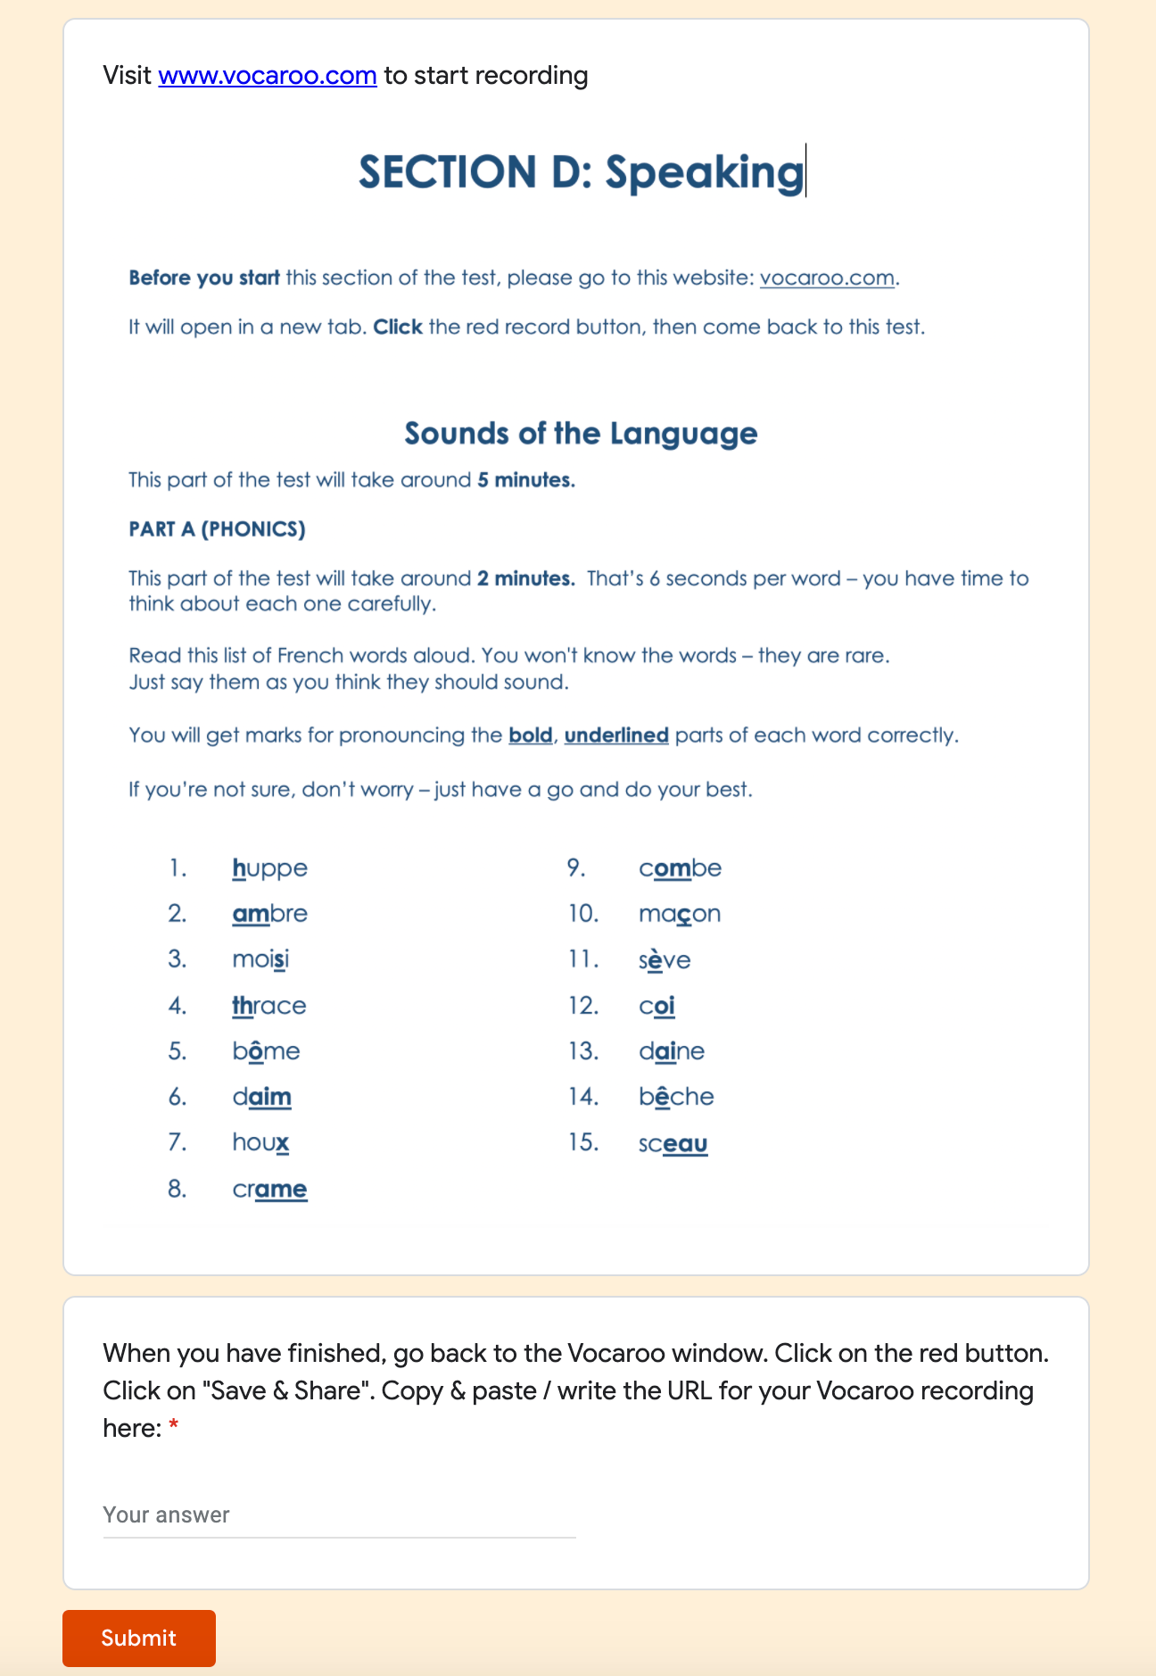
Speaking examples
Notes:
Google and MS forms are also not designed with audio input or speaking specifically in mind but there are again a couple of possible work arounds.
One is to have students record through a cloud-based audio site like Vocaroo and submit their audio url in a text field.
The other is to create a “file upload” question type and then invite students to record an audio file via their method of choice and upload to you via their form. Don’t forget that this audio recording could be captured through direct recording in Powerpoint via insert > audio > record audio.

Slide 15
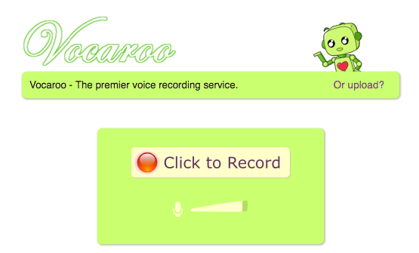
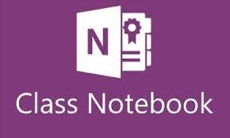
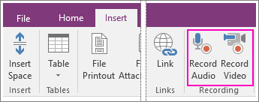
Technology-facilitated Oral Homework
Oral homework (and digital technologies) https://resources.ncelp.org/concern/resources/6m311p430?locale=en
Shanks, David. (2021). Technology-facilitated oral homework: leveraging technology to get students speaking outside the classroom. In Beaven, Tita; Rosell-Aguilar, Fernando (Eds), Innovative language pedagogy report (pp. 69-75). Research-publishing.net. https://doi.org/10.14705/rpnet.2021.50.1238
Notes:
Technology-facilitated Oral Homework refers to the idea of using any of a wide range of digital technologies to enable students to record and submit digital audio or video recordings of themselves speaking the target language.
Some of the current tools MFL teachers are putting to good use in this way are Vocaroo.com (the aforementioned browser-based audio recording website), Padlet.com (a digital bulletin board platform that accepts audio recordings via it’s app or file upload) , Flipgrid (a virtual classroom based upon video submissions), Class Notebook (which allows students to direct record audio in their online workbook) and Sanako Connect (a virtual classroom software for language teachers).
With limited curriculum contact time, TFOH can allow students to complete useful additional speaking practice, consolidate classwork and develop oral confidence at their own pace, in a lower-stakes environment away from peers. The format lends itself particularly well to the completion of phonics activities, read aloud tests and oral presentations.
Leveraging technology in this way can allow for more extensive practise of the symbol-sound correspondences. Recording spoken homework or “read aloud tests” can also make for more efficient use of class time. For example, rather than the need for 1-1 student-teacher assessment of a read aloud test in a lesson, students can do this at home or simultaneously in class and the recordings can then be assessed later by the teacher, thus freeing up teaching time.
A reminder of the A4 page Oral Homework summary document shared in previous TRGs and here is a link to my recent article entitled “Technology-facilitated oral homework: leveraging technology to get students speaking outside the classroom’, which gives an updated overview of the concept, additional ideas and further detail around a Masters dissertation completed in 2019.

Slide 16
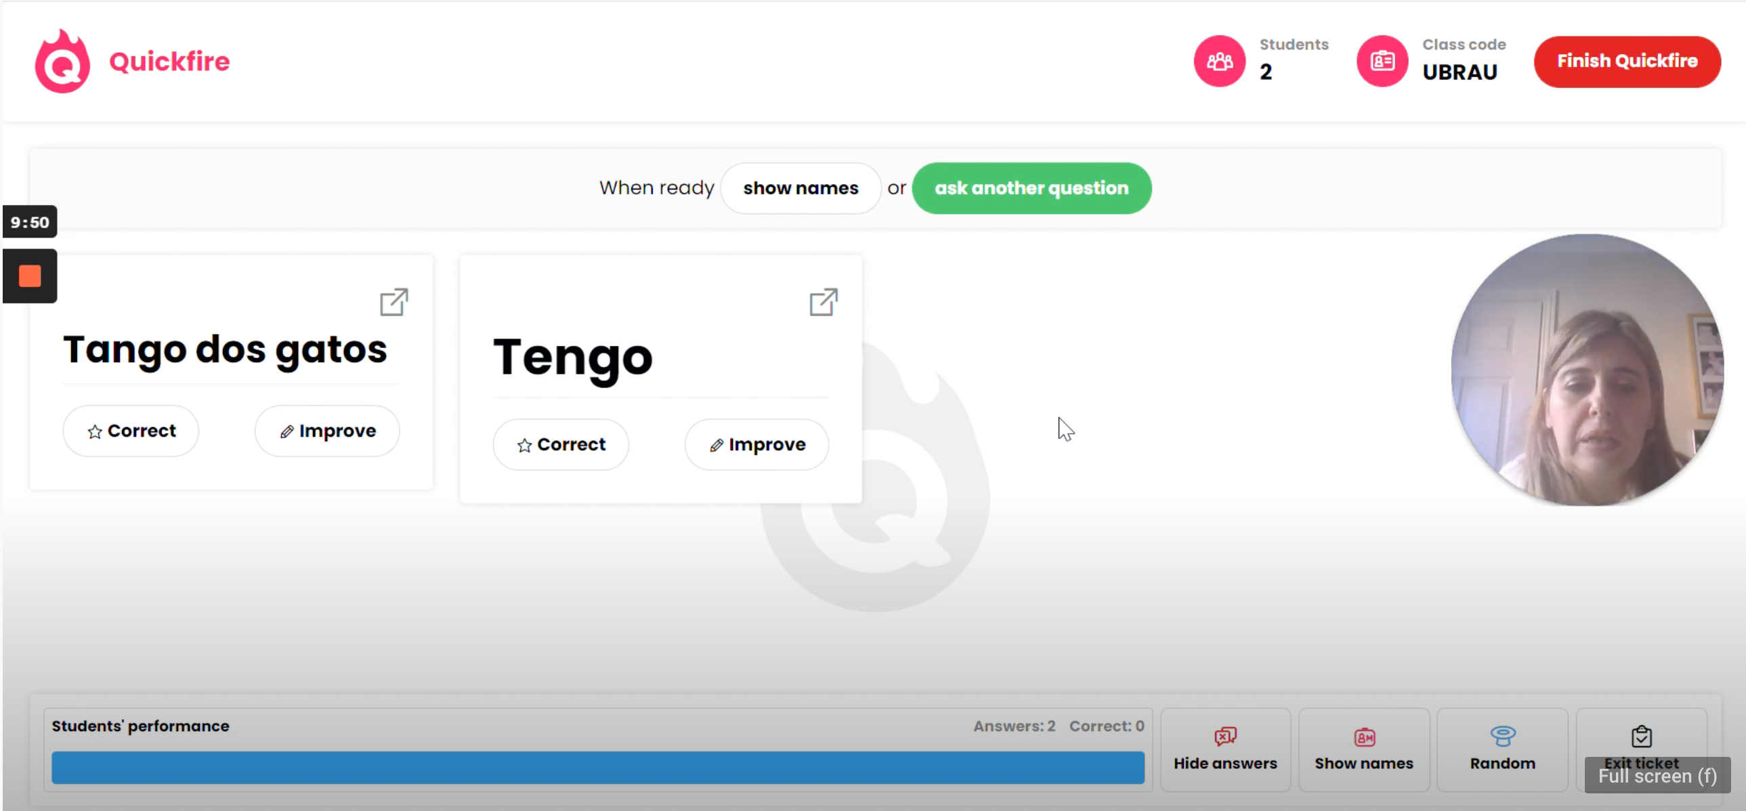
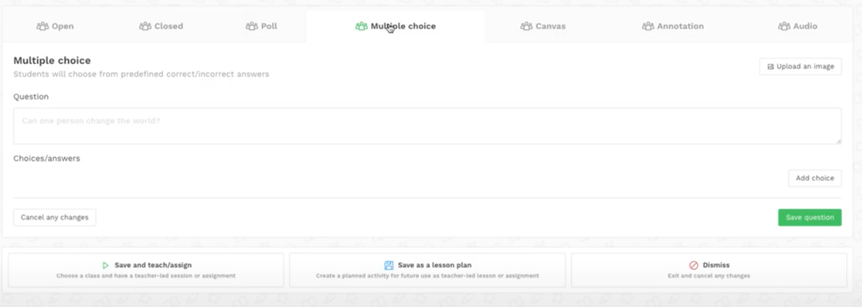
Spiral.ac
URL: https://spiral.ac/
Further info: Overview; Quickfire lite; Quickfire; MFL Teacher Esmeralda Salgado’s tutorial
Notes:
One final tool I would like to share with you is Spiral.ac. Whilst I have no first-hand experience of using it, I'm aware of a number of teachers who have been very positive about its usefulness for MFL.
Spiral calls itself “all your favourite formative assessment apps in one platform” and it does seem to combine features of formative assessment tools.
The advantages appear to be that no apps or downloads are needed and so no integration with your LMS is necessary and students access via a code. It offers both live formative feedback and asynchronous assignment setting which to me appears to be a real strength.
There are 2 main modes that are of interest to us.
Quickfire Lite: Ask a verbal question and instead of one hand going up the whole class can respond from any device, answer fed back to teacher in form of digital mini whiteboards. Higher quality formative assessment in seconds and written answers can be included so is not limited to MCQs.
Quickfire: Lets you plan a prepared quiz as a teacher-led or as a student-led independent activity. Choose a range of 7 question formats from open, closed, MCQ, polls, annotations, drawings and audio response. Assess in real-time or asynchronously.
The disadvantages are the need for a 1-1 device for use in a synchronous environment and whilst currently free, the future cost unclear.

Slide 17
Self-reflection and TRG discussion questions
Consider these questions individually and be prepared to discuss and share your answers at your TRG.
What tech did you make use of during remote teaching?
What tech have you kept, what have you dropped and why?
What technology do you or your department currently use to support assessment in MFL?
Discuss and assess any assessment tools/apps/platforms in relation to the features on slide 3 and the TPACK model. What are the relative strengths and weaknesses? Refer to NCELP content and pedagogy.
Have you used any form creation tools? If so, which ones and in what ways or question types? What learning have you to share?
Summarise what you took from the article Technology-facilitated oral homework: leveraging technology to get students speaking outside the classroom?
Have you run Technology Facilitated Oral Homework? If yes, what did you set and how? If not yet, what would you try first or what might need to change for it to be feasible?
Commit! Set yourself one principled, specific target on developing your own use of technology for assessment in MFL.

Slide 18
References
Picardo, J. (2017). Using Technology in the Classroom. London: Bloomsbury.
Shanks, David. (2021). Technology-facilitated oral homework: leveraging technology to get students speaking outside the classroom. In Beaven, Tita; Rosell-Aguilar, Fernando (Eds), Innovative language pedagogy report (pp. 69-75). Research-publishing.net. https://doi.org/10.14705/rpnet.2021.50.1238
TPACK. (2012). TPACK Explained: The Seven Components of TPACK. Retrieved from http://tpack.org
Wiliam, D. [@dylanwiliam]. (2019, June 16). Cross-sectional analyses of PISA and NAEP data suggest little or no overall relationship between technology use and student achievement: http://bit.ly/2RhROeD. We need to stop asking "Does technology help?" and start asking "When does technology help? [Tweet]. Twitter. https://twitter.com/dylanwiliam/status/1140060627580399621?s=20
David Shanks

