Slide 1
Saying what there is in different places
Word order 2 with adverbs of location
SSC [-ig]
Y7 German
Term 3.1 - Week 6 - Lesson 59
Author name(s): Natalie Finlayson / Rachel Hawkes
Artwork: Steve Clarke
Date updated: 20/12/21
Notes:
Artwork by Steve Clarke. All additional pictures selected are available under a Creative Commons license, no attribution required.
Learning outcomes (lesson 1):
Introduction of SSC [-ig]
Introduction of word order 2 with adverbs of location
Word frequency (1 is the most frequent word in German):
7.3.1.6 (introduce) dauern [744] erreichen [309] fahren² [2138] schaffen1 [285] suchen [293] viel, viele [56] das Land1 [134] Schottland [>5009] Schweiz [763] Stunde1 [276] Wien [n/a] dort [134] normalerweise [2062]
7.3.1.1 (revisit) Dienstag [1356] Mittwoch [1187] Donnerstag [1244] Freitag [981] Samstag [1112] Sonntag [804] wann? [657] am Morgen [311] Morgen [621] im Orchester [2553] Orchester [4113] im Chor [3714] Chor [>5009] Bibliothek [2366] Theater [1086] Verein [899]
7.2.1.5 (revisit) bleiben [113] brauchen [179] glauben [156] heißen [132] leben [98] liegen [107] reisen [933] verstehen [211] werden¹, wird¹ [8] Österreich [1511] nach¹ [34] nach Hause [n/a]
Source: Jones, R.L & Tschirner, E. (2019). A frequency dictionary of German: Core vocabulary for learners. London: Routledge.
The frequency rankings for words that occur in this PowerPoint which have been previously introduced in NCELP resources are given in the NCELP SOW and in the resources that first introduced and formally re-visited those words.
For any other words that occur incidentally in this PowerPoint, frequency rankings will be provided in the notes field wherever possible.

Slide 2
-ig
richtig
Notes:
Timing: 1 minute
Aim: To introduce/consolidate SSC [-ig]
Procedure: 1. Present the letter(s) and say the [-ig] sound first, on its own. Students repeat it with you. 2. Bring up the word ”richtig” on its own, say it, students repeat it, so that they have the opportunity to focus all of their attention on the connection between the written word and its sound.
3. A possible gesture for this would be to mime ‘correct’ by tracing a tick in the air with the index finger on your right hand.
4. Roll back the animations and work through 1-3 again, but this time, dropping your voice completely to listen carefully to the students saying the [-ig] sound, pronouncing ”richtigi” and, if using, doing the gesture. Word frequency (1 is the most frequent word in German): richtig [211]
Source: Jones, R.L. & Tschirner, E. (2006). A frequency dictionary of German: core vocabulary for learners. Routledge

Slide 3
-ig
richtig
Notes:
With sound and no pictures to focus all attention on the sound-symbol correspondence.

Slide 4
-ig
richtig
Notes:
Without sound to elicit pronunciation (without first hearing the teacher).
Teacher to elicit pronunciation by asking “Wie sagt man…”

Slide 5
-ig
notwendig
wichtig
[necessary]
[important]
richtig
fertig
wenig
[ready, finished]
Schwierigkeit
[little / not very much]
[difficulty]
Notes:
Timing: 2 minutes
Aim: To introduce/consolidate SSC [-ig]
Procedure:
Introduce and elicit the pronunciation of the individual SSC [-ig] and then the source word again ‘richtig’ (with gesture, if using).
Then present and elicit the pronunciation of the five cluster words.
The cluster words have been chosen for their high-frequency, from a range of word classes, with the SSC (where possible) positioned within a variety of syllables within the words (e.g. initial, 2nd, final etc.). Additionally, we have tried to use words that build cumulatively on previously taught SSCs (see the Phonics Teaching Sequence document) and do not include new SSCs. Where new SSCs are used, they are often consonants which have a similar symbol-sound correspondence in English.
Word frequency (1 is the most frequent word in German): richtig [211]; notwendig [168] wichtig [177]; fertig [717]; Schwierigkeit [866]; wenig [102]. Source: Jones, R.L. & Tschirner, E. (2006). A frequency dictionary of German: core vocabulary for learners. Routledge

Slide 6
-ig
notwendig
wichtig
richtig
fertig
wenig
Schwierigkeit
Notes:
With sound and no pictures to focus all attention on the sound-symbol correspondence.

Slide 7
-ig
notwendig
wichtig
richtig
fertig
wenig
Schwierigkeit
Notes:
Without sound to elicit pronunciation (without first hearing the teacher).
Teacher to elicit pronunciation by asking “Wie sagt man…”

Slide 8
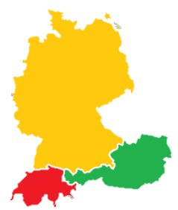
Phonetik
hören
Es gibt viele Dialekte in Deutschland, Österreich und der Schweiz!
In Norddeutschland
sagt man:
In Süddeutschland, Österreich und der Schweiz sagt man:
1
-ig wie [ich]
1
-ig wie [ik]
D
2
wichtig
2
wichtig
3
fertig
Ö
3
fertig
S
4
wenig
4
wenig
Notes:
Timing: 3 minutes
Aim: to introduce students to the idea of regional variation in pronunciation of [-ig] between the DACH countries.
Procedure: 1. Click to bring up the information about pronunciation in Northern Germany, plus the example words.
2. Click on the buttons to play each word.
3. Students mimic pronunciation chorally.
4. Repeat for Southern Germany, Austria and Switzerland examples.
Word frequency (1 is the most frequent word in German):
Dialekt [2993], Nord- [1204], Süd- [1534] wenig [102] fertig [>5009]
Source: Jones, R.L & Tschirner, E. (2011). A frequency dictionary of German: Core vocabulary for learners. London: Routledge.

Slide 9
Wo wohnen sie?
Remember! The –ig SSC is normally found at the end of words (exception: Schwierigkeit)
hören
Zuhören! Wo wohnen die Leute?
 | in Norddeutschland | in Süddeutschland, in Österreich oder in der Schweiz
1
2
3
4
5
6
Notes:
Timing: 4 minutes
Aim: to practise distinguishing regional variation in pronunciation of [-ig] between the DACH countries.
Procedure: 1. Remind students that for most examples (number 4, Schwierigkeit, being an exception) students will have to listen to the end of words to work out the answer.
2. Click on the buttons to play the audio.
3. Students listen and tick the appropriate column.
4. Click to bring up the answers one by one.
Transcript:
1. wichtig [hard]
2. wenig [soft]
3. notwendig [soft]
4. Schwierigkeit [hard]
5. richtig [soft]
6. fertig [hard]
Word frequency (1 is the most frequent word in German):
Nord- [1204], Süd- [1534] wenig [102] notwendig [742] Schwierigkeit [1541] fertig [717]
Source: Jones, R.L & Tschirner, E. (2011). A frequency dictionary of German: Core vocabulary for learners. London: Routledge.

Slide 10
Codewörter (1/4)
lesen / hören
die Stunde
Die Detektive sucht das Codewort! Kannst du helfen?
STRENG GEHEIM
erreichen
schaffen
Es ist kein Verb.
Es ist ein Ort.
Es ist ein Land in Europa.
Es hat die SSC
suchen
Schottland
dauern
Wien
die Schweiz
fahren
1
viel, viele
dort
das Land
normalerweise
Notes:
Timing: 10 minutes (all 4 slides)
Aim: to categorise the words in this week’s vocabulary set in order to work out, by process of elimination, which word is the codeword.
Procedure: 1. Ask students to draw on their existing knowledge of German to work out the meanings of Codewörter and streng geheim. Draw attention to compounding and use of plural rule 4 in the title.
2. Ask students to write down all the words in their books.
3. On clicks, the clues appear. Reveal these one by one, giving students time to score out words that don’t fit the given category. Click on the button to play the sound for the last clue.
4. Once all clues have been revealed, ask students ‘Was ist das Codewort?’
5. Go through the clues again to check the answers. Elicit responses by asking e.g. ‘Welche Wörter sind Verben?’ On clicks, groups of words eliminated at each stage disappear, until only the solution remains.
Transcript
[z]
Word frequency (1 is the most frequent word in German):
Code [>4034] Detektiv [>4034] Europa [>4034] Verb [>4034] geheim [2527]
Source: Jones, R.L & Tschirner, E. (2011). A frequency dictionary of German: Core vocabulary for learners. London: Routledge.

Slide 11
Codewörter
lesen / hören
die Stunde
Die Detektive sucht das Codewort! Kannst du helfen?
STRENG GEHEIM
erreichen
schaffen
Es ist blau.
Es ist keine Aktivität.
Es hat die SSC
Es ist ein Adverb.
suchen
Schottland
dauern
Wien
die Schweiz
2
Remember!
Adverbs describe how we do things
fahren
viel, viele
dort
das Land
normalerweise
Notes:
As for previous slide.
The bubble reminding students of the definition of an adverb primes them for the exercises to follow.
Transcript
[ei]
Word frequency (1 is the most frequent word in German):
Aktivität [1431] Adverb [>4043]
Source: Jones, R.L & Tschirner, E. (2011). A frequency dictionary of German: Core vocabulary for learners. London: Routledge.

Slide 12
Codewörter
lesen / hören
die Stunde
Die Detektive sucht das Codewort! Kannst du helfen?
STRENG GEHEIM
erreichen
schaffen
3
suchen
Es hat nicht die SSC
Es hat keinen Artikel.
Es ist kein Ort.
Es ist ein Quantitätswort.
Schottland
dauern
Wien
die Schweiz
fahren
viel, viele
dort
das Land
normalerweise
Notes:
As for previous slide.
Transcript
[w]
Word frequency (1 is the most frequent word in German):
Artikel [903] Quantität [>4043]
Source: Jones, R.L & Tschirner, E. (2011). A frequency dictionary of German: Core vocabulary for learners. London: Routledge.

Slide 13
Codewörter
lesen / hören
die Stunde
Die Detektive sucht das Codewort! Kannst du helfen?
STRENG GEHEIM
erreichen
schaffen
Es ist keine Stadt.
Es ist nicht gelb.
Es hat nicht die SSC
Es heißt gehen, aber mit Bus oder Rad.
suchen
Schottland
dauern
Wien
die Schweiz
4
fahren
viel, viele
dort
das Land
normalerweise
Notes:
As for previous slide.
The final clue provides a lead-in to the next exercise.
Transcript
[sch]
Word frequency (1 is the most frequent word in German):
Aktivität [1431] Adverb [>4043]
Source: Jones, R.L & Tschirner, E. (2011). A frequency dictionary of German: Core vocabulary for learners. London: Routledge.

Slide 14
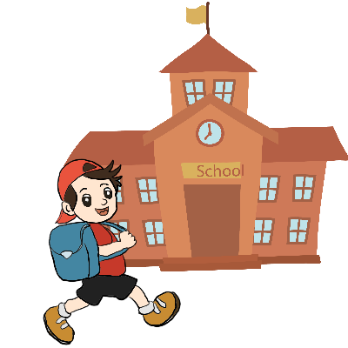
Gehen oder fahren?
Vokablen
German has two words meaning ‘to go’.
WIEN
gehen
fahren
to go (on foot)
to go (by transport)
Ich gehe in die Schule.
Wir fahren nach Wien.
When choosing a translation for ‘to go’, always ask yourself – by foot or transport?
Notes:
Timing: 2 minutes
Aim: To explain the difference between gehen and fahren.
Procedure: 1. Cycle through the information on the slide using the animation sequence.

Slide 15
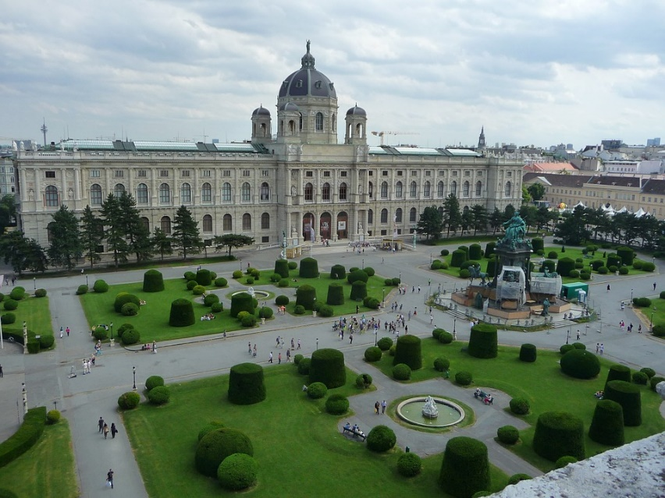
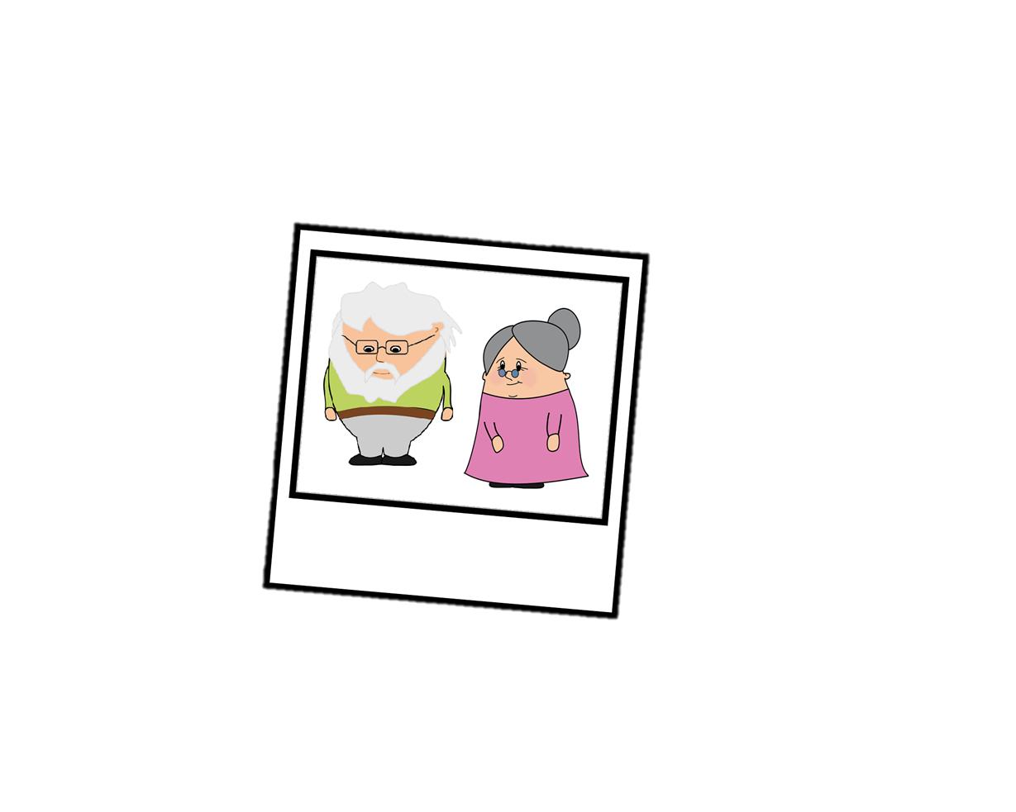
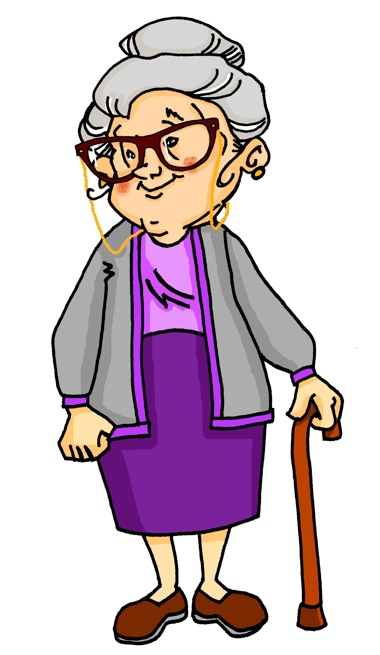
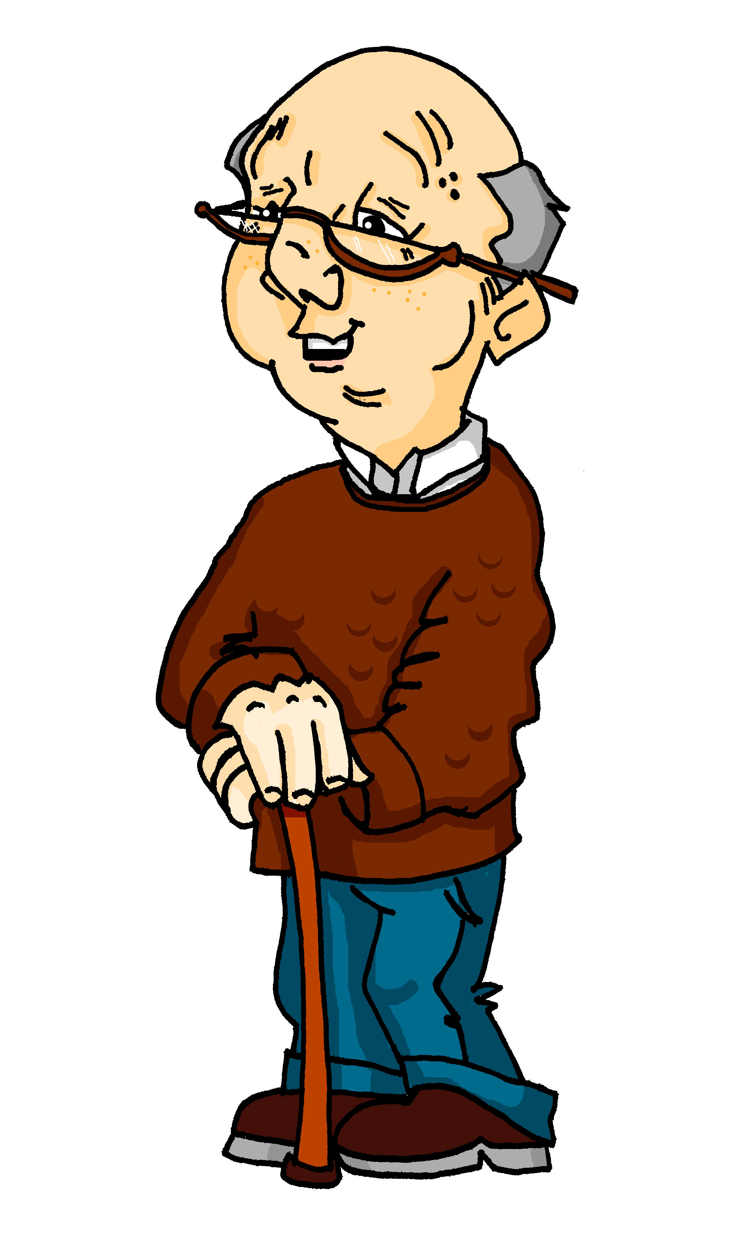
Gehen, fahren oder sein?
lesen
Wolfgang und Mia bekommen eine Postkarte!
Wer macht was? Schreib Verbformen!
_____
1. Hallo! Heute sind wir in Wien!
2. Wir sind im Moment im Stadtzentrum.
3. Heute Nachmittag gehen wir ins Kunsthistorisches Museum. Wir können laufen. Das dauert fünf Minuten!
4. Tante Laura ist in der Schweiz.
5. Ich denke, sie geht jeden Tag auf den Markt. Das schafft sie in eine Stunde.
6. Am Wochenende fahren wir auch in die Schweiz.
7. Wir fahren nach Zürich. Dort gehen wir zusammen auf eine Party! L.G. Oma u. Opa
_____
_____
Das Kunsthistorische Museum, Wien
_____
Tipp: Welche Präpositionen gibt es? Und welche Artikel haben die Wörter?
_____
_____
_____
_____
Notes:
Timing: 10 minutes
Aim: to revise knowledge of accusative and dative case with prepositions in, auf as well as the preposition nach, and practise new knowledge of the difference between gehen and fahren.
Procedure: 1. First, students must look at the prepositions and articles to decide whether movement or location is being talked about.
2. If they decide a verb of movement is required, they must then use context to work out whether the person is likely to be going by foot or by transport.
3. Then they write the correct form of gehen, fahren or sein. Remind students that they need to look for the pronoun / subject of the sentence to get the correct form.
Note: Students should be able to work out the meaning of Kunsthistorisches Museum using their knowledge of the word Kunst, and the cognate historisch [752], though they may need some guidance as the preposition ins is separated from the noun Museum. A pictured of the Kunsthistorische Museum appears on a click as the last animation of this slide.
4. Point out and explain the postcard abbreviations L.G. (Liebe Grüße) and u. (und).
5. Click to bring up the answers one by one, followed by a picture of the museum.
Word frequency (1 is the most frequent word in German):
Karte [1191] Tipp [3035] Zentrum [1110] historisch [752]
Source: Jones, R.L & Tschirner, E. (2011). A frequency dictionary of German: Core vocabulary for learners. London: Routledge.

Slide 16
Lokaladverbien
Can you think of any other adverbs of location?
Write them in the right column!
Remember!
The preposition and the article tell us whether movement or location is talked about
Grammatik
Adverbs of location give formation about where we do things. Here are some examples.
Dativ oder Akkusativ? Ordne zu!
3. nach Schottland
2. in der Schule
4. auf den Markt
1. im Verein
7. im Zimmer
6. dort
8. hier
5. im Klassenzimmer
9. in den Garten
12. in die Kirche
11. zu Hause
13. da
10. auf die Party
16. in die Stadt
14. in Wien
15. nach Hause
Row 2 (accusative)
Talking about where things go
Row 3 (dative)
Talking about where things are
Notes:
Timing: 8 minutes
Aim: to introduce students to the concept of adverbs of location and revise dative and accusative prepositions in, auf, nach and zu.
Procedure:
1. Bring up the examples, and draws attention to the fact that an adverb of location is often made up of a preposition, an article in dative or accusative, and a nouns.
2. Bring up the bubble, and revise use of dative and accusative cases with movement and location. Remind students that nach and zu are clear indicators of case, while auf and in could indicate either, and students will have to look at the article to decide.
3. Remind students that dort, da and hier are also adverbs of location, giving information about where things are.
4. Students sketch headings ‘Row 2 accusative’ and ‘Row 3 dative’ in their books, and assign the adverbs under each. Students could note down the numbers to save time.
5. Whole-class feedback. Teacher points at an adverb, and asks ‘Dative oder Akkusativ?’
6. On clicks (in numerical order) each adverb flies into the appropriate box.
7. If time, bring up the bubble containing an extension activity, asking students to think of other adverbial constructions they have come across so far (examples include im/in den Unterricht, in die/in der Bibliothek, in die/in der Moschee, im/in den Orchester, im/ins Theater …
8. If students need more practice, ask them to change the articles and/or prepositions.

Slide 17
Adverbs of place – word order 2
Grammatik
As you know, adverbs come after the verb when a sentence starts with a subject (WO1).
If the sentence starts with a time adverb, the subject comes after the verb (WO2).
This is also happens with place adverbs.
Mia
spielt
dienstags
Klarinette
WO1
Mia
spielt
dienstags
Klarinette
WO2
Mia
spielt
im Orchester
Klarinette
WO1
Mia
spielt
im Orchester
Klarinette
WO2
Notes:
Timing: 3 minutes
Aim: To explain the use of WO2 (met already with time adverbs/adverbials) following adverbs of place.
Procedure: 1. Cycle through the information on the slide using the animation sequence.

Slide 18
Alastair reist nach Berlin!
hören
Alastair ist Wolfgang und Mias Austauschpartner*. Er wohnt in Glasgow und fährt am Samstag nach Berlin. Er telefoniert mit Wolfgang und plant die Reise. Was sagt er?
1
in Glasgow / [-]
6
dort / [-]
2
in der Stadt / [-]
7
im Bus / [-]
3
London / [-]
8
nach Berlin / [-]
4
in London / [-]
9
Berlin / [-]
*der Austausch exchange
5
10
im Zug / [-]
in Berlin / [-]
Notes:
Timing: 5 minutes
Aim: to practise aural differentiation of word order 1 and 2 and use it to determine whether an expression of location begins the sentence or not.
Procedure:
1. Explain that the word order will tell them whether an expression of location begins the sentence or not. It will be worth doing the first one as an example, talked through. Students need to understand that the ‘beep’ may be obscuring the place OR nothing at all, and that it is the word order (Subject - Verb OR Verb - Subject) that makes this clear.
2. Audio (with beep at the start of each item, representing either the expression of place or the absence of one) plays on number clicks.
3. The answers are on the next slide.
Note: Students have not yet met die Reise [786], but they know the verb form reisen. Draw attention to the capital letter, and ask students to guess the meaning. der Austausch [2744]
Transcript:
Hallo Wolfgang! Na, [-] ich fahre am Samstag nach Berlin.
[-] Ich nehme zuerst den Zug nach London.
[London] erreiche ich in vier Stunden.
[In London] kann ich mein Butterbrot essen.
[-] Ich fahre dann nach Amsterdam.
[Dort] gibt es Busse nach Berlin.
[Im Bus] schlafe ich.
[-] Die Reise dauert elf Stunden!
[-] Ich erreiche früh am Sonntagmorgen Berlin.
[In Berlin] hilfst du mir, oder?
Word frequency (1 is the most frequent word in German):
planen [499] Reise [786] Austausch [2744]
Source: Jones, R.L & Tschirner, E. (2011). A frequency dictionary of German: Core vocabulary for learners. London: Routledge.

Slide 19
Alastair reist nach Berlin!
hören
Alastair ist Wolfgang und Mias Austauschpartner*. Er wohnt in Glasgow und fährt am Samstag nach Berlin. Er telefoniert mit Wolfgang und plant die Reise. Was sagt er?
1
in Glasgow / [-]
6
dort / [-]
2
in der Stadt / [-]
7
im Bus / [-]
3
London / [-]
8
nach Berlin / [-]
4
in London / [-]
9
Berlin / [-]
*der Austausch exchange
5
10
im Zug / [-]
in Berlin / [-]
Notes:
Timing: 2 minutes
Aim: To provide the answers to the activity on the previous slide.
Procedure:
1. Full answers, including expressions of location, play on number clicks. Answers revealed on clicks.
Transcript:
Hallo Wolfgang! Na, ich fahre am Samstag nach Berlin.
Ich nehme zuerst den Zug nach London.
London erreiche ich in vier Stunden.
In London kann ich mein Butterbrot essen.
Ich fahre dann nach Amsterdam.
Dort gibt es Busse nach Berlin.
Im Bus schlafe ich.
Die Reise dauert elf Stunden!
Ich erreiche früh am Sonntagmorgen Berlin.
In Berlin hilfst du mir, oder?
Word frequency (1 is the most frequent word in German):
planen [499] Reise [786] Austausch [2744]
Source: Jones, R.L & Tschirner, E. (2011). A frequency dictionary of German: Core vocabulary for learners. London: Routledge.

Slide 20
Saying what there is in different places
Word order with adverbs of time and place
Adverbs viel and viele
SSC [-ig]
Y7 German
Term 3.1 - Week 6 - Lesson 60
Author name(s): Natalie Finlayson / Rachel Hawkes
Artwork: Steve Clarke
Date updated: 20/12/21
Notes:
Artwork by Steve Clarke. All additional pictures selected are available under a Creative Commons license, no attribution required.
Learning outcomes (lesson 2):
Consolidation of SSC [-ig]
Consolidation of word order 2 with adverbs of location
Introduction of adverbs viel and viele
Introduction of word order with adverbs of time and location
Word frequency (1 is the most frequent word in German):
7.3.1.6 (introduce) dauern [744] erreichen [309] fahren² [2138] schaffen1 [285] suchen [293] viel, viele [56] das Land1 [134] Schottland [>5009] Schweiz [763] Stunde1 [276] Wien [n/a] dort [134] normalerweise [2062]
7.3.1.1 (revisit) Dienstag [1356] Mittwoch [1187] Donnerstag [1244] Freitag [981] Samstag [1112] Sonntag [804] wann? [657] am Morgen [311] Morgen [621] im Orchester [2553] Orchester [4113] im Chor [3714] Chor [>5009] Bibliothek [2366] Theater [1086] Verein [899]
7.2.1.5 (revisit) bleiben [113] brauchen [179] glauben [156] heißen [132] leben [98] liegen [107] reisen [933] verstehen [211] werden¹, wird¹ [8] Österreich [1511] nach¹ [34] nach Hause [n/a]
Source: Jones, R.L & Tschirner, E. (2019). A frequency dictionary of German: Core vocabulary for learners. London: Routledge.
The frequency rankings for words that occur in this PowerPoint which have been previously introduced in NCELP resources are given in the NCELP SOW and in the resources that first introduced and formally re-visited those words.
For any other words that occur incidentally in this PowerPoint, frequency rankings will be provided in the notes field wherever possible.

Slide 21
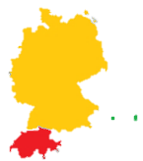
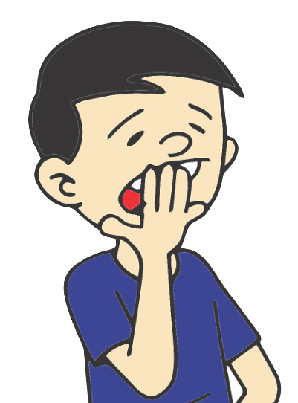
Phonetik - Partner(in) A
hören / sprechen
zwanzig
König
riesig
langweilig
billig [cheap]
vorsichtig [careful]
traurig
lustig
winzig
dreißig
Notes:
CLASSROOM VERSION (a self-study version follows these slides)
Timing: 8 minutes (both slides)
Aim: to practice practise pronouncing unknown words containing SCC [-ig] using regional accents. All other SSCs in these words have been previously practised.
Procedure:
1. Students sketch blank grids in their books.
2. Student A faces the board, student B turns away from the board.
3. Students A reads the words on the screen in the accent indicated by the ticks. Student B listens, and decides whether they have heard a North German or a South German/Austrian/Swiss pronunciation.
4. Student B faces the board and checks their answers.
5. Teacher checks understanding of the words, and asks student what type of words the majority are. Explain that –ig is a very common ending in German adjectives.
Word frequency (1 is the most frequent word in German):
zwanzig [20], König [1241], riesig [1449], langweilig [2921], billig [1672], vorsichtig [1806], traurig [1871], lustig [2262], winzig [2335], dreißig [1456]
Source: Jones, R.L & Tschirner, E. (2011). A frequency dictionary of German: Core vocabulary for learners. London: Routledge.

Slide 22
Phonetik - Partner(in) B
hören / sprechen
zwanzig
König
riesig
langweilig
billig [cheap]
vorsichtig [careful]
traurig
lustig
winzig
dreißig
Notes:
Partners swap roles.

Slide 23
Phonetik - Partner(in) A
hören / sprechen
zwanzig
König
riesig
langweilig
billig [cheap]
vorsichtig [careful]
traurig
lustig
winzig
dreißig
1
6
2
7
3
8
4
9
5
10
Notes:
SELF-STUDY VERSION (a classroom version precedes these slides)
Timing: 4 minutes
Aim: to practise pronouncing unknown words containing SCC [-ig] using regional accents. All other SSCs in these words have been previously practised.
Procedure:
1. Say the words in the accent indicated by the tick.
2. Click on the button to check pronunciation.
Transcript:
1. zwanzig [soft]
2. König [soft]
3. riesig [hard]
4. langweilig [soft]
5. billig [hard]
6. vorsichtig [hard]
7. traurig [hard]
8. lustig [soft]
9. winzig [soft]
10. dreißig [hard]
Word frequency (1 is the most frequent word in German):
zwanzig [20], König [1241], riesig [1449], langweilig [2921], billig [1672], vorsichtig [1806], traurig [1871], lustig [2262], winzig [2335], dreißig [1456]
Source: Jones, R.L & Tschirner, E. (2011). A frequency dictionary of German: Core vocabulary for learners. London: Routledge.

Slide 24
Phonetik - Partner(in) B
hören / sprechen
zwanzig
König
riesig
langweilig
billig [cheap]
vorsichtig [careful]
traurig
lustig
winzig
dreißig
1
6
2
7
3
8
4
9
5
10
Notes:
SELF-STUDY VERSION (a classroom version precedes these slides)
Timing: 4 minutes
Aim: to practise pronouncing unknown words containing SCC [-ig] using regional accents. All other SSCs in these words have been previously practised.
Procedure:
1. Click on the loudspeaker icon to hear the computer pronounce the word.
2. Decide whether you have heard a North German or a South German/Austrian/Swiss pronunciation.
3. Click to reveal answers one by one.
Transcript:
1. zwanzig [hard]
2. König [soft]
3. riesig [soft]
4. langweilig [hard]
5. billig [hard]
6. vorsichtig [soft]
7. traurig [soft]
8. lustig [hard]
9. winzig [soft]
10. dreißig [hard]
Word frequency (1 is the most frequent word in German):
zwanzig [20], König [1241], riesig [1449], langweilig [2921], billig [1672], vorsichtig [1806], traurig [1871], lustig [2262], winzig [2335], dreißig [1456]
Source: Jones, R.L & Tschirner, E. (2011). A frequency dictionary of German: Core vocabulary for learners. London: Routledge.

Slide 25
Viel oder viele?
Grammatik
Viel and viele both mean ‘lots of’.
Viel is used with uncountable nouns. Uncountable means you can’t put a number in front of it to make it plural (food, time, love …)
Viele is used with countable nouns. Countable means you can put a number in front of it to make it plural (two cats, three tables, four carrots …)
In negative sentences:
nicht viel = not much
nicht viele = not many
Ich habe viel Geld!
Wolfgang hat nicht viel Geld.
Ich habe viele Ideen!
Wolfgang hat nicht so viele Ideen.
Notes:
Timing: 2 minutes
Aim: to present the difference between viel and viele.
Procedure:
1. Explain the difference between viel and viele to the students, cycling through the information on the slide using the animaion sequence.

Slide 26
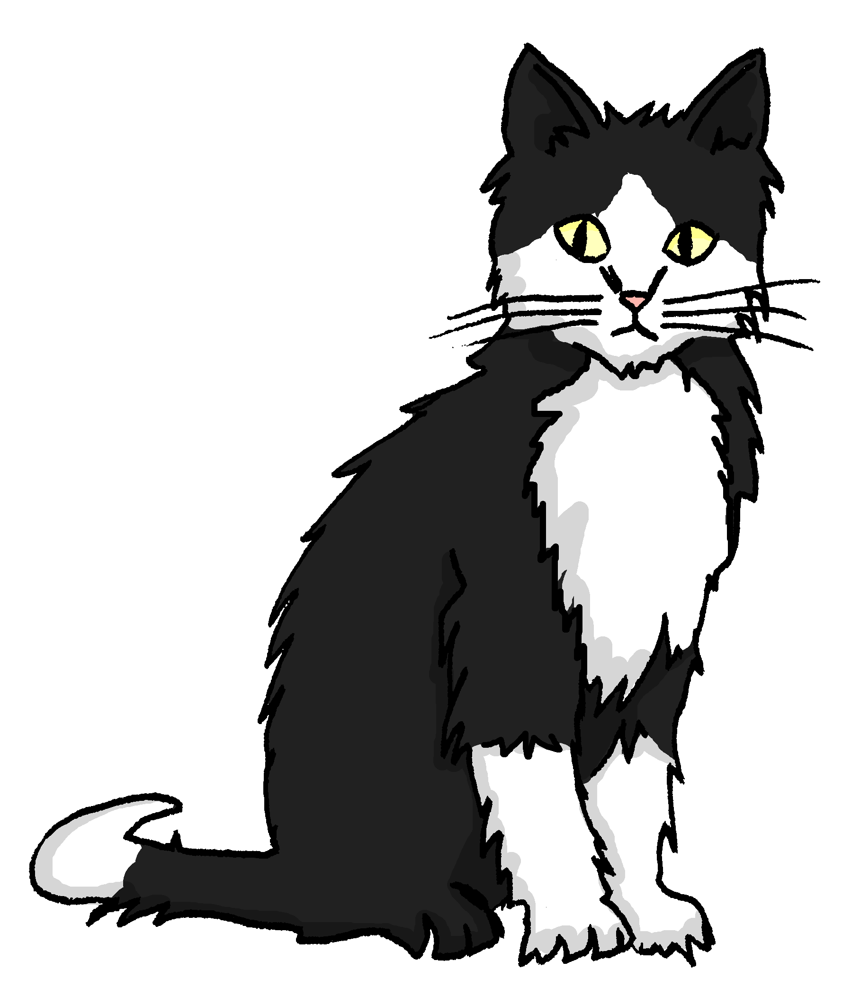
Viel oder viele?
Grammatik
Hint
To check whether a noun is countable or uncountable, try putting a number in front of the English word.
Gibt es viel oder viele?
Katzen
viel (uncountable) | viele (countable)
Essen
Musik
Leute
Taschen
Bücher
Fleisch
Notes:
Timing: 4 minutes
Aim: to practise distinguishing between countable and uncountable items, as exemplified with a number of known words.
Procedure:
1. The students copy the two columns and classify each noun shown accordingly.
2. Discuss the correct answers (N.B. the slide is not animated).

Slide 27
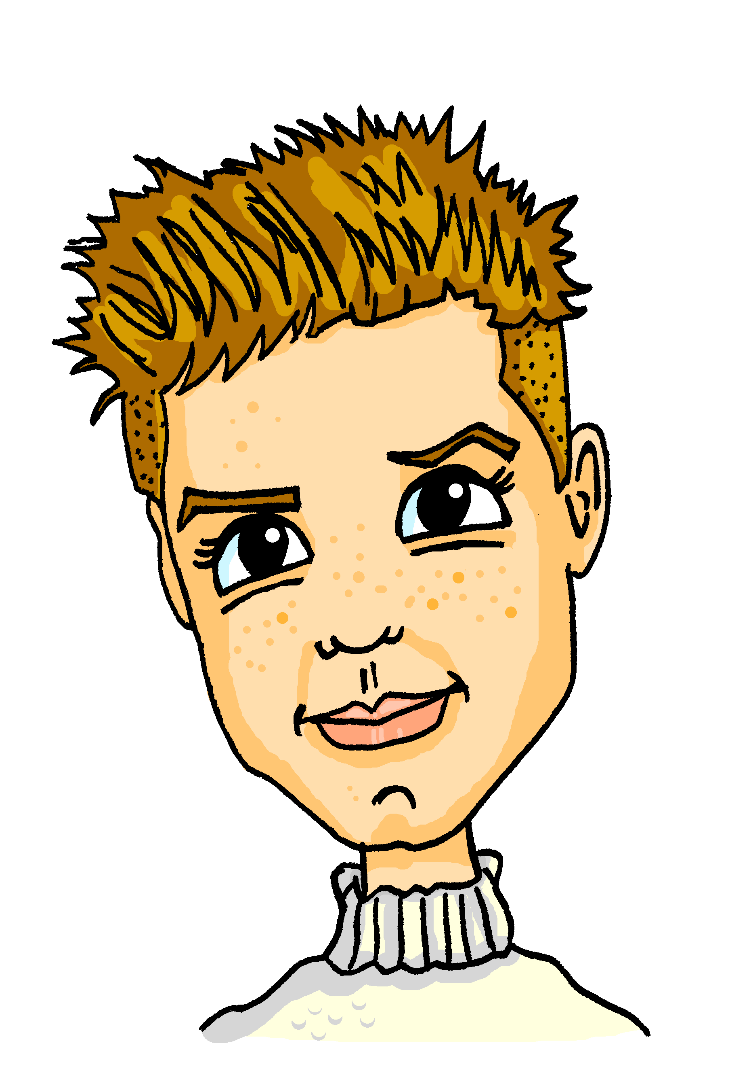
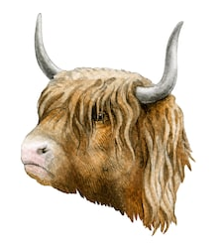
Was gibt es in Schottland?
hören
Alastair redet über Schottland. Was gibt es dort? Was gibt es dort nicht?
 | Wasser | Kirchen
 | Salz | Monster
 | Tiere | Wind
 | Museen | Musik
 | Essen | Kekse
 | Fleisch | Steaks
 | Tomaten | Obst
 | Städte | Kultur
 | Leute | Arbeit
 | Geld | Autos
1
6
2
7
3
8
4
9
5
10
Notes:
Timing: 6 minutes
Aim: to practise aural differentiation between viel and viele and correct identification of the corresponding noun.
Procedure:
1. First, check students recognise the plural forms of the nouns. They might need extra help with the irregular plural Museen. Check that the meanings of all cognates are understood.
2. Play the first audio clip. Ask students whether they heard ‘viel’ or ‘viele’ before the beep. Ask students whether this indicates a countable or uncountable noun
3. Ask students to identify which noun (Wasser or Kirchen) is uncountable. Reveal the answer on a click (only the first item is animated on this slide).
4. Proceed with clips 2-10.
5. The full answers are on the next slide.
Transcript:
1. In Schottland gibt es viel [Wasser].
2. Im Wasser gibt es aber sehr viele [Monster]!
3. In den Highlands gibt es auch viele [Tiere].
4. In Glasgow gibt es viele [Museen].
5. Es gibt auch sehr viel [Essen] – mmm, lecker!
6. Ich esse in Glasgow nicht so viel [Fleisch]. Dort ist das Essen oft vegetarisch!
7. Wir haben aber leider nicht viel [Obst] im Garten.
8. Es gibt nicht so viele [Städte] in Schottland. Das Land ist ziemlich grün.
9. Dort wohnen auch nicht so viele [Leute].
10. Die Leute in Glasgow haben nicht so viel [Geld] aber sie sind sehr nett!
Word frequency (1 is the most frequent word in German):
Kultur [593], Monster [>4043], Salz [2437], Steak [>4043], Tomaten [>4043], Wind [1080], vegetarisch [>4043]
Source: Jones, R.L & Tschirner, E. (2011). A frequency dictionary of German: Core vocabulary for learners. London: Routledge.

Slide 28
Was gibt es in Schottland?
hören
Alastair redet über Schottland. Was gibt es dort? Was gibt es dort nicht?
 | Wasser | Kirchen
 | Salz | Monster
 | Tiere | Wind
 | Museen | Musik
 | Essen | Kekse
 | Fleisch | Steaks
 | Tomaten | Obst
 | Städte | Kultur
 | Leute | Arbeit
 | Autos | Geld
1
6
2
7
3
8
4
9
5
10
Notes:
Timing: 2 minutes
Aim: to provide the answers to the activity on the previous slide.
Procedure:
1. Full audio plays on number clicks.
2. Answers revealed on clicks.
Transcript:
1. In Schottland gibt es viel Wasser.
2. Im Wasser gibt es aber sehr viele Monster!
3. In den Highlands gibt es auch viele Tiere.
4. In Glasgow gibt es viele Museen.
5. Es gibt auch sehr viel Essen – mmm, lecker!
6. Ich esse in Glasgow nicht so viel Fleisch. Dort ist das Essen oft vegetarisch!
7. Wir haben aber leider nicht viel Obst im Garten.
8. Es gibt nicht so viele Städte in Schottland. Das Land ist ziemlich grün.
9. Dort wohnen auch nicht so viele Leute.
10. Die Leute in Glasgow haben nicht so viel Geld aber sie sind sehr nett!
Word frequency (1 is the most frequent word in German):
Monster [>4043], Salz [2437], Steak [>4043], Tomaten [>4043], Wind [1080], vegetarisch [>4043]
Source: Jones, R.L & Tschirner, E. (2011). A frequency dictionary of German: Core vocabulary for learners. London: Routledge.

Slide 29
Was gibt es in Schottland?
schreiben
Mia findet Schottland toll! Was sind ihre Gründe?
Schreib drei Sätze in WO1 und drei Sätze in WO2.
Katja! Können wir bitte, bitte, bitte, den Austausch in Schottland machen?
In Schottland …
Dort …
In Glasgow …
Die Leute …
Notes:
Timing: 8 minutes
Aim: to practise written production of WO1 and WO2 with locations. Students use their notes from the previous listening activity to write sentences about Scotland.
Procedure:
1. Some suggested sentence beginnings are given. Elicit further examples from students and write them here.
Note: der Grund [230] was taught in 1.1.6. Students may not recognise it immediately in its plural form. Ensure that the meaning is clear, and ask students to identify which plural rule this is. Answer: Rule 1 - der/das nouns +Umlaut+e.
Word frequency (1 is the most frequent word in German):
Austausch [2744]
Source: Jones, R.L & Tschirner, E. (2011). A frequency dictionary of German: Core vocabulary for learners. London: Routledge.

Slide 30
Adverbs of time and place – WO1
Grammatik
As you know, the order of words in a simple German sentence is:
But what if we also want to say where Mia plays the clarinet?
If you want to use both a time adverb and a place adverb in a sentence, the time comes first.
T.P. – time, place
Mia
spielt
dienstags
Klarinette
Word order
1
SUBJECT
VERB
TIME ADVERB
OBJECT
im Orchester
Word order
1
PLACE ADVERB
Notes:
Timing: 4 minutes (two slides)
Aim: to introduce students to the TMP rule (the ‘M’ element will be introduced in Year 8). Slide 1 of 2.
Procedure:
1. Cycle through the information on the slide using the animation sequence.

Slide 31
Adverbs of time and place – WO2
Grammatik
You can move either the time adverb or the place adverb to the start for emphasis.
This triggers word order 2. The subject moves after the verb to make space for the adverb.
Mia
spielt
dienstags
im Orchester
Klarinette
Word order
1
SUBJECT
VERB
TIME ADVERB
PLACE ADVERB
OBJECT
Dienstags
spielt
Mia
im Orchester
Klarinette
TIME ADVERB
VERB
SUBJECT
PLACE ADVERB
OBJECT
Word order
2
Im Orchester
spielt
Mia
dienstags
Klarinette
PLACE ADVERB
VERB
SUBJECT
TIME ADVERB
OBJECT

Slide 32
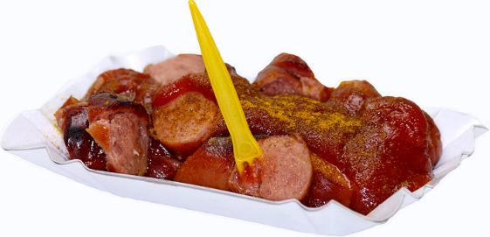
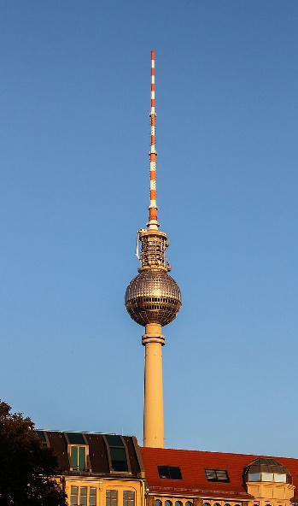
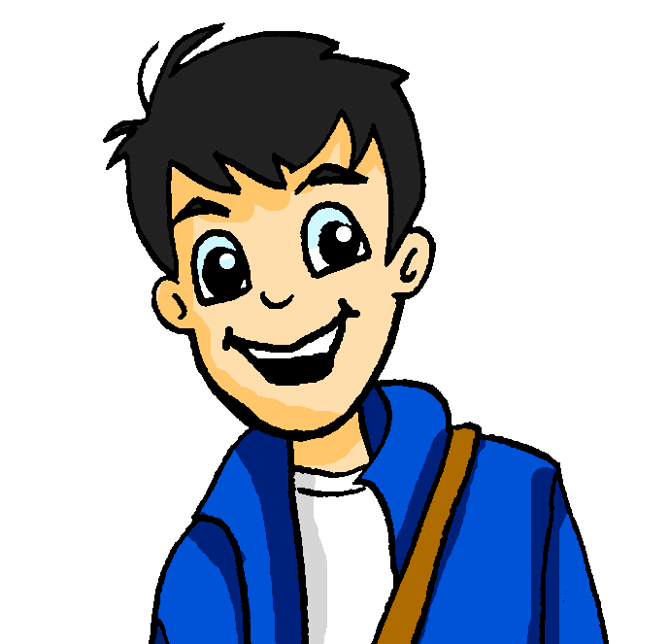
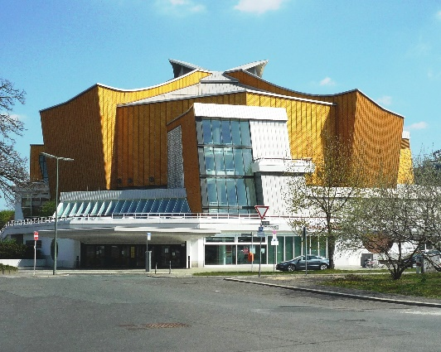
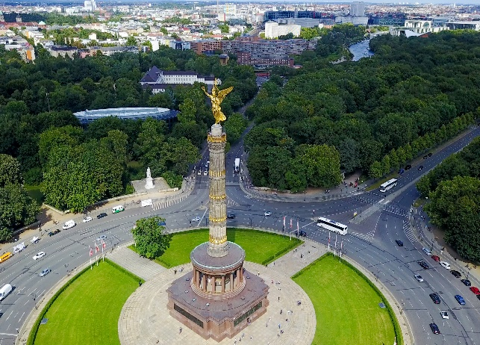
Was gibt es in Berlin?
lesen
Currywurst
Wolfgang macht Pläne für Alastairs Woche in Berlin.
Was sagt er? Schreib T (Tag), V (Verb) oder O (Ort).
der Berliner Fernsehturm
1. Am Montag lernen wir in der Schule Deutsch.
2. Wir gehen am Dienstag am Tiergarten in den Zoo.
3. Am Alexanderplatz sehen wir am Mittwoch den Fernsehturm.
4. Wir bleiben am Donnerstag zu Hause und chillen.
5. Am Freitag gibt es in der Philharmonie ein Konzert.
6. Im Restaurant essen wir am Samstag Currywurst.
7. In der Stadt suchen wir am Sonntag Souvenirs.
1
2
3
4
5
6
7
8
9
10
11
12
13
14
die Berliner Philharmonie
Tiergarten
Notes:
Timing: 8 minutes
Aim: to practise word order in complex sentences with adverbs of both time and place.
Procedure:
1. Each sentence contains a verb, a day of the week, and a place in Berlin. Two of the three sentence components are blocked out in each case. Students must use their knowledge of word order (time before place in WO1, WO2 if sentence starts with a time or place) and process of elimination to work out what types of words are missing from the sentences.
2. On clicks, numbered tiles disappear one by one to reveal the answers.
3. As a follow-up activity, elicit translations of full sentences to give students a flavour of cultural highlights in Berlin. Students can use the pictures and their knowledge of German and their knowledge of English to help them work out the meanings of the place names!
Word frequency (1 is the most frequent word in German):
Plan [954] Zoo [>5009] Turm [3118] bleiben [113] chillen [>5009] souvenir [>5009]
Source: Jones, R.L & Tschirner, E. (2011). A frequency dictionary of German: Core vocabulary for learners. London: Routledge.

Slide 33
Wer, was, wo und wann?
sprechen
SUBJECT
VERB
TIME ADVERB
PLACE ADVERB
OBJECT
ich
spielen
am Montag
in der Schweiz
einen Hut
du
essen
nie
in der Bibliothek
das Auto
er
suchen
immer
im Theater
eine Hose
sie
sehen
jeden Tag
im Zug
einen Hund
die Katze
hören
manchmal
in der Stadt
Gitarre
wir
bekommen
samstags
zu Hause
Musik
sie (plural)
putzen
oft
im Garten
ein Butterbrot
die Tiere
tragen
jede Woche
auf der Party
Kekse
Notes:
Classroom version (a self-study listening extension for this activity follows.)
Timing: 8 minutes
Aim: to practise oral production of the vocabulary in this week’s revisiting sets and practise building sentences using word order 1 and 2 with adverbs of time and place.
Note: A more complex version of this activity, in which the adverbs of place are in both dative and accusative case, can be found on slide 35.
Procedure:
1. Teacher begins by asking students to identify what the words in each column have in common – what type of words are they? What role do they play in the sentence? Column headings are revealed on clicks.
2. Check students recognise the cases in the yellow column, and whether or not these need to go with verbs of movement.
3. Students work in pairs. Teacher instructs students that they are going to orally build sentences containing one word from each column, and say these out loud to their partners. They can pick any word from the column – nonsense sentences are okay and even encouraged, as long as students can translate what they have said correctly! They must say use a different set of words from their partner.
4. Teacher starts the game by saying ‘create a sentence beginning with a pronoun’. Remind students of the need to agree the verb with the pronoun they choose, the correct word order, and the need to think about verb and case. Students say their sentences while teacher circulates. Teacher elicits examples from students.
5. Teacher continues the game by saying ‘create a different sentence beginning with a time adverb’. Remind students of the need to agree the verb with the pronoun they choose, the correct word order, and the need to think about verb and case. Students say their sentences while teacher circulates. Teacher elicits examples from students.
6. Teacher finishes the game by saying ‘create a different sentence beginning with a place adverb’. Remind students of the need to agree the verb with the pronoun they choose, the correct word order, and the need to think about verb and case. Students say their sentences while teacher circulates. Teacher elicits examples from students.
7. Continue as many times as desirable/necessary!
Option: teachers may wish to print this slide can cut out the words, creating a set of cards to each pair. This is worth the extra effort because students are able to physically move the words around and see the colour order change, getting a real feel for sentence structure.

Slide 34
Wer, was, wo und wann?
hören
Mia macht auch Sätze. Ihre Sätze sind ziemlich komisch!* Was sagt sie? Schreib auf Englisch.
Look at your notes. Would it sound better to change the word order in English?
1
The cat always listens to music in the library.
________________________________________________
2
He often looks for a hat in town.
________________________________________________
3
I’m eating a sandwich in the theatre on Monday.
________________________________________________
4
You never wear trousers at home on Saturdays!
________________________________________________
5
We sometimes see a dog at the party!
________________________________________________
The position of adverbs is different in English! Time adverbs are often the last idea in the sentence.
6
They clean the car in the garden every day.
________________________________________________
7
She plays the guitar in the train every week.
________________________________________________
8
The animals in Switzerland often receive/get biscuits!
________________________________________________
Notes:
SELF-STUDY VERSION
Timing: 10 minutes
Aim: This is the home-learning follow-up activity to the preceding speaking exercise. It can also be used for additional in-class listening practice.
Procedure:
1. Click on buttons to play the sentences in German.
2. Students translate each sentence into English.
3. Answers revealed on clicks.
Transcript:
1. Die Katze hört immer in der Bibliothek Musik.
2. Oft sucht er in der Stadt einen Hut.
3. Am Montag esse ich im Theater ein Butterbrot.
4. Samstags trägst du nie zu Hause eine Hose !
5. Manchmal sehen wir auf der Party einen Hund!
6. Jeden Tag putzen sie im Garten das Auto.
7. Im Zug spielt sie jede Woche Gitarre.
8. In der Schweiz bekommen die Tiere oft Kekse.

Slide 35
Wer, was, wo und wann?
sprechen
SUBJECT
VERB
TIME ADVERB
PLACE ADVERB
ich
schwimmen
am Montag
in die Schweiz
du
fahren
nie
in die Bibliothek
er
gehen
immer
im Theater
sie
tanzen
jeden Tag
im Zug
die Katze
reden
manchmal
in die Stadt
wir
bleiben
samstags
zu Hause
sie (plural)
springen
oft
nach Schottland
die Tiere
schlafen
jede Woche
auf der Party
Notes:
Classroom version (a self-study listening extension for this activity follows.)
Timing: 8 minutes
Aim: In this oral activity, students revise the vocabulary in this week’s revisiting sets and practise building sentences using word order 1 and 2 with adverbs of time and place.
Note: A less complex version of this activity, in which all place adverbs are in dative case, can be found on slide 33.
Procedure:
1. Teacher begins by asking students to identify what the words in each column have in common – what type of words are they? What role do they play in the sentence? Column headings are revealed on clicks.
2. Check students recognise the cases in the yellow column, and whether or not these need to go with verbs of movement.
3. Students work in pairs. Teacher instructs students that they are going to orally build sentences containing one word from each column, and say these out loud to their partners. They can pick any word from the column – nonsense sentences are okay and even encouraged, as long as students can translate what they have said correctly! They must say use a different set of words from their partner.
4. Teacher starts the game by saying ‘create a sentence beginning with a pronoun’. Remind students of the need to agree the verb with the pronoun they choose, the correct word order, and the need to think about verb and case. Students say their sentences while teacher circulates. Teacher elicits examples from students.
5. Teacher continues the game by saying ‘create a different sentence beginning with a time adverb’. Remind students of the need to agree the verb with the pronoun they choose, the correct word order, and the need to think about verb and case. Students say their sentences while teacher circulates. Teacher elicits examples from students.
6. Teacher finishes the game by saying ‘create a different sentence beginning with a place adverb’. Remind students of the need to agree the verb with the pronoun they choose, the correct word order, and the need to think about verb and case. Students say their sentences while teacher circulates. Teacher elicits examples from students.
7. Continue as many times as desirable/necessary!
Option: teachers may wish to print this slide can cut out the words, creating a set of cards to each pair. This is worth the extra effort because students are able to physically move the words around and see the colour order change, getting a real feel for sentence structure.

Slide 36
Wer, was, wo und wann?
hören
Mia macht auch Sätze. Ihre Sätze sind ziemlich komisch!* Was sagt sie? Schreib auf Englisch.
Look at your notes. Would it sound better to change the word order in English?
1
I jump into the library every day!
________________________________________________
2
You swim to Scotland every day!
________________________________________________
3
The cat sleeps in the theatre on Saturdays.
________________________________________________
4
The animals are dancing at the party on Monday.
________________________________________________
5
He sometimes goes to school …
________________________________________________
The position of adverbs is different in English! Time adverbs are often the last idea in the sentence.
6
She always stays at home!
________________________________________________
7
We go to Switzerland every week.
________________________________________________
8
They never speak in the train.
________________________________________________
Notes:
SELF-STUDY VERSION
Timing: 10 minutes
Aim: This is the home-learning follow-up activity to the preceding speaking exercise. It can also be used for additional in-class listening practice.
Procedure:
1. Click on buttons to play the sentences in German.
2. Students translate each sentence into English.
3. Answers revealed on clicks.
Transcript:
1. Ich springe oft in die Bibliothek!
2. Du schwimmst jeden Tag nach Schottland!
3. Samstags schläft die Katze im Theater.
4. Am Montag tanzen die Tiere auf der Party.
5. Manchmal geht er in die Schule …
6. Zu Hause bleibt sie immer !
7. In die Schweiz fahren wir jede Woche.
8. Im Zug reden sie nie.

Slide 37
Hausaufgaben
Vocabulary Learning Homework (Term 3.2 Week 1)
Quizlet link: Term 3.1 Mashup
Follow the link above to practise all vocabulary learned in Year 7 so far!
Notes:
Use this slide to set the homework.

