Slide 1
Defining and Assessing the Language Content: Effects on Curriculum Design
9 Feb 2022
Session presenter: Prof. Emma Marsden,
Dept of Education, University of York.
Director, National Centre for Excellence for Language Pedagogy (NCELP)

Slide 2
Session overview
Part 1/ What are ‘Language Competence’ and the ‘Subject Content’?
Part 2/ The content in 2015 and 2022
Similarities
Four Key Differences
Part 3/ Some implications for curriculum design
How much?
What?
When?

Slide 3
What does it mean to ‘know a language’?
What can be taught and learnt in the early stages?
Organisational Competence
Grammatical Competence
Textual Competence
Pragmatic Competence
Illocutionary Competence
Sociolinguistic Competence
Morphology
Syntax
Vocab
Phonology/
Graphology
Cohesion
Rhetoric
Functions of language
Register/
Genre / Dialect
Bachman (1990)
Canale & Swain (1980)
Notes:
Here is a well known model of all the different components of language knowledge.
Underpinning both this model, and other similar ones, and the Pedagogy Review, the new GCSE, the Ofsted review of research, and NCELPs activities is the basic idea – that is surely uncontroversial - that learners need, especially in the early stages, a robust body of language – in grammar, vocabulary, and sound-symbol relations – to be able to do all the things on the right.
Then other aspects of language competence are given an initial boost – they can develop, in tandem with further core knowledge development – the ability to create cohesion, or use language for various functions such as giving an opinion, or describing school life, or for developing inter-cultural competence (all of these need, or at least benefit from, being able to understand and use the language itself)

Slide 4
How does MFL education in England define and operationalise “content”, at each layer of specification?
DfE
The Subject Content and Annexes: knowledge and how it can be used
Checks exams test the content (not other things)
Checks sampling of content, year on year
Ofqual
Awarding body
The specification = syllabus
The exams
Publisher
teaching materials
Teacher
450 hours of classroom experience & materials (KS3 & 4)
Notes:
And how do teachers and learners get to experience ‘language content’ in our setting? How is this laid out and delivered?
Starting from the very foundations of this pyramid, the students experience the content through the teacher and the materials they are exposed to – a few lucky ones through primary school work that is build upon at secondary, a few have extra curricular experiences – but essentially, for the vast majority the secondary classroom is where it is at. And there are about 450 hours of it
Publishers’ materials provide language content which is in turn driven by what the awarding bodies lay out in their content, in their lists and in their exams. Ofqual checks that the exams reflect the government’s definition of what the content is. Ofqual also have to test that the content is sampled year on year, and covered, eventually.
So, today’s talk is going to be mainly focussed on that subject content document –
In fact, this takes me back to my very first task on my masters at Southampton – we had to dig out the curriculum for a language course and discuss the relations between that curriculum and the tests. As a teacher, with a PGCE and three years classroom experience, including as a Head of a small Spanish dept, I admit - I had not looked at the subject content. But, of course, it’s impact is enormous.

Slide 5
Session overview
Part 1/ What are ‘Language Competence’ and the ‘Subject Content’?
Part 2/ Comparing 2015 and 2022: similarities and differences
Part 3/ The implications for teaching and assessment(s)
Notes:
I will also talk about the rationale behind some of these changes.

Slide 6
Similarities between Subject Content in 2015 & 2022
Aims
develop ability and ambition to communicate in speech and writing
expand horizons, ways of seeing the world, cultural boundaries
provide a strong foundation for further study
Listening & reading comprehension
Spoken & written production
Language about contexts where language is spoken (e.g., culture, geography)
Grammar and vocabulary are significant areas of knowledge
Speaking includes:
role play,
talk about visual stimulus/stimuli,
unprepared conversation elements
BUT note the requirement for “clear and comprehensible” speech
(rather than spontaneity+ fluency+ polish!)

Slide 7
Changes? to address what problems?
Awarding bodies have been able to provide a word list as a guide, but
required to test words ‘off list’
no specification about what kind of words (high vs low frequency)
-> mismatch between the language content on specifications and the language used in exams

Slide 8
Some consequences of having a lexical content that is not defined and not informed by frequency
49% of the words on awarding organisations’ current lists have never been used in an exam (averaged across AQA, EdExcel, 3 langs, F & H, 4yrs)
20% of the words on current lists have only ever been used once
Lower frequency words almost twice as unpredictable as high frequency words
Putting all exams together, over 4 years, only 62% of words are high frequency
for an exam oriented to ‘communication’, we would expect around 85%
approx. 80% in written texts, and 90% in spoken)
-> Heavy reliance on inferencing, in early, vulnerable stages of learning

Slide 9
But inferencing is difficult …
Whether a student can successfully infer meaning is ‘hit and miss’:
If there were 10 unknown words in a text, a learner can infer meaning of between 2 and 6 of them
Successful inference can depend on …
Context e.g., the proportion of unknown words in the text
Learner e.g., language proficiency; analytic ability
Teaching strategies to work out unknown words becomes more effective the more proficient the learners are (Plonsky, 2011)
-> robust knowledge helpful
(e.g., Albrechtsen et al., 2008; Bengeleil & Paribakht, 2004; Fraser, 1999; H. C. M. Hu & Nassaji, 2012; Huckin & Bloch, 1993; Nassaji, 2003; Pulido, 2007; Qian, 2005; Sternberg, 1987; Wesche & Paribakht, 2009).
Notes:
Strategies, such as use the context to work it out, ask someone, use a dictionary, guess from your world knowledge
Other contextual factors: the relevance of the unknown word for comprehension, and the proportion of unknown words in the text
To ‘really’ understand a text, you need to know 98% of the words in it
To ‘just about’ understand a text, you need to know at least 90% of words in it
See research by Nation, Laufer, and colleagues

Slide 10
Key differences in 2022 Subject Content. [1/4]
The lexicon is specified:
1,200 word families [Foundation],1700 [Higher],
85% from most common 2000 word families,
30 multiword units (of up to five words)
20 cultural / geographical terms
All tasks fully accomplishable using only language from the defined vocabulary and grammar lists
Full credit given for successful production of language beyond content
Is it very unusual to have a word list?
Notes:
A word family, in this instance, is defined a a word and its inflected forms
Such as wash, washes, washed – but not washer, or unwashed – so inflectional morphology, but not derivational morphology, as that is harder for learners

Slide 11
Having a word list is not very unusual
Word lists for proficiency tests:
Japanese Language Proficiency Test until 2010 (Japan Educational Exchanges and Services, 2009)
~A2: 1,500 words / ~B1: 3,750 words
German-Zertifikat Proficiency Test (Goethe-Institut, 2016a, 2016b, 2016c)
A2: 1,300 words / B1: 2,400 words
Word lists for curricula:
France, Ministry of National Education (éduscol, 2020) lists 1,500 most frequent words in French for French primary school children (6-11 years)
China, Ministry of Education (2017) lists 1,500 words for English for 16 years olds (after 9 yrs of English)
Hungarian National Core Curriculum for English (Krizsán, 2003): 1,200 active vocabulary for 13-14 year olds
Guidelines about number of words:
Japanese Ministry of Education (MEXT, 2008, 2009, 2016, 2017, 2018) English: Junior high school students: 1,200 words; High school students: 1,800 words
Notes:
The size of the word lists seem to be not too far out from other countries and languages.
You can see here the languages highlighted in red and the numbers that are most relevant to our age and level of learners in green – the numbers in the new subject content are not much lower even than contexts in which the magic global English is being learned.

Slide 12
How many words is reasonable if we want to teach…
productive knowledge, not just receptive (Nation, Laufer, Meara, Webb)
polysemy (multiple meanings)
‘extreme’ irregulars, as lexical items (Clashen; Gor; Marslen-Wilson; Verríssimo)
some multi-word units (Crossley; Myles, Mitchell & Hopper; Siyanova-Chanturia)
some mid-low frequency words e.g., culturally important
systematic revisiting
spaced repetition (e.g., Webb 2007)

Slide 13
What might inform decisions about how many words can be really learnt?
10 words per week (e.g, Schmitt 2004)
10+ encounters needed (e.g., Webb 2007)
Students can pass current GCSE with receptive knowledge of 852 words = 4 words a lesson (Milton, 2006) or perhaps 564 words (David, 2008)
A recommendation to learn a list of 1,500 (Milton, 2015)
The practical constraint! 450 hours available:
Average of 10 words per week -> 360 words per year * 5 years = 1,700 words, for highest achievers
Notes:
Taking account of a term in year 11 where new words are unlikely to be learnt.

Slide 14
Is the amount (1,250 and 1,750) about right?
2015 GCSE (minimum) word lists, AQA:
Spanish: 1,566 word families
French: 1,300 word families
German: 1,632 word families
Tier of GCSE | Word families used to create ONE exam | Word families used to create THREE exams
Foundation | 609 | 1,173
Higher | 753 | 1,542
Median of range across awarding organisations & languages
Notes:
During the consultation about the proposed new GCSEs there was a lot of concern that the amount of words was far too low, and that the awarding bodies would not be able to create an exam with only 1,200 or 1700 words.
So, the numbers of words for the new word lists are not too far off the current lists, though the current lists vary between languages and between Awarding Bodies.
The test developers would use up the proposed numbers of different word families after creating about three years of exams using the current L & R kind of questions.
We found that far fewer words are used in the exams than are on the word lists, potentially encouraging teachers to teach many words but less well, compared to teaching fewer words but ensuring lots of practice of them.
--------------------------
On the lists there are many multi-word units and words are repeated in different parts of the list.
To get the numbers shown on the slides, we removed duplicate words and proper nouns (e.g., country names, celebrations) to count the number of unique words.
Thus, the numbers for “unique words” reflects the removal of duplicates (the use of same word in different contexts) and the absence of proper nouns.
Spanish has 24% more entries than French (17% difference in unique words)
------------
The numbers in the bottom table are the median of the range, when the ends of the range are across awarding organisations and languages

Slide 15
Why should “85%” be high frequency words?
The 2,000 most common words in a language generally cover…
80 – 87 % of an average written text (Meara, 1995; Nation, 2001; Nation & Waring, 1997).
90+ % of words in informal conversation (Nation, 2001)
How do we know what the most frequent words are in FLs?
Massive corpora: French 23 million; Spanish 2 billion; German 20 million
The very most frequent words change very little, over time or context
About 80-85% of the most frequent words are the same – no matter which large, general corpus you use
Notes:
The frequency information that is recommended in the subject content is based on these massive FL corpora mentioned in this slide.

Slide 16
Does this ‘constrained’ lexicon mean that students are less well prepared for an A level exam?
No.
On average, a new GCSE list has 13% fewer word families than a current list,
but provides 34% more coverage of the word families in typical A level exam
(averaging across AQA and Edexcel).

Slide 17
Key difference in 2022 Subject Content [2/4]
Vocabulary in Reading only:
Glossing allowed: up to 2% of words in a text can be glossed
Use of cognates more constrained: ‘same/very similar’ spelling and meaning
Derivational morphology now clearly defined, based on ‘bang for buck’
A ‘test of inferencing’ but identifiable and short: students must infer plausible meaning of words not on the list, when words are embedded in sentences that have all other words on the list
Notes:
Glossing allowed: up to 2% of words in a text can be glossed
Use of cognates more constrained: same spelling and meaning (or 1 letter different, +/- accent, for words of six letters or more) up to 2% of a text
Derivational morphology now clearly defined, based on ‘bang for buck’, and is for reading only: derived or base forms of words (where the base or derived form is on the list), following patterns specified in the grammar annexes, can be included
Content is not defined by whether or not a text is ‘authentic’: no requirement to include literary, authentic texts but they can be
A ‘test of inferencing’ will be identifiable, defined, and short: students must infer plausible meaning of words not on the list, when words are embedded in sentences that have all other words on the list

Slide 18
Hanoucca
Inferencing, in curriculum and assessment?
Use the words you know to choose the general meaning of the words in bold.
Pour la communauté juive, la fête importante de décembre est Hanoucca. C’est une fête de lumières et on utilise des bougies pour célébrer. La fête est de huit jours, et on allume une bougie le premier jour, deux bougies la deuxième jour … Les bougies sont un symbole de la bonté de Dieu. Dans une vieille histoire juive, une petite bouteille d’huile a nourri une lampe pendant huit jours, beaucoup plus de temps que normalement. On mange des beignets comme un symbole de l’huile. Les enfants jouent avec des toupies qui contiennent une phrase religieuse. Hanoucca est plus familial et spirituel que religieux.
bonté : part of body / personality / room / song
huile : a type of wood / plant / liquid / shoe
beignet : a type of drink / chair / cup / food
toupie : a type of toy / book / hat / sweet
goodness
oil
doughnut
spinning top
Notes:
Here is a text about Hanoucca
Followed by some practice at inferencing the meaning of words by using the words that we know they have already met several times and have been tested on
At this stage, lexical inferencing becomes possible because we are confident that they have a critical mass of vocabulary to start doing this.
Timing: 5 minutes Aim: to practise lexical inferencing; the written comprehension of known words to arrive at a general understanding of one unknown word in a sentence context. In addition, to revise previously learnt vocabulary in new contexts. Procedure: 1. Ensure that students understand the task (as this is the first time they are doing this type of activity). Students need to know that they are aiming to understand the general meaning, rather than specific meaning (though they may in some cases also arrive at this).
2. Students read each text and decide which of the four options is most likely, depending on their understanding of the surrounding words.
3. Click to reveal answers.
4. Proceed to the next slide for the comprehension part of the activity.
Word frequency of unknown words used (1 is the most frequent word in French):
lumière [1059], allumer [3169], bougie [>5000], deuxième [427], bonté [>5000], huile [2340], beignet [>5000], toupie [>5000]
Word frequency of cognates used (1 is the most frequent word in French): Hanoucca [>5000], bouteille [2979], lampe [4699], normal [833], familial [1622], spirituel [3047]
Source: Lonsdale, D., & Le Bras, Y. (2009). A Frequency Dictionary of French: Core vocabulary for learners London: Routledge.

Slide 19
Key difference in 2022 Subject Content [3/4]
Grammar content simplified, clarified, and sequenced:
Much greater transparency about what can be tested
(e.g., interrogative types laid out)
Some features moved from Foundation to Higher
(e.g. depuis +present; inflectional future)
Some features divided into sub-components: some can be tested at foundation, and some only at higher
reflexive use of verbs
present tense irregular verbs
Notes:
Making the content more explicit could help awarding organisations and Ofqual to ensure accountability for test content

Slide 20
Key difference in 2022 Subject Content [3/4]
Grammar content:
Some features removed completely (e.g., subjunctive)
Some features given tolerance in production at foundation (e.g., minor spelling changes in present tense stems), and are then credit bearing at Higher
Some moved from ‘grammar’ to ‘vocabulary’ (e.g., adverbs, pronouns)
Notes:
All grammar can be tested in reception and production
Except for derivational morphology - only in Reading

Slide 21
Key difference in 2022 Subject Content [4/4]
No longer just ‘isolated skills’ of L, R, S, W
Addition of sound-spelling correspondences (phonics)
Students demonstrate ability in:
transcription (dictation)
decoding (reading aloud + show comprehension in unprepared conversation)

Slide 22
Session overview
Part 1/ Language competence and Subject Content
Part 2/ Comparing 2015 and 2022: similarities and differences
Part 3/ Some implications for curriculum design

Slide 23
Implications for curriculum. The new content increases attention on …
the most used words
-> broad range of contexts and types of text
still room for individualisation in word choice for production
materials at appropriate level (see multilngprofiler.net)
independent manipulation of language
downplays heavy reliance on complex, unanalysed, fixed chunks
practice reading aloud WITH understanding
practice writing down words that are heard

Slide 24
How to sequence a curriculum, if not with phrases from topics on ‘my routine’, ‘school’, ‘jobs’?
Maintain focus on communicative contexts & functions
But select (mainly) high frequency words, from small semantically-related sets
Mixed parts of speech (v, n, adj, …) -> create sentences from lesson 1
Challenges of the specific language drives curriculum choices
Reduce language content that can mislead learners who need to ‘crack the code’
(VanPatten, Marsden & Chen/Kasprowicz/McManus)
Themes and context of use emerge from the language
Notes:
High frequency words in small semantically-related sets
mixed parts of speech (v, n, adj, …) -> create sentences from lesson 1
Rather than topic-inspired phrases, be driven by challenges of language
Avoiding input that can mislead learners trying to ‘crack the code’
(VanPatten, Marsden & Chen/Kasprowicz/McManus)
Instead of starting with je m’appelle
je m’ is not ‘I am called’ or ‘my name is’
-> Use Je suis … and Tu es … for the same function
--------------------------
Mitchell & Myles research on chunks
Analytic ability – Kasprowicz & Marsden; Roehr-Brackin
Levelling the playing field – aptitude*treatment research

Slide 25
And yet space 1750 words out, across varied, interesting contexts?
When we are “gardening in a gale” of English (Hawkins, 1996), how do you ensure there is enough revisiting of language?
-> “expanding practice schedules” (see Nakata, 2015)
revisit the same language, less and less frequently over time
so you can introduce new language

Slide 26
An expanding practice schedule
Week 1: a set of words learnt for pre-lesson homework – e.g., Quizlet
Week 2: taught & practised in lesson
wk
2
Week 5: relearnt before lesson and included in classroom activities
wk
5
Week 10: relearnt before lesson and included in classroom activities
wk
10
Week 20: tested
Week 33: tested
Each of following years: practised and tested
Nakata, T. et al. (2020). The long-term benefits of making the simple change from non-cumulative to cumulative weekly vocabulary quizzes . OASIS Summary of Nakata, T. et al. (2020) in TESOL Quarterly. https://oasis-database.org
Notes:
You will see how quickly teaching time gets filled up, once we start systematically revisiting language.
------
For the tests – how do you test the old words and test the new ones? One approach we started with was testing 50% words since last test : 50% of ‘old’. This is a ‘cumulative’ testing schedule.
But this balance will change as more words become ‘old’ relative to the number of ‘new’ words. Or the number of words tested needs to grow a lot.

Slide 27
Revisiting vocabulary in different semantic contexts
Talking about people’s lives
Asking about future intentions
Talking about the environment

Slide 28
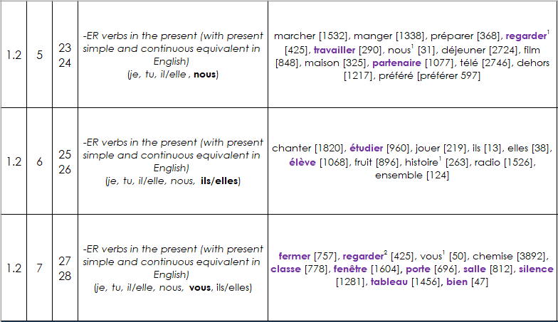
2. Design
Planning systematic vocabulary and grammatical growth
lesson | word families grow | number of words grows
grammatical growth: word families gradually get larger as new features are introduced
Notes:
In this extract from the Year 7 NCELP scheme of work, you can see that students learn a set of –ER verbs in Term 1.2 Week 5. However, they cannot yet use these verbs in the second or third person plural, because these forms are introduced in the weeks that follow. They also cannot use the verbs in any tenses other than the present.
--------
You will see this embedded in one function of the MultiLingProfiler a weekly NCELP syllabus list. These word lists are cumulative, growing along with students’ learning. These lists also differ from most lists in that they make no assumptions about students’ ability to produce all forms of a known headword, and so profile for grammatical as well as semantic knowledge. There is a different list for each week in the NCELP scheme of work, each building on progress in the last.
So, the profiling tool has to recognise students’ grammar progress as well as headword knowledge, and reflect this in results.

Slide 29
But won’t this lead to a dull diet? What about the country/ people / culture?
Notes:
There seems to be a common misapprehension – an easy dichotomous way of thinking - that defining language content in clear ways – by listing vocabulary, the details of grammar, and the sounds-symbol correspondences - this would mean that language learning was no longer about engendering an interest in the countries and people associated with the language. That defining linguistic content somehow also meant that the only rationale suddenly became an academic one only – neglecting other rationales such as raising awareness about language (in a way that could be applied to other languages later in the pupils’ lives) or imbuing a sense of curiosity in other cultures and places.
This is far too simplistic way of thinking.
Here are some texts I will whizz through to illustrate, I hope, that these views resulted from a false dichotomy, a conflation of completely different issues.
I hope to illustrate, in a whistle stop tour of some of the over 1,000 classroom resources that NCELP have created, that interesting texts and ideas can be communicated with high frequency words and basic grammar structures, in a curriculum where the vocab and grammar adheres to a schedule to ensure that particular vocab and grammar are revisited at specific times.
Please understand that building up to the texts you are about to see, are a series of meticulously planned activities that lead up to students being able to understand and interact with the texts. The activities that lead up to this span hours (over weeks) of classroom time. These activities should not be considered in isolation, but as part of a whole.

Slide 30
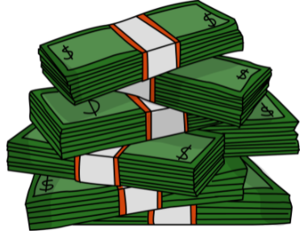
El pasado de Medellín
escuchar / escribir / leer
Escucha y completa el texto.
Medellín es una ciudad en Colombia que hace veinte años era muy peligrosa. Un grupo de criminales, el Cartel de Medellín, organizaba redes de narcotráfico* y prácticamente controlaba la ciudad. El narcotráfico era un muy _______ _________ (el Cartel ganaba hasta sesenta millones de dólares al día), así que era posible ganar mucho dinero en muy ________ _________. Sin embargo, era una ___________ _________ y el grupo usaba la violencia* muy a menudo. Mataba a policías en la calle y secuestraba* a ___________ _____________. A pesar de estas acciones, el jefe del cartel, Pablo Escobar, era una persona popular en los _________ _________. Él ayudaba a la población en lugares donde el gobierno no estaba. Por eso mucha gente de estas comunidades lo consideraba una _______ _________.
buen
negocio
poco
tiempo
actividad
ilegal
personas
importantes
barrios
pobres
gran
persona
*el narcotráfico = drug trafficking
*la violencia = violence
*secuestrar = to kidnap, kidnapping
Notes:
Timing: 10 minutes
Aims:
to learn about the past of a Spanish-speaking city
to accurately transcribe the missing words
to consolidate understanding of pre-nominal adjectives
to demonstrate understanding of key information in the text
Procedure:
Students write 1-6 down the left hand side of their books.
Explain to students that they will hear six pairs of missing words.
They listen to the text and write the missing pairs of words.
Check answers and give feedback. Elicit oral translations in English of the words in the gaps.
Ask students which pairs of words have an adjective before the noun (ANSWER: buen negocio, poco tiempo, gran persona).
Ask which pairs of words have an adjective after the noun (ANSWER: actividad illegal, personas importantes, barrios pobres).
To check comprehension of the text on this slide, the questions below could be asked. These could be written on the board by the teacher or distributed on a handout (word doc available with this resource). The answers can be checked orally in English afterwards, with reference to the Spanish text displayed on the board.
Comprehension questions:
Who was effectively in charge of Medellín twenty years ago? (The Cartel de Medellín)
How much could the Cartel de Medellín earn in a day? (Up to 60 million dollars)
What is said about violence? What examples are given? (The group used violence frequently. It killed police officers and kidnapped important people)
Why was Pablo Escobar considered to be a great person? (Because he helped the population in poor neighbourhoods where the government wasn’t present)
Notes: it is assumed that students will be able to understand ‘prácticamente’ given that the word ‘práctico’ has been taught, as well as the meaning of the affix –mente.
Based on the text length (142 words), 2% of the text is 2.6 words. In the new GCSE, a maximum of 2% of words in a text may be glossed. This is rounded up to the nearest single figure (3) here.
One additional cognate (dólar) is included as it has been used in previous phonics activities.
An additional way in which the text could be exploited would be to ask students to identify instances of ‘era’ and their meanings (e.g. ‘[it] was’ for the city, ‘[he] was’ for Escobar).
Image credits: Image retrieved from https://pixabay.com/es/illustrations/pablo-escobar-gr%c3%a1ficos-dise%c3%b1o-4439780/ (image free to use)
Sources and additional information:
Source of information regarding income: Pablo Escobar: The Life and Crimes of the Most Notorious Colombian Drug Lord By J.D. Rockefeller
Frequency of glossed words:
narcotráfico [3549]; secuestrar [>5000]; violencia [1100]
Frequency of cognates:
criminal [2884; controlar [994]; dólar [677]; ilegal [2912]

Slide 31
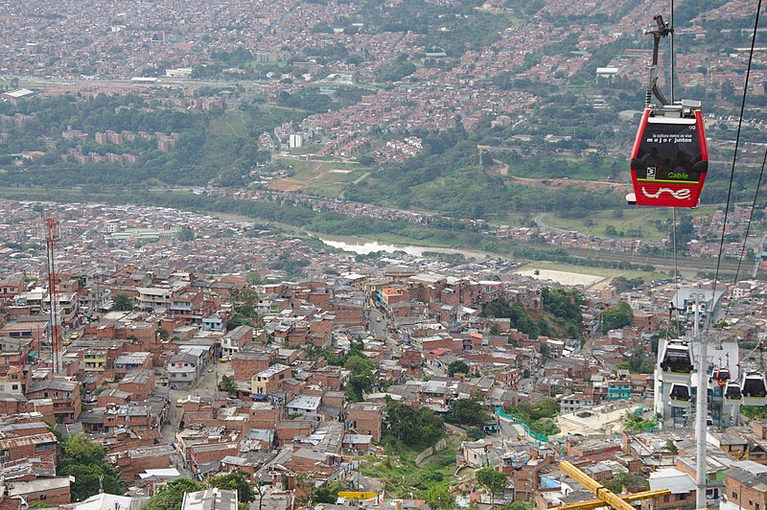
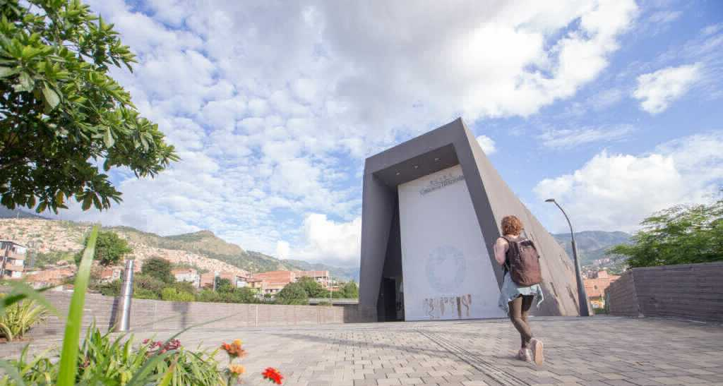
El Medellín de hoy
*la violencia = violence
leer
Escobar murió en el año 1993. Hoy en día Medellín es mucho más __________. En general la gente puede vivir tranquilamente. La zona urbana es bastante agradable, con museos, plazas y parques. Medellín es la ________ ciudad de Colombia que tiene su _________ metro y una red de “metrocables” (un tipo de transporte que conecta las partes altas de la ciudad con las partes bajas). En 2012, incluso ganó un premio a nivel ____________ por estos proyectos de transporte público.
Al _________ tiempo, la ciudad no olvida su pasado ________. En 2006 el gobierno abrió un museo, la “Casa de la Memoria”, para acordarse de la violencia y promover el diálogo. La idea: aprender del pasado para crear un futuro _______.
seguro
única
propio
El metrocable
mundial
mismo
oscuro
La Casa de la Memoria
mejor
Opciones:
propio | única | mundial | oscuro | seguro | mismo
Notes:
Timing: 8 minutes
Aims:
to learn about present day life in a Spanish-speaking city
to correctly identify the missing words in the gaps
to understand key information in the text
Procedure:
Ask students to read the text and identify which word should go in which gap.
Teachers may wish to challenge higher achieving students by not showing them the answer options initially.
Reveal each answer and give feedback. Check understanding of the text via oral translation of each sentence into English.
Notes: students may be interested to know that Escobar died in 1993 during a military attack by the Colombian armed forces. To give an indication of Escobar’s popularity, around 25,000 people attended his funeral (https://faroutmagazine.co.uk/how-pablo-escobar-became-symbol-of-resistance-popular-culture/).
Students were taught the spelling change o > u in the word ‘murió’ in Y9 T2 but it may be worth recapping this.
Frequency of unknown words:
tranquilamente [4526] (not glossed as students have learnt ‘tranquilo’ and the affix –mente); violencia [1100]; conectar [1973]
Images free to use from wikicommons and from the Museo Casa de la Memoria website.
https://commons.wikimedia.org/wiki/File:Metrocable_and_Comuna_1_in_Medell%C3%ADn_01.jpg
https://www.museocasadelamemoria.gov.co/en/elmuseo/acerca-de-nosotros/

Slide 32
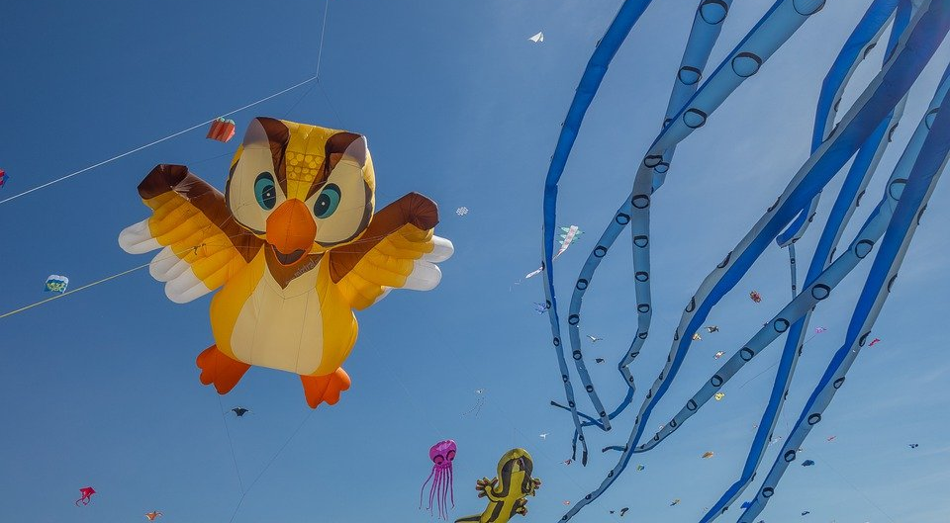
Le festival de Dieppe
lire
*le plus grand =
the biggest
*le cerf-volant = kite
*le son = sound
Comment dit-on les mots orange en anglais ?
What noun does this word look like?
What adjective does this word look like?
What noun does this word look like?
Le festival de Dieppe est le plus grand* festival de cerfs-volants* au monde.
On trouve le festival sur la plage.
Les visiteurs viennent de beaucoup de pays pour regarder des cerfs-volants traditionnels, de l'art et des acrobates. Un aspect important du festival est qu’on peut visiter sans acheter de billet. Il est gratuit !
Il y a beaucoup d'activités pour les enfants et le festival encourage l'imagination. Cet événement culturel célèbre les relations internationales. Pendant le dernier week-end du festival, on regarde les cerfs-volants illuminés pendant un show son* et lumière. Je pense à visiter le festival. Tu veut voyager au festival avec ma famille ?
visitors
What does this sentence tell you about the festival?
acrobats
traditional
The start of this word looks like the English
free
What adjective does this look like?
This word has the same stem as the previous one you worked out. What might it mean?
event
illuminated
light
What words that you already know could you use instead of the words in orange?
Answer the question at the end.
Notes:
Here is a text about a kite-festival in Dieppe with lots of language awareness activities to help learners understand cognates
Then drawing on their current lexicons – which we know what they are precisely as they have been tracked so carefully - to replace the words
Then giving their reaction to the content of the text by answering a question about whether they would like to go to the festival
----------
Timing: 5 minutes
Aim: Developing inferencing skills by using surrounding context to work out meaning of unknown words; word substitution with known words.
Procedure:
1. Students try to work out the meaning of the highlighted words based on context (text and images) and similarity to English words.
2. If students need some help, click to bring up a clue
3. Click gain to reveal the translations.
4. Click to bring up the extension. Students think of known words that could replace the orange words to make a sensible sentence.
Some suggested answers:
visiteurs -> gens, enfants, personnes … any relevant noun to describe people
traditionnels -> grands, nouveaux… any relevant adjective to describe kites
acrobates -> artistes, chanteurs … any relevant noun to describe performers
événement -> lieu, festival … (note that any relevant masculine noun works here but ‘cet’ would need to change to agree)
illuminés -> verts, bons … any relevant adjective to describe kites
lumière -> musique, film … any relevant noun to describe a show

Slide 33
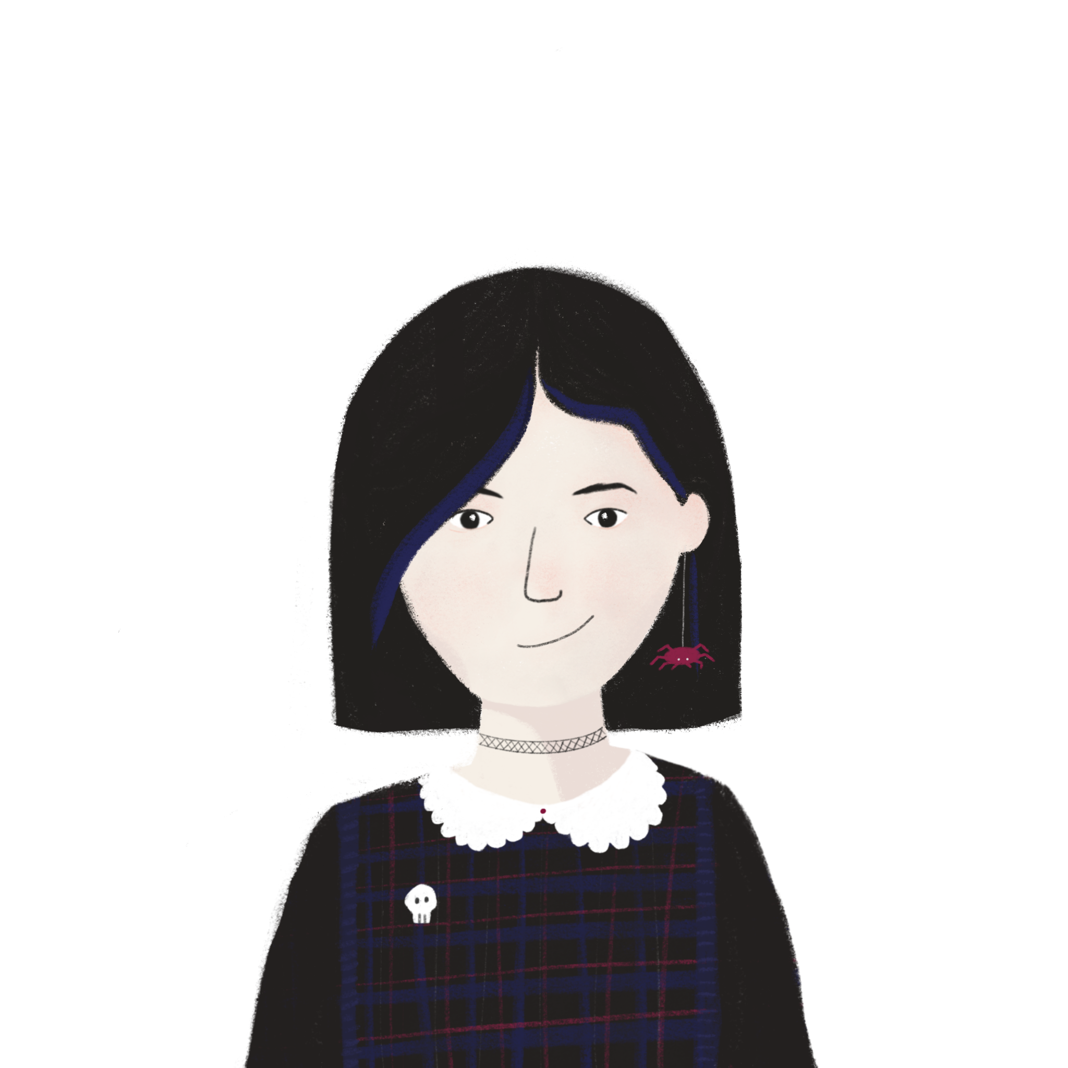
La Manche
Écris des réponses aux questions en anglais.
lire / écrire
La Manche* sépare la France et l’Angleterre. On peut traverser la Manche en bateau ou en train sous l’eau. Quand nous visitons l’Angleterre, nous aimons prendre le train – c’est plus rapide. Ils préfèrent prendre le bateau pour regarder la vue. Comment traversez-vous la Manche ?
Le tunnel sous la Manche constitue le plus long tunnel sous-marin* du monde – on trouve 38 de ses 50 kilomètres sont sous la mer*. On utilise le tunnel pour voyager entre l'Angleterre et la France. C'est idéal pour les vacances et les affaires.
*la Manche = the English Channel
*sous-marin = underwater
*la mer = sea
What is the tunnel ideal for?
holidays / business
What are two ways you can cross the Channel?
boat / train
How long is the tunnel?
50km
How much of the tunnel is under the sea?
38km
Notes:
Comprehension questions about the content.
Timing: 4 mins
Aim: Reading comprehension.
Procedure:
1. Click to bring up a comprehension questions in English.
2. Students write an answer in English.
3. Click to reveal answer.
4. Click again to reveal the next question.
5. Repeat steps 2-5 for 4 questions in total.

Slide 34
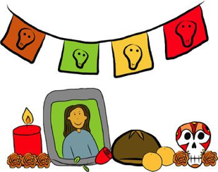
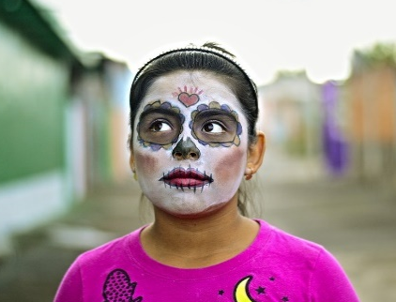
Una tradición mexicana: el Día de Muertos
leer / escuchar
Lee y escucha el texto sobre el Día de Muertos:
1
5
‘Pan de muerto’ es un tipo de pan tradicional en este día.
México tiene muchas tradiciones, pero su tradición del Día de Muertos es especialmente conocida. Es una costumbre única y muy importante para su comunidad porque es una forma de pensar en los muertos. Para los mexicanos, los muertos vienen a la tierra este día.
Nadia es mexicana y celebra el Día de Muertos con su familia. Por la mañana se levanta temprano para ayudar a su abuela: preparan pan* de muerto y un poco de fruta para el altar. Su altar tiene varios* niveles. Los niveles del altar son las diferentes partes del mundo: el primer nivel es la tierra y el segundo nivel es el cielo*. Nadia pone allí fotos de su abuelo y se sienta al lado de su abuela. Se queda unas horas en casa con su familia y se acuerda de su abuelo muerto.
Por la tarde se pone ropa divertida, se pinta de blanco y negro y va a la calle con su hermano. En su barrio hay un festival con música fuerte y luces de colores. ¡Es muy divertido!
2
6
3
7
4
*el pan = bread; *el cielo = sky, heaven; *varios = various
Notes:
This was a bimodal reading and listening task – where learners are asked to follow the text whilst they listen; every so often the audio stops and they have to say the next word or the previous one, or replace the next word with something else
This was informed by evidence that bimodal input helps learners to segment the input into words and helps their comprehension.
-------------
Timing: 8 minutes
Aims:
to reinforce understanding of the difference between ‘se’ and ‘su’.
to help students to connect the spoken and written forms of the language more securely.
to consolidate vocabulary and grammar knowledge by eliciting suggested changes to the text.
Procedure:
Students read the text and write ‘se’ or ‘su’ for each space.
Click on the audio button to play the text. Read and listen.
Note: There is a full version of the audio top right with a player. Alternatively, the audio is in 6 sections with a pause just after the words 1-5 below, to facilitate easy stop/start.
To support segmentation, stop the audio and ask students to say: a) the next word b) the previous word
In addition, to develop understanding, vocabulary and grammar knowledge, pause at key points and ask students to suggest an alternative word that could replace the next word. This is a chance to draw on previously taught grammar and vocabulary knowledge.
Es una costumbre única y muy importante para su... (students volunteer other possible nouns – e.g., gente, historia, país).
y celebra el Día de Muertos con su…..(students volunteer other possible nouns – e.g., padre, madre, primo etc.).
de su abuelo y se... (students volunteer verbs in third person singular that fit after ‘se’ – e.g., se acuerda de..., se queda, se prepara (para), etc)
en casa con su familia y se ... (students volunteer other possible verbs that fit after ‘se’ – e.g., se saca (fotos), se mira en el espejo, se presenta a otra gente).
Por la tarde se…… (students are prompted other possible verbs that fit after ‘se’)
va a la calle con su…. (students volunteer other possible nouns)
Notes:
1. The word for ‘bread’ (‘pan’) will be introduced in the next week’s vocabulary set.
Transcript
México tiene muchas tradiciones, pero su tradición del Día de Muertos es especialmente conocida. Es una costumbre única y muy importante para su comunidad porque es una forma de pensar en los muertos. Para los mexicanos, los muertos vienen a la tierra este día.
Nadia es mexicana y celebra el Día de Muertos con su familia. Por la mañana se levanta temprano para ayudar a su abuela: preparan pan* de muerto y un poco de fruta para el altar. Sualtar tiene varios niveles. Los niveles del altar son las diferentes partes del mundo: el primer nivel es la tierra y el segundo nivel es el cielo. Nadia pone allí fotos de su abuelo y se sienta al lado de su abuela. Se queda unas horas en casa con su familia y se acuerda de su abuelo muerto.
Por la tarde se pone ropa divertida, sepinta de blanco y negro y va a la calle con su hermano. En su barrio hay un festival con música fuerte y luces de colores. ¡Es muy divertido!
Frequency of unknown words and cognates:
pan [1342]; cielo [620]; varios [386]
Photos:
Photo of the child by Christian Newman, from Unsplash.
Photo of ‘Pan de muertos’ by Alejandro Ávila Cortez, from Pixabay.

Slide 35
Further resources from NCELP
https://resources.ncelp.org/
Sound-symbol correspondences are systematically taught and revisited from Y7-Y9, with frequent read aloud and transcription opportunities → phonics collection
Vocabulary selection for the fully resourced SOW is frequency-informed, comprises at least 90% words from a list of the most frequent 2000, and is systematically revisited → SOW
Grammar is explicitly taught, thoroughly practised in listening, reading, speaking and writing activities, and regularly revisited
Texts and listening extracts are carefully designed for very high readability, with unknown words glossed or cognate patterns explained
‘The culture collection’ (year 7 & 8 only currently)
Sample GCSE word lists available
Link to all resource collections
Notes:
You can see many more NCELP resources for 13-14 year olds, after 200 hours of instruction, that cover topics such as secularism in France, the Berlin Wall and divided Germany, the ‘polite you’.
One teacher has shared with us some humorous versions of well known fairy tales that they have written with the high frequency words.

Slide 36
CPD offer
CPD course is free to teachers in state schools
Content is research-informed languages teaching at KS3 and KS4
5 remote learning sessions of 2.5 hours
Course leaders are NCELP Specialist Teachers
Additional online peer and instructor support
An online self-study version of the course will be available for anyone to access for free (and to facilitate a cascade model)
There is a link to register for the course here: www.ncelp.org/cpd
Notes:
As much as possible, participants are assigned to courses regionally - led by an NCELP Specialist Teacher near them, with other participants from their region.
This offers the potential to make the most of local networking and peer support, both online and potentially also face-to-face. A self-study version of the course (with similar certification) for anyone who is unable to access a ‘live’ place will be available shortly.
---------
If this CPD deck is delivered by others, please use this feedback survey, and paste into the chat:
Google Form: https://forms.gle/Y2ztbpRTrkKZRjcp9

Slide 37
Want to hear more from NCELP?
Join the mailing list, email: enquiries@ncelp.org for regular bulletins about resources arriving on the portal
To get monthly alerts to summaries of new research, sign up in 10 seconds at
https://oasis-database.org/

Slide 38
Thanks for listening
What is language competence and GCSE Subject Content
Comparing 2015 and 2022: similarities and differences
Some implications for curriculum design

