Slide 1
Describing what people do (Work)
Present tense -ar verbs [revisited]
SSCs [ce] & [ci] [revisited]
Y8 Spanish
Term 1.2 - Week 7 - Lesson 27
Nick Avery / Victoria Hobson / Rachel Hawkes Artwork: Mark Davies
Date updated: 15/07/2022
Notes:
Artwork by Mark Davies. All additional pictures selected are available under a Creative Commons license, no attribution required.
Learning outcomes (lesson 1):
Consolidation of SSCs [ce] & [ci]
Consolidation of present tense –ar verbs in the first and third person plural (-amos, -an)
Consolidation of vocabulary, including a set of 50 vocab items from Y7
Word frequency (1 is the most frequent word in Spanish):
8.1.1.6 (revisit): empezar [175]; terminar [253]; decir [31]; ver [38]; el minuto [478]; el ejemplo [187]; la opinión [578]; la verdad [176]; el/la estudiante [795]; el alemán [761]; todo² [472]
Source: Davies, M. & Davies, K. (2018). A frequency dictionary of Spanish: Core vocabulary for learners (2nd ed.). Routledge: London
Note: Vocabulary from 8.1.2.4 is revisited in lesson 2.
Year 7 vocabulary subset (50 items): comida; botella; carne; vaso; fruta; plato; comida; bebida; grupo; llegar; hablar; escuchar; comprar; necesitar; buscar; usar; llevar²; trabajar; lavar; organizar; preparar; hacer; pedir; escribir; aprender; responder; descubrir; dormir; poder; deber; querer; beber; vivir; comer; leer; saber; rico; bonito; juntos; bien; malo; de; porque; durante; cada; todo; cómo.
These Y7 vocabulary items are also revisited across the two lessons to ensure systematic revisiting of Y7 vocabulary within Y8 revision lessons.
The frequency rankings for words that occur in this PowerPoint which have been previously introduced in NCELP resources are given in the NCELP SOW and in the resources that first introduced and formally re-visited those words.
For any other words that occur incidentally in this PowerPoint, frequency rankings will be provided in the notes field wherever possible.

Slide 2
Vocabulario
escuchar
Escucha y empareja la imagen correcta con la palabra en español.
A
B
C
D
E
E.g.
to say, saying
to finish, finishing
to see, seeing
to start, starting
F
G
H
I
J
K
opinion
truth
all,
everything
minute
student
German
1
2
3
4
5
6
7
8
9
10
11
F
J
A
G
I
D
E
H
C
K
B
Notes:
Vocabulary revisiting activity
Note: there are three options for revisiting this vocabulary set: 1) single word items as a listening (this slide); 2) reading at text level (next slide) or 3) listening at sentence level (slide after). One possibility might be to do 1) before 2) or 3). This would allow students to do a quick recap of key vocabulary before reading/listening a text in which the words appear. The lesson timings allow for this to be done within 50 minutes.
Timing: 3 minutes
Aim: to revisit vocabulary from 8.1.1.6 as per the SoW revisiting cycle.
Procedure:
Students write 1-11 in their books.
They look at the answer options to see if there are any that they can recall from memory themselves.
They then listen to the audio and write the letter of the picture that matches what they hear.
Transcript
el minuto
la verdad
terminar
el, la estudiante
la opinión
empezar
el ejemplo
el alemán
ver
todo
decir

Slide 3
Los amigos argentinos de Lucía
leer
Lucía recibe una carta de unos amigos en Argentina.
¡Hola Lucía! ¿Cómo estás? Nosotros estamos bien. Ahora vamos a otro colegio ☺. Empezamos temprano por la mañana. Siempre damos opiniones en clase, y los otros estudiantes también. ¡Estudiamos de todo! Por ejemplo ciencias, alemán y chino. Si hacemos algo malo, decimos la verdad a la profesora. Es mejor así. Si tenemos suerte, podemos terminar las clases veinte minutos antes para ver parte de una película.
Escribe el texto en inglés.
Hello Lucía. How are you? We are well/fine. We now go to another school. We start early in the morning. We always give opinions in class and the other students do, too. We study everything, for example science and German. If we do something bad, we tell the teacher the truth. It’s better like that. If we’re lucky, we can finish the classes twenty minutes early (in order) to watch part of a film.
Notes:
VARIATION
Vocabulary revisiting activity
Timing: 7 minutes
Aim: to revisit vocabulary from 8.1.1.6 as per the SoW revisiting cycle.
Procedure:
Students read the text alone or in pairs and translate it into written English.
Alternatively, the activity can be done as a whole-class oral translation. The teacher can read the text phrase by phrase aloud and ask students to translate orally into English.
Notes:
All words in this text have been previously taught, with the exception of ‘colegio’ which has been used for phonics practice with SSC [gi]. Students also encountered the idiomatic phrase ‘de todo’ in Year 7, Term 1, though they may need reminding of how it is used for emphasis. The text contains all eleven words from 8.1.1.6 that are revisited this week.
The text has been written deliberately in the 1st person plural, as this is the grammar focus for the lesson. Students attention could be drawn to this as it ties in with the rest of the lesson.

Slide 4
Los amigos argentinos de Lucía
escuchar
1
Escucha. ¿Las frases son verdaderas (V) o falsas (F)?
1. They are at the same school as before.
F
‘ahora vamos a otro colegio’
2. They start early.
V
‘empezamos temprano’
3. They participate in class.
V
‘siempre damos opiniones en clase’
4. They study Spanish and Chinese.
F
‘estudiamos […] alemán y chino’
5. They are honest.
V
‘decimos la verdad a la profesora’
‘si tenemos suerte, podemos terminar las clases veinte minutos antes’
6. Sometimes they finish early.
V
Notes:
VARIATION
Vocabulary revisiting activity
Timing: 7 minutes
Aim: to revisit vocabulary from 8.1.1.6 as per the SoW revisiting cycle.
Procedure:
Students listen to the short recording.
They then answer the true/false questions,
Students listen again. They note down the words/phrases they hear in the text that makes them decide if it’s true or false.
Transcript (revisited words from 8.1.1.6 are in bold):
¡Hola Lucía! ¿Cómo estás? Nosotros estamos bien. Ahora vamos a otro colegio ☺. Empezamos temprano por la mañana. Siempre damos opiniones en clase, y los otros estudiantes también. ¡Estudiamos de todo! Por ejemplo ciencias, alemán y chino. Si hacemos algo malo, decimos la verdad a la profesora. Es mejor así. Si tenemos suerte, podemos terminar las clases veinte minutos antes para ver parte de una película.

Slide 5
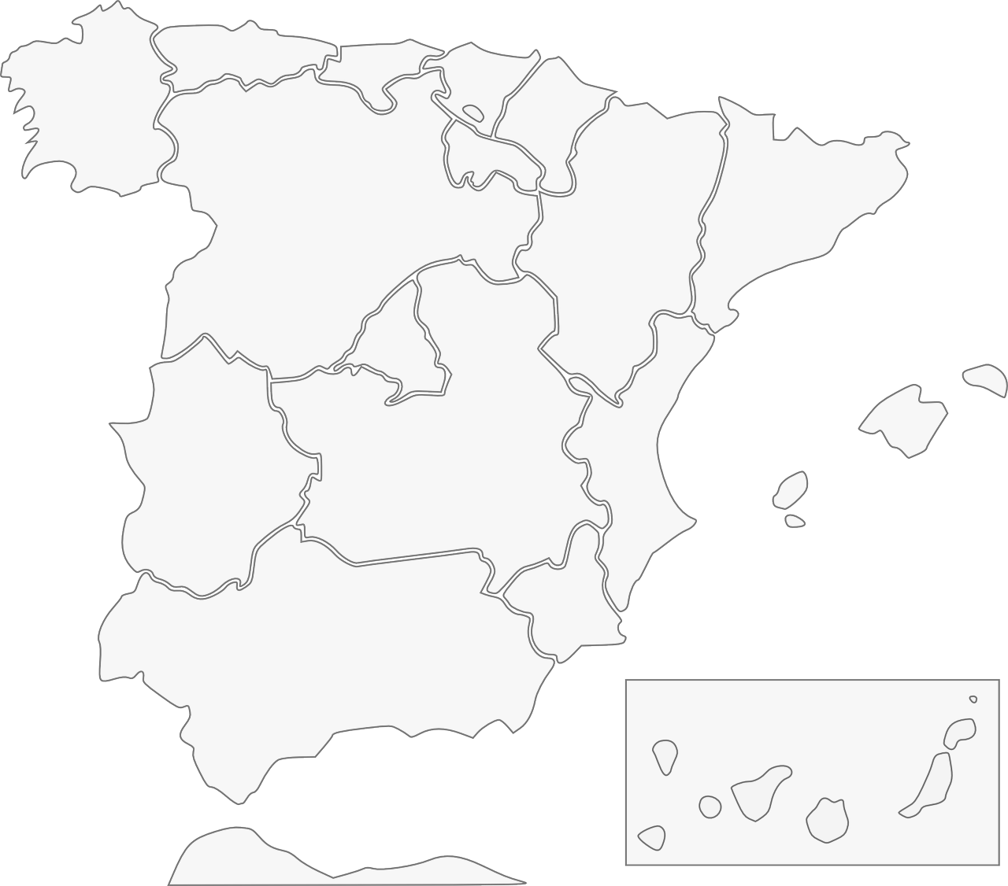
Fonética: [ci] & [ce]
escuchar / escribir
Escucha y escribe en español el nombre correcto del lugar.
1
Galicia
2
Barcelona
3
Cáceres
4
Valencia
Albacete
5
Murcia
Andalucía
7
6
Ceuta
8
Notes:
Timing: 5 minutes
Aim: to revisit the sound-spelling correspondence for the SSCs [ce] and [ci] with eight names of cities/autonomous communities Spain
Procedure:
Click on the action button to play the audio.
Click to reveal the place names in order.
Transcript:
1. Galicia
2. Barcelona
3. Valencia
4. Murcia
5. Ceuta
6. Andalucía
7. Albacete
8. Cáceres

Slide 6
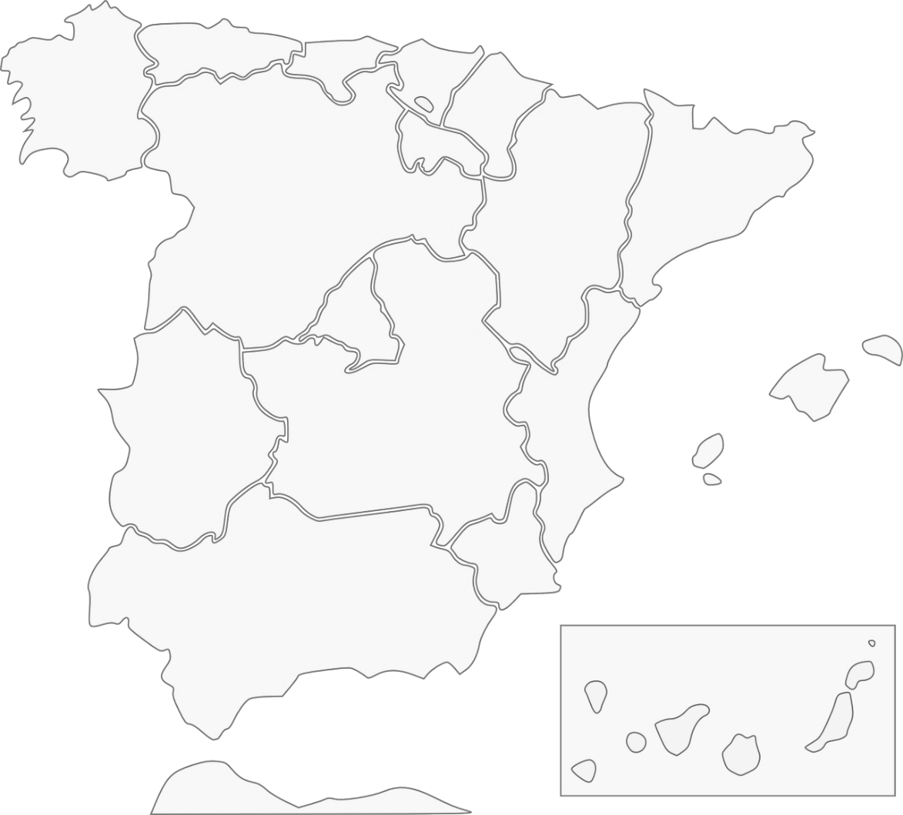
Las comunidades autónomas de España
leer
[1/2]
Hay diecisiete comunidades autónomas en España.
Cada una es una región. Aquí tienes cinco ejemplos:
Galicia
Comunidad Valenciana
Andalucía
Región de Murcia
¡Ceuta está en África!
Ceuta
Notes:
Timing: 2 minutes (slides 6 & 7)
Aim: to introduce students to the concept of Spain’s ‘comunidades autónomas’ (slide 1/2)
Procedure:
Click to reveal the five autonomous communities students have just seen as part of the phonics listening activity.
Click to show within which autonomous communities the other three cities from the listening activity are situated.
Note: teachers may want to read the information aloud for students, or alternatively ask students to read the information aloud chorally, or elicit the information from individual students.

Slide 7
Las comunidades autónomas de España
leer
[2/2]
En las comunidades autónomas hay muchas ciudades.
Aquí tienes tres ejemplos.
Barcelona es una ciudad en la comunidad de Cataluña.
Cáceres es una
ciudad en la comunidad de Extremadura.
Albacete es una ciudad en la comunidad de Castilla-La Mancha.
Notes:
Slide 2/2

Slide 8
Present tense -ar verbs: 1st person plural (-amos) & 3rd person plural (-an)
gramática
Remember that present tense –ar verbs change depending on who the verb refers to.
To mean ‘we’ with an –ar verb, remove –ar and add –amos to the stem.
____
compr-
compramos
we buy, are buying
To mean ‘they’ with an –ar verb, remove –ar and add –an to the stem.
__
compr-
compran
they buy, are buying
amos
We arrive late. = Lleg______ tarde.
They use a computer. = Us____un ordenador.
an
Notes:
Timing: 2 minutes
Aim: to recap present tense –ar verbs in first and third person plural.
Procedure:
1. Read the explanation and elicit answers from students as required.

Slide 9
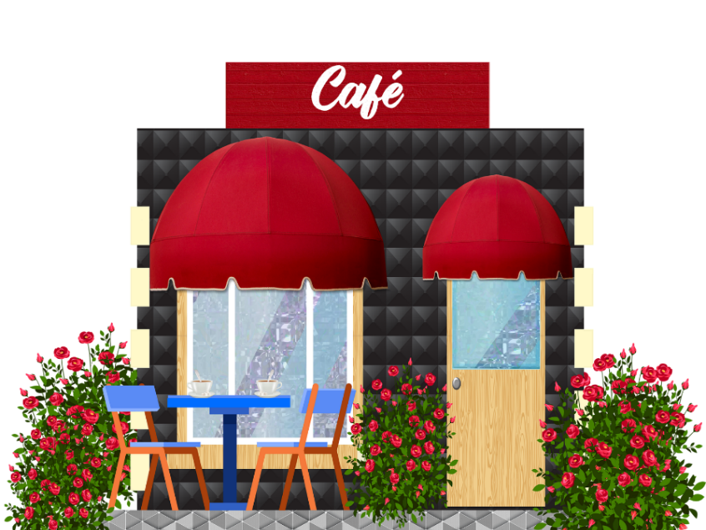
leer
Los sábados, Ana trabaja en un café. Describe las tareas. ¿Qué tareas hace Ana con los compañeros de trabajo (‘we’)? ¿Qué hacen los compañeros sin Ana (‘they’)?
Organizamos las mesas.
Trabajan por la tarde.
Preparan la paella.
Buscan fruta y unas botellas de agua.
Ana y los compañeros (‘we’) | Los compañeros (‘they’)
Work in the afternoon / evening.
Llevamos la comida y las bebidas a las mesas.
Limpiamos el suelo.
Organise the tables.
Clean the floor.
Prepare the paella.
Lavan los platos y los vasos.
Take the food and drinks to the tables.
Look for fruit and some bottles of water.
Hablamos con los clientes* cuando llegan.
Talk to the customers when they arrive.
Wash the dishes and the glasses.
*cliente = customer
Notes:
Timing: 8 minutes
Aim: to practise connecting the present tense –ar verb endings –amos and –an with ‘we’ and ‘they’ respectively.
Procedure:
The teacher goes through instuctions with students.
If necessary, ask students for the word for ‘classmate’, as compañero was first introduced in this context. Then see if students can understand the meaning of ‘compañero de trabajo’, as the word is used in a new context here.
Students read the texts and write the activities in the correct column of the table according to whether ‘we’ or ‘they’ do the tasks.
Note: the items are not numbered and may therefore be recorded in a different order from the animated order of the answers. Teachers will want to make clear to students that the order is unimportant. It is sufficient to have the four ‘we’ and four ‘they’ answers correctly noted.

Slide 10
escuchar
El jefe* dice qué tareas debe hacer el equipo en el café.
No todos los compañeros de trabajo hacen la misma tarea.
Escucha. ¿Es ‘we’ o ‘they’? También escribe la tarea en inglés.
 | We | They | Tarea en inglés
te
1
go and buy meat
2
wash the dishes (they’re dirty)
3
clean the windows
4
open the door (in a few moments)
5
take out the rubbish (now)
6
buy the ingredients for the paella (in the shop)
7
wash the floor well
Notice how ‘trabajar en equipo’ may translate as ‘work as a team’.
8
work as a team
*jefe, jefa = boss
Notes:
Timing: 8 minutes
Aim: to practise connecting the –ar verb endings –amos and –an with ‘we’ and ‘they’ in the oral modality; to practise understanding verb infinitives (after ‘necesitar’)
Procedure:
Students listen and indicate whether ‘we’ or ‘they’ do the tasks according to the verb ending.
Students also write the task in English.
Note: Depending on the confidence levels of the class, teachers may want to do one – three items initially, feeding back after each item, and then proceed with the remaining questions, checking the answers at the end. Animations facilitate a flexible approach.
Transcript:
1. Necesitamos ir a comprar carne.
2. Necesitan lavar los platos. ¡Están sucios!
3. Necesitan limpiar las ventanas.
4. Necesitamos abrir la puerta en unos momentos.
5. Necesitan sacar la basura ahora.
6. Necesitamos comprar los ingredientes para la paella en la tienda
7. Necesitan lavar bien el suelo.
8. Necesitamos trabajar en equipo.

Slide 11
Un día en el café
escribir
Un día, Daniel va con Ana para ayudar en el café. Imagina que tú eres Daniel. ¿Qué haces con los compañeros de trabajo (‘we’) y qué hacen los companeros solos (‘they’)? Escribe las frases en español.
1) We take bottles of water to each table.
2) We talk with the customers* when they arrive.
3) We work well as a team.
4) They prepare the meat dishes.
5) They organise the big groups.
6) They wash the dishes and glasses together.
Llevamos botellas de agua a cada mesa.
Hablamos con los clientes cuando llegan.
Trabajamos bien en equipo.
Preparan los platos de carne.
Organizan los grupos grandes.
Lavan los platos y los vasos juntos.
*clientes
Notes:
Timing: 8-12 minutes (see ideas for extension below)
Aim: a written production activity to practise verb endings for present tense –ar verbs in the first and third person plural.
Procedure:
1. Students translate the sentences into Spanish.
2. The English is revealed on a mouse click.
3. If there is any time left over at the end, ask students to write their own sentences using other previously taught –ar verbs. The context and grammar focus (-amos, -an) can remain the same.
Examples of other previously taught –ar verbs include: usar, caminar, comprar, escuchar, mirar, dar (damos, dan follow the same rules as normal –ar verbs), buscar, pasar, sacar, cenar, disfrutar.
To extend/enrich the language, students could be encouraged to include
temporal adverbs (generalmente, nunca, siempre, a veces, normalmente)
other time phrases (por/durante la mañana/tarde/noche)
positional adverbs (debajo, detrás, fuera, delante, cerca, lejos) with del and de la + noun.

Slide 12
Describing what people do (Festive traditions)
present tense –er & –ir verbs [revisited]
SSCs [ce] & [ci] [revisited]
Y8 Spanish
Term 1.2 - Week 7 - Lesson 28
Nick Avery / Victoria Hobson / Rachel Hawkes Artwork: Mark Davies
Date updated: 01/10/2020
Notes:
Artwork by Mark Davies. All additional pictures selected are available under a Creative Commons license, no attribution required.
Learning outcomes (lesson 2):
Consolidation of SSCs [ce] & [ci]
Consolidation of present tense –er/-ir verbs in first and third person plural (-emos, -imos, -en)
Consolidation of vocabulary, including a set of 50 vocab items from Y7
Word frequency (1 is the most frequent word in Spanish):
8.1.2.4 (revisit) paso [279]; apoyo [866]; adelante [722]; atrás [599]; izquierda [1352]; derecha [1573]; así que [que-3];
pena [743]; vergüenza [1979]; rabia [2500]; tristeza [1993]; risa [1101]; ánimo [1855]; traducción [2822]; intención [1171]
Year 7 vocabulary subset (50 items): comida; botella; carne; vaso; fruta; plato; comida; bebida; grupo; llegar; hablar; escuchar; comprar; necesitar; buscar; usar; llevar²; trabajar; lavar; organizar; preparar; hacer; pedir; escribir; aprender; responder; descubrir; dormir; poder; deber; querer; beber; vivir; comer; leer; saber; rico; bonito; juntos; bien; malo; de; porque; durante; cada; todo; cómo.
These vocabulary items are also revisited across the two lessons to ensure systematic revisiting of Y7 vocabulary within Y8 consolidation lessons.
Source: Davies, M. & Davies, K. (2018). A frequency dictionary of Spanish: Core vocabulary for learners (2nd ed.). Routledge: London
The frequency rankings for words that occur in this PowerPoint which have been previously introduced in NCELP resources are given in the NCELP SOW and in the resources that first introduced and formally re-visited those words.
For any other words that occur incidentally in this PowerPoint, frequency rankings will be provided in the notes field wherever possible.

Slide 13
leer
Elige una palabra para completar cada frase. En las frases 4-7, una imagen o una palabra en inglés indica la opción correcta.
atrás
el apoyo
izquierda
la intención
derecha
la traducción
adelante
así que
Tiene _______________ de viajar a Italia en verano.
¿Quieres leer ____________________ de la frase?
Tengo __________ de mi familia, __________ voy a tener éxito.
Primero, das un paso __________________.
Luego, das un paso __________________.
El cine está a la ___________________.
La escuela está a la ___________________.
la intención
He intends to travel to Italy in summer.
la traducción
Do you want to read the translation of the sentence?
el apoyo
así que
I have the support of my family so I am going to succeed.
adelante
[forward]
First, you take a step forward.
atrás
[backwards]
Then, you take a step backwards.
derecha
The cinema is on the right.
izquierda
The school is on the left.
Notes:
Timing: 3 minutes
Aim: to revisit vocabulary from 8.1.2.4 as per the SoW revisiting cycle.
Procedure:
Students fill the gap with the correct missing word then translate the sentences into English.
Attention to plausibility is needed, as some sentences work grammatically but are highly unlikely (e.g. tengo la traducción de mi familia, así que voy a tener éxito).
Sentences 4-7 also have a picture to indicate which word is needed.
Word frequency (1 is the most frequent word in Spanish): 8.1.2.4 (revisit) paso [279]; apoyo [866]; adelante [722]; atrás [599]; izquierda [1352]; derecha [1573]; así que [que-3]; traducción [2822]; intención [1171]
Source: Davies, M. & Davies, K. (2018). A frequency dictionary of Spanish: Core vocabulary for learners (2nd ed.). Routledge: London

Slide 14
escuchar
Escucha y elige la traducción correcta. Hay ocho opciones.
Es posible elegir la misma opción dos veces.
1
sadness
laughter
anger
2
encouragement
anger
sadness
encouragement
3
4
embarrassment
fear
embarrassment
5
laughter
Remember, ‘tristeza’ and ‘pena’ both mean sadness.
joy, happiness
sadness
6
sadness
Notes:
Timing: 2 minutes
Aim: to revisit vocabulary from 8.1.2.4 as per the SoW revisiting cycle.
Procedure:
1. Students listen to the audio and select the correct translation.
Transcript:
tristeza
ánimo
rabia
vergüenza
risa
pena
Note: ‘sadness’ is included twice as an answer option because two words were taught for this: tristeza and pena. A callout draws attention to this after the final answer is shown.
Word frequency (1 is the most frequent word in Spanish): pena [743]; vergüenza [1979]; rabia [2500]; tristeza [1993]; risa [1101]; ánimo [1855]
Source: Davies, M. & Davies, K. (2018). A frequency dictionary of Spanish: Core vocabulary for learners (2nd ed.). Routledge: London

Slide 15
SSCs [CE] y [CI]
escuchar
Remember, there are different ways to pronounce CE and CI.
In most of mainland Spain, the ‘c’ before ‘e’ or ‘i’ is pronounced
like _____ in English.
‘th’
In the Canary Islands and Latin America, this ‘c’ is often pronounced like an ____.
‘s’
Escucha. Es ¿España o Canarias / Latinoamérica?
ciencias
España
1
________________________________
ciencias
Canarias / Latinoamérica
2
________________________________
doce
Canarias / Latinoamérica
3
________________________________
doce
España
4
________________________________
Notes:
Phonics recap slide
Timing: 3 minutes
Aim: to revisit the SSCs [CE] and [CI] and consolidate understanding of the different ways in which they are pronounced in the Spanish-speaking world.
Procedure:
Read the explanation, eliciting the answers from students where prompted by gaps.
Play the audio and ask where the person is from (‘¿La persona es de…?’)
Ask students which other words they can recall from Y7 which have [ce] and [ci]. This will help to prepare them for the next activity.
Anticipate, for [CI], cine, diciembre, decir, cierto, ciudad
Anticipate, for [CE], centro, necesitar, necesario, cerca, doce, parecer.
Notes:
Teachers may also find it useful to consider the information from exam board specifications below:
AQA : “The [listening] test will be studio recorded using native speakers speaking Castilian in clearly articulated, standard speech at near normal speed. Different types of spoken language will be used, using familiar language across a range of contemporary and cultural themes. (p. 82)
EdExcel : “For listening and reading assessments, the majority of contexts are based on the culture and countries where the assessed language is spoken. […] It is, therefore, important that students are exposed to materials relating to Spanish-speaking countries throughout the course.” (p. 7)
WJEC : “This GCSE specification in Spanish for use in Wales is based on a conviction that learners studying a modern foreign language will develop their desire and ability to communicate with and understand speakers of Spanish in a variety of contexts and for a variety of purposes.” (p. 3)

Slide 16
Pilar y Conchi son de lugares diferentes, así que no tienen la misma pronunciación de [ce] y [ci]. Escucha. Quién habla, ¿Conchi o Pilar? Escribe el lugar también.
escuchar
Pilar (Islas Canarias) | Conchi (Alicante)
İHola! ¿Cómo estás? Soy Pilar y soy de Puerto Rico en las Islas Canarias.
1
Ceuta
2
Galicia
3
Valencia
4
Murcia
İBuenos días! Soy Conchi y soy de Alicante en la Comunidad Valenciana.
5
Cáceres
6
Barcelona
7
Andalucía
8
Albacete
Notes:
Phonics practice activity
Timing: 6 minutes
Aim: to raise awareness of the different ways in which the SSCs [ce] and [ci] are pronounced in the Spanish-speaking world.
Procedure:
Go through instructions with students.
Check understanding of instructions by asking students an example. E.g., ciudad (pronounced with seseo): ¿Es Pilar or Conchi? ¿Por qué? Sí, perfecto, porque Pilar es de las Islas Canarias. ¿Y en Alicante, cómo es la pronunciación?
Play the audio and ask students to tick the correct column and write the place with the target SSCs.
Check answers, including spelling, in the feedback.
Note:
Some students may be able to write the entire sentence.
Transcript:
Tengo un amigo de Ceuta.
Mi prima vive en Galicia
¿Tu madre es de Valencia?
Voy a ir de vacaciones a Murcia.
Hay una universidad muy famosa en Cárceres.
Barcelona tiene unos museos geniales.
Andalucía es una zona muy bonita.
Albacete está en el sureste de España.

Slide 17
Present tense –er/ –ir verbs: 1st person plural (-emos/-imos) & 3rd person plural (-en)
gramática
Remember that present tense –er and –ir verbs change depending on who the verb refers to.
To mean ‘we’ with an –er verb, remove –er and add –emos to the stem.
____
com-
comemos
we eat, are eating
To mean ‘we’ with an –ir verb, remove –ir and add –imos to the stem.
___
escrib-
escribimos
we write, are writing
To mean ‘they’ with an –er/ –ir verb, remove –er/ –ir and add –en to the stem.
__
com-
comen
they eat, are eating
escrib-
escriben
they write, are writing
Notes:
Timing: 2 minutes
Aim: to recap present tense –er/–ir verbs in first and third person plural.
Procedure:
1. Read the explanation and elicit answers from students as required.

Slide 18
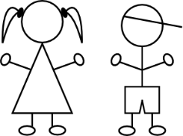
Using subject pronouns: nosotros, nosotras (‘we’) & ellos, ellas (‘they’)
gramática
nosotros
for an all male / mixed group.
To say ‘we’, use: _________
nosotras
Use: _________ for an all female group.
ellos
To say ‘they’, use: ______
for an all male / mixed group.
ellas
Use: ______ for an all female group.
Notes:
Timing: 1 minute
Aim: to recap the subject pronouns ‘nosotros/as’ and ‘ellos/as’
Procedure:
1. Go through the explanation eliciting answers as required.

Slide 19
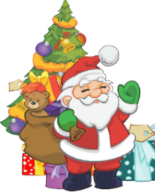
Navidad con la Familia López
escuchar y leer
1
5
Lucía y Daniel hablan sobre la Navidad en casa. Los primos normalmente están allí. ¿Qué hacen Lucía y Daniel, y qué hacen los primos?
2
6
Normalmente pasamos la Navidad con dos primos pequeños. Ellos escriben cartas a Papá Noel para pedir regalos. En cambio, ¡nosotros solo escribimos una lista para los padres!
Por la noche, Daniel y yo debemos ir a la cama, pero no tenemos sueño. En realidad, ¡dormimos muy poco porque queremos abrir regalos! Los primos beben algo y leen libros con la abuela antes de dormir. Ellos también deben descansar.
Para celebrar la Nochevieja, hacemos un viaje a la ciudad de Bilbao. No está cerca, así que vamos en coche. A medianoche comemos doce uvas en la plaza del centro. ¡Es una tradición popular en España!
3
7
4
diciembre
Papá Noel
Nochevieja
uvas
medianoche
Notes:
Timing: 8 minutes
Aim: to practise hearing and reading the revisited grammar, together with revisited vocabulary as part of the systematic revisiting of Y7 vocabulary. The suggested procedure includes strategic pausing of the audio to help students to connect the spoken and written forms of the language more securely, and a word substitution task. Additionally, this task gives a cultural insight into the Spanish New Year’s Eve tradition of eating 12 grapes on the 12 strikes of midnight.
Suggested procedure
1. Use the audio player and click on the ‘play’ button below to play the text. Read and listen.
2. To support segmentation, stop the audio and ask students to say: i. the next word ii. the previous word
3. Use the numbered action buttons on the right hand side to play segments of the text. When each segment ends, ask students to suggest a word or phrase that could replace the next one.
Each segment will end at the following points:
‘ellos’ (line two, paragraph 1), to elicit the 3rd person plural form of the verb. Try to ensure that students’ suggestions include at least one example of a verb with the –en ending (they may also volunteer irregular or –ar verbs).
‘nosotros (line three, paragraph 1), to elicit the 1st person plural form of the verb. Aim to elicit examples of the –emos or –imos ending.
‘Daniel y yo’(line one, paragraph 2), to elicit the 1st person plural form of the verb. Aim to elicit examples of the –emos or –imos ending.
‘ellos también’ (line four, paragraph 2), to elicit the 3rd person plural form of the verb. Aim to elicit examples of the –en ending.
‘Para celebrar la Nochevieja’ (line one, paragraph 3). This could generate a range of answers.
‘No está cerca, así que’ (line two, paragraph 3). This could generate a range of answers. The aim is to check understanding of ‘así que’ by allowing students to suggest a different kind of consequence (e.g. así que no vamos cada año).
Transcript
Normalmente pasamos la Navidad con dos primos pequeños. Ellos escriben cartas a Papá Noel para pedir regalos. En cambio, ¡nosotros solo escribimos una lista para los padres!
Por la noche, Daniel y yo debemos ir a la cama, pero no tenemos sueño. En realidad, ¡dormimos muy poco porque queremos abrir regalos! Los primos beben algo y leen libros con la abuela antes de dormir. Ellos también deben descansar.
Para celebrar la Nochevieja, hacemos un viaje a la ciudad de Bilbao. No está cerca, así que vamos en coche. A medianoche comemos doce uvas en la plaza del centro. ¡Es una tradición popular en España!
Note: The text contains a very high proportion of previously taught language. Although not formally taught as a lexical items ‘navidad’ and ‘papá noel’ were both encountered in Year 7 materials. Three unknown words are glossed. These words and their frequencies are given below.
Word frequency (1 is the most frequent word in Spanish): medianoche [4663]; uva [>5000]; Nochevieja [N/A];
Source: Davies, M. & Davies, K. (2018). A frequency dictionary of Spanish: Core vocabulary for learners (2nd ed.). Routledge: London

Slide 20
Navidad con la Familia López
leer
* underlined
Escribe en inglés las partes subrayadas* de las frases.
Normalmente pasamos la Navidad con dos primos pequeños. Ellos escriben cartas a Papá Noel para pedir regalos. En cambio, ¡nosotros solo escribimos una lista para los padres!
Por la noche, Daniel y yo debemos ir a la cama, pero no tenemos sueño. En realidad, ¡dormimos muy poco porque queremos abrir regalos! Los primos beben algo y leen libros con la abuela antes de dormir. Ellos también deben descansar.
Para celebrar la Nochevieja, hacemos un viaje a la ciudad de Bilbao. No está cerca, así que vamos en coche. A medianoche comemos doce uvas en la plaza del centro. ¡Es una tradición popular en España!
Papá Noel
diciembre
Nochevieja
uvas
medianoche
Notes:
Timing: 7 minutes (slides 20-21)
Aim: to connect the first and third person verb endings within sentences with their correct meaning in English.
Procedure: 1. Translate the underlined parts of the sentences (individually or in pairs)
2. Use the next slide for the feedback.

Slide 21
Respuestas
leer
1 | Ellos escriben cartas a Papá Noel para pedir regalos. | They write letters to Father Christmas (in order) to ask for presents.
2 | ¡Nosotros solo escribimos una lista para los padres! | We only write a list for the parents.
3 | Daniel y yo debemos ir a la cama, pero no tenemos sueño. | Daniel and I have to/must go to bed, but we aren’t sleepy.
4 | Dormimos muy poco porque queremos abrir regalos. | We sleep very little because we want to open presents.
5 | Los primos beben algo y leen libros con la abuela. | The cousins drink something and read books with Grandma.
6 | Ellos también deben descansar. | They must/have to also rest.
7 | Hacemos un viaje a la ciudad de Bilbao. | We go on a trip to the city of Bilbao.
8 | Comemos doce uvas en la plaza. | We eat twelve grapes in the square.
Notes:
Reading [ANSWERS]
Timing: 2 minutes
Procedure:
Click to reveal the answers one by one, from 1-8.

Slide 22
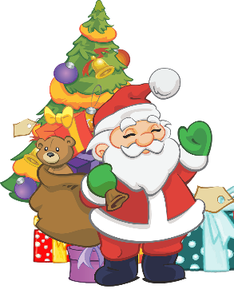
Navidad con la Familia López
hablar
Lee el tercer párrafo del texto con una pareja.
Pronuncia bien las [ce] y las [ci].
Para celebrar la Nochevieja, hacemos un viaje a la ciudad de Bilbao. No está cerca, así que vamos en coche. A medianoche comemos doce uvas en la plaza del centro. ¡Es una tradición popular en España!
diciembre
Notes:
Timing: 2 minutes
Aim: to practise reading aloud and developing SSC knowledge in full sentences. The extract contains 7 examples of [ce] and [ci]. There are also other previously taught SSCs including [j], [z] and [ñ].
Suggested procedure
1. Students read the text aloud to a partner, focusing on this week’s SSC (highlighted in orange).
2. Circulate to listen to students’ pronunciation.
Note: It does not matter whether students pronounce these SSCs with seseo or distinción, but consistency when reading the text is advisable. The background and personal experience of individual teachers will of course decide the approach taken. Students could even try reading it in both ways, as, ultimately, the aim is increase awareness of the differences in pronunciation in different parts of the Spanish speaking world.

Slide 23
escribir
-emos
Remember, to say ‘we’ with –er verbs, use the _________ ending.
-imos
To say ‘we’ with –ir verbs, use the _________ ending.
descubren
bebemos
hacen
podemos
escriben
responden
leen
aprenden
sabemos
comemos
deben
vivimos
dormimos
queremos
pedimos
-en
To say ‘they’ with –er/ –ir verbs, use the _______ ending.
A
B
C
D
E
[we ask for]
[they write]
[they learn]
[we sleep]
[they answer]
F
G
H
I
J
[they discover]
[we want]
[we can]
[we drink]
[we know]
K
L
M
N
O
[we live]
[we eat]
[they read]
[they must]
[they make/do]
Notes:
Vocabulary/grammar practice slide (productive mode)
Timing: 6 minutes
Aim: To revise in productive mode/written modality 15 –er/–ir verbs from Y7 within a limited time frame and with verb manipulation.
This activity aids as a lead into the final oral production activity.
Procedure:
1. Write A-O in books.
2. Click / press enter to flash an English prompt (e.g. we need). It will disappear after 3 seconds. Note that the pictures do not appear in alphabetical order to increase the challenge.
3. Write down the conjugated Spanish verb before it has faded away.
Notes:
Remove the rules during the activity to increase the challenge, if appropriate.
This activity could also be done in oral production with a higher-proficiency group.
-er/-ir verbs used: hacer / pedir (1st person plural only) / escribir / aprender / responder / descubrir / dormir (1st person plural only) / poder (1st person plural only) / deber / querer (1st person plural only) / beber / vivir / comer / leer / saber

Slide 24
¿Qué hace la familia López durante la Navidad?
hablar y escuchar
El día de Navidad
[we]
On the other hand…
[they]
discover lots of presents under the bed
ask for lots of presents
Persona A
El día de Navidad, nosotros pedimos muchos regalos. En cambio, ellos descubren muchos regalos debajo de la cama.
Christmas Day
We | They
Persona B
ask for lots of presents
discover lots of presents under the bed
Notes:
Timing: 10 minutes
Aim: to practise using –er/–ir verbs in the first and third person plural along with correct subject pronouns.
Procedure:
This slide can be used to model the task.
Student A uses his/her prompt sheets to give four sentences to their partner.
Student B listens and makes notes in English, following the guide on the answer grid (see slide 24).
Students then swap roles.

Slide 25
¿Qué hace la familia López durante la Navidad?
hablar y escuchar
Persona A
El día de Navidad
We discover the presents
while
they make the food.
They drink coffee
and
we read new books.
La Nochevieja
They must clean the house
but
we can play with friends.
We want to go to bed early.
However,
they eat 12 grapes at midnight.
Notes:
Student A speaking prompts
Do not display during activity
These are also available in a separate doc for ease of printing.

Slide 26
¿Qué hace la familia López durante la Navidad?
hablar y escuchar
Persona B
El día de Navidad
We sleep
while
they reply/respond to messages.
They eat tasty paella
and
we write with the new pens.
La Nochevieja
They drink coffee at home
but
we want to eat grapes in the square.
We can go to a friend’s house.
However,
they must spend time with Grandma.
Notes:
Student B speaking prompts
Do not display during activity
These are also available in a separate doc for ease of printing.

Slide 27
¿Qué hace la familia López durante la Navidad?
hablar y escuahar
Escucha las frases de tu pareja y escribe en inglés:
Christmas Day
We | They
New Year’s Eve
We | They
Notes:
Answer sheet.
This can be left displayed on the board while the activity is taking place. Students can simply make a note of the answers in their books. There is no need to print the grid.

Slide 28
Solución
hablar y escuahar
Persona A
Persona B
Christmas Day
We | They
New Year’s Eve
We | They
Christmas Day
We | They
New Year’s Eve
We | They
sleep
answer calls
discover the presents
make the food
write with the new pens
eat tasty paella
read new books
drink coffee
want to eat grapes in the square
can play with friends
must clean the house
drink coffee at home
can go to a friend’s house
must spend time with Grandma
want to go to bed early
eat 12 grapes at midnight
Notes:
Timing: 2 minutes
Teachers can use this slide to give feedback on answers and bring the pair work activity to a close.

Slide 29
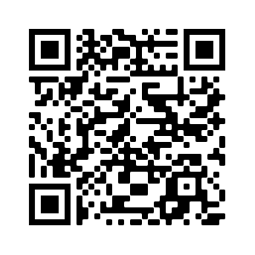
Deberes
Vocabulary Learning Homework (Term 2.1, Week 1)
Quizlet link: Y8 Term 2.1 Week 1
Quizlet QR code:
In addition, revisit: Y8 Term 1.2 Week 5
Y8 Term 1.1 Week 7

