Slide 1
Phonics
SSCs [ge], [gi]
Y7 Spanish
Term 3.1 - Week 5
Author names: St James’ Hub Teachers /
Victoria Hobson/ Nick Avery / RachelHawkes
Date updated: 16/05/20

Slide 2
ge
imagen
recoger
gesto
gente
argentino
generalmente
[generally]
[Argentinian]
Notes:
Introduce and elicit the pronunciation of the individual SSC ‘ge’ and then the source word again (with gesture, if using). Then present and elicit the pronunciation of the five cluster words.
The cluster words have been chosen for their high-frequency, from a range of word classes, with the SSC (where possible) positioned within a variety of syllables within the words(e.g. initial, 2nd, final etc..) and additionally, we have tried to use words that build cumulatively on previously taught SSCs (see the Phonics Teaching Sequence document) and do not include new SSCs. Where new SSCs are used, they are often consonants which have a similar symbol-sound correspondence in English.
Additional cluster words: generalmente and argentino build on the initial words introduced in 1.2.5

Slide 3
ge
imagen
recoger
gesto
gente
argentino
generalmente
Notes:
Without the images, students focus this time again closely on the SSC and the cluster words.

Slide 4
ge
imagen
recoger
gesto
gente
argentino
generalmente
Notes:
Without the images or sound, students have to pronounce the words themselves.

Slide 5
gi
elegir
original
Versión original
religión
imaginar
colegio
página
48
47
Notes:
Introduce and elicit the pronunciation of the individual SSC ‘gi’ and then the source word again (with gesture, if using). Then present and elicit the pronunciation of the five cluster words.
The cluster words have been chosen for their high-frequency, from a range of word classes, with the SSC (where possible) positioned within a variety of syllables within the words(e.g. initial, 2nd, final etc..) and additionally, we have tried to use words that build cumulatively on previously taught SSCs (see the Phonics Teaching Sequence document) and do not include new SSCs. Where new SSCs are used, they are often consonants which have a similar symbol-sound correspondence in English.
Additional cluster words: original and colegio build on the initial words introduced in 1.2.5

Slide 6
gi
elegir
original
religión
imaginar
colegio
página
Notes:
Without the images, students focus this time again closely on the SSC and the cluster words.

Slide 7
gi
elegir
original
religión
imaginar
colegio
página
Notes:
Without the images or sound, students have to pronounce the words themselves.

Slide 8
¿ GE o GI ?
escuchar
Escucha y escribe ge o gi.
ele_ _r
elegir
_ _neralmente
generalmente
1
7
ori_ _nal
_ _sto
original
gesto
2
8
pá_ _na
ima_ _nar
página
imaginar
3
9
reco_ _r
cole_ _o
recoger
colegio
4
10
ima_ _n
imagen
reli_ _ón
religión
5
11
_ _nte
gente
ar_ _ntino
argentino
6
12
Notes:
Students listen and complete the word with the correct SSC.
Before moving on, students should write the English for as many of the words as they can to reinforce their meanings. Students could have a minute individually then team up with a partner to see if they can achieve translations for all 12 words. See slide 10 to check answers to the translations.

Slide 9
¿ GE o GI ?
escuchar
Escucha y escribe la palabra.
elegir
generalmente
1
7
gesto
original
2
8
imaginar
página
3
9
colegio
recoger
4
10
imagen
religión
5
11
gente
argentino
6
12
Notes:
A differentiated version of the previous task where students are asked to write the whole word, rather than just the target SSC.
Before moving on, students should write the English for as many of the words as they can to reinforce their meanings. Students could have a minute individually then team up with a partner to see if they can achieve translations for all 12 words. Use the next slide to check answers to the translations.

Slide 10
¿Qué significan las palabras?
generalmente
?
elegir
?
generally
to choose, choosing
gesto
?
original
?
gesture
original
imaginar
página
?
?
page
to imagine, imagining
colegio
?
recoger
?
school
to pick up, picking up
imagen
?
religión
?
image
religion
gente
?
argentino
?
people
Argentinian
Notes:
Click on the box with ‘?’ to reveal the answer for each word. In this way, answers can be volunteered in any order.

Slide 11
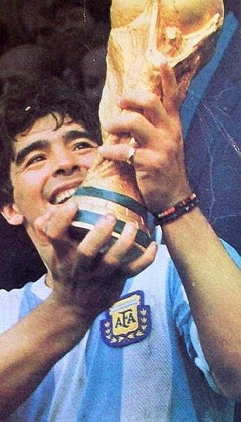
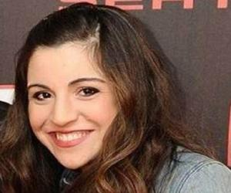
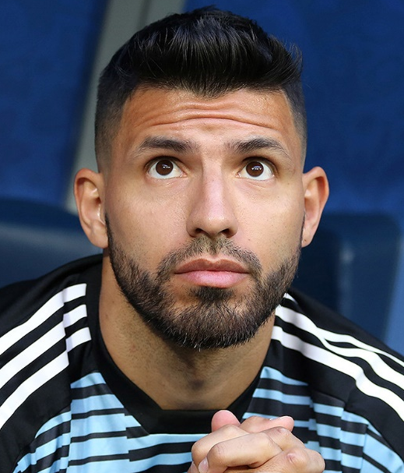
Una familia argentina famosa
ge
gi
leer
Diego Armando Maradona fue* un futbolista argentino.
También, dirigió* Gimnasia de la Plata, un equipo de la Superliga Argentina.
Tiene una hija, Giannina.
Names can be exceptions! The ‘gi’ in Giannina is pronounced a bit like ‘hee’ or ‘yee’, depending on the Spanish-speaking country.
Giannina tiene un hijo con Sergio Agüero, otro futbolista argentino.
Maradona con la Copa del Mundo de 1986.
*fue = was
*dirigió = managed
Notes:
Non-audio version of the texts on this slide – see next slide for audio version. This could be used as a read aloud task by students.
Teachers should encourage students to think about the translations into English to see if they can arrive at a full comprehension. Words are either from previous vocab sets or source/cluster words, plus some cognates and names, however, dirige is given in a gloss as this is unknown to students.
A note on pronunciation: Giannina is an exception to the ‘gi’ SSC, explained in the speech bubble. The name has Italian origins (62.5% of Argentinians have Italian heritage), but the pronunciation is not 100% Italian either. Click on Giannina’s picture to hear the name pronounced by an Argentinian.
Facts from Wikipedia, true to best of our knowledge as at April 2020. Source:
https://es.wikipedia.org/wiki/Diego_Armando_Maradona
Images:
https://es.wikipedia.org/wiki/Diego_Armando_Maradona#/media/Archivo:Maradona-Mundial_86_con_la_copa.JPG
https://www.thefamouspeople.com/profiles/giannina-maradona-36246.php
https://en.wikipedia.org/wiki/Sergio_Ag%C3%BCero

Slide 12
Una familia argentina famosa
ge
gi
escuchar
Diego Armando Maradona es un exfutbolista ar___ntino.
También, diri___ó* ___mnasia de la Plata, un equipo de la Superliga Ar___ntina.
Tiene una hija, ___annina.
ge
Gi
Names can be exceptions! The ‘gi’ in Giannina is pronounced a bit like ‘hee’ or ‘yee’.
gi
Gi
Gi
___annina tiene un hijo con Ser__o Agüero, otro futbolista ar___ntino.
ge
gi
Maradona con la Copa del Mundo de 1986.
‘Argentino’ is an adjective. The ending can change, depending on the gender and number of the noun.
ge
*fue = was
*dirigió = managed
Notes:
Listen and complete the texts with the target SSCs ‘GI’ and ‘GE’
These texts can also be used for a dictation or for a read aloud in pairs. Students will have to recall the ‘gi’ and ‘ge’ SSCs, which are missing.
A note on pronunciation: Giannina is an exception to the ‘gi’ SSC, explained in the speech bubble. It is a popular name in Latin America. The name has Italian origins (62.5% of Argentinians have Italian heritage), but the pronunciation is not 100% Italian either. Click on Giannina’s picture to hear the name pronounced by an Argentinian (pronounced like ‘hee’). The audio embedded in the three action buttons was recorded by a Spanish native speaker from the Canary Islands who naturally pronounces this as a ‘yee’.
Facts from Wikipedia, true to best of our knowledge as at April 2020. Source:
https://es.wikipedia.org/wiki/Diego_Armando_Maradona
Images:
https://es.wikipedia.org/wiki/Diego_Armando_Maradona#/media/Archivo:Maradona-Mundial_86_con_la_copa.JPG
https://www.thefamouspeople.com/profiles/giannina-maradona-36246.php
https://en.wikipedia.org/wiki/Sergio_Ag%C3%BCero

