Slide 1
Comparing lifestyles
Present tense strong verbs – ich vs er /sie
Y7 German
Term 2.2 - Week 3 - Lesson 43
Inge Alferink / Rachel Hawkes
Artwork: Steve Clarke
Date updated: 11/1/23
Notes:
Artwork by Steve Clarke. All additional pictures selected are available under a Creative Commons license, no attribution required.
Learning outcomes (lesson 1):
Introduction of Present tense strong verbs – 1st and 3rd person singular.
Word frequency (1 is the most frequent word in German):
7.2.2.3 (introduce) fahren¹ [215] geben [49] helfen [338] laufen [252] schlafen [679] vergessen [584] mir [63] Geld [235] Urlaub [1570] Zeitung [670] fast [202]
7.2.1.5 (revisit) bleiben [113] brauchen [179] glauben [156] heißen [132] leben [98] liegen [107] reisen [933] verstehen [211] werden1, wird1 [8] Österreich [1511] nach1 [34] nach Hause [n/a]
7.1.2.6 (revisit) wünschen [630] Arzt [622] Platz1 [326] Spiel [328] Stück [511] Zug [675] grün [682] auch [18] es gibt [n/a] wie viele? [n/a]
Source: Jones, R.L & Tschirner, E. (2019). A frequency dictionary of German: Core vocabulary for learners. London: Routledge.
The frequency rankings for words that occur in this PowerPoint which have been previously introduced in NCELP resources are given in the NCELP SOW and in the resources that first introduced and formally re-visited those words.
For any other words that occur incidentally in this PowerPoint, frequency rankings will be provided in the notes field wherever possible.

Slide 2
Vokabeln
lesen
laufen
leben
helfen
verstehen
fahren
geben
reisen
bleiben
brauchen
schlafen
vergessen
glauben
Notes:
Timing: 5 minutes
Aim: To revisit some of the verbs that will be used in the reading and listening activities.
Note: The sequence this week will focus on stem changes in the third person singular (contrasted with first person singular). We are using the infinitives here to be able to emphasise the vowel change later.
Procedure: 1. On a click a word will appear.
2. Students write down the word before it disappears. 3. They write the English meaning, too, if remembered. 4. Give feedback item by item. Roll back each animation, elicit the German verb, then the English meaning, and finally click again to see the verb again so learners can double-check their spelling.

Slide 3
[a] vs [ä]
Phonetik
a[long]
ä[long]
sagen
spät
a[short]
ä[short]
kalt
lächeln
1
egal
2
ständig
zählen / zahlen
7
zählen / zahlen
3
hängen
Wahlen / wählen
8
Wahlen / wählen
4
unbekannt
Geschäft / geschafft
9
Geschäft / geschafft
5
Bad
schätzen / schatzen
10
schätzen / schatzen
6
Nähe
Notes:
Timing: 5 minutes
Aim: To revisit the contrast between [a]and [ä].
Note: The contrast between [a] and [ä] is important for this week’s grammar point (strong verbs). Both sounds have been introduced already; we are simply revisiting them here.
Procedure:
Click on the SSCs and their example words (sagen / kalt / lächeln / spät) to play them and remind the students of the the sounds.
The first 6 words is a transcription (fill in the blank) task. The words are high-frequency, but haven’t yet been taught.
The second four are minimal pairs (some of these are rare).
The task is set up to do 1-6 first and correct those, and then complete 7-10.
Transcript:
egal
ständig
hängen
unbekannt
Bad
Nähe
zählen /zahlen
Wahlen / wählen
Geschäft / geschafft
schätzen / schatzen
Word frequency (1 is the most frequent word in German):
egal [932] ständig [779] hängen [590] unbekannt [1292] Bad [1637] Nähe [918] zählen [704] zahlen [832] Wahl [799] wählen [636] Geschäft [765] schaffen (geschafft) [285] schätzen [1294] schatzen [>5009]
Source: Jones, R.L & Tschirner, E. (2011). A frequency dictionary of German: Core vocabulary for learners. London: Routledge.

Slide 4
[e] vs [i]
phonetik
e[long]
i[long]
geben
wir
e[short]
i[short]
denken
finden
1
gel i ngen
2
M i ttel
winden/ wenden
7
winden/ wenden
3
eng
setzen / sitzen
8
setzen / sitzen
4
werfen
blecken / blicken
9
blecken / blicken
5
Zelle
wirken / werken
10
wirken / werken
6
S i cht
Notes:
Timing: 5 minutes
Aim: To revisit the contrast between [e]and [i].
Note: The contrast between [e] and [i] is important for this week’s grammar point (strong verbs). Both sounds have been introduced already; we are simply revisiting them here.
Procedure:
Click on the example words (denken / geben / finden / wir) to play them and remind the students of the the sounds.
The first 6 words a transcription (fill in the blank). The words are high frequency, but haven’t yet been taught.
The second four are minimal pairs (some of these are rare).
Transcript:
gelingen
Mittel
eng
werfen
Zelle
Sicht
winden / wenden
setzen / sitzen
blecken / blicken
wirken / Werken
Word frequency (1 is the most frequent word in German):
gelingen [502] Mittel [691] eng [593] werfen [718] Zelle [592] Sicht [940] winden [>5009] wenden [1530] setzen [228] sitzen [231] blecken [>5009] blicken [1256] wirken [401] werken [>5009]
Source: Jones, R.L & Tschirner, E. (2011). A frequency dictionary of German: Core vocabulary for learners. London: Routledge.

Slide 5
au/äu
au
glauben
äu
Gebäude
genau
auf
Bäume
träumen
auch
häufig
Haus
Mäuse
Häuser
ausgehen
laufen
räumlich
äußern
läuft
Urlaub
brauchen
Käufer
nach Hause
Notes:
Timing: 5 minutes
Aim: To revisit SSC [äu], introduced last week.
Note: We’re revisiting it here because it is relevant for this week’s grammar point (strong verbs and the stem change from au to äu).
Procedure:
1. This is a paired read aloud task. The students use different colours to play. Pupil A says one of the words/phrases and pupil B has 3 seconds to locate it and cross it off with their colour. If the pupil takes longer than 3 seconds pupil A can steal the point. Clearly, the classroom conditions need to be right with the individual class for friendly competition.
2. Alternatively, they can do it more slowly and carefully, scrutinising each other’s pronunciation. If one makes a mistake, then the other pupil corrects and crosses off in his/her colour.
Note: Not all of these words have been taught before, so there is the opportunity for some genuine decoding.
Word frequency (1 is the most frequent word in German):
genau [] ausgehen [] auf [] Gebäude [] träumen [] Mäuse [] läuft [] Bäume [] häufig [] äußern [] räumlich [] Käufer []
Source: Jones, R.L & Tschirner, E. (2011). A frequency dictionary of German: Core vocabulary for learners. London: Routledge.

Slide 6
Grammatik – strong verbs
Grammatik
Some German verbs change the vowel in the er / sie-form.
We call these strong verbs.
ich spreche
er spricht
You have to learn which verbs are strong, but there are some rules!
Only verbs with an a or an e in their stem can be strong.
ich gebe
Stems with an e change to i or ie:
er gibt
ich lese
sie liest
sie fährt
Stems with an a change to ä:
ich fahre
This includes the a in au!
ich laufe
er läuft
Notes:
Timing: 2 minutes
Aim: To introduce the concept of strong verbs.
Procedure:
1. Cycle through the information on the slide using the animation sequence.
Rule: must have 'a' or 'e' in the stem to be a potential strong verb.
a → ä (includes au → äu!)
e → i
e → ie
Most verbs do not get a vowel change, but a number of high frequency verbs do!
We will expand the paradigm to include the second person in next week’s sequence.

Slide 7
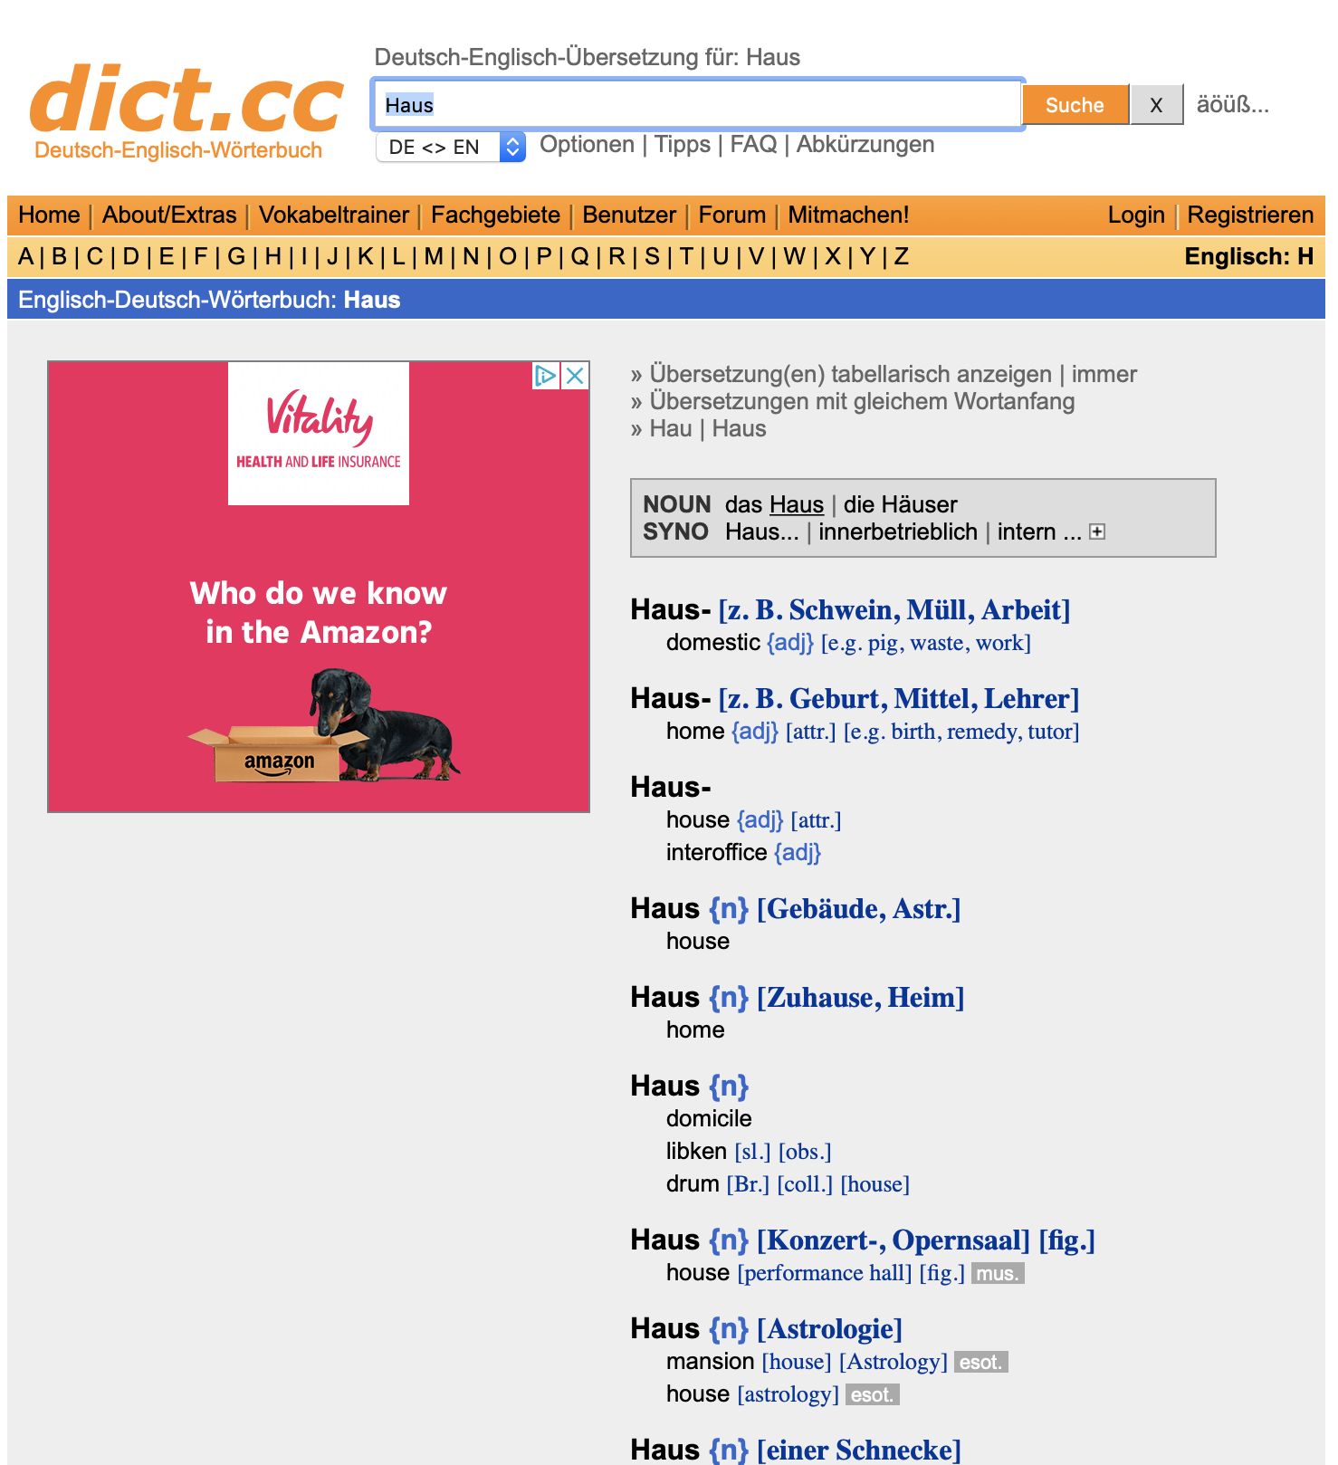
Wie finde ich das?
Verbs
strong or weak?
Nouns
plural?
Notes:
Timing: 2 minutes
Aim: To explain how to find out about stem changes using the dictionary.
Note: This is a brief explanation of how to find out whether a verb has a stem change or not. We will have a more thorough dictionary lesson at another point in the SOW.
Procedure:
1. Cycle through the information on the slide using the animation sequence.
Only verbs with a or an e in the stem can change.
A dictionary entry for a verb will always tell you whether the verb gets a stem change or not.
Similarly, entries for nouns will tell you what the plural form is.

Slide 8
Meine Tante Laura - 1
lesen
Mia is staying with her aunt Laura for the holidays.
She is texting a friend about some of the things she does and some of the things her aunt does.
Unfortunately, a virus has changed some of the letters to strange symbols.
Read Mia’s texts and decided which ones refer to Mia (ich) and which ones refer to aunt Laura (sie).
Remember: pay attention to the vowel in the verb.
Notes:
Timing: 2 minutes
Aim: To explain the reading exercise on the next slide.
Procedure:
Cycle through the instructions on the slide using the animation sequence.

Slide 9
Meine Tante Laura - 1
lesen
1. Sie fährt jeden Tag Fahrrad.
4. kls vergissl nie meine Telefonnummer.
7. owa liesa oft Bücher.
ich
2. Ich gebe Wolfgang ein Geschenk.
5. xha laufp einmal die Woche.
8. ptl sprichb viele Fremdsprachen.
3. hjt hilfy manchmal in der Schule.
6. bzw schlafn manchmal im Unterricht.
sie
Notes:
Timing: 5 minutes
Aim: To practise recognising stem changes between ich and sie.
Note: Mia is staying with her aunt Tante Laura. Mia is messaging her friend about some of the things she does and some things Tante Laura does. However, a virus has changed some letters to strange symbols.
Procedure:
Students write down 1 to 8 in their exercise books.
Students read Mia’s messages, and for each message say whether it applies to ich (Mia) or sie (Tante Laura), based upon whether or not there is a stem change.
Note: we will get to know Aunt Laura a bit better in the second lesson!

Slide 10
Antworten
lesen
1. Sie fährt jeden Tag Fahrrad.
4. Sie vergisst nie meine Telefonnummer.
7. Sie liest oft Bücher.
ich
2. Ich gebe Wolfgang ein Geschenk.
5. Ich laufe einmal die Woche.
8. Sie spricht viele Fremdsprachen.
3. Sie hilft manchmal in der Schule.
6. Ich schlafe manchmal im Unterricht.
sie
Notes:
Timing: 2 minutes
Aim: To provide the answers to the reading exercise on the next slide.
Procedure:
Click to bring up the complete messages one by one, with the vowel(s) in the stem highlighted, together with the verb ending.
Answers:
1. Sie fährt jeden Tag Fahrrad.
2. Ich gebe Wolfgang ein Geschenk.
3. Sie hilft manchmal in der Schule.
4. Sie vergisst nie meine Telefonnummer
5. Ich laufe einmal die Woche.
6. Ich schlafe manchmal im Unterricht.
7. Sie liest oft Bücher.
8. Sie spricht viele Sprachen.

Slide 11
Meine Tante Laura - 2
hören
 |  |  | Englisch
 |  |  | I read an E-book.
 |  |  | I often forget something.
 |  |  | She sleeps for eight hours.
 |  |  | I often help in the garden.
 |  |  | She sometimes travels to Berlin.
 |  |  | She runs three times a week.
 |  |  | I don’t understand that.
 |  |  | She gives me a piece of pizza.
Ich
Sie
1
2
3
4
5
6
7
8
Notes:
Timing: 10 minutes
Aim: To practise recognising stem changes between ich and sie.
Note: Mia also talks to her mum about some of the things she does and some of the things Tante Laura does. To force students to pay attention to the vowel the pronouns have been left out. We realise the verb ending is also a clue, but leaving both out would disrupt the sentence too much.
Procedure:
Students write down 1 to 8 in their exercise books.
Students listen to Mia’s answerphone messages, and for each message say whether it applies to ich (Mia) or sie (Tante Laura), based upon the verb form heard.
They then translate each sentence heard into English.
Click to reveal the correct tick, followed by the English translation, for each item in turn.
Transcript:
[Ich] lese ein E-Book.
[Ich] vergesse oft etwas.
[Sie] schläft acht Stunden.
[Ich] helfe oft im Garten.
[Sie] fährt manchmal nach Berlin.
[Sie] läuft dreimal die Woche.
[Ich] verstehe das nicht.
[Sie] gibt mir ein Stück Pizza.

Slide 12
Tante Laura schreibt an Mias Mutter!
schreiben
Hallo liebe Schwester. Wie geht’s? Ich schreibe ein paar Infos über Mia. Im Moment [she is reading] ein E-Book. [She is] sehr gut in der Schule, nur manchmal [she forgets] etwas und [she doesn’t understand that]! Zu Hause [she often helps] im Garten. Wann kommst du nach Hause? Bis bald, deine Schwester Laura xx
Copy out the email, putting the words in brakets into German. Pay attention to word order!
Notes:
Timing: 7 minutes (including answers)
Aim: To provide written production practice in using some regular, irregular and strong verbs already encountered, in the third person singular form.
Procedure:
Students copy the email, putting the words in brackets into German (remind them to pay attention to the word order implications of the sentence structure).
The answers are displayed on the next slide.

Slide 13
Antworten
schreiben
Hallo liebe Schwester. Wie geht’s? Ich schreibe ein paar Infos über Mia. Im Moment liest sie ein E-Book. Sie ist sehr gut in der Schule, nur manchmal vergisst sie etwas und sie versteht das nicht! Zu Hause hilft sie oft im Garten. Wann kommst du nach Hause? Bis bald, deine Schwester Laura xx
Notes:
Answer slide.

Slide 14
Comparing lifestyles
Present tense strong verbs – ich vs er /sie
SSC [r]
Y7 German
Term 2.2 - Week 3 - Lesson 44
Inge Alferink / Rachel Hawkes
Artwork: Steve Clarke
Date updated: 20/12/21
Notes:
Artwork by Steve Clarke. All additional pictures selected are available under a Creative Commons license, no attribution required.
Learning outcomes (lesson 2):
Introduction of SSC [r] (x2)
Consolidation of Present tense strong verbs – 1st and 3rd person singular.
Word frequency (1 is the most frequent word in German):
7.2.2.3 (introduce) fahren¹ [215] geben [49] helfen [338] laufen [252] schlafen [679] vergessen [584] mir [63] Geld [235] Urlaub [1570] Zeitung [670] fast [202]
7.2.1.5 (revisit) bleiben [113] brauchen [179] glauben [156] heißen [132] leben [98] liegen [107] reisen [933] verstehen [211] werden1, wird1 [8] Österreich [1511] nach1 [34] nach Hause [n/a]
7.1.2.6 (revisit) wünschen [630] Arzt [622] Platz1 [326] Spiel [328] Stück [511] Zug [675] grün [682] auch [18] es gibt [n/a] wie viele? [n/a]
Source: Jones, R.L & Tschirner, E. (2019). A frequency dictionary of German: Core vocabulary for learners. London: Routledge.
The frequency rankings for words that occur in this PowerPoint which have been previously introduced in NCELP resources are given in the NCELP SOW and in the resources that first introduced and formally re-visited those words.
For any other words that occur incidentally in this PowerPoint, frequency rankings will be provided in the notes field wherever possible.

Slide 15
Vokabeln
die Zeitung
nach Hause
fast
Öster r eich
reisen
die Hausaufgaben
das Geld
wie vie l e
mit Freunden
_ _ _ _ _ _ _ _ _
d
e
r
U
r
l
a
u
b
Notes:
Timing: 3 minutes
Aim: To practise recall of new and revisited vocabulary.
Note: Fill in the missing letters. Together they form a word. What is it?
Procedure:
1. Students suggest the missing letters in the words as displayed – use the animation sequence to check, one by one.
2. Students then rearrange the missing letters to form an item of vocabulary (‘der Urlaub’) at the bottom – again, use the animation sequence to check.
3. Teachers also check that sudents know the meaning of the words.

Slide 16
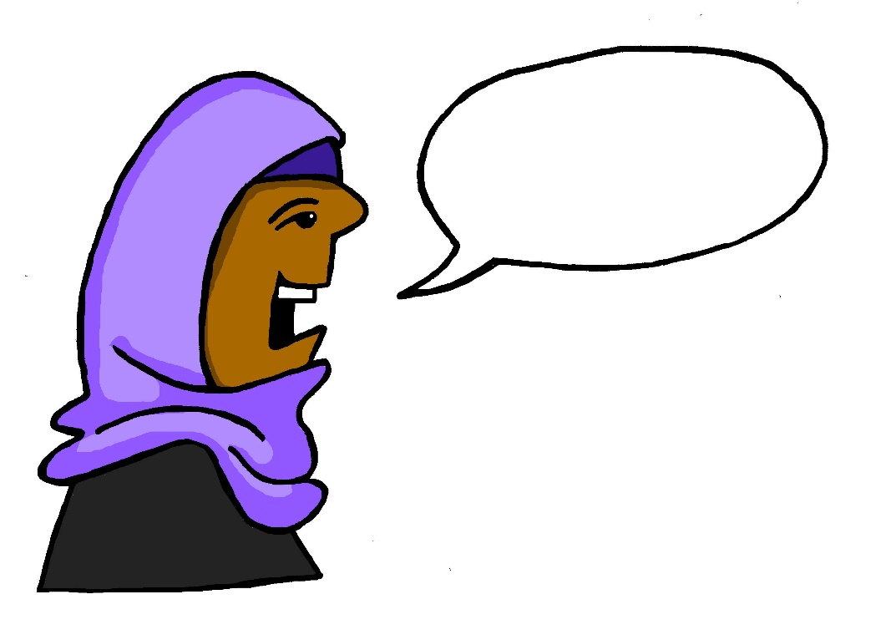
r
reden
Notes:
Timing: 1 minute
Aim: To introduce/consolidate SSC [r]
Procedure: 1. Present the letter(s) and say the [r] sound first, on its own. Students repeat it with you. 2. Bring up the word ”reden” on its own, say it, students repeat it, so that they have the opportunity to focus all of their attention on the connection between the written word and its sound.
3. A possible gesture for this would be to mime talking between your right hand and your left hand.
4. Roll back the animations and work through 1-3 again, but this time, dropping your voice completely to listen carefully to the students saying the [r] sound, pronouncing ”reden” and, if using, doing the gesture. Word frequency (1 is the most frequent word in German): reden [356]
Source: Jones, R.L. & Tschirner, E. (2006). A frequency dictionary of German: core vocabulary for learners. Routledge

Slide 17
r
reden
Notes:
With sound and no pictures to focus all attention on the sound-symbol correspondence.

Slide 18
r
reden
Notes:
Without sound to elicit pronunciation (without first hearing the teacher).
Teacher to elicit pronunciation by asking “Wie sagt man…”

Slide 19
r
Regel
rot
reden
warum?
Beruf
Reise
Notes:
Timing: 2 minutes
Aim: To introduce/consolidate SSC [r]
Procedure:
Introduce and elicit the pronunciation of the individual SSC [r] and then the source word again ‘reden’ (with gesture, if using).
Then present and elicit the pronunciation of the five cluster words.
The cluster words have been chosen for their high-frequency, from a range of word classes, with the SSC (where possible) positioned within a variety of syllables within the words (e.g. initial, 2nd, final etc.). Additionally, we have tried to use words that build cumulatively on previously taught SSCs (see the Phonics Teaching Sequence document) and do not include new SSCs. Where new SSCs are used, they are often consonants which have a similar symbol-sound correspondence in English.
Word frequency (1 is the most frequent word in German): reden [356]; Regel [484] rot[381]; warum? [246]; Reise [786]; Beruf [477 Source: Jones, R.L. & Tschirner, E. (2006). A frequency dictionary of German: core vocabulary for learners. Routledge

Slide 20
r
Regel
rot
reden
warum?
Beruf
Reise
Notes:
With sound and no pictures to focus all attention on the sound-symbol correspondence.

Slide 21
r
Regel
rot
reden
warum?
Beruf
Reise
Notes:
Without sound to elicit pronunciation (without first hearing the teacher).
Teacher to elicit pronunciation by asking “Wie sagt man…”

Slide 22
r
Uhr
Notes:
Timing: 1 minute
Aim: To introduce/consolidate SSC [r]
Procedure: 1. Present the letter(s) and say the [r] sound first, on its own. Students repeat it with you. 2. Bring up the word ”Uhr” on its own, say it, students repeat it, so that they have the opportunity to focus all of their attention on the connection between the written word and its sound.
3. A possible gesture for this would be to look at your left wrist and tap your imaginary watch twice, to emphasise the two distinct sounds you hear – Uh-r.
4. Roll back the animations and work through 1-3 again, but this time, dropping your voice completely to listen carefully to the students saying the [r] sound, pronouncing ”Uhr” and, if using, doing the gesture. Word frequency (1 is the most frequent word in German): Uhr [349] Source: Jones, R.L. & Tschirner, E. (2006). A frequency dictionary of German: core vocabulary for learners. Routledge

Slide 23
r
Uhr
Notes:
With sound and no pictures to focus all attention on the sound-symbol correspondence.

Slide 24
r
Uhr
Notes:
Without sound to elicit pronunciation (without first hearing the teacher).
Teacher to elicit pronunciation by asking “Wie sagt man…”

Slide 25
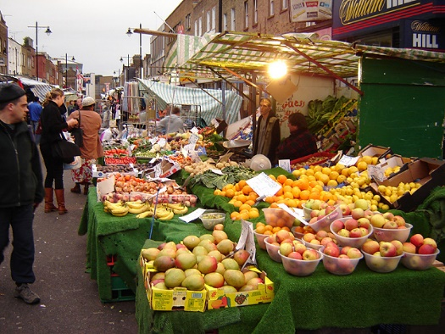
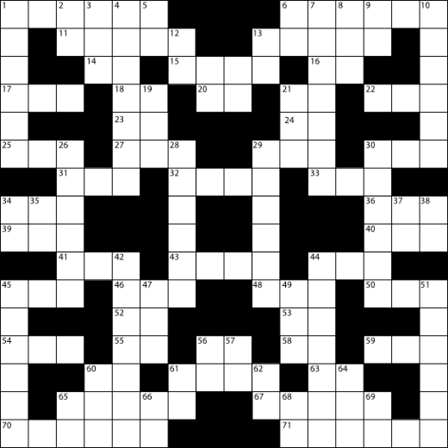
r
Markt
Morgen
Uhr
By Tarquin Binary - Own work, CC BY-SA 2.5
Kultur
Wort
dort
W O R T
Notes:
Timing: 2 minutes
Aim: To introduce/consolidate SSC [r]
Procedure:
Introduce and elicit the pronunciation of the individual SSC [r] and then the source word again ‘uhr’ (with gesture, if using).
Then present and elicit the pronunciation of the five cluster words.
The cluster words have been chosen for their high-frequency, from a range of word classes, with the SSC (where possible) positioned within a variety of syllables within the words (e.g. initial, 2nd, final etc.). Additionally, we have tried to use words that build cumulatively on previously taught SSCs (see the Phonics Teaching Sequence document) and do not include new SSCs. Where new SSCs are used, they are often consonants which have a similar symbol-sound correspondence in English.
Word frequency (1 is the most frequent word in German): Uhr [349]; Markt [508] Morgen [311]; Kultur [593]; dort [104]; Wort [243]. Source: Jones, R.L. & Tschirner, E. (2006). A frequency dictionary of German: core vocabulary for learners. Routledge

Slide 26
r
Markt
Morgen
Uhr
Kultur
Wort
dort
Notes:
With sound and no pictures to focus all attention on the sound-symbol correspondence.

Slide 27
r
Markt
Morgen
Uhr
Kultur
Wort
dort
Notes:
Without sound to elicit pronunciation (without first hearing the teacher).
Teacher to elicit pronunciation by asking “Wie sagt man…”

Slide 28
Vokabeln
fahren
leben
helfen
verstehen
liegen
geben
bleiben
laufen
reisen
schlafen
brauchen
vergessen
sprechen
glauben
schwimmen
lesen
STRONG
WEAK
Notes:
Timing: 3 minutes
Aim: To practise recalling whether verbs are strong or weak.
Procedure:
1. Teacher reminds the students that strong means a vowel change and weak means no change.
2. For each verb say whether it is strong or weak.

Slide 29
German compound nouns
Separate unfamiliar words to try to understand them.
German often combines two (or more!) nouns to make one word, a compound noun.
Beispiel:
der Urlaub → der Campingurlaub
___ Camping + ___ Urlaub →
das
der
der
camping holiday →
?
___ Campingurlaub
The gender of the new noun is the gender of the final noun.
Sometimes, extra letters join the two nouns to make the new noun easier to say: -s-, -es-, -e-, -n-, -en-, -(e)r-
What is the definite article (‘the’) for these compound nouns?
holiday money →
Urlaub + Geld →
___ Urlaubsgeld
das
daily newspaper →
Tag + -es- + Zeitung →
___ Tageszeitung
die
market place →
Markt + Platz →
der
___ Marktplatz
So, German has some very long words. For example…
das Rindfleischetikettierungsüberwachungsaufgabenübertragungsgesetz
Notes:
Timing: 5 minutes
Aim: To develop vocabulary knowledge.
Note: One of the most fascinating things about German is its habit of joining nouns to make new words, new meanings. This is the first formal introduction to compound nouns in German.
The slide looks busy but the animations break the content into very small steps. It is designed to work interactively, with the teacher eliciting responses from students at every stage to gauge their understanding.
Procedure:
1. Cycle through the information on the slide using the animation sequence.
2. The main knowledge is that: i] German combines nouns to make single, new words. ii] The gender of the new word is the gender of the final noun iii] Some additional letters can be required (the rules for these are complex and have many exceptions so will not be explicitly taught so students will not automatically be able to produce accurate new compound nouns themselves) iv] However, they will vastly increase their receptive vocabulary and often be able to comprehend compound nous, even if only one part is known, by using the surrounding context in addition. They should be encouraged, when faced with apparently unfamiliar, to try to separate them, as they may find they know both nouns, individually. 3. The final item is for fun, and teachers may omit, if preferred. The information point is that German places no limits on the number of nouns that can be combined, which leads to some very long German words. This particular example has 63 letters. Word for word in English it means ‘beef-meat labelling monitoring tasks legislative law’
Or, slightly more freely translated, it means: ‘legislative law for the monitoring of beef labelling’
Word frequency (1 is the most frequent word in German):
das Urlaubsgeld [>5009] die Tageszeitung [4586] der Marktplatz [>5009]
Note: in Term 1.1 Week 7 students previously learnt the prefix ‘Lieblings-’ and the way it combines with other nouns: Lieblingsband, Lieblingsbuch, Lieblingsfilm, Lieblingslehrerin, Lieblingslied, Lieblingssäanger, Lieblingssängerin die Band [>5009] das Buch [295] der Film [524] die Lehrerin [2696] das Lied [1726] der Sänger [3916] die Sängerin [3916]
Source: Jones, R.L & Tschirner, E. (2011). A frequency dictionary of German: Core vocabulary for learners. London: Routledge.

Slide 30
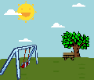
German compound nouns
Sometimes the English is NOT a word-for-word translation, and could also be one word: das Haustier → house animal → pet! Try exercise 2. The pictures may help.
3 Lieblingsurlaube. Separate the words. Was ist das auf Englisch?
1 Schreib den Artikel (der, die, das, die). Schreib das Wort auf Englisch, auch.
Winterurlaub
Aktivurlaub
Rucksackurlaub
Familienurlaub
Tagesurlaub
Bootsurlaub
Strandurlaub
1 die Lieblingsnummer
2 der Deutschunterricht
3 der Frühzug
4 die Sprachschule
5 der Wochentag
winter holiday
favourite number
German lesson
activity holiday / active holiday
early train
backpacking holiday
language school
family holiday
week day
day’s holiday
boating holiday
beach holiday
2 Schreib den Artikel (der, die, das, die). Schreib das Wort auf Englisch, auch.
4 Urlaubssachen Separate the words. Was ist das auf Englisch?
die Haustür
das Liebespaar
der Spielplatz
das Grünblau
das Schlafzimmer
front door
der Urlaubstag
die Urlaubsideen
der Urlaubsort
das Urlaubshotel
das Urlaubsgeld
holiday day
(romantic)couple
holiday ideas
playground
holiday place / location
greeny blue
holiday hotel
bedroom
holiday money
Notes:
Timing: 8 minutes
Aim: To develop understanding of compound nouns.
Procedure:
Task 1. We first practise the application of gender knowledge of previously taught nouns, combining them to make new compound nouns, which students should then also know the meaning of, without reference to a dictionary. This reinforces the importance of gender knowledge, which is a theme running right through this SOW!
Note: This task also includes three words from the revisited sets for this week: der Zug [613] der Platz [344] grün [556] Task 2. Using previously-taught words, students are again asked to provide the gender and the English meaning. This time, however, the English meanings are less transparent, and require further thinking. This represents a very important opportunity for developing vocabulary depth - many high-frequency words have multiple meanings. Students have been taught these words previously in one context. The way they are combined here is often with a slightly different meaning.
Note: In tasks 1 and 2, all words have been previously taught within the SOW, although some featured as verbs - e.g. lieben (Liebe as phonics source word), schlafen.
Lieblings- [>4037] Nummer [1048] Deutsch [105] Unterricht [1107] früh [322] Sprache [1791] Schule [208] Woche [209] Tag [108] Haus [159] Tür [400] Liebe [843] lieben [816] Paar [284] Spiel [500] Platz [344] grün [556] blau [1016] schlafen [787] Zimmer [609] Task 3. This task moves us into the theme of holidays. Second, we practise segmentation of some compound nouns, all starting or ending with the word Urlaub. Some of these will feature previously taught language, some will contain cognates, and finally, others with have unfamiliar words. With the unfamiliar words, it is not expected that students guess the meaning. They are to segment the word, and then look up the unfamiliar part to try to work out its meaning. Ask the students why they don’t need to work out the articles in Task 3 (answer - they will all be ‘der’ like ‘der Urlaub’). der Urlaub [1192] is in this week’s vocabulary set. Winter [1288] is a cognate and was met in the Christmas lesson sequence; aktiv [861] a near cognate; Rucksack [3915] cognate and previously met; Familie [310] previously taught; Tag [108] is known but the -es may confuse at first; Boot [1927] not yet met - will need looking up; Strand [2047] not yet met - will need looking up.
Note: in good online dictionaries many compound nouns will be listed. However, typically school paper dictionaries may not, and either way, it is helpful for students to recognise the usefulness of breaking compound nouns down into their component nouns, as a comprehension strategy. Task 4 This task continues the focus on holidays, but this time, Urlaub- is the first word, meaning that the genders need to be worked out, as well as the English meanings. All words were previously taught, except the cognate Hotel. Tag [108], Idee [641] Ort [383] Hotel - cognate [1129] Geld [249] Note: Not all tasks need to be completed in one lesson. Teachers to differentiate for their own classes. There is a clear overlap with word families work, here, though the focus is on compound nouns. Subsequent lessons will explore links between word classes: how verbs become nouns, nouns become verbs etc.

Slide 31
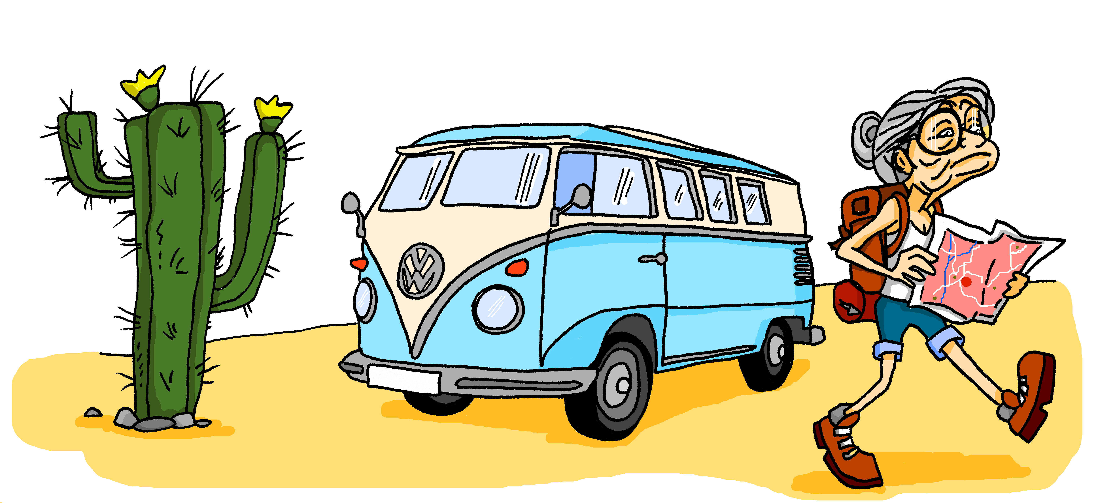
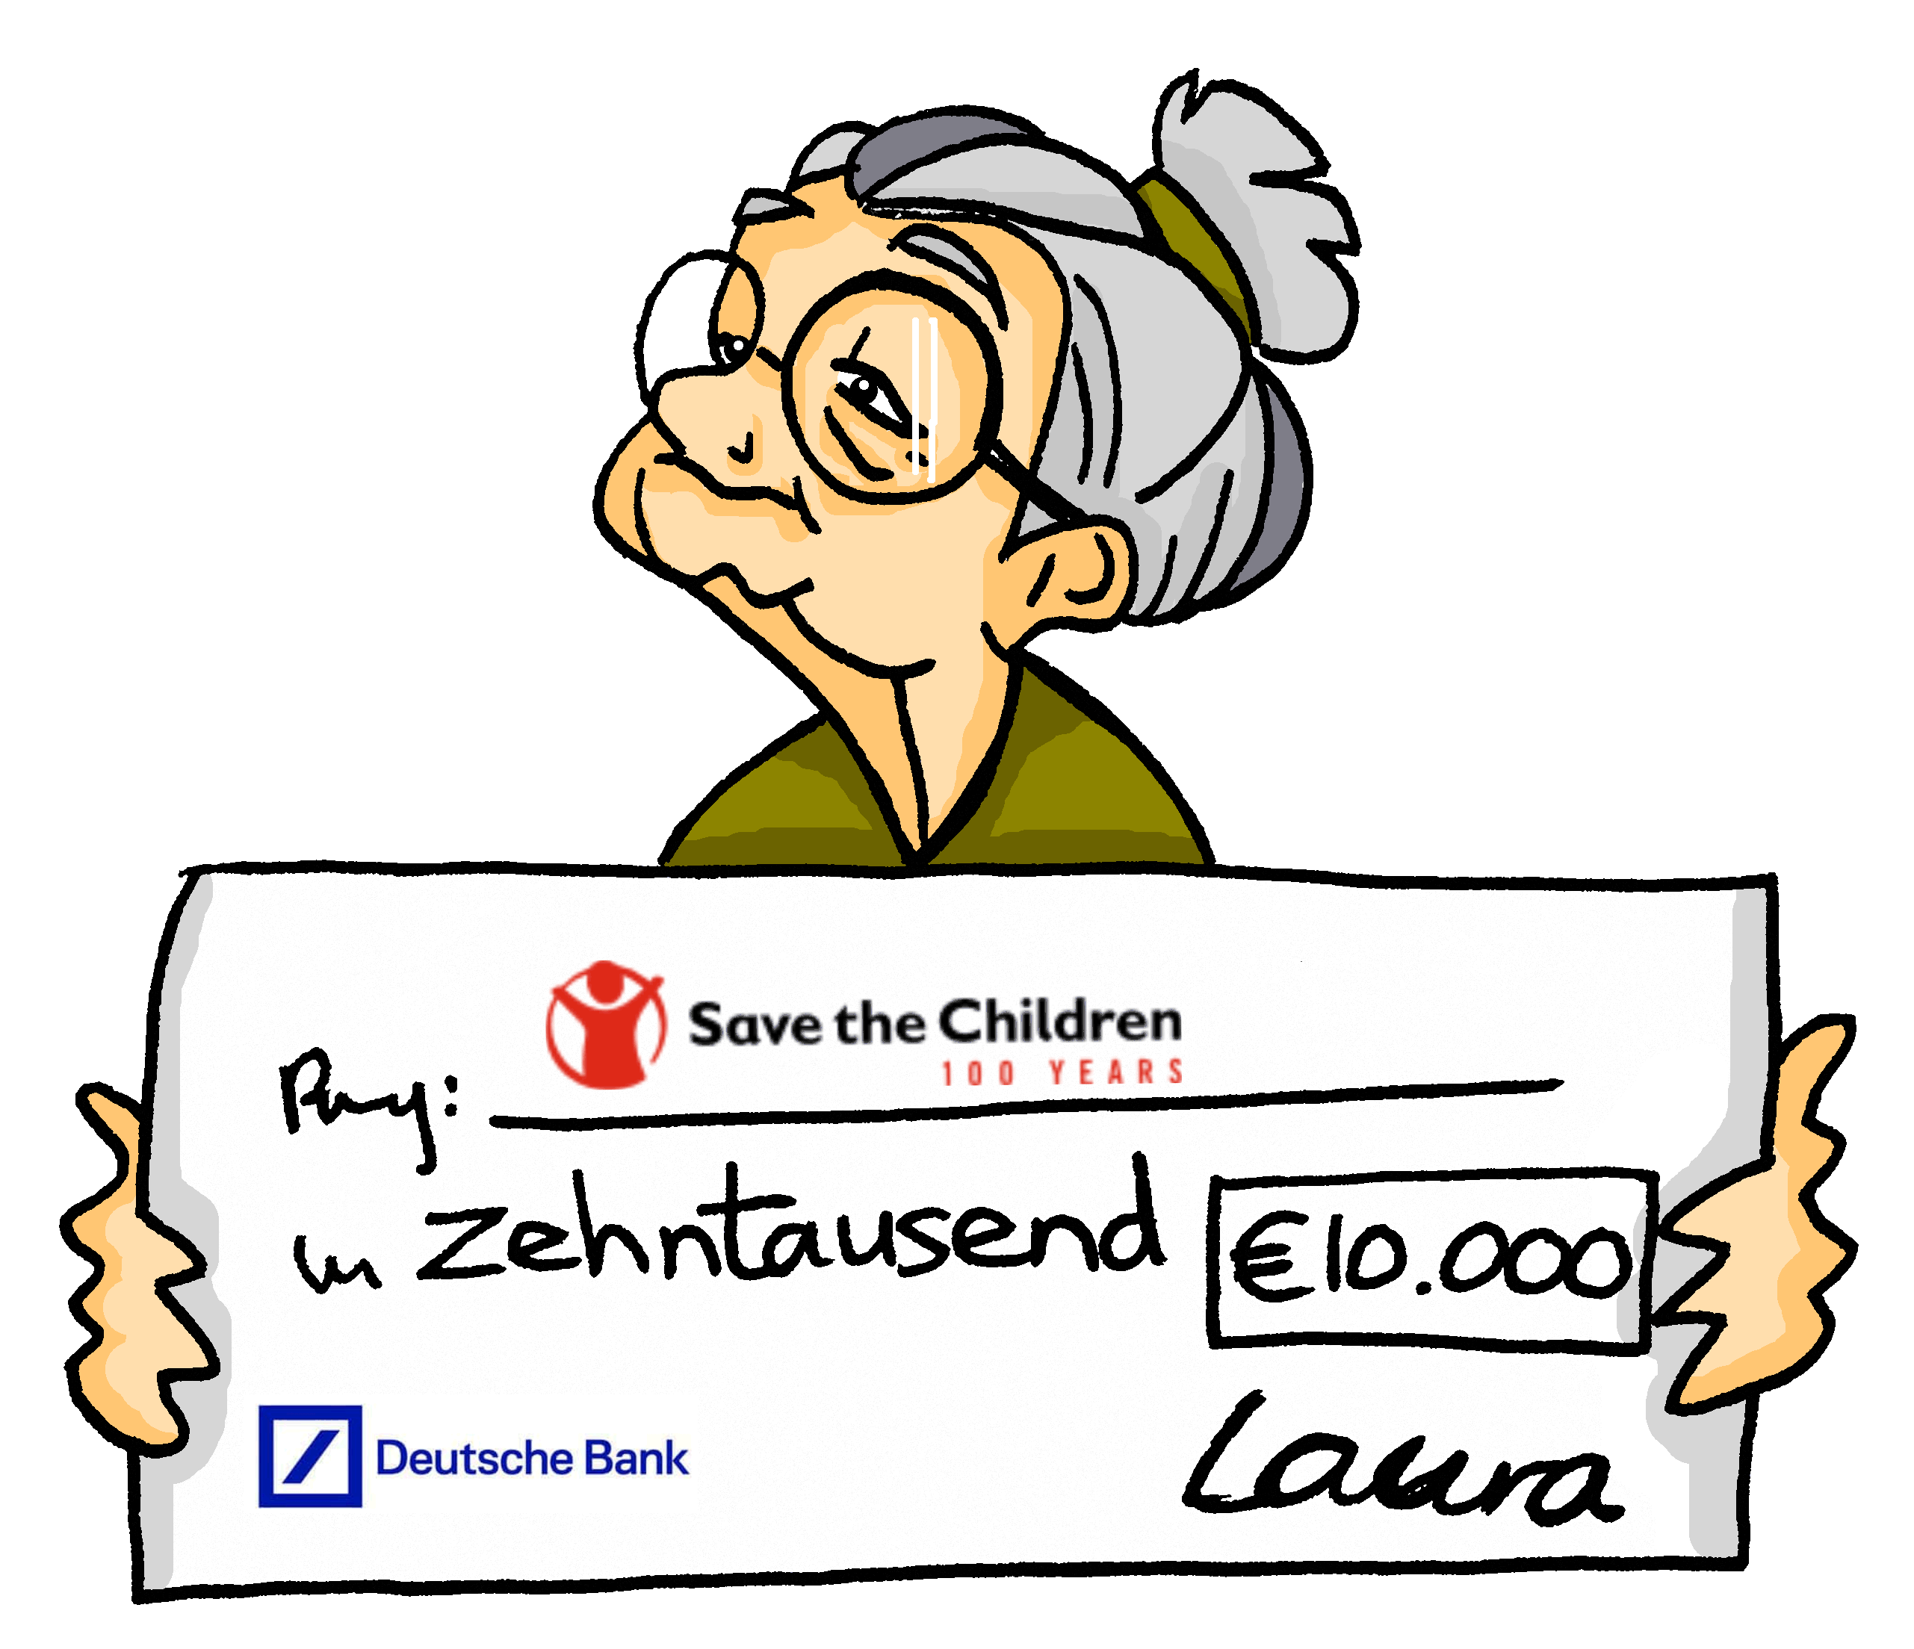
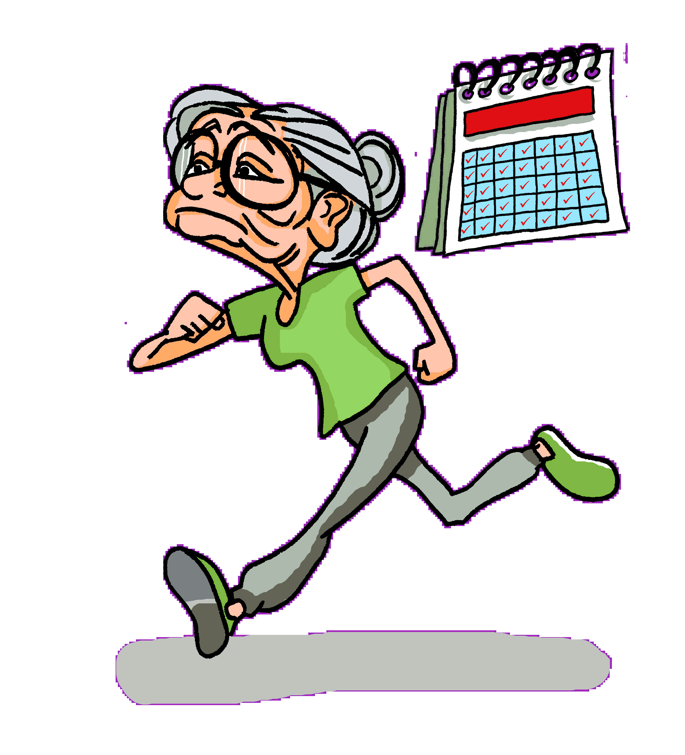
PERSON A
sprechen
vergessen
sprechen
fahren
laufen
geben
Notes:
Timing: 10 minutes
Aim: To practise spoken production of strong verb forms (1st and 3rd person singular).
Note: Tante Laura defies expectations! She lives an active and busy life.
This is Student A’s card.
Note: This speaking activity intentionally requires each learner to produce just one verb form at a time, for a few sentences, before swapping to the other form. Then, in the next activity, more ‘desirable difficulty’ is built in as they have to actively choose which form they use each time they make a sentence.
Procedure:
Students work in pairs.
Person A and person B have a different set of pictures.
Person A describes one of their pictures (Tante Laura….).
Person B finds the corresponding picture for Mia and describes it from Mia’s perspective (Ich…).
Then person A starts with the next picture.
Repeat until all pictures have been described.
Activity could be repeated in different order with roles swapped.

Slide 32
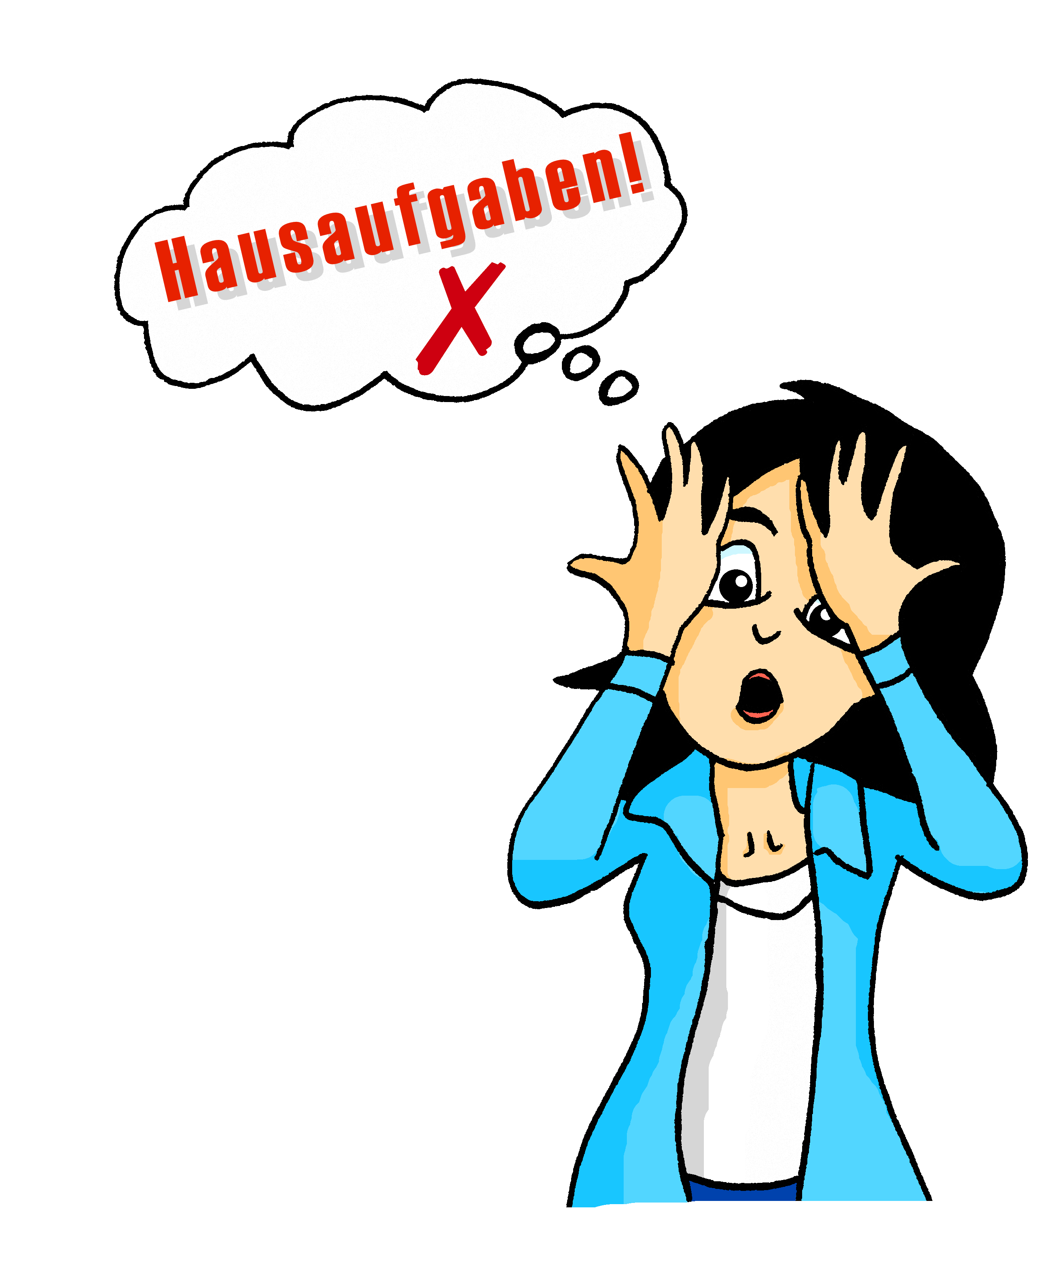
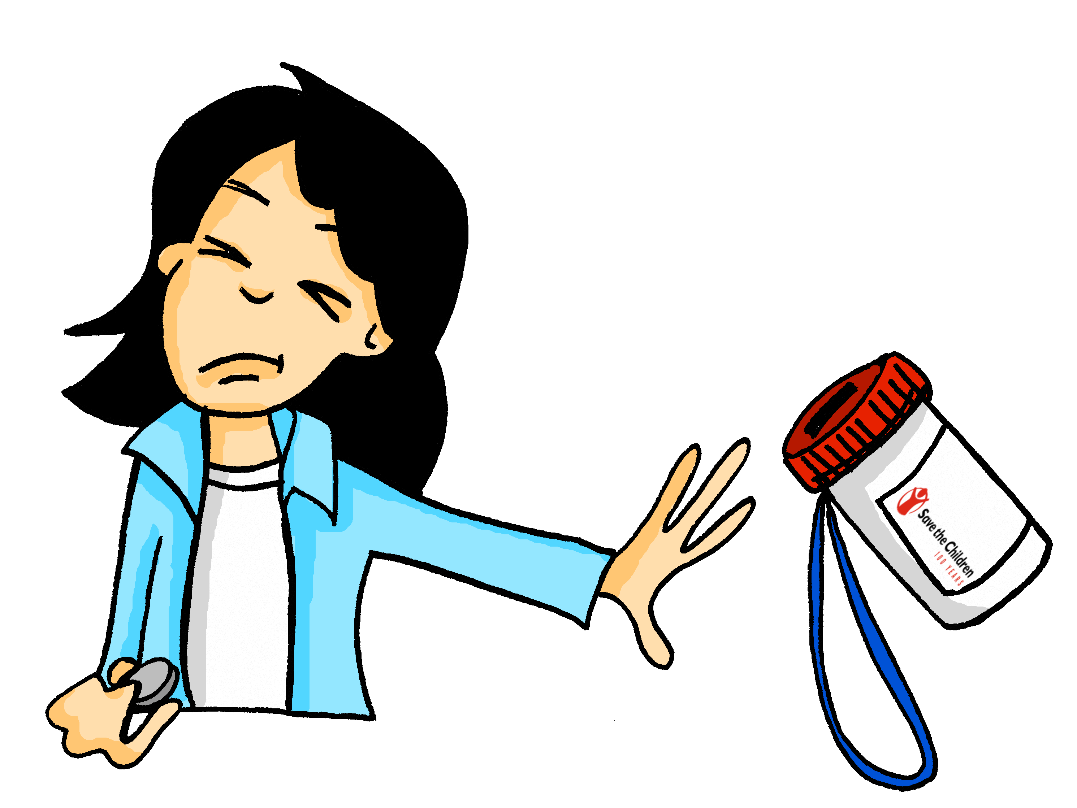
PERSON B
sprechen
vergessen
sprechen
schlafen
laufen
geben
Notes:
This is Student B’s card.

Slide 33
Die perfekte Mia
schreiben
Mia
Die perfekte Mia
Ich spreche Chinesisch, aber kein Englisch
Sie spricht Chinesisch und Englisch
Notes:
Timing: 2 minutes
Aim: To explain the writing activity on the next slide (involving producton of strong verb forms).
Note: After her stay with tante Laura, Mia is inspired to make some changes in her life!
Procedure:
Cycle through the examples on this slide using the animation sequence.
For each pair of pictures on the next slide, students write a sentence about the current Mia (ich) and the perfect Mia (sie).

Slide 34
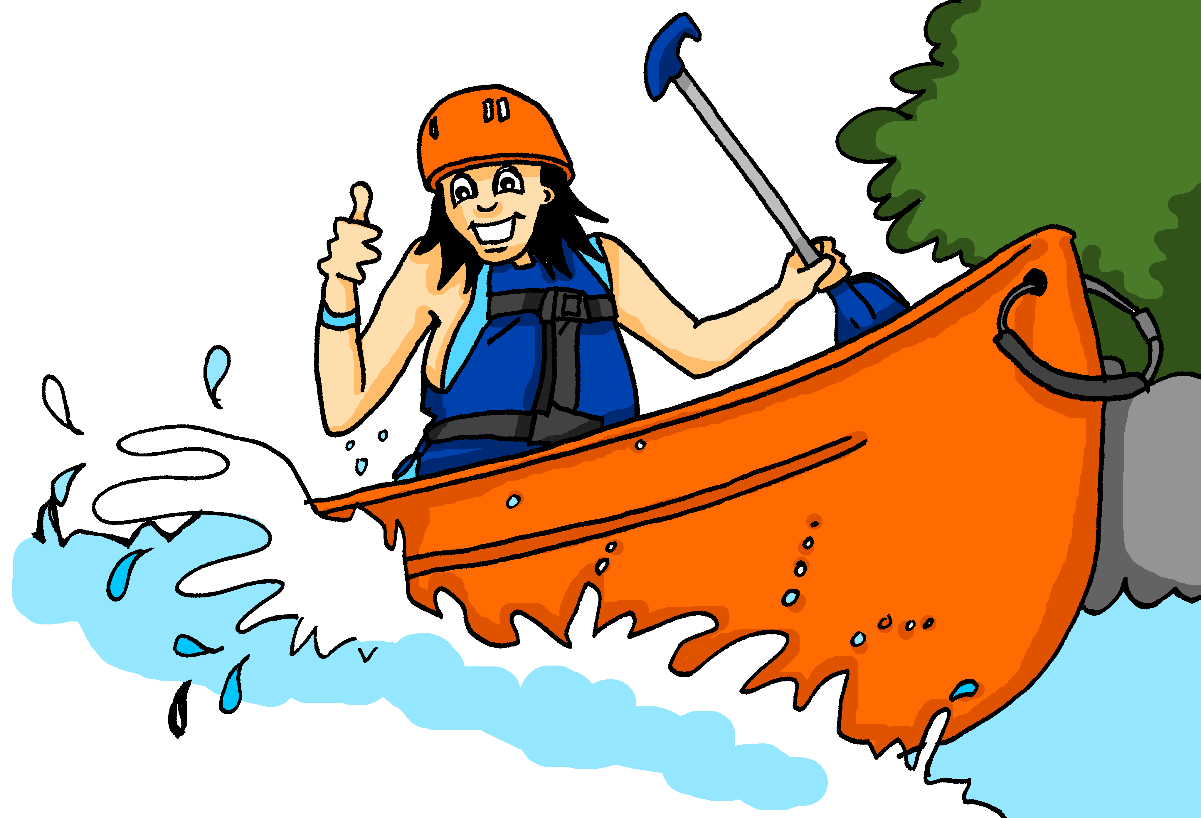
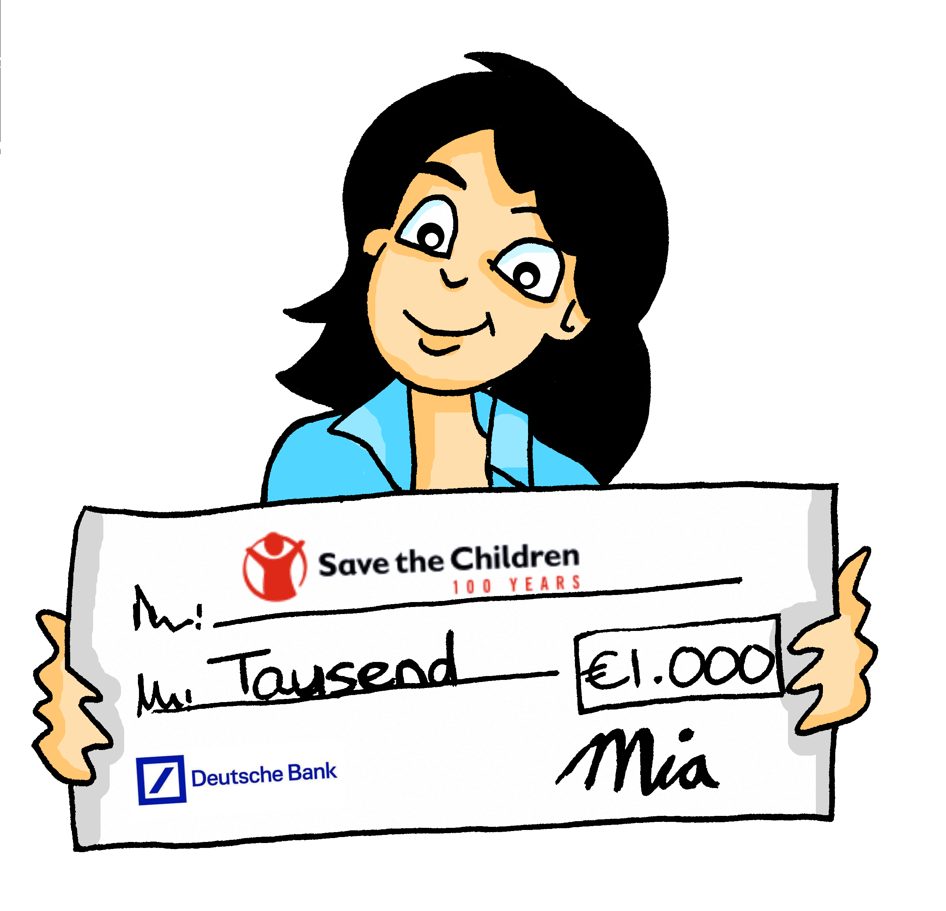
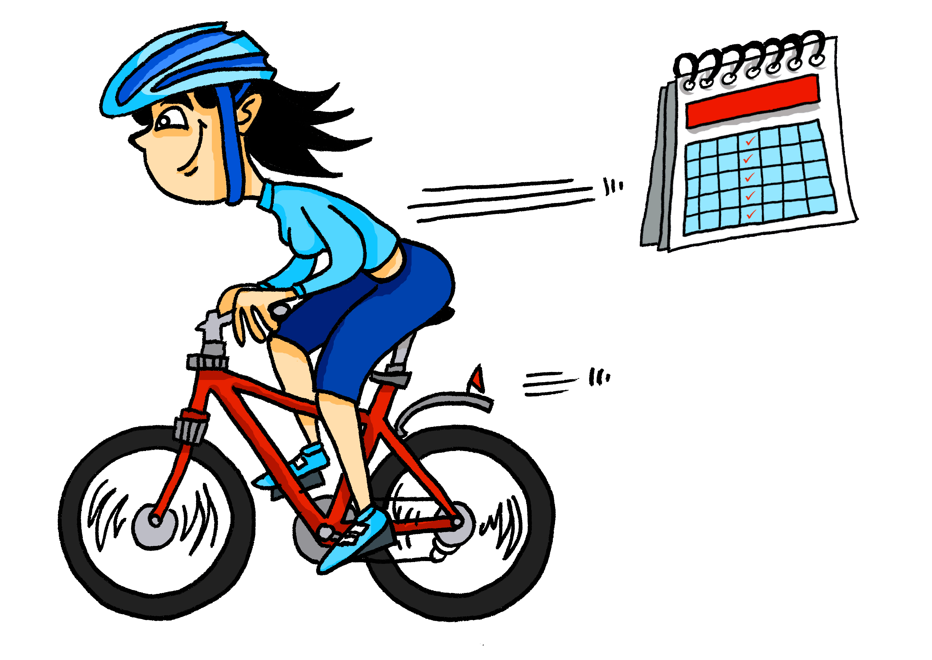
Die perfekte Mia
3
1
4
2
+
5
Notes:
Timing: 8 minutes
Aim: To practise written production of strong verb forms (1st and 3rd person singular).
Note: After her stay with tante Laura, Mia is inspired to make some changes in her life!
Procedure:
1. Taking current Mia’s perspective, students write a sentence about the current Mia (ich) and the perfect Mia for each pair of pictures.

Slide 35
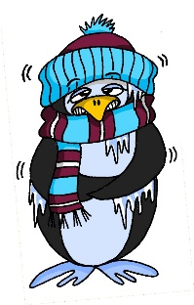
Phonics
ä
Verhältnis
Phonetik
haben
Mann
lächeln
kalt
fahren
klar
wählen
lang
Hälfte
Paar
spät
ändern
Klasse
zählen
danke
Nähe
Tag
ständig
a
Mädchen
erklären
Gast
ähnlich
sagen
Notes:
BONUS PHONICS ACTIVITY
Timing: 5 minutes (or as desired – could be finished for homework)
Aim: To make your own tongue twister
Procedure:
1. Students (alone or in pairs) pick, or teacher assigns, one of the following sound pairs:
- a vs ä
e vs i
au vs äu
These sound contrasts are useful for the vowel changes in the verbs.
2. Students create three sentences using the source and cluster words for their sounds as well as (some) other words that have appeared in the scheme of work so far:
i) A sentence using as many instances of the first sound
ii) A sentence using as many instances of the second sound
iii) A sentence alternating the two sounds
Note: This slide and the next two show source and cluster words for each pair. Students could use proper names as well (e.g. Max, Laura. Paul, Hilde, or Berlin, Wien etc.). Before starting students could do a short brainstorm to come up with more words that include the relevant sounds.

Slide 36
Fonetik
i
Leben
Phonetik
Kirche
Meer
sehen
wir
ihr
mehr
Ende
Familie
bitte
Hilfe
eng
Idee
finden
mit
besser
denken
privat
helfen
e
Linie
wissen
Bett
interessant
geben
Notes:
Make your own tongue twister e / i

Slide 37
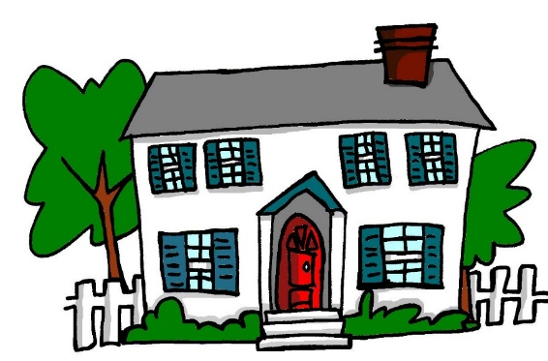
äu
au
Phonetik
Gebäude
genau
häufig
Bäume
auch
auf
Haus
träumen
glauben
Mäuse
ausgehen
Häuser
Notes:
Make your own tongue twister au / äu

Slide 38
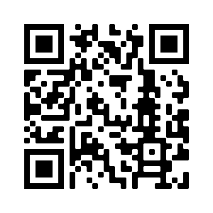
Hausaufgaben
Vocabulary Learning Homework (Term 2.2, Week 4)
Audio file
Audio file QR code:
Student worksheet
Quizlet link
In addition, revisit: Term 1.2 Week 7
Term 2.2 Week 1
Notes:
Use this slide to set the homework.

