Slide 1
Describing what people do and did (sport)
HACER in the preterite: ‘hice’ and ‘hiciste’
Final syllable stress and spelling [revisited]
Y8 Spanish
Term 3.1 – Week 5 – Lesson 57
Pete Watson / Mollie Bentley-Smith / Nick Avery Artwork: Mark Davies
Date updated: 26/05/21
Notes:
Artwork by Mark Davies. All additional pictures selected are available under a Creative Commons license, no attribution required.
Native teacher feedback provided by Blanca Román.
Learning outcomes (lesson 1):
Introduction of ‘hice’ and ‘hiciste’
Introduction of new vocabulary
Consolidation of ‘hago’ and ‘haces’
Consolidation of adverbs of position and ‘del’/’de la’
Consolidation of final syllable stress and spelling rules
Word frequency (1 is the most frequent word in Spanish):
8.3.1.5 (introduce) vocab set: hice [26]; hizo [26]; evitar [495]; fila [1976]; fuego [884]; daño [1319]; fondo [413]; habitación [1069]; jardín [1195]; mayo [909]; junio [1035]; viejo [225]; dentro [548]; campo² [342]; estadio [2581]
8.3.1.2 (revisit) nuestro [77]; tío [988]; tía [1205]; hijo [140]; hija [769]; científico [1711]; médico [692]; músico [2060]; abogado [1211]; débil [1946]; conocido [759]; tan [104], and numbers 21-30, veinticuatro [4059]; veinticinco [2643]; treinta [829]; all rest [>5000]
8.2.2.2 (revisit) me² [22]; te² [48]; le [25]; regalar [1420]; tirar [685]; quitar [668]; reloj [1683]; caja [1074]; tarjeta [1958]; lleno [684]; vacío [1585]
Source: Davies, M. & Davies, K. (2018). A frequency dictionary of Spanish: Core vocabulary for learners (2nd ed.). Routledge: London
The frequency rankings for words that occur in this PowerPoint which have been previously introduced in NCELP resources are given in the NCELP SOW and in the resources that first introduced and formally re-visited those words.
For any other words that occur incidentally in this PowerPoint, frequency rankings will be provided in the notes field wherever possible.

Slide 2
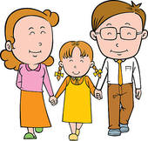
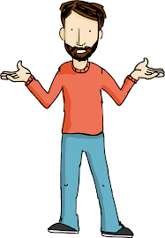
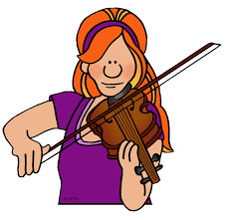
¿Cómo se dice en español?
hablar
[1/3]
la h_ _ _
nuestro
la hija
n_ _ _ _ _ _
[our (m)]
[daughter]
el t_ _
la música
el tío
[uncle]
la m _ _ _ _ _
[musician (f)]
el c_ _ _ _ _ _ _ _ _
el científico
tan
t_ _
[so (for emphasis)]
[scientist (m)]
Notes:
Vocabulary recall activity
Timing: 4 min.
Aim: to recall previously taught vocabulary from 8.3.1.2 and 8.2.2.2 (this week’s revisited vocabulary sets)
Procedure:
Students say the word in Spanish represented by image prompt and/or English translation. To encourage learners to recall this vocabulary only the first letter of each word is provided.
Teacher reveals answers one at a time.

Slide 3
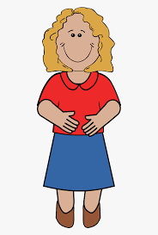
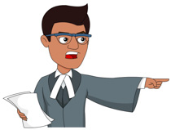
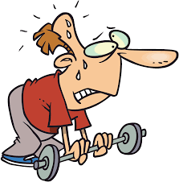
¿Cómo se dice en español?
hablar
[2/3]
el médico
el m_ _ _ _ _
la t_ _
la tía
[aunt]
[doctor (m)]
el a_ _ _ _ _ _
c_ _ _ _ _ _ _
el abogado
conocido
[well-known (m)]
[lawyer (m)]
[yourself, to you]
d_ _ _ _
[weak]
t_
débil
te
Notes:
(continued)
See slide 2 for instructions

Slide 4
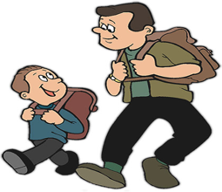
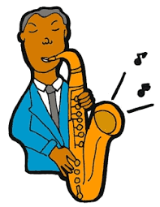
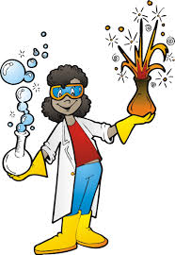
¿Cómo se dice en español?
hablar
[3/3]
la médica
la m_ _ _ _ _
la abogada
la a_ _ _ _ _ _
[doctor (f)]
[lawyer (m)]
el h_ _ _
el m_ _ _ _ _
el hijo
el músico
[son]
[musician (m)]
la c_ _ _ _ _ _ _ _ _
me
la científica
m_
[myself, to me]
[scientist (f)]
Notes:
(continued)
See slide 2 for instructions

Slide 5
Using the written accent Final syllable stress and spelling
fonética
Remember, if a Spanish word with stress on the last syllable ends in the consonants ___ or ___, an accent is needed on the vowel of that last syllable.
n
s
Ejemplos:
según
después
quizás
también
If it ends in any other consonant, no accent is used.
reloj
realidad
total
color
Notes:
Timing: 2 minutes
Aim: to briefly recap the use of the written accent for words with final syllable stress
Procedure:
1. Teachers click to recap the first part of the rule for final syllable stress spelling. Gaps are left for teachers to elicit answers from students.
2. Teachers show example words one by one, encouraging students to pronounce each word and say the meaning in English (all vocabulary has been previously taught).
3. This is then repeated with the second part of the rule.

Slide 6
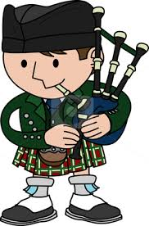
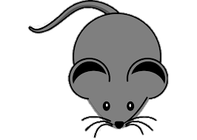
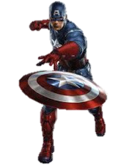
Fonética
‘Tilde’ es otra palabra para ‘acento’ (e.g. é, ñ, ó).
escuchar
Escucha y escribe las palabras: ¿llevan tilde o no?
1
televisión
television
6
francés
French
2
azul
blue
7
claridad
clarity
3
escocés
Scottish
8
ratón
mouse
4
real
real, royal
9
galés
Welsh
emotion, excitement
5
capitán
captain
10
emoción
Notes:
Timing: 4 minutes
Aim: to decide whether a word has an accent based on last letter of the word (all words have final syllable-stress); to transcribe the words accurately
Procedure:
1. Students should write 1-10 in their books.
2. Teachers click on the button to hear the word and students write down how they think the word should be spelled, paying attention to the stress of the word and what letter it ends in.
3. Teachers click to reveal the correct spelling of each word.
4. A further click reveals pictures and translations of the vocabulary. All words are unknown, except ‘azul’, though some words will be recognisable as they are near-cognates.
5. Students can also try saying the correctly spelt words aloud to practise pronunication of words with stress in this position.
Note: This is the first time that the term ‘tilde’ has been used in resources. Regarding the terms used to refer to the written accent, Butt & Benjamin (2004) state that “the Academy and many Hispanic grammarians call both the curly sign over an ñ and the acute accent (‘) la tilde, but in everyday language the latter usually means only the sign over ñ”.
Source: Butt, J. & Bejamin, C. (2004). A New reference grammar of modern Spanish (4th ed.). London: Hodder
The RAE also suggest using ‘tilde’ may be preferable given that the term ‘acento’ is polysemous: https://www.rae.es/duda-linguistica/se-puede-usar-acento-para-la-tilde
‘Tilde’ appears to typically be used as a feminine noun, but may also been used in masculine form: https://dle.rae.es/?w=tilde&origen=REDLE
Transcript:
televisión
azul
escocés
real
capitán
francés
claridad
ratón
galés
emoción
Frequency of unknown words/cognates (1 is the most frequent word in Spanish): capitán (1774); francés (563); ratón (3416); real (444); escocés (>5000); galés (>5000); claridad (2268)

Slide 7
vocabulario
‘Fila’ and ‘daño’ are often used with ‘hacer’. They may be translated with words other than ‘do’ or ‘make’!
vocabulario
‘Hacer (una) fila’ means ‘to line up’ (or ‘to make a line’).
Segundos
‘Hacer daño’ means ‘to hurt’ (or ‘to do harm’).
60
 | español | inglés
1 | la fila | line
2 | el daño | harm, damage
3 | el campo | countryside, pitch
4 | el fondo | back, end
5 | al fondo de | at the back of, at the end of
6 | el estadio | stadium
7 | mayo | May
8 | junio | June
9 | dentro (de) | inside
The translation of ‘el fondo’ depends on the context.
Ejemplos:
al fondo de la tienda
at the back of the shop
al fondo de la calle
at the end of the road
0
INICIO
Notes:
Timing: 5 minutes
Aim: Vocabulary practice slide for this week’s vocabulary set.
Procedure:
The words are first presented, along with callouts which highlight additional relevant information.
Pupils either work by themselves or in pairs, reading out the words and studying their English meaning (1 minute). Teachers click on the ‘inicio’ button to start the 1 minute timer or can use their own timing device.
Then the English meanings are removed by clicking and students try to recall them, looking at the Spanish (1 minute).
Then the Spanish meanings are removed by clicking and students try to recall them, looking at the English (1 minute)
Further rounds of learning can be facilitated by one pupil turning away from the board, and his/her partner asking him/her the meanings. This activity can work from L2 to L1 or L1 to L2.
Notes:
1. Teachers may also wish to tell students that ‘cancha’ is another word used for ‘pitch’, especially in Latin American countries. ‘Cancha’ can also mean ‘court’ (e.g. tennis, basketball court).
2. Spanish also has the term ‘hacer cola’, which translates as ‘to queue’ (e.g. outside a shop). ‘Hacer fila’ is used in this lesson in the context of sport, but is likely to also reflect students’ lived experience of school (e.g. lining up one behind the other before a lesson).
3. ‘Al’ in ‘al fondo de’ is deliberately in bold to draw attention to the spelling (as ‘el’ and ‘al’ appear very similar).

Slide 8
Saying what you do and did Using ‘hice’ and ‘hiciste’
gramática
Remember, to say ‘I do’ or ‘I make’ in Spanish, use ______.
hago
I do sport.
Hago deporte.
haces
To say ‘you do’ or ‘you make’ in Spanish, use _______.
You make friends.
Haces amigos.
To say ‘I did’ or ‘I made’ for a completed event in the past, use ‘hice’.
Hice ejercicio.
I did exercise.
To say ‘you did’ or ‘you made’ for a completed event, use ‘hiciste’.
Hiciste un video.
You made a video.
Notes:
Timing: 2 minutes
Aim: to recap ‘hago’ and ‘haces’ and introduce the first and second person singular of ‘hacer’ in the preterite.
Procedure:
1. Teachers click to go through the slide and examples. Animations allow teachers to elicit answers for recapped grammar and example sentences.

Slide 9
hice
[I did, I made]
hiciste
[you did, you made]
Notes:
Timing: 3 minutes for sequence of six slides
Aim: to introduce the 1st person singular and plural of ‘hacer’ in the preterite more explicitly as ‘hacer’ is one of the 25 most frequently used verbs in Spanish.
Procedure
Teachers bring up the word ‘hice’ on its own, say it, students repeat it.
Teachers try to elicit the meaning from the students.
Teachers then bring up the English translations. Emphasise the two meanings for ‘hacer’ in English.
Teachers bring up the ‘tú’ form ‘hiciste’’, say it, students repeat it.
Teachers try to elicit the meaning from the students.

Slide 10
hice
[I did, I made]
hiciste
[you did, you made]
Notes:
Cycle through the first and second persons singular forms of the preterite again.

Slide 11
hice
[I did, I made]
Hice ejercicio ayer.
[I did exercise yesterday.]
Notes:
Teachers introduce the 1st person singular of the preterite in a sentence.

Slide 12
hiciste
[you did, you made]
Hiciste un cambio al equipo.
[You made a change to the team.]
Notes:
Teachers introduce the 2nd person singular of the preterite in a sentence.
Note: it may be of interest to students that ‘un cambio de equipo’ would mean ‘you changed team’. Prepositions matter!

Slide 13
hice
[I did, I made]
Hice
_____ ejercicio ayer.
[I did exercise yesterday.]
Notes:
Teachers cycle through the 1st person singular in the preterite again.

Slide 14
hiciste
[you did, you made]
Hiciste
_______ un cambio al equipo.
[You made a change to the team.]
Notes:
Teachers cycle through the 2nd person singular in the preterite again.

Slide 15
Talking about places and locations Using ‘del’ and ‘de la’ with adverbs
gramática
Remember, in Spanish you can give locations using adverbs like ‘cerca’ or ‘lejos’.
You often use ‘de’ after them to refer to a person, place or thing.
Hay un reloj dentro de la caja.
There is a watch inside the box.
In English we use several words for this ‘de’:
near (to), far (from), in front (of). Or no word: under (-), behind (-), outside (-)
To refer to a singular masculine noun (e.g. el cine), change de + el to ‘____’.
del
La jugadora está fuera del estadio.
The player (f) is outside the stadium.
To refer to a singular feminine noun (e.g. la estación), use ‘_____’.
de la
Nuestro tío está delante de la casa.
Our uncle is in front of the house.
Notes:
Timing: 2 minutes
Aim: to recap the rules on ‘del’ vs ‘de la’ with various adverbs of position that were introduced in Year 7.
Procedure:
Go through the grammar explanation with students, revealing each new sentence on a mouse click.
Notes:
Although words such as ‘cerca’ are adverbs, they function in a similar way to prepositional phrases when used with ‘estar’, ‘de’ and a noun.

Slide 16
¡Una jugadora de fútbol habla! La actividad, ¿cuándo pasa / pasó? ¿Normalmente o ayer? Escribe ‘del’ o ‘de la’. También escribe la acción en inglés, y dónde pasa.
leer
 | ¿Del o de la? |  |  | ¿Qué y dónde?
1 | Hago una fila detrás ______ capitana antes de jugar.
2 | Hice gestos tontos al lado ______ árbitra*.
3 | Durante el verano hago cosas al fondo ____ campo.
4 | En mayo hice una entrevista dentro ______ estadio.
5 | Hice un esfuerzo delante ______ entrenadora (f)*.
6 | En junio hago ejercicio cerca ______ mercado.
7 | Hice un ataque* a la izquierda ______ jugadora.
normalmente
ayer
de la
lines up (makes a line) behind the captain
made silly gestures next to the referee
de la
does things at the end of the pitch
del
del
did an interview inside the stadium
de la
made an effort in front of the coach (f)
does exercise near the market
del
made an attack to the left of the player (f)
de la
*el/la entrenador/a - coach
*el/la árbitro/a - referee
*el ataque - attack
Notes:
Timing: 8 minutes
Aim: reading exercise to practise distinguishing between ‘hago’ and ‘hice’, using ‘del’ / ‘de la’ and understanding adverbs of position.
Procedure:
1. Students first should look at the sentences and decide if the activity was done today or yesterday.
2. They then decide between del and ‘de la’.
3. Finally students should write in English what happens and where the action occurs/occurred.
4. Answers are animated to reveal from left to right, across each row, starting with the ‘del’ / ‘de la’ column, then the ‘hoy o ayer’ column, and finally the right hand column.
5. During feedback, the teacher can elicit from students the meaning of the full sentence. It is worth focusing in particular here on the use of ‘hacer’: does it translate as ‘do’, ‘make’ or something else (e.g. hacer fila – to line up)?
Notes:
Several time markers (e.g. en mayo) are inserted to avoid all sentences beginning with a verb (which might give away answers). These could plausibly refer to the habitual present or preterite, so won’t give away the answers about when the event occurred.
Other examples of sport-related vocabulary used with hacer include (hacer un pase, hacer un contraataque, hacer una falta/una infracción, hacer un penalty).
Frequency of unknown words/cognates:
entrenador [3328]; árbitro [4602]; ataque [1116]; capitán [1774]

Slide 17
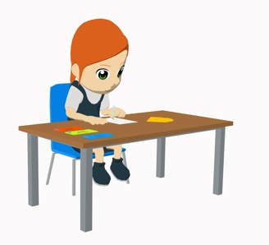
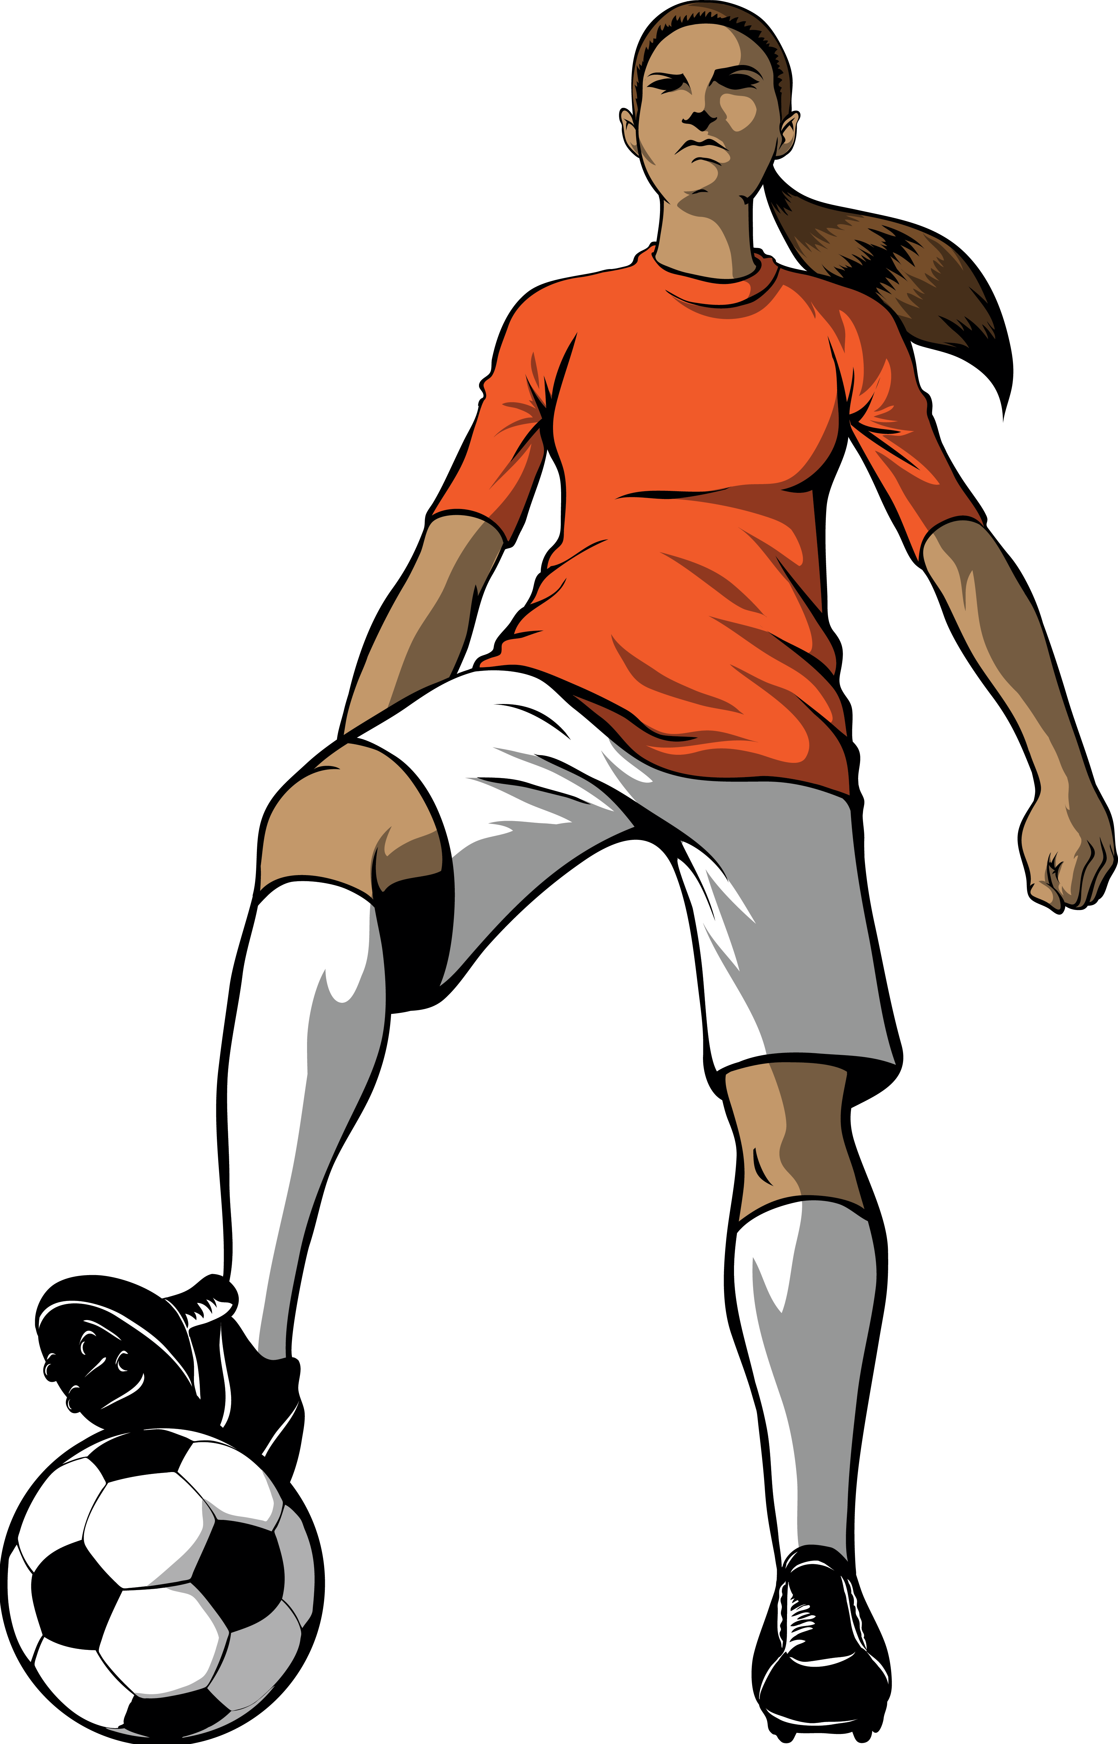
La jugadora de fútbol famosa hace una visita. Lucía prepara una entrevista con la ayuda del profesor para el periódico del colegio. Escucha las preguntas y marca las opciones correctas.
escuchar
Do you?
Did you?
 |  |  | La acción | ¿Qué palabra termina la frase?
 |  |  |  | playa | centro
 |  |  |  | edificio | montaña
 |  |  |  | estadio | ciudad
 |  |  |  | partido | playa
 |  |  |  | escuela | equipo
 |  |  |  | autobús | entrenadora*
 |  |  |  | grupo | capitana
 |  |  |  | ciudad | campo
1
1
do sport (in May)
2
2
do exercise (in June)
3
3
do important things
4
4
do many activities
5
5
make friends
hurt (‘do harm to’) another player
6
6
7
7
line up (‘make a line’)
8
8
make videos
*coach (f)
Notes:
Timing: 8 minutes
Aim: to distinguish meaning between the meanings of ‘haces’ and ‘hiciste’; to recognise what gender of noun follows ‘del’ and ‘de la’.
Procedure:
1. Teachers click the number button to play the recording. Students should copy out the grid and put a cross in either the ‘do you’ (present) column or the ‘did you (past) column. Then they write the action and which of the two words would correctly complete the sentence.
2. Answers are shown by clicking. On the first click, a set of beige buttons will appear. These can be used to play the full sentence, so that students can check their answers with audio reinforcement. All answers are shown from left to right for each question item before going on to the next question.
Note: Optionally, teachers could also ask the students to translate the adverb of position, as this is the one part of the sentence that isn’t an explicit focus of the activity. This may require a further listen.
Transcript:
¿Hiciste deporte en mayo cerca del…?
¿Hiciste ejercicio en junio encima de la…?
¿Haces cosas importantes lejos del…?
¿Hiciste muchas actividades fuera del…?
¿Haces amigos dentro del…?
¿Hiciste daño a otra jugadora delante de la…?
¿Hiciste una fila detrás del…?
¿Haces videos al fondo de…?
Frequency of unknown words/cognates:
entrenador [3328]; árbitro [4602]; ataque [1116]; capitán [1774]

Slide 18
hablar / escuchar
¿Qué hice y qué hiciste?
Estudiante A pregunta en el pasado con ‘hice’ or ‘hiciste.
Estudiante B elige la respuesta correcta. Luego, lee la respuesta a Estudiante A.
Estudiante A escribe en inglés la frase que dice Persona B en inglés.
¡Toma turnos!
Un ejemplo:
Sí, delante de la entrenadora.
¿Hice un esfuerzo?
Estudiante B (contesta):
Estudiante A (pregunta):
Ask your partner these questions.
Which question did you hear?
Was it ‘hice’ (‘I’) or ‘hiciste’ (‘you’)?
Give the answer in Spanish.
Write down the answer in English.
a) Did I make an effort?
→ Yes, in front of the coach (f).
1. ¿Did I make an effort?
Yes, in front of the coach.
b) Did you make an effort?
→ Yes, all the time!
Notes:
Timing: 12 minutes
Aim: to practise understanding yes-no questions with ‘hacer’ in the 1st and 2nd person preterite (–í and –iste); to consolidate adverbs and the gender of nouns that follow them
Procedure:
Student A reads aloud the question on their prompt card. This will either need ‘hice’ or ‘hiciste’ for a completed action in the past.
Student B listens and decides which of the two sentences they heard: a) or b)
Student B then says the corresponding answer in Spanish depending on which of the two sentences they heard.
Student A listens and translates the sentence into English.
Notes:
Teachers could encourage students to answer with the verb as well if the answer is yes.

Slide 19
Persona A
Ask your partner these questions.
Which question did you hear, ‘a’ or ‘b’? Was it hice (‘I’) or hiciste (‘you’)? Give the answer in Spanish.
Write down the answer in English.
1. Did you do something in May?
→ Yes, next to the coach (f).
1a) Did I do an interview?
1b) Did you do an interview?
→ Yes, inside the stadium.
2. Did I hurt (‘do harm to’) another player?
2a) Did you make an attack?
2b) Did I make an attack?
→ Yes, to the left of the player (f).
→ Yes, to the right of the team.
3. Did I do exercise in June?
3a) Did I line up with the team?
3b) Did you line up with the team?
→ Yes, behind the captain* (f).
→ Yes, with the referee (m).
4. Did you make a silly gesture?
4a) Did you make friends?
4b) Did I make friends?
→ Yes, outside the team.
→ Yes, inside the team.
5. Did I do important things?
5a) Did I make videos?
5b) Did you make videos?
→ Yes, at the end of the pitch.
→ Yes, on top of the house.
*captain (f) - la capitana
Notes:
DO NOT DISPLAY DURING ACTIVITY
See accompanying Word doc for printable version.

Slide 20
Persona B
Ask your partner these questions.
Which question did you hear, ‘a’ or ‘b’? Was it hice (‘I’) or hiciste (‘you’)? Give the answer in Spanish.
Write down the answer in English.
1. Did you do an interview?
1a) Did I do something in May?
1b) Did you do something in May?
→ Yes, far from the city.
→ Yes, near the city.
2. Did you make an attack*?
2a) Did I hurt the other player?
2b) Did you hurt the other player?
→ Yes, in front of the team.
→ Yes, behind the coach (m).
3. Did I line up (‘make a line’) with the team?
3a) Did you do exercise in June?
3b) Did I do exercise in June?
→ Yes, I did a lot of sport.
→ Yes, outside the stadium.
4. Did you make friends?
4a) Did I make a silly gesture?
4b) Did you make a silly gesture?
→ Yes, behind the referee (f).
→ Yes, next to the referee (f).
5. Did I make videos?
5a) Did you do important things?
5b) Did I do important things?
→ Yes, at the end of the pitch.
→ Yes, you made a video with friends.
*attack (m) – el ataque
*referee (f) - la árbitra
Notes:
DO NOT DISPLAY DURING ACTIVITY
See accompanying Word doc for printable version.

Slide 21
Persona A
Persona B
Ask your partner these questions.
Ask your partner these questions.
Write down the answer in English.
Write down the answer in English.
1. ¿Hiciste algo en mayo?
1. ¿Hiciste una entrevista?
Yes, far from the city.
Yes, inside the stadium.
2. ¿Hice daño a otro jugador/a?
2. ¿Hiciste un ataque?
Yes, in front of the team.
Yes, to the left of the player (f).
3. ¿Hice ejercicio en junio?
3. ¿Hice fila antes del partido?
Yes, outside the stadium.
Yes, behind the captain (f).
4. ¿Hiciste un gesto tonto?
4. ¿Hiciste amigos?
Yes, next to the referee (f).
Yes, outside the team.
5. ¿Hice cosas importantes?
5. ¿Hice videos?
Yes, you made a video with friends.
Yes, at the end of the pitch.
Notes:
ANSWERS – DISPLAY DURING FEEDBACK

Slide 22
Describing what people do and did [2]
HACER in the preterite: ‘hizo’
Final syllable stress and spelling [revisited]
Y8 Spanish
Term 3.1 – Week 5 – Lesson 58
Pete Watson / Amanda Izquierdo / Nick Avery
Artwork: Mark Davies
Date updated: 26/05/21
Notes:
Artwork by Mark Davies. All additional pictures selected are available under a Creative Commons license, no attribution required.
Native teacher feedback provided by Blanca Román.
Learning outcomes (lesson 1):
Introduction of ‘hizo’
Introduction of new vocabulary
Consolidation of ‘hice’ and ‘hiciste’
Consolidation of subject pronouns
Consolidation of final syllable stress and spelling
Word frequency (1 is the most frequent word in Spanish):
8.3.1.5 (introduce) vocab set: hice [26]; hizo [26]; evitar [495]; fila [1976]; fuego [884]; daño [1319]; fondo¹ [413]; habitación [1069]; jardín [1195]; mayo [909]; junio [1035]; viejo [225]; dentro [548]; campo² [342]; estadio [2581]
8.3.1.2 (revisit) nuestro [77]; tío [988]; tía [1205]; hijo [140]; hija [769]; científico [1711]; médico [692]; músico [2060]; abogado [1211]; débil [1946]; conocido [759]; tan [104], and numbers 21-30, veinticuatro [4059]; veinticinco [2643]; treinta [829]; all rest [>5000]
8.2.2.2 (revisit) me² [22]; te² [48]; le [25]; regalar [1420]; tirar [685]; quitar [668]; reloj [1683]; caja [1074]; tarjeta [1958]; lleno [684]; vacío [1585]
Source: Davies, M. & Davies, K. (2018). A frequency dictionary of Spanish: Core vocabulary for learners (2nd ed.). Routledge: London
The frequency rankings for words that occur in this PowerPoint which have been previously introduced in NCELP resources are given in the NCELP SOW and in the resources that first introduced and formally re-visited those words.
For any other words that occur incidentally in this PowerPoint, frequency rankings will be provided in the notes field wherever possible.

Slide 23
Fonética
leer / escibir
60
¡Elige siete! Escribe las 7 palabras que deben llevar tilde.
avion
[plane]
adios
[goodbye]
total
[total]
jardin
[garden]
avión
adiós
jardín
mejor
[better]
peor
[worse]
salud
[health]
accion
[action]
acción
corazon
[heart]
reloj
[watch]
habitacion
[bedroom]
interes
[interest]
corazón
habitación
interés
0
INICIO
Notes:
Timing: 4 minutes
Aim: to correctly apply spelling rules (use of accent) for words ending in final syllable stress
Procedure:
Explain to students that they will have one minute to find and write down the seven words in the grid that should have an accent.
Click on ‘inicio’ to start the clock, or keep time using another method.
When a minute is up, click again and all the words in the grid will disappear.
Students should then work in pairs. Person A says the seven words that they have written down to their partner. Person B then says their seven words back. They can work together to try to reach agreement on any differences. (The teacher could monitor position of syllable stress in students’ oral production here, and offer feedback afterwards, if useful.)
The pairs of students can then be asked for their seven words. Click to reveal the seven correct words that should have an accent. Students can also be asked why the 5 remaining words don’t have an accent (anticipate: because they end in consonants other than ‘n’ or ‘s’).
Note: ‘jardín’ and ‘habitación’ will also be introduced as a vocabulary items in this lesson.
Frequency of unknown words/cognates (1 is the most frequent word in Spanish): total [1482]; avión [1399]; jardín [1195]; acción [404]; corazón [475]; habitación [1069]; interés [388].

Slide 24
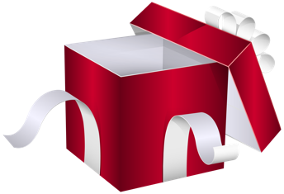
¿Qué pasó en la fiesta de Nadia? Vocabulary practice
escuchar
Escucha y completa las frases en inglés.
 | Her son threw an empty box at her.
 | Her uncle offered her a present.
 | Her daughter took her phone off her.
 | Her boyfriend sent her twenty five emails.
 | Her cousin wrote her a birthday card.
 | Her Dad gave her a beautiful dress.
 | Her brother bought her a watch.
 | Her aunt organised a party full of people for her!
1
___
_______
_______
____
2
______
_________
_________
3
___________
_____
____
4
___________
_______
____
5
______
__________
_____
6
_____
_____
______
7
________
_________
8
______
___
___
________
Notes:
Timing: 6 minutes
Aim: listening exercise to revisit one of this week’s vocabulary sets (8.3.1.2)
Procedure:
Teacher plays the audio for each sentence by clicking the number button.
Students complete the English translations.
Teacher shows the answers for each sentence, one word at a time
Note: Students could be asked if any of the sentences are sound odd or unlikely. For example, in the narrative so far, no mention has been made of Nadia having a child. This was included in the activity as it is a revisited vocabulary item this week.
Transcript:
Su hijo le tiró una caja vacía.
Su tío le ofreció un regalo.
Su hija le quitó el móvil.
Su novio le envió veinticinco correos electrónicos.
Su primo le escribió una tarjeta de cumpleaños.
Su padre le regaló un vestido precioso.
Su hermano le compró un reloj.
Su tía le organizó una fiesta llena de gente.

Slide 25
¡Hacer fila! There has been a race and the announcer reads out the finishing positions. Escribe los números en el orden correcto.
escuchar
¿Qué números llevan tilde?
1
2
3
4
5
veintidós
veintiséis
6
7
8
9
10
veintitrés
Notes:
Timing: 3 minutes
Aim: to revise numbers 21-30, which are part of one of this week’s revisited vocabulary sets
Procedure:
1. Students write 1-10 in their exercise books.
2. Teachers have two options about how to play the recording. Either click the player in the top right to play the audio of the order in which the athletes finished in a race in its entirety, or click the numbers buttons 1-10 to play each one separately.
3. On clicking, the numbers will move into the order in which they were read out.
4. Teachers can also revisit here which of the numbers has an accent on it due to the spelling and final syllables stress rules. The 3 numbers with an accent on the final vowel appear on a further click.
Transcript: (full)
Señoras y señores, el orden final: Isabela Ruíz, número veinticinco… Catalina Sánchez, número veintidós... Ana González, número treinta... Paula Pérez, número veintiséis... María Velasco, número veintiocho... Elisa Ramírez, número veintitrés ... Margarita Torres, número veintisiete ... Luisa Daza, número veintiuno ... Ángela Gómez, número veinticuatro ... , y finalmente, Yolanda Vega, número veintinueve.
Transcript (individual)
Señoras y señores, el orden final: Isabela Ruíz, número veinticinco
Catalina Sánchez, número veintidós
Ana González, número treinta
Paula Pérez, número veintiséis
María Velasco, número veintiocho
Elisa Ramírez, número veintitrés
Margarita Torres, número veintisiete
Luisa Daza, número veintiuno.
Ángela Gómez, número veinticuatro
y finalmente, Yolanda Vega, número veintinueve

Slide 26
Vocabulario
Want to say ‘to avoid doing something’?
Use evitar + infinitive.
to line up, make a line
hacer (una) fila
Palabras nuevas:
?
evitar
to avoid, avoiding
to hurt (‘do harm to’)
hacer daño
?
la habitación
bedroom
countryside, pitch
el campo
?
el fuego
fire
back, end
el fondo
?
el jardín
garden
at the back, end of
al fondo de
?
viejo, vieja
old
stadium
el estadio
?
‘Antiguo’ is often used for places and things that are ancient (e.g. a city, a coin).
‘Viejo’ can be used for objects (e.g. un coche viejo) or people, but be careful – ‘una persona vieja’ can be rude!
May
mayo
?
junio
June
?
inside
?
dentro
Notes:
Vocabulary recall and introduction activity
Timing: 3 minutes
Aim: to improve recall of vocabulary introduced in lesson 1 and introduce five new items (the rest of this week’s set).
Procedure:
Students say the Spanish translation of the English word/phrase on the left of the slide.
Teachers reveal answers one at a time.
Teachers click to reveal the new vocabulary items.
Notes:
1. Students could be given a minute to recall the Spanish words from lesson 1 orally (in pairs or individually) and/or be challenged to recall the English meanings of the five other words from the vocabulary homework (if pre-learning has been done before the lesson).
2. It may be worth adding that ‘una persona mayor’ is a more polite way to say ‘an old person’.
3. Months of the year are written in lowercase in Spanish. It may be worth reminding students of this, given the two examples included here.

Slide 27
Saying what different people did HACER in the preterite
gramática
hice
To say ‘I did’ or ‘I made’ in Spanish, use ______.
I did the activity.
Hice la actividad.
hiciste
To say ‘you did’ or ‘you made’, use _________.
You made a change.
Hiciste un cambio.
To say ‘s/he did / made’ or ‘it did/made’, say hizo.
She did an interview.
Hizo una entrevista.
Notes:
Timing: 1 minute
Aim: introduce ‘hizo’ alongside recapping the present and preterite singular forms of ‘hacer’ taught thus far.
Procedure:
Teachers click to go through the sentences and examples. Gaps are left for teachers to elicit answers from students.

Slide 28
Comparing what different people do subject pronouns [revisited]
gramática
Remember to use subject pronouns when comparing what different people do or did.
Ejemplo:
I made an effort but you only made noise.
Yo
___ hice un esfuerzo, pero ___ sólo hiciste ruido.
tú
Ejemplo:
She did the homework, whereas he did little.
Ella
él
____ hizo los deberes, mientras que ___ hizo poco.
The verb (e.g. hizo) is the same for ‘he’ and ‘she’, so sometimes we need the pronoun to say who does what!
Notes:
Timing: 1 minute
Aim: to recall how subject pronouns are used when comparing one person’s actions with another.
Procedure:
Teachers click to go through the sentences and examples. Gaps are left for teachers to elicit answers from students.

Slide 29
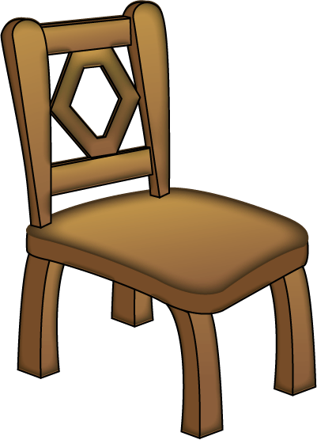
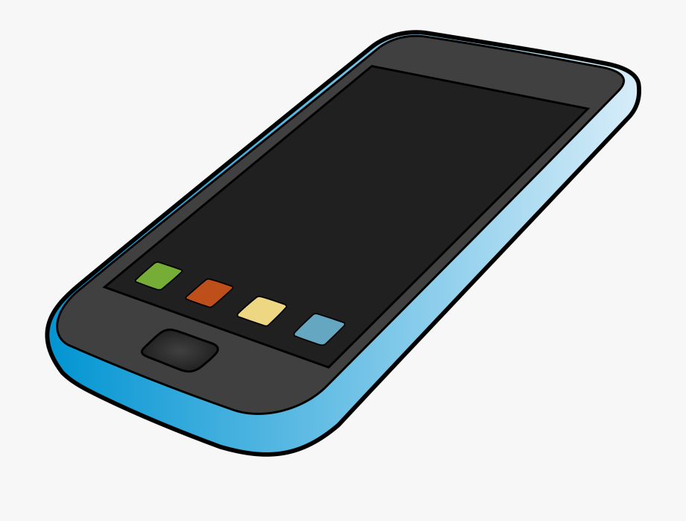
Un sábado lleno de actividades
leer
Lee los extractos de una conversación entre Lucía y Daniel. Lucía describe las actividades del sábado pasado.
¿Who…? | Lucía (I) | Daniel (you) | Nadia (she)
1. did homework?
2. made calls?
3. made a fire?
4. did some sport?
5. did some work?
6. made a new chair?
Completa la tabla. Escribe los pronombres en español.
tú
1. “Pues el sábado _____ hiciste los deberes… y _____ hice unas llamadas”.
yo
Ella
2. _____ hizo un fuego […] Luego _____ hiciste deporte al fondo del jardín.”
tú
Yo
3. “_____ hice trabajo dentro de la casa con mi madre […] _____ hizo una silla nueva.”
ella
Notes:
Timing: 6 minutes
Aim: reading activity to practise understanding ‘hice’, ‘hiciste’ and ‘hizo’, and to also associate these verb forms with the correct subject pronoun in Spanish.
Procedure:
Students read the three extracts in order to fill in the table, ticking the correct column for the person who did each action. If working in their exercise books, they can just write, for example, 1. you.
Students then write the correct subject pronoun. They could either do this at the same time as step 1 or after it.
The teacher clicks to reveal the answers.
Optionally, students could also be asked for suggestions of other activities that happened that day. This would be a chance to recall other examples of nouns used with hacer (e.g. ejercicio, entrevista, mesa, vídeo, algo, deberes).
Notes:
The activity could easily be adapted for a higher-achieiving group by changing the order of the questions, which currently appear in the same order as in the text.
‘Fogata’ [>5000] and ‘hoguera’ [>5000] (a bonfire, which might be for a celebration e.g. las Hogueras de San Juan) are alternative, more specific terms for ‘fire’.

Slide 30
Un sábado lleno de actividades
leer / escuchar
Do
homework
Make
Escucha y completa el texto.
sport
work
fire
trip
Luego busca todos los ejemplos de hacer + nombre. ¿Cuántos ejemplos hay de ‘do’ y de ‘make’?
nothing else
video
chair
list
noise
“Pues, el sábado tú hiciste los deberes por la mañana y yo hice unas llamadas a nuestros tíos. Después, llegó Nadia con Hugo y ella hizo un fuego en el jardín mientras que _______________ en el móvil. Luego, tú hiciste deporte al fondo del jardín y __________________________ con Nadia para comprar en el pueblo. Por la tarde __________________________ en autobús, y yo hice trabajo dentro de la casa con mi madre. Nadia también ayudó. Ella hizo una silla nueva porque hay un problema con la silla vieja. Sin embargo, Hugo evitó ayudar. ¡_________________ y nada más*!
calls
él hizo un vídeo
yo hice una lista de cosas
hiciste un viaje al pueblo
Él solo hizo ruido
*nada más = nothing else
Notes:
Timing: 8 minutes
Aim: reading and listening activity to practise understanding other phrases with ‘hacer’ in the preterite, including their translation into English (with ‘do’ or ‘make’)
Procedure:
Teachers click the audio player and students listen to the recording whilst following the text.
Students fill in the missing phrases, each of which contains a different form of ‘hacer’ in the preterite with a subject pronoun preceding it.
Students read through the text again, noting down all the examples of the verb ‘hacer’ that would be translated using the verb ‘to do’ in English and all those which would be translated using the verb ‘to make’.
Frequency of unknown words/cognates (1 is the most frequent word in Spanish):
nada [87] (although nada has appeared as part of ‘de nada’ as a Y7 vocabulary item).

Slide 31
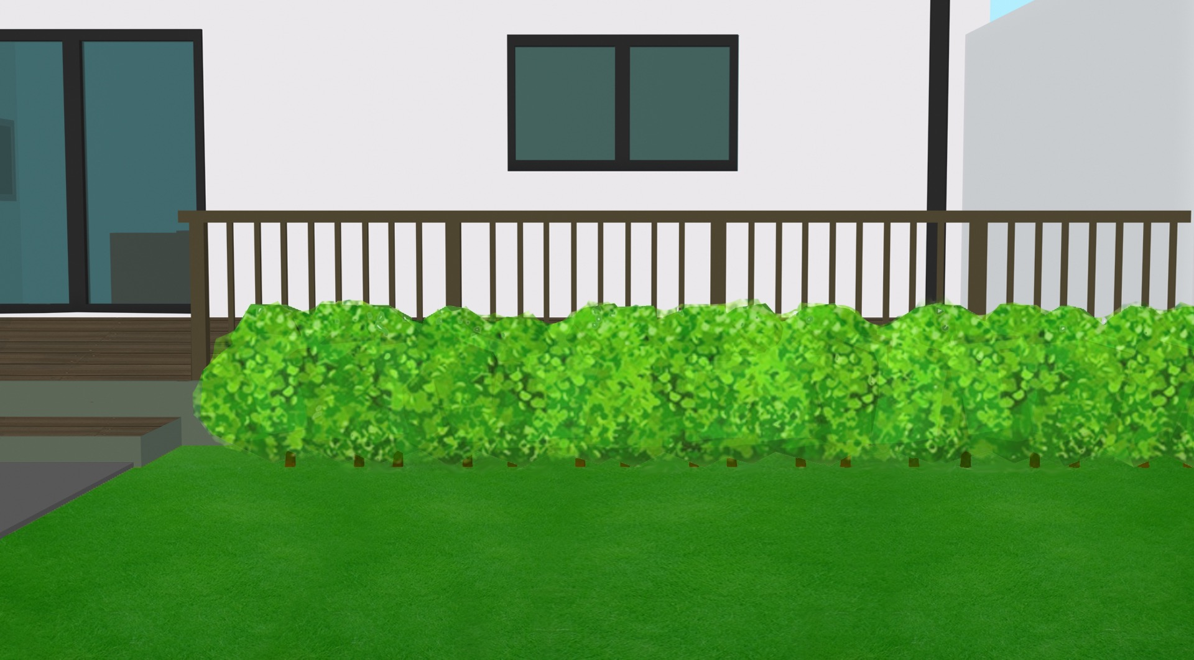
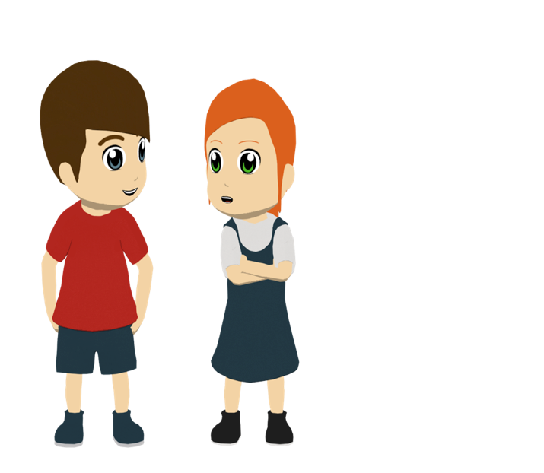
Escucha y lee. Lucía habla con Daniel del sábado pasado. ¿Puedes reemplazar las palabras en el texto?
leer / escuchar
“Pues, el sábado tú hiciste los deberes por la mañana y yo hice unas llamadas a nuestros tíos. Después, llegó Nadia con Hugo y ella hizo un fuego en el jardín mientras que él hizo un vídeo en el móvil. Luego, tú hiciste deporte al fondo del jardín y yo hice una lista de cosas con Nadia para comprar en el pueblo. Por la tarde hiciste un viaje al pueblo en autobús, y yo hice trabajo dentro de la casa con mi madre. Nadia también ayudó. Ella hizo una silla nueva porque hay un problema con la silla vieja. Sin embargo Hugo evitó ayudar. ¡Él solo hizo ruido y nada más!”
Text
1
5
2
6
3
7
4
Notes:
Timing: 8 minutes
Aim: to help students to connect the spoken and written forms of the language more securely; to consolidate vocabulary and grammar knowledge by eliciting suggested changes to the text.
Procedure:
1. Teachers click on the audio button to play the text. Read and listen.
Note: There is a full version of the audio top left with a player. Alternatively the audio is in 7 sections with a pause just after the words 1-6 below, to facilitate easy stop/start.
2.To support segmentation, stop the audio and ask students to say: a) the next word b) the previous word
3. In addition, to develop understanding, vocabulary and grammar knowledge, pause at the key points and ask students to suggest an alternative word.
The recordings are divided up as follows, with the words in bold in the speech bubble to be replaced.
“Pues, el sábado tú hiciste los deberes por la mañana y yo… (students supply an activity with the first person singular of ‘hacer’.
… hice unas llamadas a nuestros tíos. Después, llegó Nadia con Hugo y ella hizo un fuego… (students supply an adverb of location in relation to something, eg dentro de la casa’ (!)
... en el jardín mientras que él hizo un video en el móvil. Luego, tú hiciste deporte… (students supply an adverb of position, eg lejos de la casa)
... al fondo del jardín y yo hice una lista de cosas con Nadia para… (students supply an infinitive and detail)
… comprar en el pueblo. Por la tarde hiciste un viaje al pueblo en autobús, y yo….. (students supply a 1st person singular form of hacer with an activity and where)
... hice trabajo dentro de la casa con mi madre. Nadia también ayudó. Ella hizo una silla nueva porque hay un problema con la silla vieja. Sin embargo Hugo evitó ayudar. ¡Él solo hizo…(students add an activity Hugo could have done)
Transcript:
Pues, el sábado tú hiciste los deberes por la mañana y yo hice unas llamadas a nuestros tíos. Después, llegó Nadia con Hugo y ella hizo un fuego en el jardín mientras que él hizo un video en el móvil. Luego, tú hiciste deporte al fondo del jardín y yo hice una lista con Nadia de cosas para comprar en el pueblo. Por la tarde hiciste un viaje al pueblo en autobús, y yo hice trabajo dentro de la casa con mi madre. Nadia también ayudó. Ella hizo una silla nueva porque hay un problema con la silla vieja. Sin embargo Hugo evitó ayudar. ¡Él solo hizo ruido y nada más!

Slide 32
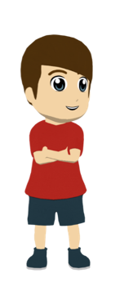
¡Ahora tú escribes!
escribir
Escribe el texto otra vez, pero debes cambiar cosas.
Puedes usar una persona diferente (yo, tú, él, mi padre...).
También puedes cambiar las acciones con ‘hacer’.
Puedes cambiar donde pasó la acción con otros adverbios.
deporte
ejercicio
actividades
trabajo
daño
la cama
algo
cosas graciosas
una película
dinero
amigos
una lista
un viaje
sobre
al lado de
dentro de
detrás de
encima de
delante de
a la derecha de
a la izquierda de
cerca de
lejos de
entre
Después vas a leer tu texto. Tu pareja va a escuchar para completar una tabla con información; primero el estudiante A, y luego el estudiante B.
Notes:
Timing: 10 minutes
Aim: to allow students to write more freely and creatively using 1st, 2nd and 3rd person singular forms of ‘hacer’; to further consolidate use of subject pronouns
Procedure:
After going through the instructions on this slide, the full text can be displayed (see next slide).
Students write a new version of the text. They should replace or modify the information in the underlined parts of the text. This will include some or all of the following: 1) subject pronoun/person; 2) verb, including its ending; 3) vocabulary; 4) Adverbs, eg dentro de, cerca de, a la derecha de. Students can consider the surrounding discourse, e.g., the language that comes after the bold sections, when they think about how they will change the sentence.
Notes:
If working with a higher-attaining group, the teacher could ask students to adapt more parts of the text than those that are already in bold on the next slide. Students could also also be asked to add time markers in the text (e.g. el lunes, el fin de semana pasado etc.)
An even freer variation of the activity would be for students to imagine that they have spent a day together with some friends and to write a dialogue between two people saying what ‘I’, ‘you’ and ‘s/he’ did that day (trying to use hice, hiciste and hizo).
Once a new text has been written, students could even dictate it to a partner and then compare texts to check answers.
One further use of the text could be for the text to be rewritten in the present tense (thus using the previously taught forms ‘hago’, ‘haces’ and ‘hace’). This might suit higher ability groups.

Slide 33
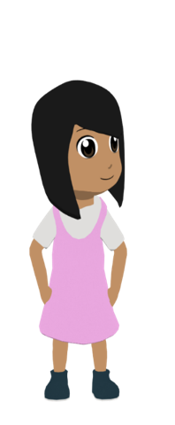
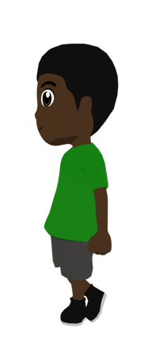
Escribe otra versión del texto. Puedes cambiar las partes subrayadas.
escribir / hablar / escuchar
“Pues, el sábado tú hiciste los deberes por la mañana y yo hice unas llamadas a nuestros tíos. Después, llegó Nadia con Hugo y ella hizo un fuego en el jardín mientras que él hizo un video en el móvil. Luego, tú hiciste deporte en el fondo del jardín y yo hice una lista con Nadia de cosas para comprar en el pueblo. Por la tarde hiciste un viaje al pueblo y yo hice trabajo dentro de la casa con mi madre. Nadia también ayudó. Ella hizo una silla nueva porque hay un problema con la silla vieja. Sin embargo Hugo evitó ayudar. ¡Él solo hizo ruido y nada más!”
Notes:
DISPLAY DURING ACTIVITY
Bold parts are those that students can change.

Slide 34
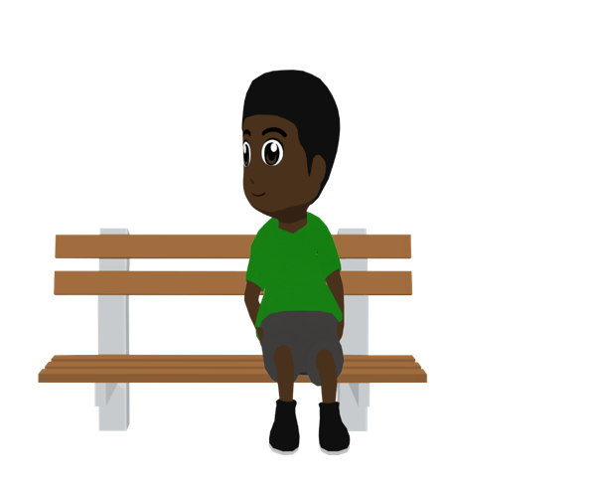
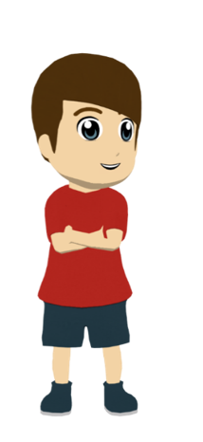
Los amigos hablan del sábado pasado. ¿Puedes decir las frases en español?
hablar
Hugo
(Ella) hizo una lista de cosas para comprar.
5. She made a list of things to buy.
(Yo) hice deporte al fondo del jardín.
1. I did sport at the back of the garden.
6. She made a fire in the garden.
(Ella) hizo un fuego en el jardín.
(Tú) hiciste unas llamadas a nuestros tíos.
2. You made some calls to our uncles.
(Tú) hiciste los deberes en tu habitación.
7. You did the homework in your bedroom.
Lucía
3. I made a new chair.
(Yo) hice una silla nueva.
Daniel
(Él) hizo ruido y nada más.
8. He made noise and nothing else*.
(Él) hizo un vídeo en su móvil.
4. He made a video on his mobile phone.
Nadia
*nada más = nothing else
Notes:
OPTIONAL
Aim: to practise oral production of singular forms of ‘hacer’ in the preterite tense and vocabulary
Procedure:
This could be done as a whole-class activity or in pairs.
If done in pairs, students talk to their partners for two minutes about how they would say the sentences in Spanish.
To keep the focus on oral production, students should be encouraged not to write down the translations.
Answers could then be given in whole-group feedback.
Notes:
Because the sentences here are in isolation, the translations in Spanish leave the use of subject pronouns as optional. However, they would often be used in the context of making comparisons between what different people do, so it is worth pointing out why they could be included.

Slide 35
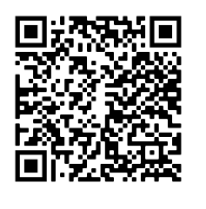
Deberes
Vocabulary Learning Homework (Y8, Term 3.1, Week 6)
Audio file
Audio file QR code:
Student worksheet
Quizlet link
In addition, revisit: Term 3.1 Week 3 Term 2.2 Week 3

