Slide 1
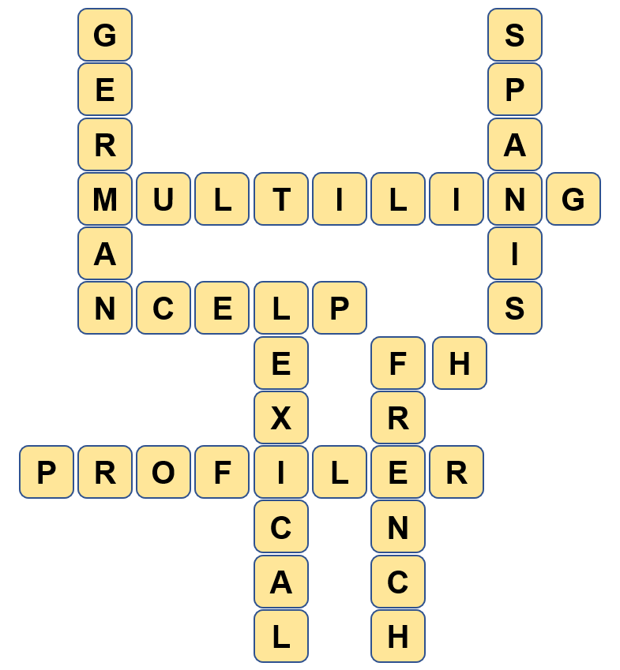
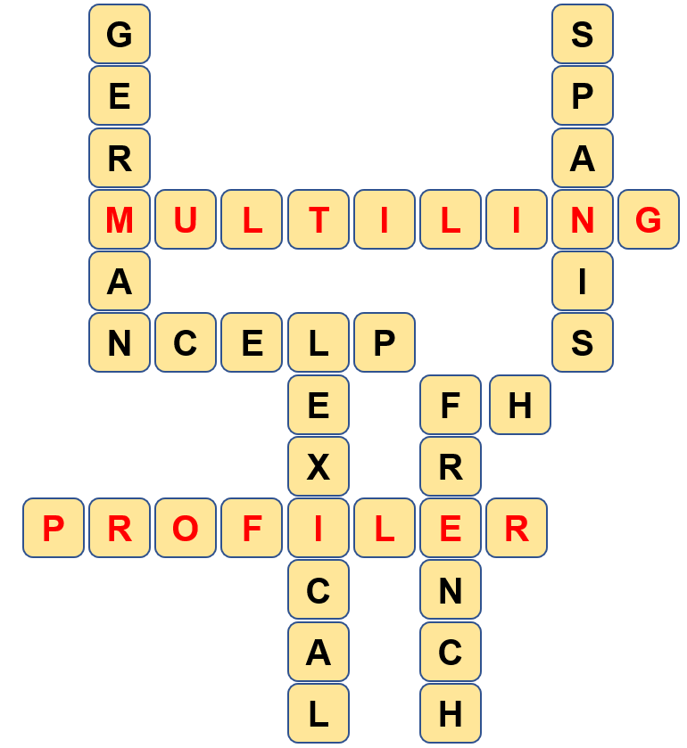

Slide 2
Using the MultiLingProfiler
Louise Bergon
Archbishop Temple School
Preston
Notes:
This is the presentation for CPD 8/TRG 4 of 2020: Revisiting PVG and meaningful practice.

Slide 3
Aims of the session
The core objectives for this session are:
1. To explain what lexical profiling is & how to do it.
2. To introduce teachers to the MultiLingProfiler tool.
3. To demonstrate how to use the tool.
Notes:
This slide lists the core objectives of the session.

Slide 4
What is lexical profiling?
Lexical profiling is the process of analysing words in a text to determine how suitable these are for a specific purpose.
Lexical profiling can be performed manually by reading a text and cross-referencing words in it with frequency values or syllabi by hand.
The process is very time consuming, and the risk of human error is high.
Alternatively, lexical profiling can be carried out with NCELP’s new programme which was created specifically for this the “MultiLingProfiler”.
Lexical profiling in this way is instant and gives accurate results.
Notes:
Lexical profiling is the process of analysing words in a text to determine how suitable these are for a specific purpose.
Lexical profiling can be performed manually by reading a text and cross-referencing words in it with frequency values or syllabi by hand.
The process is very time consuming, and the risk of human error is high.
Alternatively, lexical profiling can be carried out NCELP’s new programme created specifically for this the “MultiLing Profiler”.
Lexical profiling in this way is instant and gives accurate results.

Slide 5
Why do lexical profiling?
The MultiLingProfiler has been specially designed to support anyone following the frequency-led approach to the teaching of French, German or Spanish vocabulary, up to GCSE level.
It will help teachers, test developers and textbook publishers assess the suitability of written texts and listening transcripts for inclusion in their classes, assessments, and publications.
It answers questions like:
What percentage of the words in this text are high-frequency words?
Does this text contain any low-frequency words which I will need to gloss or replace?
How many of the words in this text have students learned so far?
Are there any words and word forms belonging to the top 2000 most frequent word families in a language?
These questions can be answered quickly and accurately using the MultiLing Profiler site.
Notes:
The MultiLing Profiler has been specially designed to support anyone following the frequency-led approach to the teaching of French, German or Spanish vocabulary, up to GCSE level.
It will help teachers, test developers and textbook publishers assess the suitability of written texts and listening transcripts for inclusion in their classes, assessments, and publications.
It answers questions like: What percentage of the words in this text are high-frequency words?
Does this text contain any low-frequency words which I will need to gloss or replace?
How many of the words in this text have students learned so far?
Are there any words and word forms belonging to the top 2000 most frequent word families in a language?
These questions can be answered quickly and accurately using the MultiLing Profiler site.

Slide 6
Why is it a useful tool?
The MultiLingProfiler is programmed to analyse a text and give a % score of the words which lie within and outside the 2000-frequency band.
It is especially useful to those following the NCELP Scheme of Work as it can be used to see which words have and have not been taught in any given week of the syllabus.
The Profiler can be used to inform the adaption of texts as users can edit texts directly in the program by removing, glossing, or replacing highlighted words and replacing them with appropriate alternatives.
Notes:
The MultiLing Profiler is programmed to analyse a text and give a % score of the words which lie within and outside the 2000-frequency band.
It is especially useful to those following the NCELP Scheme of Work as it can be used to see which words have and have not been taught in any given week of the syllabus.
The Profiler can be used to inform the adaption of texts as users can edit texts directly in the program by removing, glossing, or replacing highlighted words and replacing them with appropriate alternatives.

Slide 7
How does the MultiLing Profiler work?
MultiLingProfiler profiles texts using two list types.
1. Word frequency lists. Using lists of the 2,000 most frequently occurring words in a language, the MultiLingProfiler can help assess the suitability of written texts and listening transcripts for students at GCSE level or equivalent. Users can edit texts directly in the program and then check edits for suitability.
2. NCELP weekly lists. Teachers adopting the NCELP scheme of work might be interested to know how suitable a text is for inclusion each week. Using special SOW-compatible wordlists created by NCELP, MultiLingProfiler can perform bespoke lexical profiling for NCELP-led syllabi.
Notes:
MultiLing Profiler profiles texts using two list types. 1. Word frequency lists. Using lists of the 2,000 most frequently occurring words in a language, the MultiLingProfiler can help assess the suitability of written texts and listening transcripts for students at GCSE level or equivalent. Users can edit texts directly in the program by removing, glossing, or replacing highlighted words and checking edits for suitability.
2. NCELP weekly lists. Teachers adopting the NCELP scheme of work might be interested to know how suitable a text is for inclusion each week. Using special SOW-compatible wordlists created by NCELP, MultiLingProfiler can perform bespoke lexical profiling for NCELP-led syllabi.

Slide 8
Profiling using Word Frequency lists
This is what the MultiLingProfiler looks like:
Just select the Language you require from French, German or Spanish and then which list type you want to use.
Once you have pasted your text into the box it will process the vocabulary and cross-reference it with the lists.
Words which don’t appear in the lists will be highlighted in orange and the statistics are shown at the bottom.
Notes:
This is what the MultiLing Profiler looks like: Just select the Language you require from French, German or Spanish and then which list type you want to use.
Once you have pasted your text into the box it will process the vocabulary and cross-reference it with the lists.
Words which don’t appear in the lists will be highlighted in orange and the statistics are shown at the bottom.

Slide 9
Statistics
There are two sets of statistics to view:
1) Statistics for the Word Frequency Lists (Top 2000 words).
2) Statistics for the weekly NCELP SOW Lists*.
* Please bear in mind the weekly lists are updated as and when resources appear on the portal.

Slide 10
GCSE Translation Questions - French
2018 - Foundation Tier
J’apprends l’italien à l’université. Mon frère ne veut pas rester au collège. Il va faire un apprentissage. Je suis allé en Espagne pour pratiquer mon espagnol. Si on parle une autre langue, on peut travailler dans un pays différent.
2018 - Foundation Tier
J’apprends l’italien à l’université. Mon frère ne veut pas rester au collège. Il va faire un apprentissage. Je suis allé en Espagne pour pratiquer mon espagnol. Si on parle une autre langue, on peut travailler dans un pays différent.
Statistics – From the top 2000 most frequent words:

Slide 11
GCSE Translation Questions - French
2018 Higher Tier
Je vais au collège en autobus. J’adore les maths parce que j’aime le prof. Je déteste l’histoire car nous avons trop de devoirs. Hier, j’ai travaillé jusqu’à vingt-deux heures. Je n’ai pas eu le temps de sortir avec mon copain.
2018 Higher Tier
Je vais au collège en autobus. J’adore les maths parce que j’aime le prof. Je déteste l’histoire car nous avons trop de devoirs. Hier, j’ai travaillé jusqu’à vingt-deux heures. Je n’ai pas eu le temps de sortir avec mon copain.
Statistics – From the top 2000 most frequent words:

Slide 12
GCSE Translation Questions - French
2019 - Foundation Tier
Mon collège est assez petit. Les profs sont sympas, sauf le prof d’histoire, car il nous donne trop de travail. J’ai toujours aimé les sciences mais l’anglais est dur. À l’avenir, j’espère devenir médecin. Après mes examens, j’irai à l’université.
Mon collège est assez petit. Les profs sont sympas, sauf le prof d’histoire, car il nous donne trop de travail. J’ai toujours aimé les sciences mais l’anglais est dur. À l’avenir, j’espère devenir médecin. Après mes examens, j’irai à l’université.
Statistics – From the top 2000 most frequent words:

Slide 13
GCSE Translation Questions - French
2019 - Higher Tier
Depuis ma naissance, j’habite une banlieue où il n’y a pas grand-chose à faire. Mes parents viennent de me dire qu’on va trouver une nouvelle maison en centre-ville. Moi, je préférerais rester ici, même si je trouve que c’est trop tranquille. Il n’y a qu’un petit terrain de jeux qu’on a besoin de réparer.
Depuis ma naissance, j’habite une banlieue où il n’y a pas grand-chose à faire. Mes parents viennent de me dire qu’on va trouver une nouvelle maison en centre-ville. Moi, je préférerais rester ici, même si je trouve que c’est trop tranquille. Il n’y a qu’un petit terrain de jeux qu’on a besoin de réparer.
Statistics – From the top 2000 most frequent words:

Slide 14
GCSE Translation Questions - German
2018 – Foundation Tier
Mein bester Freund heißt Stefan. Wir machen viel zusammen. Ich mag ihn, weil er immer sehr freundlich ist. Letzten Samstag sind wir in die Stadt gegangen. Nächsten Dienstag werden wir vielleicht ins Kino gehen, um seinen Geburtstag zu feiern.
Mein bester Freund heißt Stefan. Wir machen viel zusammen. Ich mag ihn, weil er immer sehr freundlich ist. Letzten Samstag sind wir in die Stadt gegangen. Nächsten Dienstag werden wir vielleicht ins Kino gehen, um seinen Geburtstag zu feiern.
Statistics – From the top 2000 most frequent words:

Slide 15
GCSE Translation Questions - German
2018 – Higher Tier
Letzte Woche habe ich in einem neuen deutschen Restaurant meinen sechzehnten Geburtstag gefeiert. Obwohl ich Meeresfrüchte als Hauptgericht bestellt hatte, habe ich leider ein Omelett mit Pommes bekommen. Ich musste sofort mit dem Kellner sprechen, weil ich Eier nicht essen darf. Trotz des Missverständnisses würde ich allen das Restaurant empfehlen.
Letzte Woche habe ich in einem neuen deutschen Restaurant meinen sechzehnten Geburtstag gefeiert. Obwohl ich Meeresfrüchte als Hauptgericht bestellt hatte, habe ich leider ein Omelett mit Pommes bekommen. Ich musste sofort mit dem Kellner sprechen, weil ich Eier nicht essen darf. Trotz des Missverständnisses würde ich allen das Restaurant empfehlen.
Statistics – From the top 2000 most frequent words:

Slide 16
GCSE Translation Questions - German
2019 Foundation Tier
Mein Mann arbeitet in einem Musikgeschäft. Das liegt in der Stadtmitte von Hamburg. Er arbeitet gern dort, weil er viele Instrumente spielt. Gestern hat er eine Trompete verkauft. Nächsten Sonntag ist der Laden geschlossen und er wird zu Hause bleiben.
Mein Mann arbeitet in einem Musikgeschäft. Das liegt in der Stadtmitte von Hamburg. Er arbeitet gern dort, weil er viele Instrumente spielt. Gestern hat er eine Trompete verkauft. Nächsten Sonntag ist der Laden geschlossen und er wird zu Hause bleiben.
Statistics – From the top 2000 most frequent words:

Slide 17
GCSE Translation Questions - German
2019 Higher Tier
Letztes Jahr habe ich mit meiner Familie eine Woche in Süddeutschland verbracht. Um die Gegend zu sehen, haben wir ein Auto gemietet. Obwohl es teuer war, hat es uns sehr gefallen, weil wir schöne Familienausflüge machen konnten. In den Ferien haben wir vor, in den Schwarzwald zu fahren, und wir freuen uns sehr darauf
Letztes Jahr habe ich mit meiner Familie eine Woche in Süddeutschland verbracht. Um die Gegend zu sehen, haben wir ein Auto gemietet. Obwohl es teuer war, hat es uns sehr gefallen, weil wir schöne Familienausflüge machen konnten. In den Ferien haben wir vor, in den Schwarzwald zu fahren, und wir freuen uns sehr darauf
Statistics – From the top 2000 most frequent words:

Slide 18
GCSE Translation Questions - Spanish
2018 Foundation Tier
En mi ciudad hay un festival de música. Es en diciembre, cuando tenemos nuestras fiestas de Navidad. El año pasado vinieron artistas extranjeros. Tocaron diferentes instrumentos y los bailes eran hermosos. ¿Te gustaría venir a verlo el año que viene?
En mi ciudad hay un festival de música. Es en diciembre, cuando tenemos nuestras fiestas de Navidad. El año pasado vinieron artistas extranjeros. Tocaron diferentes instrumentos y los bailes eran hermosos. ¿Te gustaría venir a verlo el año que viene?
Statistics – From the top 2000 most frequent words:

Slide 19
GCSE Translation Questions - Spanish
2018 Higher Tier
Parar el acoso escolar es responsabilidad de todos. Los institutos no deben cerrar los ojos a este problema. Las reglas necesitan ser estrictas y los alumnos deben saber las consecuencias de no seguirlas. Los psicólogos recomiendan que en las clases haya una caja para que los estudiantes puedan poner sus quejas secretas.
Parar el acoso escolar es responsabilidad de todos. Los institutos no deben cerrar los ojos a este problema. Las reglas necesitan ser estrictas y los alumnos deben saber las consecuencias de no seguirlas. Los psicólogos recomiendan que en las clases haya una caja para que los estudiantes puedan poner sus quejas secretas.
Statistics – From the top 2000 most frequent words:

Slide 20
GCSE Translation Questions - Spanish
2019 - Foundation Tier
Hoy llevo una falda negra y una camisa porque voy a ir a una entrevista. Quiero ser voluntaria en el hospital. Estoy libre todos los fines de semana. Tengo experiencia porque he ayudado allí antes. En el futuro quisiera ser enfermera.
Hoy llevo una falda negra y una camisa porque voy a ir a una entrevista. Quiero ser voluntaria en el hospital. Estoy libre todos los fines de semana. Tengo experiencia porque he ayudado allí antes. En el futuro quisiera ser enfermera.
Statistics – From the top 2000 most frequent words:

Slide 21
GCSE Translation Questions - Spanish
2019 - Higher Tier
Estudio español y decidí que necesitaba hablar este idioma fuera de clase. Tuve suerte, ya que conocí a Susana, una chica mexicana interesada en hacer un intercambio español-inglés. Nos reunimos a menudo y me doy cuenta de que cada vez hablamos mejor. Pronto tendremos nuestros exámenes y espero que saquemos buenas notas.
Estudio español y decidí que necesitaba hablar este idioma fuera de clase. Tuve suerte, ya que conocí a Susana, una chica mexicana interesada en hacer un intercambio español-inglés. Nos reunimos a menudo y me doy cuenta de que cada vez hablamos mejor. Pronto tendremos nuestros exámenes y espero que saquemos buenas notas.
Statistics – From the top 2000 most frequent words:

Slide 22
Aims of the session
The core objectives for this session were:
1. To explain what lexical profiling is & how to do it.
2. To introduce teachers to the MultiLingProfiler tool.
3. To demonstrate how to use the tool.
Thank you for listening!
Notes:
This slide lists the core objectives of the session.

Slide 23
References
Anthony, L., Finlayson, N., Marsden, E., Avery, N. & Hawkes, R. (2020). MultiLingProfiler Version 1. [Computer Software]. Available at https://www.multilingprofiler.net/
Davies, M., & Davies, K. (2018). A frequency dictionary of Spanish: Core vocabulary for
learners (2nd ed.). London: Routledge
Jones, R., & Tschirner, L. (2006). A frequency dictionary of German: Core vocabulary for
learners. Oxford: Routledge
Lonsdale, D. & Le Bras. Y. (2009). A frequency dictionary of French: Core vocabulary for
learners. Oxford: Routledge

