Slide 1
Phonics
SSC [au], [eau], [o] [re-visited]
Y7 French
Term 2.1 - Week 3
Natalie Finlayson / Emma Marsden / Rachel Hawkes
Date updated: 10/03/21

Slide 2
au
[au / eau / o]
gauche
Notes:
Source word: gauche [607]
1. Present the letter and say the [au] sound first, on its own. Students repeat it with you. 2. Bring up the word ‘‘gauche” on its own, say it, students repeat it, so that they have the opportunity to focus all of their attention on the connection between the written word and its sound.
3. A possible gesture for this would be to point to the students’ left (teacher’s right!) to indicate this direction. 4. Roll back the animations and work through 1-3 again, but this time, dropping your voice completely to listen carefully to the students saying the [au] sound, pronouncing ‘‘gauche” and, if using, doing the gesture.

Slide 3
au
[au / eau / o]
gauche
Notes:
Source word: gauche [607]
With sound and no pictures to focus all attention on the sound-symbol correspondence.

Slide 4
au
[au / eau / o]
gauche
Notes:
Source word: gauche [607]
Without sound to elicit pronunciation (without first hearing the teacher).
Teacher can elicit pronunciation by asking ‘Comment dit-on ‘left’?’

Slide 5
au
faux
photo
[au / eau / o]
beau
eau
gauche
aussi
[also]
Notes:
Recap individual SSC [au] and then the source word again (with gesture, if using). Then present and elicit the pronunciation of the five cluster words. The cluster words have been chosen for their high-frequency, from a range of word classes, with the SSC (where possible) positioned within a variety of syllables within the words (e.g. initial, 2nd, final etc.). Additionally, we have tried to use words that build cumulatively on previously taught SSCs (see the Phonics Teaching Sequence document) and do not include new SSCs. Where new SSCs are used, they are often consonants which have a similar symbol-sound correspondence in English. Word frequency rankings (1 is the most common word in French): gauche [607]; aussi [44]; faux [555] photo [1412]; beau [393]; eau [475] Source: Londsale, D., & Le Bras, Y. (2009). A Frequency Dictionary of French: Core vocabulary for learners London: Routledge.

Slide 6
au
faux
photo
[au / eau / o]
beau
eau
gauche
aussi
Notes:
With sound and no pictures to focus all attention on the sound-symbol correspondence. Word frequency rankings (1 is the most common word in French): gauche [607]; aussi [44]; faux[555] photo [1412]; beau [393]; eau [475] Source: Londsale, D., & Le Bras, Y. (2009). A Frequency Dictionary of French: Core vocabulary for learners London: Routledge.

Slide 7
au
faux
photo
[au / eau / o]
beau
eau
gauche
aussi
[also]
Notes:
Without sound to elicit pronunciation (without first hearing the teacher).
Teacher can elicit pronunciation by asking Comment dit-on false, water etc.?
Word frequency rankings (1 is the most common word in French): gauche [607]; aussi [44]; faux[555] photo [1412]; beau [393]; eau [475] Source: Londsale, D., & Le Bras, Y. (2009). A Frequency Dictionary of French: Core vocabulary for learners London: Routledge.

Slide 8
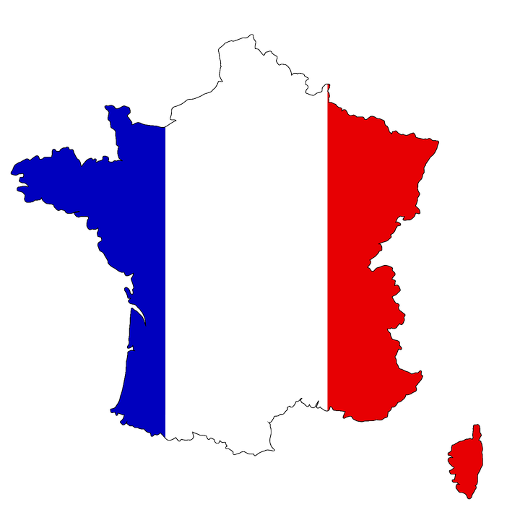
Phonétique
écouter / parler
Do these place names contain the sound [au]? Écoutez et cochez.
 |  | Oui | Non
 | Bordeaux
 | Gren o ble
 | C o rse
 | Beauvais
 | L au sanne
 | O rléans
 | Aix-en-Pr o vence
 | Monaco
1
____
2
____
3
____
4
____
The letter ‘o’ is sometimes (but not always!) pronounced like [au] too.
5
____
6
____
7
____
8
____
Notes:
Timing: 5 minutes
Aim: Oral recognition of SSC [au].
The exercise also provides an opportunity to review SFCs (Bordeaux, Beauvais, Orléans) and the previously studied SSCs [é] (Orléans), [en] (Aix-en-Provence) and [ai] (Beauvais, Aix-en-Provence).
Procedure:
1. The place names are heard on individual number clicks. To allow students to compare the sounds, it is recommended that the teacher cycles through the recordings (from 1-8) at least twice.
2. Teacher reveals answers on clicks. Teacher to highlights the fact that some place names, (Bordeaux, Monaco) contain both sounds, and that the letter ‘o’ is not always pronounced [au] (this will be explored further in Year 8). Teacher can illustrate this by giving examples of previously encountered words such as modèle, école, ordinateur …
3. Teacher elicits pronunciation by pointing at the word and asking ‘Comment dit-on numéro un, deux…’
4. Teacher plays each place name again, and students repeat chorally.
Transcript:
Bordeaux
Grenoble
Corse
Beauvais
Lausanne
Aix-en-Provence
Orléans
Monaco

