Slide 1
Talking about wanting (Festive seasons & relations)
QUERER - quiero/quieres/quiere + noun
SSC [n]/[ñ]
Y7 Spanish
Term 1.2 - Week 7 - Lesson 27
Nick Avery / Rachel Hawkes Artwork: Mark Davies
Date updated: 16/08/21
Notes:
Learning outcomes (lesson 1):
Introduction of SSC [n], [ñ]
Introduction of querer - quiero/quieres/quiere + noun
Consolidation of indefinite articles
Note: this week we introduce two verbs: querer and dar. We practise them both in singular persons in receptive activities, with one production activity at the end of lesson 2. The verbs will be incorporated into more production activities in the first lesson of Term 2.1.
Word frequency (1 is the most frequent word in Spanish):
7.1.2.7 (introduce) dar [42]; doy; das; da; querer [58]; quiero; quieres; quiere; regalo [1986]; padre [162]; madre [226]; hermano [333]; hermana [3409]; dinero [364]; a [8]
7.1.2.4 (revisit) son [ser-7]; pequeño [202]; bueno [98]; malo [368]; famoso [997]; bonito [891]; feo [2373]; rico¹ [398]; caro [2179]; barato [2164]; antiguo [446] ¿cómo es? [cómo-151]
7.1.1.6 (revisit) ¿quién? [289]; hablar [90]; comprar [361]; bailar [1323]; llegar [75]; escuchar [281]; amiga [1172]; música [340]; tarde¹ [392]; temprano [1578]; importante [171]; bien [78]; con [14]; otra vez [59-vez]; pareja¹ [892]
Source: Davies, M. & Davies, K. (2018). A frequency dictionary of Spanish: Core vocabulary for learners (2nd ed.). Routledge: London

Slide 2
ñ
español
Notes:
Introduce and elicit the pronunciation of the individual SSC ‘ñ’ and then present and practise the pronunciation of the source word ‘español’.
A possible gesture for this source word would be to raise the right hand high above the head, and lower the left, putting middle finger and thumb together to simulate a ‘flamenco’ dance posture. Reverse the position of the hands (left hand up / right hand down) on the <ñ> syllable.

Slide 3
ñ
español
Notes:
Repeat the sound and elicit the source word.

Slide 4
ñ
español
Notes:
Repeat the sound and elicit the source word.

Slide 5
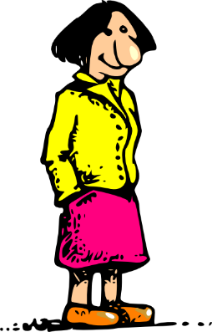
ñ
año
montaña
2019
señora
niña
español
mañana
[morning; tomorrow]
Notes:
Introduce and elicit the pronunciation of the individual SSC ‘ñ’ and then the source word again (with gesture, if using). Then present and elicit the pronunciation of the five cluster words.
The cluster words have been chosen for their high-frequency, from a range of word classes, with the SSC (where possible) positioned within a variety of syllables within the words (e.g. initial, 2nd, final etc.). Additionally, we have tried to use words that build cumulatively on previously taught SSCs (see the Phonics Teaching Sequence document) and do not include new SSCs. Where new SSCs are used, they are often consonants which have a similar symbol-sound correspondence in English.

Slide 6
ñ
año
montaña
señora
niña
español
mañana
Notes:
Without the images, students focus this time again closely on the SSC and the cluster words.

Slide 7
ñ
año
montaña
señora
niña
español
mañana
Notes:
Without the images or sound, students have to pronounce the words themselves.

Slide 8
n
mano
Notes:
Introduce and elicit the pronunciation of the individual SSC ‘n’ and then present and practise the pronunciation of the source word ‘mano’.
A possible gesture for this source word would be to open the palm of both your hands, one after the other on each syllable, ma-no.

Slide 9
n
mano
Notes:
Repeat the sound and elicit the source word.

Slide 10
n
mano
Notes:
Repeat the sound and elicit the source word.

Slide 11
n
noche
poner
mano
nada
nosotros
tener
[to have]
Notes:
Introduce and elicit the pronunciation of the individual SSC ‘n’ and then the source word again (with gesture, if using). Then present and elicit the pronunciation of the five cluster words.
The cluster words have been chosen for their high-frequency, from a range of word classes, with the SSC (where possible) positioned within a variety of syllables within the words (e.g. initial, 2nd, final etc.). Additionally, we have tried to use words that build cumulatively on previously taught SSCs (see the Phonics Teaching Sequence document) and do not include new SSCs. Where new SSCs are used, they are often consonants which have a similar symbol-sound correspondence in English.

Slide 12
n
noche
poner
mano
nada
nosotros
tener
Notes:
Without the images, students focus this time again closely on the SSC and the cluster words.

Slide 13
n
noche
poner
mano
nada
nosotros
tener
Notes:
Without the images or sound, students have to pronounce the words themselves.

Slide 14
escuchar / escribir
Escucha. ¿Es ‘n’ o ‘ñ’?
n
ñ
Escucha otra vez. Escribe la palabra en español.
1
planta
2
pequeño
3
mano
4
español
5
señora
6
poner
7
nosotros
8
año
9
pregunta
10
tener
Notes:
Phonics practice activity
Timing: 5 minutes
Aim: to practise mapping the sound of [n] and [ñ] to their spelling
Procedure:
Students write 1-10. They first listen out and write ‘n’ or ‘ñ’, depending on what they hear.
They then listen again and write the whole word. Higher-achieving groups may be able to write the whole word the first time they listen.
Notes: 1. Pregunta’ and ‘planta’ (taught in T1.1, week 5) were recently revisited on Quizlet for homework.
Transcript:
Planta
Pequeño
Mano
Español
Señora
Poner
Nosotros
Año
Pregunta
Tener
Word frequency (1 is the most frequent word in Spanish): mano [135]; tener [19]; nosotros [165]; planta [768]; poner [91]; pregunta [507]; español [262]; año [46]; señora [509]; pequeño [202]
Source: Davies, M. & Davies, K. (2018). A frequency dictionary of Spanish: Core vocabulary for learners (2nd ed.). Routledge: London

Slide 15
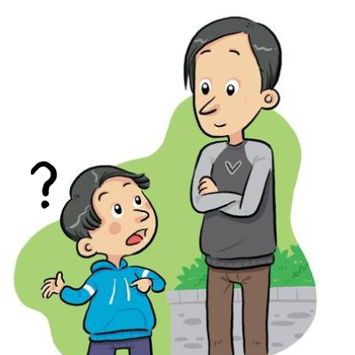
leer
Identifica la imagen y escribe la letra correcta.
2019
planta
E
A
B
C
pequeño
F
[to put]
mano
H
español
I
D
E
F
G
señora
D
[to have]
poner
C
nosotros
J
H
I
J
año
A
pregunta
B
tener
G
Notes:
OPTIONAL
Having focused on the sound-spelling correspondence(s), students now focus on the meaning of the words used for practice.
They will already have written these in their books, so can simply write the letter next to the word, as above.
Elicit the letter in Spanish to practise letters of the alphabet.
Word frequency (1 is the most frequent word in Spanish): mano [135]; tener [19]; nosotros [165]; planta [768]; poner [91]; pregunta [507]; español [262]; año [46]; señora [509]; pequeño [202]
Source: Davies, M. & Davies, K. (2018). A frequency dictionary of Spanish: Core vocabulary for learners (2nd ed.). Routledge: London

Slide 16
Vocabulario
hablar
60
 | Español | Inglés
1 | querer | to want, wanting
2 | quiero | I want
3 | quieres | you want
4 | quiere | s/he wants, it wants
5 | el regalo | present
6 | el padre | father
7 | la madre | mother
8 | el hermano | brother
9 | la hermana | sister
10 | el dinero | money
11 | a | to
Segundos
0
INICIO
Notes:
Vocabulary practice slide Pupils either work by themselves or in pairs, reading out the words and recapping their English meaning (1 minute). Then the English meanings are removed and they try to recall them, looking at the Spanish (1 minute). Then the Spanish meanings are removed and they to recall them, looking at the English (1 minute) Further rounds of learning can be facilitated by one pupil turning away from the board, and his/her partner asking him/her the meanings. This activity can work from L2 → L1 or L1 → L2.
Word frequency (1 is the most frequent word in Spanish): querer [58]; quiero; quieres; quiere; regalo [1986]; padre [162]; madre [226]; hermano [333]; hermana [3409]; dinero [364]; a [8]
NB Lesson 2 will present dar [42]; doy; das; da
Source: Davies, M. & Davies, K. (2018). A frequency dictionary of Spanish: Core vocabulary for learners (2nd ed.). Routledge: London

Slide 17
querer
[to want| wanting]
quiere
[wants | s/he wants]
Notes:
Timing: 3 minutes for sequence of six slides
Aim: to introduce the verb ‘querer’ more explicitly. Querer is one of the 25 most frequently used verbs in Spanish. All 25 most frequent verbs will be introduced early on using the same format. Both long form (infinitive) and short form (3rd person singular) are introduced in order to familiarise students with various forms of the same verb.
Procedure
Bring up the word ‘querer’ on its own, say it, students repeat it, and remind them of the phonics. Draw attention to ‘que’.
Try to elicit the meaning from the students.
Bring up the picture, and, if using gestures, a possible gesture would be to outstretch your arm and grasp your fingers.
Then bring up the English translations. Emphasise the two meanings for the infinitive.
Bring up the short form ‘quiere’, say it, students repeat it. Draw attention to ‘que’.
Try to elicit the meaning from the students. Emphasise the two meanings for the short form.

Slide 18
querer
[to want| wanting]
quiere
[wants | s/he wants]
Notes:
Cycle through the long and short form again.

Slide 19
quiere
[wants]
Emilia quiere una casa.
[Emilia wants a house.]
Notes:
Introduce the short form in a sentence.

Slide 20
querer
[to want| wanting]
Querer una casa es normal.
[Wanting a house is normal.]
Notes:
Introduce the long form in a sentence.

Slide 21
quiere
[wants]
Emilia ______ una casa.
quiere
[Emilia wants a house.]
Notes:
Cycle through the short form in context again.

Slide 22
querer
[to want| wanting]
______ una casa es normal.
Querer
[Wanting a house is normal.]
Notes:
Cycle through the long form in context again.

Slide 23
leer
Oh no! Someone put your Spanish homework through the shredder.
¿Qué significa?
Marca la opción correcta.
‘to want’, ‘wanting’ (the action in general) | someone wants
¿Qué cosa? (en inglés)
1
querer un amigo
a (male) friend
2
quiere un teléfono
a phone
3
quiere una revista en español
a magazine in Spanish
4
querer un caballo
a horse
5
quiere una botella de Pepsi
a bottle of Pepsi
6
querer una tarea
a task
7
quiere dinero
money
8
querer un periódico
a newspaper
Notes:
Reading activity
Timing: 6 minutes
Aim: to understand the difference in meaning between ‘quiere’ and ‘querer’; to consolidate understanding of the nouns (taught in 1.1.5)
Procedure:
Students write 1-8.
They read the Spanish sentences. For each one, they write the answer (or tick it, if they have copied the column headers at the top).
3. They also translate the nouns into Spanish.
Notes: This is the first time that students following the SoW have encountered ‘¿Qué significa?’ so ensure that the meaning is clear
Word frequency (1 is the most frequent word in Spanish): querer [58]; quiere; dinero [364]; amigo [210]; periódico [1026]; caballo [907]; teléfono [866]; botella [1878]; revista [920]; tarea [995]; español¹ [262]
Source: Davies, M. & Davies, K. (2018). A frequency dictionary of Spanish: Core vocabulary for learners (2nd ed.). Routledge: London

Slide 24
leer / escribir
You find six more pieces in the shredder!
Escribe seis frases completas en español.
Usa una frase de ‘A’ y una frase de ‘B’.
B
querer una tarea
A
es importante
mi hermana
querer un caballo
es normal
es raro
quiere una botella de Pepsi
mi hermano
mi padre
quiere un teléfono
querer un periódico
Escribe las frases en inglés.
Un ejemplo:
quiere una revista
“It’s strange to want a cat.”
Notes:
OPTIONAL Sentence matching task
Timing: 7 minutes
Aim: to understand the difference between ‘quiere’ and ‘querer’; to consolidate understanding of vocabulary
Procedure:
Students read the 12 sentence fragments (those in box ‘B’ were on the previous slide).
The fragments can be combined to make 6 sentences. A number of combinations are grammatically possible. Students have to make sure that they use a sentence starter that is compatible with ‘querer’ or ‘quiere’.
Encourage students to think about the meaning of the sentences (the translation into English will facilitate this).
They will come up with different sentence combinations, so when checking the answers, ask which seem most and least likely.
Word frequency (1 is the most frequent word in Spanish): querer [58]; quiere; periódico [1026]; caballo [907]; teléfono [866]; botella [1878]; revista [920]; tarea [995]; padre [162]; hermano [333]; hermana [3409]; importante [171]; raro¹ [1005]; importante [171]
Source: Davies, M. & Davies, K. (2018). A frequency dictionary of Spanish: Core vocabulary for learners (2nd ed.). Routledge: London

Slide 25
quiero
[I want]
Notes:
Before the next activity, briefly run through the 1st person singular.

Slide 26
quiero
[I want]
Quiero un bolígrafo.
[I want a pen.]
Notes:
Introduce the 1st person singular in a sentence.

Slide 27
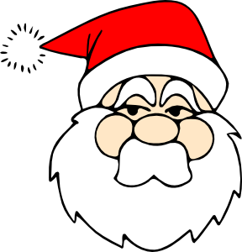
leer
¡Estás con Papá Noel! You’re telling him what you want for Christmas.
You also tell him what your sister wants.
Completa la tabla en inglés.
Yo (“I want”)
Mi hermana (“she wants”)
“Quiero una película y quiere un teléfono.”
“Quiere una camisa y unos zapatos.”
“Quiero unas flores y una planta.”
“Quiere dinero.”
“Quiero un gato y quiere un caballo.”
“Quiero diez regalos.”
a film
a phone
some flowers
a shirt
a plant
some shoes
a cat
money
ten presents
a horse
Notes:
Reading activity
Timing: 7 minutes
Aim: to understand the difference between ‘quiero’ and ‘quiere’
Procedure:
1. Students write 1-5 and two columns in their books: ‘I want’ and ‘she wants’
2. They complete the table, writing the nouns in English in the correct column.
Notes: ‘Mi’ hasn’t yet been taught in the NCELP Y7 Spanish, so make sure that the meaning of this word is clear (it can be mistakenly understood to be the English ‘me’).
Word frequency (1 is the most frequent word in Spanish): querer [58]; quiero, quiere; caballo [907]; teléfono [866]; planta [768]; camisa [1873]; película [543]; flor [739]; zapato [1477]; regalo [1986]; dinero [364]; gato [1728]
Source: Davies, M. & Davies, K. (2018). A frequency dictionary of Spanish: Core vocabulary for learners (2nd ed.). Routledge: London

Slide 28
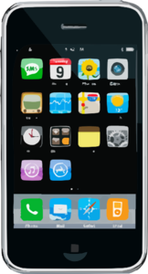
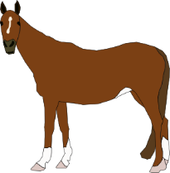
escuchar
You also tell Papá Noel what your Dad wants.
Escucha.
¿Es ‘quiero’ o ‘quiere’?
¿Es ‘A’ o ‘B’?
Yo (I want)
Mi padre (he wants)
A
B
1
2
3
4
5
Notes:
Listening [1/2]
Timing: 8 minutes
Aim: to understand the difference between ‘quiero’ and ‘quiere’ in listening
Procedure:
Students copy the grid into their books.
They listen and tick ‘I want’ or ‘he wants’.
They listen again and write ‘A’ or ‘B’ depending on whether they hear a singular or plural noun.
Continue to items 6-10 on next slide.
Notes: Mi’ hasn’t yet been taught in the NCELP Y7 Spanish, so make sure that the meaning of this word is clear (it can be mistakenly understood to be the English ‘me’).
Transcript:
Quiero un periódico.
Quiero una revista.
Quiere unos teléfonos.
Quiero un caballo.
Quiere unas plantas.
Word frequency (1 is the most frequent word in Spanish): querer [58]; quiero, quiere; periódico [1026]; caballo [907]; teléfono [866]; revista [920]; planta [768]
Source: Davies, M. & Davies, K. (2018). A frequency dictionary of Spanish: Core vocabulary for learners (2nd ed.). Routledge: London

Slide 29
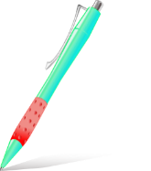
escuchar
You also tell Papá Noel what your Dad wants.
Escucha.
¿Es ‘quiero’ o ‘quiere’?
¿Es ‘A’ o ‘B’?
Yo (I want)
Mi padre (he wants)
A
B
6
7
8
9
10
Notes:
Listening [2/2]
Transcript:
6. Quiere una moneda.
7. Quiero un libro.
8. Quiere una camisa.
9. Quiere un vaso.
10. Quiero unos bolígrafos.
Word frequency (1 is the most frequent word in Spanish): querer [58]; quiero, quiere; moneda [1577]; camisa [1873]; vaso [1609]; bolígrafo [>5000]; libro [230]
Source: Davies, M. & Davies, K. (2018). A frequency dictionary of Spanish: Core vocabulary for learners (2nd ed.). Routledge: London

Slide 30
quieres
[you want]
Notes:
Briefly present the 2nd person singular form of querer.

Slide 31
quieres
[you want]
Quieres una silla.
[You want a chair.]
Notes:
Introduce the 2nd person singular in a sentence.

Slide 32
leer
Your Mum is the director of a town planning project.
You compare what you want and what she wants.
Marca la opción correcta.
Yo (‘I want’)
La directora (‘you want’)
1. “Quiero once museos.”
2. “Quieres nueve iglesias.”
3. “Quieres cinco escuelas.”
4. “Quiero ocho tiendas.”
5. “Quiero seis mercados.”
6. “Quieres tres bancos.”
7. “Quiero dos plazas.”
8. “Quieres siete teatros.”
9. “Quieres diez monumentos.”
10. “Quiero cuatro bares.”
Notes:
Reading
Timing: 5 minutes
Aim: to understand the difference in form and meaning between the 1st and 2nd person singular of ‘querer’.
Procedure:
1. Students write 1-10.
2. For each item, they write ‘I want’ or ‘you want’.
Notes: The vocabulary included here is largely from 1.2.5, which was taught 2 weeks earlier. ‘Monumento’ and ‘bar’ are not in the SoW but are cognates.
Word frequency (1 is the most frequent word in Spanish): dos [64]; tres [134]; cuatro [241]; cinco [284]; seis [438]; siete [603]; ocho [641]; nueve [991]; diez [449]; once [1700]; museo [1114]; banco [728]; teatro [605]; mercado [487]; tienda [1515]; plaza [806]; iglesia [437]; escuela [424]; monumento [3149]; bar [1938]
Source: Davies, M. & Davies, K. (2018). A frequency dictionary of Spanish: Core vocabulary for learners (2nd ed.). Routledge: London

Slide 33
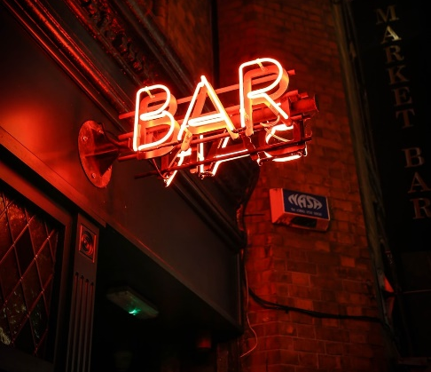
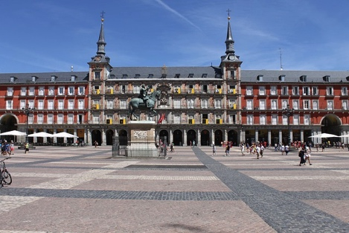
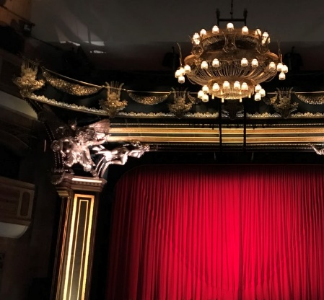
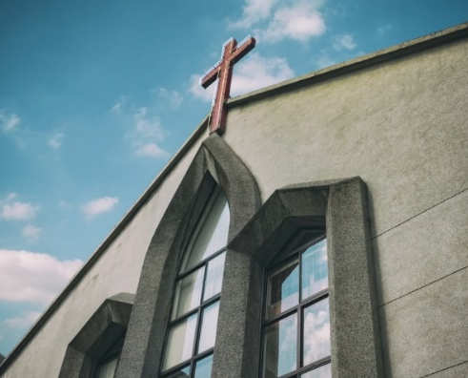
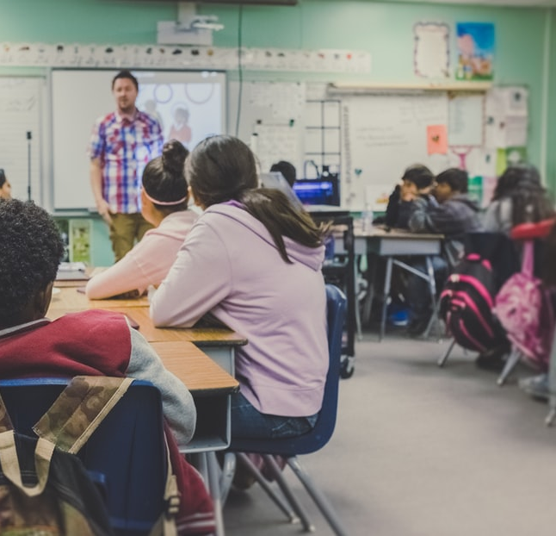
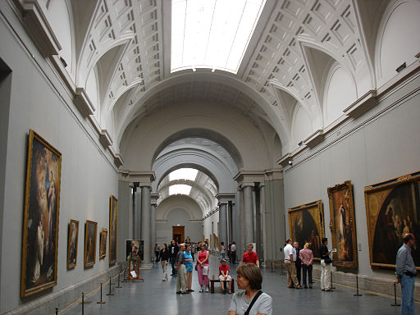
Lee las frases otra vez.
A
B
C
D
leer
Escribe la letra de la imagen.
How many are mentioned?
Escribe el número en inglés.
1. “Quiero once museos.”
I
11
E
F
G
2. “Quieres nueve iglesias.”
F
9
3. “Quieres cinco escuelas.”
H
5
4. “Quiero ocho tiendas.”
E
8
5. “Quiero seis mercados.”
C
6
J
H
I
6. “Quieres tres bancos.”
G
3
7. “Quiero dos plazas.”
B
2
8. “Quieres siete teatros.”
D
7
9. “Quieres diez monumentos.”
J
10
10. “Quiero cuatro bares.”
A
4
Notes:
Timing: 5 minutes
Aim: to consolidate understanding of the vocabulary items (including numbers)
Procedure:
1. Students look again at the sentences that they read in the previous activity, but they now need to think about the meaning of the nouns and numbers.
2. Students will already have numbers of the sentences 1-10 written in their books from the previous activity.
3. For each one, they now write down the letter of the picture which depicts the noun. For example, sentence 1 mentions ‘museos’, which is picture I, so students write that letter.
4. Then, they write down the number mentioned (in this case 11).
5. Answers appear in the order of the Spanish sentences.
Note: All pictures from www.unsplash.com (free to use)
Word frequency (1 is the most frequent word in Spanish): dos [64]; tres [134]; cuatro [241]; cinco [284]; seis [438]; siete [603]; ocho [641]; nueve [991]; diez [449]; once [1700]; museo [1114]; banco [728]; teatro [605]; mercado [487]; tienda [1515]; plaza [806]; iglesia [437]; escuela [424]; monumento [3149]; bar [1938]
Source: Davies, M. & Davies, K. (2018). A frequency dictionary of Spanish: Core vocabulary for learners (2nd ed.). Routledge: London

Slide 34
escribir
¿Cómo se dice en español?
1. Quiero tres museos.
I want three museums.
2. Quieres ocho mercados.
You want eight markets.
3. Quiero nueve escuelas.
I want nine schools.
4. Quieres diez tiendas.
You want ten shops.
5. Quiero cuatro plazas.
I want four squares.
Notes:
OPTIONAL EXTENSION SLIDE
This could also be given as homework between lesson 1 and 2.
Students can opt to produce the sentences in any order. The shapes are triggered to reveal the English translation when the shape itself is clicked

Slide 35
Giving and wanting (Festive seasons & relations)
DAR - doy/das/da + noun
SSCs [n], [ñ] (cont.)
Y7 Spanish
Term 1.2 - Week 7 - Lesson 28
Nick Avery / Rachel Hawkes Artwork: Mark Davies
Date updated: 16/08/21
Notes:
Learning outcomes (lesson 2):
Introduction of DAR - doy/das/da + noun
Consolidation of querer - quiero/quieres/quiere + noun
Consolidation of indefinite article (un/a/os/as)
Consolidation of SSC [n], [ñ]
Word frequency (1 is the most frequent word in Spanish):
7.1.2.7 (introduce) dar [42]; doy; das; da; querer [58]; quiero; quieres; quiere; regalo [1986]; padre [162]; madre [226]; hermano [333]; hermana [3409]; dinero [364]; a [8]
7.1.2.4 (revisit) son [ser-7]; pequeño [202]; bueno [98]; malo [368]; famoso [997]; bonito [891]; feo [2373]; rico¹ [398]; caro [2179]; barato [2164]; antiguo [446] ¿cómo es? [cómo-151]
7.1.1.6 (revisit) ¿quién? [289]; hablar [90]; comprar [361]; bailar [1323]; llegar [75]; escuchar [281]; amiga [1172]; música [340]; tarde¹ [392]; temprano [1578]; importante [171]; bien [78]; con [14]; otra vez [59-vez]; pareja¹ [892]
Source: Davies, M. & Davies, K. (2018). A frequency dictionary of Spanish: Core vocabulary for learners (2nd ed.). Routledge: London

Slide 36
¿Cómo se dice en español…?
La persona, el regalo o los dos?
famous
f______
famoso
Notes:
Vocabulary revision
Timing: 5 minutes (slides 30-43)
Aim: to recall the Spanish words by looking at the English prompts; to reflect on their meanings
Procedure:
Students supply the Spanish word (orally or in writing, e.g., after using mini-whiteboards)
For slides 30-36, students can consider whether the adjectives (i.e. their meanings) normally refer to a person, present or could refer to both.
Words revisited in this activity:
famoso [997]; feo [2373]; rico [398]; caro [2179]; barato [2164]; antiguo [446] ¿cómo es? [cómo - 151]
¿quién? [289]; comprar [361]; llegar [75]; tarde (adj.) [392]; temprano [1578]; bien [78]; con [14]

Slide 37
¿Cómo se dice en español…?
La persona, el regalo o los dos?
ugly
feo
f__

Slide 38
¿Cómo se dice en español…?
La persona, el regalo o los dos?
rich
r___
rico

Slide 39
¿Cómo se dice en español…?
La persona, el regalo o los dos?
expensive
caro
c___

Slide 40
¿Cómo se dice en español…?
La persona, el regalo o los dos?
cheap
barato
b_____

Slide 41
¿Cómo se dice en español…?
La persona, el regalo o los dos?
old
a______
antiguo

Slide 42
¿Cómo se dice en español…?
La persona, el regalo o los dos?
What’s s/he like?
What’s it like?
¿C____ ___
¿Cómo es?

Slide 43
¿Cómo se dice en español…?
Who?
¿Q______
¿Quién?

Slide 44
¿Cómo se dice en español…?
to buy, buying
comprar
c____

Slide 45
¿Cómo se dice en español…?
to arrive, arriving
l______
llegar

Slide 46
¿Cómo se dice en español…?
late
t_______
tarde

Slide 47
¿Cómo se dice en español…?
early
t_______
temprano

Slide 48
¿Cómo se dice en español…?
well
bien
b____

Slide 49
¿Cómo se dice en español…?
with
c____
con

Slide 50
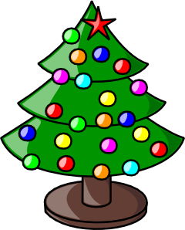
Fonética
escuchar / escribir
Navidad en mi casa
ñ
Hola, soy Daniel. Es la ma__ana de Navidad, y estoy con mi herma__a, Camila. Mi herma__o, Martín, está aquí también. Mi padre hoy tiene trabajo, pero mi madre está con nosotros. Está super alegre. Canta con mi ni__a en espa__ol ¡y en inglés!
La casa está muy bo__ita porque mi madre po__e luces en las ventanas. Hay muchos regalos también. Unos son gra__des; otros son peque__os. Martín está impaciente. ¡Quiere un regalo!
n
n
ñ
ñ
n
n
n
ñ
Notes:
This text can be exploited for phonics, vocabulary and grammar:
Phonics: Students listen and complete the gaps in the words with ‘n’ or ‘ñ’ (practising the phonics SSCs taught this week). The text could be adapted so that higher-achieving groups have to write the whole of a missing word, rather than just the letter.
Vocabulary: Students are asked to translate the five nouns taught this week: hermano, hermana, madre, padre, regalo. The teacher could also challenge students to also translate the phonics practice words (luces, porque, nosotros).
Grammar: Ask students what ‘quiere un regalo’ means (NB ‘he wants’ in the context of this text, but can also be ‘she wants’). Then ask them how you would say ‘I want a present’ or ‘You want a present’ to revise the singular person forms of querer from last lesson.
Notes:
1. Mi’ hasn’t yet been taught in the NCELP Y7 Spanish, so make sure that the meaning of this word is clear (it can be mistakenly understood to be the English ‘me’).
2. A number of words that students have just revisited for homework are included here: ‘también’, ‘tarea’, ‘bonita’, ‘pequeño’, ‘son’.
3. ‘Impaciente’ hasn’t yet been taught but is a near-cognate.
Transcript:
Hola, soy Daniel. Es la mañana de Navidad, y estoy con mi hermana, Camila. Mi hermano, Martín, está aquí también. Mi padre hoy tiene trabajo, pero mi madre está con nosotros. Está super alegre. Canta con mi niña en español ¡y en inglés!
La casa está muy bonita porque mi madre pone luces en las ventanas. Hay muchos regalos también. Unos son grandes; otros son pequeños. Martín está impaciente. ¡Quiere un regalo!
Word frequency (1 is the most frequent word in Spanish): español [262]; año [46]; señora [509]; mañana [799]; niña [622}
Source: Davies, M. & Davies, K. (2018). A frequency dictionary of Spanish: Core vocabulary for learners (2nd ed.). Routledge: London

Slide 51
dar
[to give | giving]
da
[gives | s/he gives]
Notes:
Timing: 3 minutes for sequence of six slides
Aim: to introduce the verb ‘dar’ more explicitly. ‘Dar’ is one of the 25 most frequently used verbs in Spanish. All 25 most frequent verbs will be introduced early on using the same format. Both long form (infinitive) and short form (3rd person singular) are introduced in order to familiarise students with various forms of the same verb.
Procedure
Bring up the word [dar] on its own, say it, students repeat it, and remind them of the phonics. Draw attention to [a].
Try to elicit the meaning from the students.
Bring up the picture, and, if using gestures, a possible gesture would be [to mime passing something to someone].
Then bring up the English translations. Emphasise the two meanings for the infinitive.
Bring up the short form [da], say it, students repeat it. Draw attention to [a].
Try to elicit the meaning from the students. Emphasise the two meanings for the short form.

Slide 52
dar
[to give | giving]
da
[gives | s/he gives]
Notes:
Cycle through the long and short form again.

Slide 53
da
[gives]
Da mucho a un amigo.
[S/he gives a lot to a friend.]
Notes:
Introduce the short form in a sentence.

Slide 54
dar
[to give | giving]
Dar mucho es bueno.
[Giving a lot is good.]
Notes:
Introduce the long form in a sentence.

Slide 55
da
[gives]
Da
___ mucho a un amigo.
[S/he gives a lot to a friend.]
Notes:
Cycle through the short form in context again.

Slide 56
dar
[to give | giving]
____ mucho es bueno.
Dar
[Giving a lot is good.]
Notes:
Cycle through the long form in context again.

Slide 57
leer
These sentences are from an article about what to give at Christmas.
Lee. Completa la frase con la opción correcta.
…un libro es una buena idea.
1
Dar
…un libro.
…dinero a un amigo no es necesario.
Da
2
…dinero a un amigo.
…una película a un amigo.
3
Dar
…una película es una mala idea.
…tres regalos es normal.
4
Dar
…tres regalos.
…una revista.
5
Da
…una revista es importante.
Notes:
Reading - sentence completion [1/2]
Timing: 7 minutes (slides 51-52)
Aim: to understand the difference between ‘dar’ and ‘da’
Procedure:
Students are provided with ‘dar’ or ‘da’ and have to finish the sentence with the correct ending.
Sentences beginning with ‘dar’ make a verb phrase, e.g. ‘giving a book’, ‘giving three presents’ which then needs a complement (e.g. is a good idea, is normal).
Word frequency (1 is the most frequent word in Spanish): dar [42]; doy; das; da; regalo [1986]; dinero [364]; a [8]; película [543]; libro [230]; revista [920]
Source: Davies, M. & Davies, K. (2018). A frequency dictionary of Spanish: Core vocabulary for learners (2nd ed.). Routledge: London

Slide 58
leer
…arte a un amigo es una buena idea.
Navidad
6
Da
…arte a un amigo.
…mucho.
Da
7
…mucho no es necesario.
…vasos.
8
Dar
…vasos es una opción.
…flores es romántico.
9
Da
…flores.
…una moneda a un amigo no es mucho.
10
Dar
…una moneda a un amigo.
Notes:
Reading - sentence completion [2/2]
Word frequency (1 is the most frequent word in Spanish): arte [208]; amigo [210]; idea [247]; vaso [1609]; opción [1175]; flor [739]; moneda [1577]
Source: Davies, M. & Davies, K. (2018). A frequency dictionary of Spanish: Core vocabulary for learners (2nd ed.). Routledge: London

Slide 59
¿Cómo se dice en inglés?
1. Giving a lot isn’t necessary.
Dar mucho no es necesario.
2. S/he gives money to a friend.
Da dinero a un amigo.
3. Giving flowers is romantic.
Dar flores es romántico.
4. S/he gives some magazines.
Da unas revistas.
5. Giving a book to a friend is a good idea.
Dar un libro a un amigo es una buena idea.
Notes:
OPTIONAL
Students can opt to produce the sentences in any order. The shapes are triggered to reveal the English translation when the shape itself is clicked.

Slide 60
doy
[I give]
Notes:
This is a brief run-through of the 1st person singular.

Slide 61
doy
[I give]
Doy dinero a Daniel.
[I give money to Daniel.]
Notes:
Introduce ‘doy’ in a sentence.

Slide 62
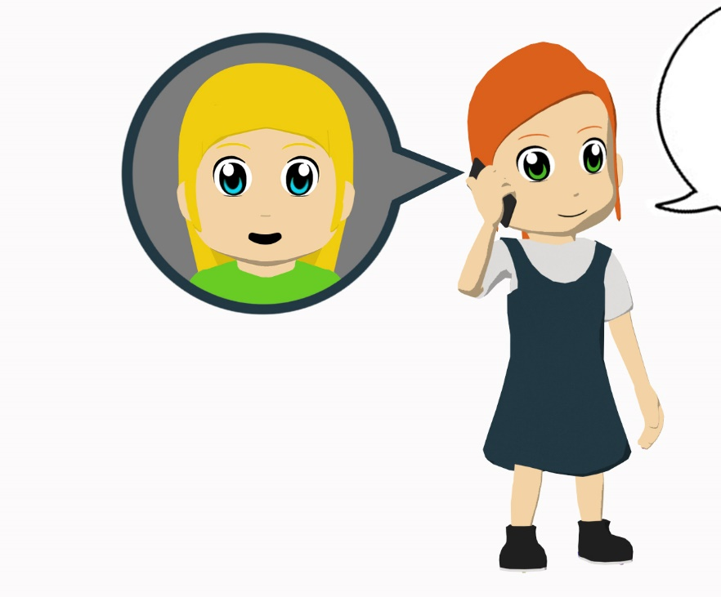
leer
Lucía is telling a friend what presents she gives to people for Christmas.
She also says what her brother gives.
Da una bicicleta a mi madre.
Doy unos bolígrafos a mi hermana.
Doy dinero a mi padre.
Da unas camisas a mi hermano.
Doy una camisa a un amigo.
Da una revista de música a un amigo.
Doy un libro a mi profesor de inglés.
Da productos de España a una chica.
Lee y completa la tabla en español.
Amanda (‘I give’)
El hermano (‘he gives’)
Who receives…
unos bolígrafos
una bicicleta
the bike?
mother
dinero
unas monedas
the pens?
sister
una camisas
una revista de música
the money?
father
un libro
unos productos de España
the shirts?
brother
Notes:
Reading activity
Timing: 8 minutes
Aim: to recognise the difference between the verbs ‘doy’ and ‘da’ and their meanings
Procedure:
1. Students copy the blank grid on the LHS into their books.
2. They read the sentences in the speech bubble and complete it with the information in English.
3. They then answer the questions on the RHS, which prompt them to think about the meaning of the vocabulary items for family members
Notes:
1. The ‘who receives’ table requires students to pay attention to the meaning of the nouns taught this week and others that are revisited.
2. Mi’ hasn’t yet been taught in NCELP Y7 Spanish SoW, so make sure that the meaning of this word is clear (it can be mistakenly understood to be the English ‘me’).
Transcript:
Word frequency (1 is the most frequent word in Spanish): dar [42]; doy; da; padre [162]; madre [226]; hermano [333]; hermana [3409]; dinero [364]; a [8]; bolígrafo [>5000]; moneda [1577]; bicicleta [3684]; libro [230]; revista [920]; producto [394]; camisa [1873];
Source: Davies, M. & Davies, K. (2018). A frequency dictionary of Spanish: Core vocabulary for learners (2nd ed.). Routledge: London

Slide 63
das
[you give]
Notes:
This is a brief run-through of the 2nd person singular.

Slide 64
das
[You give]
Das unos regalos.
[You give some presents.]
Notes:
Introduce ‘das’ in a sentence.

Slide 65
escuchar
Escucha. Es ‘doy’ o ‘das’?
Escucha otra vez. Escribe el artículo.
¡Inventa el regalo! Completa la frase.
Make sure the noun agrees in gender and number with the article (‘un’, ‘una’ etc.).
‘I give’
‘You give’
un/una/unos/unas
1
una
2
unos
3
unas
Un ejemplo: ‘mesa’
(Es feminino y singular.)
4
un
Un ejemplo: ‘zapatos’
(Es masculino y plural.)
5
unos
6
una
7
un
8
unos
Notes:
Listening activity
Timing: 7 minutes
Aim: to practise distinguishing between the meanings of ‘doy’ and ‘das’; to revisit indefinite articles
Procedure:
1. Students first listen to see if they can hear ‘doy’ or ‘das’.
2. They then listen again and write down the indefinite article that they hear. [Note: some classes may complete both steps in one listening.]
3. Finally, they think of a noun to complete the sentence. Encourage students to pay attention to the preceding article here, which determines the gender and number of the noun.
4. Students could then practise reading these aloud to each other in pairs.
Transcript:
Doy una [beep]
Das unos [beep]
Das unas [beep]
Doy un [beep]
Doy unos [beep]
Das una [beep]
Doy un [beep]
Das unos [beep].
Word frequency (1 is the most frequent word in Spanish): dar [42]; doy; das
Source: Davies, M. & Davies, K. (2018). A frequency dictionary of Spanish: Core vocabulary for learners (2nd ed.). Routledge: London

Slide 66
Una tarea escrita
escribir
Escribe diez frases.
Include
a) what you want for Christmas.
b) what you give for Christmas.
c) what your friend / family member wants for Christmas.
d) what your friend / family member gives for Christmas.
Usa la forma correcta de ‘dar’ o ‘querer’.
Notes:
Writing activity
Timing: 10-15 minutes
Aim: to use ‘dar’ and ‘querer’ in written production (singular persons only)
Procedure:
1. If students need to recap the different forms of ‘dar’ and ‘querer’ before starting, refer to the accompanying help slide (see next slide).
2. They then write the sentences, using different verb forms to talk about different people
Note:
1. Dictionaries would be useful for this task, since students may wish to use previously untaught vocabulary.
2. Students could also say who they give to, using ‘a’. This could either require use of indefinite article (…a un amigo) or the use of ‘mi’ (…a mi madre). ‘Mi’ isn’t formally taught until Term 3, but students will naturally want to use it to refer to family members.
3. This activity could also be given for homework.

Slide 67
¿Necesitas ayuda?
quiero
I give
s/he wants
I want
da
s/he gives
doy
quiere
el padre
father
mother
la madre
brother
sister
el hermano
la hermana
Notes:
This help slide can be used to do a quick recap of the different forms of dar and querer. Click once on any box to reveal the Spanish translation. The boxes can be clicked in any order.

Slide 68
Deberes
Quizlet link
In addition, revisit: Term 1.2 Week 5
Term 1.1 Week 7

