Slide 1
Phonics: [v] and [b] SSCs
Y7 Spanish
Term 2.1 - Week 1 - Lesson 29
Victoria Hobson / Rachel Hawkes / Nick Avery
Date updated: 30/03/2019

Slide 2
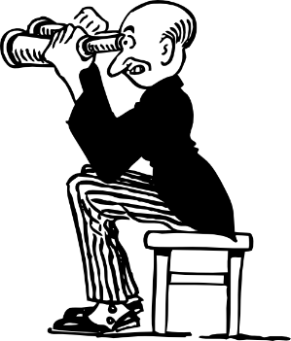
v
verdad
joven
[young]
ver
verde
vivir
[to live]
Notes:
Introduce and elicit the pronunciation of the individual SSC ‘v’ and then the source word again (with gesture, if using). Then present and elicit the pronunciation of the five cluster words.
The cluster words have been chosen for their high-frequency, from a range of word classes, with the SSC (where possible) positioned within a variety of syllables within the words (e.g. initial, 2nd, final etc..) and additionally, we have tried to use words that build cumulatively on previously taught SSCs (see the Phonics Teaching Sequence document) and do not include new SSCs. Where new SSCs are used, they are often consonants which have a similar symbol-sound correspondence in English.

Slide 3
v
verdad
joven
ver
verde
vivir
Notes:
Without the images, students focus this time again closely on the SSC and the cluster words.

Slide 4
v
verdad
joven
ver
verde
vivir
Notes:
Without the images or sound, students have to pronounce the words themselves.

Slide 5
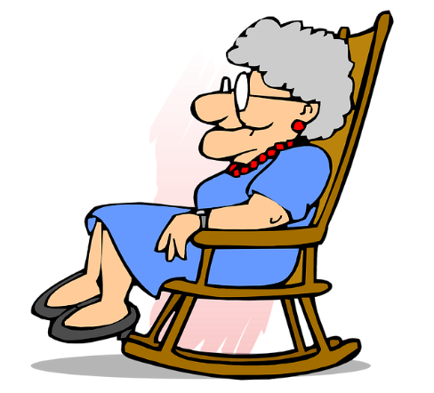
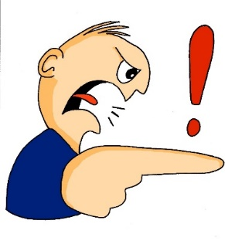
b
abuela
deber
[must]
celebrar
saber
bastante
[to know]
[quite]
Notes:
Introduce and elicit the pronunciation of the individual SSC ‘b’ and then the source word again (with gesture, if using). Then present and elicit the pronunciation of the five cluster words.
The cluster words have been chosen for their high-frequency, from a range of word classes, with the SSC (where possible) positioned within a variety of syllables within the words (e.g. initial, 2nd, final etc..) and additionally, we have tried to use words that build cumulatively on previously taught SSCs (see the Phonics Teaching Sequence document) and do not include new SSCs. Where new SSCs are used, they are often consonants which have a similar symbol-sound correspondence in English.

Slide 6
b
abuela
deber
celebrar
saber
bastante
Notes:
Without the images, students focus this time again closely on the SSC and the cluster words.

Slide 7
b
abuela
deber
celebrar
saber
bastante
Notes:
Without the images or sound, students have to pronounce the words themselves.

Slide 8
¿‘v’ o ‘b’?
escuchar
A
B
C
jo__en
v
v
__erdad
cele__rar
b
D
E
F
__erde
b
b
v
__astante
de__er
G
H
I
b
sa__er
v
_i_ir
a__uela
v
b
Notes:
*Audio to be inserted*
Students write the missing letter. Although audio is (to be) provided for this activity, this is simply to provide input to help establish the sound-spelling connection (it will not help them to distinguish ‘b’ from ‘v’). See next slide for a variation of this activity (where students have to write full word).

Slide 9
¿‘v’ o ‘b’?
escuchar
celebrar
verdad
joven
A
B
C
bastante
deber
verde
D
E
F
abuela
vivir
saber
G
H
I
Notes:
*Audio to be inserted*
Variation: Students listen and write the full word.

Slide 10
Identifica la palabra correcta.
deber
hablar
vivir
verde
[to know]
1
2
3
4
[young]
5
6
[to live]
joven
verdad
7
8
[quite]
9
[must]
saber
bastante
celebrar
abuela
Notes:
Having focused on the sound-spelling correspondence, students now focus on the meaning of the words used for practice.
The teacher says the number (either in numerical or random order, to challenge students more). Students have to search the options around the edge of the box to decide which is the corresponding word. Pause for several seconds to allow students to search, then elicit the Spanish word from students in chorus.
To allow for flexibility in the order of numbers, the answers have not been animated.

Slide 11
Escucha y completa la frase.
escuchar / escribir
¿Cómo se dice en inglés?
1) Quiere _______ la _________.
saber
verdad
5) Da una bolsa a la señora en la tienda.
Es ___________ grande.
bastante
S/he wants to know the truth.
S/he gives a bag to the lady in the shop. It’s quite big.
2) Quiero __________ lejos de aquí.
celebrar
6) Doy películas a una amiga.
______ películas con ella es maravilloso!
I want to celebrate far from here.
Ver
I give films to a (female) friend.
Seeing / watching films with her is marvellous!
3) ¿Qué color quieres? ¿_______?
Verde
What colour do you want? Green?
abuela
4) ¿Das unas cosas a la _________?
Do you give some things to grandma?
Notes:
*AUDIO TO BE INSERTED*
This activity integrates grammar, vocabulary and phonics revision.
Phonics: Students first have to listen and write the missing word, which contains either the ‘b’ or ‘v’ SSC.
Grammar: After writing the missing words, students have to translate the sentence. Each one contains DAR and QUERER in 1st, 2nd or 3rd person singular.
Vocabulary is revisited from various earlier weeks. ‘Lejos’, ‘tienda’, ‘cosa’ and ‘bolsa’ are from the two vocabulary sets revisited this week (1.1.7 and 1.2.5) in the SoW.
Note: ‘ella’ has previously been encountered as a phonics word.

