Slide 1
Adjective agreement
masculine & feminine singular
Notes:
In this sequence, adjective agreement is recapped (learnt in week 1), with a wider set of adjectives from the Week 2 vocab set.

Slide 2
Adjective agreement
In French, when an adjective describes a feminine noun, the adjective’s spelling and sometimes its sound change.
The most common change is an ‘e’ on the end of the adjective.
(for adjectives not already ending in ‘e’.)
Masculine
Il est intelligent.
He is intelligent.
Je suis petit.
I (a boy) am small.
Tu es anglais.
You (a boy) are English.
Feminine
Elle est intelligente.
She is intelligent.
Je suis petite.
I (a girl) am small.
Tu es anglaise.
You (a girl) are English.
Victoria Hobson / Emma Marsden
Notes:
Here is a recap of the rules on adjective agreement from Week 1 that students have learnt. Teachers may wish to ask students if they can remember the rule before showing the text.
Teachers may wish to ask students which adjectives (of those they have learnt so far) will fall into this category and which won’t. (Use your judgement here)
By week 2 these are: grand, petit, français, anglais, content, méchant, amusant, intelligent.
The three already ending in –e are: aimable / calme / malade. You then may wish to flag up that we don’t need to practise these ones as they stay the same for feminine.

Slide 3
Adjective agreement
Pronunciation can change when adding an ‘e’ to an adjective.
Remember the two rules: Silent Final Consonant & Silent Final ‘e’.
An ‘e’ at the end, means you pronounce the final consonant.
Masculine
Il est intelligent.
Silent final consonant.
The ‘t’ is not pronounced.
Feminine
Elle est intelligente.
Silent final ‘e’.
The ‘t’ is pronounced.
The ‘e’ is not pronounced.
Victoria Hobson / Emma Marsden
Notes:
Again, the changes to pronunciation are recapped, exemplified with an adjective from the week 2 set. Teachers may wish to ask students how the adjectives will be pronounced, before the text appears.

Slide 4
Lire
Here are descriptions of two characters from a book, Chloe (a girl) and Isaac (a boy). The book has been read so often that some of the text has worn away. Are the descriptions of Chloe (C) or Isaac (I)?
1 | grand |  |  | 5 | intelligente
2 | content |  |  | 6 | petite
3 | méchante |  |  | 7 | anglaise
4 | français |  |  | 8 | amusant
I
C
I
C
Victoria Hobson

Slide 5
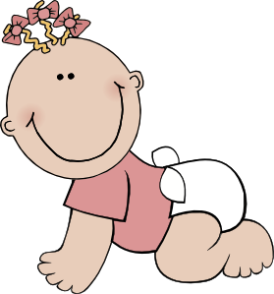
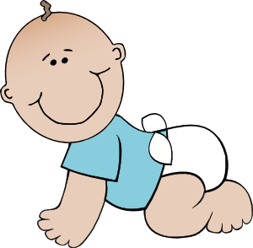
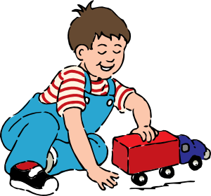
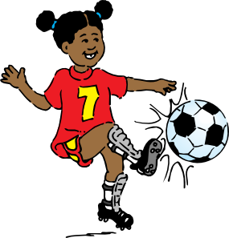
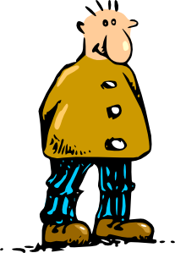
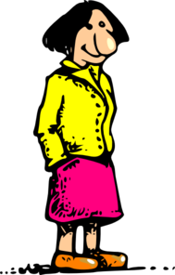
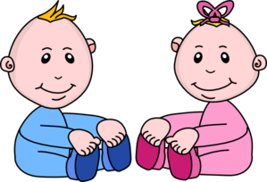
Écouter
There is also an audio book. This chapter describes Chloe’s family. Some of the sound hasn’t downloaded properly. Who is being described – the male or the female?
1
5
2
6
3
7
4
8
Victoria Hobson
Notes:
Transcript
1) [noise] petit
2) [noise] intelligente
3) [noise] grande
4) [noise] amusant
5) [noise] française
6) [noise] contente
7) [noise] méchant
8) [noise] anglais

Slide 6
Masculine
Feminine
Meaning
intéressant
intéressante
interesting
grand
grande
big
petit
petite
small
amusant
amusante
fun
anglais
anglaise
English
français
française
French
content
contente
happy
méchant
méchante
naughty
Victoria Hobson
Notes:
This slide can be used in a number of ways:
To reinforce pronunciation changes ahead of the speaking, in a listen and repeat style
To check students’ understanding of the vocab
To practise pronunciation changes.
Whole class – the teacher asks individuals to give the correct answer.
or:
Pairwork: when the adjective disappears, ask students to turn to their partner and say the adjective out loud. This could be then be practised a few times, with a competition element added by shortening the time sequence on the animation. Challenge pairs to complete within the new speeded up time.
4) As a help sheet which can be printed out for reference at any point during the speaking and writing activities for those students who need it. (Duplicate the slide and select print 2 to a page for A5 size)
A note about the verbs needed for the production activities that follow:
Following on from students’ learning of être in week 1, the following pairs are practised in this sequence:
The speaking activity practises Je suis / Tu es
The writing activity practises Il / Elle est

Slide 7
Qui suis-je?
Parler
Partner A
Partner B
Je suis (+ adjective)
Tu es (+ name)
Oui / Non
Victoria Hobson
Notes:
Explain the title of the slide – who am I? Explain each component part of the phrase.
Teachers may wish to use this slide to model/aid the instructions for the pair work before displaying the master, or print this out as a prompt for those pairs who need support.
Partner A picks out a card (for these cards, see later slides) and gives a sentence to describe the card as though they were the person on the card (“I am … adjective”).
They must not give the name of the person.
e.g. ‘Je suis grand’
Explain to the pupils that they have to pronounce the adjective correctly, with the correct ending, otherwise their partner cannot guess who they are.
Partner B looks at the master on the board and says ‘Tu es Marc’
Partner A would reply ‘Oui’ if correct or ‘Non’ if incorrect.
Teachers may need to explain ‘oui’ and ‘non’ if some learners aren’t familiar with these words.
For each correct identification players could tally their scores.

Slide 8
Marc
Hélène
Clara
Philippe
(big)
(big)
(intelligent)
(intelligent)
Lucie
Pierre
Isaac
Emiile
(naughty)
(naughty)
(French)
(French)
Chloe
Oscar
Ella
Chloe
Luc
(happy)
(happy)
(English)
(English)
Anna
Manon
Felix
Paul
Anna
(fun)
(fun)
(small)
(small)
Victoria Hobson
Notes:
Qui suis-je? Who am I?
Master – display this on the IWB whilst the speaking activity is taking place.
Players take it in turns to select a picture from their set of 8. They imagine they are the person they have picked.
They give a sentence to describe themselves (I am …). The other player has to identify who is being described.
Explain to the pupils that they have to pronounce the adjective correctly, with the correct ending, otherwise their partner cannot guess who they are.
The English adjective is given underneath so that students know which to use in case it is not obvious from the picture.
Manon is the only name that might need clarifying to ensure the pupils know it is a girl’s name!

Slide 9
Marc
Clara
Lucie
Emilie
Luc
Ella
Paul
Felix
Victoria Hobson
Notes:
Note: The creation of cards is optional. Alternatives: 1. Show the master slide (8) and give students 10 seconds to write down 8 names of their choice. 2. Use the final slide (12) – print one sheet and cut into 32 pieces 16 x Partner A, 16 x Partner B.
Partner A cards
Cut up these cards into 8 separate cards and put them into a small envelope/bag.
Partner A picks out a card and gives a sentence to describe the card, as though they were the person on the card (“I am … adjective”). They must not give the name of the person.
e.g. ‘Je suis grand’
Partner B would then look at the master and say ‘Tu es Marc’
Partner A would reply ‘Oui’ if correct or ‘Non’ if incorrect. For each correct identification players could tally their scores.

Slide 10
Hélène
Philippe
Pierre
Isaac
Chloe
Oscar
Anna
Manon
Victoria Hobson
Notes:
Partner B cards
Cut up these cards into 8 separate cards and put them into a small envelope/plastic bag.
Partner B picks out a card and gives a sentence to describe the card (WITHOUT using the name!)
e.g. ‘Je suis grande’
Partner A looks at the master and says ‘Tu es Hélène’
Partner B replies ‘Oui’ if correct or ‘Non’ if incorrect.
For each correct identification players could tally their scores.

Slide 11
Écrire
Remember:
Il = ‘he’
Elle = ‘she’
The following characters will appear in the next book in the series.
Construct eight sentences describing these new characters.
1 | Madame Lafayette
2 | Monsieur Le Brun
3 | Mademoiselle Coco
4 | Hugo
5 | Raphael
6 | Louis
7 | Sophia
8 | Mia
e.g. 1) Elle est intelligente
Victoria Hobson
Notes:
Teachers may wish to revise the use of il / elle here and their meanings. The prompt and the worked example reflect this.
Alternatively teachers could change the example to read Madame Lafayette est intelligente, to prompt students to use the names instead.

Slide 12
Marc Clara Lucie Emilie Luc Paul Ella Felix
Marc Clara Lucie Emilie Luc Paul Ella Felix
Marc Clara Lucie Emilie Luc Paul Ella Felix
Marc Clara Lucie Emilie Luc Paul Ella Felix
Marc Clara Lucie Emilie Luc Paul Ella Felix
Marc Clara Lucie Emilie Luc Paul Ella Felix
Marc Clara Lucie Emilie Luc Paul Ella Felix
Marc Clara Lucie Emilie Luc Paul Ella Felix
Marc Clara Lucie Emilie Luc Paul Ella Felix
Marc Clara Lucie Emilie Luc Paul Ella Felix
Marc Clara Lucie Emilie Luc Paul Ella Felix
Marc Clara Lucie Emilie Luc Paul Ella Felix
Marc Clara Lucie Emilie Luc Paul Ella Felix
Marc Clara Lucie Emilie Luc Paul Ella Felix
Marc Clara Lucie Emilie Luc Paul Ella Felix
Marc Clara Lucie Emilie Luc Paul Ella Felix
Hélène Philippe Pierre Isaac Chloe Anna Oscar Manon
Hélène Philippe Pierre Isaac Chloe Anna Oscar Manon
Hélène Philippe Pierre Isaac Chloe Anna Oscar Manon
Hélène Philippe Pierre Isaac Chloe Anna Oscar Manon
Hélène Philippe Pierre Isaac Chloe Anna Oscar Manon
Hélène Philippe Pierre Isaac Chloe Anna Oscar Manon
Hélène Philippe Pierre Isaac Chloe Anna Oscar Manon
Hélène Philippe Pierre Isaac Chloe Anna Oscar Manon
Hélène Philippe Pierre Isaac Chloe Anna Oscar Manon
Hélène Philippe Pierre Isaac Chloe Anna Oscar Manon
Hélène Philippe Pierre Isaac Chloe Anna Oscar Manon
Hélène Philippe Pierre Isaac Chloe Anna Oscar Manon
Hélène Philippe Pierre Isaac Chloe Anna Oscar Manon
Hélène Philippe Pierre Isaac Chloe Anna Oscar Manon
Hélène Philippe Pierre Isaac Chloe Anna Oscar Manon
Hélène Philippe Pierre Isaac Chloe Anna Oscar Manon

